Slide 1
Logical Clock Synchronization for Distributed Mutual Exclusion
By Myint Myat Thura (31861067)

Slide 2
Research Paper & Introduction
Lamport, L. (2019). Time, clocks, and the ordering of events in a distributed system. In Concurrency: the Works of Leslie Lamport (pp. 179–196).
Background: In distributed systems, processes operate concurrently and independently, leading to potential ambiguities in event sequences and system states.
Lamport's Contribution: The paper addresses the challenge of understanding temporal relationships between events across distributed processes.
Logical Clocks: Introduction of a mechanism to order events and resolve ambiguities, even with imperfectly synchronized physical clocks.
Consistency and Coordination: Foundation for achieving reliable system behavior in distributed environments.
Relevance: Exploration of the paper’s concepts, algorithms, and their lasting impact on distributed systems and contemporary technology.
Objective: To provide a comprehensive understanding of Lamport’s work and its applications in distributed systems.

Slide 3
Problem Statement and Hypothesis
Synchronization errors caused by inaccurate physical clocks for distributed systems. Distributed systems that are not well synchronized can lead to ambiguous behavior which can lead to issues such as deadlocks, maintenance problems and ambiguous behavior.
We aim to overcome this problem by introducing logical clocks to maintain total order and ensure predictable and accurate series of operations.
Leslie Lamport Hypothesis that if we were able to introduce a hypothetical clock for each process, we will be able to maintain the order of operations.

Slide 4
Research Gaps
Does not suggest a preferred algorithm.
Implementation seems to follow a Token-based Ring approach, does not consider other algorithms (Berkeley’s Algorithm (or) Christian’s Algorithm)
Paper has no analysis on performance compared to other programs or other optimization techniques.

Slide 5
Related Works
Fidge, C. (1991). Logical time in distributed computing systems. Computer, 24(8), 28-33. https://doi.org/10.1109/2.84874
Sampath, A., Tripti, C. (2012). Synchronization in Distributed Systems. In: Meghanathan, N., Nagamalai, D., Chaki, N. (eds) Advances in Computing and Information Technology. Advances in Intelligent Systems and Computing, vol 176. Springer, Berlin, Heidelberg. https://doi.org/10.1007/978-3-642-31513-8_43
Basu, Sandipan. (2011). Token Ring Algorithm To Achieve Mutual Exclusion In Distributed System – A Centralized Approach. International Journal of Computer Science Issues. 8.

Slide 6
C. Fidge’s Proposal
8 Rules that are necessary to maintain a partial order of operations.
Initialization: Initialize the time to an empty set at program start, each process has an auxiliary variable c to hold current partially ordered time.
Ticking: Counter should never decrease and increment the counter of a process whenever an event occurs.
Monotonically Increasing Counters: Counter values must never decrease
Process Creation: Newly created processes inherit the current time from parent process.
Process Termination: When a child process terminates, the parent process merges the child’s logical clock by maximizing counter values.
Synchronous Events: During a synchronization event, all involved processes maximize their local clocks with counter values from every other participating process.
Sending: When a process sends a message, it includes its current logical clock in the message.
Receiving: Upon receiving a message, a process maximizes its logical clock counters with those received in the timestamp of the incoming message.

Slide 7
C. Tripti & A. Sampath’s Hypothesis
This paper presents the use of logical clock to implement Distributed Mutual Exclusion. This paper mentions the following related paper regarding Token based ring systems.
This hypothesis states that if there was one token to be passed and the processes receive this token in order, we are sure that Mutual Exclusion can be achieved.
We will talk about this further in the coming slides.

Slide 8
Sandipan Basu’s Hypothesis
Basu Sandipan goes in depth about the ring based algorithm that is used to implement Distributed Mutual Exclusion with the help of Logical Clocks using Lamport’s approach.
This follows the same concept of
Unique identification
Single requesting process
Single resource competition
Fully connected nodes
Single critical section entry
Logical clocks for ordering

Slide 9
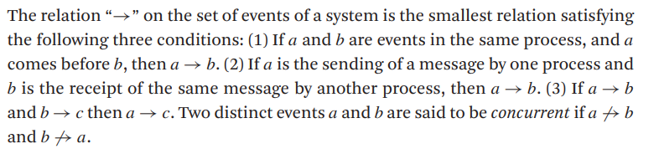
What is Partial Ordering?
In the realm of physical time, we can say that event a happened before event b if a happened at an earlier time than b.
We must make sure that our specifications for our system must be given in terms of events observable within the system.
We do not wish to use real clocks as they are not perfectly accurate within the system and do not keep precise physical time.

Slide 10
How are concurrent events defined?
Two events are concurrent if neither can causally affect the other.
Concurrent events use the “->” notation.
Assume a -> b, this means a and b is concurrent.
We can claim two processing are concurrent even if we do not know what the latter process is doing. As long as we know what the latter process plans to do, we can claim them to be concurrent.
In this paper, we take a more pragmatic approach by considering messages that are actually sent and not those that could be sent.

Slide 11
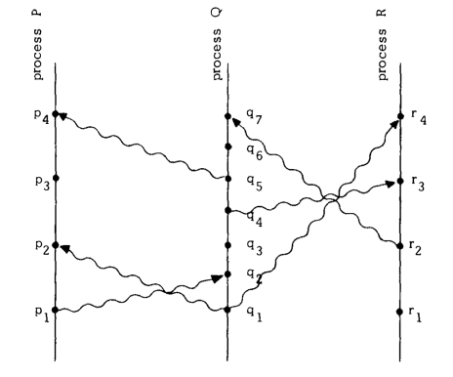
Visualization of concurrent events
Lamport, L. (2019). Time, clocks, and the ordering of events in a distributed system. In Concurrency: the Works of Leslie Lamport (pp. 179–196). (Reprinted from page 182, Figure 1).

Slide 12
What is Total Ordering?
Back in Partial Ordering, the sequence of operations are not definitive.
Total ordering makes it so that the sequences are definitive.
Total ordering can only consist of A -> B (or) B -> A (or) A = B.
Total ordering is achieved through the use of Logical Clocks which we can define the values of and define its behavior.
Logical Clocks are covered in the next slide.

Slide 13
What are Logical Clocks?
Logical clocks are implemented through clock and only exists within the system, it is not a representation of physical time.
We define a clock Cᵢ for each process Pᵢ, we can denote this as Cᵢ(a) where a is any event in that process.
We now consider what does it mean for a time to be correct.
For any events a, p: if a → p then Cₐ < Cₚ

Slide 14
Introducing Logical Clocks to improve synchronization
Firstly we must meet the conditions that are as follows:
Each process Pᵢ increments Cᵢ between any two successive events
If event a is sending a message m by process Pᵢ, then the message m requires a timestamp Tₘ = Cᵢ(a).
Upon receiving a message, Pⱼ sets Cⱼ greater than or equal to its present value and greater than Tₘ
In essence, this is a way to ensure that logical clocks are implemented into our processes and changed accordingly. In the next slide we will explore how we use this implementation to maintain order and synchronization from an algorithmic perspective.

Slide 15
Ordering the Events Totally
We order events by the times at which they occur (logical clock).
If event a occurs at time 2, it will be before all events that occurs at time >= 2.
If the events occur at the same time, we will break the tie using arbitrary total order of the processes. Process 1 will be executed before Process 2.

Slide 16
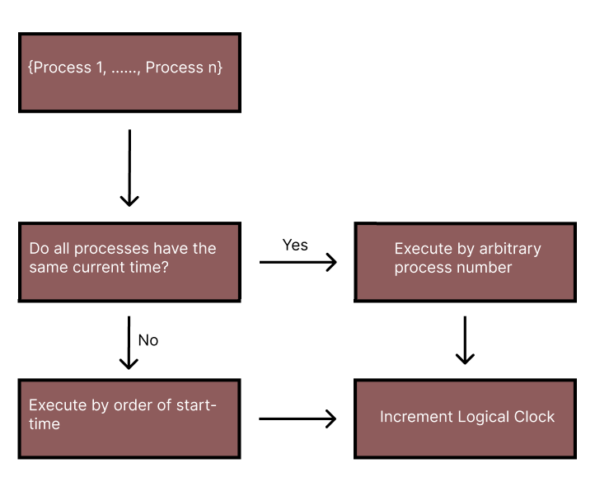
Visualizing the Total Events Ordering

Slide 17
What is Distributed Mutual Exclusion and how do Logical Clocks help?
In distributed systems, Distributed Mutual Exclusion is the concept of allowing only one process to access the critical section at a time.
A critical section refers to part of a program that accesses shared resources and needs to be executed atomically.
Let δ be our critical section. Since we know that processes are going to be ordered totally, we can pick and choose the sequence of processes that will be accessing δ. Therefore we can make sure only one process has access to δ at a time.

Slide 18
Requests, Replies, Release and privileges
Request, Replies and Release are terms used to describe the process of accessing a critical section in a distributed system.
The privilege is something that a process is given that is used to enter the critical section. Without a privilege, processes cannot enter a critical section, therefore there will be one privilege in a program.
Here is a brief structure of the program
Requests for privilege made to process currently holding the privilege.
Processes that are not in critical section replies that they are not interested.
The process that is holding the privilege exits the critical section and pass the privilege to the interested process.
Repeats

Slide 19

Real Life Visualization
The children are the processes
The blue child has the the privilege

Slide 20
Real Life Visualization
The green child sends a request to every process that it wants access to the critical section.

Slide 21
Real Life Visualization
Every other child either has no interest or has a higher time-stamp

Slide 22
Real Life Visualization
The process with the privilege exits the critical section and releases the privilege for everyone

Slide 23
Real Life Visualization
The appropriate process receives the privilege. Then the process can enter the critical section freely.

Slide 24
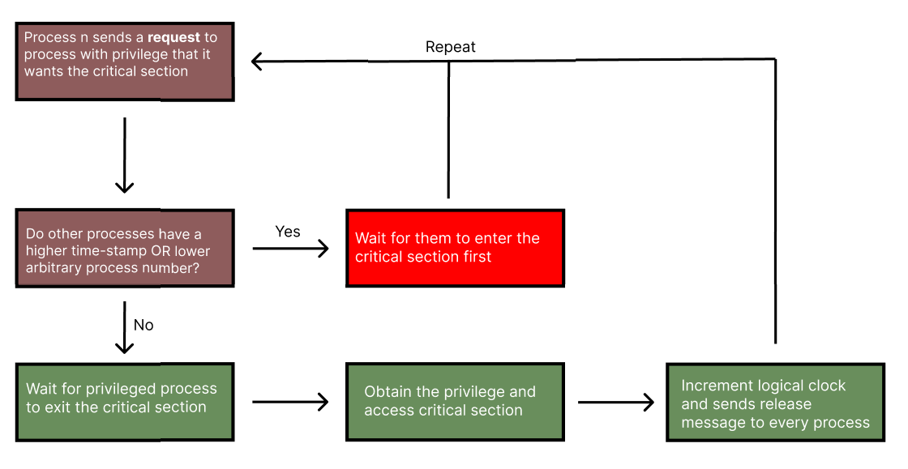
Flow Chart Visualization
Requests
Replies
Release
Privilege

Slide 25
Proof of Concept
Now we will move to Visual Studio Code to check a program written in C using openMPI.

Slide 26

Conclusive Statement

Slide 27
References
Lamport, L. (2019). Time, clocks, and the ordering of events in a distributed system. In Concurrency: the Works of Leslie Lamport (pp. 179–196).
Fidge, C. (1991). Logical time in distributed computing systems. Computer, 24(8), 28-33. https://doi.org/10.1109/2.84874
Sampath, A., Tripti, C. (2012). Synchronization in Distributed Systems. In: Meghanathan, N., Nagamalai, D., Chaki, N. (eds) Advances in Computing and Information Technology. Advances in Intelligent Systems and Computing, vol 176. Springer, Berlin, Heidelberg. https://doi.org/10.1007/978-3-642-31513-8_43
Basu, Sandipan. (2011). Token Ring Algorithm To Achieve Mutual Exclusion In Distributed System – A Centralized Approach. International Journal of Computer Science Issues. 8.

