Slide 1
LIVE AWS DEMO
Auto-Scaling &
Self-Healing
TEAM
1
Myisha Siddiqui
240905560
Cloud-Native Student Task Manager
2
Manan Bhasin
240905492
Kubernetes • Docker • Terraform • AWS
3
Rishabh Raj
240905420
AWS Sydney / ap-southeast-2
STUDENT TASK MANAGER • CLOUD COMPUTING MINI PROJECT
1
Notes:
Good morning. Our project is an auto-scaling and self-healing cloud-native Student Task Manager. We built the application with Spring Boot, packaged it with Docker, provisioned AWS using Terraform, and deployed it on Kubernetes using K3s. The project was completed by Myisha Siddiqui, Manan Bhasin, and Rishabh Raj.

Slide 2
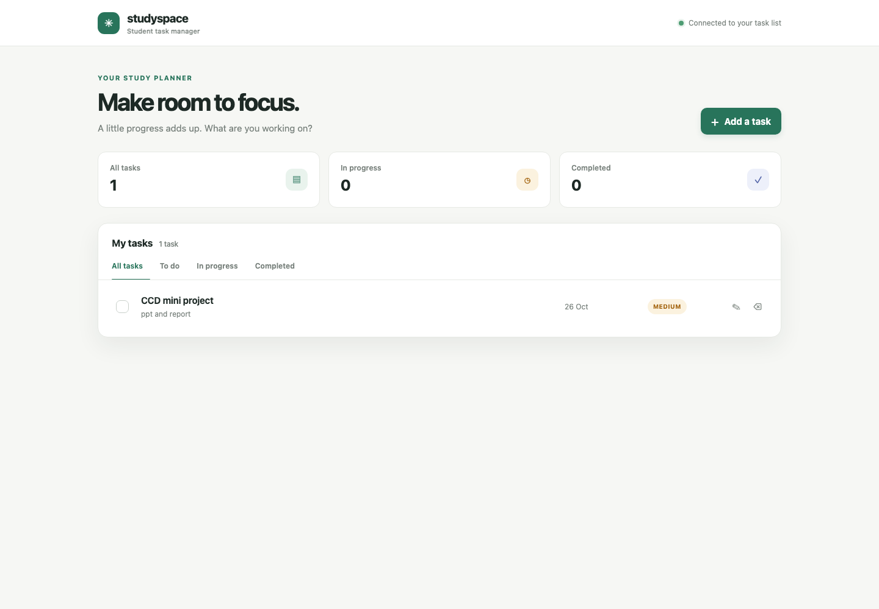
02
THE APPLICATION
A useful app—and a workload for cloud behaviour
What the user can do
● Create, edit, complete, filter and delete study tasks
● Refresh the browser without losing saved task data
● Use the same Spring Boot service for the UI and REST API
● Persist every task in a private MySQL database
STATELESS API
PERSISTENT DATA
Live StudySpace browser dashboard
STUDENT TASK MANAGER • CLOUD COMPUTING MINI PROJECT
2
Notes:
The visible application is a Student Task Manager called StudySpace. A student can create, edit, complete, filter, and delete tasks. The browser sends requests to the Spring Boot REST API, and the API stores the records in MySQL. Refreshing the page proves that the data is persistent rather than held only in the browser. This real workload gives us something meaningful to scale and recover.

Slide 3
03
ARCHITECTURE
One request path, one monitoring path
The database is private; only the browser-facing demo ports are exposed.
BROWSER
K3S SERVICE
SPRING BOOT
RDS MYSQL
StudySpace UI
NodePort 30080
1–2 API pods
Private subnets
REQUEST + DATA PATH
Infrastructure delivery
Observability
Terraform
VPC • EC2 • RDS • ECR • IAM
Prometheus → Grafana
STUDENT TASK MANAGER • CLOUD COMPUTING MINI PROJECT
3
Notes:
The request path is Browser to the Kubernetes NodePort Service, then to one or more Spring Boot pods, and finally to private RDS MySQL. The pods are stateless, so either replica can serve a request while all replicas share the same database. Docker creates the image and ECR stores it. Terraform provisions the VPC, EC2 host, RDS, ECR, IAM, and security rules. Prometheus collects metrics and Grafana visualizes them.

Slide 4
04
IMPLEMENTATION
How each technology contributes
1
Docker
2
Amazon ECR
3
Terraform
Builds one portable Spring Boot image
Stores the image pulled by K3s
Creates repeatable AWS infrastructure
4
Kubernetes / K3s
5
RDS MySQL
6
GitHub Actions
Runs pods, probes, Services and HPA
Keeps task data outside the pods
Tests the app and validates Terraform
STUDENT TASK MANAGER • CLOUD COMPUTING MINI PROJECT
4
Notes:
Each technology has a clear responsibility. Docker provides a consistent image. ECR stores that image. Terraform makes the infrastructure repeatable. K3s provides Kubernetes features on a cost-conscious EC2 host. RDS keeps data independent of pod lifecycles. GitHub Actions tests the application and validates the infrastructure code. The main design point is separation: pods can be replaced without losing tasks.

Slide 5
05
AUTO-SCALING
HPA responds to CPU demand—and scales back down
CPU target: 60% • Minimum: 1 pod • Maximum: 2 pods
01
NORMAL
02
LOAD
03
SCALE UP
04
COOLDOWN
1 pod
CPU > 60%
2 pods
1 pod
Low CPU
Peak 319%
Both Ready
After 180 s
5,699
0%
403.98 ms
43.7/s
HTTP REQUESTS
FAILED REQUESTS
P95 RESPONSE TIME
REQUEST RATE
Measured with a bounded k6 run at 30 maximum virtual users.
STUDENT TASK MANAGER • CLOUD COMPUTING MINI PROJECT
5
Notes:
The Horizontal Pod Autoscaler targets 60 percent CPU and is limited to one to two replicas for this low-cost demo. During a bounded k6 load run, CPU rose above the target and peaked at 319 percent of the requested CPU. Kubernetes increased the deployment from one pod to two, and both became Ready. The run completed 5,699 requests with zero failures and a p95 of 403.98 milliseconds. After the 180-second stabilization period, it returned to one pod.

Slide 6
06
SELF-HEALING
Kubernetes restores the desired state
Two controlled tests proved replacement and health-probe recovery.
TEST 1
TEST 2
Pod deletion
Liveness failure
● Running API pod was deleted
● Deployment detected a missing replica
● Replacement pod reached 1/1 Running
● Deployment remained available
● Java process was paused intentionally
● Liveness probe failed three times
● Kubernetes restarted the container
● Readiness returned UP
Scope: pod/container recovery on one EC2 node — not EC2 host failover.
STUDENT TASK MANAGER • CLOUD COMPUTING MINI PROJECT
6
Notes:
Self-healing was demonstrated in two ways. First, we deleted the running API pod. The Deployment controller compared the actual state with the desired state of one replica and created a replacement, which reached 1/1 Running. Second, we intentionally paused the Java process. After the liveness probe failed, Kubernetes restarted the container and readiness returned UP. This proves pod and container recovery; it does not claim EC2 host-level failover because the cluster has one node.

Slide 7
07
MONITORING
Prometheus collects; Grafana explains
What the dashboard shows
LIVE PIPELINE
1
Spring Boot Actuator
Request rate
Error rate
API + JVM metrics
TRAFFIC
RELIABILITY
Prometheus
API latency
Ready replicas
2
Scrape every 15 seconds
PERFORMANCE
AVAILABILITY
Grafana
JVM heap
Process CPU
3
RUNTIME
SCALING INPUT
Six-panel dashboard
Prometheus targets: API, Kubernetes state and Prometheus itself
Grafana health: database OK • Version 12.4.13 • Dashboard provisioned from code
STUDENT TASK MANAGER • CLOUD COMPUTING MINI PROJECT
7
Notes:
Spring Boot Actuator exposes application and JVM metrics. Prometheus scrapes those metrics every 15 seconds together with Kubernetes state metrics. Grafana presents six operational panels: request rate, error rate, latency, ready replicas, JVM heap, and process CPU. The application also has a Demo Console that combines current Kubernetes and Prometheus information on one page. Grafana health is currently OK and the dashboard is provisioned from code.

Slide 8
08
LIVE DEMONSTRATION
Show the result in four clean steps
All three links are clickable in Slide Show mode.
1
Application
Create a task → complete it → refresh
OPEN ↗
2
Demo Console
Show readiness, pod, HPA and metrics
OPEN ↗
3
Autoscaling
Run bounded load and watch replicas 1 → 2
OPEN ↗
4
Grafana
Open the live six-panel operations view
OPEN ↗
Demo access is temporary and unauthenticated. RDS remains private; close public ports after presenting.
STUDENT TASK MANAGER • CLOUD COMPUTING MINI PROJECT
8
Notes:
For the live demonstration, first open StudySpace. Create a task, mark it complete, and refresh to prove that RDS persists the data. Next open the Demo Console and point out readiness, the Deployment, pod state, HPA configuration, and live metrics. Start the bounded read-only load generator and explain that the HPA can move from one to two replicas when CPU exceeds 60 percent. Finally open Grafana and show the six panels. Conclude that Docker delivered the image, Terraform built AWS, Kubernetes scaled and recovered the workload, and Prometheus plus Grafana made the behaviour visible. Public access is temporary and should be closed after the presentation.

