Slide 1


The maximum Separation subspace in sufficient dimension reduction with categorical response (Xin Zhang, Qing Mai, Hui Zou, 2020)
Present BY: Sheng Hu

Slide 2
Outline
Principle at the population level
Estimation and consistency
Relationship with other methods
Simulation

Slide 3

Motivation
Find The subspace of X separate the conditional distribution $X | Y = i$the most.

Slide 4

General notations
the univariate response $Y∈\{1, …, C\}$ and the multivariate predictor $X∈R^{p}$
$f_{k}\left(X\right) k=1, …, C$denotes the conditional density function of $X|Y=k$
$f_{k}\left(B^{T}X\right) k=1, …, C$denotes the conditional density function of $B^{T} X|Y=k$, where $B∈R^{p×q}$
Let $δ(f_{1} ,f_{2})$be a distance of the two (conditional) probability density functions

Slide 5

The property of distance
$δ\left(f_{1} ,f_{2}\right)=δ(f_{2} ,f_{1})$
$δ\left(f_{1} ,f_{2}\right)≥0$ for all density functions $f_{1}$ and $f_{2}$with equality if and only if $f_{1}=f_{2}$almost everywhere
$δ\left(f_{1} ,f_{2}\right)$≤ $δ\left(f_{1} ,f_{3}\right)$+ $δ\left(f_{3} ,f_{2}\right)$
Remark:
The property of $δ\left(f_{1} ,f_{2}\right)$ will depend on the chosen form of $δ\left(f_{1} ,f_{2}\right)$, For further exploration, we suppose that $δ\left(f_{1} ,f_{2}\right)$ = $δ\left({f′}_{1} ,{f′}_{2}\right)$ , where ${f′}_{k}\left(X\right) k=1, …, C$denotes the conditional density function of $X′|Y=k$, $X^{′}=X −a$, where $a$ is a vector with constant value

Slide 6

Definition of Distance
squared Hellinger distance:
$δ_{H}\left(f_{1} ,f_{2}\right)=\frac{1}{2}{\int{(\sqrt{f_{1}(x)}}−\sqrt{f_{2}\left(x\right)})}^{2}ⅆx=1−\int{\sqrt{f_{1}(x)f_{2}(x)}ⅆx}$
total variation distance:
$δ_{TV}\left(f_{1} ,f_{2}\right)=\frac{1}{2}\int{|f_{1}(x){−f}_{2}(x)|}ⅆx$
the KL distance:
$δ_{KL}\left(f_{1} ,f_{2}\right)=\int{f_{1}\left(x\right)log⁡(\frac{f_{1}(x)}{f_{2}(x)})}ⅆx$ +$\int{f_{2}\left(x\right)log⁡(\frac{f_{2}(x)}{f_{1}(x)})}ⅆx$

Slide 7

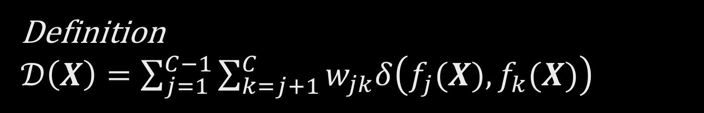
Definition $𝒟\left(X\right)=\sum_{j=1}^{C−1}{\sum_{k=j+1}^{C}{w_{jk}δ\left(f_{j}(X),f_{k}(X)\right)}}$
where $\sum_{j=1}^{C−1}{\sum_{k=j+1}^{C}{w_{jk}=1},w_{jk}>0}$
In the above definition, $w_{jk}$ is the weight of the distance between jth and kth conditional distribution among all pairwise distance.
One choice is equal weights.
Another choice is $w_{jk}=\frac{\operatorname{Pr}\left(Y=j\right)+\operatorname{Pr}\left(Y=k\right)}{\sum_{l=1}^{C−1}{\sum_{m=l+1}^{C}{(\operatorname{Pr}\left(Y=l\right)+\operatorname{Pr}\left(Y=m\right))}}}$, Then this weight $w_{jk}$ is proportional to the probability that an observation falls in to either class j or class k.
$𝒟_{H}\left(X\right)$ denotes using the Hellinger distance，and $ℋ(X) ≡𝒟_{H}\left(X\right)$

Slide 8


We want the distance has the following properties, For any matrices $A∈R^{p×r}$and$B∈R^{p×q}, 0≤r≤q≤p$
(Boundedness) ${0≤𝒟(A}^{T}X)≤1$
(Indistinguishability) ${𝒟(A}^{T}X)=0$ if and only if all pairs of probability density functions $f_{j}\left(A^{T}X\right)$and $f_{k}\left(A^{T}X\right)$are identical almost everywhere for $A^{T}X∈R^{r}$
(Perfect separation) ${𝒟(A}^{T}X)=1$ if and only if $f_{j}\left(A^{T}X\right)$and $f_{k}\left(A^{T}X\right)$have non-overlapping support on $R^{r}$ for any $j≠k$
(Invariance) If $span\left(A\right)=span(B)$, then ${𝒟(A}^{T}X)=$ ${𝒟(B}^{T}X)$
(Monotonicity) If $span\left(A\right)⊆span(B)$, then ${𝒟(A}^{T}X)≤$ ${𝒟(B}^{T}X)$

Slide 9
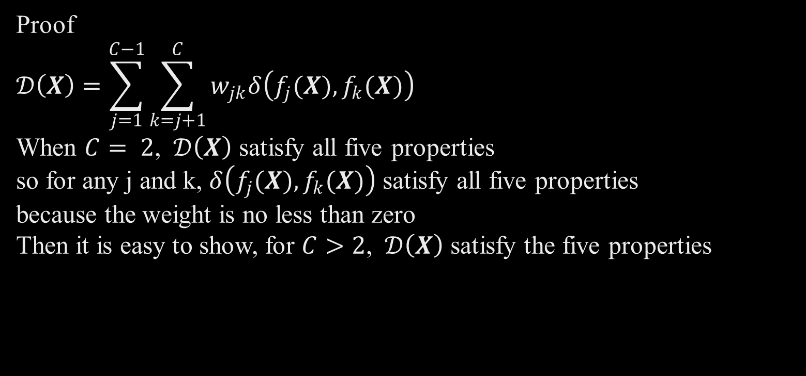

Proposition 1 If any of the previous five properties are satisfied for $C= 2$, then they are also true for $C>2$
Proof
$$𝒟\left(X\right)=\sum_{j=1}^{C−1}{\sum_{k=j+1}^{C}{w_{jk}δ\left(f_{j}(X),f_{k}(X)\right)}}$$
When $C= 2$, $𝒟\left(X\right)$ satisfy all five properties
so for any j and k, $δ\left(f_{j}(X),f_{k}(X)\right)$ satisfy all five properties
because the weight is no less than zero
Then it is easy to show, for $C>2$, $𝒟\left(X\right)$ satisfy the five properties

Slide 10
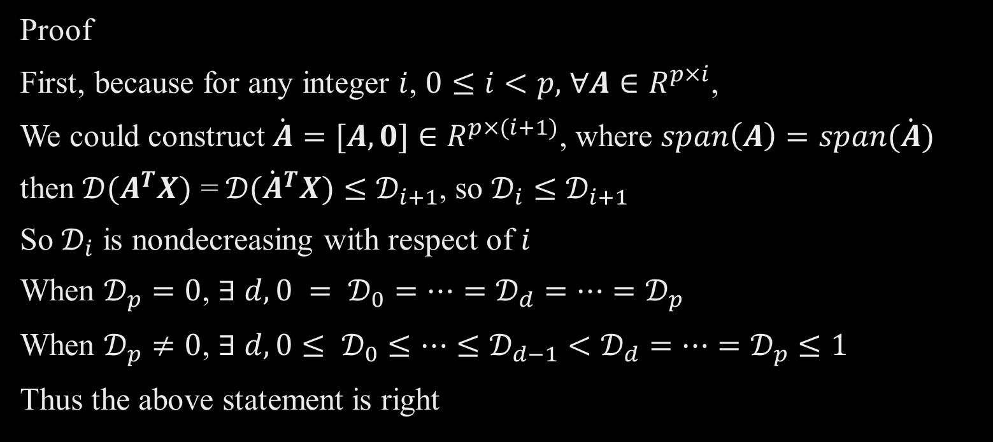
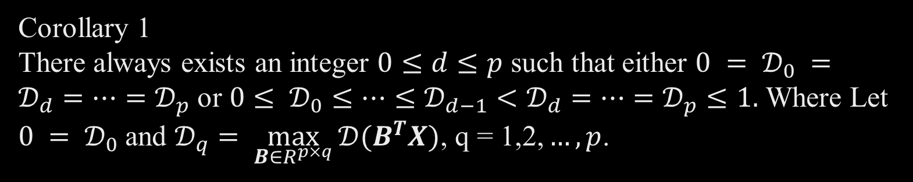
Corollary 1 There always exists an integer $0≤d≤p$ such that either $0 = 𝒟_{0} =𝒟_{d}=…=𝒟_{p}$ or $0≤ 𝒟_{0}≤…≤𝒟_{d−1}<𝒟_{d}=…=𝒟_{p}≤1.$ Where Let $0 = 𝒟_{0}$and $𝒟_{q}= \max_{B∈R^{p×q}}{{𝒟(B}^{T}X)\text{, }\text{q}\text{ = 1,2,}…,p}$.
Proof
First, because for any integer $i$, $0≤i<p,$ $∀A∈R^{p×i}$,
We could construct $\dot{A}=[A, 0]∈R^{p×(i+1)}$, where $span\left(A\right)=span(\dot{A})$
then ${𝒟(A}^{T}X)\text{ =} {𝒟(\dot{A}}^{T}X)≤𝒟_{i+1}$, so $𝒟_{i}≤𝒟_{i+1}$
So $𝒟_{i}$ is nondecreasing with respect of $i$
When $𝒟_{p}=0$, $∃ d, 0 = 𝒟_{0}=…=𝒟_{d}=…=𝒟_{p}$
When $𝒟_{p}≠0$, $∃ d,0≤ 𝒟_{0}≤…≤𝒟_{d−1}<𝒟_{d}=…=𝒟_{p}≤1$
Thus the above statement is right

Slide 11

Definition
Let $β=\underset{B∈R^{p×d}}{argmax}{{𝒟(B}^{T}X)}$. The subspace $span\left(β\right)$ is called the maximum separation subspace (MASES) under the distance$𝒟$ and is denoted by $𝒟_{Y|X}$, where$𝒟$ is an arbitrary distance that satisfies the properties in Proposition 1.
let $ℋ_{Y|X}$ be the MASES under the squared Hellinger distance

Slide 12
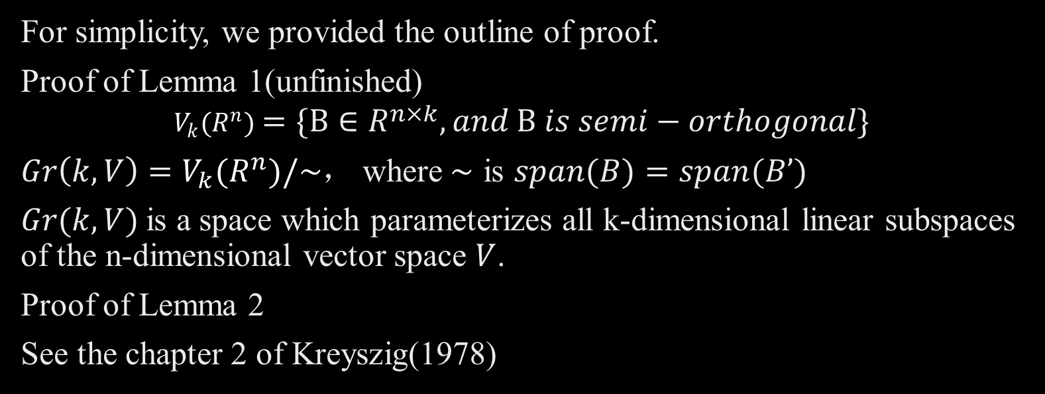
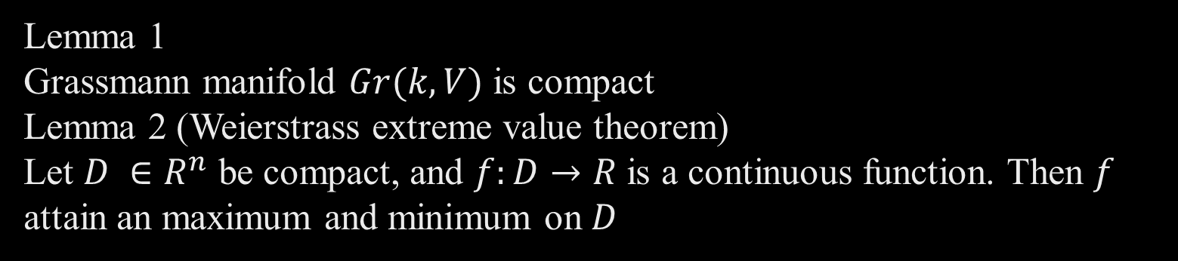
Lemma 1 Grassmann manifold $Gr(k, V)$ is compact Lemma 2 (Weierstrass extreme value theorem) Let $D ∈R^{n}$ be compact, and $f:D→R$ is a continuous function. Then $f$ attain an maximum and minimum on $D$
For simplicity, we provided the outline of proof.
Proof of Lemma 1(unfinished)
$$V_{k}(R^{n})=\{B∈R^{n×k}, and B is semi−orthogonal\}$$
$Gr\left(k, V\right)=$ $V_{k}(R^{n})/\sim$， where$\sim$ is $span(B)=span(B’)$
$Gr(k, V)$is a space which parameterizes all k-dimensional linear subspaces of the n-dimensional vector space $V$.
Proof of Lemma 2
See the chapter 2 of Kreyszig(1978)

Slide 13
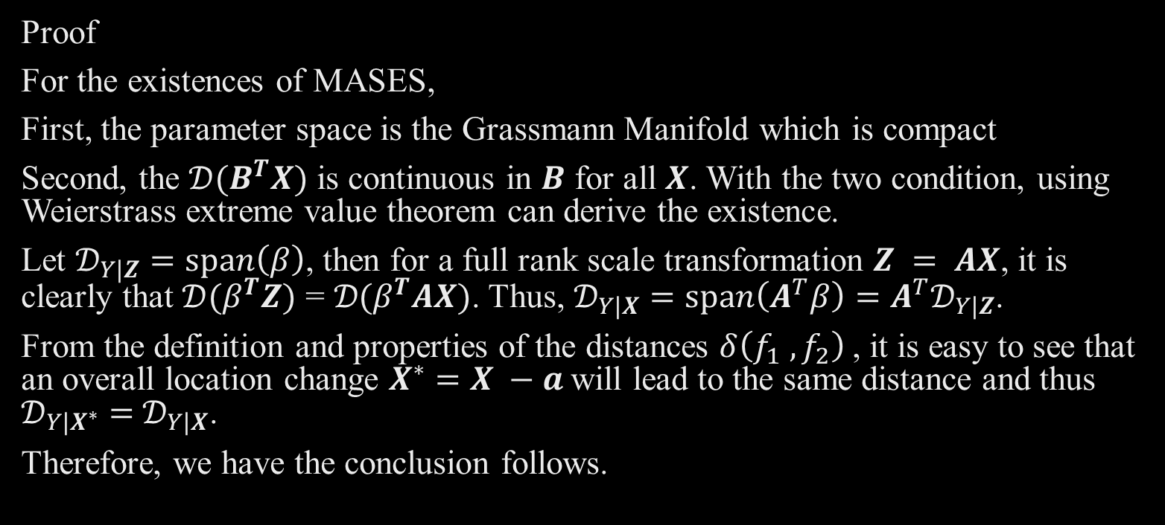
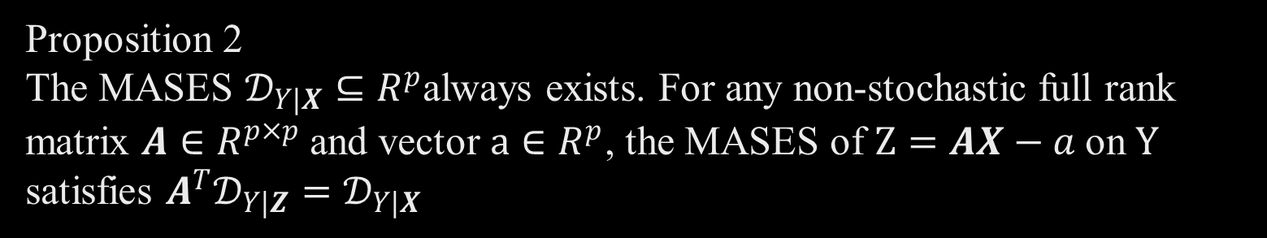
Proposition 2 The MASES $𝒟_{Y|X}⊆R^{p}$always exists. For any non-stochastic full rank matrix $A∈R^{p×p}$and vector $a∈R^{p}$, the MASES of $Z=AX−a$on $Y$ satisfies ${A^{T}𝒟_{Y|Z}=𝒟}_{Y|X}$
Proof
For the existences of MASES,
First, the parameter space is the Grassmann Manifold which is compact
Second, the ${𝒟(B}^{T}X)$ is continuous in $B$ for all $X$. With the two condition, using Weierstrass extreme value theorem can derive the existence.
Let $𝒟_{Y|Z}=span\left(β\right)$, then for a full rank scale transformation $Z = AX$, it is clearly that ${𝒟(β}^{T}Z)\text{ = }{𝒟(β}^{T}AX)$. Thus, $𝒟_{Y|X}=span\left(A^{T}β\right)=A^{T}𝒟_{Y|Z}$.
From the definition and properties of the distances $δ\left(f_{1} ,f_{2}\right)$, it is easy to see that an overall location change $X^{∗}=X −a$will lead to the same distance and thus $𝒟_{Y|X^{∗}}=$ $𝒟_{Y|X}$.
Therefore, we have the conclusion follows.

Slide 14
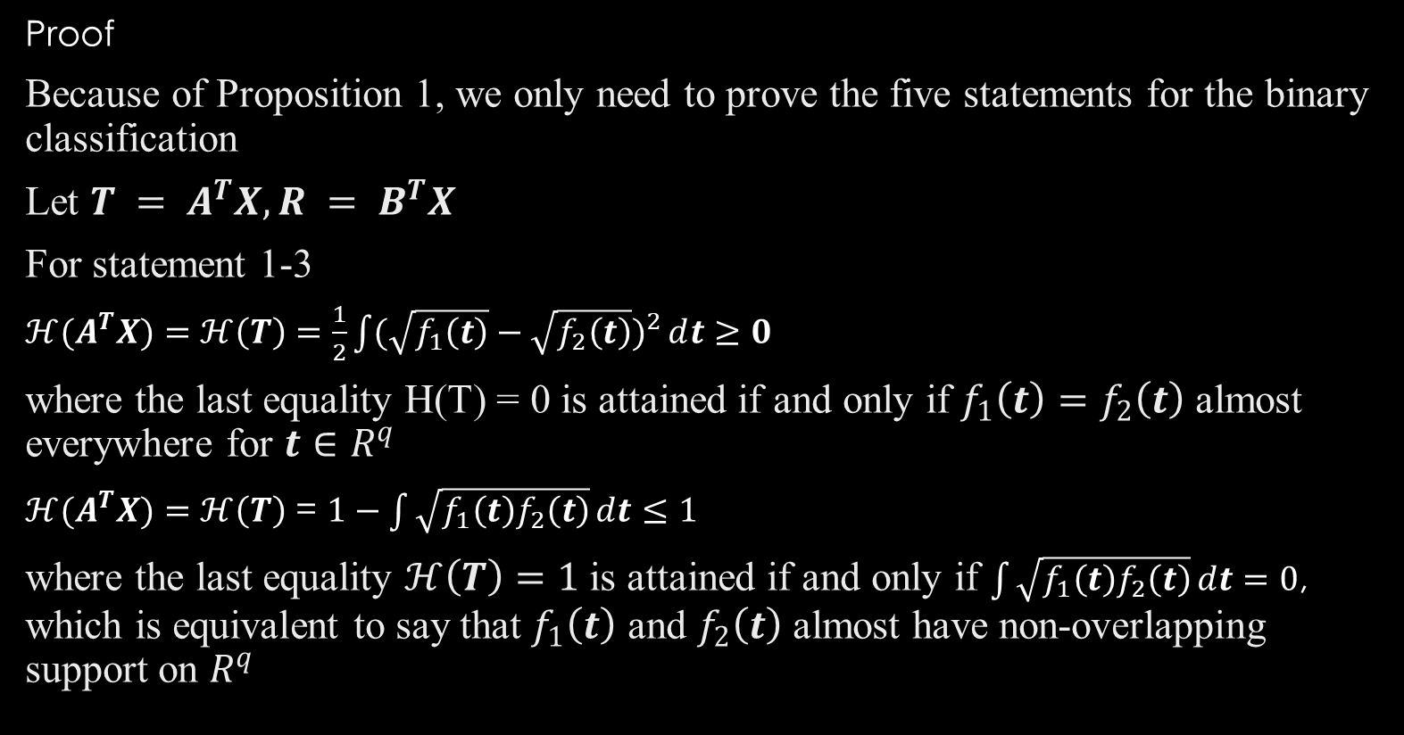

Proposition 3 The properties in Proposition 1 are satisfied by $𝒟_{H}(X)$
Proof
Because of Proposition 1, we only need to prove the five statements for the binary classification
Let $T = A^{T}X, R = B^{T}X$
For statement 1-3
$ℋ(A^{T}X)=$ $ℋ\left(T\right)=\frac{1}{2}{\int{(\sqrt{f_{1}\left(t\right)}}−\sqrt{f_{2}\left(t\right)})}^{2}ⅆt≥0$
where the last equality H(T) = 0 is attained if and only if $f_{1}\left(t\right)=f_{2}\left(t\right)$ almost everywhere for $t∈R^{q}$
$ℋ(A^{T}X)=$ $ℋ\left(T\right)$ = $1−\int{\sqrt{f_{1}\left(t\right)f_{2}\left(t\right)}ⅆt}≤1$
where the last equality $ℋ\left(T\right)=1$ is attained if and only if $\int{\sqrt{f_{1}\left(t\right)f_{2}\left(t\right)}ⅆt}=0$, which is equivalent to say that $f_{1}\left(t\right)$ and $f_{2}\left(t\right)$ almost have non-overlapping support on $R^{q}$

Slide 15

Proof of Proposition 3
For statement 4
For any matrices $A∈R^{p×r}$and$B∈R^{p×q}$, construct $A^{′}=\left[A 0\right]$ $∈R^{p×q}$
$$span\left(A′\right)=span\left(A\right)=span(B)$$
So exist a non-singular matrix $S∈$ $R^{q×q}$ that $A^{′}=BS$, $T^{′}=SR$,
Let $g_{k}\left(r\right)$ denotes the pdf of $R | Y=k$,$T^{′}={A′}^{T}X={\left[A 0\right]}^{T}X=[{T^{T}0^{T}]}^{T}$
$\int{\sqrt{f_{1}\left(t\right)f_{2}\left(t\right)}ⅆt}=\int{\sqrt{f_{1}\left(t′\right)f_{2}\left(t′\right)}ⅆt^{′}=\int{\sqrt{\frac{g_{1}\left(r\right)}{det⁡(S)}\frac{g_{2}\left(r\right)}{det⁡(S)}}ⅆSr}}=$ $\int{\sqrt{g_{1}\left(r\right)g_{2}\left(r\right)}ⅆr}$
So $ℋ(A^{T}X)=$ $ℋ(B^{T}X)$

Slide 16
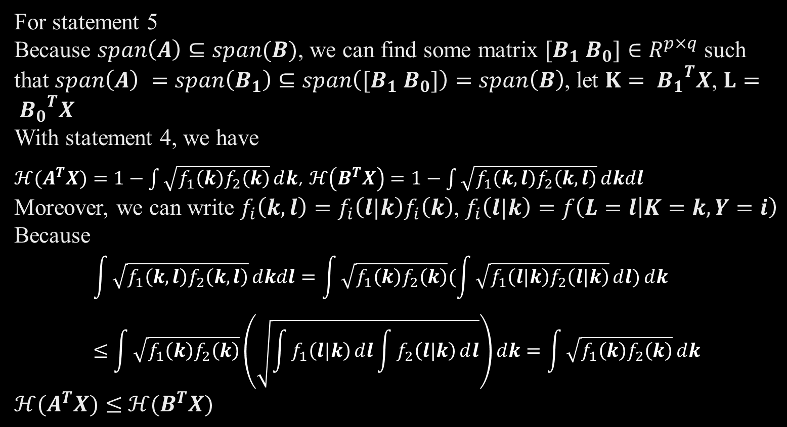
Proof of Proposition 3
For statement 5
Because $span\left(A\right)⊆span(B)$, we can find some matrix $[B_{1}{ B}_{0}]$ $∈R^{p×q}$ such that $span\left(A\right) =span\left(B_{1}\right)⊆span\left([B_{1}{ B}_{0}]\right)=$ $span\left(B\right)$, let $K= {B_{1}}^{T}X$, $L= {B_{0}}^{T}X$
With statement 4, we have
$ℋ(A^{T}X)=$ $1−\int{\sqrt{f_{1}\left(k\right)f_{2}\left(k\right)}ⅆk}$, $ℋ\left(B^{T}X\right)=1−\int{\sqrt{f_{1}\left(k,l\right)f_{2}\left(k,l\right)}ⅆkdl}$
Moreover, we can write ${f_{i}\left(k,l\right)=f_{i}\left(l|k\right)f}_{i}\left(k\right)$, $f_{i}\left(l|k\right)=f\left(L=l | K=k,Y=i\right)$
Because
$$\int{\sqrt{f_{1}\left(k,l\right)f_{2}\left(k,l\right)}ⅆkdl}=\int{\sqrt{f_{1}\left(k\right)f_{2}\left(k\right)}(\int{\sqrt{f_{1}\left(l|k\right)f_{2}\left(l|k\right)}ⅆl})ⅆk}≤\int{\sqrt{f_{1}\left(k\right)f_{2}\left(k\right)}\left(\sqrt{\int{f_{1}\left(l|k\right)ⅆl}\int{f_{2}\left(l|k\right)ⅆl}}\right)ⅆk}=\int{\sqrt{f_{1}\left(k\right)f_{2}\left(k\right)}ⅆk}$$
${ℋ(A}^{T}X)≤$ ${ℋ(B}^{T}X)$

Slide 17
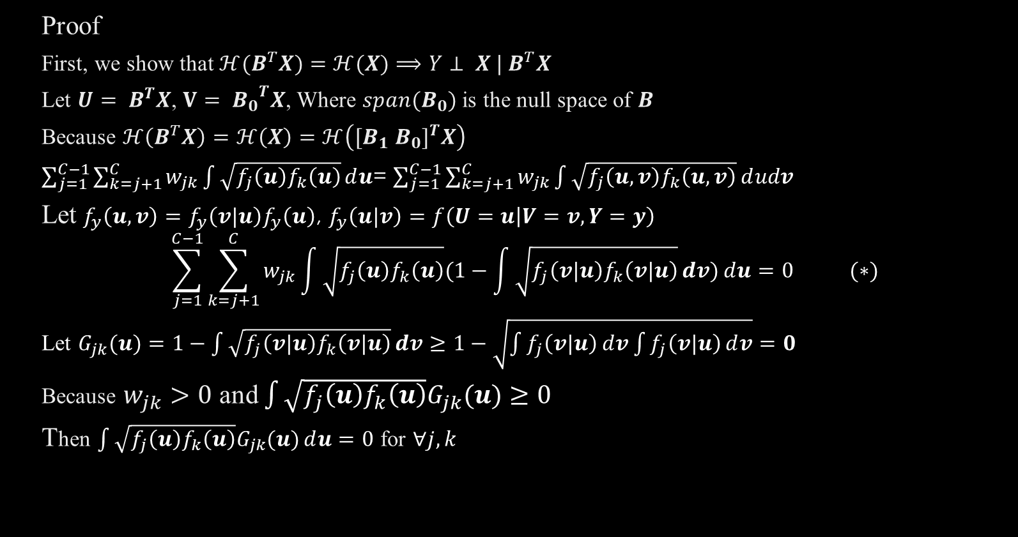
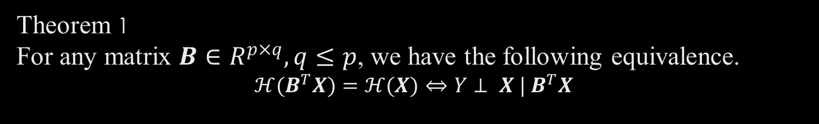
Theorem 1 For any matrix $B∈R^{p×q}, q≤p$, we have the following equivalence. $$ℋ(B^{T}X)=ℋ(X)⇔Y⊥ X | B^{T}X$$
Proof
First, we show that $ℋ(B^{T}X)=ℋ(X)⟹Y⊥ X | B^{T}X$
Let $U= B^{T}X$, $V= {B_{0}}^{T}X$, Where $span(B_{0})$ is the null space of $B$
Because $ℋ\left(B^{T}X\right)=ℋ\left(X\right)=ℋ\left({[B_{1}{ B}_{0}]}^{T}X\right)$
$\sum_{j=1}^{C−1}{\sum_{k=j+1}^{C}{w_{jk}\int{\sqrt{f_{j}\left(u\right)f_{k}\left(u\right)}ⅆu}}}$= $\sum_{j=1}^{C−1}{\sum_{k=j+1}^{C}{w_{jk}\int{\sqrt{f_{j}\left(u,v\right)f_{k}\left(u,v\right)}ⅆudv}}}$
Let ${f_{y}\left(u,v\right)=f_{y}\left(v|u\right)f}_{y}\left(u\right)$, $f_{y}\left(u|v\right)=f\left(U=u | V=v,Y=y\right)$
$$\sum_{j=1}^{C−1}{\sum_{k=j+1}^{C}{w_{jk}\int{\sqrt{f_{j}\left(u\right)f_{k}\left(u\right)}(1−\int{\sqrt{f_{j}\left(v|u\right)f_{k}\left(v|u\right)}}ⅆv)ⅆu}}}=0 (∗)$$
Let $G_{jk}(u)=1−\int{\sqrt{f_{j}\left(v|u\right)f_{k}\left(v|u\right)}}ⅆv≥1−\sqrt{\int{f_{j}\left(v|u\right)ⅆv}\int{f_{j}\left(v|u\right)ⅆv}}=0$
Because $w_{jk}>0$ and $\int{\sqrt{f_{j}\left(u\right)f_{k}\left(u\right)}G_{jk}(u)}≥0$
Then $\int{\sqrt{f_{j}\left(u\right)f_{k}\left(u\right)}G_{jk}(u)ⅆu}=0$ for $∀j,k$

Slide 18

Partition the support of U as $T_{1} ∪ T_{2}$, where $T_{1}$ $⊆R^{d}$and $T_{2}$ $⊆R^{d}$are defined as follows.
For $u ∈T_{1}$, $f_{j}\left(u\right)f_{k}\left(u\right)=0$, $∀j, k = 1,…,C$
For $u ∈T_{2}$,$G_{jk}(u)=0$, $∀j,k = 1,…,C$
Notice that we do not require $T_{1}$ and $T_{2}$ to be disjoint.
For $u ∈T_{1}$, $f_{j}\left(u\right)f_{k}\left(u\right)=0$, $∀j, k = 1,…,C$ implies that at most one class has non-zero density. Then given $U = u$, we know the value of $Y$ with probability one and hence $Y$ is independent of $X$ given $U=β^{T}X$.
On the other hand, for $u ∈T_{2}$, , if $G_{jk}(u)=0$, $1=\int{\sqrt{f_{j}\left(v|u\right)f_{k}\left(v|u\right)}}ⅆv$
The equality hold only for $f_{j}\left(v|u\right){=f}_{k}\left(v|u\right)$
then $V|(U=u,Y=j) \sim V|(U=u,Y=k)⟹Y⊥V | U=u$
So $Y⊥V | U⟺$ $Y⊥{B_{0}}^{T}X |{ B}^{T}X⟺$ $Y⊥ X | B^{T}X$
Next, we show $Y⊥ X | B^{T}X⟹ℋ(B^{T}X)=ℋ(X)$
Following the same logic, we can straightforwardly shown that $Y⊥ X | B^{T}X$ implies $(∗)$, and therefore $ℋ(B^{T}X)=ℋ(X)$.

Slide 19

Remark of the proof:
The proof from the paper may have a little bit problem, it doesn’t consider that when only for some $j,k$, $f_{j}\left(u\right)f_{k}\left(u\right)≠0$ and $G_{jk}(u)=0$ and the other $j,k$, $f_{j}\left(u\right)f_{k}\left(u\right)=0$ and $G_{jk}(u)≠0$
I revise it by following the paper origin idea.
Denote the index set as $I(u)=\{i, f_{i}\left(u\right)≠0\}$
When $i∈\left\{1,2,…,C\right\}−I\left(u\right)$ , $f_{i}\left(u\right)=0$, which means it could not happen
For a given $u$, we have $f_{j}\left(u\right)f_{k}\left(u\right)≠0$, when $j≠k$, $j,k∈I(u)$
Then $G_{jk}(u)=0$, according to the Cauchy inequality, $f_{j}\left(v|u\right){=f}_{k}\left(v|u\right)$
Then $V|U=u,Y=i, i∈I\left(u\right)$ all have the same distribution
So $Y⊥V | U⟺$ $Y⊥{B_{0}}^{T}X |{ B}^{T}X⟺$ $Y⊥ X | B^{T}X$

Slide 20
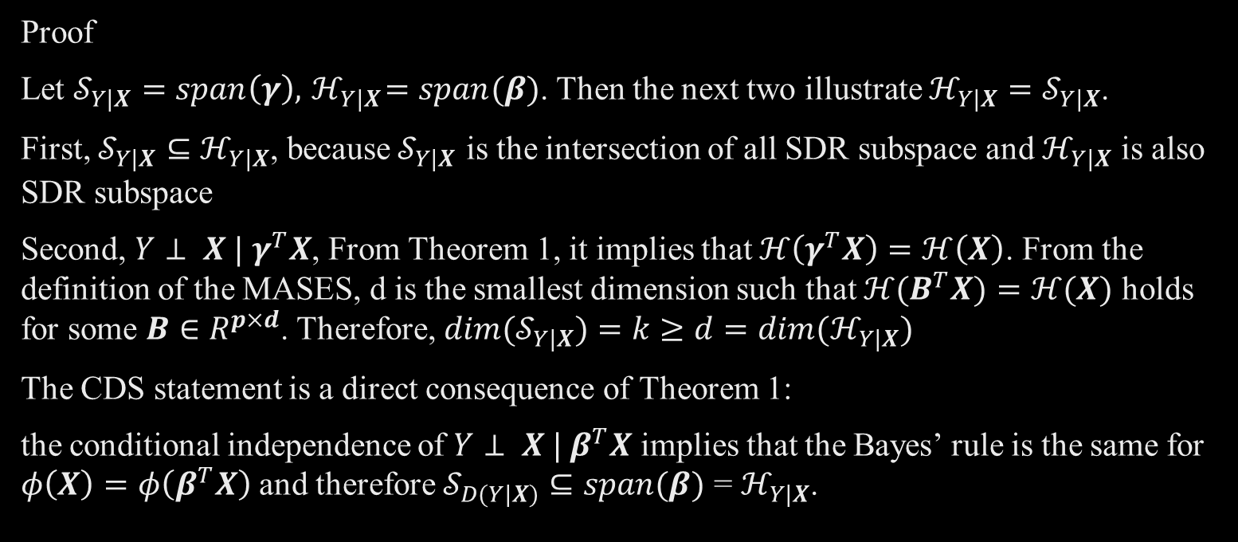
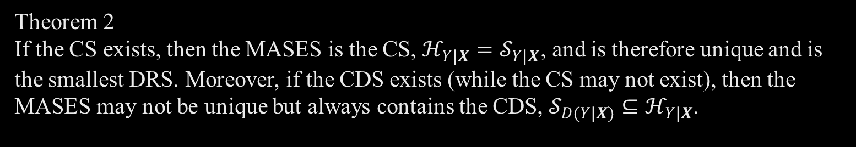
Theorem 2 If the CS exists, then the MASES is the CS, $ℋ_{Y|X}=𝒮_{Y|X}$, and is therefore unique and is the smallest DRS. Moreover, if the CDS exists (while the CS may not exist), then the MASES may not be unique but always contains the CDS, $𝒮_{D(Y|X)}⊆ℋ_{Y|X}$.
Proof
Let $𝒮_{Y|X}=span\left(γ\right),{ ℋ}_{Y|X}=span(β)$. Then the next two illustrate $ℋ_{Y|X}=𝒮_{Y|X}$.
First, $𝒮_{Y|X}⊆ℋ_{Y|X}$, because${ 𝒮}_{Y|X}$ is the intersection of all SDR subspace and $ℋ_{Y|X}$ is also SDR subspace
Second, $Y⊥ X | γ^{T}X$, From Theorem 1, it implies that $ℋ\left(γ^{T}X\right)=ℋ\left(X\right)$. From the definition of the MASES, d is the smallest dimension such that $ℋ(B^{T}X)=ℋ(X)$ holds for some $B∈R^{p×d}$. Therefore, ${dim(𝒮}_{Y|X})=k≥d=dim(ℋ_{Y|X})$
The CDS statement is a direct consequence of Theorem 1:
the conditional independence of $Y⊥ X | β^{T}X$ implies that the Bayes’ rule is the same for $φ\left(X\right)=φ\left(β^{T}X\right)$ and therefore $𝒮_{D(Y|X)}⊆{span(β)\text{ = }ℋ}_{Y|X}$.

Slide 21
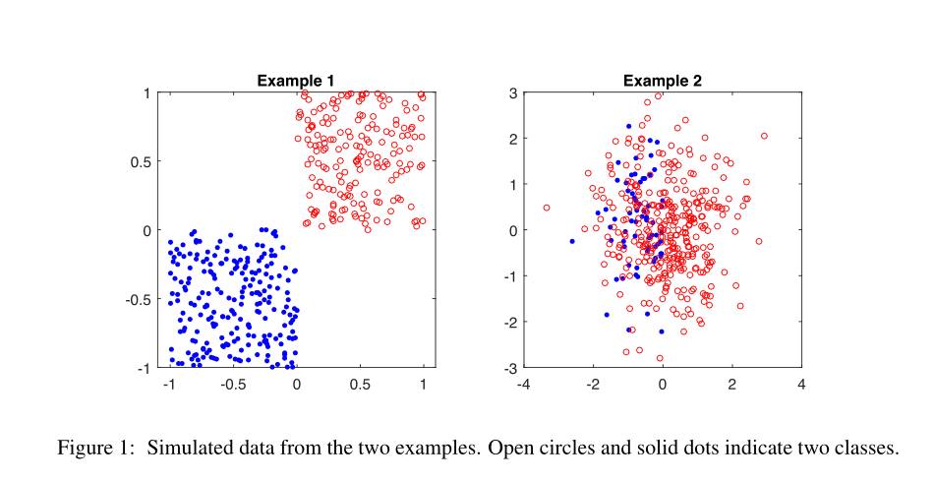

Two illustrative examples
There are two examples which illustrate the possible scenarios where (i) the CS and the CDS do not exist, and, (ii) the CDS is a proper subset of the MASES. For demonstration and visualization, consider the following two simulated data sets with a binary response $Y = 1 or 2$and a bivariate predictor ${X = (X_{1} , X_{2})}^{T}$, and plot the data in Figure 1.
Picture comes from the origion paper of Xin Zhang, Qing Mai, Hui Zou, 2020

Slide 22
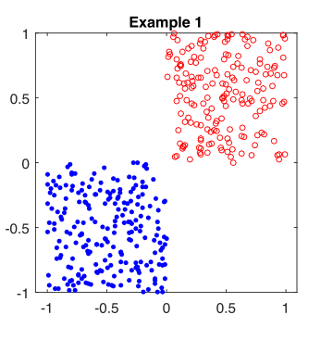

Example 1
In Example 1, $X_{1} \sim Uniform\left(−1,1\right)$ and $X_{2}=sign\left(X_{1}\right)Z$, where $Z\sim Uniform\left(0,1\right)$is independent of $X_{1}$ . Then $Y = 1$if $X_{1}> 0$and $Y = 2$ otherwise. It is apparent from Figure 1 that perfect separation of the two classes is achieved through the sign of $X_{1}$, which is the same as the sign of $X_{2}$ . Then the CS (or the CDS) does not exist, because both $span(({1,0)}^{T} )$ and $span({(0,1)}^{T} )$are DRS but their intersection is no longer a DRS. However, the MASES still exists. It is any one-dimensional $B^{T}X = b_{1}X_{1}+b_{2}X_{2}{, b}_{1},b_{2}≥ 0{, b}_{1}b_{2}≠ 0$, keeps the perfect separation. The non-uniqueness of MASES is not an issue in practice, because the dimension of MASES is always well-defined. Therefore, all these MASES become equivalent in terms of separating classes and the estimation procedure is guarantee to converge to one of the MASES by Theorem 4.

Slide 23
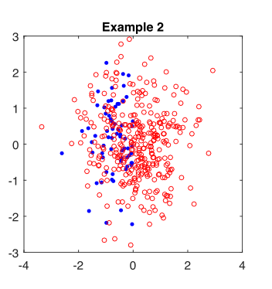

Example 2
In Example 2, $X_{1}$ and $X_{2}$ are independent standard normal random variable, and $Y$is a Bernoulli random variable with $Pr⁡(Y=1|X_{1}> 0) = 1$and $Pr⁡(Y=1|X_{1}< 0) =0.6$.
Clearly $Y$ only depends on $X_{1}$ , but the Bayes’ rule is to always classify $Y = 1$, regardless of the predictor information. This means that the CDS is the null space$∅$, while the CS and MASES is $span(({1,0)}^{T} )$ , which contains useful information in the discriminant analysis beyond Bayes’ rule. From Figure 1, we see that the solid dots all reside in the half plane of $X_{1}< 0$. This example shows that the CDS may miss some information of the conditional distributions $X | Y$ and $Y | X$.

Slide 24

Connection with other methods
1. Under Linear discriminant analysis model $X|Y=y\sim N\left(μ_{y},Σ\right), y=1,2,…,C$, all the following subspace are equal to the MASES $ℋ_{Y|X}$, which has dimension $d≤min⁡(C−1,p)$: $𝒮_{Y|X}$, $𝒮_{LDA}=Σ^{−1}span\left(Σ_{b}\right),𝒮_{SIR}={Σ_{X}}^{−1}span\left(Σ_{b}\right),𝒮_{SAVE}={Σ_{X}}^{−1}span\left(Σ_{X}−Σ\right),$ Where $Σ_{b}=\sum_{y=1}^{C}{\left(μ_{y}−EX\right){\left(μ_{y}−EX\right)}^{T}/C}$.
2. Under Quadratic discriminant analysis model $X|Y=y\sim N\left(μ_{y},Σ_{y}\right), y=1,2,…,C,$ then $𝒮_{LDA}=𝒮_{SIR}⊆ℋ_{Y|X}=𝒮_{Y|X}=𝒮_{SAVE}=$ ${Σ_{X}}^{−1}span(Σ_{1}−Σ_{X},Σ_{2}−Σ_{X},…,Σ_{C}−Σ_{X})$
3. Under Multinomial Index model $Pr⁡(Y=j | X) = Pr⁡(Y=j |β^{T}X) = f_{j}(β^{T}X,ε_{j} ), j = 1,…,C$, where $f_{j}$ are functions with positive values and $ε_{j}$ potential random disturbance that are independent of $X$, then $𝒮_{SIR}∪𝒮_{SAVE}⊆span\left(β\right)=ℋ_{Y|X}=𝒮_{Y|X}$

Slide 25


Estimation and consistency Now we get the estimation method in $C =2$.
$F_{pop}\left(B\right)≡1−ℋ\left(B^{T}X\right)=\int{\sqrt{f_{1}\left(B^{T}x\right)f_{2}\left(B^{T}x\right)}}ⅆx=E\{\frac{\sqrt{f_{1}\left(B^{T}X\right)f_{2}\left(B^{T}X\right)}}{f\left(B^{T}X\right)}\}$
$F\left(B\right)=\sum_{i=1}^{n}{\frac{\sqrt{{\hat{f}}_{1}\left(B^{T}X_{i}\right){\hat{f}}_{2}\left(B^{T}X_{i}\right)}}{{{\hat{p}}_{1}\hat{f}}_{1}\left(B^{T}X_{i}\right){+{\hat{p}}_{2}\hat{f}}_{2}\left(B^{T}X_{i}\right)+δ_{n}}}=\sum_{i=1}^{n}{F_{i} (B)}$
${\hat{p}}_{k}=\frac{n_{k}}{n}$
${\hat{f}}_{k}\left(B^{T}X_{i}\right)=\frac{{(2π)}^{−\frac{d}{2}}}{(n−1)h_{n}^{d}}\sum_{Y_{j}=k,j≠i}{exp}\{−\frac{{||B^{T}(X_{i}−X_{j})||}_{2}^{2}}{2h_{n}^{2d}}\}$
$h_{n}=1.06∙\hat{σ}∙n^{−0.2}$

Slide 26

Next, we calculate the derivative of $F\left(B\right)$, which will be used in the following Grassmann manifold optimization.
$$\frac{dF\left(B\right)}{dB}=\sum_{i=1}^{n}{\frac{dF_{i}\left(B\right)}{dB}}=\sum_{i=1}^{n}{\sum_{j=1}^{n}{A_{i}W_{ij}}}(X_{i}−X_{j}){{(X}_{i}−X_{j})}^{T}B$$
Where$W_{ij}=\frac{{\left(−1\right)}^{Y_{j}}h_{n}^{−2d}U_{ij}}{\sum_{Y_{m}=Y_{j},m≠i}{U_{im}}}, U_{ij}=exp \{−\frac{{||B^{T}(X_{i}−X_{j})||}_{2}^{2}}{2h_{n}^{2d}}\}$

Slide 27

Stiefel and Grassmann manifolds optimization
“Minimization with orthogonality constraints (e.g., $X^{T}X = I$) and/or spherical constraints (e.g., ${||x||}_{2} = 1$) has wide applications. These problems are difficult because the constraints are not only non-convex but numerically expensive to preserve during iterations.” (Zaiwen Wen, 2012)
Based on the explicit forms of $F\left(B\right)$ and $\frac{dF\left(B\right)}{dB}$, we may use any off-the-shelf optimization methods to obtain the MASES estimator. The authors current implementation adopts the sg_min Matlab package for Stiefel and Grassmann manifolds optimization, which preserves the orthogonality constraint $B^{T}B = I$ .
For repeated the simulation work, I use the R package “GrassmannOptim”, which could find the maximum of a function constrained on Grassmann manifold.

Slide 28

Initialization
For this non-convex iterative optimization, it is crucial to obtain a good initial estimator.
When $d = 1$, we randomly generate 100 directions $B_{1},B_{2},…,B_{100}∈R^{p}$and select the one with the smallest $F\left(B\right)$ as the initial estimator.
When $d > 1$, we could use the following sequential algorithm to obtain the initial estimator $\hat{B_{d}}=(\hat{b_{1}},\hat{b_{2}},…,\hat{b_{j}})∈R^{p×d}$.
Sequential Algorithm
Let $\hat{B_{j}}=(\hat{b_{1}},\hat{b_{2}},…,\hat{b_{j}})$, for $j =0,1,…,d$. And $\left(\hat{B_{j}},\hat{B_{0j}}\right)$ be the orthogonal basis of $R^{p}$. Set initial value $\hat{b_{0}}=\hat{B_{0}}=∅$, $\hat{B_{00}}=I_{p}$. Then do the following step for $j =0,1,…,d−1$:
1. Minimize the sample objective function$, \hat{b}=\underset{b∈R^{p},b^{T}b=1}{argmin}{F( \hat{B_{0j}}b) }$
2. Let $\hat{b_{j}}=$ $\hat{B_{0j}}\hat{b}$ be the (j + 1)-th maximal separation direction.

Slide 29

Dimension selection
The above sequential algorithm provides a nested solution for the MASES and hence motivates the MASES dimension selection procedure as follows.
For $q =1,2,…,p$, we define $λ_{q}=$ $\hat{ℋ}\left({\hat{b_{q}}}^{T}X\right)=1−n^{−1}F(\hat{b_{j}})$. Then
$$\hat{d}=\underset{q}{argmin}{\frac{λ_{q+1}}{λ_{q}}}$$
This is conceptually similar to the ratio-based estimators of dimension in SDR and factor analysis literature (Lam et al., 2011; Lee and Shao, 2016, e.g.)
Therefore, we select the MASES dimension based on the sequential directions.

Slide 30

Consistency
(C1) There exists a constant $M_{1}>0$such that the density function $f_{k}\left(B^{T}X\right)$ satisfies that ${||∇^{2}f_{k}\left(B^{T}x\right)||}_{op}$for any $x$. The operator norm of a matrix $M∈R^{p×q}$is defined as ${||M||}_{op}=inf⁡\text{\{}\text{c}\text{ ≥ 0}:{||Mv||}_{2}≤{c||v||}_{2},\text{∀} \text{v}\text{ ∈ }R^{q}\}$
(C2) There exists a constant $M_{2}>0$such that the density function $f_{k}\left(B^{T}X\right)≤M_{2}$
Under the two condition we have the following two theorem.

Slide 31

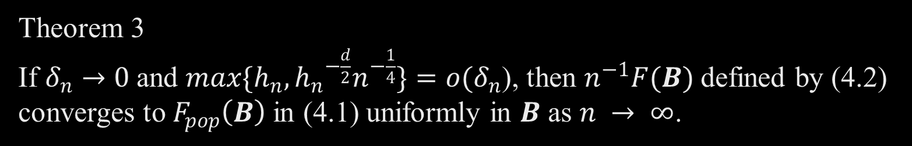
Theorem 3 If $δ_{n}→0$and $\max{\{h_{n},{h_{n}}^{−\frac{d}{2}}n^{−\frac{1}{4}}\}}=o(δ_{n}$), then $n^{−1}F(B)$defined by (4.2) converges to $F_{pop}\left(B\right)$in (4.1) uniformly in $B$ as $n → ∞$.
Outline of proof
$\left|n^{−1}F\left(B\right)−F_{pop}\left(B\right)\right|≤\left|n^{−1}F\left(B\right)−n^{−1}\sum_{i=1}^{n}{\frac{\sqrt{\hat{f_{1.i}^{B}}\hat{f_{2.i}^{B}}}}{p_{1}\hat{f_{1.i}^{B}}+p_{2}\hat{f_{2.i}^{B}}+δ_{n}}}\right|$+ $\left|n^{−1}\sum_{i=1}^{n}{\frac{\sqrt{\hat{f_{1.i}^{B}}\hat{f_{2.i}^{B}}}}{p_{1}\hat{f_{1.i}^{B}}+p_{2}\hat{f_{2.i}^{B}}+δ_{n}}}−n^{−1}\sum_{i=1}^{n}{\frac{\sqrt{{f_{1.i}^{B}f}_{2,i}^{B}}}{p_{1}f_{1,i}^{B}+p_{2}f_{1,i}^{B}+δ_{n}}}\right|$+ $\left|n^{−1}\sum_{i=1}^{n}{\frac{\sqrt{{f_{1.i}^{B}f}_{2,i}^{B}}}{p_{1}f_{1,i}^{B}+p_{2}f_{1,i}^{B}+δ_{n}}}−E\frac{\sqrt{{f_{1.i}^{B}f}_{2,i}^{B}}}{p_{1}f_{1,i}^{B}+p_{2}f_{1,i}^{B}+δ_{n}}\right|$+ $\left|E\frac{\sqrt{{f_{1.i}^{B}f}_{2,i}^{B}}}{p_{1}f_{1,i}^{B}+p_{2}f_{1,i}^{B}+δ_{n}}−F_{pop}\left(B\right)\right|=L_{1}+L_{2}{+L}_{3}$ ${+L}_{4}$
And then show the four term converge to zero in probability uniformly in $B$

Slide 32
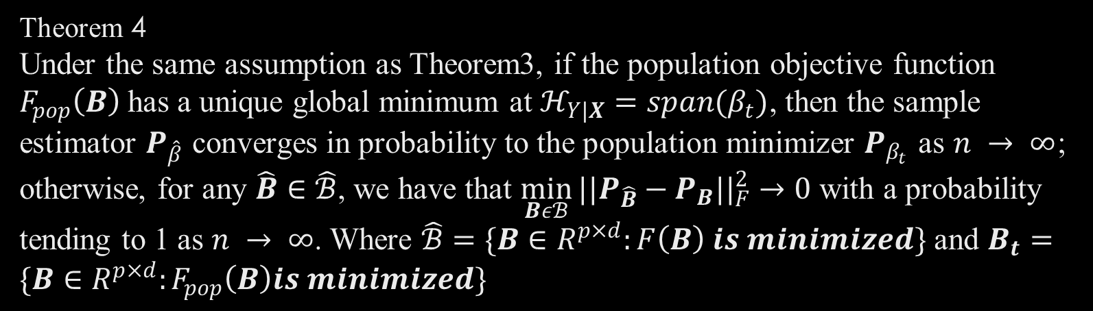
Theorem 4 Under the same assumption as Theorem3, if the population objective function $F_{pop}\left(B\right)$has a unique global minimum at $ℋ_{Y|X}=span(β_{t})$, then the sample estimator $P_{\hat{β}}$ converges in probability to the population minimizer $P_{β_{t}}$ as $n → ∞$; otherwise, for any $\hat{B}∈\hat{ℬ}$, we have that $\min_{Bεℬ}{{||P_{\hat{B}}−P_{B}||}_{F}^{2}}→0$ with a probability tending to 1 as $n → ∞$. Where $\hat{ℬ}=\{B∈R^{p×d}:F\left(B\right) is minimized\}$ and $B_{t}=\{B∈R^{p×d}:F_{pop}\left(B\right)is minimized\}$
Proof omitted

Slide 33
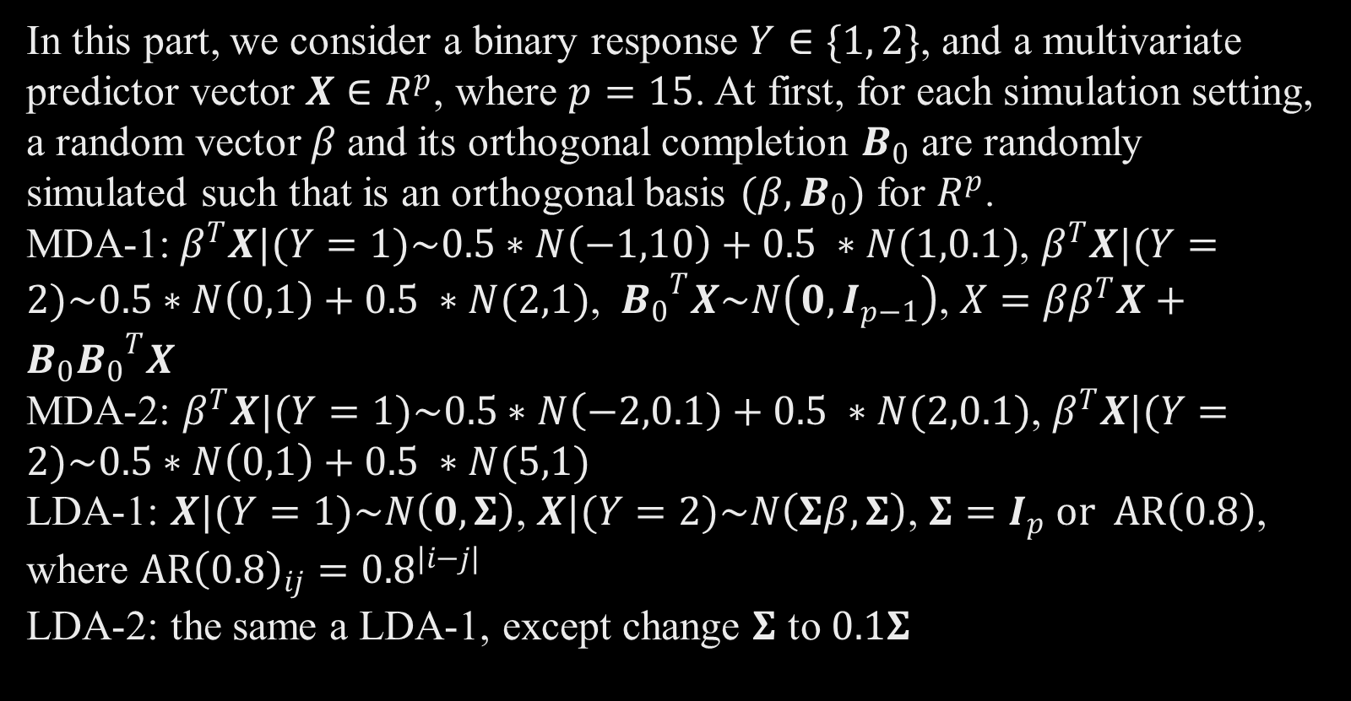
Simulation (Inverse Model)
In this part, we consider a binary response $Y∈\{1, 2\}$, and a multivariate predictor vector $X∈R^{p}$, where $p=15$. At first, for each simulation setting, a random vector$β$and its orthogonal completion $B_{0}$ are randomly simulated such that is an orthogonal basis $(β,B_{0})$ for $R^{p}$.
MDA-1:$β^{T}X|(Y=1)\sim 0.5∗N\left(−1,10\right)+0.5 ∗N(1,0.1)$, $β^{T}X|(Y=2)\sim 0.5∗N\left(0,1\right)+0.5 ∗N(2,1)$, ${B_{0}}^{T}X\sim N\left(0,I_{p−1}\right)$, ${X=ββ}^{T}X+{B_{0}B_{0}}^{T}X$
MDA-2: $β^{T}X|(Y=1)\sim 0.5∗N\left(−2,0.1\right)+0.5 ∗N(2,0.1)$, $β^{T}X|(Y=2)\sim 0.5∗N\left(0,1\right)+0.5 ∗N(5,1)$
LDA-1: $X|(Y=1)\sim N\left(0,Σ\right)$, $X|(Y=2)\sim N\left(Σβ,Σ\right)$, $Σ=I_{p} or AR\left(0.8\right)$, where ${AR\left(0.8\right)}_{ij}={0.8}^{|i−j|}$
LDA-2: the same a LDA-1, except change $Σ$ to $0.1Σ$

Slide 34
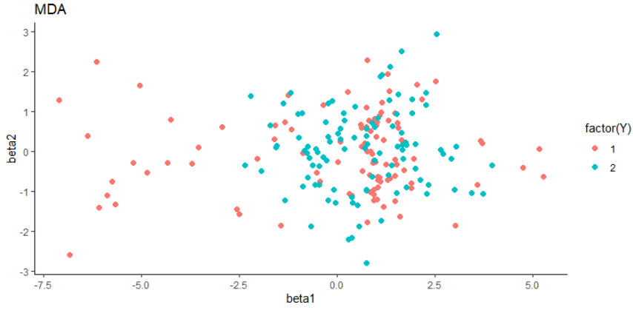
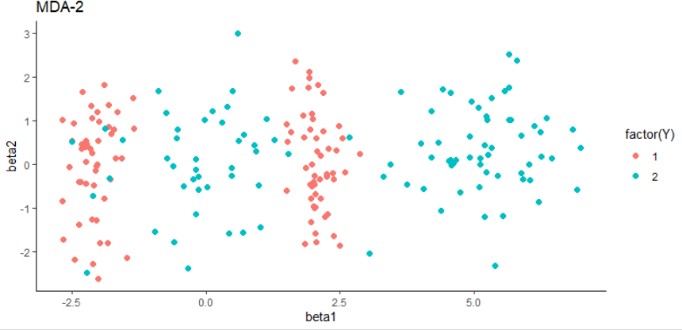
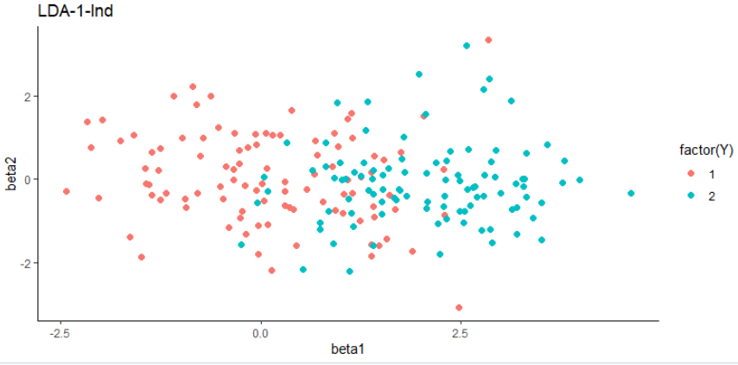
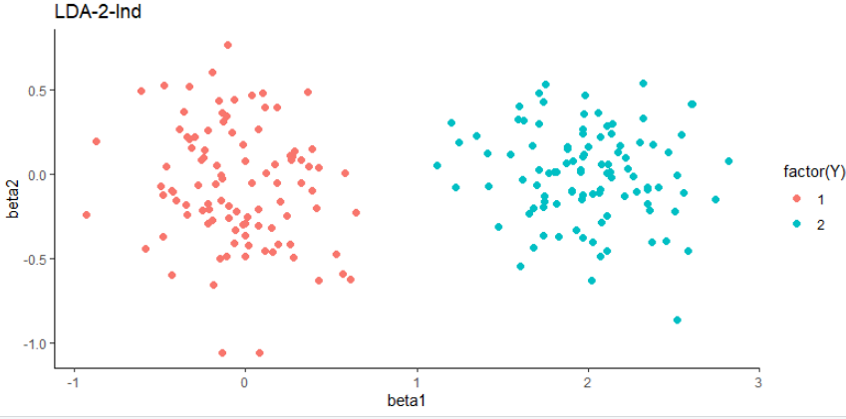

Slide 35
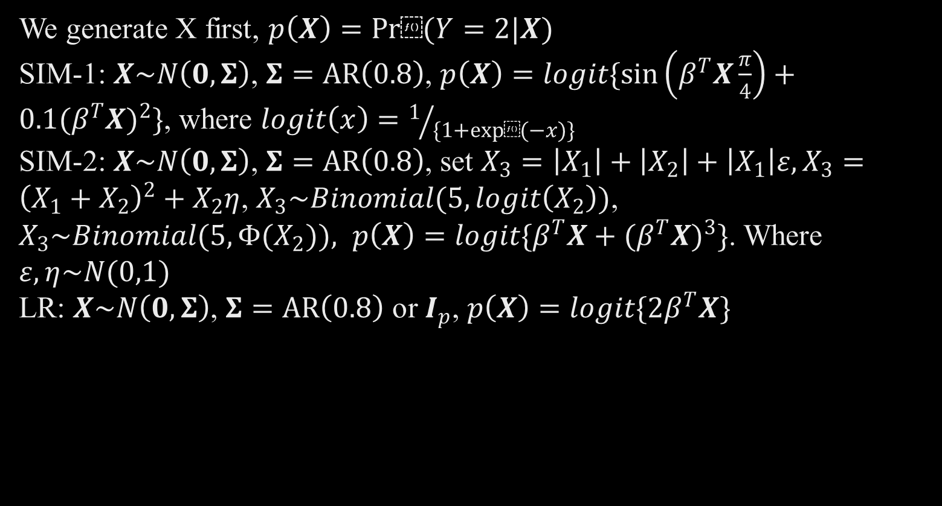
Simulation (Forward Model)
We generate X first, $p\left(X\right)=Pr⁡(Y=2|X)$
SIM-1: $X\sim N\left(0,Σ\right)$, $Σ=AR\left(0.8\right)$, $p\left(X\right)=logit\{\sin\left(β^{T}X\frac{π}{4}\right)+0.1{(β^{T}X)}^{2}\}$, where $logit\left(x\right)=1/{\{1+exp⁡(−x)\}}$
SIM-2: $X\sim N\left(0,Σ\right)$, $Σ=AR\left(0.8\right)$, set $X_{3}=\left|X_{1}\right|+\left|X_{2}\right|+\left|X_{1}\right|ε,X_{3}={\left(X_{1}+X_{2}\right)}^{2}+X_{2}η$, $X_{3}\sim Binomial(5,logit\left(X_{2}\right))$, $X_{3}\sim Binomial(5,Φ(X_{2})), p\left(X\right)=logit\{β^{T}X+{(β^{T}X)}^{3}\}$. Where $ε,η\sim N(0,1)$
LR: $X\sim N\left(0,Σ\right)$, $Σ=AR\left(0.8\right)$ or $I_{p}$, $p\left(X\right)=logit\{2β^{T}X\}$

Slide 36
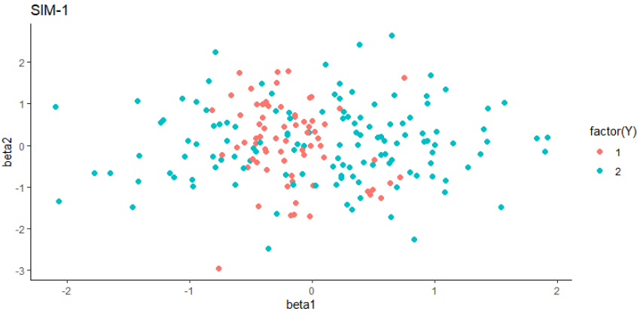
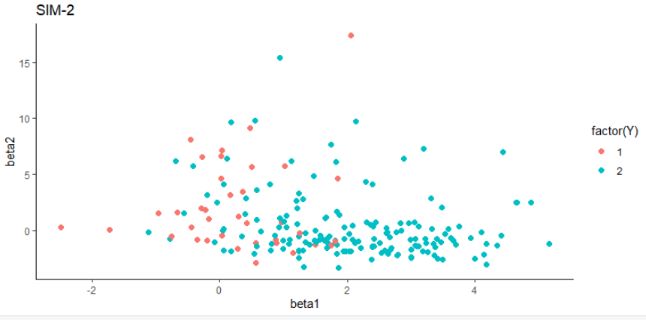
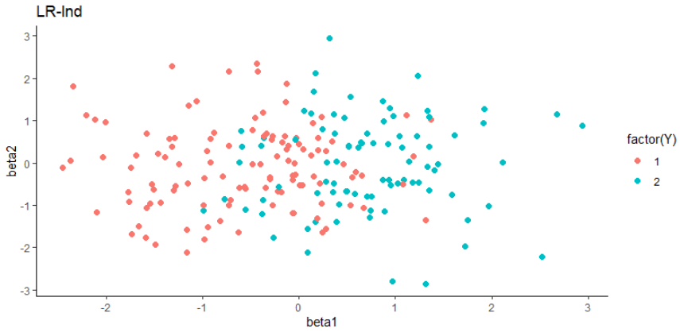

Slide 37
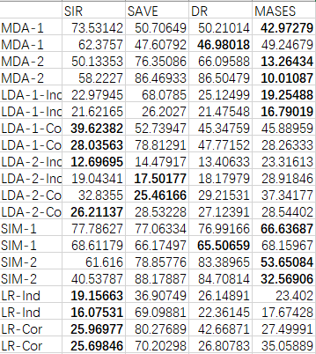
Simulation Outcome
The value is the angle between the true direction which is used to generate data, and the estimated direction.

Slide 38

Energy distance---Another method
What is energy distance?
It’s a statistics that could measures the distance between distributions in a similar sense.
Definition: (Székely & Rizzo, 2004 )
Let $A = \{a_{1}, … ,a_{n_{1}}\}$ and $B = \{b_{1}, … ,b_{n_{2}}\}$be disjoint nonempty subsets of $R^{d}$ . Euclidean norm is denoted by $∥ · ∥$. Define the e-distance $e(A, B)$between $A$ and $B$ as
$$e\left(A, B\right)= \frac{n_{1}n_{2}}{n_{1}+n_{2}}[\frac{2}{n_{2}n_{2}}\sum_{i=1}^{n_{1}}{\sum_{j=1}^{n_{2}}{∥a_{i}− b_{j}∥}}−\frac{1}{n_{1}n_{1}}\sum_{i=1}^{n_{1}}{\sum_{j=1}^{n_{1}}{∥a_{i}− a_{j}∥}}$$
$−\frac{1}{n_{2}n_{2}}\sum_{i=1}^{n_{2}}{\sum_{j=1}^{n_{2}}{∥b_{i}− b_{j}∥}}$]

Slide 39

Energy distance
The energy distance come from the following inequality:
If $X, X′ , Y, Y ′$are independent random vectors in $R^{d}$ with finite expectations, $X \sim X′$and $Y \sim Y ′$, then
$2E∥X−Y∥− E∥X−X′∥− E∥Y−Y′∥ ≥ 0$
and equality holds if and only if $X$ and $Y$ are identically distributed
Because of the condition of holding equality, We could use the energy distance to find the Maximum separation subspace.

Slide 40

Apply energy distance to MSAES
Initial setting,
We have sample $\left\{X_{i}, Y_{i}\right\},$ $Y_{i}∈\{1,…,C\}$, $X_{i}∈R^{P}$, we want to find the $B∈$ $R^{P×d}$ which maximum the following objective function. Because the scale of B will influence the object function.
Objective function:
$$F\left(B^{T}X\right)=\sum_{i=1}^{C}{\sum_{j=i+1}^{C}{e\left(A_{i},A_{j}\right)}}$$
Where $A_{i}=$ $\{{B^{T}X^{i}}_{1}, … ,{B^{T}X^{i}}_{n_{i}}\}$, ${X^{n}}_{m}$ means the $m$th sample of $X$ whose $Y =i$, $n_{i}$ is the number of $Y =i$
And the derivative:
$$\sum_{i=1}^{C}{\sum_{j=i+1}^{C}{\frac{n_{i}n_{j}}{n_{i}+n_{j}}[\frac{2}{n_{i}n_{j}}\sum_{m=1}^{n_{i}}{\sum_{n=1}^{n_{j}}{∥{{{B^{T}X^{i}}_{m}−{B^{T}X^{j}}_{n}∥}^{−1}\left({X^{i}}_{m}−{X^{j}}_{n}\right)\left({X^{i}}_{m}−{X^{j}}_{n}\right)}^{T}B}}\text{]}}}$$
$$−\frac{1}{n_{i}n_{i}}\sum_{m=1}^{n_{i}}{\sum_{n=1}^{n_{i}}{∥{{B^{T}X^{i}}_{m}−{B^{T}X^{i}}_{n}∥}^{−1}\left({X^{i}}_{m}−{X^{i}}_{n}\right){\left({X^{i}}_{m}−{X^{i}}_{n}\right)}^{T}B}}−\frac{1}{n_{j}n_{j}}\sum_{m=1}^{n_{j}}{\sum_{n=1}^{n_{j}}{∥{{B^{T}X^{j}}_{m}−{B^{T}X^{j}}_{n}∥}^{−1}}\left({X^{j}}_{m}−{X^{j}}_{n}\right){\left({X^{j}}_{m}−{X^{j}}_{n}\right)}^{T}B}]$$

Slide 41

Problem of applying Energy distance
The upper bound of the energy distance may not exist, the origin paper only refer the lower bound of energy distance holds when the sample comes from the same distribution. So it does not necessary means that the larger the energy distance is, the better separation for the two conditional distribution is.
The same span of $B$ may not lead to the same value of energy distance. Moreover, The scale of Matrix B could influence the value of the objective function. In my application, I constrain it into semi-orthogonal matrix, But the other matrix which don’t have the orthonormal columns may the maximizer of the objective function.
The theoretical basement of applying energy distance to MASES is not sufficient. Such as weather five property needed in MASES is satisfied by the energy distance.

Slide 42
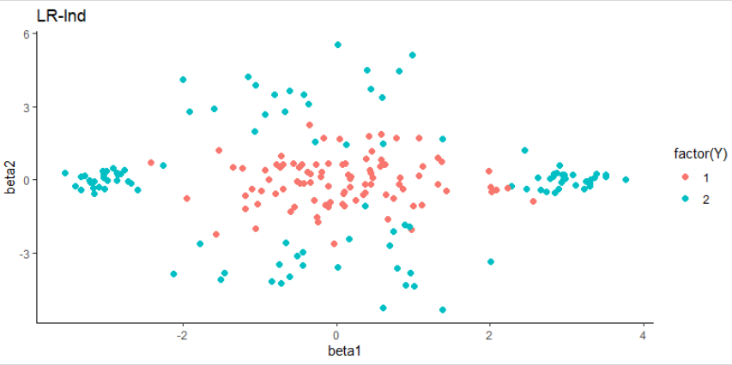

Simulation (Two-dimension Model)
In this section, we consider $β=(β_{1},β_{2})∈R^{p×2}$
MIM-2: $β^{T}X|Y=1\sim N\left(0,I_{p−2}\right)$,$β^{T}X|Y=2\sim 0.25∗N\left(\left(0,3\right),I_{p−2}\right)+0.25∗N\left(\left(0,−3\right),I_{p−2}\right)+0.25∗N\left(\left(3,0\right),{0.1I}_{p−2}\right)+0.25∗N\left(\left(−3,0\right),0.1I_{p−2}\right)$, ${B_{0}}^{T}X\sim N\left(0,I_{p−2}\right)$

Slide 43
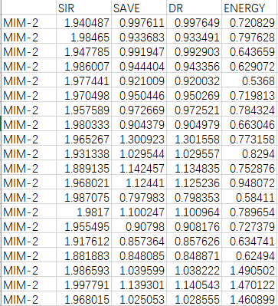


Simulation
The value is $||{P_{β}−P_{\hat{β}}||}_{F}$.
If we average the outcome which is converged .

Slide 44

Conclusion
The maximum separation subspace is based on the idea of find the subspace of 𝑿 which could separate the conditional distribution given the categorical response 𝑌 the most.
For continuous response $Y$, To apply the MASES method, we could slice Y like what SIR and SAVE method did.
The MASES could contain more information than the conditional moment relation method, because MASES try to get the information from the distribution.
The energy distance could be possible applied to the MASES method, But more work is needed to get the theoretical explanation.

Slide 45
Reference
Zhang, X., Mai, Q., & Zou, H. (2020). The Maximum Separation Subspace in Sufficient Dimension Reduction with Categorical Response. Journal of Machine Learning Research, 21(29), 1-36.
Adragni, K. P., Cook, R. D., & Wu, S. (2012). Grassmannoptim: An R package for Grassmann manifold optimization. Journal of Statistical Software, 50(5), 1-18.
Székely, G. J., & Rizzo, M. L. (2004). Testing for equal distributions in high dimension. InterStat, 5(16.10), 1249-1272.
Kreyszig, E. (1978). Introductory functional analysis with applications (Vol. 1). New York: wiley. Chapter 3.

