Slide 1



Header
Hello Alice
Sign Out
When logged in.
Logout will show up on mouse-over
Alice’s Favs
Sign In
Register
My Favs
Dimmed color
E.g. jcrew pants
Clothing
Shoes
Accessories
Home
Luxuries
New Arrivals
We may add more categories later
When keyed in, it will show auto-complete suggestions
Footer
About Us
Contact Us
Jobs
Copyright ©2015 Alice’s Favs Inc. All rights reserved.

Slide 2
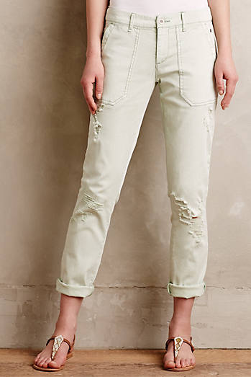
Header
Home Screen
Clothing
more>>
Brand Name
Product Name
$123.45 $103.45 (25%)
Anthropologies
Mosaic Charlie Trousers
$123.45
Anthropologies
Pilcro Hyphen Distressed Chinos
$123.45
Anthropologies
Paige Verdugo Printed Ankle J…
$123.45
Shoes
more>>
Brand Name
Product Name
$123.45 $103.45 (25%)
Anthropologies
Mosaic Charlie Trousers
$123.45
Anthropologies
Pilcro Hyphen Distressed Chinos
$123.45
Anthropologies
Paige Verdugo Printed Ankle J…
$123.45
Footer

Slide 3
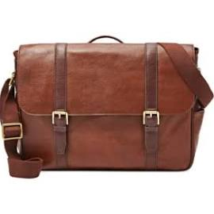
Header
Category or Brand Screen
Clothing – Anthropologies
Brand Name
Product Name
$123.45 $103.45 (25%)
Anthropologies
Mosaic Charlie Trousers
$123.45
Anthropologies
Pilcro Hyphen Distressed Chinos
$123.45
Anthropologies
Paige Verdugo Printed Ankle J…
$123.45
Price is bold and biggest
Price is red when product is on sale
Brand name is next biggest
Product name is smallest
Ad will be on the right side
If an image is smaller than the area, it should show as it is.
If an image is greater than the area, whatever width or height,
it should shrink and fit in keeping the ratio.
Even if image is not found, this layout should not break
Brand Name
Product Name
$123.45 $103.45
Brand Name
Product Name
$123.45 $103.45
Ad might be below the pagination
Prev 1 2 3 4 5 Next
Go to Top
Top
Footer

Slide 4
Header
Category or Brand Screen
Clothing – Anthropologies
No sale item is found from Anthropologies
Screen when no item is found
Footer

Slide 5

X button or any non-popup area click should close the popup
Show image bigger than the one in product list
This will show a balloon tooltip text
Disclaimer
Brand Name
Product Name
Item No: 123456
balloon tooltip text on mouse over each price
$103.45 now (23%)
$123.45
$153.45
$123.45
30 days ago
Shop
Add to My Favs
$153.45
$123.45
$123.45
After add
No sale item price
Added
제품상세페이지를 따로 또 해야할까? Use case???

Slide 6
Header
Same screen as product detail popup, but in normal page with header and footer
Disclaimer
Brand Name
Product Name
Item No: 123456
$103.45 now (23%)
$123.45
$153.45
$123.45
30 days ago
Shop
Add to My Favs
Footer

Slide 7
Header
Sign In
Email Address
Password
Forgot password?
Keep me signed in
Sign In
Footer

Slide 8
Sign up
Header
When password boxed got a focus
Email Address
At least more than 6 characters
Email Address is required
Password
At least more than 6 characters
Password is required
Name
Let us know how you want us to call you
Name is required
Sign Up
With sign up
- you can get emails on various sale information
- you can get emails when the price of your favs change
Footer

Slide 9
General message page
Header
I also need some bold title
You are successfully registered but we need to verify your email.
Please check your email and confirm the verification.
Footer

Slide 10
Forgot password
Header
Reset Password
We will email you instructions for resetting your password.
Email Address
Reset My Password
Return to Sign In
Footer

Slide 11
About Us
Header
Highlight 1
We are blah blah blah
Highlight 2
We are blah blah blah
Highlight 3
We are blah blah blah
Footer

Slide 12
Contact Us
Header
Footer

