Slide 1


Introduction
About Me:
Name: Siddharth Kulkarni | Degree: BTech CSE 2022 | University Gold Medalist
My Area of Interests: Participating in Hackathons related to AI/ML, Playing Cricket & Chess
About Project: Skycam Images Based Cloud Coverage Prediction via CV & ML
Aim: To find the cloud coverage from a skycam image (Range: 0% - 100%)
Domain: Computer Vision | Machine Learning
Theme: EcoTech: Climate Patterns
Data: Scraped the data previously which had sky images & cloud coverage present in image
Final Data: Used OCR to extract the cloud coverage from images and stored it in csv

Slide 2
Objectives of Project
Cloud Coverage Prediction: To develop a robust model that accurately calculates cloud coverage from skycam images. This model aims to analyze the cloud formations in the provided images and provide a percentage indicating the extent of cloud coverage.
Automation: Automate the process of cloud coverage assessment using sky images. This will reduce the need for manual monitoring and provide real-time information on the cloud conditions.
Motivation Behind This Project:
Accurate weather monitoring is crucial for various applications including agriculture and disaster management. Cloud coverage is a key parameter in weather forecasting and automating its assessment can improve weather predictions.
Providing real-time information on cloud coverage can benefit industries that rely on weather conditions, such as renewable energy generation, outdoor event planning, and transportation.
The integration of the cloud coverage model with skycam can serve as an early warning system for impending storms or heavy rains and climatic drifts. This can help in taking preventive measures and ensuring public safety.

Slide 3
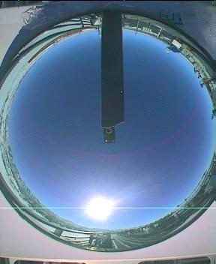
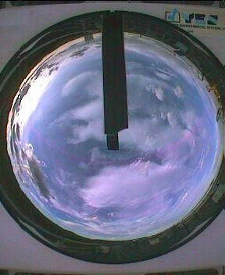
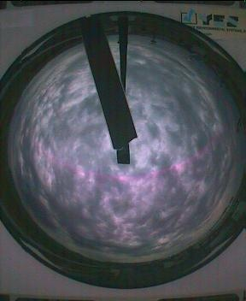
Domain Knowledge
What is a Skycam ?
It is an automated camera system to periodically record images of the entire sky from dusk until dawn.
Skycam image for low cloud coverage
Skycam image for moderate cloud coverage
Skycam image for high cloud coverage

Slide 4
System Architecture
Training Pipeline
UI Inference Pipeline
Data (Skycam Images + Labels)
User
Labels (cloud coverage): y
Skycam Image
Labels ➡ Text Labels
Gradio App
Generate Text Labels
Catboost Regressor
in %
Cloud Coverage
Skycam Image
CLIP Model
Images + Text Labels
Image Encoder ➡ Image Features
Image Features (2048)
CLIP Model Fine-tune
Catboost Regressor
Image Encoder ➡ Image Features
in %
Image Features
Cloud Coverage
Image Features (2048): x

Slide 5







Technological Stack

Slide 6
Implementation
Part I: CLIP Model:
Generated text from the cloud coverage value. Ex: cloud coverage = 97 , Text = “There is High Cloud Coverage. Opaque Cloud Coverage is 97%”
Fine-tuned Contrastive Language Image Pretrained (CLIP) model on the skycam images + corresponding text.
Reason: CLIP is used for image text similarity problems. Fine-tuned model is used to extract features from all the images.
Part II: Cat-Boost Model:
Reason: Since there are 2048 input features, Catboost is used as its robust to outliers, highly efficient, provides out of box support & is fast.
Extracted features from CLIP, will act as input features to Cat-Boost Model + cloud coverage value will act as target feature.
Found out best Hyperparameters for Catboost model and implemented a Regressor which predicts cloud coverage in %.
Part III: User Interface:
Developed & Deployed Gradio App on Hugging Face, inputs a skycam image and outputs cloud coverage in %.
Github Repo Link | Webapp Link | Demo Link | Article Link

Slide 7
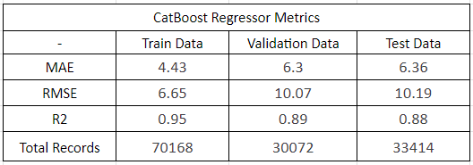
Conclusion
The project successfully predicts cloud coverage (0% to 100%) (metrics given below) from skycam images, offering valuable weather information.
Future opportunities includes integration of the model with skycam’s and also creating early alerting systems w.r.t climatic drifts.
Figure: Catboost Model Regressor Metrics

Slide 8
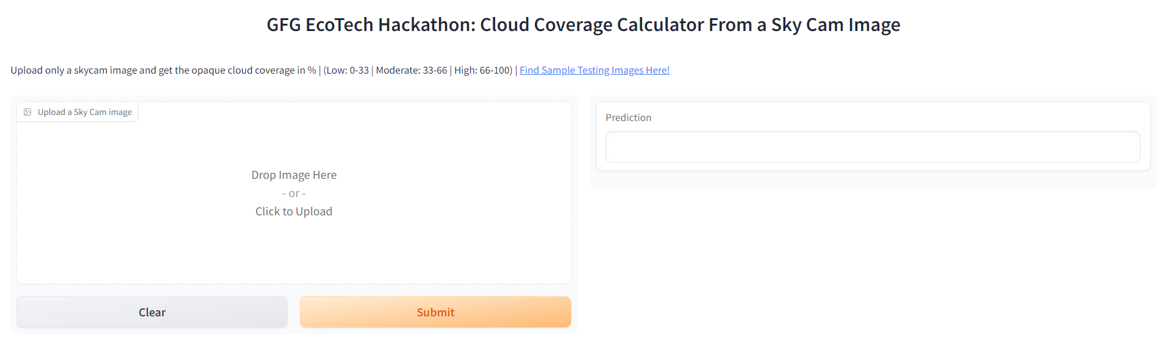
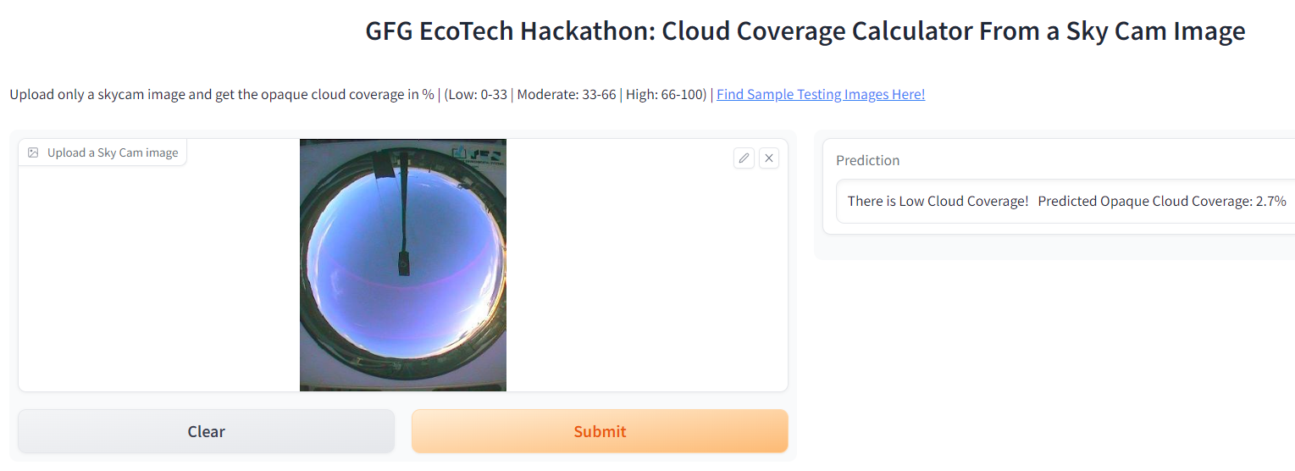
Demo Screenshots
Figure: Gradio UI Deployed on Hugging Face
Figure: Low Cloud Coverage Sample

Slide 9
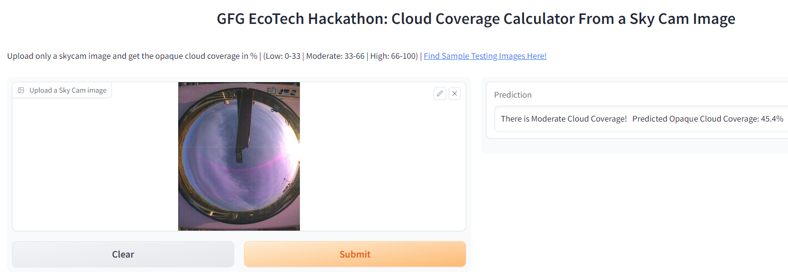
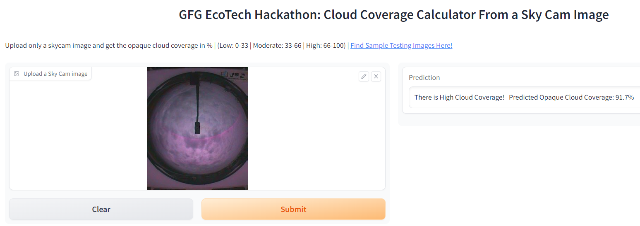
Demo Screenshots
Figure: Moderate Cloud Coverage Sample
Figure: High Cloud Coverage Sample

Slide 10
Thank You!

