Slide 1

< Infyzero >
Machine Learning
Code Gladiators 2021

Slide 2
Problem Statement
Conversion fraud in Digital Advertising
Segregate the test data between genuine and false conversions by identifying the maximum possible leads generated by the malignant technique.

Slide 3
Approach
Joining ImprCr (Train & Test) ImprID (Click & Log) using Left-Outer Join
Feature Selection
Data Visualizations
Encoding Text Data
Data Imputation
Data Modeling & Evaluation

Slide 4
Technology Stack
Platform Used: Kaggle
Language Used: R
Libraries Imported:
1. readr: For Data Reading
2. dplyr: For Data Manipulation
3. ggplot2, funModeling: For Data Visualizations
4. superml: For Encoding
5. h2o: For Data Modeling

Slide 5
Why our team is the best!
We both support each other with varieties of ideas to improve the quality of work.
We were excited for learning new techniques everyday and sharing the knowledge.
We are like: Think more….Code less!

Slide 6
Associated Files
Procedure: infyzero.txt
Source code: infyzero-cg-2021.ipynb
Output: infy.csv

Slide 7
Challenges
Left Outer Joining the csv files ImprCr (Train/Test) and ImprID (Click-Log).
We classified ClickIP column respective of their IP addresses into Class A,B,C & Invalid for IPv4 and addresses ranging from 2000/3000 onwards into IPv6.
Firstly, we encoded ImprID_CR, ClumbserID_CR columns into Numeric by separating the data with and ‘-’ separator.

Slide 8
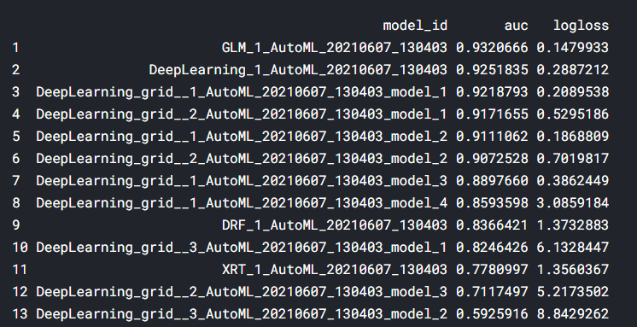
Executive Summary
Used Auto-ML using h2o in R.
Best model id: GLM_1_AutoML_20210607_130403.
Auto-ML models:

Slide 9
Thank you!

