Slide 1

Marijuana Sales & Tax Revenue
5-Year Projection of Texas
By Mychael A. Solis-Wheeler (Team 7)
8/7/2019

Slide 2

Overview
Business Understanding
Data Understanding
Data Preparation
Modeling
Evaluation
Deployment

Slide 3
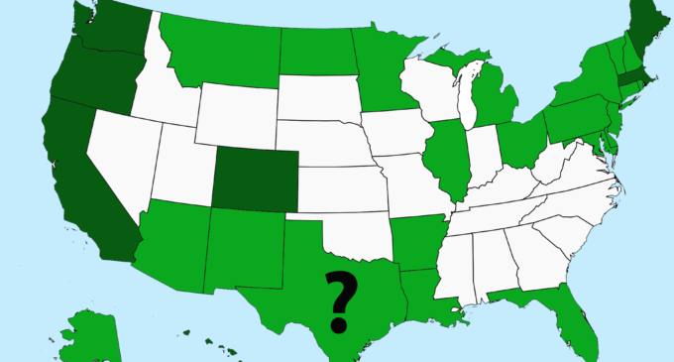
Business Understanding
$78.5 Billion in losses from US Opioid Epidemic
$6.7 Billion Marijuana Sales since 2014 in CO
What if TX had full marijuana legalization since 2018?
Both for medical & recreational marijuana

Slide 4
Business Understanding
Business Objectives & Success Criteria:
2018-2022 projected financial value in TX:
Marijuana Sales Revenue
Marijuana Tax Revenue

Slide 5
Business Understanding
Data Mining Objectives & Success Criteria:
Create CO rate models
Calculate 2018 TX county marijuana sales & tax revenue
Project 2018-2022 TX state & city marijuana sales & tax revenue

Slide 6



II. Data Understanding-Data Definitions
Data Definitions: 8 Total Datasets
3 from the US Census Bureau website
5 from CO’s state government websites

Slide 7
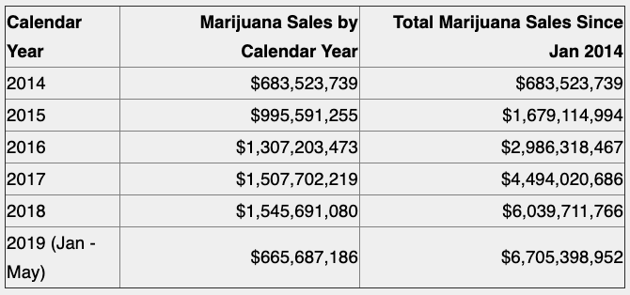
II. Data Understanding-Descriptive Analysis
Figure 1. 2014-2019 CO Marijuana Sales Summary

Slide 8
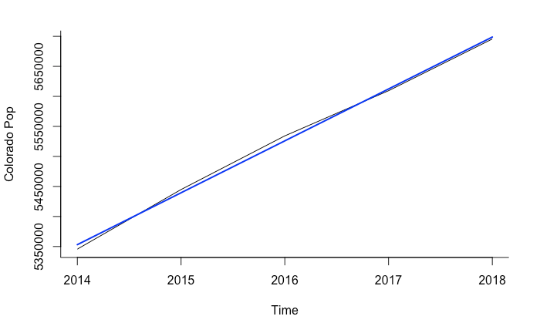
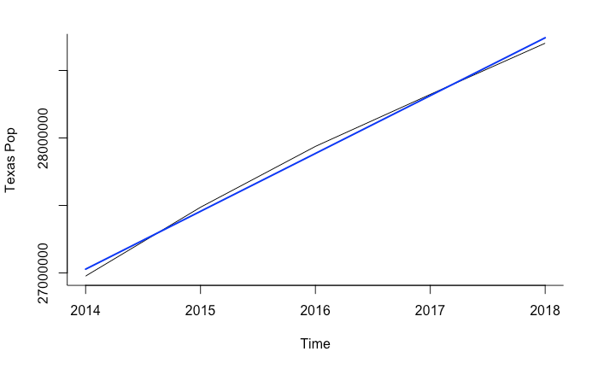
II. Data Understanding-Exploratory Analysis
Figure 2ab. 2014-2018 CO state (a-left) and TX state populations (b-right) with linear trendlines

Slide 9
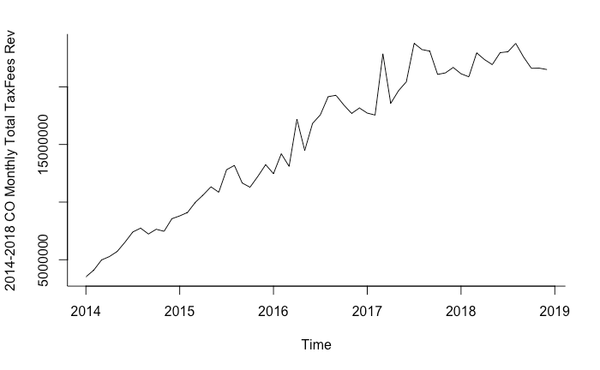
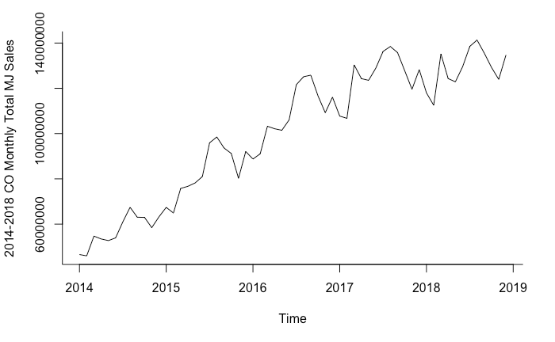
II. Data Understanding-Exploratory Analysis
Figure 3ab. 2014-2019 CO monthly total marijuana sales (a-left) and tax fees revenue (b-right)

Slide 10
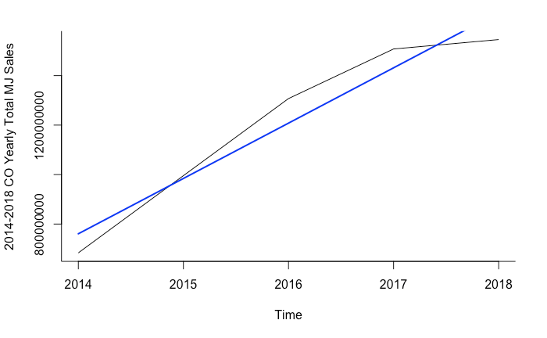
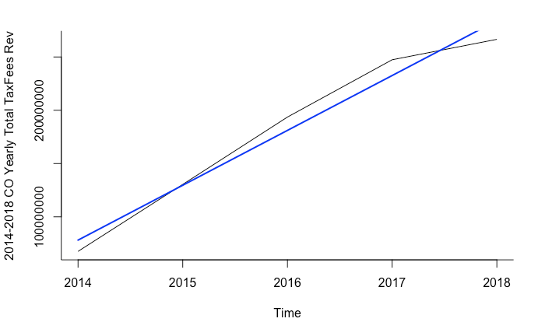
II. Data Understanding-Exploratory Analysis
Figure 4ab. 2014-2018 CO yearly total marijuana sales (a-left) and tax fees revenue (b-right)

Slide 11
III. Data Preparation
DATA CLEANING
(read, checked, & prepared data)
DATA PROCESSING
(managed, transformed, & merged data)
REVIEW ANALYSIS
(reviewed, explored, & assessed processed data)
DATA PARTITIONING
(created training & validation sets)

Slide 12
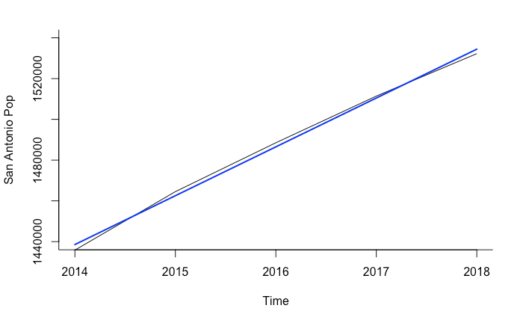
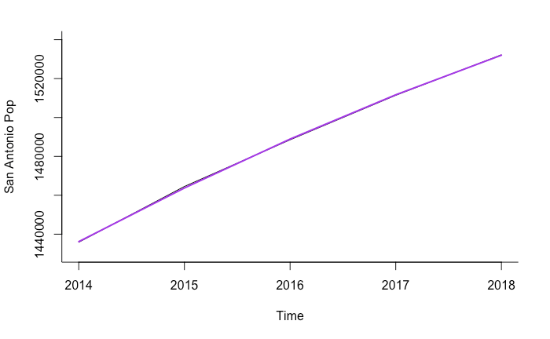
III. Data Preparation-Data Partitioning
Figure 9ab. 2014-2018 San Antonio population linear (a-blue) and quadratic (b-purple)

Slide 13
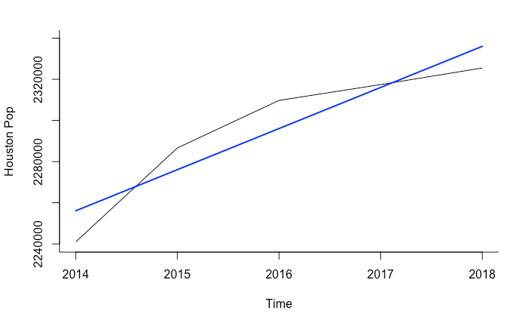
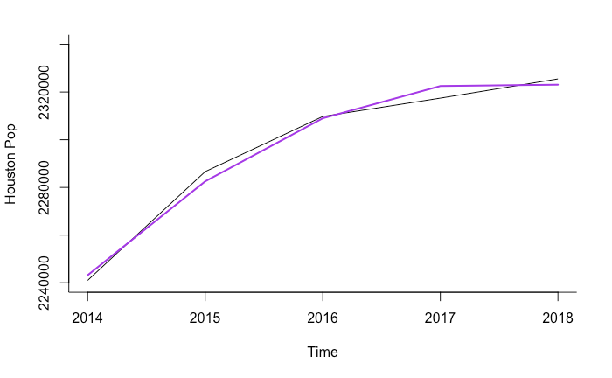
III. Data Preparation-Data Partitioning
Figure 10ab. 2014-2018 Houston population linear (a-blue) and quadratic (b-purple)

Slide 14
IV. Modeling
CO RATE MODELS
(Dollar Per Person From 2014-2018 in CO)
POP
FORECASTING MODEL
(For 2018-2022 in TX)
PROJECTED MJ SALES & TAX REVENUE
(For 2018-2022 in TX)

Slide 15
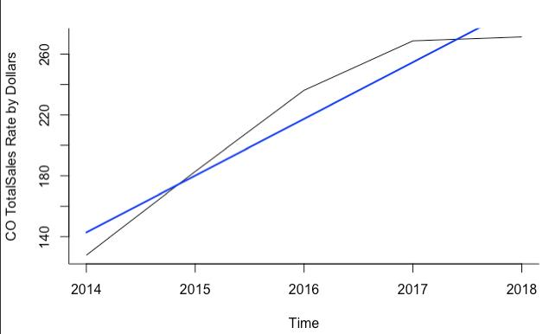
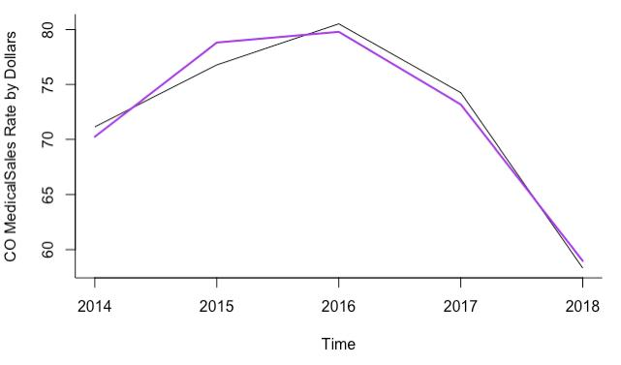
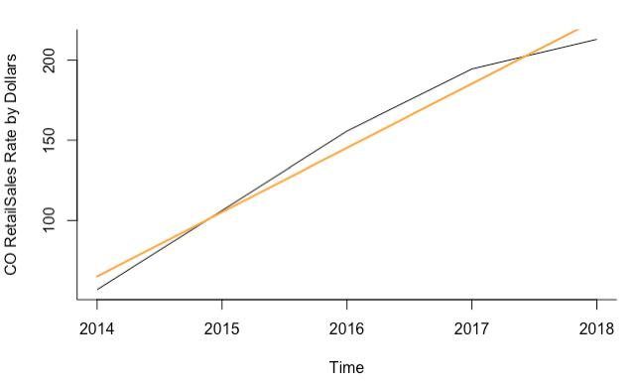
IV. Modeling-CO Rate Models
Figure 13abc. 2014-2018 CO rate of total (a-blue), medical (b-purple), and retail marijuana sale dollars (c-orange) per person

Slide 16
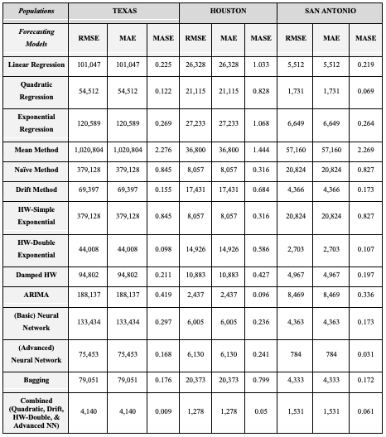
IV. Modeling
14 TOTAL MODELS TESTED
BEST ACCURACY:
Combined Model
Quadratic
Drift
Holt Winters-Double Exponential
Advanced Neural Networks (50/100)
Notes:
Combined model accurately predicted generally 99% of these populations

Slide 17
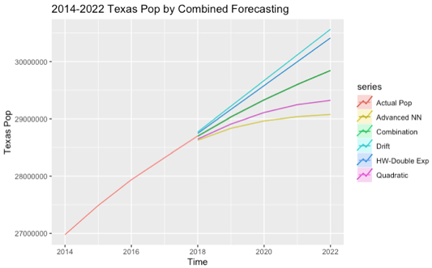
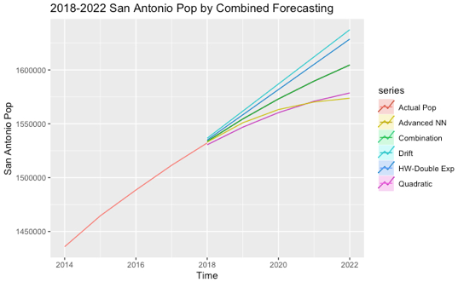
IV. Modeling-Pop Forecasting Model
Figure 14abc. 2014-2018 forecasted Texas (a-left) and San Antonio populations from Combined model forecasting

Slide 18
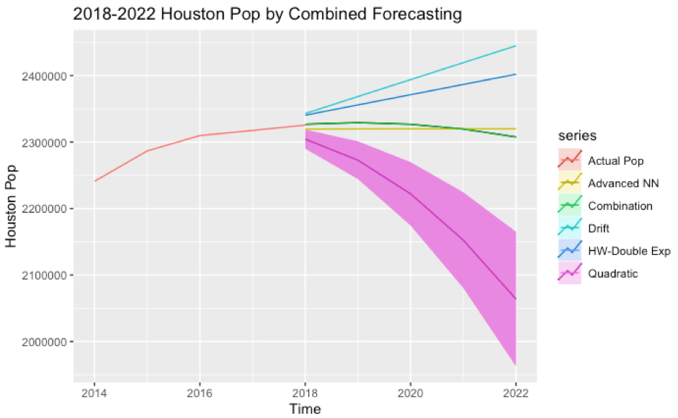
IV. Modeling-Pop Forecasting Model
Figure 15. 2014-2018 forecasted Houston populations from Combined model forecasting

Slide 19

IV. Modeling-Limitations
One Model May Not Rule Them All
More Factors Getting That Revenue
No Time-Series Cross-Validation Done

Slide 20
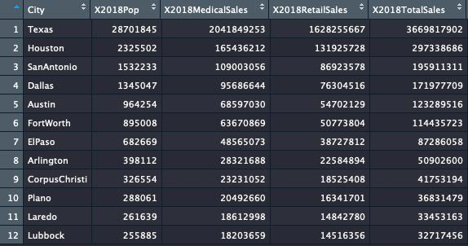
V. Evaluation-TX Cities

Slide 21
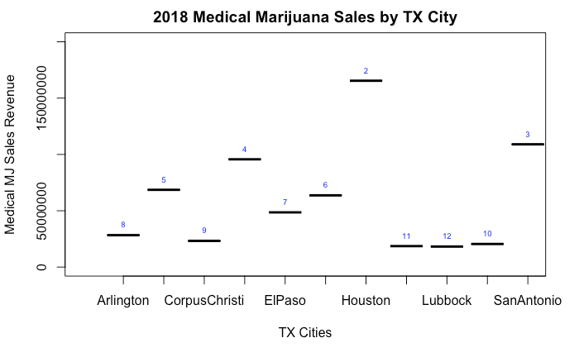
Dallas
Austin
FtWorth
Laredo
Plano

Slide 22
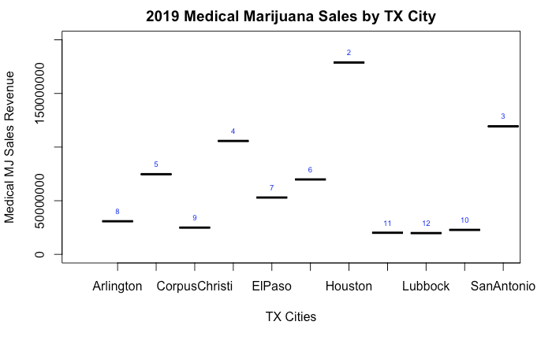

Slide 23
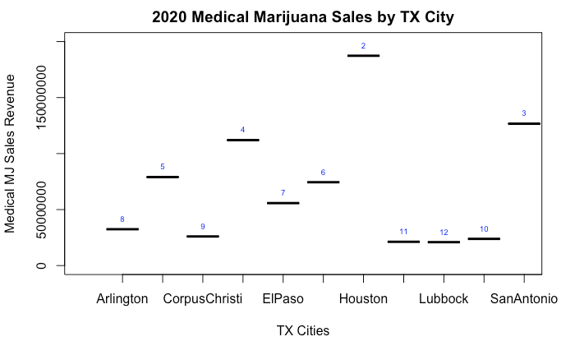

Slide 24


Slide 25
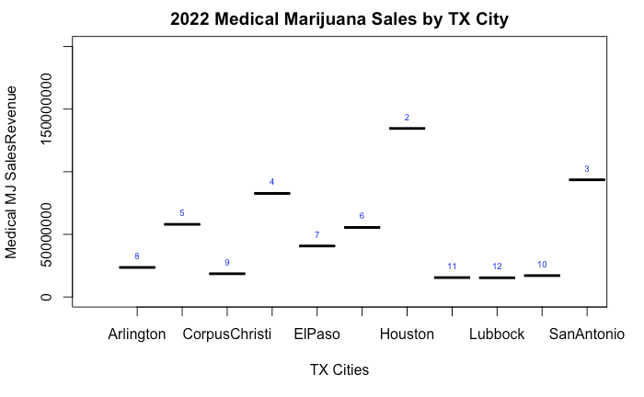
Dallas
Austin
FtWorth
Laredo
Plano

Slide 26
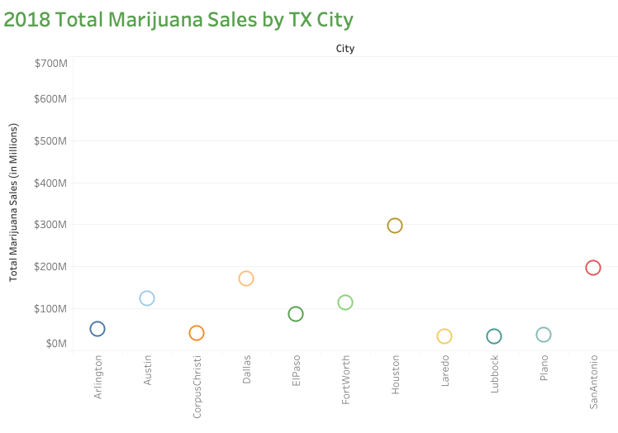

Slide 27
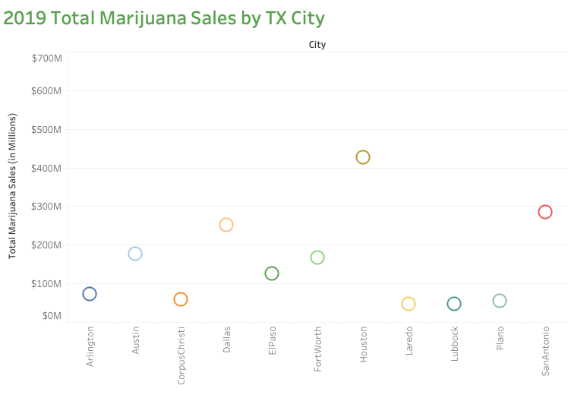

Slide 28
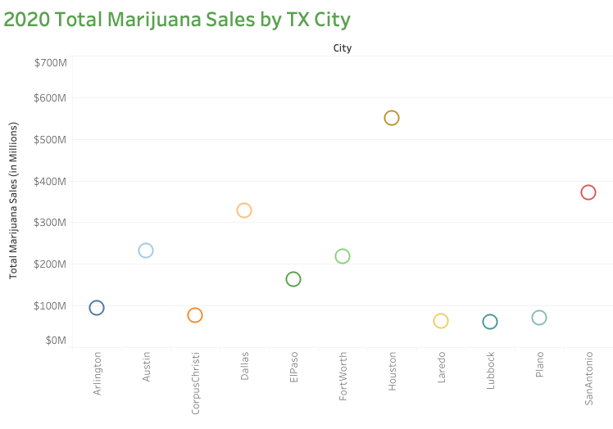

Slide 29
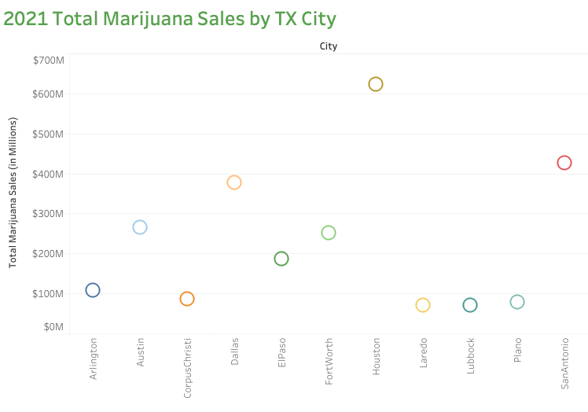

Slide 30
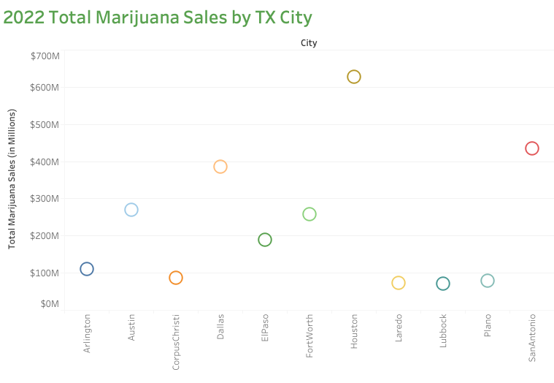

Slide 31
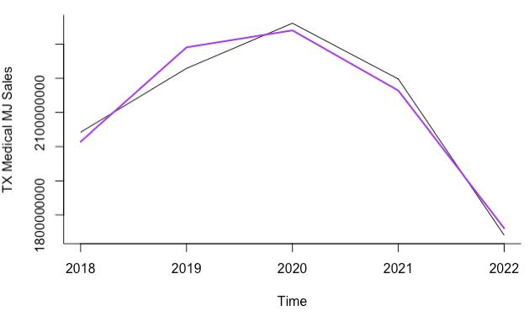
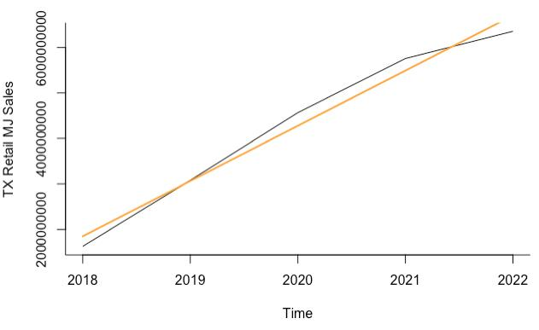
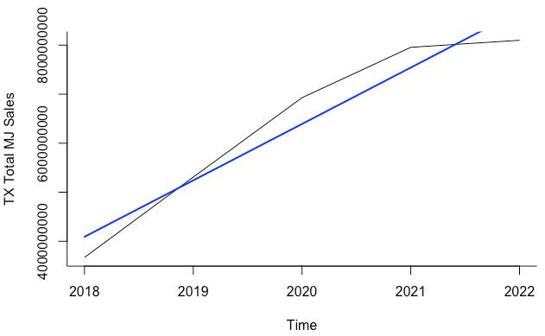
V. Evaluation-TX State
Figure 16 2018-2022 TX forecasted total (a-blue), medical (b-purple), and retail (c-orange) marijuana sales with trend lines.

Slide 32
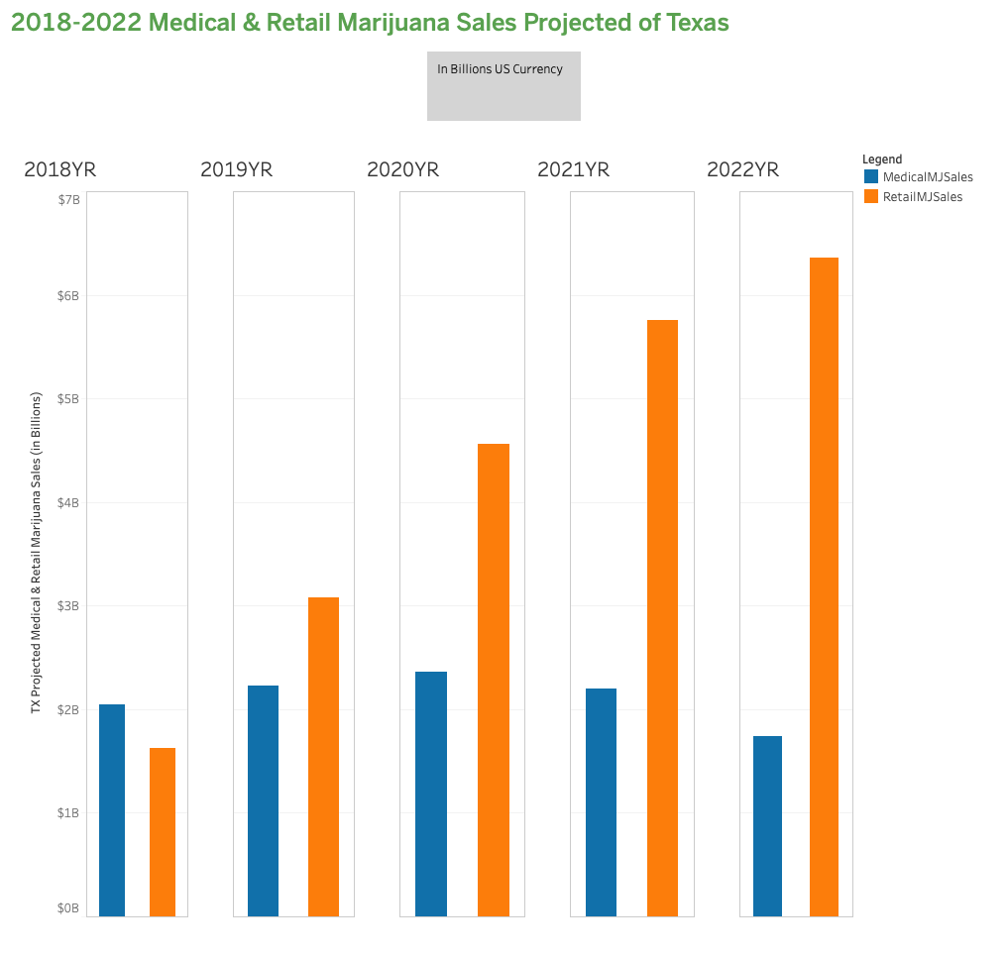
V. Evaluation-TX State

Slide 33

V. Evaluation-The Numbers
For 2018 (1st Full Legalized Year) in TX Overall
$3.6 Billion in Total Marijuana Sales
$2 Billion in Medical Marijuana Sales
$1.6 Billion in Recreational Marijuana Sales
$300 Million in TX Sales Tax Revenue
For 2022 (5th Full Legalized Year) in TX Overall
$8.1 Billion in Total Marijuana Sales
$1.7 Billion in Medical Marijuana Sales
$6.4 Billion in Recreational Marijuana Sales
$670 Million in TX Sales Tax Revenue
For 2018-2022 in TX Overall Summed
$42.2 Billion in Total Marijuana Sales
$14 Billion in Medical Marijuana Sales
$28.2 Billion in Recreational Marijuana Sales
$460 Million in Licenses & Fees Revenue
$3.5 Billion in TX Sales Tax Revenue
$6.3 Billion in Total Tax Fees Revenue (exclusively w/CO tax rates)
$4-6 Billion from total
taxes & fees summed
across these 5 years!
Notes:
In 2018, TX Alcohol Tax Revenue was $1.3 Billion
For this 5YR projection summed, TX can generate between:
$4-6 Billion in Total Tax Fees Revenue

Slide 34


VI. Deployment
For Assisting Marijuana Business
To locate
To invest
For TX State & Local governments
To plan
To regulate
For TX consumers & prospective employees
To be informed
To participate

Slide 35
Conclusion
Business Understanding
Data Understanding
Data Preparation
Modeling
Evaluation
Deployment

Slide 36

Questions?

Slide 37
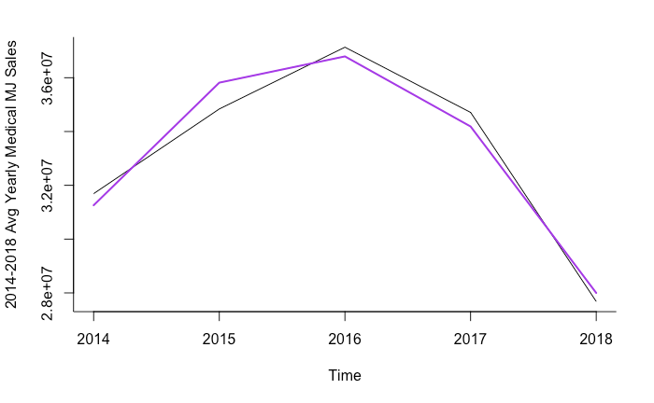
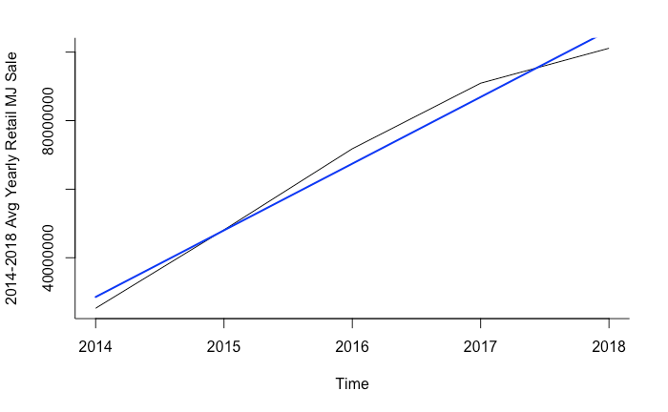
III. Data Preparation-Review Analysis
Figure 6ab. 2014-2018 CO average yearly medical (a-left) and retail marijuana sales (b-right)

Slide 38
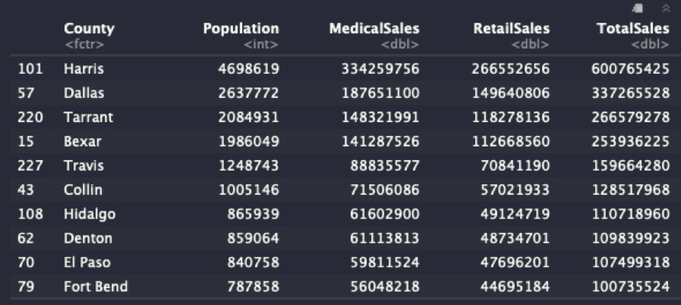
III. Data Preparation-Review Analysis
Figure 7. 2018 TX top 10 TX counties by total marijuana sales from 2014 CO rate models

