Slide 1

Marijuana Sales & Tax Revenue
5-Year Projection of Texas
By Mychael A. Solis-Wheeler (Team 7)
8/7/2019

Slide 2

Overview
Business Understanding
Data Understanding
Data Preparation
Modeling
Evaluation
Deployment

Slide 3
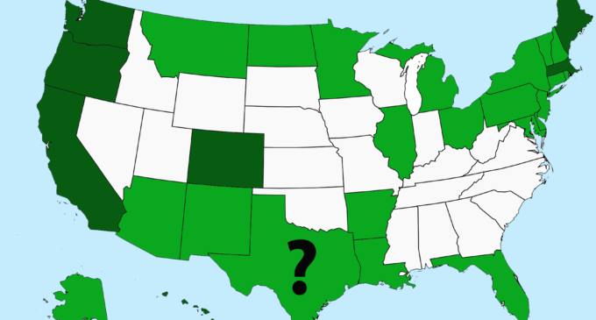
Business Understanding
$78.5 Billion in losses from US Opioid Epidemic
$6.7 Billion Marijuana Sales since 2014 in CO
What if TX had full marijuana legalization since 2018?
Both for medical & recreational marijuana

Slide 4
Business Understanding
Business Objectives & Success Criteria:
2018-2022 projected financial value in TX:
Marijuana Sales Revenue
Marijuana Tax Revenue

Slide 5
Business Understanding
Data Mining Objectives & Success Criteria:
Create CO rate models
Calculate 2018 TX county marijuana sales & tax revenue
Project 2018-2022 TX state & city marijuana sales & tax revenue

Slide 6



II. Data Understanding-Data Definitions
Data Definitions: 8 Total Datasets
3 from the US Census Bureau website
5 from CO’s state government websites

Slide 7
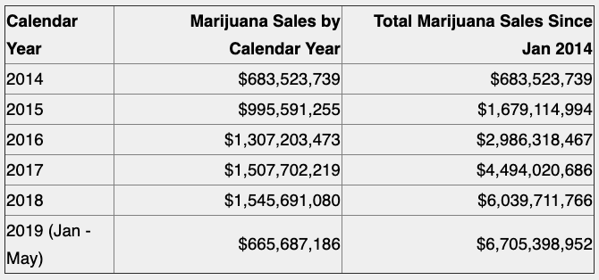
II. Data Understanding-Descriptive Analysis
Figure 1. 2014-2019 CO Marijuana Sales Summary

Slide 8
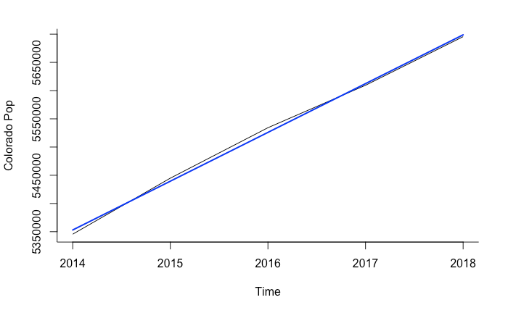
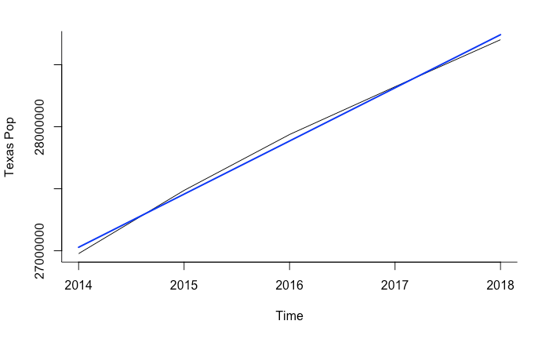
II. Data Understanding-Exploratory Analysis
Figure 2ab. 2014-2018 CO state (a-left) and TX state populations (b-right) with linear trendlines

Slide 9
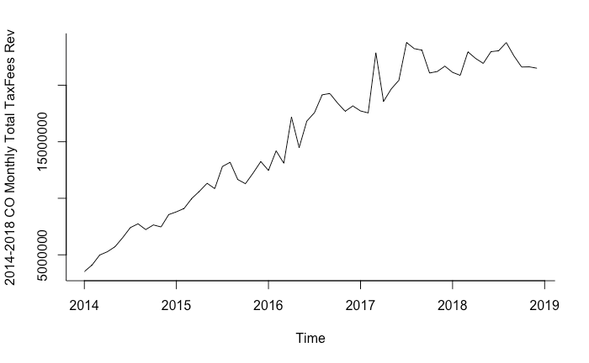
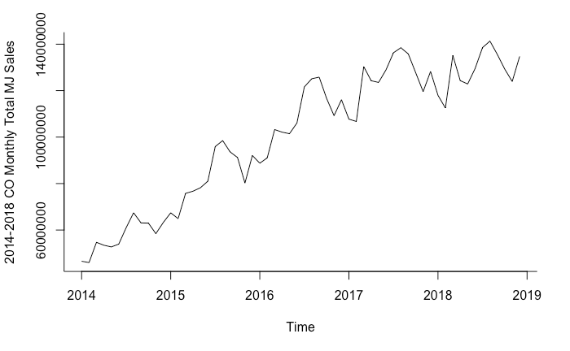
II. Data Understanding-Exploratory Analysis
Figure 3ab. 2014-2019 CO monthly total marijuana sales (a-left) and tax fees revenue (b-right)

Slide 10
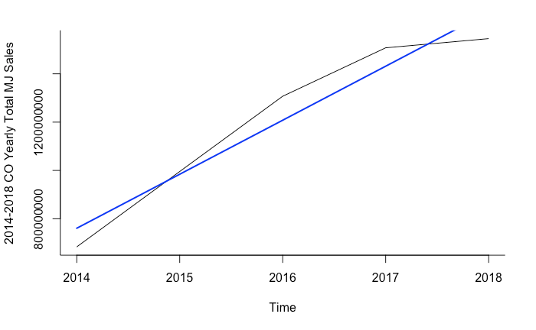
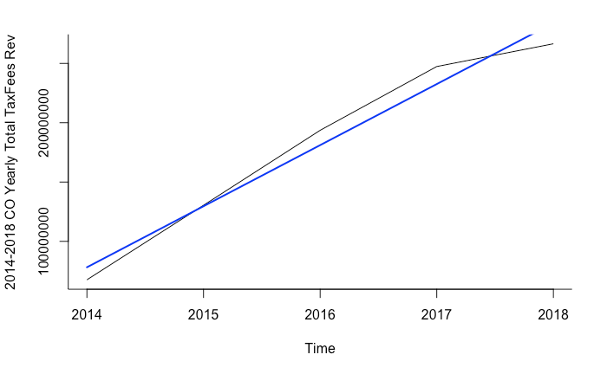
II. Data Understanding-Exploratory Analysis
Figure 4ab. 2014-2018 CO yearly total marijuana sales (a-left) and tax fees revenue (b-right)

Slide 11
III. Data Preparation
DATA CLEANING
(read, checked, & prepared data)
DATA PROCESSING
(managed, transformed, & merged data)
REVIEW ANALYSIS
(reviewed, explored, & assessed processed data)
DATA PARTITIONING
(created training & validation sets)

Slide 12
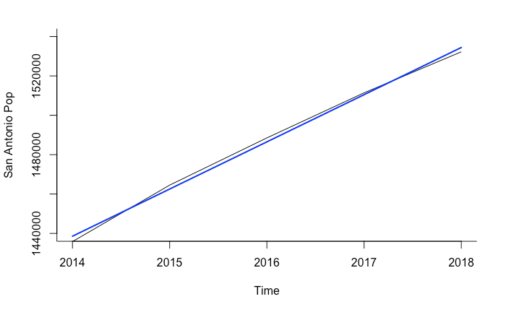
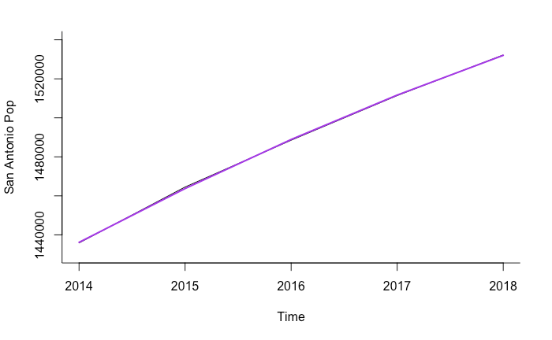
III. Data Preparation-Data Partitioning
Figure 9ab. 2014-2018 San Antonio population linear (a-blue) and quadratic (b-purple)

Slide 13
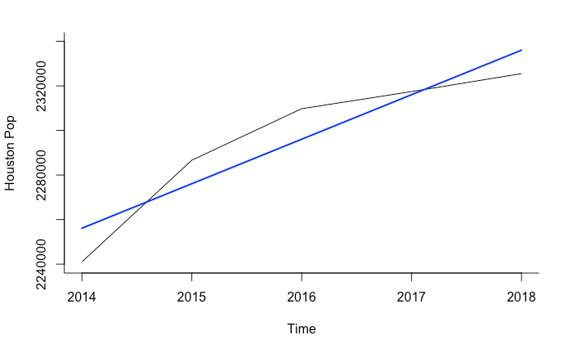
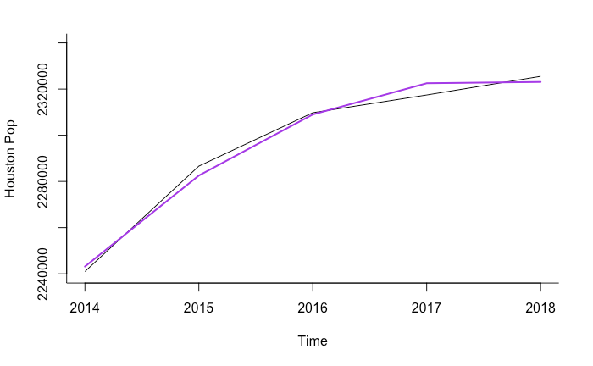
III. Data Preparation-Data Partitioning
Figure 10ab. 2014-2018 Houston population linear (a-blue) and quadratic (b-purple)

Slide 14
IV. Modeling
CO RATE MODELS
(Dollar Per Person From 2014-2018 in CO)
POP
FORECASTING MODEL
(For 2018-2022 in TX)
PROJECTED MJ SALES & TAX REVENUE
(For 2018-2022 in TX)

Slide 15
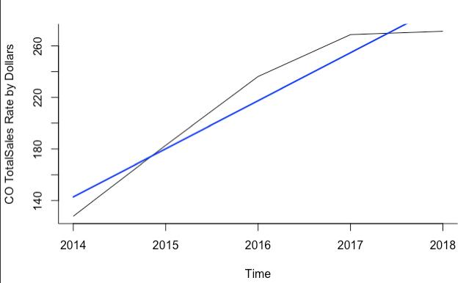
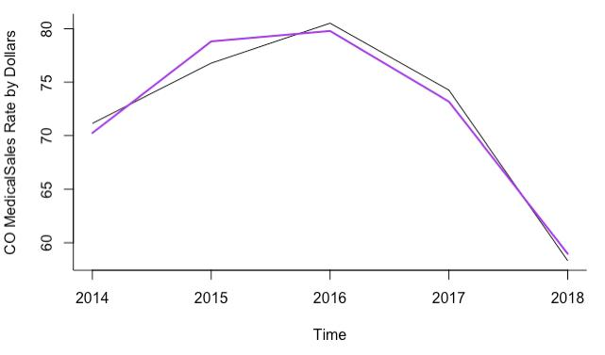
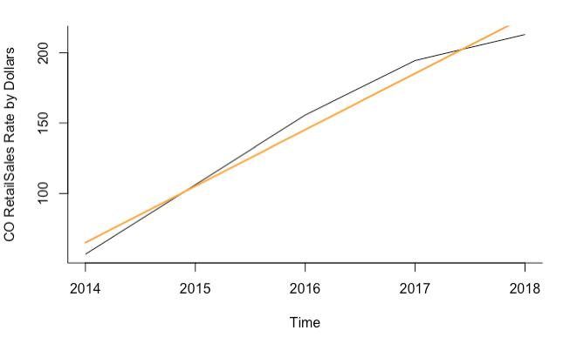
IV. Modeling-CO Rate Models
Figure 13abc. 2014-2018 CO rate of total (a-blue), medical (b-purple), and retail marijuana sale dollars (c-orange) per person

Slide 16
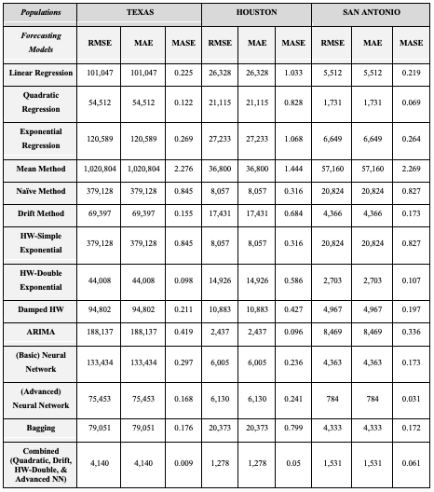
IV. Modeling
14 TOTAL MODELS TESTED
BEST ACCURACY:
Combined Model
Quadratic
Drift
Holt Winters-Double Exponential
Advanced Neural Networks (50/100)
Notes:
Combined model accurately predicted generally 99% of these populations

Slide 17
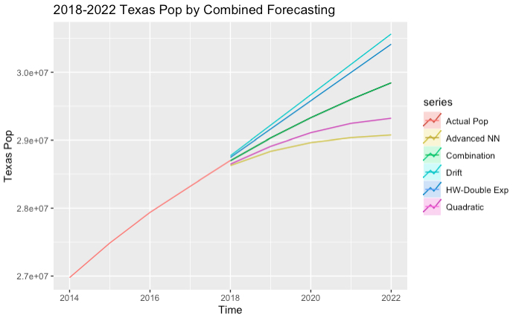
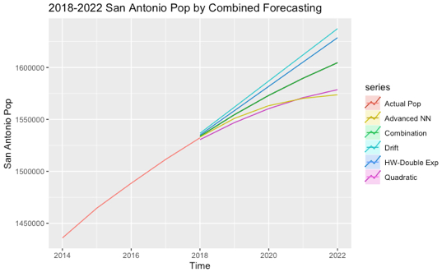
IV. Modeling-Pop Forecasting Model
Figure 14abc. 2018-2022 forecasted Texas (a-left) and San Antonio populations from Combined model forecasting

Slide 18
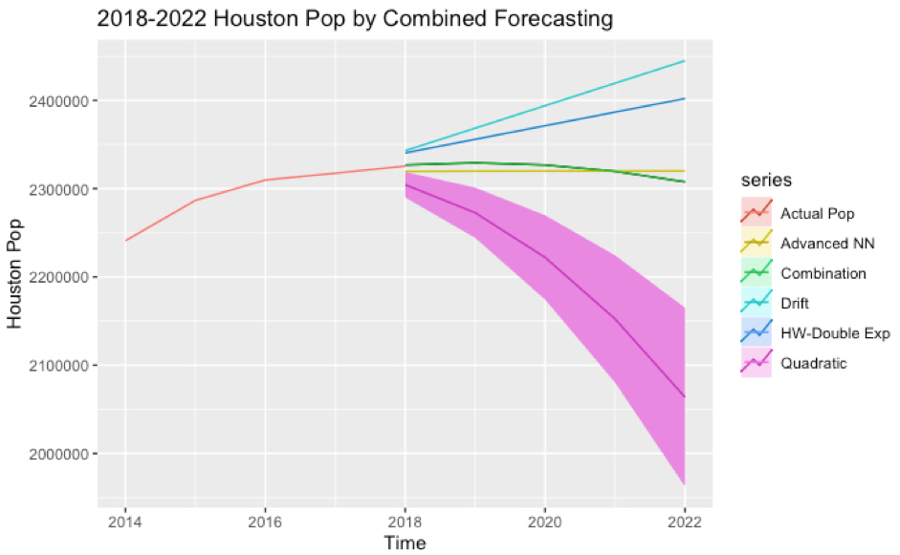
IV. Modeling-Pop Forecasting Model
Figure 15. 2018-2022 forecasted Houston populations from Combined model forecasting

Slide 19

IV. Modeling-Limitations
One Model May Not Rule Them All
More Factors Getting That Revenue
No Time-Series Cross-Validation Done

Slide 20
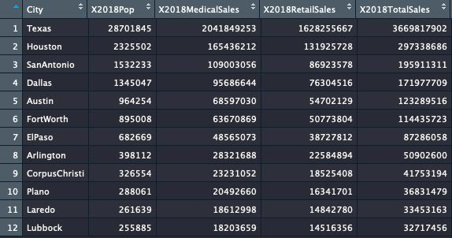
V. Evaluation-TX Cities

Slide 21
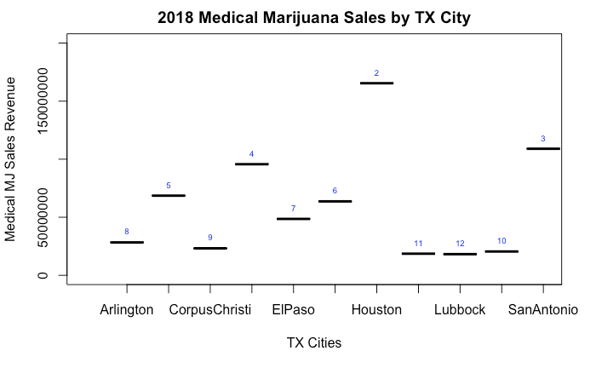
Dallas
Austin
FtWorth
Laredo
Plano

Slide 22
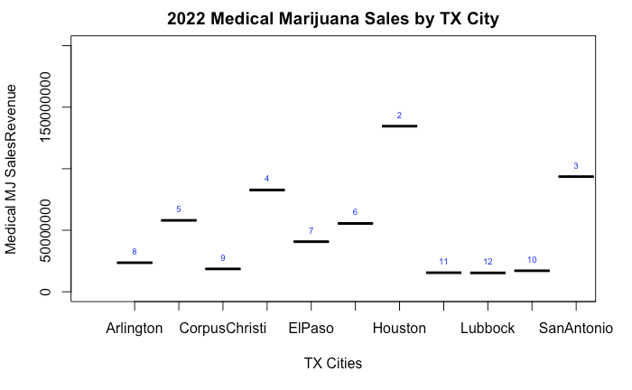
Dallas
Austin
FtWorth
Laredo
Plano

Slide 23
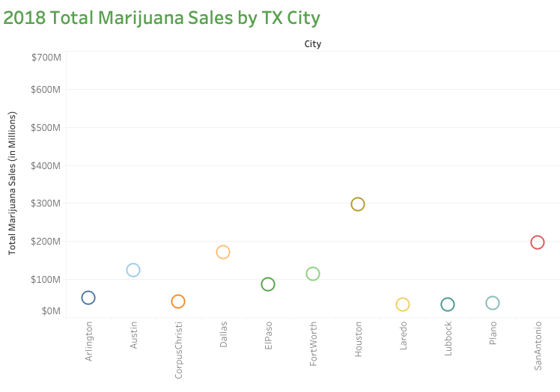

Slide 24
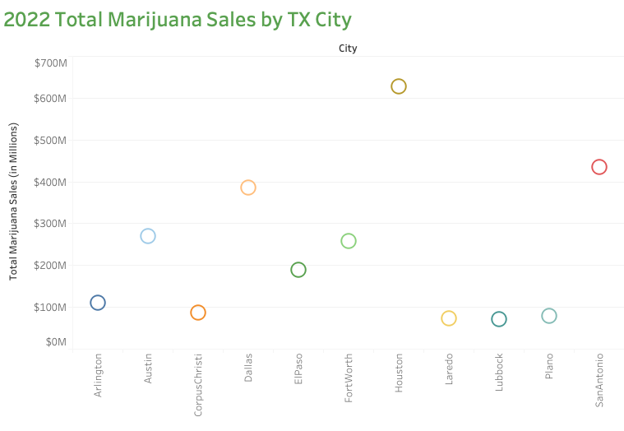

Slide 25
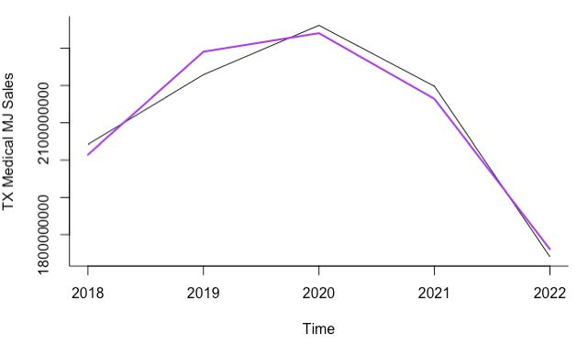
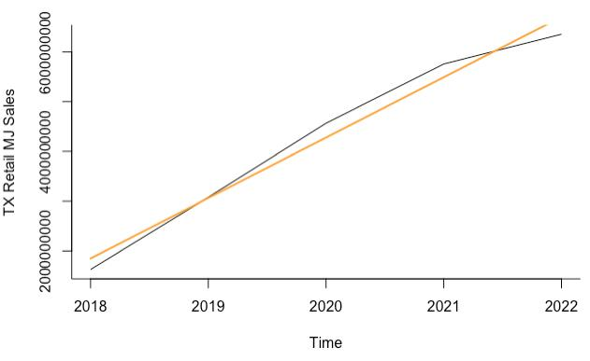
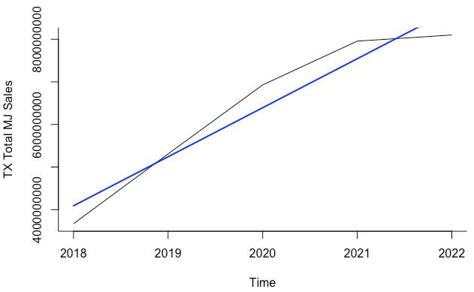
V. Evaluation-TX State
Figure 16 2018-2022 TX forecasted total (a-blue), medical (b-purple), and retail (c-orange) marijuana sales with trend lines.

Slide 26
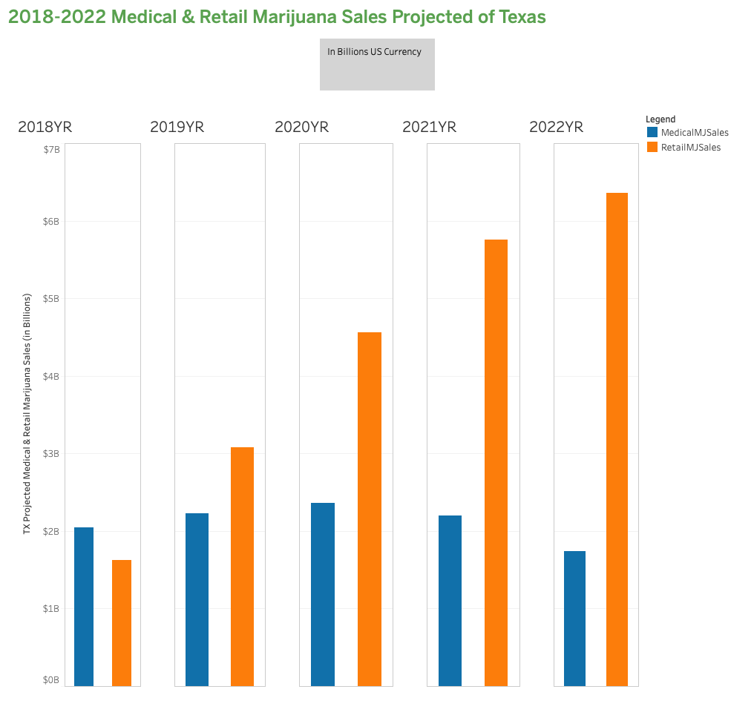
V. Evaluation-TX State

Slide 27

V. Evaluation-The Numbers
For 2018 (1st Full Legalized Year) in TX Overall
$3.6 Billion in Total Marijuana Sales
$2 Billion in Medical Marijuana Sales
$1.6 Billion in Recreational Marijuana Sales
$300 Million in TX Sales Tax Revenue
For 2022 (5th Full Legalized Year) in TX Overall
$8.1 Billion in Total Marijuana Sales
$1.7 Billion in Medical Marijuana Sales
$6.4 Billion in Recreational Marijuana Sales
$670 Million in TX Sales Tax Revenue
For 2018-2022 in TX Overall Summed
$42.2 Billion in Total Marijuana Sales
$14 Billion in Medical Marijuana Sales
$28.2 Billion in Recreational Marijuana Sales
$460 Million in Licenses & Fees Revenue
$3.5 Billion in TX Sales Tax Revenue
$6.3 Billion in Total Tax Fees Revenue (exclusively w/CO tax rates)
$4-6 Billion from total
taxes & fees summed
across these 5 years!
Notes:
In 2018, TX Alcohol Tax Revenue was $1.3 Billion
For this 5YR projection summed, TX can generate between:
$4-6 Billion in Total Tax Fees Revenue

Slide 28


VI. Deployment
For Assisting Marijuana Business
To locate
To invest
For TX State & Local governments
To plan
To regulate
For TX consumers & prospective employees
To be informed
To participate

Slide 29
Conclusion
Business Understanding
Data Understanding
Data Preparation
Modeling
Evaluation
Deployment

Slide 30

Questions?

Slide 31
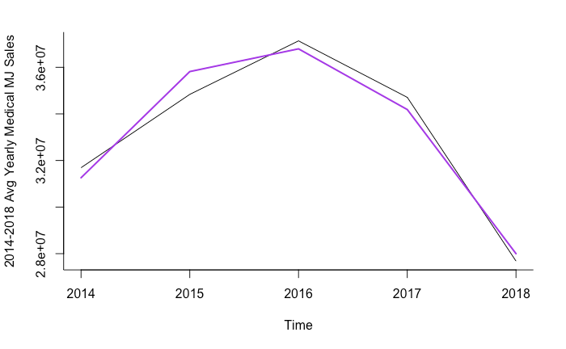
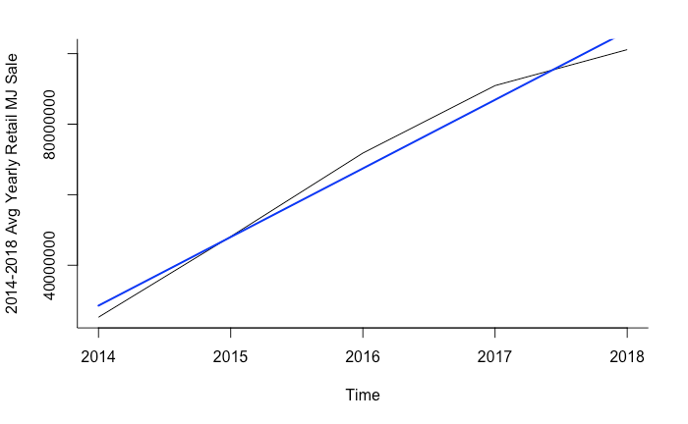
III. Data Preparation-Review Analysis
Figure 6ab. 2014-2018 CO average yearly medical (a-left) and retail marijuana sales (b-right)

Slide 32
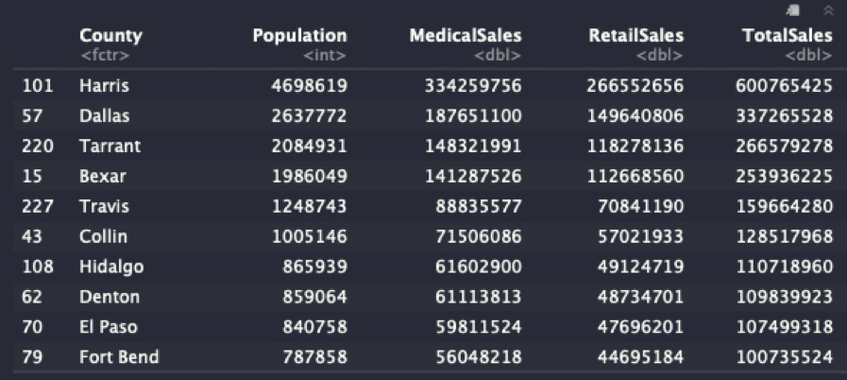
III. Data Preparation-Review Analysis
Figure 7. 2018 TX top 10 TX counties by total marijuana sales from 2014 CO rate models

