Slide 1
Support Vector Machine
PGR216
Mohib Ullah
19 March 2026

Slide 2
Content
Support Vector Machine
Understand the intuition behind SVM
Linear Classifier
Maximum Margin
Constrained optimization
Quadratic programming
Soft margin Vs hard margin
SVM kernels
SVM for Classification & Regression

Slide 3
Support Vector Machines
SVMs are one of the popular fully supervised efficiently trained linear machines.
They are famous because they are:
Effective in high dimensional spaces.
Effective in cases where number of dimensions is greater than the number of samples.
Very efficient in training stage. They use a subset of training points in the decision function and use the computer memory in an effective way.
Versatile: different kernel function can be specified for the decision function. Common kernels are provided, but it is also possible to specify custom kernels.
https://scikit-learn.org/stable/modules/svm.html

Slide 4
Support Vector Machines
A supervised learning algorithm
Used for:
Classification
Regression
Finds an optimal decision boundary / function
Maximizes margin between data points
Uses kernel functions for non-linear problems

Slide 5
Linear Machine
Equation of a linear function is written as:
Y = mx + c
f(x,w,b) = w^{T}x + b (linear machine)
Where m is slope of the line and c is the y intercept.
However, the most generic equation of a linear machine/straight line is:
ax + by + c = 0
If a = 0, the line is horizontal, and if b = 0, it would be a vertical line.

Slide 6
Decision Boundry
For different configuration of parameter (a, b, c), there exist infinite solutions.
Support Vector Machine (SVM) finds an optimal* solution.
Maximizes the distance between the (line, plane, or hyperplane, depending on dimensions) and the “difficult points” close to decision boundary
One intuition: if there are no points near the decision boundary, then we will have a very certain classification decisions

Slide 7
Two key attributes of SVMs are:
1. Sparseness
Using subset of training points for training
2. Convexity
Define a convex objective function.

Slide 8

Linear Classifier
Parameters
x
f
y
Label y:
denotes +1
denotes -1
f(x,w,b) = sign(w x + b)
w x+ b>0
How would you classify this data?
w x+ b<0

Slide 9
Linear Classifier
Parameters
x
f
_{y}est
f(x,w,b) = sign(w x + b)
denotes +1
denotes -1
How would you classify this data?

Slide 10
Linear Classifier
Parameters
x
f
_{y}est
denotes +1
denotes -1
f(x,w,b) = sign(w x + b)
How would you classify this data?

Slide 11
Linear Classifiers
Parameters
x
f
_{y}est
f(x,w,b) = sign(w x + b)
denotes +1
denotes -1
Any of these would be fine..
..but which is the best?

Slide 12
Linear Classifiers
Parameters
x
f
_{y}est
f(x,w,b) = sign(w x + b)
denotes +1
denotes -1
How would you classify this data?
Misclassified to +1 class

Slide 13
Classifier Margin
Parameters
x
f
_{y}est
f
f(x,w,b) = sign(w x + b)
Define the margin of a linear classifier as the width that the boundary could be increased by before hitting a data point.
denotes +1
denotes -1

Slide 14



Maximum Margin
1. Maximizing the margin makes sense according to intuition
+ b)
denotes +1
denotes -1
2. It implies that only support vectors are important; other training examples can be discarded without affecting the training result.
Support Vectors are those datapoints that the margin pushes up against
The maximum margin linear classifier is the linear classifier with the maximum margin.
This is the simplest kind of SVM (Called an LSVM)
Linear SVM

Slide 15
Maximum Margin
Parameters
x
f
_{y}est
denotes +1
denotes -1
f(x,w,b) = sign(w x + b)
Keeping only support vectors will not change the maximum margin classifier.
Robust to the small changes (noise) in non- support vectors
The maximum margin linear classifier is the linear classifier with the maximum margin.
This is the simplest kind of SVM (Called an LSVM)
Linear SVM

Slide 16
Linear Classifier
Binary classifier → Task of separating classes in the feature space
w^{T}x + b = 0
w^{T}x + b > 0
w^{T}x + b < 0
f(x) = sign(w^{T}x + b)

Slide 17
3 Important facts
W is perpendicular to the line
Distance from a point to a line is 1/|w|
Distance between two lines (margin) is 2/|w|
We will proof this one by one.

Slide 18
W perpendicularity
Finding perpendicular to the plane (line)
w^{T}x + b = 0
W ^{T} X ′ + b = 0
W ^{T} X ′ + b = 0
(W ^{T} X ′ + b) − (W ^{T} X ′ + b) = 0
W ^{T} X ′ + b −W ^{T} X ′ − b = 0
W ^{T} X ′ −W ^{T} X ′ = 0
W ^{T} ( X ′ − X ′ ) = 0
W
X ′
X ′
W is perpendicular a to line (hyper plane)

Slide 19
Distance from a point to a line is 1/|w|
Binary classifier → Task of separating classes in feature space
Distance from a point to a line (hyper plane)
w^{T}x + b =1
w x + b = 0
_{Wˆ =} W
W
T
Unit vector
X_{n}
_{W}ˆ
w
ˆ
W ( X − X )
= ( X − X )
X
n
W
1
n
W^{ˆ} ( X − X ) =
(W .X −W .X )
n
W
1
n
W^{ˆ} ( X − X ) =
(W .X + b −W .X − b)
n
W
n
1
W^{ˆ} ( X − X ) =
n
W

Slide 20
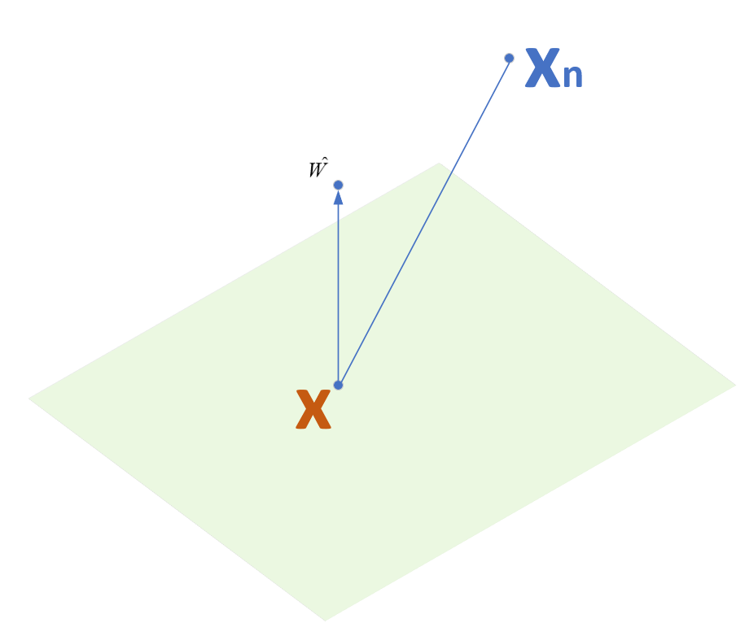
Distance from a point to a line is 1/|w|
Distance between x_{n} and the plane:
Take any point x on the plane
Projection of (x_{n} – x) on w
_{Wˆ =} W
||W||

Slide 21
Distance between two lines (margin) is 2/|w|
Margin 2 γ of the separator is the width of separation between classes.
w^{T}x + b =1
2γ
W ( X − X ₋)
W^{ˆ} ( X ₊ − X ₋) =
+
w^{T}x + b =-1
W
WX −WX ₋
W^{ˆ} ( X ₊ − X ₋) =
+
_{W}ˆ
W
WX + b −WX ₋ − b
X ₊
W^{ˆ} ( X ₊ − X ₋) =
+
X ₋
W
WX + b − (WX ₋ + b)
W^{ˆ} ( X ₊ − X ₋) =
+
W
2
W^{ˆ} ( X
− X ) =
+
−
W

Slide 22
Linear SVM Mathematically
Goal: 1) Correctly classify all training data
wx_{i} + b ≥ 1 wx _{i} + b ≤ − 1 y_{i} (wx_{i} + b) ≥ 1
2) Maximize the Margin
same as minimize
if y_{i} = +1 if y_{i} = -1
for all i₂
M =
w^{t} w
w
1
2

Slide 23
Linear SVM Mathematically
We can formulate a Quadratic Optimization Problem and solve for w and b
Minimize
Φ(w) = ¹ w^{t}w
2
y_{i} (wx_{i} + b) ≥ 1
(Convexity)
∀i
subject to

Slide 24
Quadratic programming
“Quadratic programming is the process of solving a special type of
mathematical optimization problem specifically, a quadratic optimization
problem, that is, the problem of optimizing a quadratic function of several
variables subject to linear constraints on these variables.” (wiki)

Slide 25
Linear SVM
Now we can formulate the quadratic optimization problem as
Given a linearly separable training sample S = ((x₁,y₁),...(x_{n} ,y_{n})),
the hyperplane (w,b) that solves the optimization problem
minimizes <w * w>
subject to y_{i}(<w * x_{i}> + b) ≥ 1 i = 1,....n

Slide 26
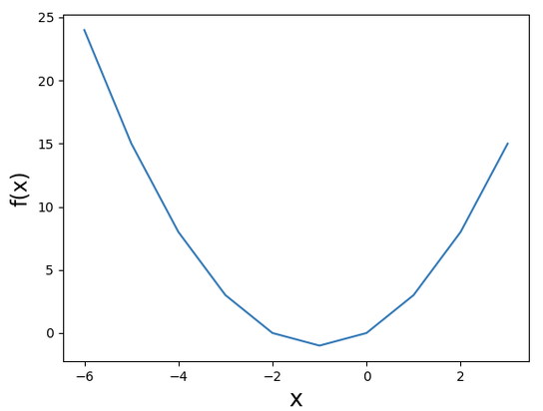
Detour (Unconstrained optimization)
In order to find a maxima/minima of a function, we need to find the points where the gradient of the function is zero.
If the function is convex, it will give us global maxima/minima.
If the function is non-convex,
it will give us local maxima/minima.

Slide 27
Detour (Unconstrained optimization)
If f(x) is a function which is constraints by another function g(x). Then, the gradient of the function f(x) and the gradient of the corresponding constraints g(x) are either parallel/anti-parallel vectors at the optimal point.
In order to form the optimal value of function f(x), we need to write the function and it’s constrained in a close form.
Lagrange multiplier give us this close form representation.

Slide 28
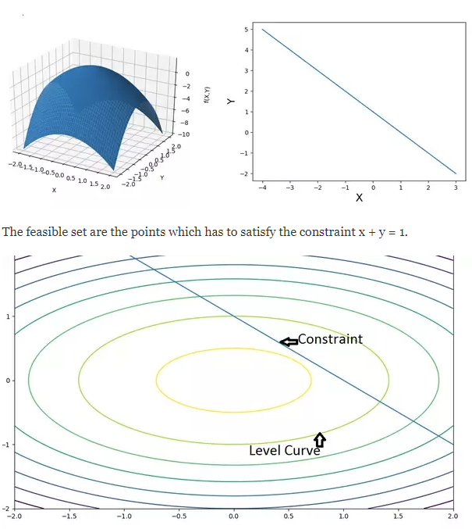

Detour: (Lagrange Multiplier)
The method of Lagrange multipliers is a strategy for finding the local maxima/minima of a function subject to equality constraints.
Constraints are in the form of constants or another
functions that have to be satisfied exactly by
the chosen values of the variables
to achieve the optimal value.
For example:
Optimize:
With the constraints: x + y = 1
$$f(x,y)=2−x^{2}−2y^{2}$$

Slide 29
Linear SVM
minimizes <w * w>
subject to yi(<w * x_{i}> + b) ≥ 1 i = 1,....n
Convert the problem from the primal form into the dual form
n
L(w,b,α) = 1<w * w> – ∑α_{i} [y_{i} (<w * x_{i}> + b) – 1]
2
i = 1
n
n
∂L(w*,α*,β*) ₌ w - ∑y_{i}α_{i}x_{i}
∂L(w*,α*,β*) ₌ ∑y_{i}α_{i = 0}
= 0
∂w
i= 1
∂b
i = 1
n
n
w = ∑y_{i}α_{i}x_{i}
i = 1
0 = ∑y_{i}α_{i}
i = 1

Slide 30
Linear SVM
w =∑y_{i}α_{i}x_{i}
i = 1
Now we plug the newly defined w into the L(w, b, α)
l
L(w,b,α) = 1<w * w> – ∑α_{i} [y_{i} (<w * x_{i}> + b) – 1]
=
2
i = 1
n n n n n
1 ∑∑y_{i}y_{j}α_{i}α_{j}<x_{i} * x_{j}> – ∑∑y_{i}y_{j}α_{i}α_{j}<x_{i} * x_{j}> + ∑α_{i} =
2 _{i = 1 j = 1} i = 1 j = 1 j = 1
^{n} n n
∑α_{i} - 1∑∑ y_{i}y_{j}α_{i}α_{j}<x_{i} * x_{j}>
i = 1 2 i = 1 j = 1

Slide 31
Linear SVM
The dual form of the original problem is
n
n
n
maximize W(α) = ∑α_{i} – 1
∑∑y_{i}y_{j}α_{i}α_{j}<x_{i} * x_{j}>
2 i = 1 j = 1
i = 1
n
∑y_{i}α_{i} = 0
i = 1
subject to
α_{i} ≥ 0 i = 1,....,n.
n
w* = ∑y_{i}α*_{i}x_{i}
The optimal weight vector given by:
i = 1
realizes the maximal margin hyperplane with the geometric margin
given by:
γ =
1
||w||₂

Slide 32
Solving the Optimization Problem
Find α₁…α_{N} such that
Q(α) =Σα_{i} - ½ΣΣα α y yx^{T}x is maximized and
i j i j i j
Σα_{i} y_{i} = 0
α_{i} ≥ 0 for all α_{i}

Slide 33
Finding b from the linear constraints
y_{k} (W X_{k} + b) = 1
T
(W ^{T} X + b) = ¹
k
y
k
(W ^{T} X + b) = y
k k
b = y_{k} −W ^{T} X_{k}

Slide 34
The Optimization Problem Solution
The solution has the form:
w =Σα_{i}y_{i}x_{i}
b= y_{k}- w^{T}x_{k}
for any x_{k} such that α_{k}≠ 0
α_{i} must satisfy Karush-Kuhn-Tucker conditions:
α_{i} [y_{i}(w^{T}x_{i}+b)-1]=0, for any i
If α_{i} >0, y_{i}(w^{T}x_{i}+b)-1=0, x_{i} is on the margin
If y_{i}(w^{T}x_{i}+b)>1, α_{i} =0
Each non-zero α_{i} indicates that corresponding x_{i} is a support vector.
(Sparsity)

Slide 35
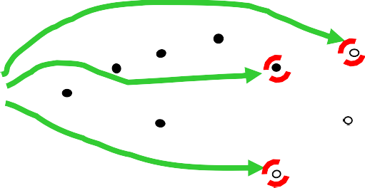
Maximum Margin
denotes +1
denotes -1
w, b depends only on Support Vectors via active constraints
y_{i}(w^{T}x_{k}+b)-1=0

Slide 36
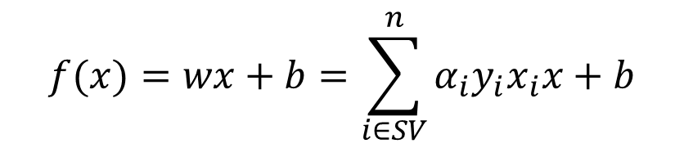
The Optimization Problem Solution
To classify the new test point x, we use
$$f(x)=wx+b=\sum_{i∈SV}^{n}{α_{i}y_{i}x_{i}x+b}$$
Find α₁…α_{N} such that
Q(α) =Σα_{i} - ½ΣΣα α y y x ^{T}x is maximized and
i j i j i j
Σα_{i} y_{i} = 0
α_{i} ≥ 0 for all α_{i}

Slide 37
Dataset with noise
Hard Margin: So far , all data points are classified correctly
- No training error
What if the training set is noisy?

Slide 38
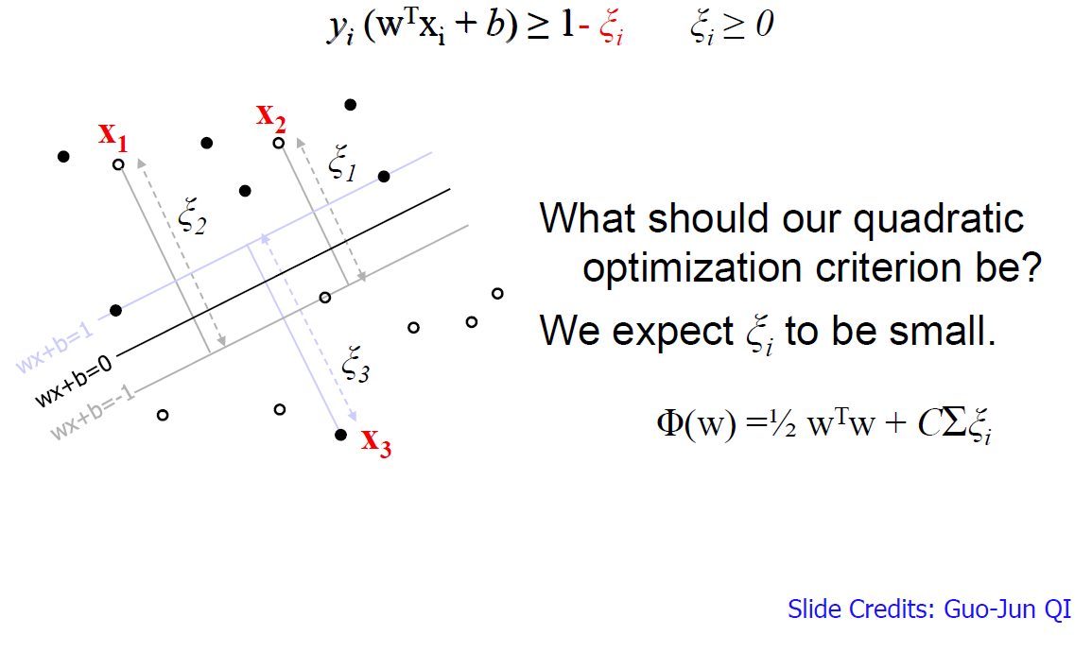
Soft Margin
Introduce a slack
variable in the
soft margin.
Slack variables
quantify the
miss-classification

Slide 39
Hard Margin vs. Soft Margin
The old formulation:
Find w and b such that
Φ(w) =½ w^{T}w is minimized and for all {(x_{i} ,y_{i})}
y_{i} (w^{T}x_{i} + b) ≥ 1
The new formulation incorporating slack variables:
Find w and b such that
Φ(w) =½ w^{T}w + CΣξ_{i} y_{i} (w^{T}x_{i} + b) ≥ 1- ξ_{i}
is minimized and for all {(x_{i} ,y_{i})}
and ξ_{i} ≥ 0 for all i
Similar solution can be obtained to that of hard margin
Parameter C can be viewed as a way to control overfitting.

Slide 40
Linear SVM:
The classifier is essentially a separating hyperplane.
The most “important” training points are the support vectors; they define the hyperplane.
Quadratic optimization algorithms can identify which training points x_{i} are support vectors with non-zero Lagrangian multipliers α_{i}.
Both in the dual formulation of the problem and in the solution, training points appear only inside inner products:
Find α₁…α_{N} such that
Q(α) =Σα_{i} - ½ΣΣα_{i}α_{j}y_{i}y_{j}x_{i}^{T}x_{j} is maximized and
(1) Σα_{i}y_{i} = 0
(2) 0 ≤ α_{i} ≤ C for all α_{i}
f(x) = Σα_{i}y_{i}x_{i}^{T}x + b

Slide 41
Non-linear SVM
Datasets that are linearly separable (with some noise) work out great:
0
x
But what are we going to do if the dataset is just too hard?
x
0
x²
How about … mapping data to a higher-dimensional space:
0
x

Slide 42
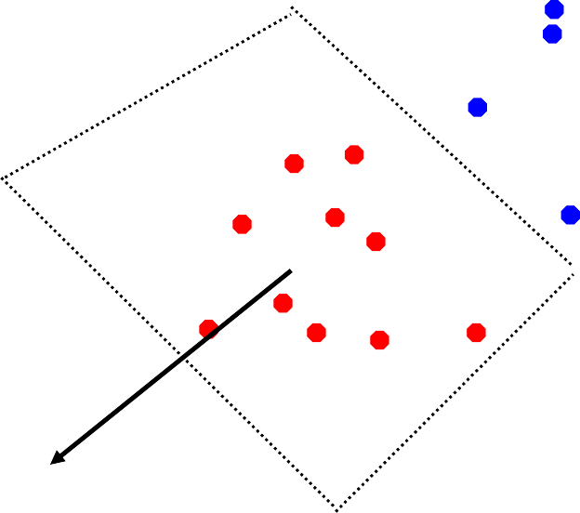
Non-linear SVMs: Feature spaces
General idea: the original input space can always be mapped to some higher-dimensional feature space where the training set is linearly separable:
Φ: x → φ(x)

Slide 43
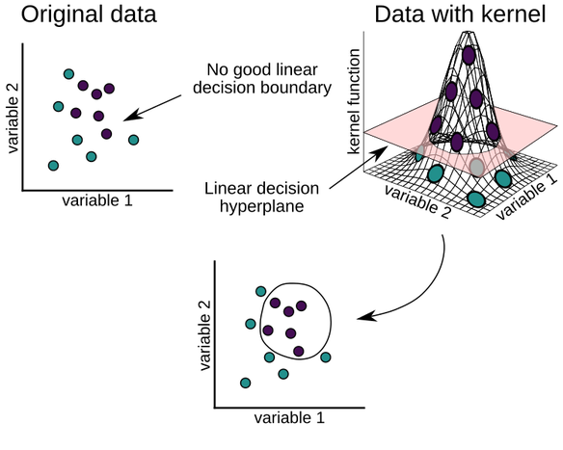
Kernels
Why use kernels?
Make non-separable problem separable.
Map data into better representational space
Common kernels
Linear
Polynomial K(x,z) = (1+x^{T}z)^{d}
Radial basis function (infinite dimensional space)
K(x_{i},x_{j}) = exp-{||x_{i}-x_{j}||²}/2σ²
https://www.r-bloggers.com/support-vector-machines-with-the-mlr-package/

Slide 44
Kernel Representation
In general, complex real-world applications require more expressive models than linear functions.
Kernel representation offers an alternative solution by projecting the data into a high (abstract) dimensional feature space to increase the computational power of the linear learning machines (i.e., classifiers and regressors).
The use of linear machines in the dual formulation makes it possible to apply the so-called kernel trick, i.e., to replace the inner product with an appropriate kernel function, performing thus implicitly the desired mapping into a feature space of higher dimensionality.

Slide 45

The “Kernel Trick”
The linear classifier relies on an inner product between vectors K(x_{i},x_{j})=x_{i}^{T}x_{j}
If every datapoint is mapped into high-dimensional space via some transformation
Φ: x → φ(x), the inner product becomes:
K(x_{i},x_{j})= φ(x_{i}) ^{T}φ(x_{j})
A kernel function is some function that corresponds to an inner product in some expanded feature space.

Slide 46
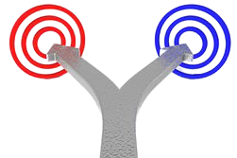
The “Kernel Trick”
In a nutshell, kernel trick allow us to operate in the original feature space without computing the coordinates of the date in a higher dimensional space.
So, with the kernel trick, we hit two targets with a singal shot. (data transformation, reduced computational)

Slide 47
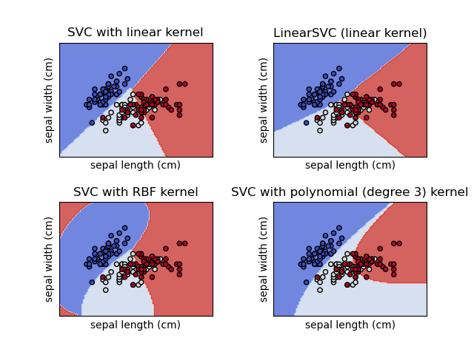
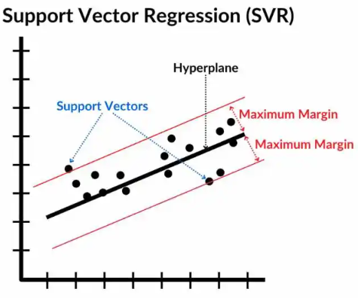
SVM in classification and regression
Support Vector Machines (SVMs) are used for:
Classification → SVC (Support Vector Classifier)
Regression → SVR (Support Vector Regressor)
https://scikit-learn.org/stable/modules/svm.html
https://spotintelligence.com/2024/05/08/support-vector-regression-svr/

Slide 48

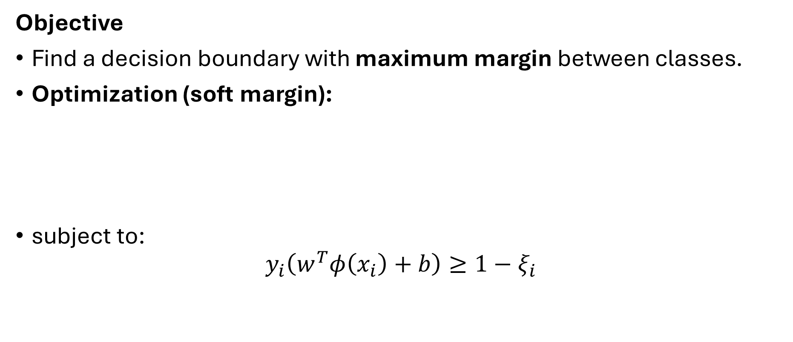
SVM for Classification (SVC)
Objective
Find a decision boundary with maximum margin between classes.
Optimization (soft margin):
subject to:
$$y_{i}\left(w^{T}φ\left(x_{i}\right)+b\right)≥1−ξ_{i}$$

Slide 49
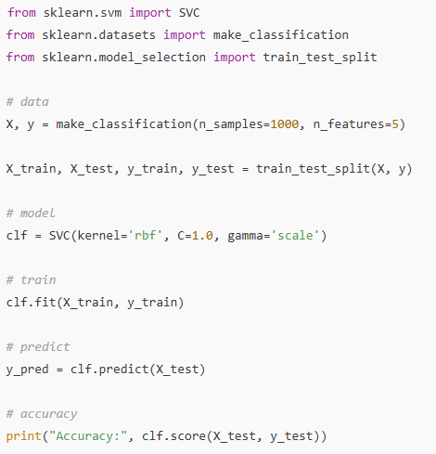
Simple Python Example

Slide 50
Important Parameters (Classification)
Parameter | Meaning
C | Regularization (higher → less margin, overfit)
kernel | linear, rbf, poly, sigmoid
gamma | Kernel width (rbf/poly)
class_weight | Handle class imbalance

Slide 51


SVM for Regression (SVR)
SVR tries to fit a function such that:
errors smaller than ε are ignored
Objective
subject to:
$$∣y_{i}−f\left(x_{i}\right)∣≤ε$$

Slide 52
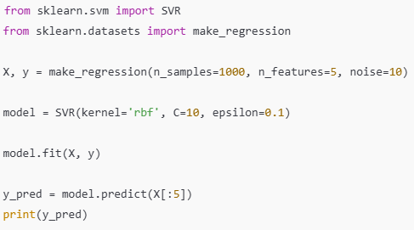
Python Example (SVR)

Slide 53
Important Parameters (Regression)
Parameter | Meaning
C | Error penalty
epsilon | Width of "no penalty" tube
kernel | Same as SVC
gamma | Kernel smoothness

Slide 54
Advantages of SVM
Strong theoretical foundation
Works well in high dimensions
Effective with small datasets
Robust to overfitting
Flexible via kernels

Slide 55
Limitations
Computationally expensive for large datasets
Sensitive to hyperparameters
Requires feature scaling
Harder to interpret than linear models

Slide 56
When to Use SVM
Use SVM when:
Dataset size is medium
Feature dimension is high
Clear margin exists
Accuracy is more important than speed
Avoid when:
Dataset > 100k samples
Real-time training needed

Slide 57
Summary
SVM finds maximum margin solutions
Used for classification (SVC) and regression (SVR)
Kernels enable non-linear learning
Hyperparameters control bias–variance tradeoff
Powerful but computationally demanding

Slide 58
Slides Adapted from:
Pattern Recognition and Machine Learning Book by Christopher Bishop
Kevin Murphy, UBC Machine learning course
Mubarak Shah, UCF Computer Vision course
Farid Melgani, UoT Pattern Recognition course
Pattern Classification Book by Duda and Hart

Slide 59


