Slide 1
AI Evaluation Methods: Quantitative & Qualitative
26 Jan, 2026
Instructor: Mohib Ullah
AI and Cyber Security applications (PGR216)

Slide 2
Content
Types of evaluation
Quantitative
Precision
Recall
Accuracy
F1 Score
Qualitative
Mean Opinion Score (MOS)
User Satisfaction Score (USS)
Naturalness Rating

Slide 3
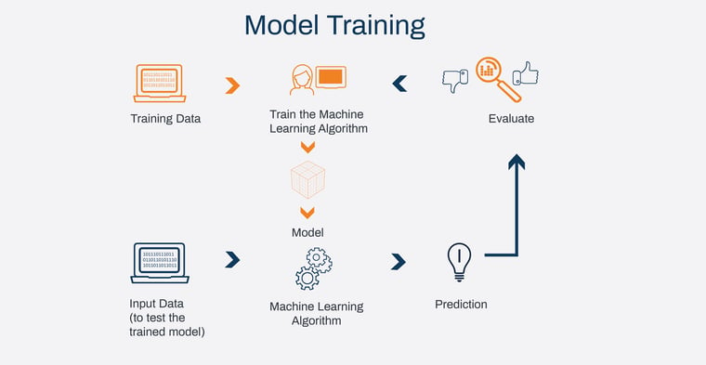
AI Model Evaluation
We will explore how to evaluate AI models using both quantitative and qualitative methods.
AI models are only useful if they perform well in the real world. How do we measure "good performance"?
Figure courtesy: https://www.columbusglobal.com/en/blog/critical-steps-to-training-and-evaluating-ai-and-ml-models

Slide 4
Quantitative Vs Qualitative
Quantitative Evaluation (Objective, Metric-Based)
Uses Numerical Metrics – AI models are evaluated using accuracy, precision, recall, F1-score, IoU, etc.
Enables Benchmarking – Models can be compared across datasets with standard performance scores.
Automated & Scalable – Large-scale evaluation is possible without human intervention.
Focuses on Statistical Validity – Performance is judged based on statistical measures like mean error, variance, etc.
Limited Interpretability – High accuracy doesn’t always mean correct reasoning (e.g., biased models).

Slide 5
Quantitative Vs Qualitative
Qualitative Evaluation (Subjective, Human-Based)
Focuses on Interpretability – Evaluates how understandable and trustworthy AI outputs are.
Human Judgment is Key – Experts review model predictions for fairness, and usability.
Evaluates User Experience – Used in chatbot interactions, medical AI, and recommendation systems.
Context-Sensitive – Some AI decisions cannot be quantified (e.g., creativity in AI-generated art).
Time-Consuming & Costly – Requires human effort, making it harder to scale compared to automated methods.

Slide 6
Quantitative Metrics
Classification models predict labels (e.g., spam vs. not spam, disease vs. no disease).
Accuracy is the simplest metric, but it doesn’t work well for imbalanced datasets.
Precision vs. Recall Trade-off:
Precision: "Of all the positive predictions, how many were correct?"
Recall: "Of all actual positives, how many were detected?"
Example: In cancer detection, recall is more important than precision.
F1-Score balances precision & recall (useful when both are important).
Specificity is important when detecting normal behaviour correctly is important. Mathmatically it is defined as:
Specificity=TN/(TN+FP)
Accuracy = (TP + TN) / (TP + TN + FP + FN)
Precision = TP / (TP + FP)
Recall = TP / (TP + FN)
F1-Score = 2 × (Precision × Recall) / (Precision + Recall)
Specificity (True Negative Rate)

Slide 7
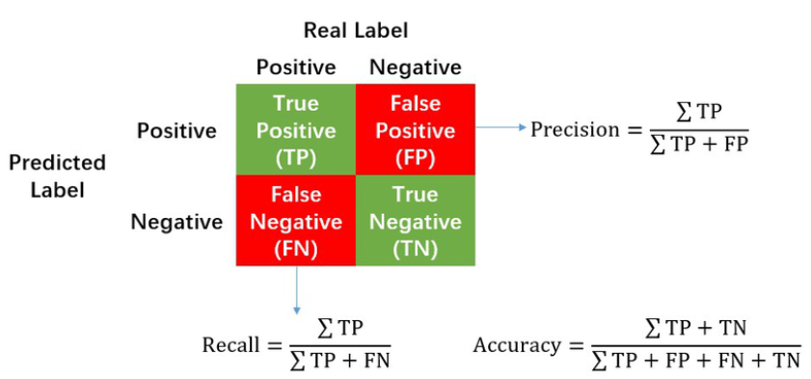
Confusion Matrix
What is a Confusion Matrix?
A table summarizing AI predictions vs. actual results.
True Positives (TP): AI correctly detects a positive case.
False Positives (FP): AI incorrectly predicts positive (false alarm).
False Negatives (FN): AI misses a real positive case.
True Negatives (TN): AI correctly predicts negative.
Why is it useful?
Helps analyze model performance beyond simple accuracy.
Used to compute Precision, Recall, F1-score.

Slide 8
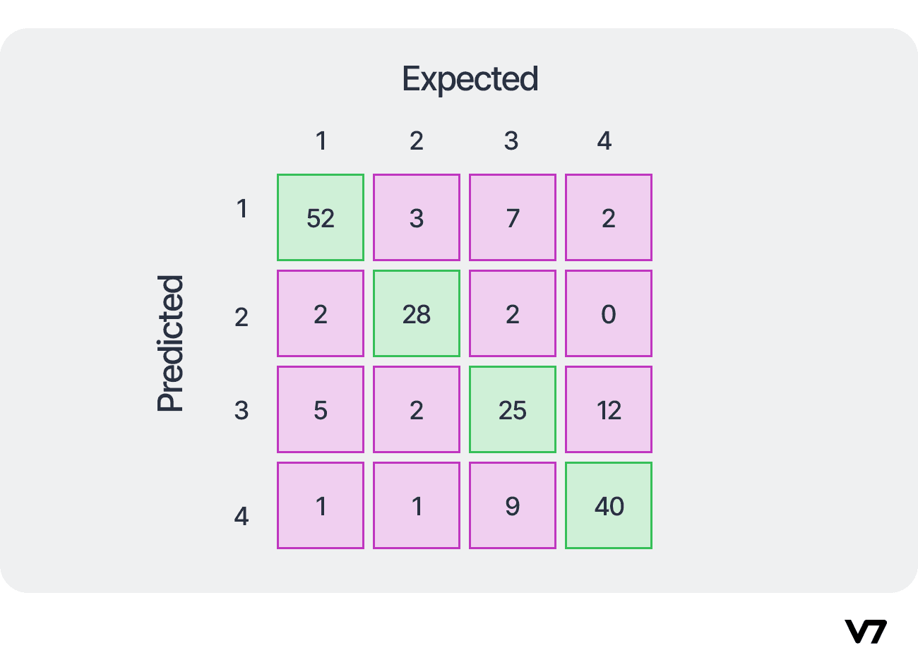
Confusion Matrix
A confusion matrix is a table used in machine learning to evaluate a classification model's performance by comparing actual outcomes with predicted outcomes, revealing correct and incorrect classifications (True Positives, True Negatives, False Positives, False Negatives) to understand where the model confuses classes, helping calculate metrics like accuracy, precision, and recall.
It's a foundational tool for assessing how well a model predicts different categories, with diagonal elements showing correct predictions.

Slide 9
Quantitative Metrics
R-squared (R²):
Measures how well the model explains the variance in the target variable, with values ranging from 0 (poor fit) to 1 (perfect fit).
Mean Absolute Error (MAE):
Calculates the average absolute difference between actual and predicted values, giving a direct measure of prediction error.
Mean Squared Error (MSE):
Computes the average squared difference between actual and predicted values, penalizing larger errors more than MAE.
Intersection over Union (IoU):
Evaluates object detection performance by measuring the overlap between predicted and ground-truth bounding boxes.
Mean Average Precision (mAP):
Used in object detection to measure how well the model detects multiple objects.

Slide 10
Qualitative Metrics
Mean Opinion Score (MOS):
A 1-5 scale rating used for subjective assessment, often in speech synthesis, video quality, and human-AI interactions.
User Satisfaction Score (USS):
Measures user experience and satisfaction through surveys or feedback, commonly used in AI-driven recommendation systems and chatbots.
Naturalness Rating:
Used in speech, text, and image generation models to judge how "human-like" the AI output feels (e.g., evaluating AI-generated voices or GPT outputs).

Slide 11
Pros and Cons
Accuracy measure overall correctness:
Accuracy = (TP + TN) / (TP + TN + FP + FN)
It is very simple to calculate
It is helpful when the classes are balanced
It is misleading for imbalanced datasets

Slide 12
Precision
Precision measures how many predicted positives are actually correct:
Precision = TP / (TP + FP)
Pros of High Precision
Reduced alert fatigue for security teams When precision is high, most alerts are real threats (low false positives). This means analysts spend less time investigating noise and can focus on actual incidents i.e., faster and more effective response.
Lower operational cost and business disruption High-precision detection means fewer unnecessary blocks, quarantines, or resets. This reduces:
False-positive-induced downtime
Helpdesk tickets from wrongly blocked users
Wasted compute/storage resources on inspecting benign activity
Cons of Very High Precision
Higher risk of missing real attacks (lower recall) To achieve very high precision, detection rules and models usually become more strict/narrow i.e., sophisticated or slightly mutated attacks can more easily slip through (classic precision VS recall tradeoff).
Slower reaction to new/emerging threats High-precision systems often require more evidence or longer observation periods before firing an alert. This can delay detection of novel attacks, zero-days, or living-off-the-land techniques that don't match strong, well-known patterns.

Slide 13
Recall (Sensitivity)
Recall measures how many actual positives are detected.
Pros of High Recall
Minimizes the risk of missing real threats High recall ensures that the vast majority of actual attacks, malware, intrusions, or malicious behaviors are flagged. In cybersecurity, failing to detect an active breach (false negative) can lead to data exfiltration, ransomware encryption, or persistent access consequences far more damaging than investigating extra alerts.
Better suited for high-stakes or early-warning scenarios Environments like critical infrastructure, financial systems, APT-targeted organizations, or zero-trust architectures prioritize “catch everything first, filter later.” High-recall detection acts as a broad safety net, especially against novel/unknown threats (zero-days, living-off-the-land, polymorphic malware) where strict signatures would fail.
Cons of Very High Recall
Massive increase in false positives and alert fatigue To catch almost every threat, detection becomes much broader/sensitive which means many benign activities trigger alerts. Security teams drown in noise, leading to burnout, delayed responses to real incidents, and even alert i.e., ignore habits.
Higher operational cost and business friction More alerts mean more triage time, more automated blocks/quarantines of legitimate traffic/users, increased helpdesk load, and potential disruption (e.g., blocking a developer’s script, dropping customer sessions, or quarantining critical files). This raises SOC costs and can hurt productivity or user experience.

Slide 14
F1-Score
F1 score measures combines precision and recall in a balance way.
Pros of Using F1-Score
Balances precision and recall in imbalanced real-world scenarios: Cybersecurity datasets are heavily skewed (very few actual attacks compared to normal traffic). F1-score (harmonic mean of precision and recall) penalizes models that chase high recall at the cost of flooding analysts with false positives, or high precision that misses many real threats. It gives a single, more realistic number than accuracy (which is misleadingly high when ignoring rare attacks) i.e., it better reflects operational effectiveness.
Encourages models suitable for security operations workflows: A good F1-score pushes for detectors that are neither too noisy (low precision which may alert fatigue, burnout) nor too conservative (low recall which may lead to missed breaches). This makes it particularly useful when comparing ML/DL-based IDS, EDR models, phishing classifiers, or anomaly detectors during research, vendor evaluations, or tuning thresholds.
Cons of Using F1-Score
Ignores true negatives and unequal costs of errors: In cybersecurity, the cost of a false negative (missed attack i.e., potential breach, data loss, ransomware) is usually orders of magnitude higher than a false positive (wasted analyst time). F1-score treats both types of errors equally in its calculation and completely ignores true negatives i.e., it can favor models that look "balanced" on paper but are actually too risky or inefficient in practice.
Not cost-sensitive or business-aligned for many security use cases: Recent research highlights that F1-score can be suboptimal for threat detection because it doesn't account for asymmetric costs (e.g., FP might cost minutes of triage, FN might cost millions). Alternatives like cost-aware metrics (e.g., Cscore proposals), expected cost, or prioritizing recall with precision thresholds often better match SOC priorities, leading some teams to de-emphasize pure F1 optimization.

Slide 15
Specificity
It measures how well a detection system correctly identifies non-malicious activity i.e., how good it is at not flagging benign behavior as threats.)
Pros of High Specificity
Greatly reduces false positives and alert fatigue High specificity means very few benign activities (normal user behavior, legitimate scripts, known-good software) are flagged as threats. This keeps the volume of alerts low, allowing security analysts to focus on real incidents without being overwhelmed by noise — a common reason SOC teams burn out or miss genuine attacks.
Minimizes business disruption and user friction When specificity is high, legitimate traffic, applications, and user actions are rarely blocked, quarantined, or reset. This leads to:
Fewer helpdesk tickets
Less productivity loss (e.g., developers can run scripts without constant interruptions)
Better user experience and adoption of security tools
Cons of Very High Specificity
Can lead to lower sensitivity/recall (more missed threats) To achieve very high specificity, detection rules or models often become very strict. This increases the risk of false negatives — real attacks that look “normal enough” (e.g., living-off-the-land techniques, subtle credential abuse, or low-and-slow exfiltration) slip through undetected.
Makes the system less effective against novel or evasive threats High-specificity detectors rely heavily on well-known malicious patterns. Zero-days, polymorphic malware, or attackers using legitimate tools in unusual ways are more likely to be classified as benign. This can create a false sense of security in environments facing sophisticated or unknown adversaries.

Slide 16
Internal vs External Clustering Evaluation Metrics
In clustering, evaluation metrics are divided into two types based on what information they use:
Internal metrics is use only the data and cluster assignments
External metrics is compare clustering results with ground‑truth labels

Slide 17
Intuition
Internal metrics answer: “How good is this clustering based only on the data itself?”
External metrics answer: “How close is this clustering to the true labels?”

Slide 18
Internal Clustering Metrics
Internal metrics evaluate clustering quality using only:
the data points
the distances between them
the cluster assignments
No ground‑truth labels are required

Slide 19
When are internal metrics used?
Unsupervised learning (no labels available)
Exploratory data analysis
Comparing different values of k in k‑means
Real‑world problems where true labels are unknown

Slide 20
What do internal metrics measure?
They typically measure two properties:
Cohesion means data points in the same cluster should be close. In other words, similar data should be close to one another.
Separation means data points in different clusters should be far apart. In other words, different data should be we far from one another in the feature space.

Slide 21
Clustering Metrics (Unsupervised AI)
1. Silhouette Score Measures how similar an object is to its own cluster (cohesion) compared to other clusters (separation).
Range: -1 to +1
Higher is better (close to +1 = well-separated, compact clusters; near 0 = overlapping; negative = possible misassignment).
Very widely used because it's intuitive and works well for assessing cluster quality visually and numerically.
2. Davies-Bouldin Index (DB Index) Evaluates the average similarity between each cluster and its most similar one (ratio of within-cluster scatter to between-cluster separation).
Range: ≥ 0 (lower is better; 0 would be perfect separation).
Useful for comparing different numbers of clusters or algorithms; penalizes overlapping or poorly separated clusters.

Slide 22
Clustering Metrics (Unsupervised AI)
3. Calinski-Harabasz Index (Variance Ratio Criterion) Ratio of between-cluster dispersion to within-cluster dispersion.
Range: > 0 (higher is better).
Especially good for compact, well-separated clusters (e.g., in k-means-like algorithms); often used in elbow-method extensions to choose the number of clusters.
4. Inertia (Within-Cluster Sum of Squares – WCSS) Sum of squared distances between each point and its cluster centroid.
Range: ≥ 0 (lower is better).
Primary metric for k-means; commonly plotted in the "elbow method" to find the optimal k. Note: it always decreases with more clusters, so it's not comparable across different algorithms.

Slide 23
Popular Metrics (when ground-truth labels are available for benchmarking)
Adjusted Rand Index (ARI) Measures similarity between predicted clusters and true labels, adjusted for chance.
Range: -1 to +1 (1 = perfect match, 0 = random, negative = worse than random).
One of the most robust and commonly reported external metrics.
Normalized Mutual Information (NMI) Quantifies shared information between cluster assignments and true labels, normalized to [0,1].
Higher is better (1 = perfect agreement).

Slide 24
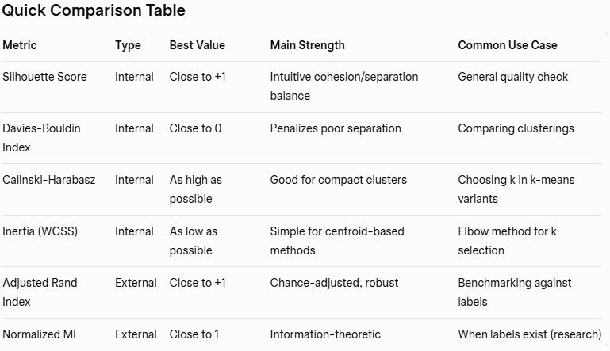

Slide 25
Efficiency & System Metrics
Inference Time
Time per prediction (ms)
Throughput
Predictions per second
Model Size
Memory footprint (MB)
Energy / Power
Important for edge AI
Notes:
(Often Ignored but Important)

Slide 26
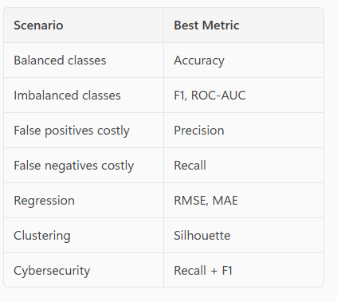
How to choose the right metric?

Slide 27


