Slide 1
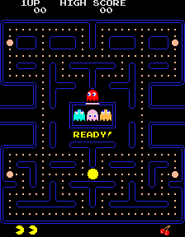

@abstract
screenshoter.py
numpy array
ImageParser
Bot
CrazyBot
pyautogui
opencv
moves randomly
OldSchoolBot
moves by hardcoded algorithm
game.py
Field
self.pacman
AdvancedBot
self.ghosts
trained neural net
self.has_bonus
self.cookies
self.powerups
self.round
action_executor.py
self.score
selenium
self.lives
def go_left()
def go_right()
def go_up()
def go_down()
pynput

