Slide 1

Amazon Web Services(AWS)
GLOBAL INFRASTRUCTURE
CLOUD COMPUTING KNOWLEDGE

Slide 2
AWS GLOBAL INFRASTRUCTURE – REGIONS & AZ’s
REGION:
Geographic location across the world
Cluster data centres
You can choose any region to deploy your workloads on AWS
Consist of multiple, isolated, and physically separate AZs within a geographic area
Lower latency applications
Regulatory/Compliance
Region_Code | Region
us-east-2 | US East (Ohio)
ap-south-1 | Asia Pacific (Mumbai)
ap-southeast-2 | Asia Pacific (Sydney)
eu-central-1 | Europe (Frankfurt)
me-south-1 | Middle East (Bahrain)
CLOUD COMPUTING KNOWLEDGE

Slide 3
AWS GLOBAL INFRASTRUCTURE – REGIONS & AZ’s
AVAILABLITY ZONES:
Every region has 2 or more clusters of data centres called AZ
One or more discrete data centers with redundant power,
networking, and connectivity
Highly available, fault tolerant, and scalable
All traffic between AZ’s is encrypted
Multiple AZ’s – Application high availability, Synchronous replication
Fault tolerance, Near DR site
CLOUD COMPUTING KNOWLEDGE

Slide 4
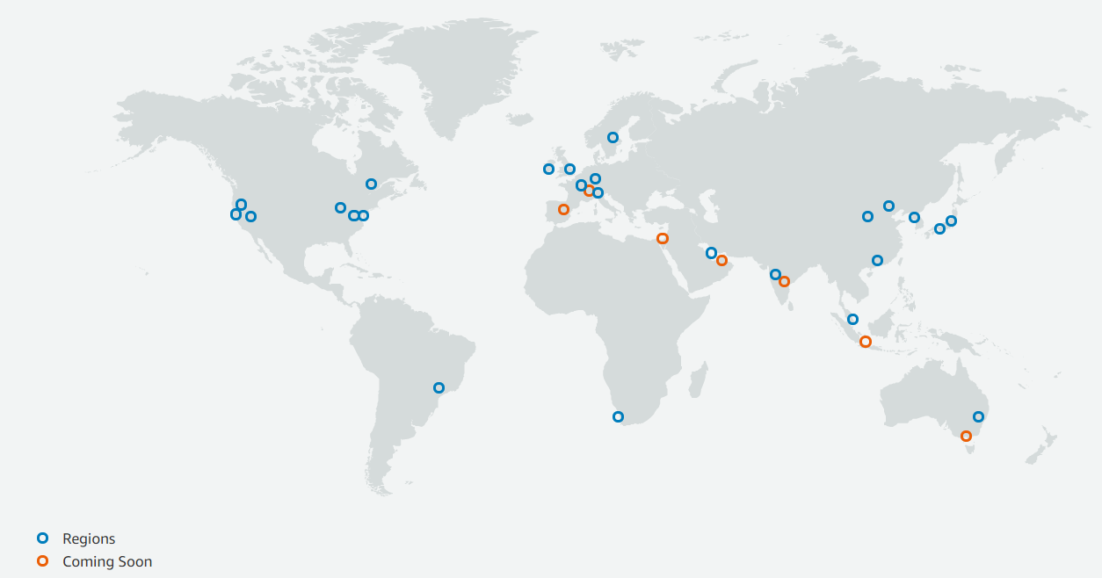
AWS GLOBAL INFRASTRUCTURE
25 – Regions
81 – Availability Zones
218 + - Edge Locations
CLOUD COMPUTING KNOWLEDGE

Slide 5
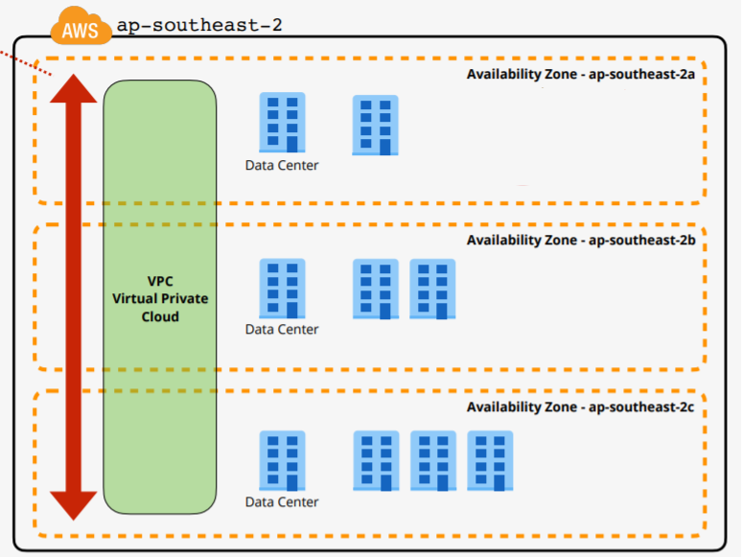
AWS GLOBAL INFRASTRUCTURE – REGIONS & AZ’s
Region – Asia Pacific (Sydney)
Region Code – ap-southeast-2
AZ - ap-southeast-2a
ap-southeast-2b
ap-southeast-2c
CLOUD COMPUTING KNOWLEDGE

Slide 6
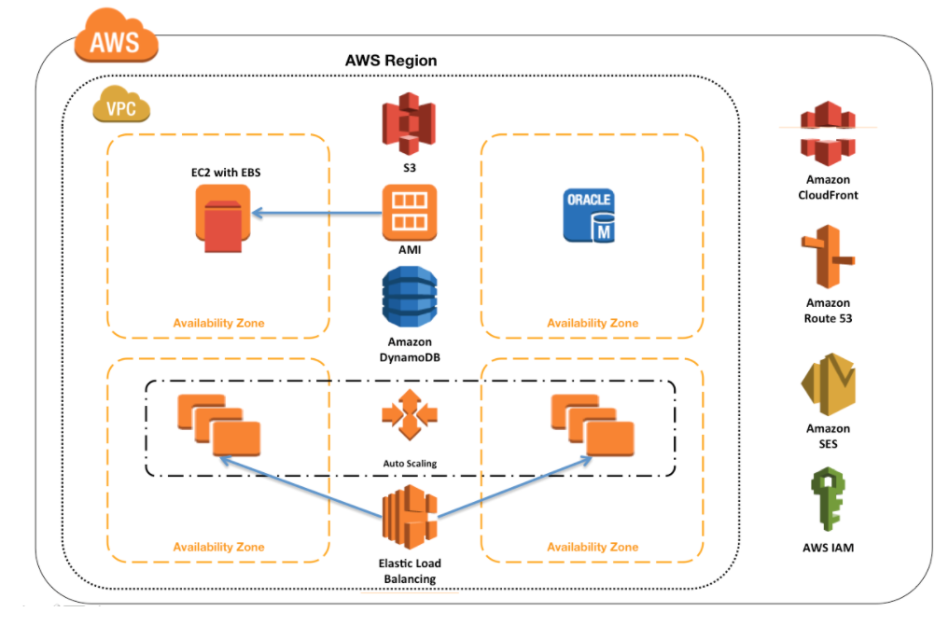
AWS GLOBAL INFRASTRUCTURE – SAMPLE ARCHITECTURE
CLOUD COMPUTING KNOWLEDGE

Slide 7
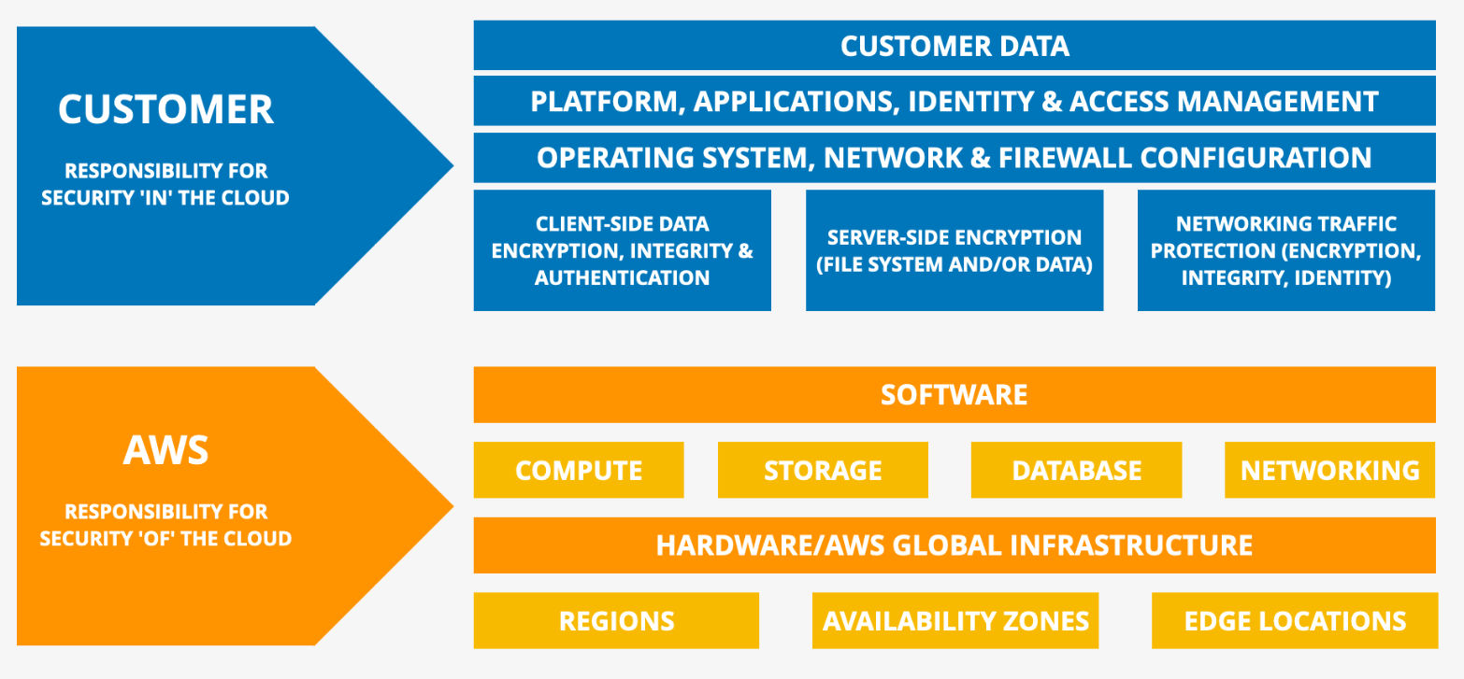
AWS SHARED RESPONSIBILITY MODEL
CLOUD COMPUTING KNOWLEDGE

