Slide 2
The Problem With Travel
Tourism is a profitable global industry that is on a post-pandemic rise
Many travelers encounter significant issues while planning and experiencing their dream vacations, ranging from the mundane (being unable to decide on an excursion) to the devastating (losing your baggage or getting lost)
We Want to Fix That

Slide 3

What Is OneGlobe?
OneGlobe is an all-in-one travel service that focuses on bringing people together, all over the world.

Slide 4
Key Features
Ability to connect with individuals from around the world.
Tools for international travelers to find travel assistance
Suggestions from locals on places to eat and visit based on your location
Learn about other cultures and countries
Plan your vacation and receive travel suggestions, customize each detail and make it your own
Receive updates during travel about weather, traffic, and other events

Slide 5
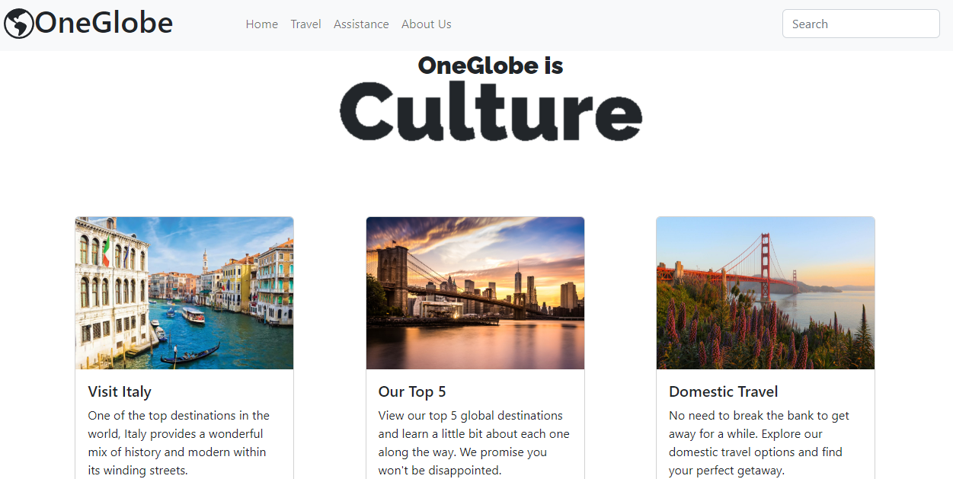

Slide 6
Vision
OneGlobe will provide a centralized service for all aspects of the user’s vacation, from start to finish
In so doing, we hope to create a service that will be able to reach adventurers from every demographic around the globe
This will be achieved by providing a completely unique user experience with each vacation plan being completely customizable and adjustable for each adventurer

Slide 7

What Does OneGlobe Mean To You?
Notes:
In the modern era, the world feels smaller than ever. Anyone can find the information they are looking for with a few taps on their phone or clicks on their computer. You can view resource after resource about any destination anywhere on the globe! But, at OneGlobe we believe there is no substitute for real human interaction. That's why we are committed to bridging differences between people in order to make the world feel a little bit safer for everyone. We hope to bring people together as users explore and make exciting discoveries all over the world. OneGlobe is more than a tourism service, and it is more than a social media platform; OneGlobe is a mechanism for real social change all over the world.

