Slide 1
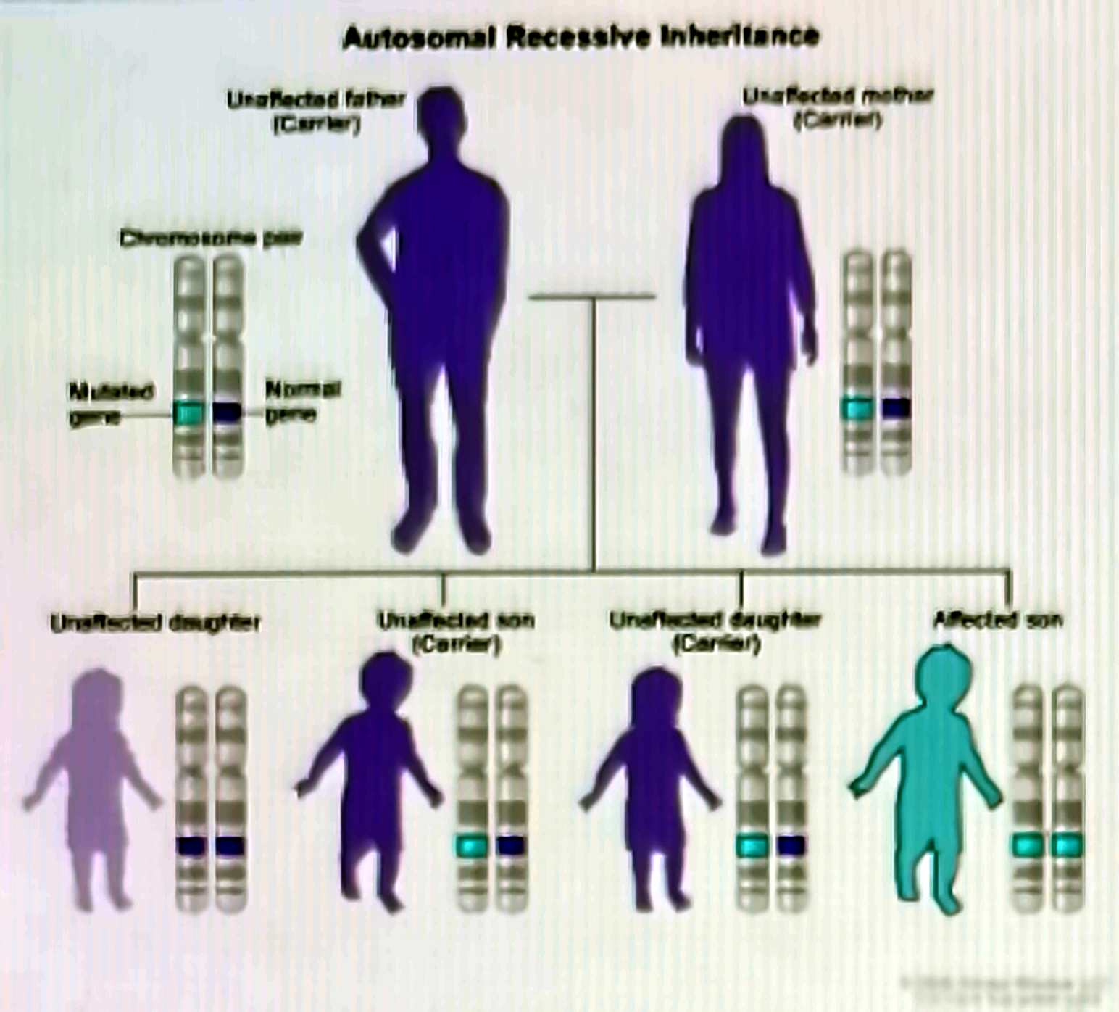
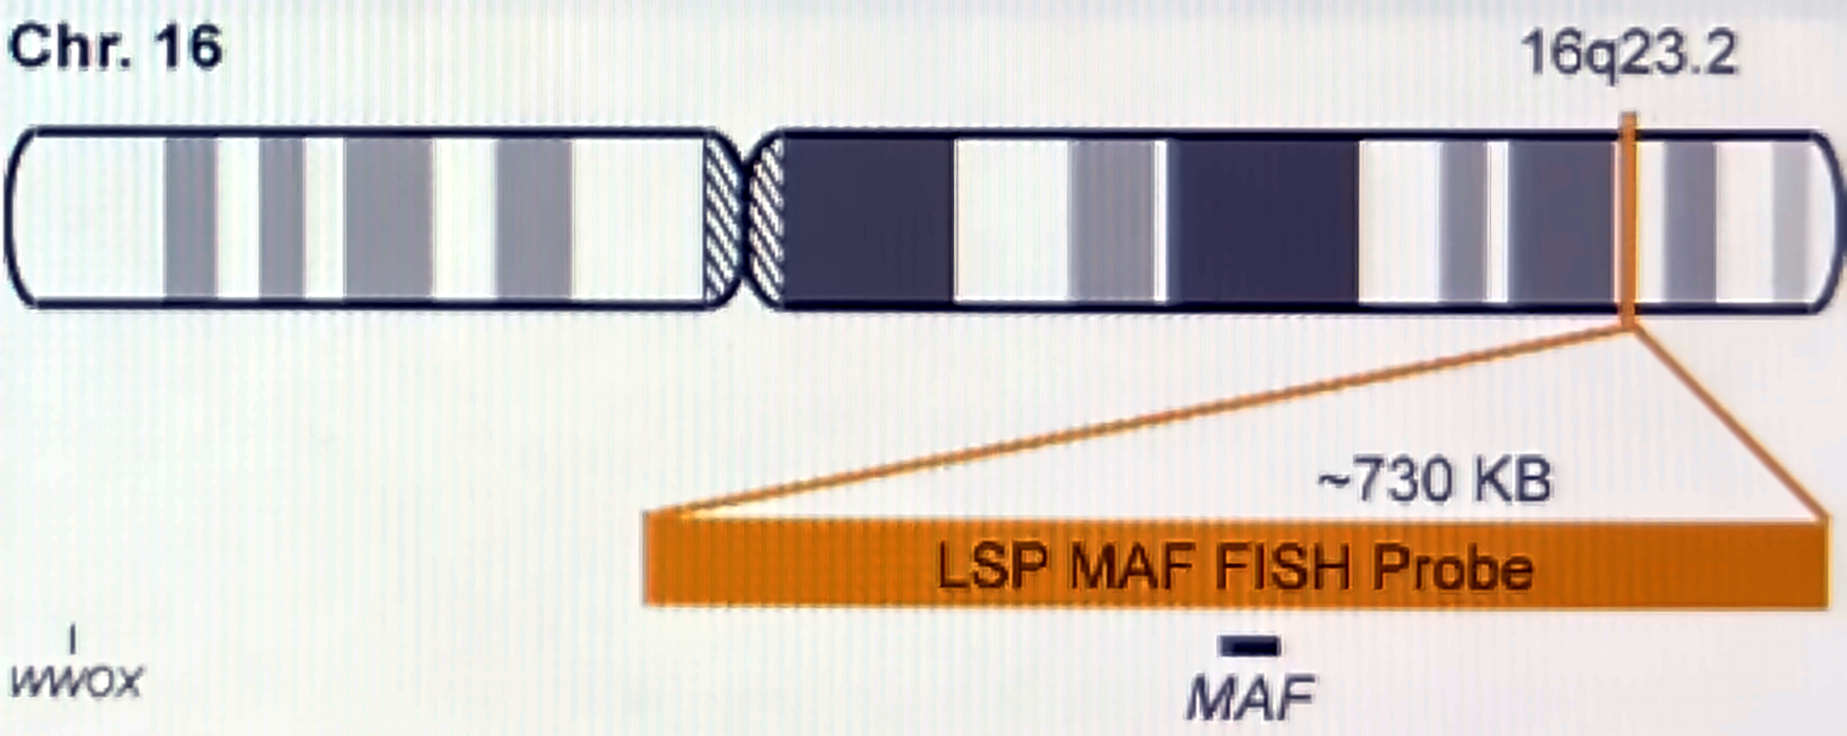
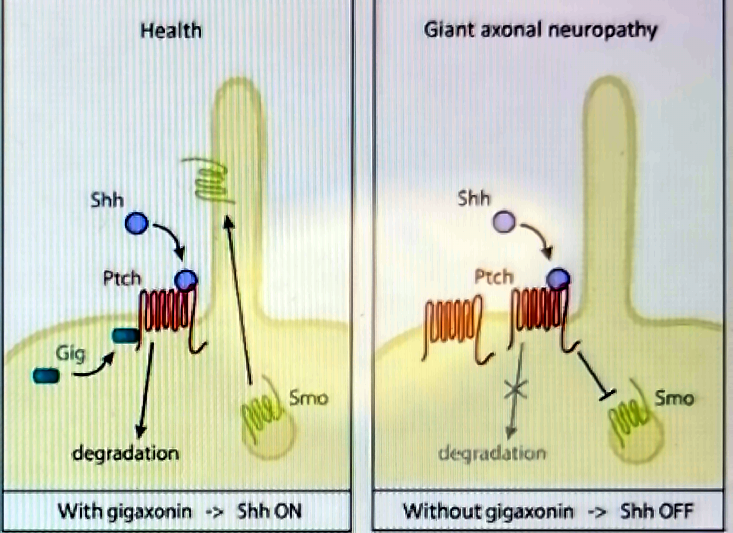
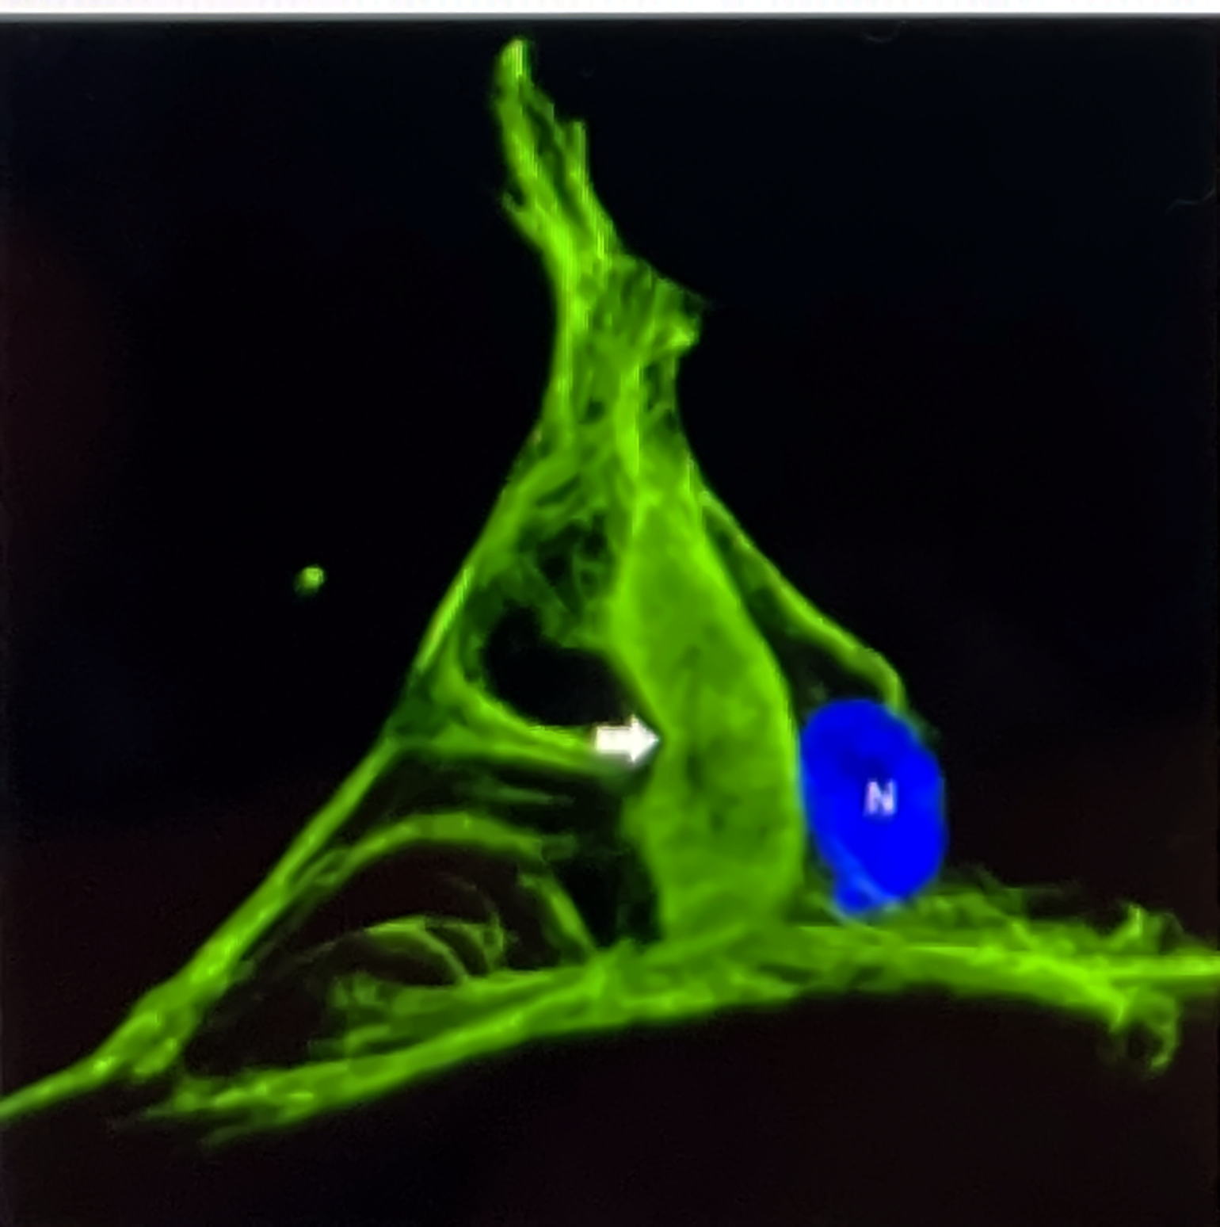
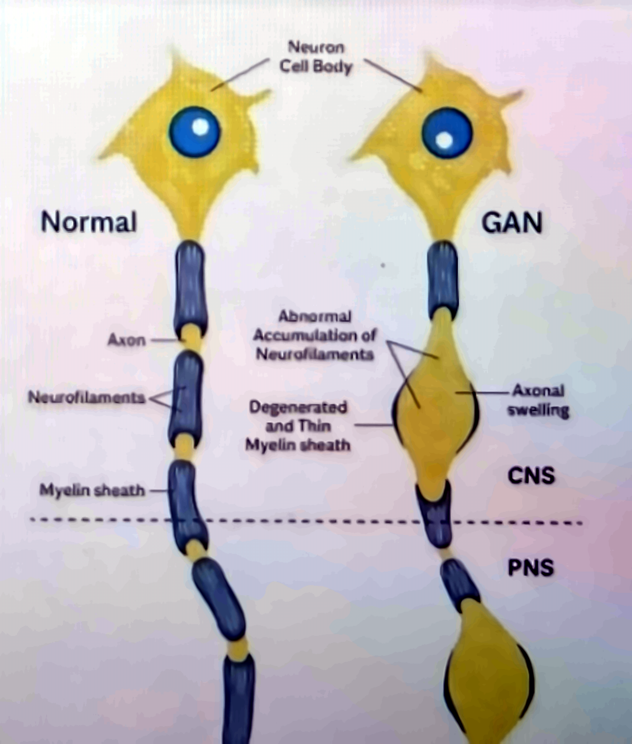
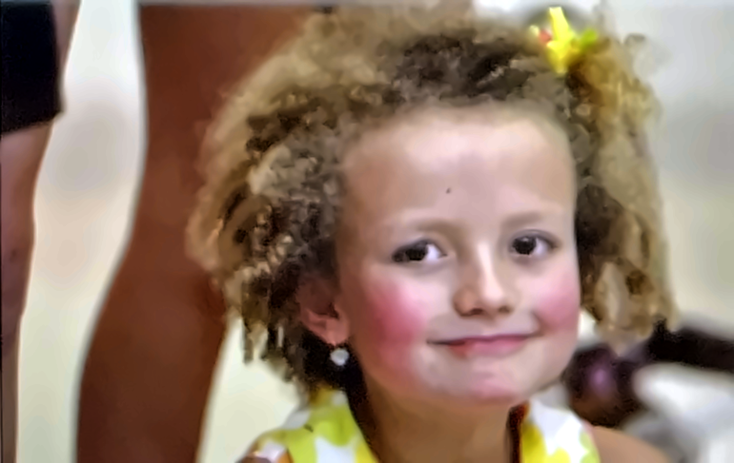
RARE NEUROGENETIC DISEASE · OMIM #256850
Giant Axonal
Neuropathy
How the loss of one small protein, gigaxonin, makes nerve fibres swell and die — and how one family's fight produced the world's first intrathecal gene therapy.
GENE: GAN
CHROMOSOME 16Q23.2
AUTOSOMAL RECESSIVE
ONSET ≈ 3 YEARS
PREVALENCE < 1 IN 1,000,000
1
THE GENETIC ROOT CAUSE
One gene, two broken copies
GENE
GAN — chromosome 16, band 16q23.2
PROTEIN
Gigaxonin — 597 aa, BTB/Kelch family
FUNCTION
Adaptor for a Cul3 E3 ubiquitin ligase
MECHANISM
Loss of function — >100 variants
● Autosomal recessive: disease appears only when both inherited copies of GAN are defective.
● Carrier parents are healthy — one working copy is enough. Each pregnancy carries a 25% risk of an affected child.
MUTATION LOCUS Long arm of chromosome 16, band q23.2 — home of the GAN gene
INHERITANCE PATTERN Two carriers → 1 in 4 affected, 2 in 4 carriers, 1 in 4 unaffected
2
WHAT GIGAXONIN DOES — AND WHAT FAILS WITHOUT IT
The cell's filament recycler goes missing
● Normal role: gigaxonin tags intermediate filament (IF) proteins — neurofilaments, vimentin, peripherin, GFAP, keratins — for degradation by the proteasome.
● Without gigaxonin: filaments are never cleared and pile up into dense aggregates that choke axonal transport.
● Second hit: gigaxonin also degrades the receptor Patched. When Patched accumulates it keeps Smoothened off, so Sonic hedgehog signalling stays OFF.
INTERMEDIATE FILAMENT AGGREGATE
Patient cell — the hallmark of gigaxonin loss (arrow). N = nucleus.
AFFECTED PATHWAY With gigaxonin → Shh ON · Without gigaxonin → Shh OFF
3
THE PHENOTYPE, CELL BY CELL
Axons that swell into giants
● Focal axonal swellings several times the normal diameter, packed with tangled neurofilaments — the "giant axons" that name the disease.
● Myelin thins and degenerates over each swelling; conduction slows, then fails.
● Both nervous systems are hit: peripheral nerves (PNS) and the cerebellum, brainstem and white-matter tracts (CNS).
● Not only neurons: GFAP aggregates in astrocytes (Rosenthal fibres); disordered keratin gives the characteristic tightly curled "kinky" hair.
3–5×
PNS + CNS
MRI
typical diameter of a swollen "giant" axon vs. a healthy one
a length-dependent axonopathy that becomes a whole-brain disease
cerebellar and brainstem white-matter change supports diagnosis
NORMAL VS GAN Neurofilament accumulation → axonal swelling → myelin loss, in CNS and PNS
4
SYMPTOMS AND CLINICAL COURSE
A slow, relentless loss — from the feet upward
ONSET · ≈ 3 YEARS
CHILDHOOD · 5–10 YEARS
ADOLESCENCE
EARLY ADULTHOOD
The clumsy walker
Peripheral neuropathy
Central nervous system
Late stage
Unsteady gait, frequent falls, weak feet and hands, high-arched feet, diminished reflexes. Tightly curled hair unlike either parent is a visible clue.
Loss of vibration and position sense, absent reflexes, muscle wasting below knees and elbows. Nerve biopsy shows giant axons; genetic testing confirms GAN variants.
Wheelchair dependence, cerebellar ataxia, nystagmus, slurred speech, scoliosis, seizures and cognitive decline as brain white matter degenerates.
Swallowing and breathing muscles weaken; most patients die of respiratory failure in the 2nd–3rd decade. Until 2015 there was no treatment beyond supportive care.
5
THE CASE THAT CHANGED THE FIELD
"We decided to fight."
● 2007: at age 3 Hannah's walking lags behind; a year of tests ends with a GAN diagnosis in March 2008.
● The hardest genotype: two deletions — Hannah makes no gigaxonin at all (CRIM-negative), so her immune system had never "seen" the protein.
● Hannah's Hope Fund, founded within months by Lori and Matt Sames, convenes the first GAN symposium (2008), raises >$8 million and funds Steven Gray (UNC) to build the vector.
HANNAH SAMES
Rexford, New York · diagnosed 24 March 2008, aged 4
Hannah's parents found themselves in the unimaginable situation of having funded a clinical trial that might have to exclude their own child.
DNA SCIENCE, JULY 2016
6
THE GENETIC TREATMENT · SCAAV9/JET-GAN · FIRST-IN-HUMAN INTRATHECAL AAV TRIAL, NIH CLINICAL CENTER 2015 (NCT02362438)
A working gene, delivered into the spinal fluid
1
→
2
→
3
→
4
Build the vector
Load the cargo
Single lumbar injection
Restore gigaxonin
scAAV9: a self-complementary AAV9 shell that enters neurons and spreads through spinal cord and brain. No viral genes; does not integrate.
A codon-optimised human GAN gene driven by JeT, a tiny synthetic promoter that fits the compact genome.
One dose — up to 3.5 × 10¹⁴ vector genomes — into the CSF, bathing motor neurons and dorsal root ganglia and bypassing the blood–brain barrier.
Transduced neurons make gigaxonin within ~2 weeks, clearing aggregates and letting damaged sensory nerves regenerate.
May 2015
21 July 2016
CRIM-negative
first human ever to receive a therapeutic gene via the spinal fluid — a GAN patient
Hannah, aged 12, treated as the 5th child (≈120 trillion vector genomes)
making no gigaxonin, Hannah needed a dedicated immunosuppression protocol
7
WHAT THE TRIAL SHOWED — NEJM, MARCH 2024
Bending the curve of an "untreatable" disease
14
1
−7.2 → −1.9
● Not a cure — yet. Existing damage is not reversed; benefit is largest when children are treated young and early.
● A template for the field: intrathecal AAV9 delivery pioneered here now underpins trials for many other childhood brain diseases.
● Next: programme licensed to industry (Taysha, TSHA-120); Hannah's Hope Fund funds a second injection site.
children aged 6–14 treated at four dose levels, followed for a median of 68.7 months
serious adverse event (fever) possibly related; CSF inflammation managed with steroids
MFM-32 points lost per year before vs. after the 1.8 × 10¹⁴ vg dose
99%
6 / 14
3–48×
One family with no medical background turned a diagnosis into a first-in-human therapy — proof of what patient-driven science can do.
TAKE-HOME MESSAGE
posterior probability that motor decline slowed at that dose — above the 95% bar
regained, stabilised or newly recordable sensory nerve responses after dosing
more regenerating nerve-fibre clusters in sensory-nerve biopsies at one year
Sources: Bharucha-Goebel DX et al. Intrathecal Gene Therapy for Giant Axonal Neuropathy. N Engl J Med 2024;390:1092-1104 · ClinicalTrials.gov NCT02362438 · NIH News, March 2024 · Hannah's Hope Fund (hannahshopefund.org) · The Children's Inn at NIH, "Hannah's Story" · DNA Science (PLOS), July 2016. Figures adapted from the source poster.
Giant Axonal Neuropathy
FROM GENE TO GENE THERAPY

