Slide 1
RARE NEUROGENETIC DISEASE
OMIM #256850
CASE STUDY · GENE TO GENE THERAPY
Giant Axonal
Neuropathy
01
The genetic root cause
02
Gigaxonin and the broken pathway
03
Phenotype: the giant axon
04
Symptoms and clinical course
05
Hannah Sames
How the loss of one small protein, gigaxonin, causes nerve fibres to swell and die — and how one family's fight produced the world's first intrathecal gene therapy.
06
scAAV9/JeT-GAN gene therapy
07
Results and legacy
GENE: GAN
CHR 16q23.2
AUTOSOMAL RECESSIVE
ONSET ≈ 3 YEARS
01 / 08
Notes:
Opening. Giant Axonal Neuropathy (GAN) is an ultra-rare, autosomal recessive neurodegenerative disease of childhood (OMIM #256850). The talk moves from the gene, to the cell, to the patient, to the first-in-human intrathecal gene therapy.

Slide 2
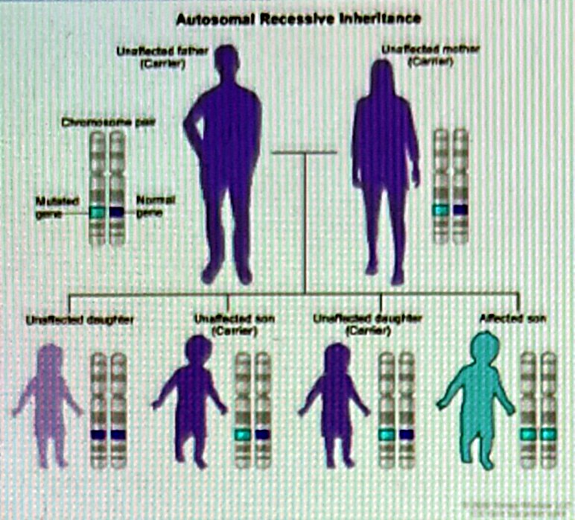
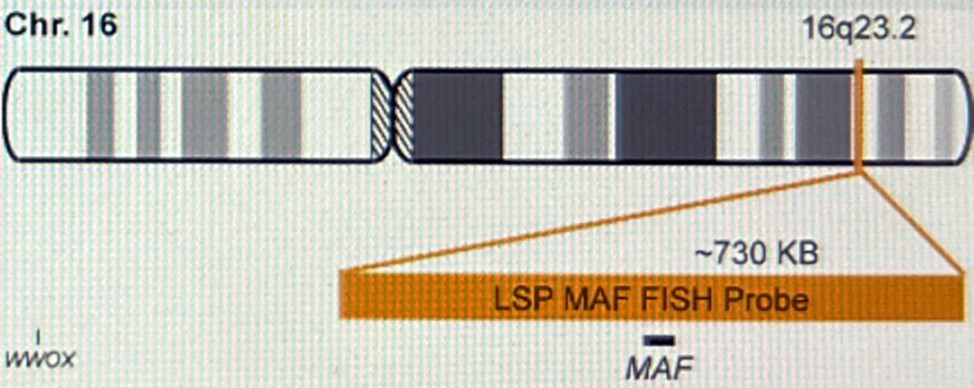
01 · GENETIC ROOT CAUSE
GIANT AXONAL NEUROPATHY
THE ROOT CAUSE
One gene, two broken copies
GENE
GAN — chromosome 16, band 16q23.2
PROTEIN
Gigaxonin — 597 aa, BTB/Kelch family
FUNCTION
Substrate adaptor for a Cul3 E3 ubiquitin ligase
MECHANISM
Loss of function — >100 variants (missense, nonsense, frameshift, deletions)
● Autosomal recessive: disease appears only when both inherited copies of GAN are defective.
● Carrier parents are healthy — one working copy is enough. Each pregnancy carries a 25% risk of an affected child.
● Ultra-rare: prevalence below 1 in 1,000,000; more frequent in consanguineous families.
INHERITANCE PATTERN Two carriers → 1 in 4 affected, 2 in 4 carriers, 1 in 4 unaffected
MUTATION LOCUS Long arm of chromosome 16, band q23.2 — home of the GAN gene
02 / 08
Notes:
GAN is caused by biallelic loss-of-function variants in the GAN gene (16q23.2) encoding gigaxonin, a BTB-Kelch substrate adaptor for the Cul3 E3 ubiquitin ligase. Inheritance is autosomal recessive: carrier parents are unaffected; each pregnancy has a 25% risk. Prevalence is estimated below 1 per million.

Slide 3
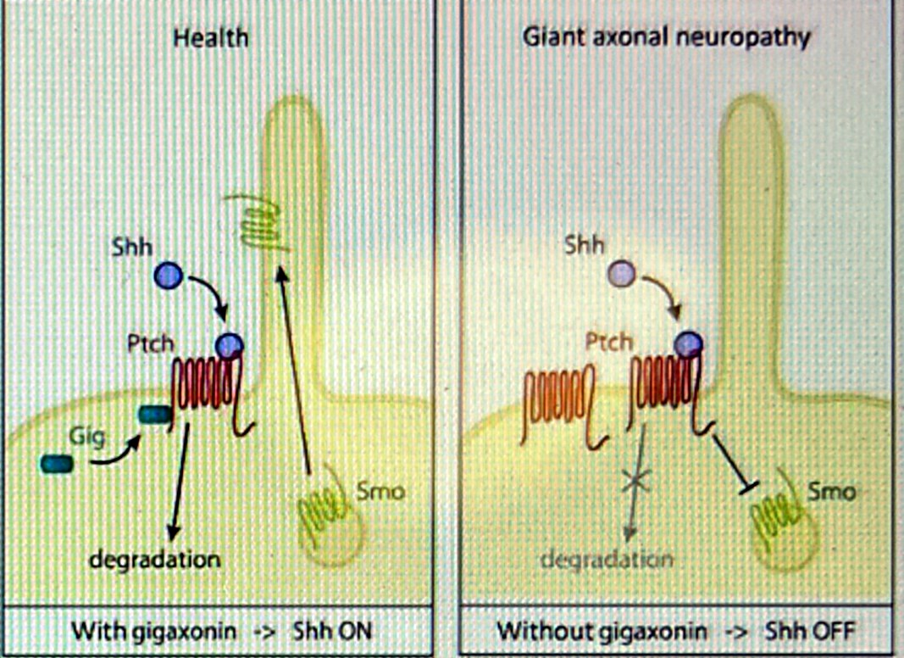
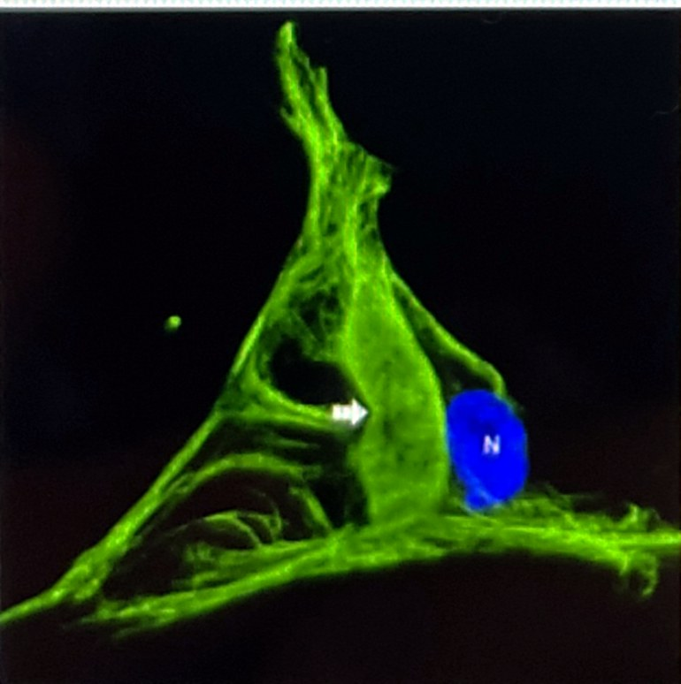
02 · MOLECULAR MECHANISM
GIANT AXONAL NEUROPATHY
WHAT GIGAXONIN DOES — AND WHAT FAILS WITHOUT IT
The cell's filament recycler goes missing
● Normal role: gigaxonin tags intermediate filament (IF) proteins — neurofilaments, vimentin, peripherin, GFAP, keratins — for degradation by the proteasome.
● Without gigaxonin: IFs are never cleared. They pile up into dense, disorganised aggregates that choke axonal transport.
● Second hit — Sonic hedgehog (Shh) signalling: gigaxonin also degrades the receptor Patched (Ptch). When Ptch accumulates, it keeps Smoothened (Smo) switched off, so the Shh pathway — key for neural development and repair — stays OFF.
INTERMEDIATE FILAMENT AGGREGATE Patient cell — the hallmark of gigaxonin loss (arrow), N = nucleus
AFFECTED PATHWAY With gigaxonin → Shh ON · Without gigaxonin → Shh OFF
03 / 08
Notes:
Gigaxonin controls turnover of all intermediate-filament classes. Loss leads to IF aggregation in neurons, glia, fibroblasts and hair. Gigaxonin also mediates degradation of Patched; without it Patched persists and Smoothened remains inhibited, silencing Sonic hedgehog signalling.

Slide 4
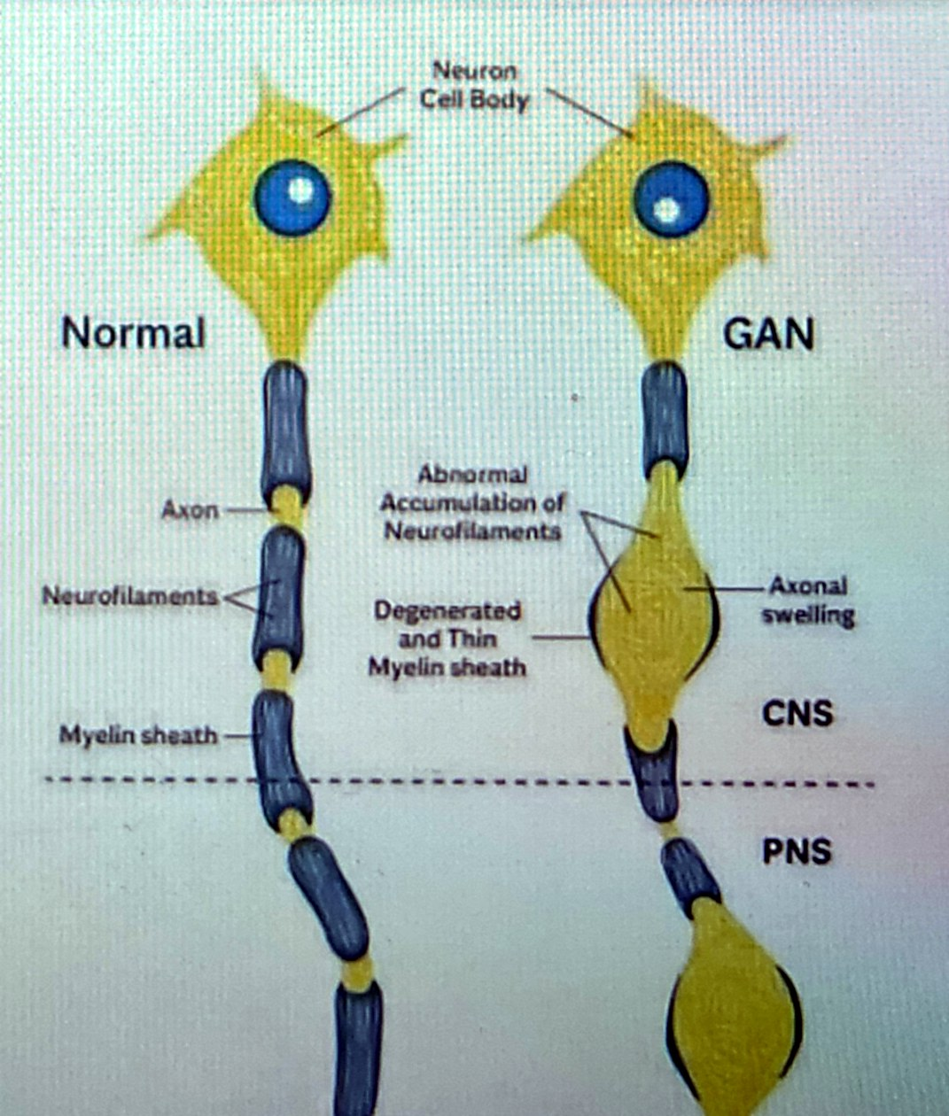
03 · PHENOTYPE
GIANT AXONAL NEUROPATHY
THE PHENOTYPE, CELL BY CELL
Axons that swell into giants
● Focal axonal swellings several times the normal diameter, packed with tangled neurofilaments — the "giant axons" that name the disease.
● Myelin thins and degenerates over each swelling; conduction slows, then fails.
● Both nervous systems are hit: peripheral sensory and motor nerves (PNS) and the cerebellum, brainstem and long white-matter tracts (CNS).
● Not only neurons: astrocytes fill with GFAP aggregates (Rosenthal fibres); disordered keratin filaments give the characteristic tightly curled, "kinky" hair.
3–5×
PNS + CNS
MRI
typical diameter of a swollen "giant" axon vs. a healthy one
a length-dependent axonopathy that later becomes a whole-brain disease
white-matter signal change in cerebellum and brainstem supports diagnosis
NORMAL VS GAN Neurofilament accumulation → axonal swelling → myelin loss, in CNS and PNS
04 / 08
Notes:
Histology: enlarged axons filled with densely packed neurofilaments, thin or absent myelin. Rosenthal fibres (GFAP aggregates in astrocytes) are common. Brain MRI shows cerebellar and brainstem white-matter signal change. Kinky hair reflects keratin IF disorganisation.

Slide 5
04 · SYMPTOMS
GIANT AXONAL NEUROPATHY
SYMPTOMS AND CLINICAL COURSE
A slow, relentless loss — from the feet upward
GAN typically presents in a toddler who walks "clumsily", and progresses over two decades from peripheral weakness to whole-brain involvement.
ONSET · ≈ 3 YEARS
CHILDHOOD · 5–10 YEARS
ADOLESCENCE
EARLY ADULTHOOD
The clumsy walker
Peripheral neuropathy
Central nervous system
Late stage
Unsteady gait, frequent falls, weakness in feet and hands, high-arched feet (pes cavus), diminished reflexes. Tightly curled hair unlike either parent is a visible clue.
Loss of vibration and position sense, absent reflexes, muscle wasting below knees and elbows. Nerve biopsy shows giant axons; genetic testing confirms GAN variants.
Wheelchair dependence, cerebellar ataxia, nystagmus, slurred speech, scoliosis, seizures and cognitive decline as brain white matter degenerates.
Swallowing and breathing muscles weaken; most patients die of respiratory failure in the 2nd–3rd decade. Until 2015 there was no treatment beyond supportive care.
Diagnosis: clinical picture + nerve biopsy (giant axons) + brain MRI + GAN sequencing. Motor decline is tracked with the 32-item Motor Function Measure (MFM-32).
05 / 08
Notes:
Classic GAN begins before age 3 with gait disturbance and distal weakness, evolves into a severe sensorimotor neuropathy, then adds CNS signs (ataxia, nystagmus, dysarthria, seizures, cognitive decline). Most patients are wheelchair-bound in the second decade and die of respiratory failure by the third.

Slide 6
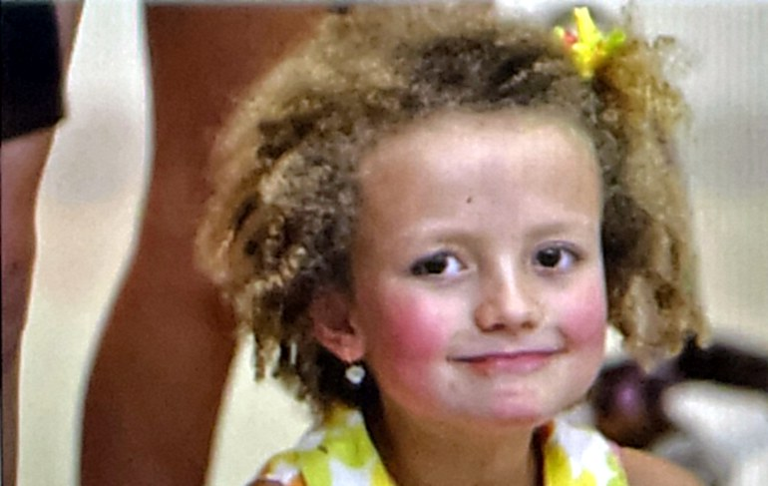
05 · ONE PATIENT
GIANT AXONAL NEUROPATHY
THE CASE THAT CHANGED THE FIELD
"We decided to fight."
● 2007: at age 3 Hannah's walking and balance lag behind; doctors call it growing pains. Nearly a year of tests ends with a GAN diagnosis in March 2008.
● The hardest genotype: two deletion mutations — Hannah makes no gigaxonin at all (CRIM-negative), so her immune system had never "seen" the protein.
● Hannah's Hope Fund is founded within months by parents Lori and Matt Sames. Their first symposium (Boston, Aug 2008) gathers 20 experts, who conclude: gene therapy is the only path fast enough.
● The fund raises >$8 million, pays for all pre-clinical work and a natural-history study, and recruits a young UNC post-doc, Steven Gray, to build the vector.
HANNAH SAMES
Rexford, New York · diagnosed 24 March 2008, aged 4
Hannah's parents found themselves in the unimaginable situation of having funded a clinical trial that might have to exclude their own child.
DNA SCIENCE, JULY 2016
06 / 08
Notes:
Hannah Sames (born 2004, Rexford NY) was diagnosed on 24 March 2008. Her two deletion mutations mean she produces no gigaxonin (CRIM-negative). Lori and Matt Sames founded Hannah's Hope Fund, convened the first GAN symposium in August 2008, raised over $8 million and funded Steven Gray's vector development at UNC.

Slide 7
06 · TREATMENT
GIANT AXONAL NEUROPATHY
THE GENETIC TREATMENT · SCAAV9/JET-GAN
A working gene, delivered into the spinal fluid
The first-in-human trial of an AAV gene therapy given intrathecally — into the cerebrospinal fluid — opened at the NIH Clinical Center in 2015 (NCT02362438, led by Carsten Bönnemann, NINDS).
1
2
3
4
Build the vector
Load the cargo
Single lumbar injection
Restore gigaxonin
scAAV9: a self-complementary adeno-associated virus 9 shell that can enter neurons and spread through spinal cord and brain. It carries no viral genes and does not integrate.
→
A codon-optimised human GAN transgene driven by JeT, a tiny synthetic promoter — small enough to fit the compact self-complementary genome.
→
One dose — up to 3.5 × 10¹⁴ vector genomes — is injected into the CSF by lumbar puncture, bathing motor neurons and dorsal root ganglia directly and bypassing the blood–brain barrier.
→
Transduced neurons begin making gigaxonin within ~2 weeks, clearing filament aggregates and letting damaged sensory nerves regenerate.
May 2015
21 Jul 2016
CRIM-neg
UNC → UTSW
first human ever to receive a therapeutic gene via the spinal fluid — a GAN patient
Hannah, aged 12, treated as the 5th child (≈120 trillion vector genomes)
as the first patient making no gigaxonin, Hannah needed a dedicated immunosuppression protocol
vector designed by Steven Gray in Jude Samulski's UNC Gene Therapy Center, funded by Hannah's Hope Fund
07 / 08
Notes:
scAAV9/JeT-GAN: self-complementary AAV9 capsid, codon-optimised human GAN cDNA, minimal synthetic JeT promoter. Developed by Steven Gray (UNC, now UT Southwestern) with funding from Hannah's Hope Fund. Delivered once by lumbar intrathecal injection at the NIH Clinical Center (NCT02362438, PI Carsten Bönnemann). First patient dosed May 2015; Hannah treated 21 July 2016 at 1.2 × 10^14 vg with an added immunosuppression protocol because she is CRIM-negative.

Slide 8
07 · RESULTS & LEGACY
GIANT AXONAL NEUROPATHY
WHAT THE TRIAL SHOWED — NEJM, MARCH 2024
Bending the curve of an "untreatable" disease
● Not a cure — yet. Damage already done is not reversed, and motor nerves kept declining; benefit is largest when children are treated young and early.
● A template for the field: intrathecal AAV9 delivery pioneered here is now used in trials for many other childhood neurological diseases.
● Next steps: the programme was licensed to industry (Taysha, TSHA-120); Hannah's Hope Fund funds a second injection site and research into treating the autonomic nervous system.
14
1
−7.2 → −1.9
MFM-32 points lost per year before vs. after the 1.8 × 10¹⁴ vg dose (slope slowed by 5.3 points)
children aged 6–14 treated at four dose levels, followed for a median of 68.7 months
serious adverse event (fever) possibly related to treatment; CSF inflammation was managed with steroids
99%
6 / 14
3–48×
posterior probability that motor decline slowed at that dose — above the prespecified 95% bar
regained, stabilised or newly recordable sensory nerve responses 6–24 months after dosing
more regenerating nerve-fibre clusters in sensory-nerve biopsies one year after treatment
One family with no medical background turned a diagnosis into a first-in-human therapy — proof of what patient-driven science can do.
TAKE-HOME MESSAGE
Bharucha-Goebel DX et al. Intrathecal Gene Therapy for Giant Axonal Neuropathy. N Engl J Med 2024;390:1092-1104.
08 / 08
Notes:
Bharucha-Goebel et al., NEJM 2024: 14 children, doses 3.5×10^13 to 3.5×10^14 vg, median follow-up 68.7 months. One serious adverse event possibly related (fever). Pre-treatment MFM-32 slope −7.17 points/year; at 1.8×10^14 vg the slope improved by 5.32 points (99% posterior probability of slowing, above the 95% threshold). Sensory nerve action potentials recovered or stabilised in 6 of 14; nerve biopsies showed 3–48× more regenerating clusters. Two older low-dose participants died of disease-related events. The programme was licensed to Taysha (TSHA-120).

