Slide 1
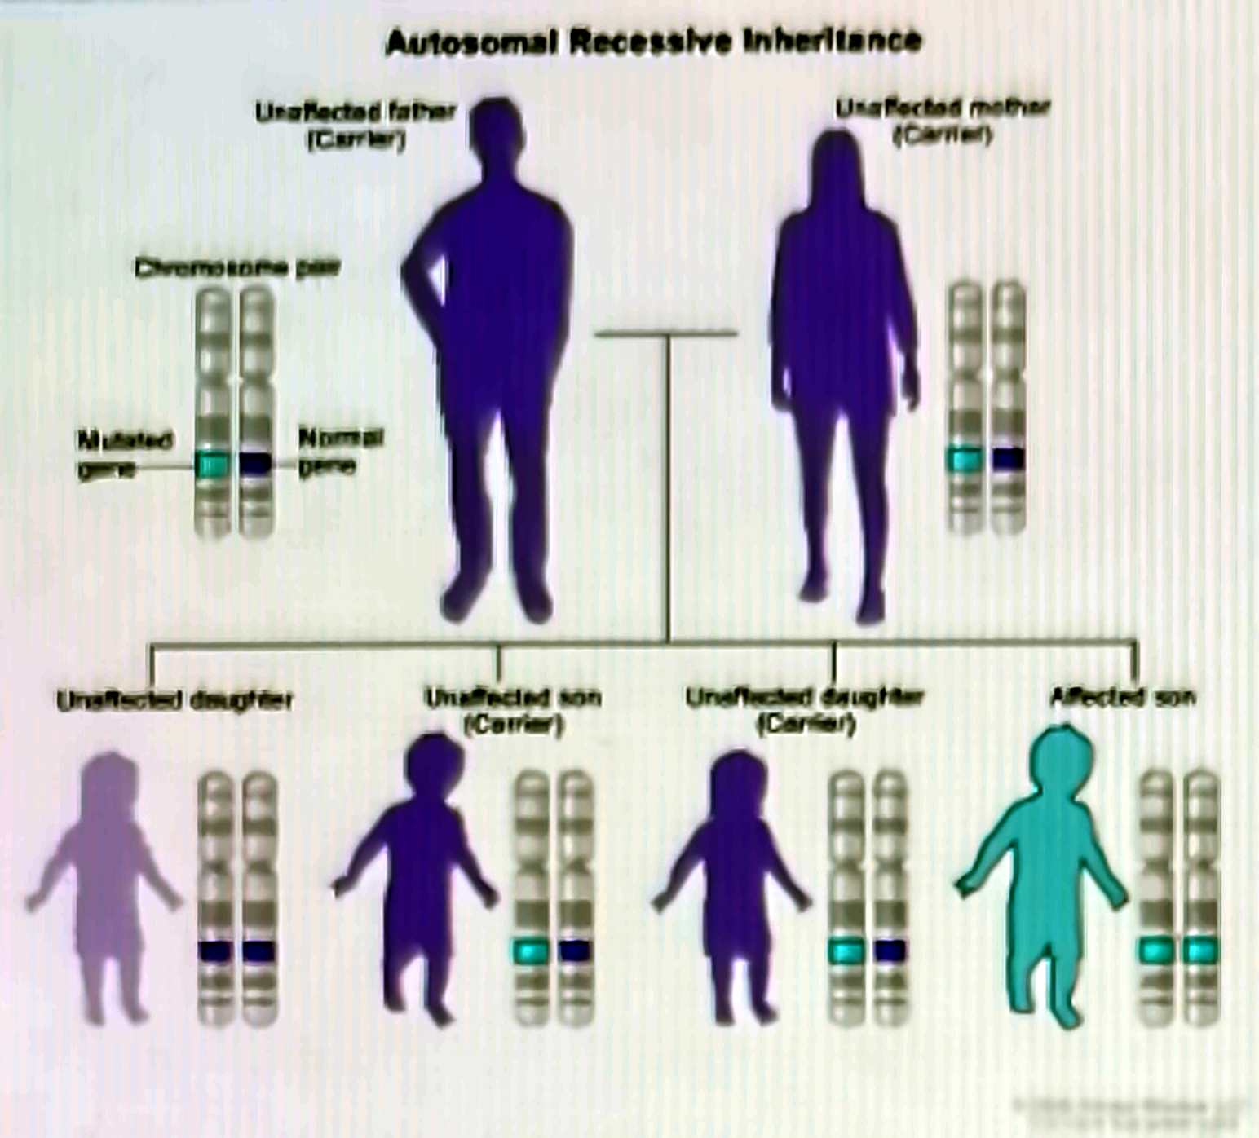
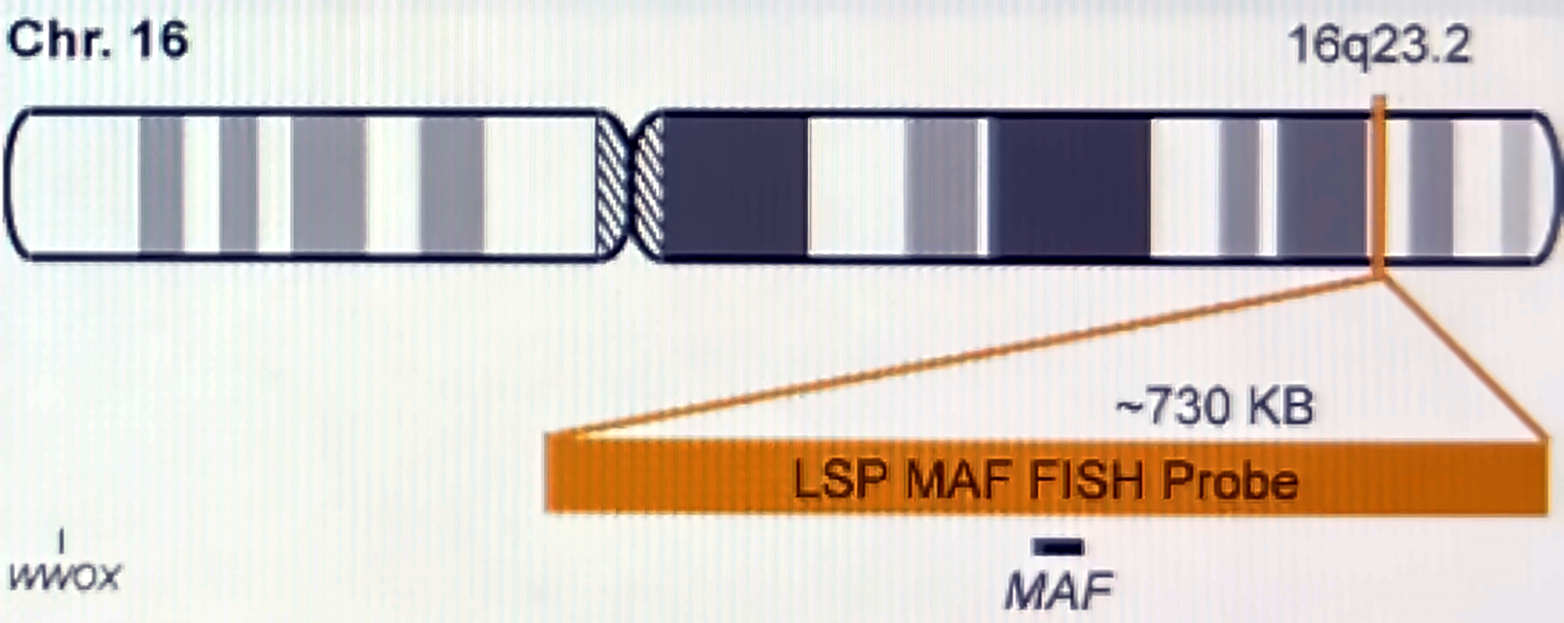






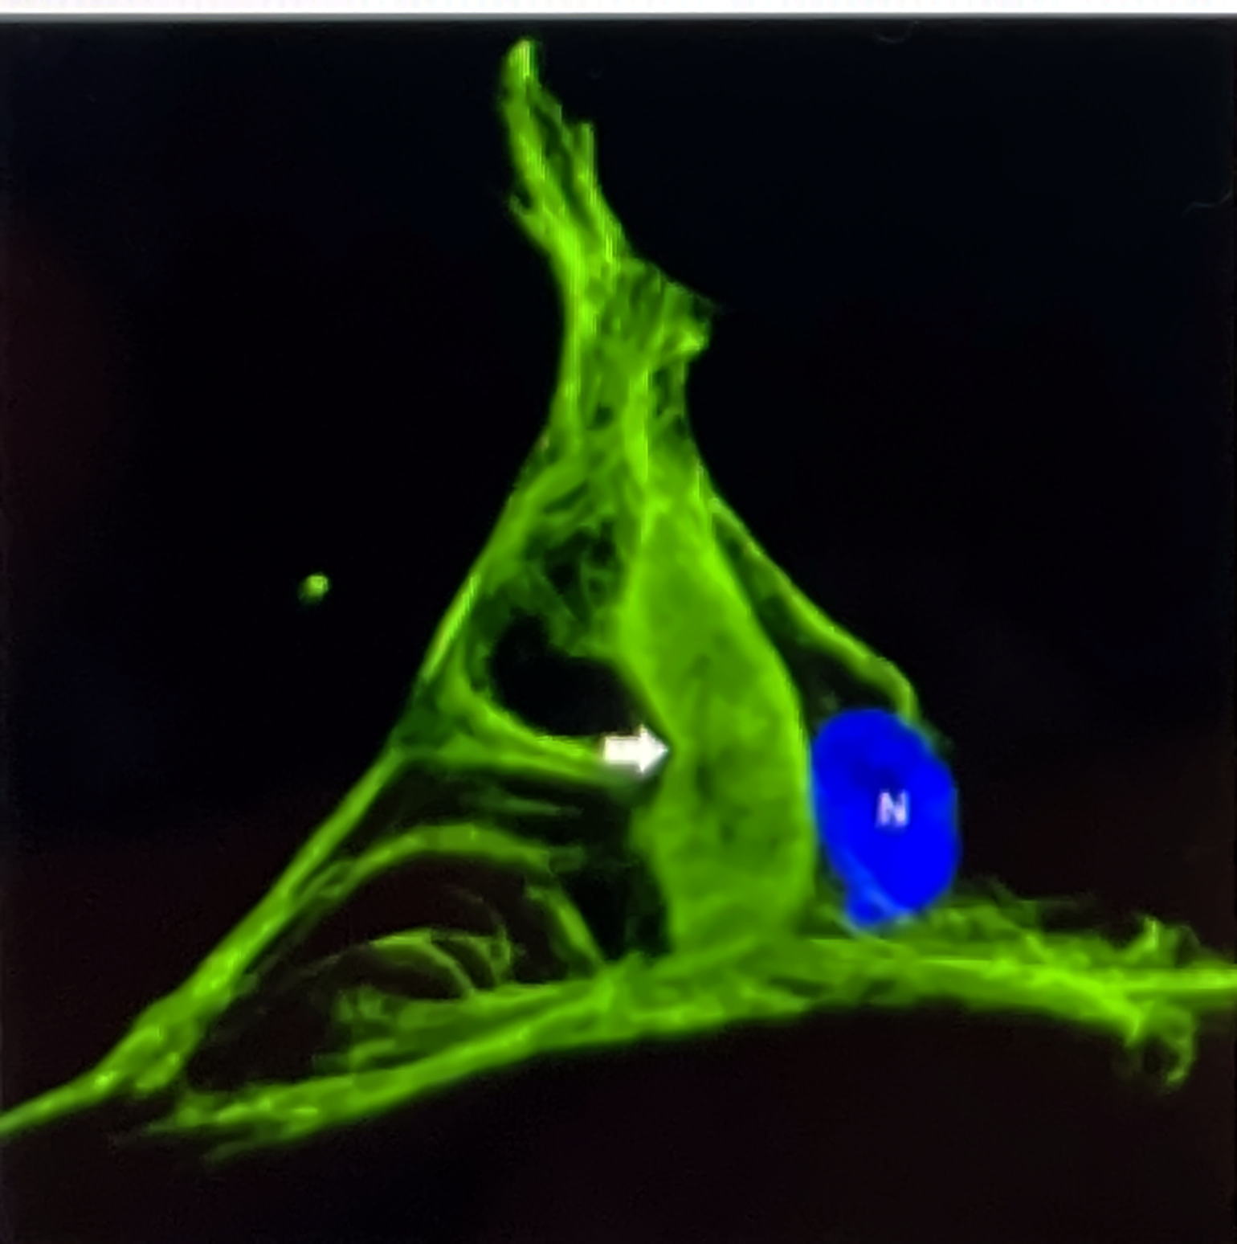
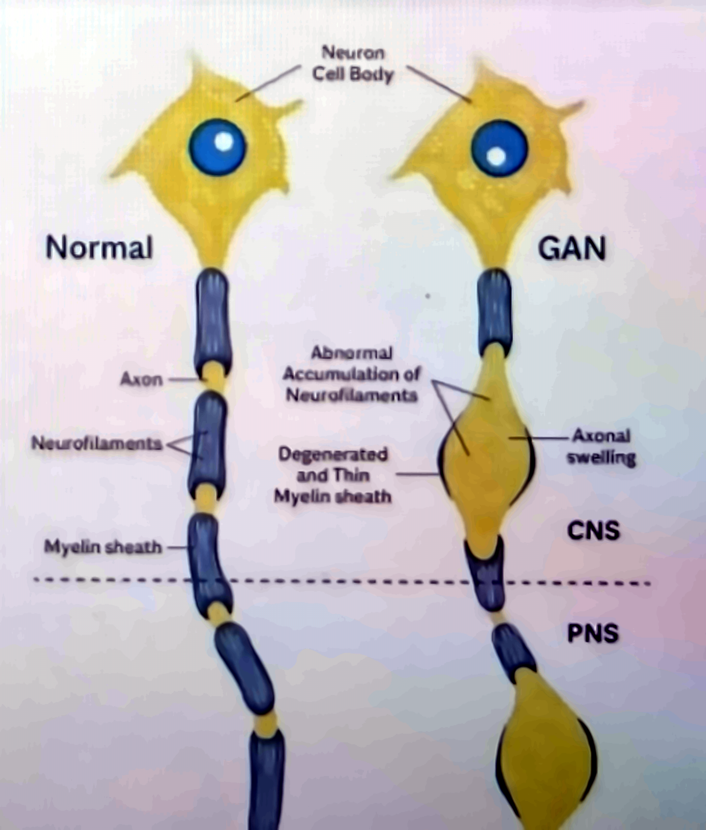




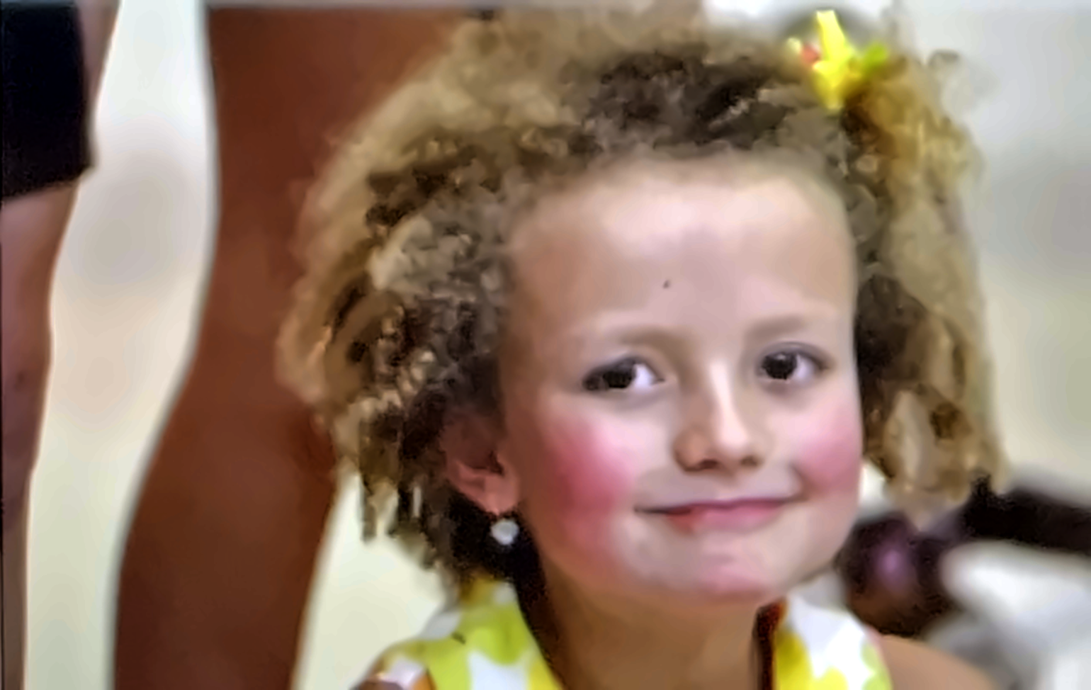




RARE NEUROGENETIC DISEASE · OMIM #256850
Giant Axonal Neuropathy
From a missing protein to the first gene therapy delivered into the spinal fluid.
GENE: GAN
CHROMOSOME 16Q23.2
AUTOSOMAL RECESSIVE
ONSET ≈ 3 YEARS
< 1 IN 1,000,000
1
THE GENETIC ROOT CAUSE
One gene, two broken copies
GENE
PROTEIN
VARIANTS
GAN
Gigaxonin
> 100
chromosome 16 · band q23.2
597 aa · BTB / Kelch family
all loss-of-function
MUTATION LOCUS Long arm of chromosome 16, band q23.2
TWO HEALTHY CARRIERS each child: 1 in 4 affected · 2 in 4 carriers · 1 in 4 unaffected
2
THE GIGAXONIN PATHWAY — HOW ONE MISSING PROTEIN DAMAGES THE NERVE
The cell's filament recycler goes missing
1
›
2
›
3
›
4
›
5
›
6
GAN mutated
No gigaxonin
Filaments not tagged
Aggregates pile up
Axon swells
Signal fails
Both copies carry a loss-of-function variant
The adaptor of the Cul3 E3 ubiquitin ligase is absent
Neurofilaments, vimentin, GFAP and keratin are never ubiquitinated
The proteasome cannot clear them; dense tangles form
Focal "giant" swellings; myelin thins over them
Transport and conduction break down in nerves and brain
3–5×
diameter of a swollen "giant" axon compared with a healthy one
PNS + CNS
peripheral nerves first, then cerebellum, brainstem and white matter
Curly hair
disordered keratin filaments — a visible clue at diagnosis
STEP 4 Intermediate-filament aggregate in a patient cell — the hallmark of gigaxonin loss
STEP 5 Normal vs GAN neuron: accumulation → swelling → myelin loss
3
SYMPTOMS AND CLINICAL COURSE
A slow loss — from the feet upward
≈ 3 YEARS
5–10 YEARS
ADOLESCENCE
20S
Clumsy walker
Peripheral nerves
Brain involved
Late stage
● Unsteady gait, falls
● Weak feet, high arches
● Tightly curled hair
● Lost reflexes and sensation
● Muscle wasting
● Biopsy: giant axons
● Wheelchair, ataxia
● Slurred speech, nystagmus
● Scoliosis, seizures
● Swallowing, breathing fail
● Respiratory failure
● No treatment until 2015
4
THE CASE THAT CHANGED THE FIELD
"We decided to fight."
2008
2008
$8 M+
Diagnosed at 4
Hannah's Hope Fund
Raised for a cure
Two deletions — Hannah makes no gigaxonin at all
Founded by her parents; first GAN symposium the same year
Funds Steven Gray (UNC) to build the gene-therapy vector
HANNAH SAMES
Rexford, New York
5
THE GENETIC TREATMENT · SCAAV9/JET-GAN · NIH CLINICAL CENTER · NCT02362438
A working gene, delivered into the spinal fluid
1
Build the vector
2
Load the gene
3
One lumbar injection
4
Gigaxonin restored
scAAV9 shell: enters neurons, spreads through cord and brain
→
Healthy human GAN gene with a tiny JeT promoter
→
Into the CSF — bypassing the blood–brain barrier
→
Neurons clear aggregates; sensory nerves regenerate
May 2015
21 July 2016
1 dose
first person ever to receive a therapeutic gene through the spinal fluid
Hannah, aged 12, becomes the 5th child treated
up to 3.5 × 10¹⁴ vector genomes, given once
6
WHAT THE TRIAL SHOWED — NEJM, MARCH 2024
Bending the curve of an "untreatable" disease
Not a cure yet — but the first proof that an "untreatable" childhood neuropathy can be slowed.
14
99%
6 / 14
1
children treated, followed ≈ 6 years
probability motor decline slowed at the best dose
regained or stabilised sensory nerve responses
serious adverse event, managed with steroids
Sources: Bharucha-Goebel DX et al. Intrathecal Gene Therapy for Giant Axonal Neuropathy. N Engl J Med 2024;390:1092-1104 · ClinicalTrials.gov NCT02362438 · NIH News, March 2024 · Hannah's Hope Fund · The Children's Inn at NIH, "Hannah's Story" · DNA Science (PLOS), July 2016. Figures adapted from the source poster.
Giant Axonal Neuropathy
FROM GENE TO GENE THERAPY

