Slide 1
Communication
20151030

Slide 2
Contents
Framework
Inverse Knematics
PID
Git

Slide 3
Miracle Framework

Slide 4
UT Framework

Slide 5
HftcEngine FrameWork

Slide 6
Thread
Wordmodel
Action
How To Build A New Framework?
Agentmodel
Strategy
Skill

Slide 8
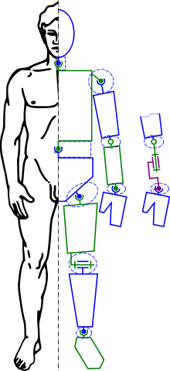
Inverse Knematics
There are many methods of modelling and solving inverse kinematics problems.
The most flexible of these methods typically rely on iterative optimization to seek out an approximate solution, due to the difficulty of inverting the forward kinematics equation and the possibility of an empty solution space.
The core idea behind several of these methods is to model the forward kinematics equation using a Taylor series expansion, which can be simpler to invert and solve than the original system

Slide 9
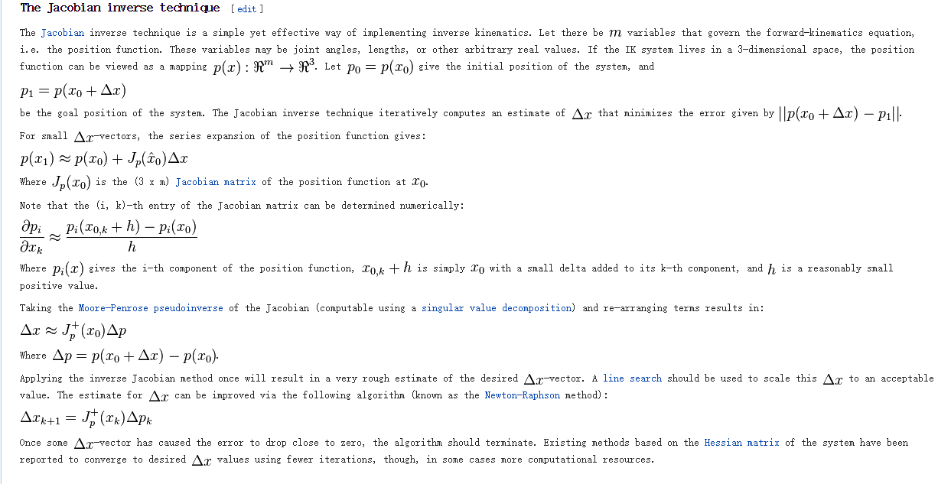
Approximating solutions to IK systems

Slide 10
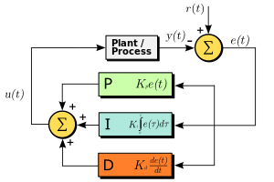

PID
Proportional gain, a tuning parameter
Integral gain, a tuning parameter
Derivative gain, a tuning parameter
Error
Time or instantaneous time (the present)
Variable of integration; takes on values from time 0 to the present .

Slide 11
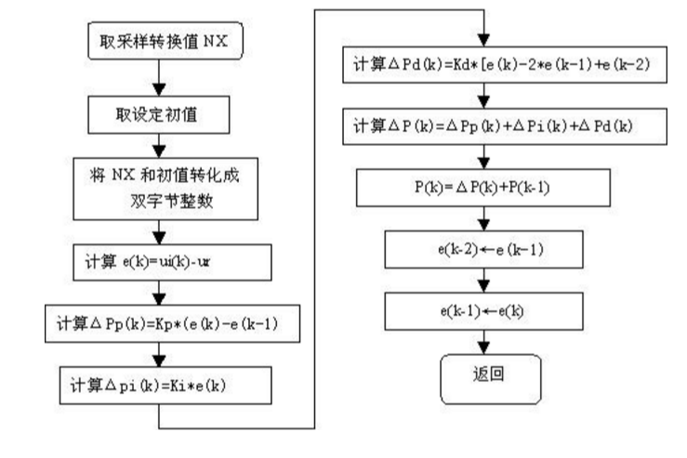

Slide 12
proportional-integral-derivative controller
http://cn.mathworks.com/discovery/pid-control.html

Slide 13
Git—CVS Softeware
git init
git clone
git add readme
git commit –m “xaushciusa”
git push
git rm
.gitingore
GitHub
apt-get install git

Slide 14
Question
多个模型的动作设计？
多协作策略？COLLADA
进程之间的通信？

Slide 15
Action Angle
PID 比例积分微分控制
Genetic Algorithm 遗传算法
入口 （未实现某个状态）
出口（某个状态）
SVM 核基函数
（或者SOM，在给出训练集之后可以得到优化的参数）

Slide 16
Other
PyODE swig c++
openRAVE
Other ODE
Matlab Robotic Model

Slide 17
遗传算法的缺点：
手动控制的遗传进化率
（）免疫算法：

Slide 18
叶剑桥
SOM
MATLAB

