Slide 1

Pandemic Containment Model Application Engineer &amp; Dev - INFO5100
Team BFC:
Prajwal Mylar Pramod Pai Nityashree Vijaykumar

Slide 2
What does it mean to live during pandemic
Without a natural immunity to fight off an illness, many people can become sick as it spreads
Limited access to food and supply
Limited access to hospitals and other basic medical needs
Shutting down borders, building walls, canceling all air travel
Cancellations of mass events, closures, adopting remote work and remote education
Negative impacts on economy
quarantining entire nations indefinitely
In absence of vaccine, number of people getting infected rises drastically
More demand on healthcare system, and the system becomes overloaded

Slide 3
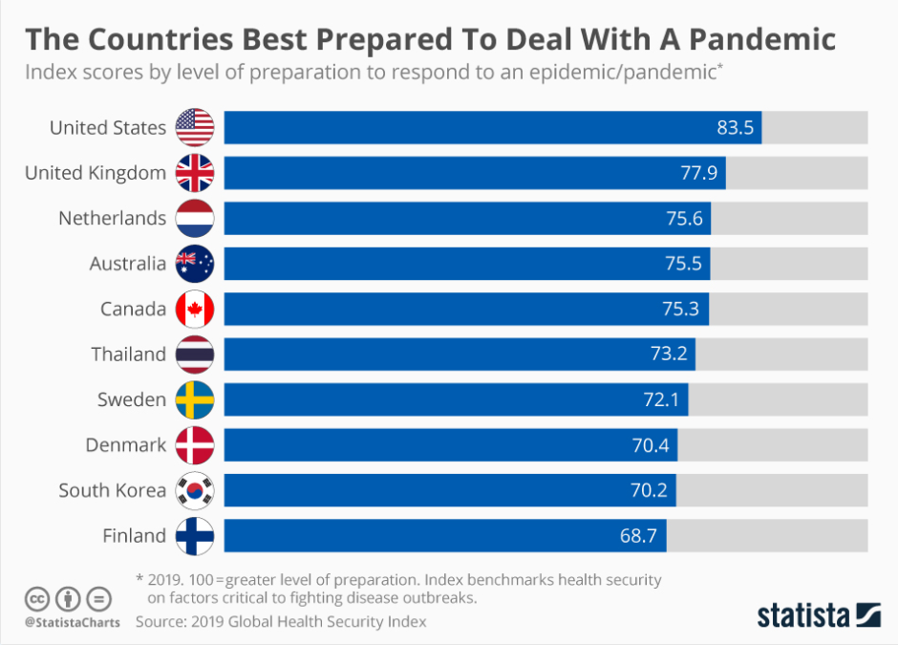
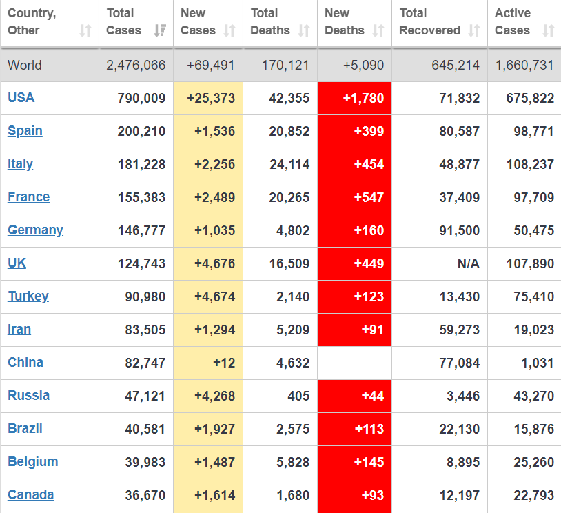
2019- level of Pandemic preparation chart
2020- Pandemic cases chart(COVID-19)

Slide 4
What can we DO to mitigate this situation?
Pandemic Containment
Proportional Food Supply
Isolating the sick
Contact Tracing
Providing basic medical help
Social Distancing
Access to Medicine
Develop, design and deploy a multi-party organization that helps in achieving the below:
Provides isolation facility for the ones showing symptoms
Helps civilian access to other medical needs without getting in contact with the sick
Helps healthcare system to stock up the requirements
Makes sure the food supply is proportionally rationed and delivered to each family
Tracks down everyone who were in contact with the infected

Slide 5
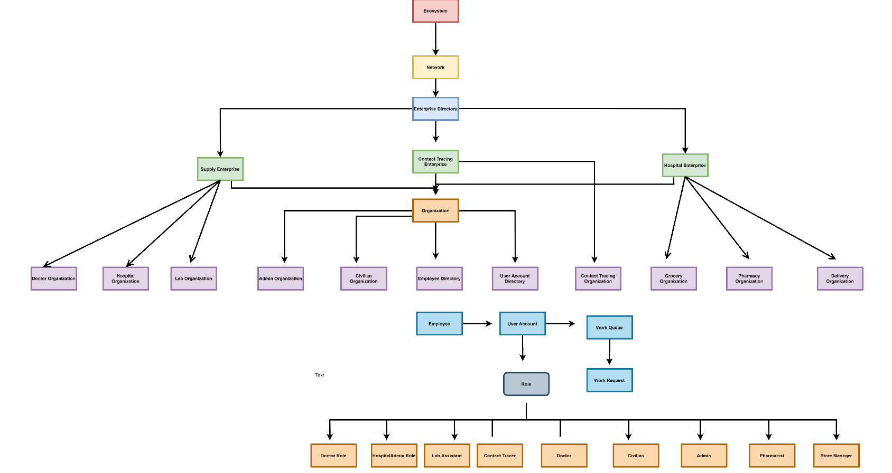
ECOSYSTEM architecture

Slide 6
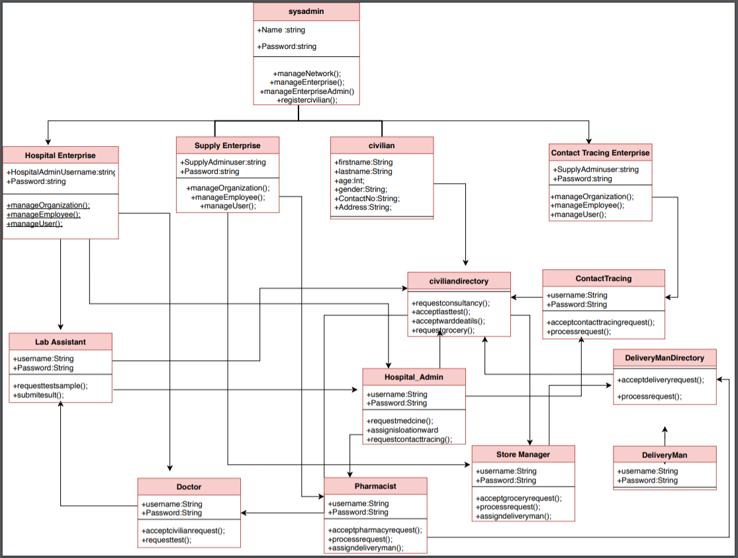
UML Diagram

Slide 7
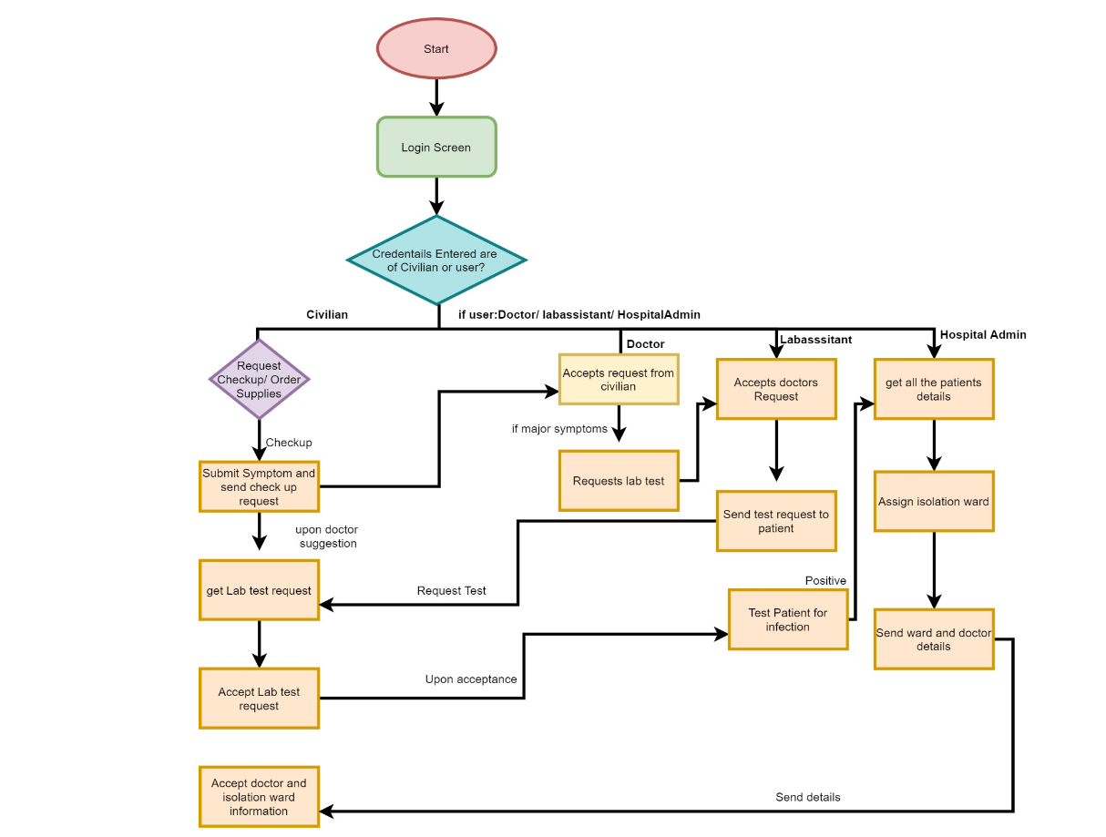
Work Flow
The workflow here explains how a civilian showing symptom logs into the system and requests for the check up and effective resolution by doctor, lab assistant and hospital admin
The same way of work flow is applicable to all requests between organizations and users

Slide 8


