Slide 1
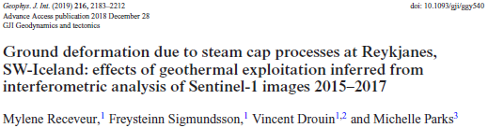

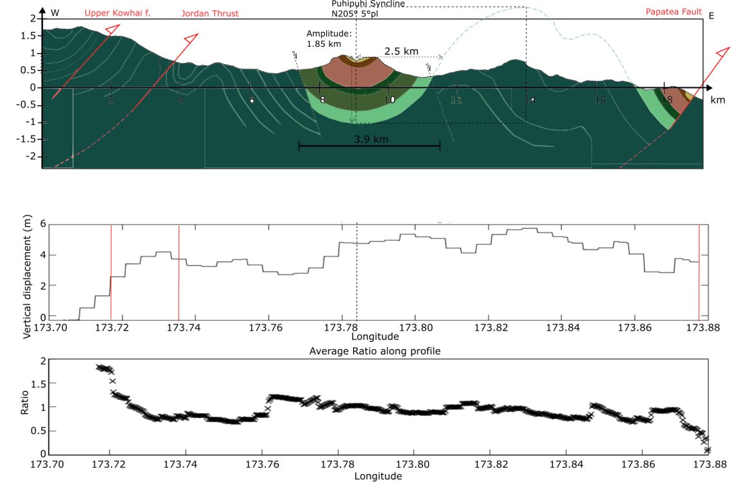
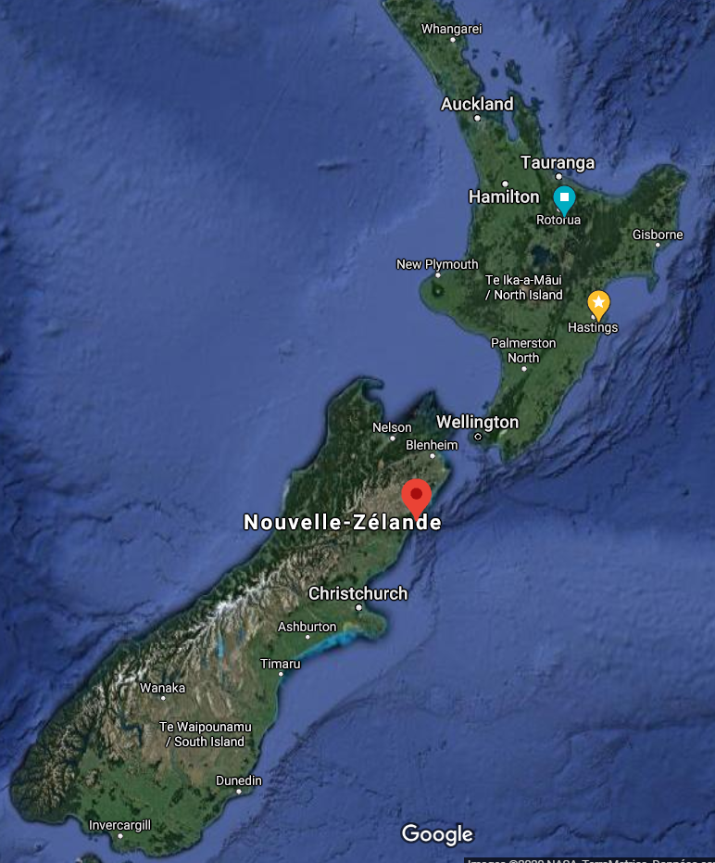
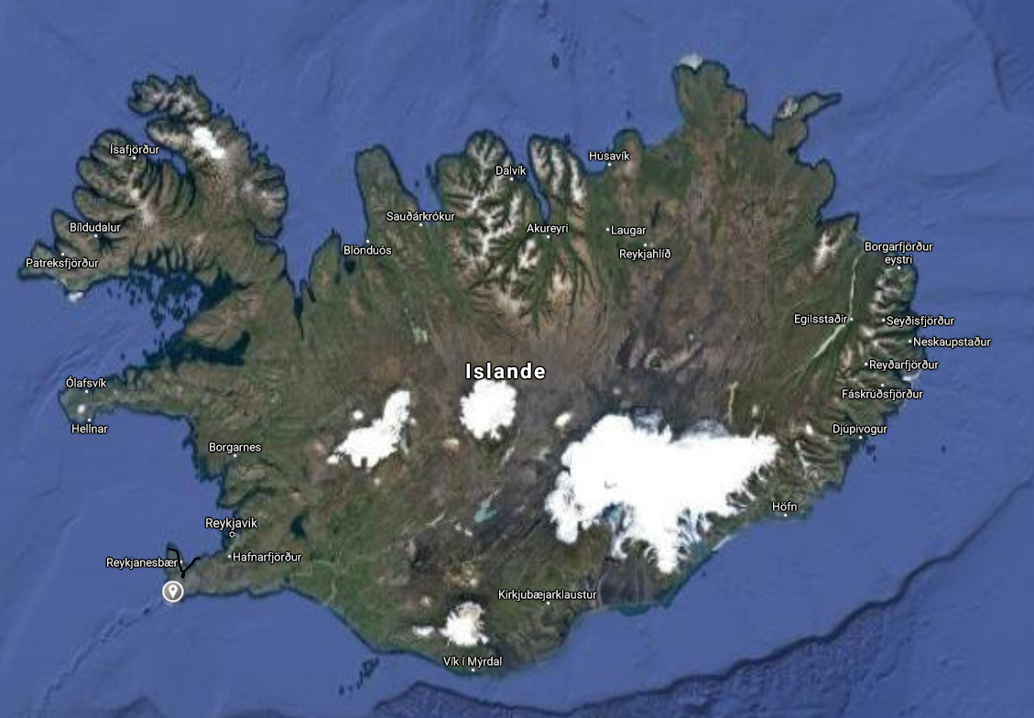
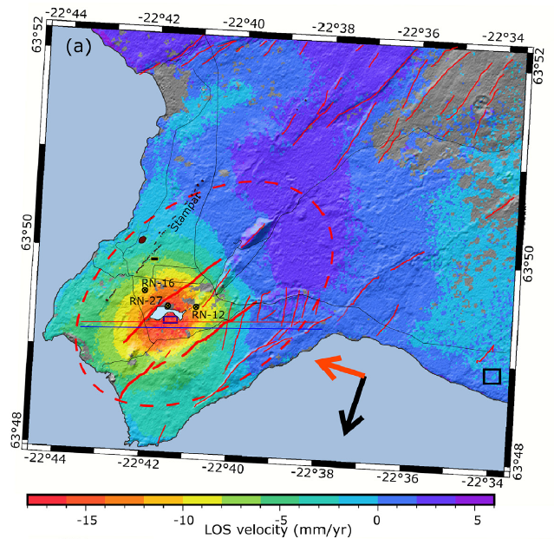

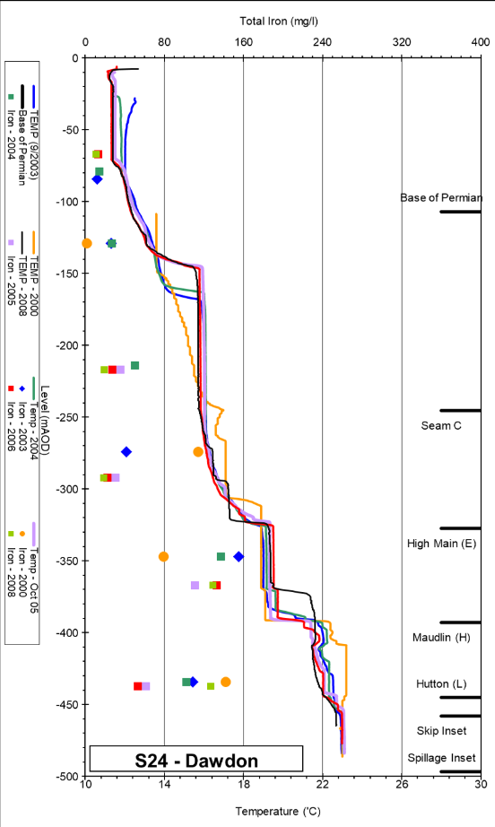
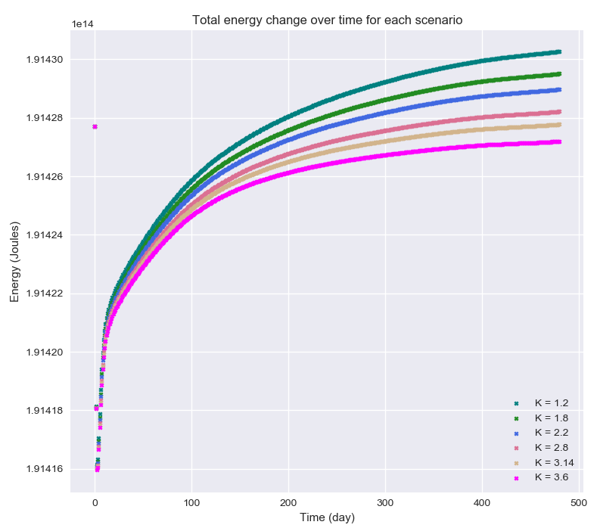

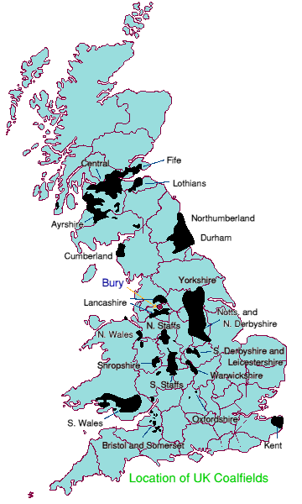
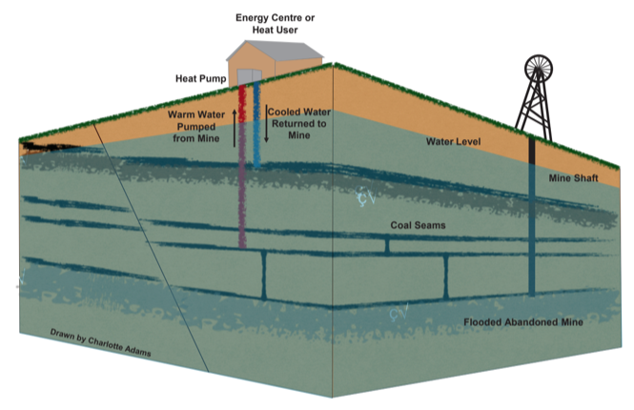
© Coal Authority
Notes:
UK target to reach net-zero by 2050 → needs to find low carbon heat sources. Coal mines a good solution as it contains warm water than could be used for domestic water and space heating, and is available everywhere (25% of the UK populatio lives in former mining areas)
Recent studies showed that their was no clear correlation between depth and temperature of mine water(For a same depth, large range of temperature measured in coalfield ). But understand the temperature distribution in mines is essential to understand its long-term heat potential.
The aim of my PhD is therefore to identify:
What are the key controls on MW temperature: the heat sources and heat recharge mechanisms, if not only the gradient?
What are the key mine features to consider to built representative hydrogeological and heat flow mine model (i.e. fracture zone, interconnectivity of workings and mines, type of workings)?
What is the effect of past mining activities, residence time of water and pumping on the temperature gradient?
To answers these questions, I am using numerical modeling. The idea is to assess the impact of different parameters (geometries, rock properties), on the temperature profiles (using available data from the coal authority) and the energy change in the model. I started to do this using simple 2D models.

