Slide 1
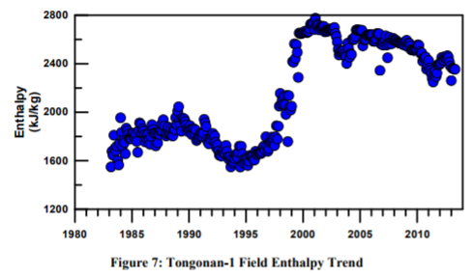
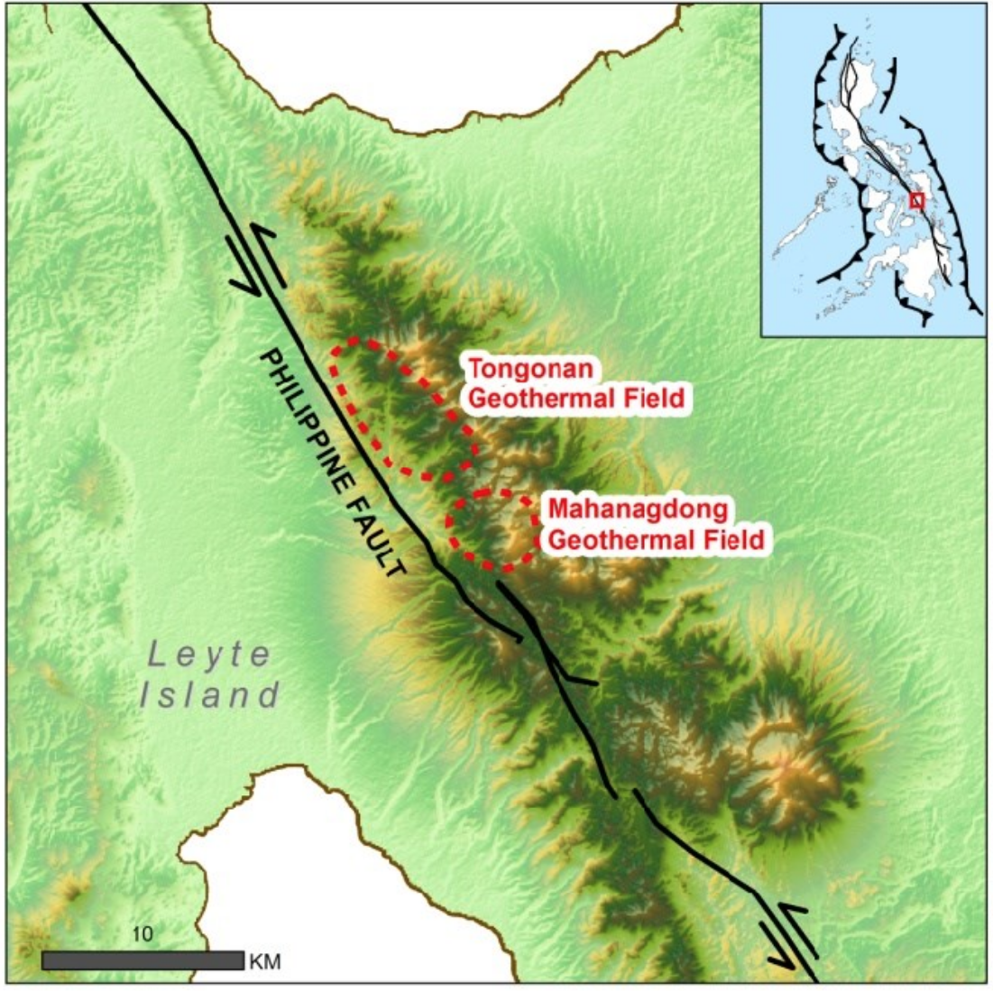
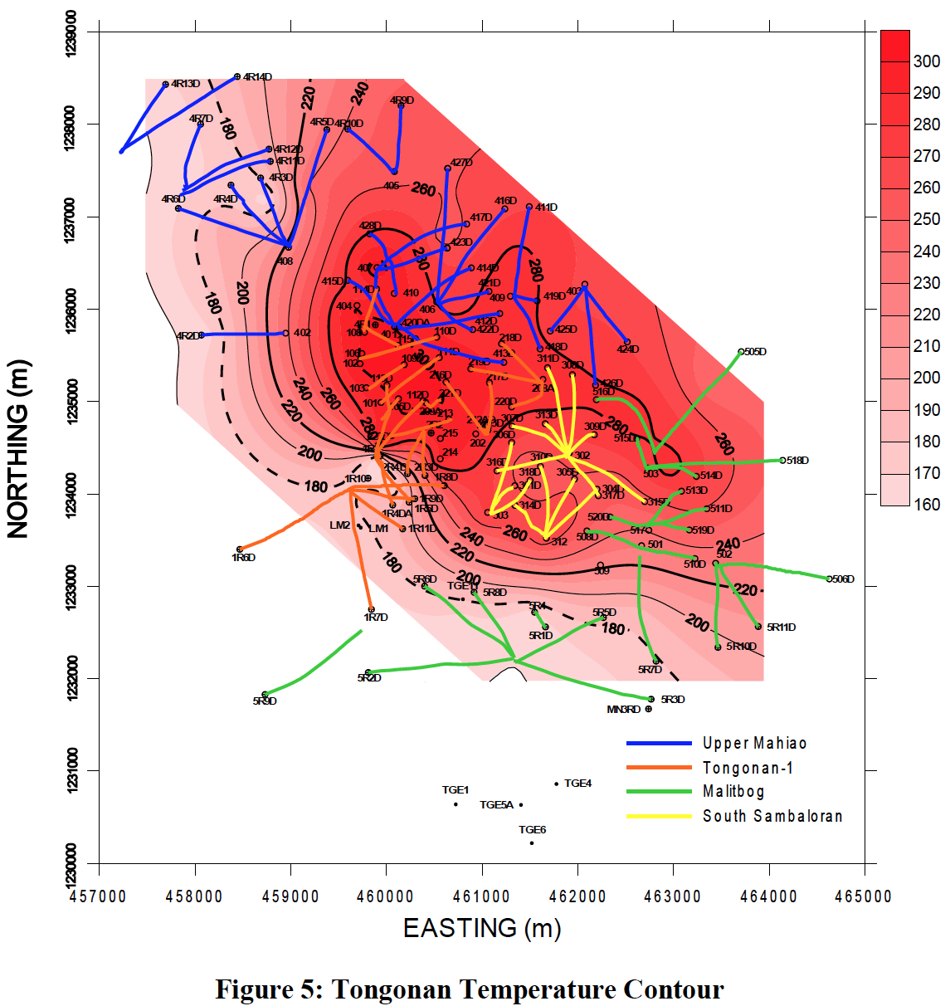
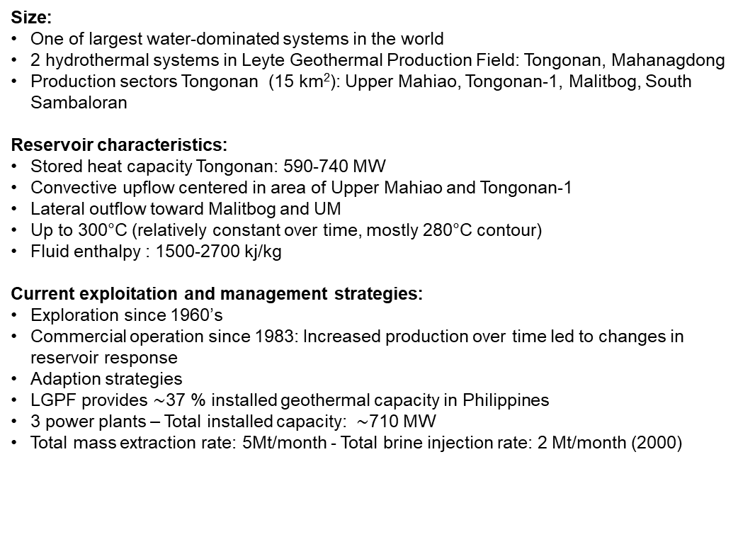
Tongonan geothermal reservoir, Philippines Di Rienzo D.I., Dirscherl M., Preine J., Receveur M., Repczynska M.M.
Location:
In central highlands of Leyte province/island (Eastern Visayas region)
Geological Setting:
Within tectonically active Philippine Mobile Belt
Eastern bound: Philippine Trench
Western bound: Manila Trench, Negros Trench, Cotabato Trench
Philippine Fault Zone (NW-SE)
Hosted by andesitic volcano-sedimentary units intruded by microdioritic dykes
Size:
One of largest water-dominated systems in the world
2 hydrothermal systems in Leyte Geothermal Production Field: Tongonan, Mahanagdong
Production sectors Tongonan (15 km²): Upper Mahiao, Tongonan-1, Malitbog, South Sambaloran
Reservoir characteristics:
Stored heat capacity Tongonan: 590-740 MW
Convective upflow centered in area of Upper Mahiao and Tongonan-1
Lateral outflow toward Malitbog and UM
Up to 300°C (relatively constant over time, mostly 280°C contour)
Fluid enthalpy : 1500-2700 kj/kg
Current exploitation and management strategies:
Exploration since 1960’s
Commercial operation since 1983: Increased production over time led to changes in reservoir response
Adaption strategies
LGPF provides $\sim$37 % installed geothermal capacity in Philippines
3 power plants – Total installed capacity: $\sim$710 MW
Total mass extraction rate: 5Mt/month - Total brine injection rate: 2 Mt/month (2000)
References: Uribe et al., 2015; Dacillo et al., 2010; Ana et al., 1999; Austria et al., 2015; Mismanos and Vasquez, 2015.
Notes:
changes in reservoir respond (e.g. pressure , -> increased discharge enthalpie,s boiling central production field -> two-phase regions (steam), cooler water inflow)
(Subduction Philippine Sea Plate under PMB)
(Subduction Sunda Plate under PMB))
New strategies developed (e.g. interconnection steam lines, well workovers, steam production)

