Slide 1
Investigating geothermal heat resources of legacy mine workings, why are some mine waters hotter than others?
Mylene Receveur
Christopher McDermott, Stuart Gilfillan, Andrew Fraser-Harris

Slide 2
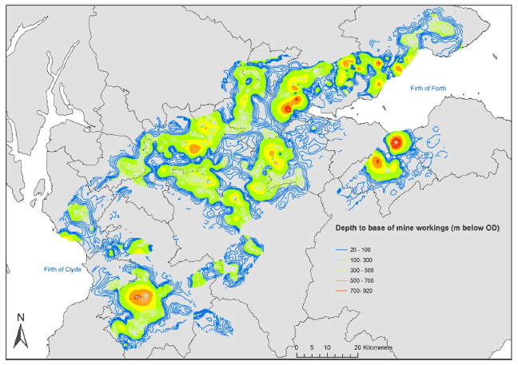
Study background
Introduction
Methods
Objectives
Conclusion
Summary
XXX % of UK population located above abandonned coal mines
Low-temperature geothermal resource (Temperature ranges from 12 to 20 °C)
Heat demand = >1/3 of energy consumption in the UK
7% of Scotland’s heat requirement could be sourced from abandoned flooded mine workings (Todd et al., 2019)
Can contribute to decarbonization of residential heat
Figure 16. Depth of mine workings viewed in GOCAD ® (©Paradigm) 3D modelling software, showing deepest workings in orange and red (Gillespie et al., 2013)

Slide 3
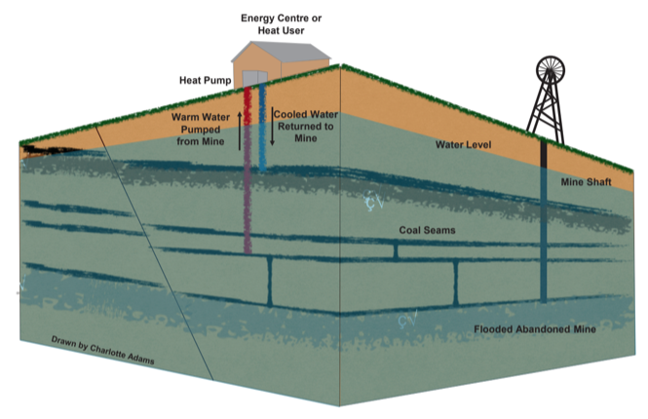
Mine-water Heat: Resource definition
Introduction
Methods
Objectives
Conclusion
Summary
Mine gets flooded when mining stops
Warm water can be extracted at high rates from enhanced-permeability reservoirs
GSHP used to extract heat from the ground or from the water using open-loop systems.
Injection/production of cold/hot water can be reversed seasonally
Existing case study: Germany, Canada, USA, UK (Shettleston, Dawdon, Markham), Poland, The Netherlands, Spain
Figure 11: Schematic Diagram of a mine water heat pump system (Drawn by Charlotte Adams)

Slide 4
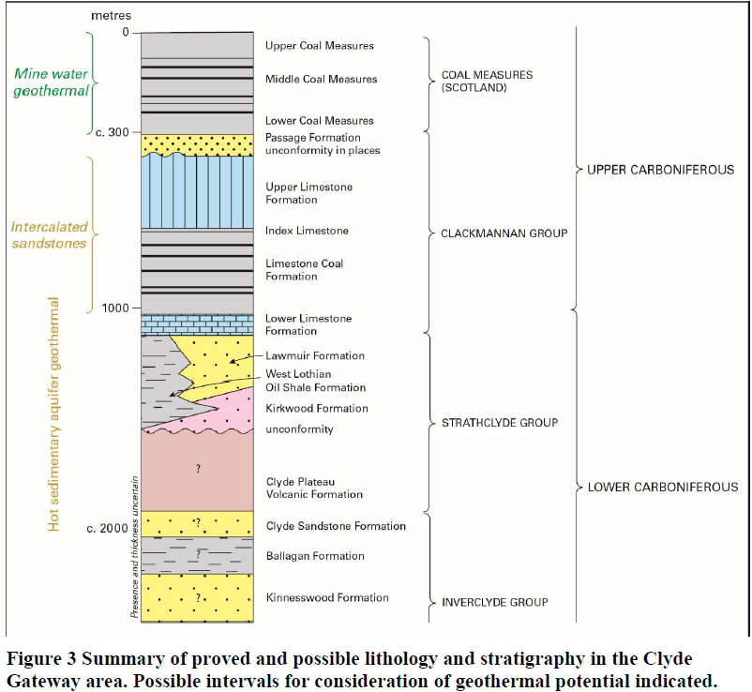
Mine-water Heat: Resource definition
Introduction
Methods
Objectives
Conclusion
Summary
Coal Measures
Limestone Coal formation

Slide 5
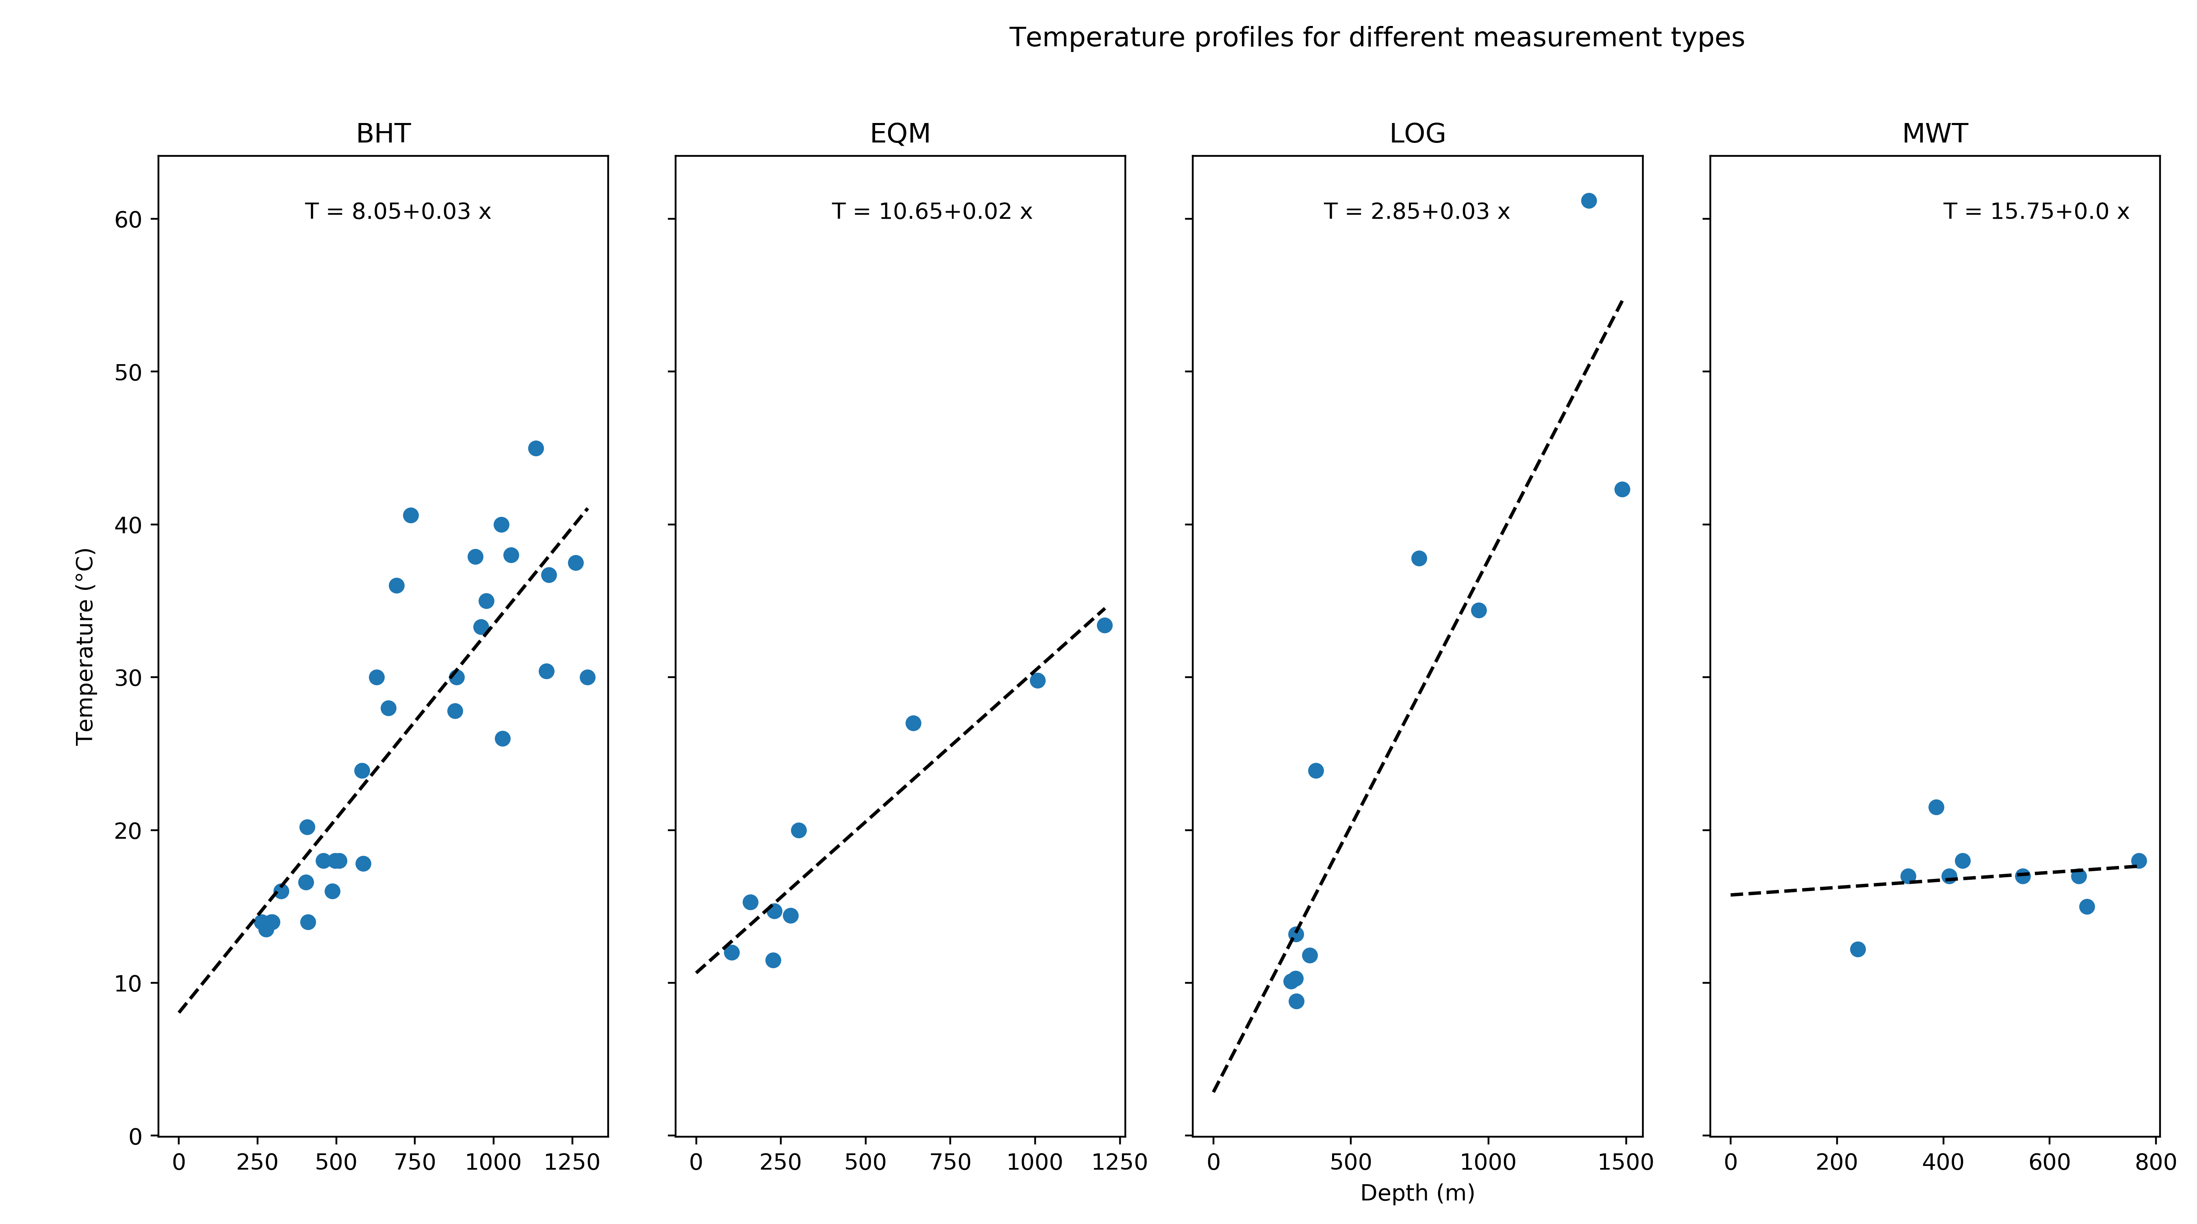
Research question
Introduction
Methods
Objectives
Conclusion
Summary
What are the main control on mine water temperature ?
Necessary to evaluate the geothermal potential of coal mines.
Notes:
Poor understanding of the origin of heat in mines: issue to evaluate the geothermal potential
No clear correlation of temperature with depth (Gillespie et al., 2013)
Extracting water can induce inflow of recharge water (from infiltration, lateral aquifers), or re-injection can be performed.
Need to know what are the heat recharge mechanisms, the rate heat recovery and the area impacted by heat extraction, to ensure sustainable production

Slide 6
Summary
Introduction
Methods
Objectives
Conclusion
Summary
Research objectives
Methods
Literature review
Suggested methodology
Conclusion
Expected results

Slide 7
Introduction
Methods
Objectives
Conclusion
Summary
Determine the main heat sources and heat transfer mechanisms in flooded coal mines
What is the heat recovery rate?
Assess the important geometrical features in mine plans.
How can representative simplification of mine plans be made?
Evaluate the footprint area of heat extraction
What is the geothermal potential of mines?
Can a sustainable heat extraction rate be maintained?

Slide 8
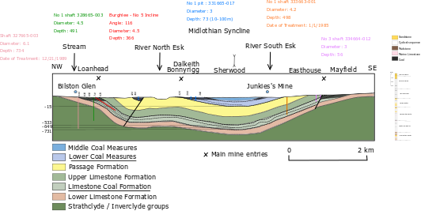
Introduction
Methods
Objectives
Conclusion
Summary
Numerical modelling using OpenGeosys
2 Case study
Notes:
The research will involve numerical modelling of mines, calibrated and validated using real data from 2 different areas:
Bilston Glen in Scotland
Dawdon in NE England
Difficulty in mine systems (which differs from usual aquifers) is the necessity to solve for water, heat and mass transport in a system composed of a porous media (Darcy flow) and open void (pipe flow) that can lead to numerical instability.

Slide 9
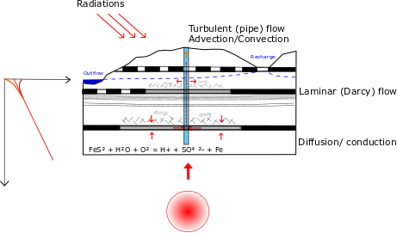
Objective 1
Introduction
Methods
Objectives
Conclusion
Summary
Determine the main heat sources and heat transfer mechanisms in flooded coal mines
What is the heat recovery rate?
Assess the important geometrical features in mine plans.
How can representative simplification of mine plans be made?
Evaluate the footprint area of heat extraction
What is the geothermal potential of mines?
Can a sustainable heat extraction rate be maintained?

Slide 10
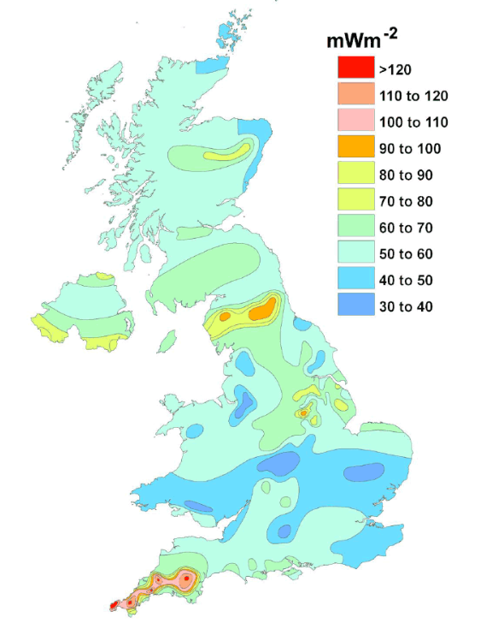
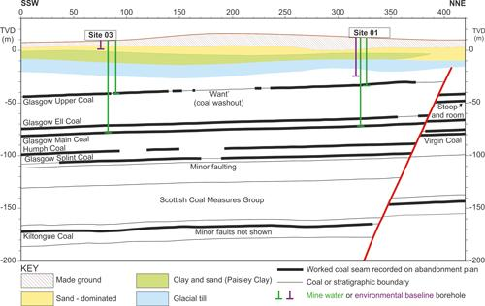

Objective 1
Introduction
Methods
Objectives
Conclusion
Summary
Potential source of heat
natural heat flow
local heat generation
solar influx
groundwater flow
geological structure
Extent/connectivity of mine workings
$${FeS}_{2}+\frac{7}{2}O_{2}+H_{2}O→{Fe}^{2+}+2 {SO}_{4}^{2−} {2H}^{+}$$
Notes:
Local heat generation : radiactive decay, pyrite oxidation
Groundwater flow = convective flux
geological structure: geological formation with specific material, thermal and hydraulic properties; geological disturbances (i.e. faults)

Slide 11
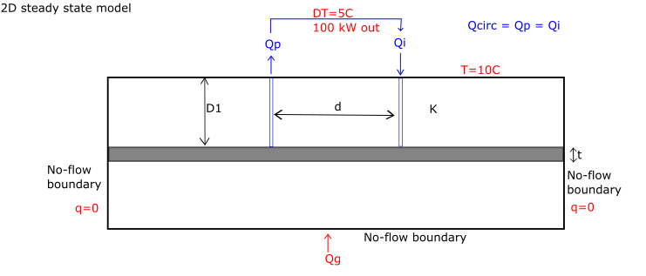
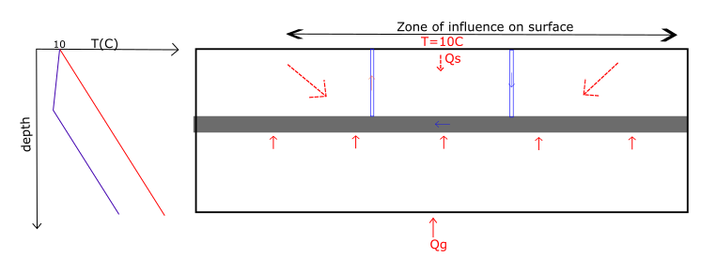
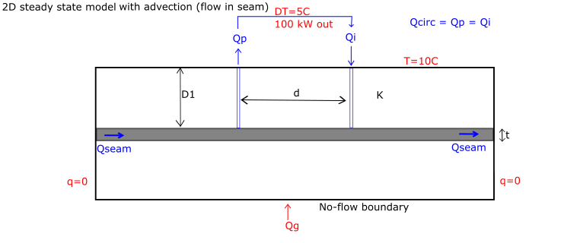
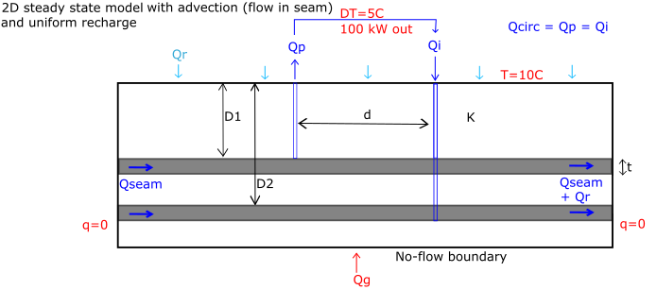
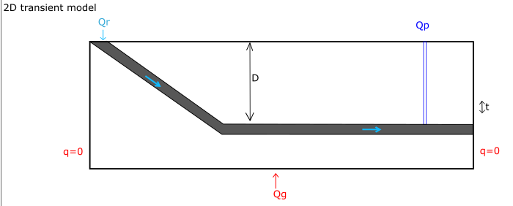
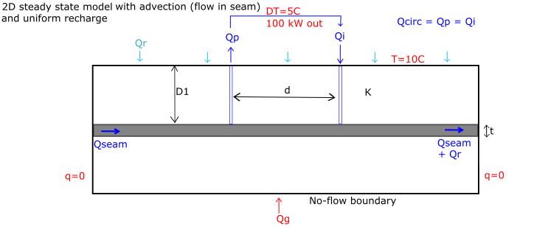
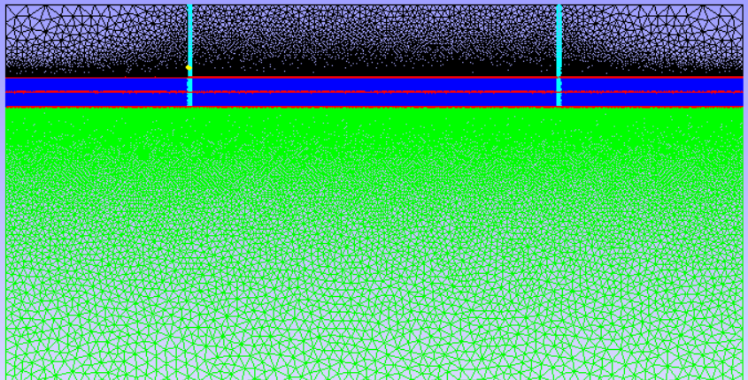
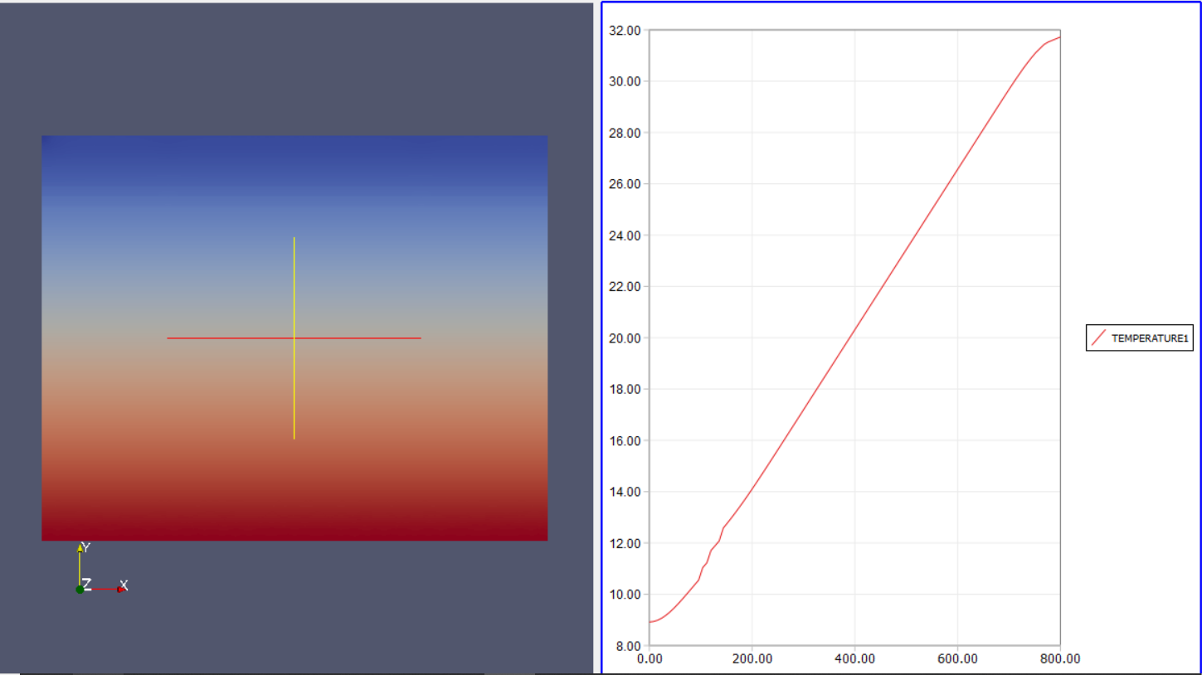
Objective 1
Introduction
Methods
Objectives
Conclusion
Summary
Data overview
Temperature
Water level
Geochemistry
Conceptual models
Sensitivity analysis
Notes:
1) Data inventory made
Mine temperature profiles/time-series will be compared to geological, climatic conditions in Scotland and in the UK
Geochemistry: Deep water in Dawdon (Chloride anion dominant = long residence time) while shallow water in Bilston Glen (Bicarbonate dominant) according to Chebotarev chart
2) 1D model for linear temperature profiles (compare with existing EC-T logs) + 2D models based on conceptual/simple mine geometry
3) Sensitivity analysis on geometrical, technical or numerical parameters: Simulation of cold water injection/recharge will allow determining, through sensitivity analysis, the parameters the more likely to influence mine water temperature.

Slide 12
Objective 2
Introduction
Methods
Objectives
Conclusion
Summary
Determine the main heat sources and heat transfer mechanisms in flooded coal mines
What is the heat recovery rate?
Assess the important geometrical features in mine plans.
How can representative simplification of mine plans be made?
Evaluate the footprint area of heat extraction
What is the geothermal potential of mines?
Can a sustainable heat extraction rate be maintained?
Notes:
Mine plans are complex. A certain level of simplification is necessary. To what extent can we simplify it and what features are really important?

Slide 13
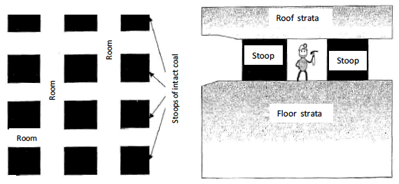
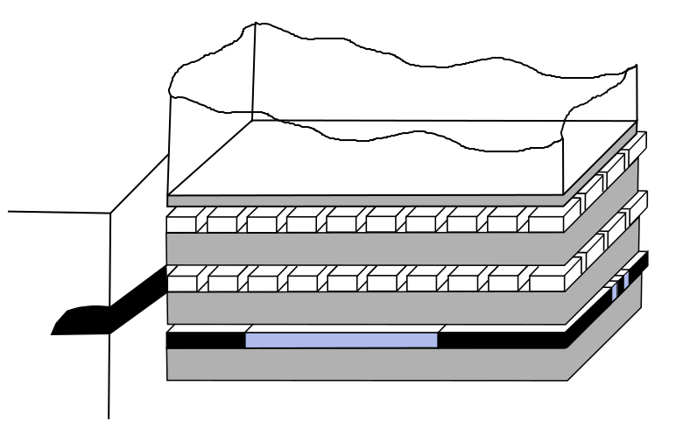
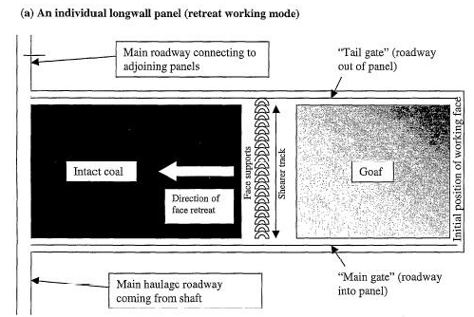
Introduction
Methods
Objectives
Conclusion
Summary
Underground workings:
Pillar and stall
Longwall mining
Main pathways :
Shafts
Roadways
Objective 2
Figure 13: Layout of typical longwall mine workings (Younger and Adams, 1999).
Figure 12: Layout of stoop and room mine workings. Plan view on left and profile view on right. (Younger and Adams, 1999).

Slide 14
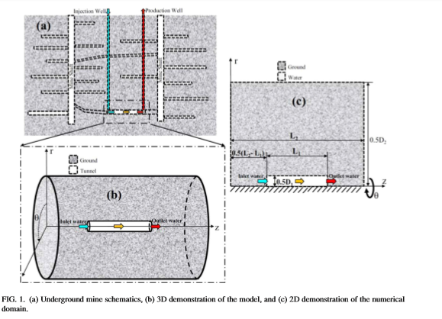
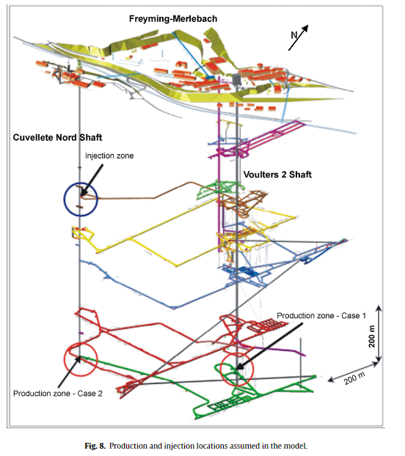
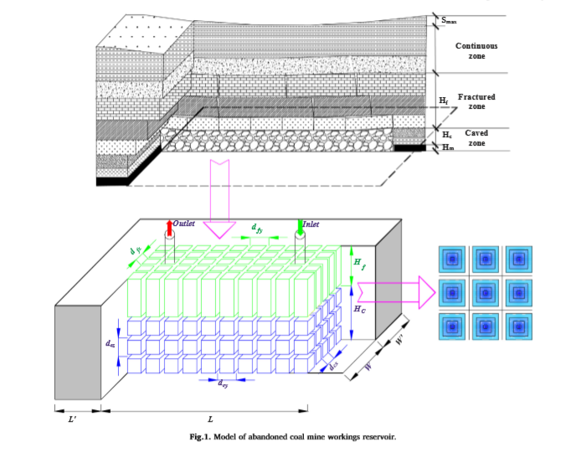
Introduction
Methods
Objectives
Conclusion
Summary
Modeling approches in the literature
Objective 2
Heat transfer in mine tunnels, Ghoreishi Madeish et al. (2012)
Combined 3D porous medium and 1D pipe flow (Raymond and Therrien, 2008)
Dual-porosity medium (Guo at al., 2018)
Combined 3D/2D/1D model of porous medium and pipe flow (Renze et al., 2009)

Slide 15
Introduction
Methods
Objectives
Conclusion
Summary
2D Horizontal models: heat transfer analysis in different type of underground workings
2D Vertical models
Case study:
Bilston Glen Area
Dawdon (NE England)
Model calibration using available data:
Water level (simulation of flooding)
Flow rate
Temperature
→ reproduce temperature profiles
Issue with loggers: no information about the depth of the sensor, but can inform on seasonal changes in temperature
Objective 2
Notes:
A series of model will be created through the development of a methodology to generate a representative statistical distribution of mine working network / roadways. Calibration and validation of model using existing data.
Water level = logger and on site measurements
Temperature: Logger temperature and on-site measurements (Temperature versus time)
+ Temperature and conductivity logs

Slide 16
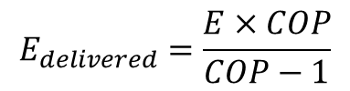

Objective 3
Introduction
Methods
Objectives
Conclusion
Summary
Determine the main heat sources and heat transfer mechanisms in flooded coal mines
What is the heat recovery rate?
Assess the important geometrical features in mine plans.
How can representative simplification of mine plans be made?
Evaluate the footprint area of heat extraction
What is the geothermal potential of mines?
Can a sustainable heat extraction rate be maintained?
$$E=Q×ΔT ×S_{w}$$
$$E_{delivered}=\frac{E×COP}{COP−1}$$

Slide 17
Introduction
Methods
Objectives
Conclusion
Summary
Based on 2D / 3D models of Bilston Glen / Dawdon
Validation with data acquired through the phD time
Temperature profile
Water level, flow rate and temperature time series
Objective 3
Notes:
Based on calibrated model, evaluation of the recharge rate / heat recovery rate of mine water. How long can it be sustained? what is the footprint area for providing heat for domestic heating?

Slide 18
Introduction
Methods
Objectives
Conclusion
Summary
Development of a predictive (conceptual or numerical) tool.
Recommendation on a scientific approach to guide the licensing of heat
Support the dimensioning of GSHP systems

Slide 19
References
Gillespie, M., Crane, E., and Barron, H. (2013). Study into the Potential for Deep Geothermal Energy in Scotland - Volume 2. AEC/001/11. Scottish Government, p. 129.
Todd, F., McDermott, C., Harris, A. F., Bond, A., and Gilfillan, S. (2019). Coupled hydraulic and mechanical model of surface uplift due to mine water rebound: implications for mine water heating and cooling schemes. Scottish Journal of Geology [online], sjg2018–028. ISSN: 0036-9276, 2041-4951. DOI: 10.1144/sjg2018-028.

