Slide 2
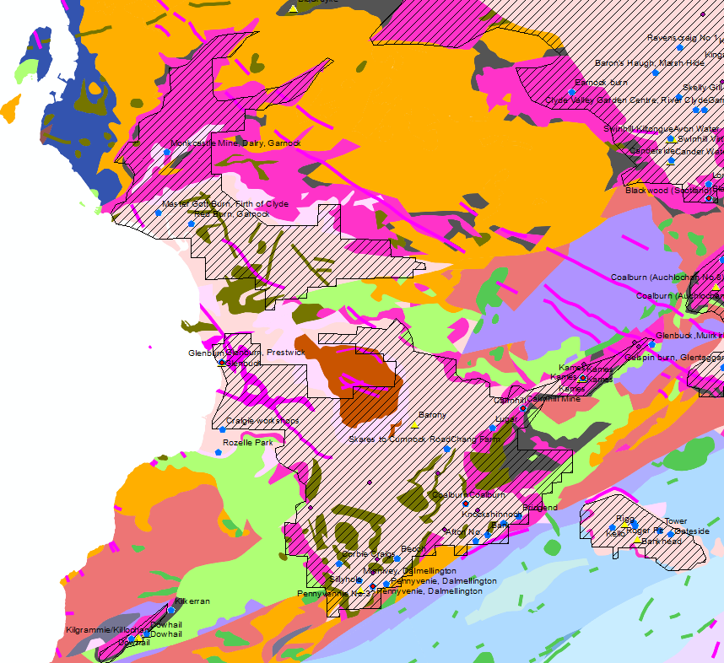
SC – central Ayrshire
Pennsyvennie No3
Cairnhill
Coalburn Mine (Muir Burn)
Glenbuck
Kames

Slide 3
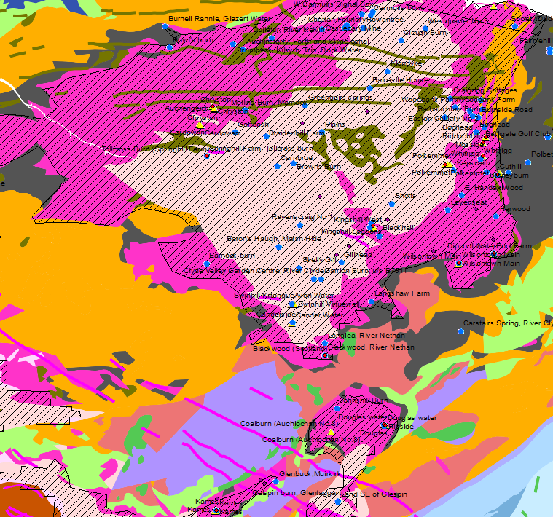
SC - Central coalfield
Auchengeich
Tollcross Burn (Sprinhill Farm)
Mosside BH
Riddochill Shaft
Whitrigg BH
Polkemmet
Cuthill
Kingshill
Wilsontown (Mousewater)
Blackwood

Slide 4
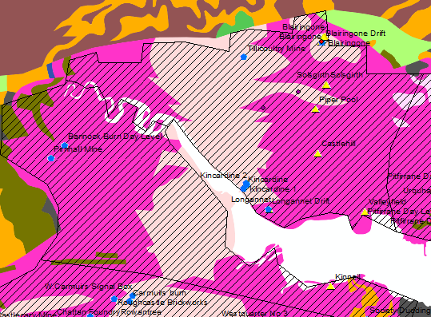
SC Clackmannan & West Fife
Blairingone

Slide 5
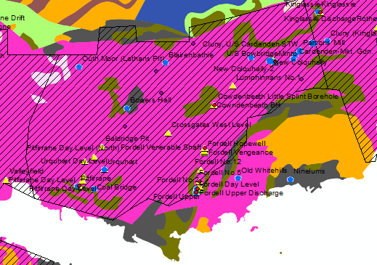
SC – Central Fife
Pitfrane Discharge
Cowdenbeath BH
Fordell Venerable shaft
Fordell No2 shaft
Fordell Upper discharge
Fordell day level
Minto

Slide 6
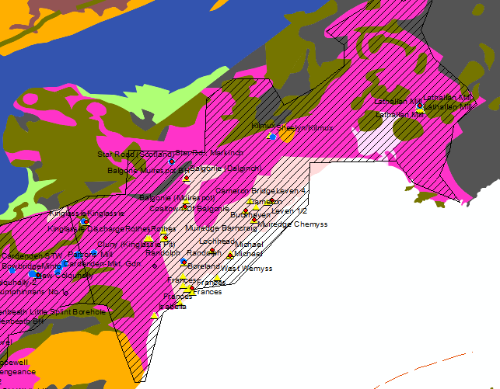
SC- East Fife
Lathallan Mill
Star Road
Balgone Muirespot BH
Balgonie Dalginch BH
Leven 4
Cameron BH
Muiredge Chemyss BH
Middlefield BH
Lochhead BH
Michael shaft
Randolph BH
Frances

Slide 7
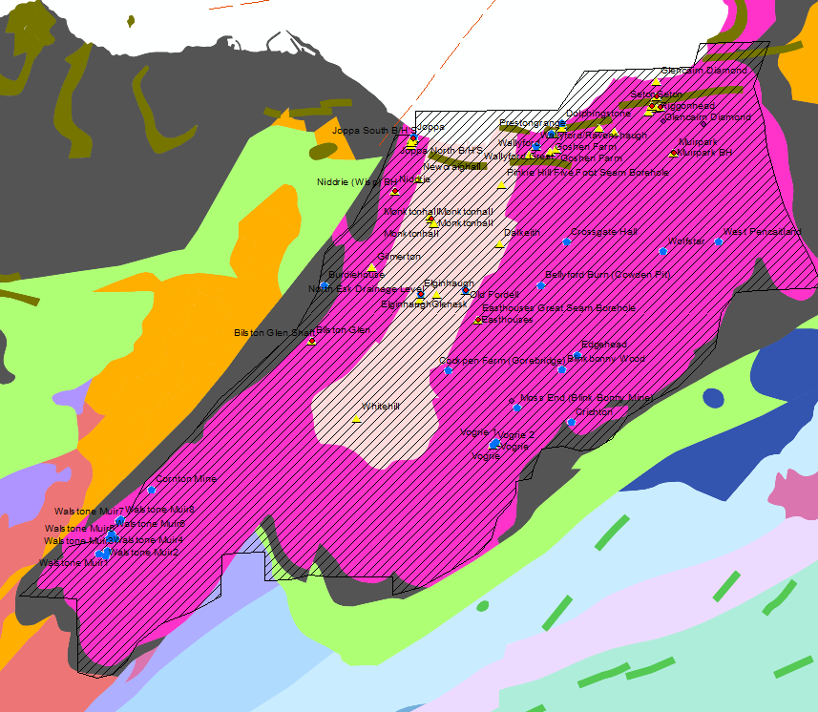
SC - Midlothian
Riggonhead
Blindwells
Seton BHs
Muirpark BH
Niddrie BH
Monktonhall
Old Fordell (Junckies) Discharge
Elginhaugh
Easthouse
Bilston Glen
Joppa

Slide 8
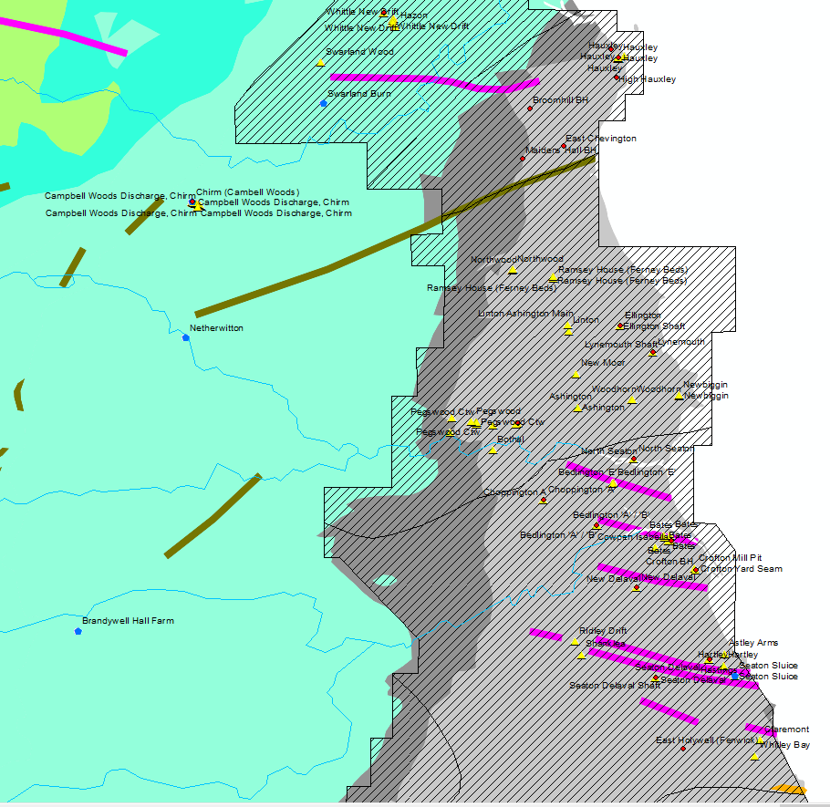
North East England
Whittle New Drift
Hauxley
High Hauxley
Broomhill
East Chevington
Maiders Hall BH
Ellington shaft
Lynemouth
Pegs wood
North Seaton
Choppington
Bedington
Bates
Crofton
New Delaval
Hartley
Hastings BH
Seaton Delaval shaft
East Holywell

Slide 9
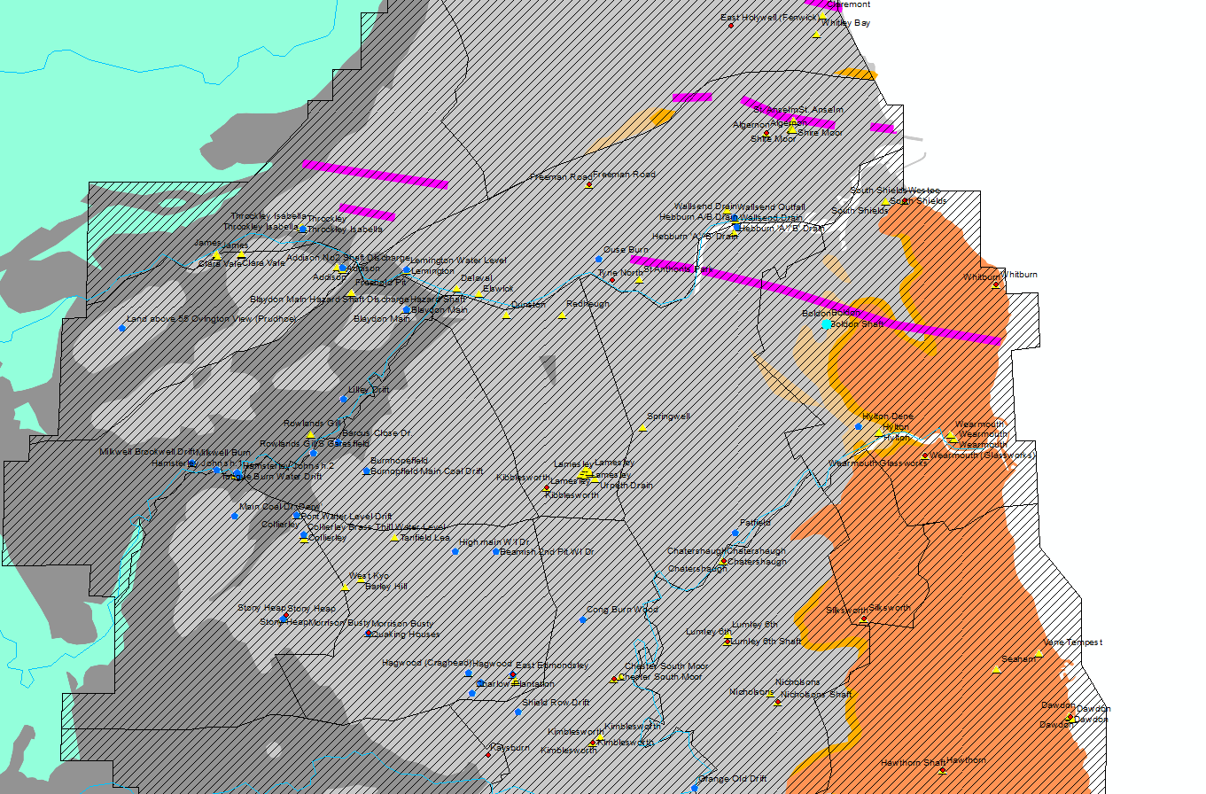
North East
Algernon
Boldon
Chatershaugh
Chester South Moor
Dawdon
East Edmondsley
East Holywell
Freeman road
Hawthorn Shaft
Kaysburn
Kibblesworth
Kimblesworth
Lumley 6th shaft
Nicholsons shaft
Quaking Houses
Seaton
Silksworth
Stoney Heap
Tyne North
Westoe shaft (South Shield)
Wearmouth Glassworks
Whitburn

Slide 10
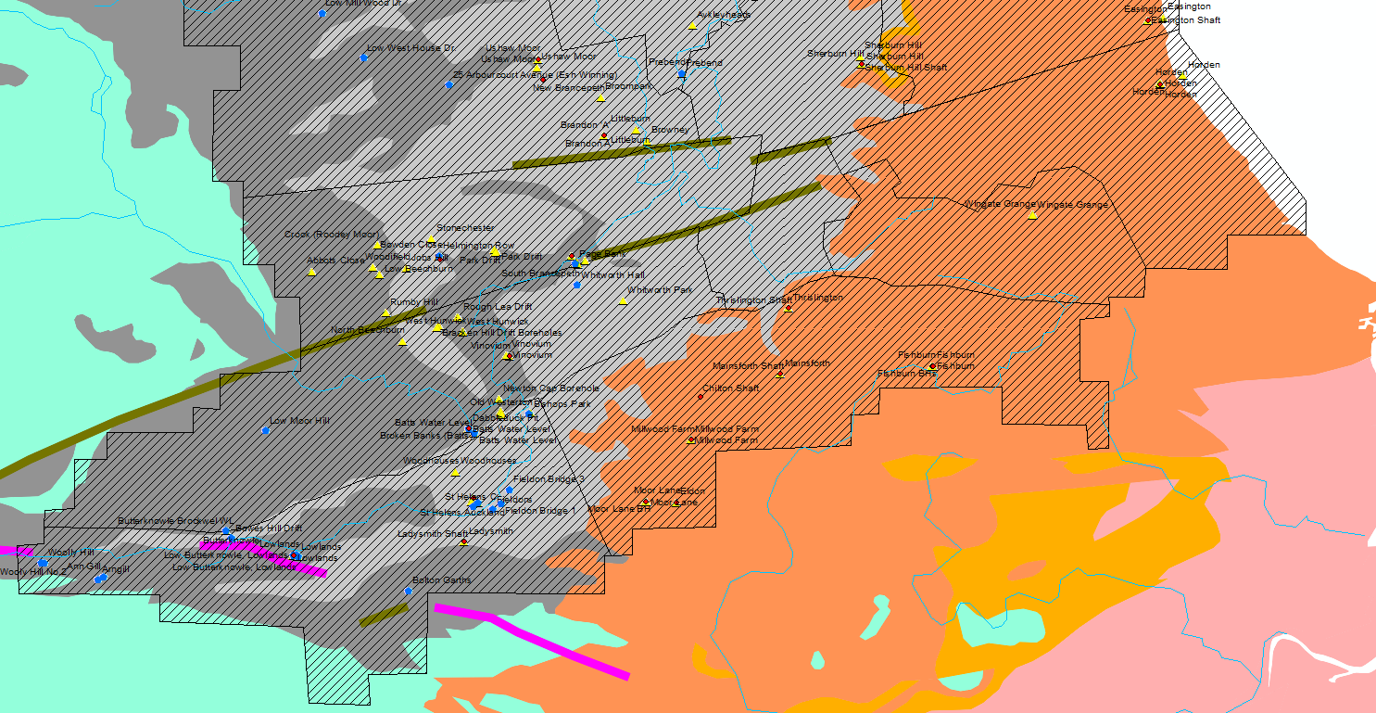
North East
Brandon A
Broken Banks
Chilton Shaft
Crook
Easington
Horden
Eldone
Fishburn
Ladysmith shaft
Mainsforth
Milwood Farm
Moor Lane
New Brancepeth
Page bank
Sherburn Hill Shaft
Thrislington
Tindale (St Helens)
Ushaw Moor
Vivonium

Slide 11
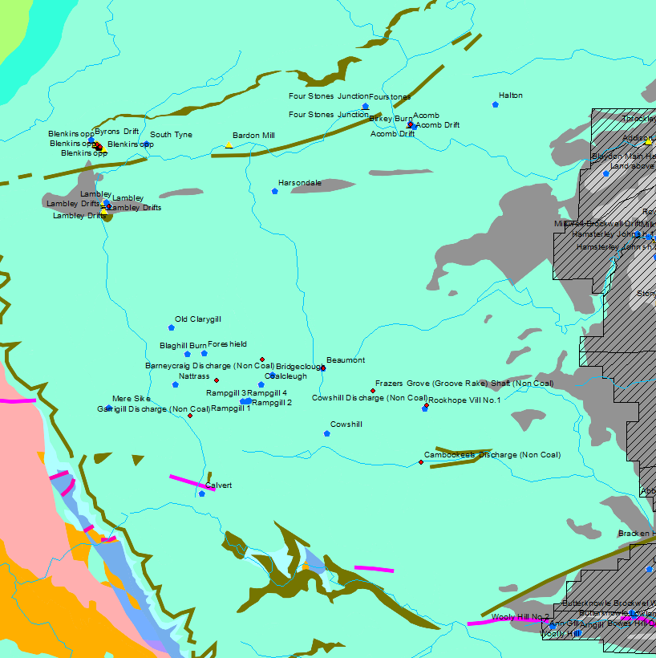
North East (non coal)
Acomb
Blenkinsopp

Slide 12
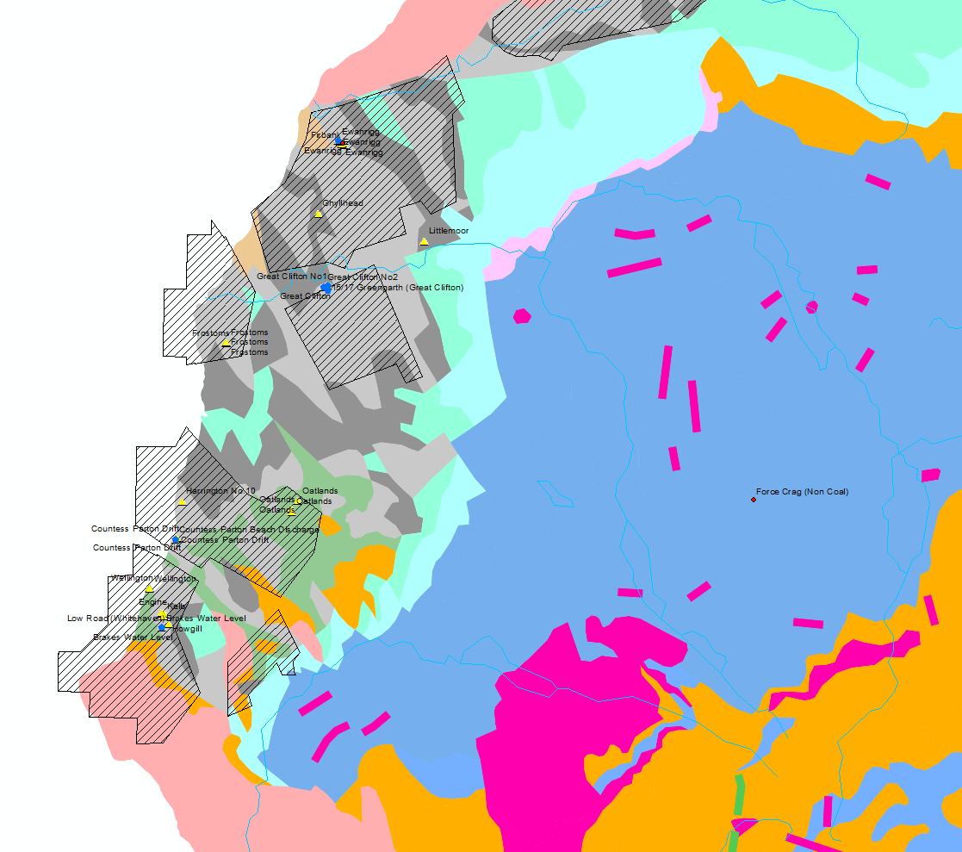
North West
Ewanrigg
Force Crag

Slide 13
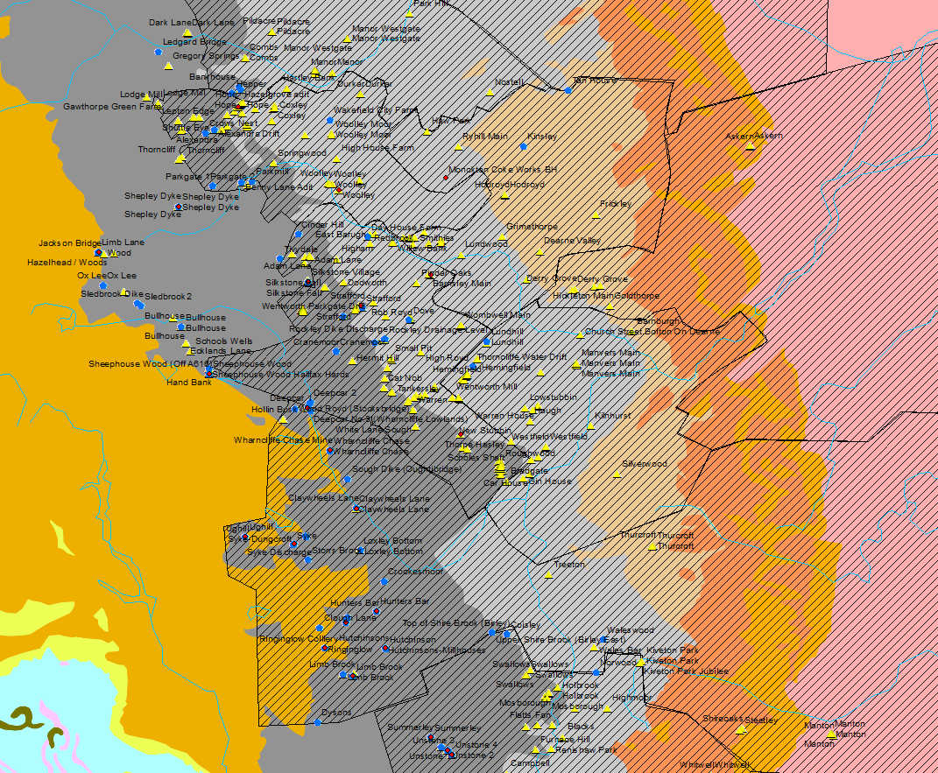
Yorkshire Area
Caphouse
Woolley
Monckton Coke Works BH
Shepley Dyke
Silkstone Fall
Strafford
Barnsley Main Shaft
Thorpe Hesley shaft
Deepcar
Wharncliffe Chase
Claywheels Lane
Ughill
Syke-Dungcroft
Hunters Bar
Greystones-Whiteley (Clough Lane)
Ringinglow
Hutchinsons-Millhouses
Limb brook

Slide 14
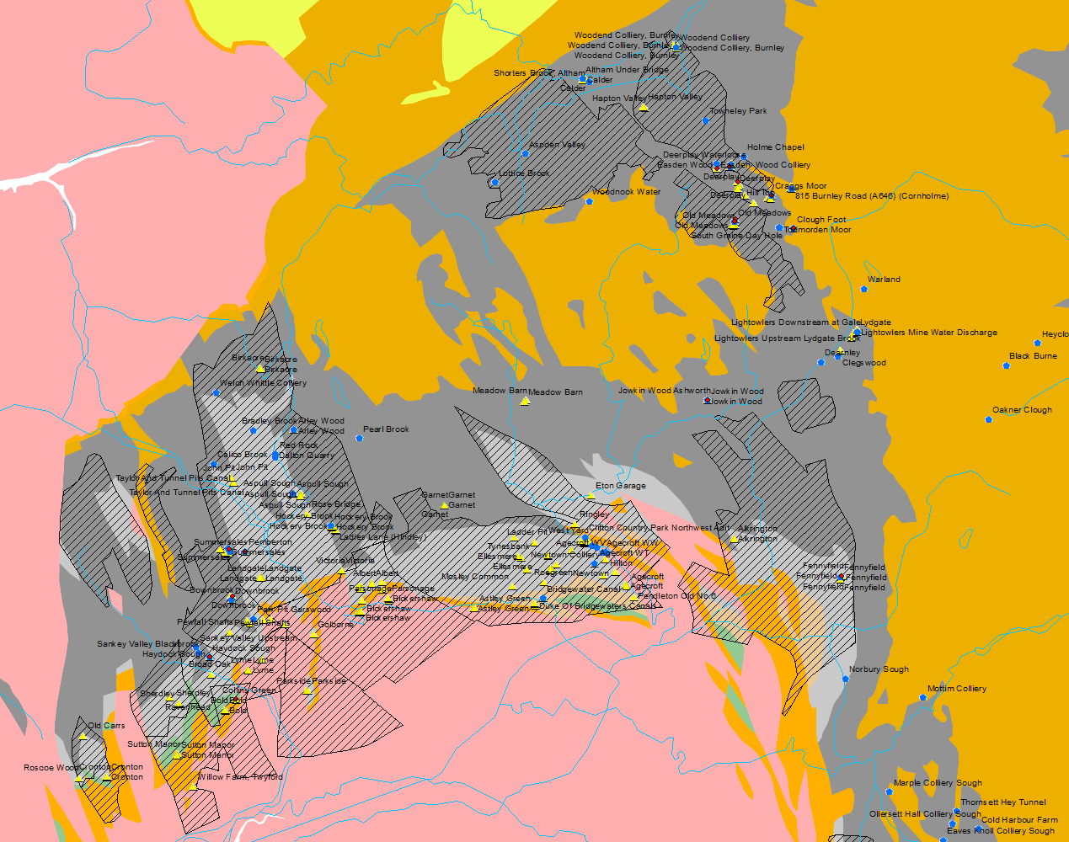
Lancashire
Blackclough Waterloose
Deerplay
Carr and Craggs
Old meadows
Clough Foot
Jowk in Wood
Downbrook
Summersales
Pemberton
Haydock Sough Discharge
Collins green
Fennyfield

Slide 15
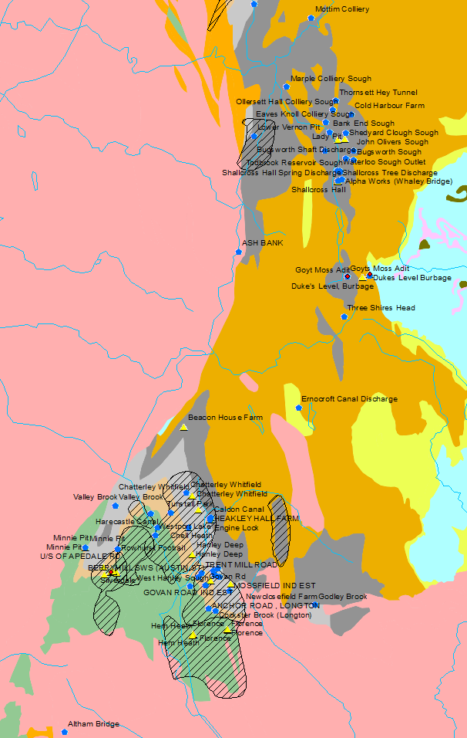
Staffordshire
Goyt Moss adit
Dukes Level
Silverdale

Slide 16
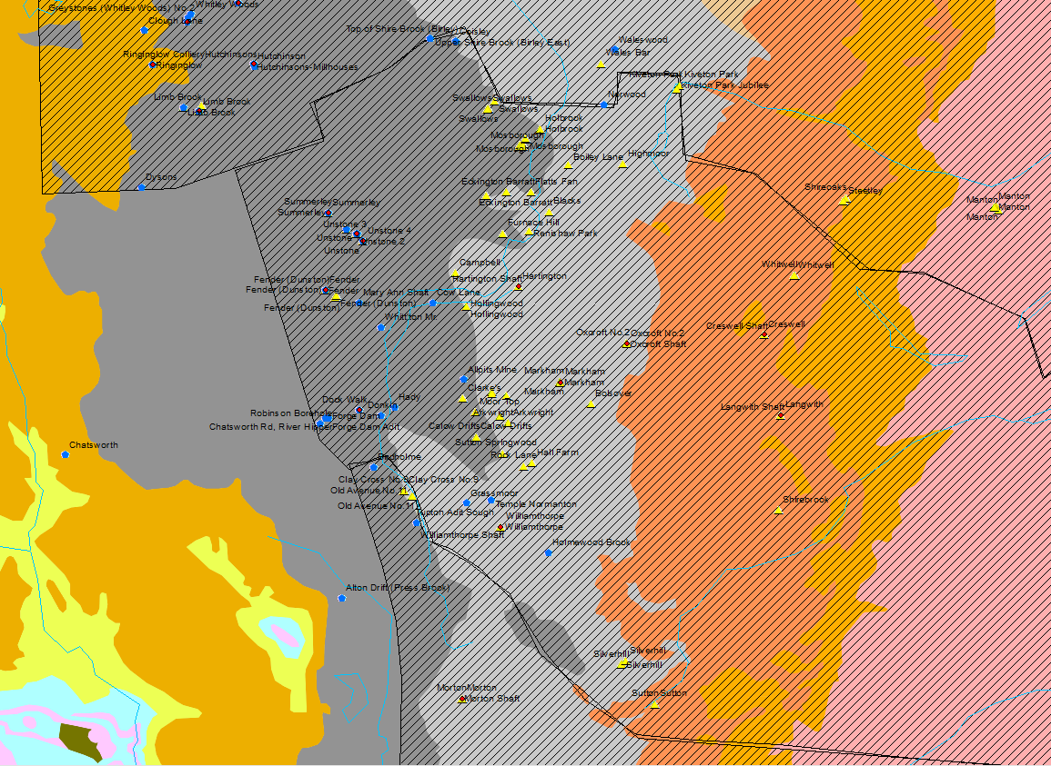
Notts North
Summerley
Unstone
Williamthorpe
Oxcroft shaft
Harrington
Creswell shaft
Langwith shaft

Slide 17
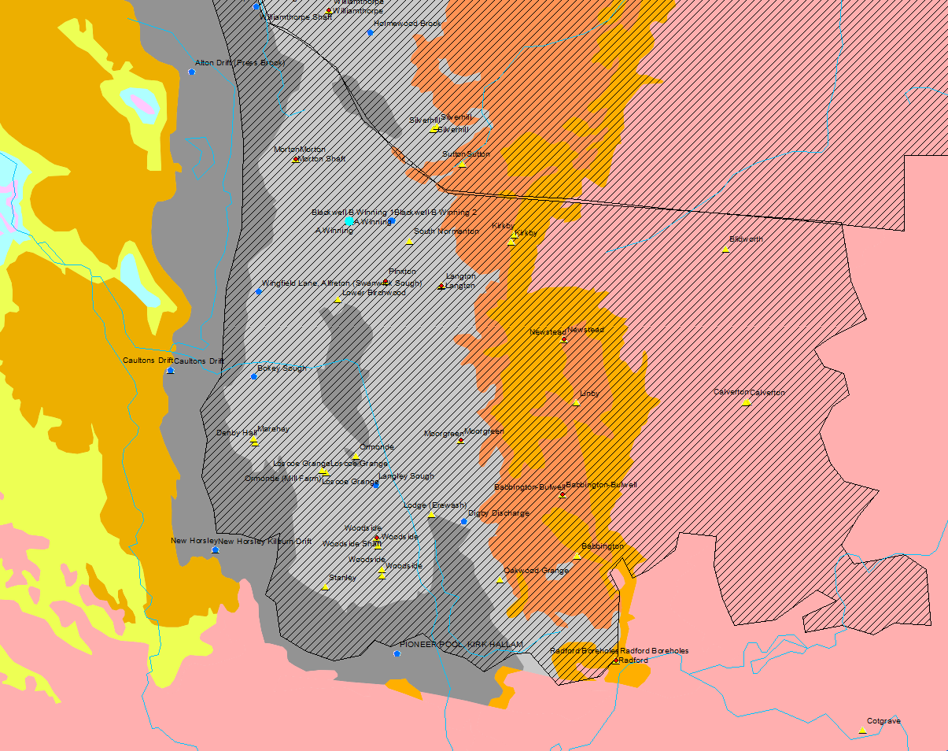
Notts- south
A winning
Babbington
Morton shaft
Langton
Pinxton BH
Woodside shaft
Newstead

Slide 18
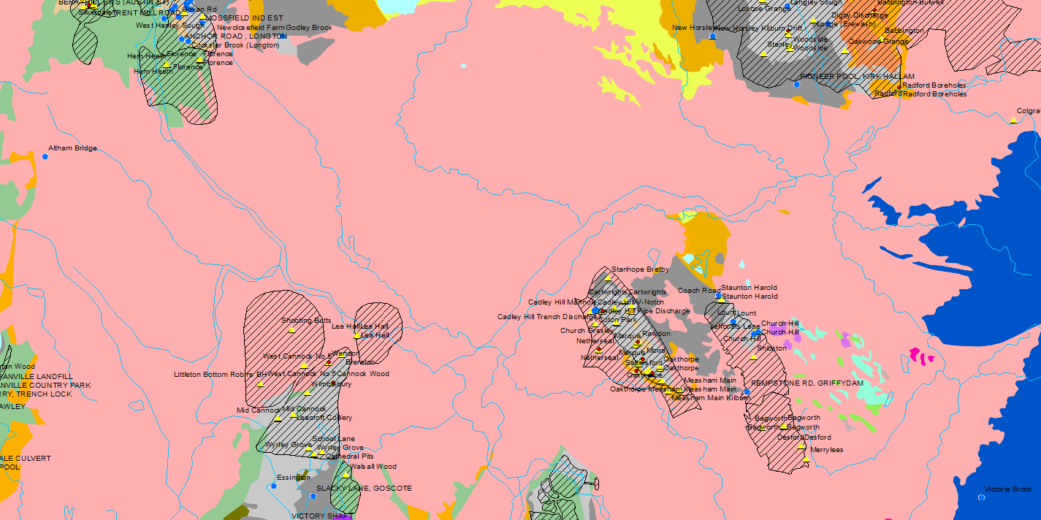
Derbyshire
West Cannock
Wandon BH
Cadley Hill
Rawdon Upper Seams
Moira
Saltersford
Netherseal
Oathorpe Bungalow BH

Slide 19
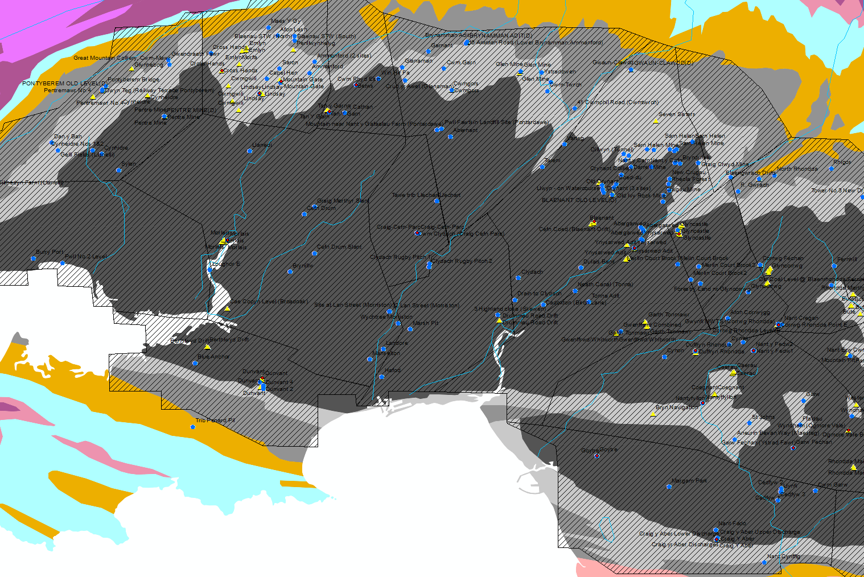
South Wales West
Cross hands
Lindsay
Mountain Gate
Betws
Cwm Clydach
Morlais
Dunvant
Cefn Coed
Goytre
Ynysarwed
Glyncastle
Duffryn Rhondda
Nantyfyllon
Nant y Fedw
Graig yr Aber Discharge

Slide 20
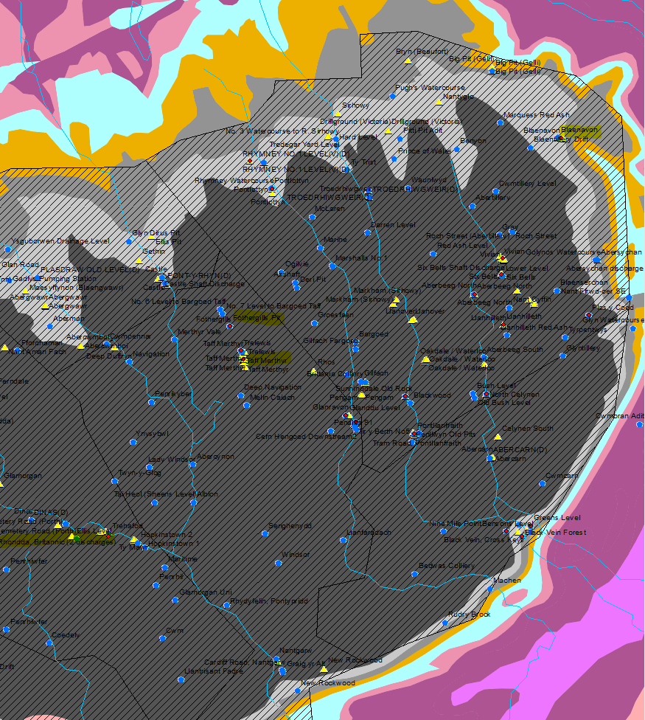
South Wales East
Rhondda Deep BH
Ogmore Vale
Fothergills
Trelewis
Taff Merthyr
Pontlottyn
Glanddu Level
Cefn Hengoed
Sunningdale Discharge
Tram Road
Graig Fawr
Six Bells
Vivian
Blaenavon
Aberbeeg north
Plas y Coed

