Slide 1
Investigating geothermal heat resources of legacy mine workings, why are some mine waters hotter than others?
Mylene Receveur
Christopher McDermott, Stuart Gilfillan, Andrew Fraser-Harris

Slide 2
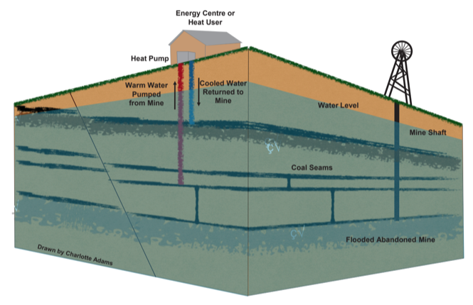
Introduction
Abandonned flooded mines = low-temperature geothermal resource
Warm water can be extracted at high rates from highly permeable reservoirs
Heat demand = >1/3 of energy consumption in the UK
7% of Scotland’s heat requirement could be sourced from abandoned flooded mine workings (Todd et al., 2019)
Mine = Local source of energy
Can contribute to the decarbonization of residential heat
Existing cas estudy (coal mines): Germany, Canada, USA, UK (Shettleston, Dawdon, Markham), Poland, The Netherlands, Spain
Figure 11: Schematic Diagram of a mine water heat pump system (Drawn by Charlotte Adams)

Slide 3
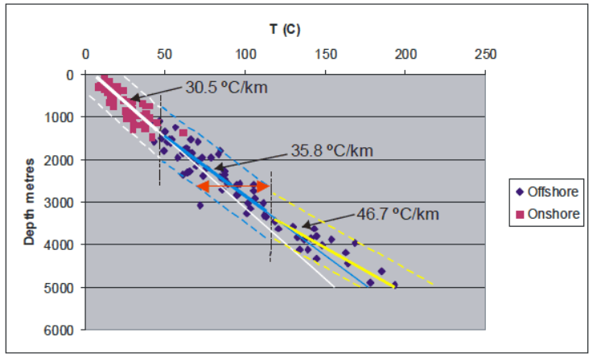
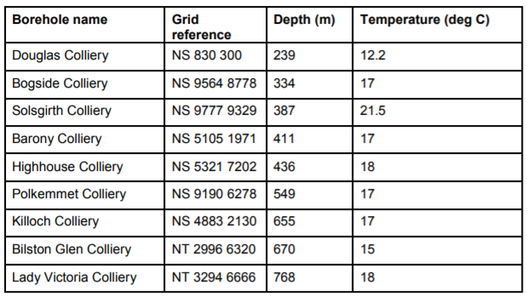
Reserch question
Why do different mines have different temperatures?
Poor understanding of the origin of heat in mines: issue to evaluate the geothermal potential
No clear correlation of temperature with depth (Gillespie et al., 2013)
Need to know what are the heat recharge mechanisms, the rate heat recovery and the area impacted by heat extraction, to ensure sustainable production
Figure 20. Combined onshore and offshore BHT (Gillespie et al., 2013)
Temperature at mine boreholes (Gillspie et al., 2013)

Slide 4
Summary
I. Mine systems
II. Research Objectives
III. Methods
IV. Conclusion

Slide 5
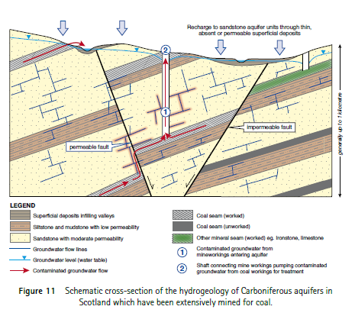
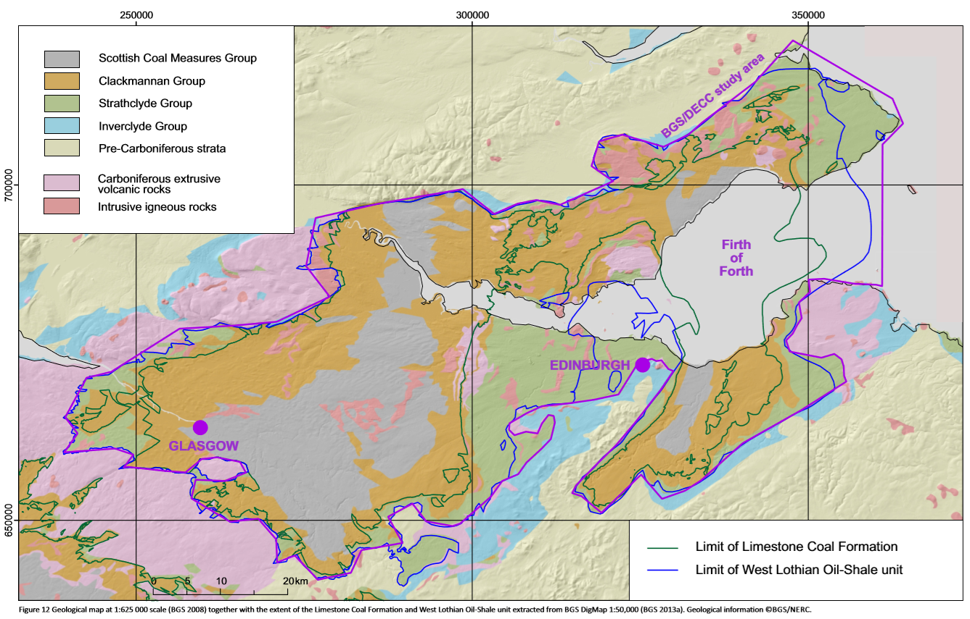
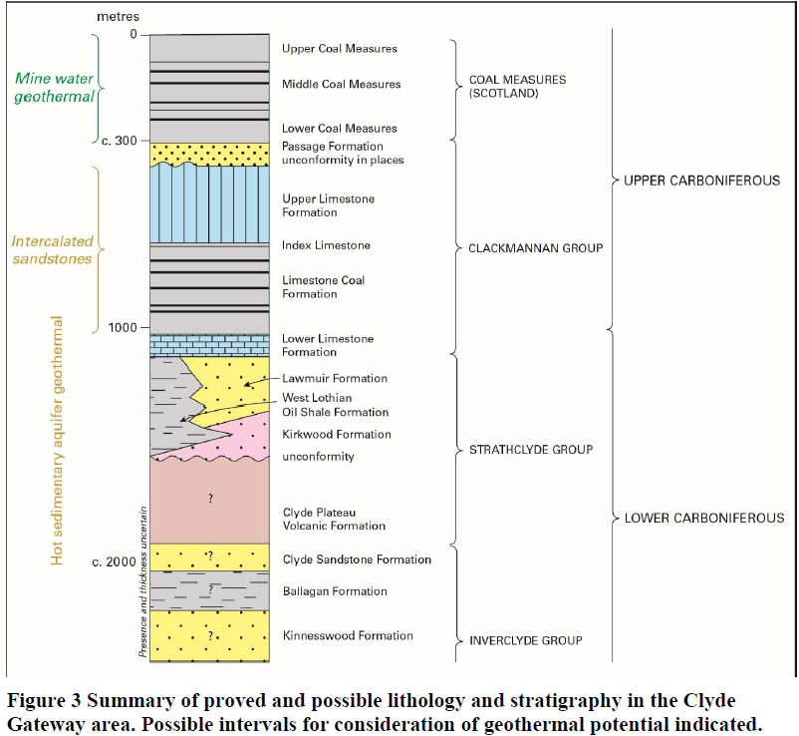
Mine systems
Figure 9. Geological map at 1:625 000 scale (BGS 2008) together with the extent of the Limestone Coal Formation and West Lothian Oil-Shale unit extracted from BGS DigMap 1:50,000 (BGS 2013a). Geological information ©BGS/NERC (Monaghan, 2014).

Slide 6
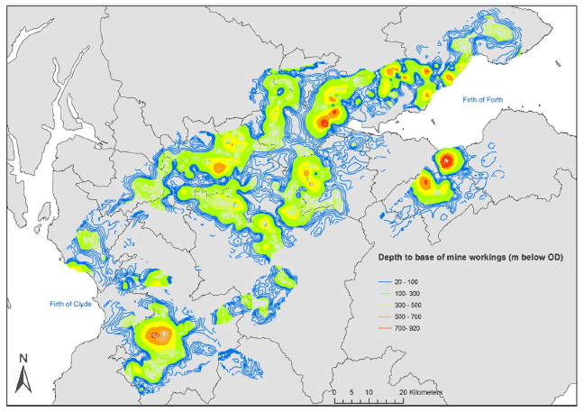
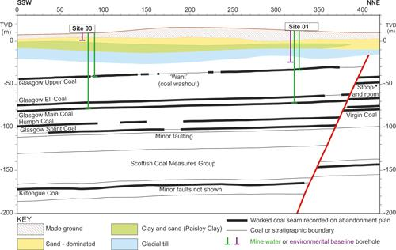
Figure 16. Depth of mine workings viewed in GOCAD ® (©Paradigm) 3D modelling software, showing deepest workings in orange and red (Gillespie et al., 2013)

Slide 7
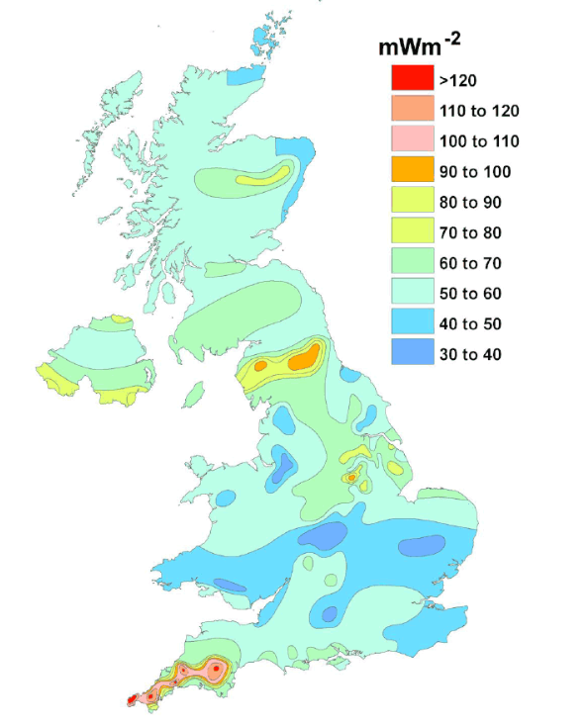
Question 1
What are the main heat sources and transfer mechanisms controlling temperature distribution in mines ?
natural heat flow
local heat generation (i.e. radioactive day, pyrite oxidation)
solar influx
groundwater flow
geological structure (i.e. geological formation with specific material, thermal and hydraulic properties, faults)
Extent/connectivity of mine workings.
Figure 18. Heat Flow in the UK (Gillespie et al., 2013)

Slide 8
Question 1
Data inventory and comparison between different mines in Scotland and in the UK
1D model for linear temperature profiles (compare with existing EC-T logs) + 2D models based on conceptual schemes
Sensitivity analysis on geometrical, technical or numerical parameters

Slide 9
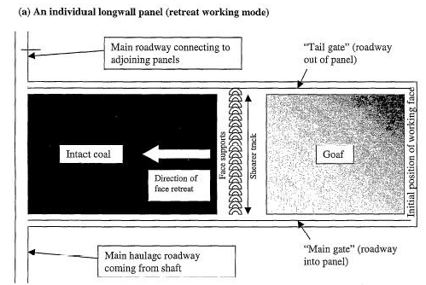
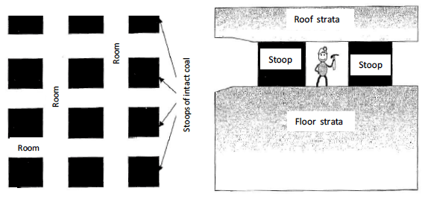
Question 2
What are the important structural features that need to be considered in mine plans ?
Shafts
Underground workings (thickness, type, depth)
Roadways
Figure 13: Layout of typical longwall mine workings (Younger and Adams, 1999).
Figure 12: Layout of stoop and room mine workings. Plan view on left and profile view on right. (Younger and Adams, 1999).

Slide 10
Question 2
Model calibration using available data
Water level (simulation of flooding)
Logger and on-site measurements
Temperature
Logger temperature and on-site measurements (Temperature versus time)
Temperature and conductivity logs Water level logger: inform on the temperature at the depth of the sensor but is not associated to
Issue: no information about the depth of the sensor, but can inform on seasonal changes in temperature

Slide 11
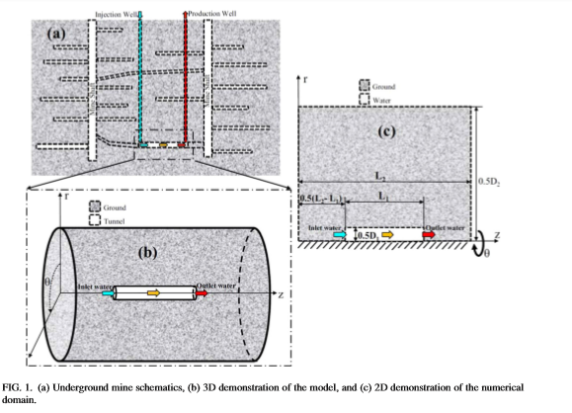
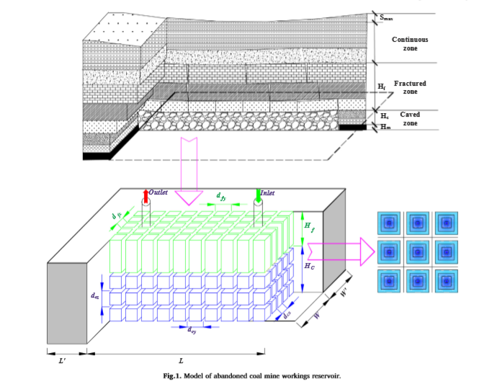
Question 2
Heat transfer in mine tunnels, Ghoreishi Madeish et al. (2012)
Combined 3D porous medium and 1D pipe flow (Raymond and Therrien, 2008)
Dual-porosity medium (Guo at al., 2018)
Combined 3D/2D/1D model of porous medium and pipe flow (Renze et al., 2009)

Slide 12
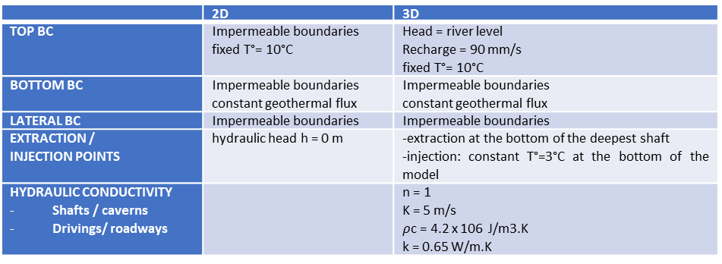
Data requirements and management
 | 2D | 3D
TOP BC | Impermeable boundaries fixed T°= 10°C | Head = river level Recharge = 90 mm/s fixed T°= 10°C
BOTTOM BC | Impermeable boundaries constant geothermal flux | Impermeable boundaries constant geothermal flux
LATERAL BC | Impermeable boundaries | Impermeable boundaries
EXTRACTION / INJECTION POINTS | hydraulic head h = 0 m | -extraction at the bottom of the deepest shaft -injection: constant T°=3°C at the bottom of the model
HYDRAULIC CONDUCTIVITY Shafts / caverns Drivings/ roadways |  | n = 1 K = 5 m/s $ρ$c = 4.2 x 106 J/m3.K k = 0.65 W/m.K
Material solid properties | Porosity, tortuosity, storage, hydraulic conductivity, mass dispersion
Material properties | Density, thermal conductivity, thermal capacity, thermal diffusivity
Fluid properties | Type, density, viscosity, heat capacity, thermal conductivity
Initial/boundary condition | Hydraulic head, reservoir temperature, geothermal gradient, surface temperature
Simulation parameters | Time steps, duration
Source terms | Production/injection rate, injection temperature Natural recharge/discharge (precipitation, river infiltration - i.e. Pruess and Bovardsson, 1983) Thermal/solar flux
Geometrical (mesh) | Length and radius of the reinjection channel Lateral/vertical interconnectivity of the parts of the mines (Watzlaf and Ackmann, 2006).

Slide 13
Question 3
What is the footprint area of heat extraction (GSHP) ?
What is the time necessary for water to heat up (recovery rate) ?

Slide 14
Question 3
2D/3D models
Validation with data acquired through the phD time (temperature profile and time series)

Slide 15
Conclusion
Development of a predictive (conceptual or numerical) tool.
Recommendation on a scientific approach to guide the licensing of heat
Support the dimensioning of GSHP systems

Slide 16
References
Gillespie, M., Crane, E., and Barron, H. (2013). Study into the Potential for Deep Geothermal Energy in Scotland - Volume 2. AEC/001/11. Scottish Government, p. 129.
Todd, F., McDermott, C., Harris, A. F., Bond, A., and Gilfillan, S. (2019). Coupled hydraulic and mechanical model of surface uplift due to mine water rebound: implications for mine water heating and cooling schemes. Scottish Journal of Geology [online], sjg2018–028. ISSN: 0036-9276, 2041-4951. DOI: 10.1144/sjg2018-028.

