Slide 1



Quick Introduction to E4 DTP

Slide 2
Introduction
E4 DTP: Edinburgh Earth, Ecology and Environment Doctoral Training Partnership
Led by the School of GeoSciences (Richard Essery)
Funded by NERC (Natural Environment Research Council)
Train 5 cohorts of PhD students annually between 2019 and 2023. Students with different background and PhD topic: biology, chemistry, geology, ocean and atmospheric sciences, environmental conservation, ecology…
Promote multi-disciplinarity
Core training and Advanced training
Social activities (in non-Covid context…)
Notes:
Richard: E4 DTP Director

Slide 3
Core Training
25 hours of professional Transferable skills
Generic PhD skills training (health and safety, research ethics, T&D)
Frontiers in Environmental
Numeracy, Modelling and Data Sciences
Research Planning and Management: Confirmation process
ECCI workshops:
Consultancy Innovation Training Introduction
Making your Research Matter
Business, Project Management & Consultancy skills
Innovation Challenges & Opportunities
Residential workshops
Geosciences PGR conferences (10 min oral/poster presentation)
Notes:
1- This session highlights the value of innovation knowledge, skills and awareness to you as a researcher, by introducing the programme aims and the work of the Edinburgh Centre for Carbon Innovation
2- Delivered by ClimateXChange, this session focusses on the connection between research and policy, and in particular how research is used to both support and inform the decisions of Scottish Government, and how to communicate your research effectively to influence policy makers. This is particularly useful for anyone who thinks their research is driven by or can influence the development and implementation of national environmental or sustainability related policies.
3- introduce some of the core business skills you will need for both research projects with business partners and your future career – covering some key principles of negotiating and agreeing a scope and a brief for your work, defining outputs and deliverables, managing expectations, and how to present the results for maximum impact
4- participative workshop will help you learn from others who have turned their research into innovation and responded to real world challenges around climate and resources. It will examine key opportunities and challenges for innovation in the context of global climate change, and help you understand how you can connect these with your research

Slide 4
Advanced training
Required to do 25 hours of personal training
Depending on your interest or what skills you need
Training Need Analysis based on Researcher Development Framework (IAD)
Training Research and Output log
Possibility of training given by NERC academic, governmental, inductrial or research organisation parters (SRUC, SAMS, ECCI, Bayes Center, CEH, BGS, Met Office, RBG, NTS…), Coding Cub, IAD and other schools of the UoE
Notes:
Training Research and Output Log (TROL)
Record all training courses, publications, outreach and engagement events, conferences, media interaction placements, networking events, awards and prizes
Record events when they happen – don’t keep it for later!
Return to DTP manager when prompted (likely October 2020)

Slide 5
Time frame and opportunities
Stipend length: 42 months
DTP covers tuition fees for 4 years (max submission date)
Funding: RTSG £1,150 per year
(+ CASE studentship from CASE partner)
Possibility of tutoring/demonstrating
E3/E4 DTP Overseas Research Visit & Conference Fund (ORVCF): up to 750£
Professional internship program (PIP) : up to 3 months
Professional Development Scheme (PDS): up to 2 extra months of stipend if 2 papers submitted as first author
Notes:
The DTP provides an Overseas Research Visit & Conference Fund that enables students to gain experience in an overseas research environment and/or present their work at an international conference. These funds are specifically targeted to stimulate new collaborations and expand network. They are not intended to top up standard RTSG funding
The Professional Internship Program
The PIP is intended for students in their 3rd or 4th year but is also possible while in 2nd year if a suitable occasion arises. The PIP must be done within your PhD maximum end date and before you submit your thesis, The PIP is an opportunity to try things you haven’t been doing yet and get experience you don’t have. This can happen within your research area and it is not a problem if the PIP is related to your PhD subject in some way. You might even get the opportunity to collect useful data you wouldn’t have expected and that is fine. → extension of funding but not time
The Professional Development Scheme (PDS)
The Professional Development Scheme provides a 2-month stipend extension for DTP
students who would have submitted a minimum of 2 publications as first author by the
half of their 4th year.

Slide 6
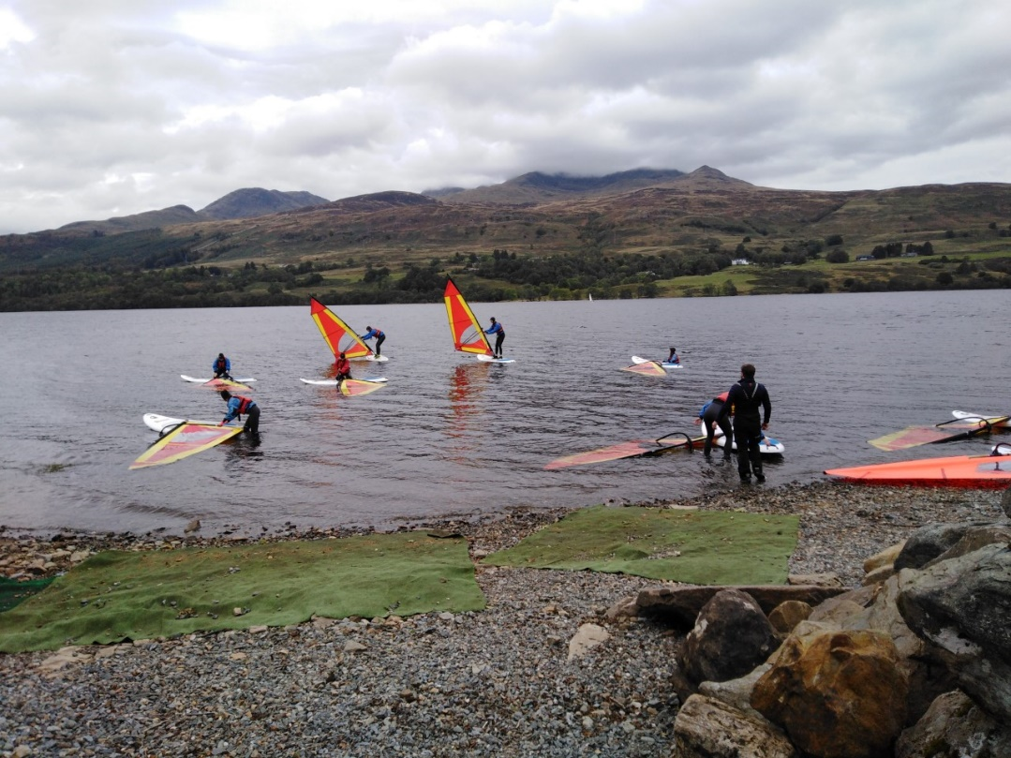
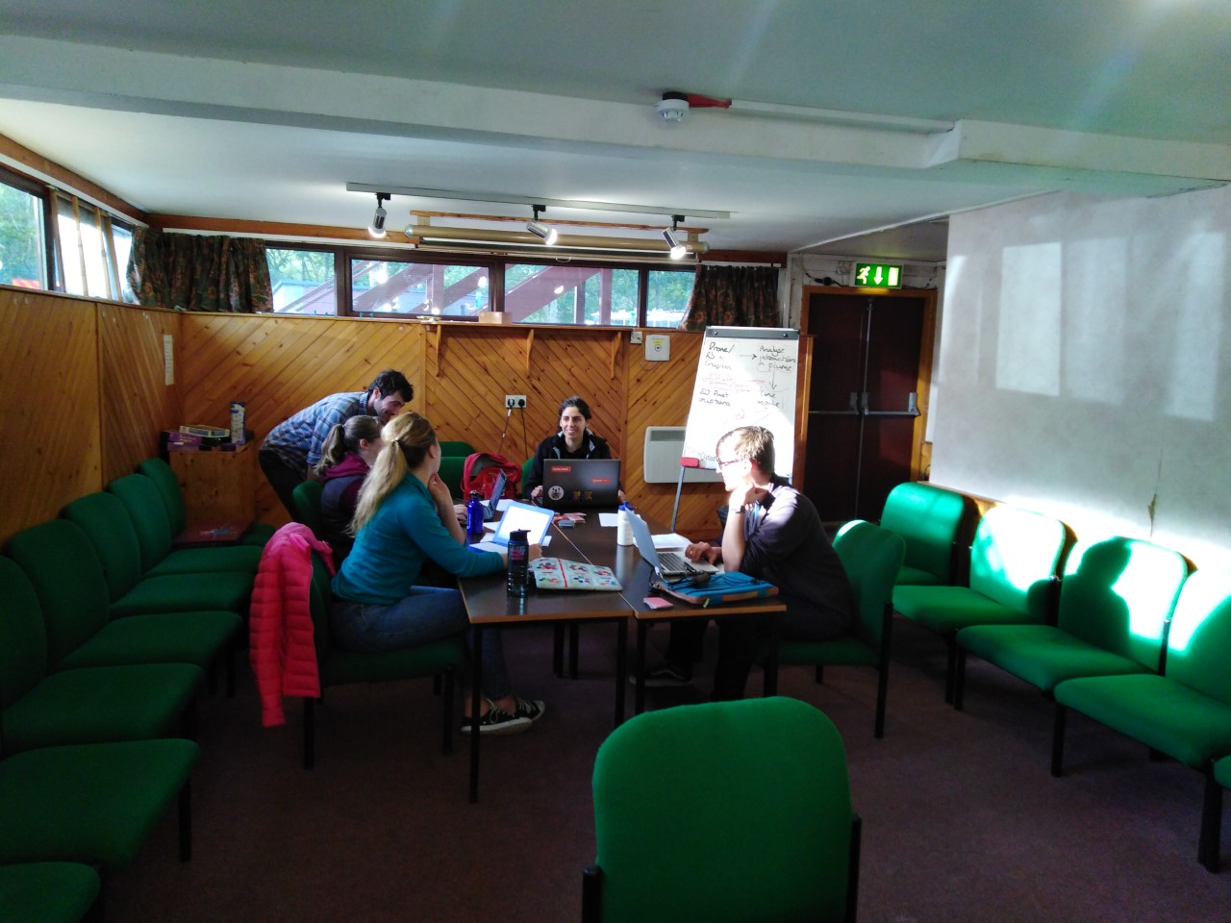
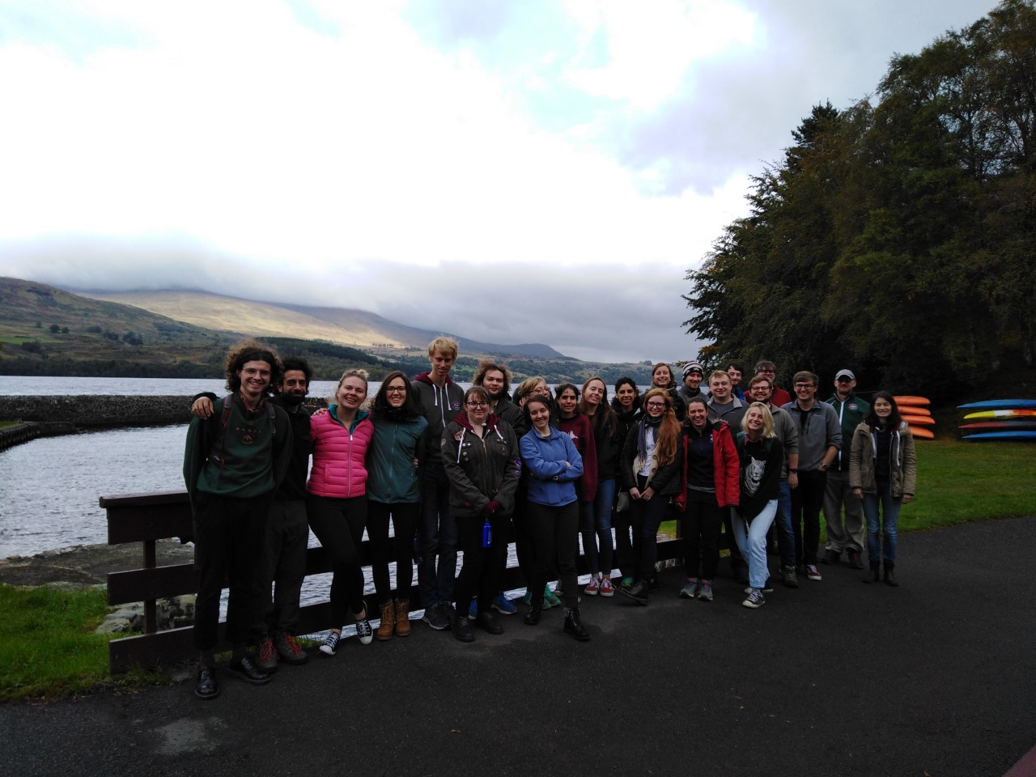
Year 1: Firbush Residential Training
Notes:
Presentation of the Frontiers in Environmental Sciences lecture series (Richard Essery) and 1st course (Emma Cunningham from the School of Biological Sciences)
Global Grand Challenges: Group session in which you will be asked to think about the sort of research activities NERC might find attractive and think are important to support. Following this exercise, you will be organised into teams and given a proposal topic. Each group will have the evening and the following morning to put together a proposal presentation. More details on what is required will be provided at this session.
Cohort building activities
Admin Q&A session

