Slide 1
VIO 2.0 & NSX-v Network Topologies Configuration Guide
Dimitri Desmidt – TPM
ddesmidt@vmware.com

Slide 2
Goal
Get a very deep technical understanding on
How to configure the different network and security services in OpenStack
How VIO/NSX-v works
Pre-requirements
Very good technical knowledge on NSX-v

Slide 3
Agenda
OpenStack Network and Security services available within VIO / NSX-v
VIO/NSX-v requirements + config files
For each VIO/NSX-v Network and Security service:
Configuration via Horizon (UI) + CLI (API)
Validation via Horizon (UI) + CLI (API)
What happens in the backend (NSX-v configuration)
Limitation or bug

Slide 4
Agenda
OpenStack Network and Security services available within VIO / NSX-v
VIO/NSX-v requirements + config files
For each VIO/NSX-v Network and Security service:
Configuration via Horizon (UI) + CLI (API)
Validation via Horizon (UI) + CLI (API)
What happens in the backend (NSX-v configuration)
Limitation or bug

Slide 5




What are the Neutron services available in VIO with NSX-v? (1/4)
NSX-v offers to VIO
Layer 2
via VXLAN (support any Layer 2 fabric or Layer 3 fabric)
with DHCP
with overlapping IP@ support
And all configurable from standard OpenStack API !
Tenant1
Web-Tier-01
10.0.1.0/24
App-Tier-01
10.0.2.0/24
DB-Tier-01
10.0.3.0/24
VXLAN
web-01
web-02
App-01
App-02
DB-01
DB-02
.11
.12
.11
.12
.11
.12
Tenant2
Web-Tier-01
10.0.1.0/24
App-Tier-01
10.0.2.0/24
DB-Tier-01
10.0.3.0/24
web-01
web-02
App-01
App-02
DB-01
DB-02
.11
.12
.11
.12
.11
.12

Slide 6


What are the Neutron services available in VIO with NSX-v? (2/4)
NSX-v offers to VIO
Layer3
with centralized routing
with distributed routing
with external network
with static routes
with floating IP
with no-NAT support
And all configurable from standard OpenStack API !
Logical Router can be:
. centralized or distributed
Tenant1
External
20.20.20.0/24
VLAN
VXLAN
.1
.1
.1
Web-Tier-01
10.0.1.0/24
App-Tier-01
10.0.2.0/24
DB-Tier-01
10.0.3.0/24
web-01
web-02
App-01
App-02
DB-01
DB-02
dgw=.1
dgw=.1
dgw=.1
.11
.12
.11
.12
.11
.12

Slide 7

What are the Neutron services available in VIO with NSX-v? (2/4)
NSX-v offers to VIO
Layer4+
with load balancing
And all configurable from standard OpenStack API !
Logical Router can be:
. centralized or distributed
Tenant1
External
20.20.20.0/24
VLAN
VXLAN
.1
.1
.1
Web-Tier-01
10.0.1.0/24
App-Tier-01
10.0.2.0/24
DB-Tier-01
10.0.3.0/24
web-01
web-02
App-01
App-02
DB-01
DB-02
dgw=.1
dgw=.1
dgw=.1
.11
.12
.11
.12
.11
.12

Slide 8


What are the Neutron services available in VIO with NSX-v? (3/4)
NSX-v offers to VIO
Security
with distributed stateful firewalling
even within the same network (subnet)
And all configurable from standard OpenStack API !
Tenant1
External
20.20.20.0/24
VLAN
VXLAN
.1
.1
.1
Web-Tier-01
10.0.1.0/24
App-Tier-01
10.0.2.0/24
DB-Tier-01
10.0.3.0/24
web-01
web-02
App-01
App-02
DB-01
DB-02
dgw=.1
dgw=.1
dgw=.1
.11
.12
.11
.12
.11
.12

Slide 9

What are the Neutron services available in VIO with NSX-v? (4/4)
NSX-v offers to VIO
Meta-data service
allow instances to access instance-specific metadata,
such as hostname, SSH key, DNS info, etc
And all configurable from standard OpenStack API !
Tenant1
External
20.20.20.0/24
VLAN
VXLAN
.1
.1
.1
Web-Tier-01
10.0.1.0/24
App-Tier-01
10.0.2.0/24
DB-Tier-01
10.0.3.0/24
web-01
web-02
App-01
App-02
DB-01
DB-02
dgw=.1
dgw=.1
dgw=.1
.11
.12
.11
.12
.11
.12

Slide 10
Network and Security services – NSX-v versus vDS (1/3)
VIO comes with 2 "flavors":
VIO + vDS
VIO + NSX-v
VMware strongly recommend VIO + NSX-v since only that flavor offers rich network and security services

Slide 11
Network and Security services – NSX-v versus vDS (2/3)
 | NSX | VDS Only | Description
Network and Security features
Switching
VLAN Provider Networks | Yes | Yes | Create provider networks that are backed by VLANs on the physical network. Instances connected to the provider network will be plugged directly to these VLANs.
Overlapping IP subnets support | Yes | No | Each project can dynamically create networks that are private to the project. These networks can have IP subnets that overlap with each other.
DHCP | Yes | Yes | Instances get automatic addressing via DHCP (with vDS it's using dnsmasq, with NSX it's using Edge-DHCP)
Routing
Logical Routing | Yes | No | Enable routing among multiple private logical networks, as well as between a logical network and an external network.
External Networks | Yes | No | Networks that provide external access to the instances. Private networks will be uplinked to the external network via a router to provide external access to the instances on the private networks.
Static Routes | Yes | No | Insert a static route.
Floating IP for Instances | Yes | No | Assign publicaly routable IP addresses to instances to enable external access in to the instances.
No-NAT Routers | Yes | No | No-NAT routing topology supported by NSXv Neutron Plugin (bug 1424942)
Dynamic Routing Protocols | No | No | OpenStack doesn't support dynamic routing
Security
Firewalling (Security Groups) | Yes | No | OpenStack security groups (with NSX, security group are used + DFW rules created using those SG. This allow micro-segmentation)
Port Security | Yes | No | Neutron Port Security is implemented using NSX SpoofGuard capabilities
Firewalling (L3 FWaaS) | Future | No | OpenStack FWaaS (with NSX, firewall rules are created on logical router Edge)
Other services
Load Balancing | Yes | No | with NSX, LB poo/VIP are created on logical router Edge. Target for LBaaS is Kilo.
Quality of Service () | Not commited for future | No
Extension: Allowed Address Pairs | Future | No | This extension is to support VMs running VRRP. So VMs that will change their IP@ or have a second IP@

Slide 12
Network and Security services – NSX-v versus vDS (3/3)
 | NSX | VDS Only | Description
OpenStack features
Meta-data service | Yes | No | Metadata Service allows instances to access instance-specific metadata (such as hostname, IP address, DNS info etc) from a well known IP address.
Miscellaneous
Support L3 fabric (like Leaf/Spine) | Yes | No | With vDS, all ESXi requires public VLAN access. With NSX, only Edge-Cluster requires public VLAN access (NSX creates an overlay network).

Slide 13
Agenda
OpenStack Network and Security services available within VIO / NSX-v
VIO/NSX-v requirements + config files
For each VIO/NSX-v Network and Security service:
Configuration via Horizon (UI) + CLI (API)
Validation via Horizon (UI) + CLI (API)
What happens in the backend (NSX-v configuration)
Limitation or bug

Slide 14
Requirements
Note: VIO requires DRS (in Enterprise and Enterprise+ license) + vDS (in Enterprise+ license only)
Note2: NSX license includes vDS.
vCenter
VIO 1.0: vCenter 5.5U2 and 6.0 with Enterprise license
Note: If VIO without NSX, you must have VIO+NSX Enterprise+ license.
VIO 2.0: vCenter xxx with Enterprise license
Note: If VIO without NSX, you must have VIO+NSX Enterprise+ license.

Slide 15
Important configuration files
NSX-v plugin configuration (/etc/neutron/plugins/vmware/nsxv.ini)
Section [nsxv]
Main settings: NSX-Mgr information, Compute-Cluster, External Network, # of pre-deployed Edges/DLR, MetaData configuration settings.
Example in the Notes.
Neutron configuration (/etc/neutron/neutron.conf)
NSX-v plugin (core_plugin = neutron.plugins.vmware.plugin.NsxVPlugin)
VIO Neutron configuration (/opt/vmware/vio/etc/omjs.properties)
Useful when you want to deploy a "smaller" version of VIO
Example of settings changed in the Notes
User write in those files is NOT supported (only PSO is allowed).
!!! Only read of the files is supported !!!
Notes:
NSX-v plugin configuration (/etc/neutron/plugins/vmware/nsxv.ini)
# URL for NSXv manager
manager_uri = https://192.168.70.5
# User name for NSXv manager
user = admin
# Password for NSXv manager
password = ZmVybmV0IGdBQUFBQUJWTG5xSVUzRm10RjJlR0VQc0pvZzNYRXpXR1FGbGdWQnNTSzJVeWZodFF0MGtCWlljNWRHTUJhaVFKd2cyRzgzYnFVSm94dG4zVjdLZzdNV1ZPUDFzM0pPelZ3PT0=
# Cluster IDs for Compute clusters containing OpenStack hosts
cluster_moid = domain-c7,domain-c970
# (Required) Datacenter ID for Edge deployment
datacenter_moid = datacenter-2
# (Optional) Resource pool ID for NSX Edge deployment
resource_pool_id = resgroup-1583
# (Optional) Datastore ID for NSX Edge deployment
datastore_id = datastore-29
# (Required) UUID of logic switch for physical network connectivity
external_network = dvportgroup-1442
# (Optional) Network scope ID for VXLAN virtual wires
vdn_scope_id = vdnscope-1
# (Optional) DVS ID for VLANS
dvs_id = dvs-32
# (ListOpt) Define backup edge pool's management range with the four-tuple:
# <edge_type>:[edge_size]:<minimum_pooled_edges>:<maximum_pooled_edges>.
# edge_type:'service'(service edge) or 'vdr'(distributed edge).
# edge_size: 'compact', 'large'(by default), 'xlarge' or 'quadlarge'.
#
# By default, edge pool manager would only manage service edge
# with compact and large size, distributed edge with large size as following:
# default is backup_edge_pool = service:large:1:3,service:compact:1:3
#
# Example: backup_edge_pool = service:large:1:3,service:compact:1:3,
# vdr:large:1:3 to make edge pool manager also manage distributed edge.
backup_edge_pool = service:compact:16:50,vdr:compact:2:4
# Configuration for metadata
nova_metadata_port = 8775
nova_metadata_ips = 192.168.70.61
mgt_net_proxy_netmask = 255.255.255.0
mgt_net_proxy_ips = 192.168.70.62,192.168.70.63
mgt_net_moid = dvportgroup-29
metadata_shared_secret = ZmVybmV0IGdBQUFBQUJWTG5xSTAza1hXY0dMSjd4QkdZUjcwRW91WC1Tdi1yQm5HRzBtWmV6UFJFZnMtd3JmWUhIZ2FlQjZGdEttS1U5dFlvS2pwX0JYbXJOV0YwZElSaV9XUWJ4bW03N28xVzlfcElJd1lxZVU4cEhxTDFrPQ==
# Configure the metadata_initializer roles. If True, the server instance will
# attempt to initialize the metadata infrastructure
metadata_initializer = True
# Indicates whether distributed-firewall rule for security-groups
# blocked traffic is logged
log_security_groups_blocked_traffic = False
# Indicates whether distributed-firewall security-groups rules are logged
log_security_groups_allowed_traffic = False
Note: The whole list of nsxv options is available under https://github.com/openstack/neutron/blob/master/etc/neutron/plugins/vmware/nsx.ini (section [nsxv])
VIO Neutron configuration (/opt/vmware/vio/etc/omjs.properties)
Note: Reboot the OMS to get the settings applied
# Remove the need for 3 datastores (for the DB)
oms.disable_datastores_anti_affinity = true
# Remove high disk space requirements using linked_clone for the VIO VMs
oms.use_linked_clone = true
# Reduce the CPU usage of the VIO VMs
oms.vmsize.cpu.lb = 2
oms.vmsize.cpu.controller = 2
oms.vmsize.cpu.db = 2
oms.vmsize.cpu.dhcp = 2
oms.vmsize.cpu.mq = 2
oms.vmsize.cpu.memcache = 2
oms.vmsize.cpu.compute = 2
oms.vmsize.cpu.storage = 2
oms.vmsize.cpu.smoke = 2
# Reduce the RAM usage of the VIO VMs
oms.vmsize.memory.lb = 4096
oms.vmsize.memory.controller = 4096
oms.vmsize.memory.db = 4096
oms.vmsize.memory.dhcp = 4096
oms.vmsize.memory.mq = 4096
oms.vmsize.memory.memcache = 4096
oms.vmsize.memory.compute = 4096
oms.vmsize.memory.storage = 4096
oms.vmsize.memory.smoke = 4096

Slide 16
Agenda
OpenStack Network and Security services available within VIO / NSX-v
VIO/NSX-v requirements + config files
For each VIO/NSX-v Network and Security service:
Configuration via Horizon (UI) + CLI (API)
Validation via Horizon (UI) + CLI (API)
What happens in the backend (NSX-v configuration)
Limitation or bug
High-Availability of OpenStack Network Services
Troubleshooting
Scale of VIO / NSX-v

Slide 17
List of network and security services
L2
Switching
DHCP
L3
External Network
Logical Routing Centralized
Logical Routing Distributed
Static Route
Floating IP@
No-NAT
Security
Firewalling
Port Security
Load Balancing
Metadata Service

Slide 18
List of network and security services
L2
Switching
DHCP
L3
External Network
Logical Routing Centralized
Logical Routing Distributed
Static Route
Floating IP@
No-NAT
Security
Firewalling
Port Security
Load Balancing
Metadata Service

Slide 19
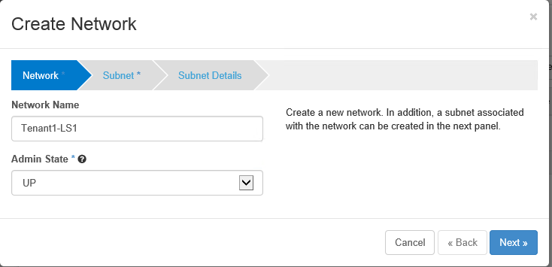
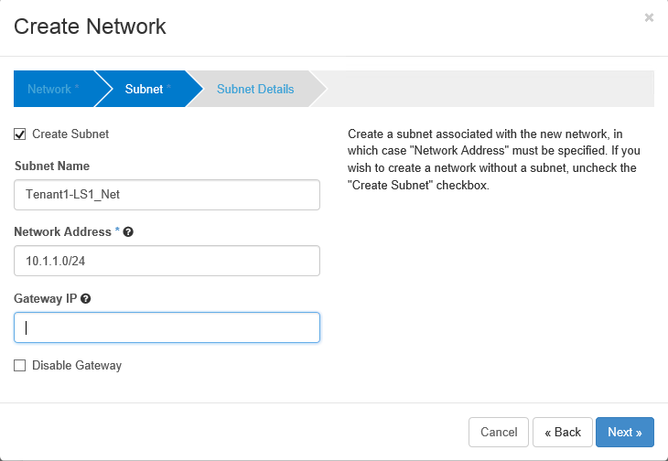
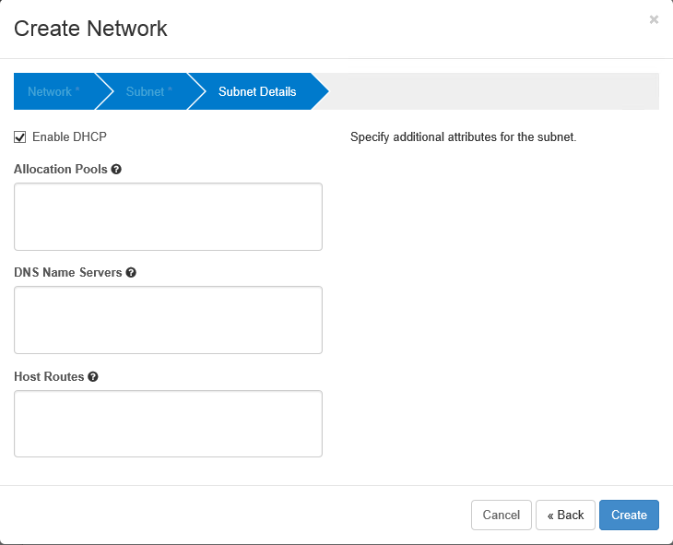
Switching – OpenStack Configuration (1/3)
Tenant1-LS1
10.1.1.0/24
Tenant1-LS2
10.1.2.0/24
Create a Logical Switch (OpenStack Network)
Horizon (UI)
Under "Project - Network – Networks", Create Network
1
2
3
If empty, all subnet will be used for DHCP minus the dgw IP@ (first IP@ of the range is used for DHCP server)
Currently only 1 IP@ can be entered in UI (use CLI for more than one) – bug 1506196
If empty, first IP@ of subnet will be used for the default gateway
Currently not supported in VIO

Slide 20
Switching – OpenStack Configuration (2/3)
Tenant1-LS1
10.1.1.0/24
Tenant1-LS2
10.1.2.0/24
Create a Logical Switch (OpenStack Network)
CLI (API)
From VIO Controller (how to access the VIO Controller in the Notes)
Create a Network
1
root@controller01:~# neutron net-create Tenant1-LS2
Created a new network:
+-----------------------+--------------------------------------+
| Field | Value |
+-----------------------+--------------------------------------+
| admin_state_up | True |
| id | b1436207-f50c-4742-ae45-58226f8dd631 |
| name | Tenant1-LS2 |
| port_security_enabled | True |
| router:external | False |
| shared | False |
| status | ACTIVE |
| subnets | |
| tenant_id | 40e97bec2b06462098b241f04a224167 |
+-----------------------+--------------------------------------+
Notes:
Access to the VIO Controller:
SSH to the VIO OMS (viouser / pwd)
ssh viouser@x.x.x.x
Note: First time go on console to set up your password
From VIO OMS, SSH to the VIO Controller01
viouser@localhost:~$ ssh controller01
Note: You don’t need to use the IP@, the VIO OMS has in its /etc/hosts file the "VIO VM names / IP" resolution
Enter your OpenStack credentials
viouser@controller01:~$ sudo su -
. For admin: root@controller01:~# source cloudadmin.rc
Note: To avoid entering each time the admin pwd, add the following line in cloudadmin.rc "export OS_PASSWORD=password"
. For tenant1: copy the cloudadmin.rc to tenant1.rc and modify the following variables "export OS_TENANT_NAME", "export OS_USERNAME", "export OS_PASSWORD"

Slide 21
Switching – OpenStack Configuration (3/3)
Tenant1-LS1
10.1.1.0/24
Tenant1-LS2
10.1.2.0/24
Create a Logical Switch (OpenStack Network)
CLI (API)
Associate a Subnet to the Network
2
root@controller01:~# neutron subnet-create --name Tenant1-LS2_Net Tenant1-LS2 10.1.2.0/24
--dns-nameservers list=true 10.33.38.1 10.33.38.2
Created a new subnet:
+-------------------+--------------------------------------------+
| Field | Value |
+-------------------+--------------------------------------------+
| allocation_pools | {"start": "10.1.2.2", "end": "10.1.2.254"} |
| cidr | 10.1.2.0/24 |
| dns_nameservers | 10.33.38.1 |
| | 10.33.38.2 |
| enable_dhcp | True |
| gateway_ip | 10.1.2.1 |
| host_routes | |
| id | d7eb0562-95d9-42ab-99b7-cfb40519b45c |
| ip_version | 4 |
| ipv6_address_mode | |
| ipv6_ra_mode | |
| name | Tenant1-LS2_Net |
| network_id | b1436207-f50c-4742-ae45-58226f8dd631 |
| subnetpool_id | |
| tenant_id | 40e97bec2b06462098b241f04a224167 |
+-------------------+--------------------------------------------+

Slide 22
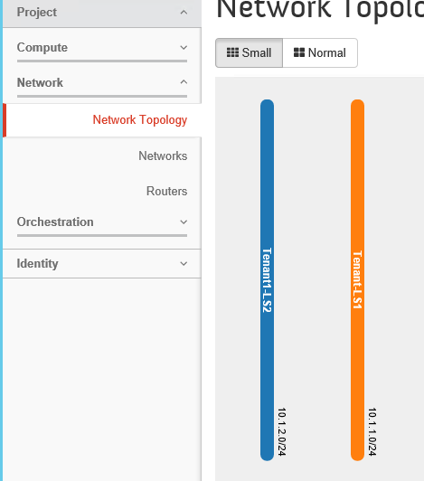
Switching – OpenStack Validation (1/2)
Tenant1-LS1
10.1.1.0/24
Tenant1-LS2
10.1.2.0/24
Visualize Logical Switch in OpenStack
Horizon (UI)
Under "Project - Network – Network Topology"

Slide 23
Switching – OpenStack Validation (2/2)
Tenant1-LS1
10.1.1.0/24
Tenant1-LS2
10.1.2.0/24
Visualize Logical Switch in OpenStack
CLI (API)
More information:
on specific network with "neutron net-show <net-uuid>"
on specific subnet with "neutron subnet-show <subnet-uuid>"
root@controller01:~# neutron net-list
+--------------------------------------+-------------+--------------------------------------------------+
| id | name | subnets |
+--------------------------------------+-------------+--------------------------------------------------+
| b1436207-f50c-4742-ae45-58226f8dd631 | Tenant1-LS2 | d7eb0562-95d9-42ab-99b7-cfb40519b45c 10.1.2.0/24 |
| 6d868ba6-5a70-4ca9-a7d3-822558571d40 | Tenant1-LS1 | a8175a61-9162-4253-971d-9e675aba3cbf 10.1.1.0/24 |
+--------------------------------------+-------------+--------------------------------------------------+
root@controller01:~# neutron subnet-list
+--------------------------------------+-----------------+-------------+--------------------------------------------+
| id | name | cidr | allocation_pools |
+--------------------------------------+-----------------+-------------+--------------------------------------------+
| d7eb0562-95d9-42ab-99b7-cfb40519b45c | Tenant1-LS2_Net | 10.1.2.0/24 | {"start": "10.1.2.2", "end": "10.1.2.254"} |
| a8175a61-9162-4253-971d-9e675aba3cbf | Tenant1-LS1_Net | 10.1.1.0/24 | {"start": "10.1.1.2", "end": "10.1.1.254"} |
+--------------------------------------+-----------------+-------------+--------------------------------------------+

Slide 24
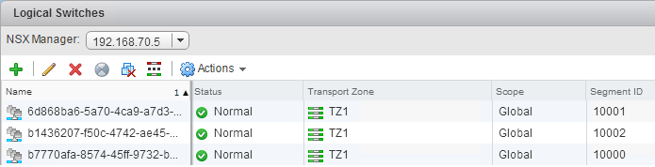
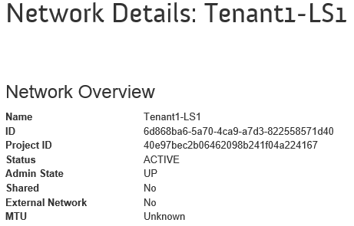
Switching – What happens in the backend (1/3)
Tenant1-LS1
10.1.1.0/24
Tenant1-LS2
10.1.2.0/24
For each OpenStack Network created:
1 Logical Switch is created in NSX
Under "NSX – Logical Switches"
Note: The Logical Switch name is the OpenStack Network UUID.
You can find the OpenStack Network UUID via Horizon (edit the network)
or CLI
1
root@controller01:~# neutron net-list --all-tenants
(requires admin credentials)
+--------------------------------------+----------------+
| id | name |
+--------------------------------------+----------------+
| b1436207-f50c-4742-ae45-58226f8dd631 | Tenant1-LS2 |
| b7770afa-8574-45ff-9732-becd8bfff90e | inter-edge-net |
| 6d868ba6-5a70-4ca9-a7d3-822558571d40 | Tenant1-LS1 |
+--------------------------------------+----------------+

Slide 25

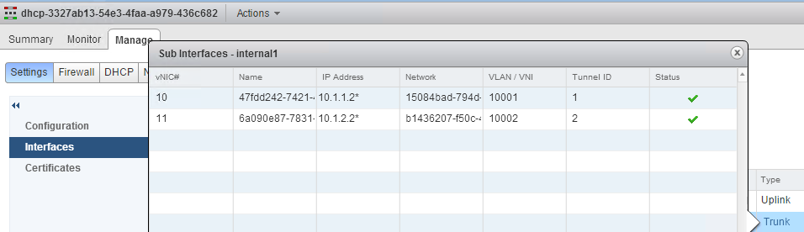
Switching – What happens in the backend (2/3)
Tenant1-LS1
10.1.1.0/24
Tenant1-LS2
10.1.2.0/24
For each OpenStack Network created:
The DHCP Edge is updated
Under "NSX – NSX Edges"
with LS in trunk interface
with IP@ = first IP@ of DHCP range
2
.2
.2
Trunk interface
DHCP-Edge
LS-to-metadata
169.254.128.0/17
To metadata
server
In OpenStack UI the DHCP-Edge and LS-to-metadata are not represented.
This allow VMs to reach the metadata server when the network is created with no gateway (more info in the metadata section)
In OpenStack CLI the admin can see the LS-to-metadata network called "inter-edge-net" (neutron net-list --all-tenants)

Slide 26
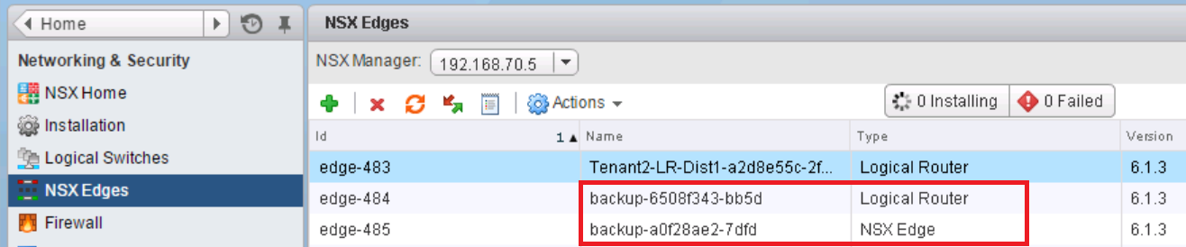
Switching – What happens in the backend (3/3)
Technical Note:
A new DHCP Edge is created (from the backup-xxx edges*) in case of :
more than 160 logical networks
new subnet is IP overlapping with an existing network on the DHCP Edge
The subnet is attached to a Distributed Logical Router
*: New deployment of NSX-v Edges or DLR is slow (1 to 2 mns). To speed-up the deployment process, NSX-v plugin pre-deploys NSX Edges and DLR with the name "backup-xxx".
When a new Edge or DLR is needed for Network (logical switch) or Router (logical router), one "backup-xxx" is simply renamed and a new "backup-xxx" is pre-deployed.
Note: The number of pre-deployed and maximum Edges and DLR as well as its type (compact, large, etc) is defined in /etc/neutron/plugins/vmware/nsxv.ini with setting "backup_edge_pool"

Slide 27
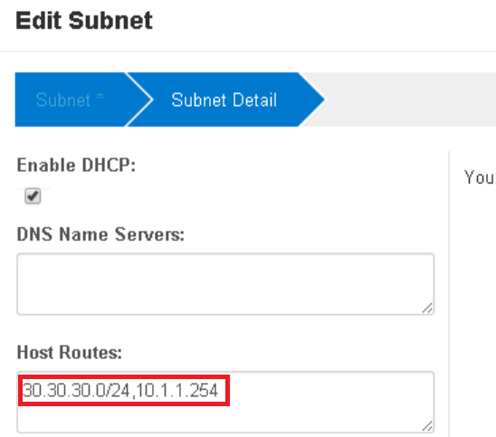

Switching – Limitation or bug (1/1)
Tenant1-LS1
10.1.1.0/24
Tenant1-LS2
10.1.2.0/24
Bug
No Horizon UI for multiple DNS server (bug 1506196)
Limitation:
No IPv6 support
No Host Routing support (bug 1471988)
Physical
Router2
Physical
Router1
.1
.1
External-VLAN102
21.21.21.0/24
External-VLAN101
20.20.20.0/24
.254
Tenant1-LS1
10.1.1.0/24
.1
Tenant1-LS2
10.1.2.0/24
VM
VM
VM
VM
dgw = .1
static route 30.30.30/0 via .254

Slide 28


Switching – Specific use case "Provider Network" Tenant VMs in the same subnet as physical servers/routers/appliance
Case1 with 1 single vDS for "Compute + Mgt-Edge":
Logical View
Physical View
Provider-Net1 VLAN111
10.2.1.0/24
vDS Provider-Net1 PortGroup
VLAN111
VLAN111
VM
VM
VM
VM
Instances
DHCP-Edge
Physical
servers/appliances
Instances
DHCP-Edge
Physical
servers/appliances
Compute, Mgt-Edge VDS
Cluster
Compute
Cluster
Mgt-Edge
VLAN111 must be available
on all ESXi Compute (for the VM) and on all ESXi Edge (for DHCP) on the vDS-Transport

Slide 29
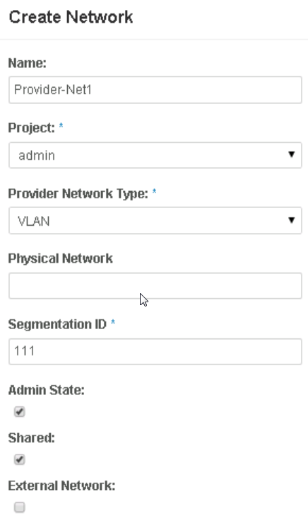
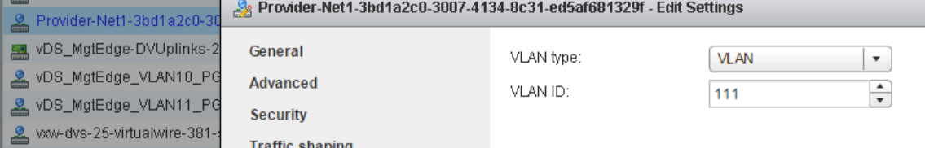
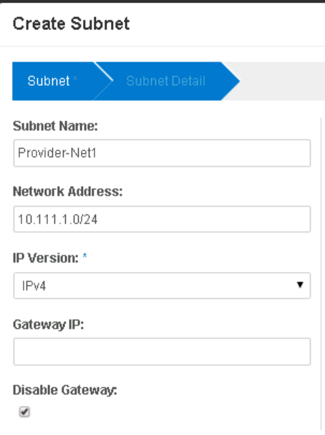
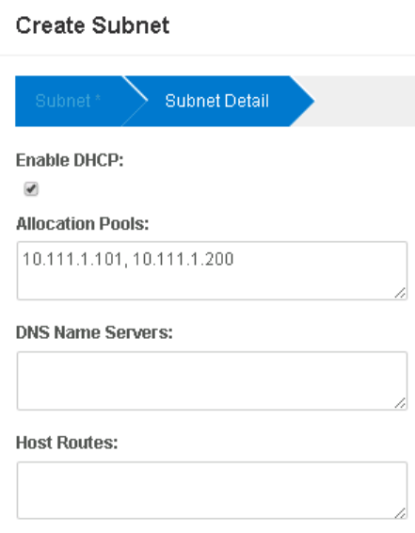
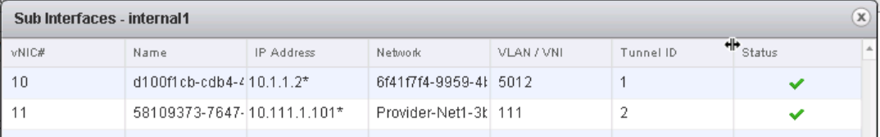
Switching – Specific use case "Provider Network" Tenant VMs in the same subnet as physical servers/routers/appliance
Case1 with 1 single vDS for "Compute + Edge":
Create a VLAN Provider Network (as admin)
Under "Admin - System Panel - Networks - Create Network" with option "shared"
This creates a new VDS port group
Create a Subnet on that provider network (as admin)
Attention: Check "Disable Gateway" + "Enable DHCP"
This creates a new Edge DHCP Trunk interface
Logical View
Physical View
Provider-Net1 VLAN111
10.2.1.0/24
vDS Provider-Net1 PortGroup
VLAN111
VLAN111
VM
VM
VM
VM

Slide 30
Switching – Specific use case "Provider Network" Tenant VMs in the same subnet as physical servers/routers/appliance
Case2 with different vDS for "Compute" and "Edge":
Logical View
Physical View
Provider-VXLAN-Net1 / VLAN112
10.112.1.0/24
vDS Provider-VXLAN-Net1
Port Group
VLAN112
VM
VM
VM
VM
Instances
DHCP-Edge
Physical
servers/appliances
Instances
DHCP-Edge
Physical
servers/appliances
Compute VDS
Mgt-Edge VDS
Cluster
Compute
Cluster
Edge
VLAN112 must be available
Only on ESXi Edge (for VXLAN/VLAN bridging) on the vDS-Transport

Slide 31
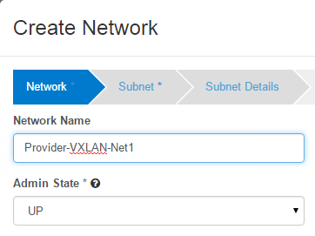
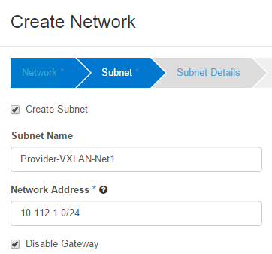
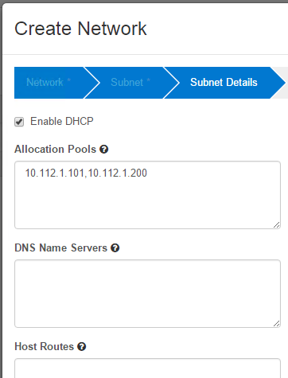
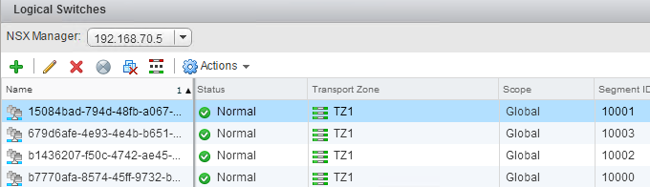
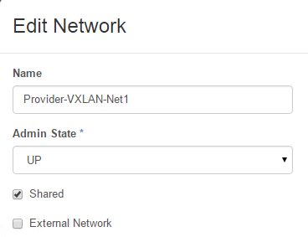
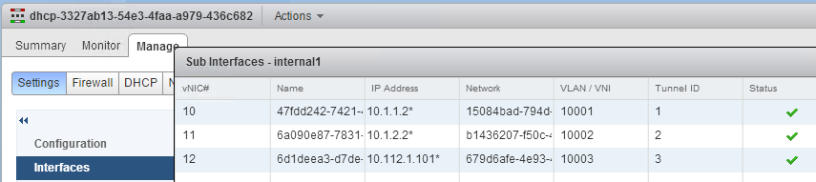
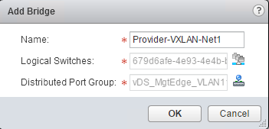
Switching – Specific use case "Provider Network" Tenant VMs in the same subnet as physical servers/routers/appliance
Case2 with different vDS for "Compute" and "Edge":
Create a VXLAN Provider Network + Subnet (as admin)
Create an admin VXLAN Network + Subnet
This step is NOT created under "Admin - System Panel - Networks - Create Network"
This step is created under "Project – Network – Create Network"
Attention: Check "Disable Gateway" + "Enable DHCP"
This creates a new VXLAN network
and a new Edge DHCP Trunk interface
Update that Network to be Shared (as admin)
Under "Admin - Network", edit that created network and enable "Shared"
The network is now a VXLAN provider network
Create a VXLAN/VLAN bridging
This step is currently done outside of OpenStack (bug 1464848 is
tracking the enhancement to support "neutron net-gateway-connect" in VIO)
In NSX-v, create a new DLR and configure VXLAN/VLAN bridging
Logical View
Physical View
Provider-VXLAN-Net1 / VLAN112
10.112.1.0/24
vDS Provider-VXLAN-Net1
Port Group
VLAN112
VM
VM
VM
VM

Slide 32
List of network and security services
L2
Switching
DHCP
L3
External Network
Logical Routing Centralized
Logical Routing Distributed
Static Route
Floating IP@
No-NAT
Security
Firewalling
Port Security
Load Balancing
Metadata Service

Slide 33
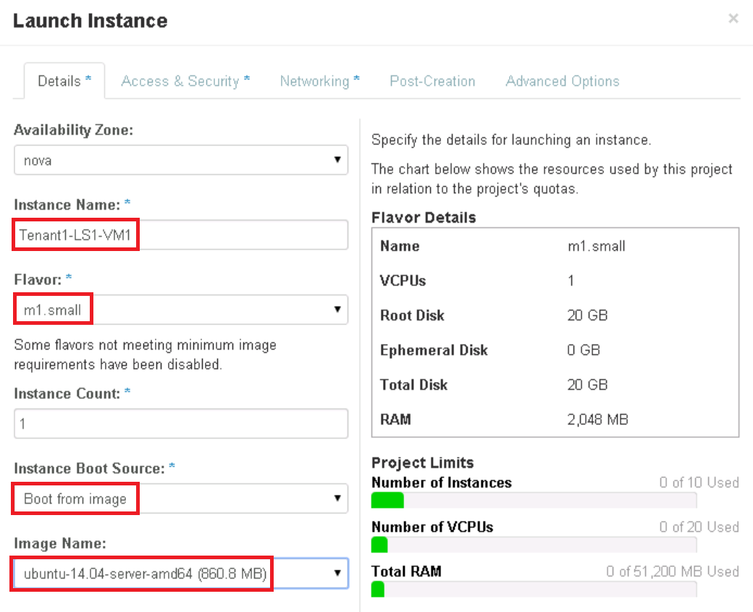
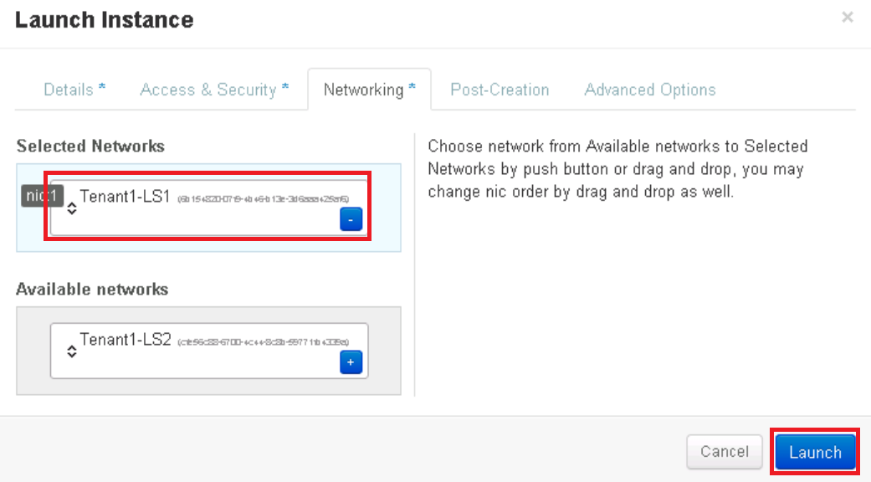
DHCP – OpenStack Configuration (1/3)
Tenant1-LS1
10.1.1.0/24
Tenant1-LS2
10.1.2.0/24
Create a VM (OpenStack Instance)
Horizon (UI)
Under "Project – Compute – Instances", Launch Instance
VM
VM
1
2

Slide 34
DHCP – OpenStack Configuration (2/3)
Tenant1-LS1
10.1.1.0/24
Tenant1-LS2
10.1.2.0/24
Create a VM (OpenStack Instance)
CLI (API)
From VIO Controller (how to access the VIO Controller in the Notes)
Get the Network UUID
VM
VM
1
root@controller01:~# neutron net-list
+--------------------------------------+-------------+--------------------------------------------------+
| id | name | subnets |
+--------------------------------------+-------------+--------------------------------------------------+
| cfe56c88-6700-4c44-8c8b-59771fb4339a | Tenant1-LS2 | e7b2df94-279b-41b8-8c11-5e03a9913535 10.1.2.0/24 |
| 6b154820-07f9-4b46-b13e-3d6aaa425af6 | Tenant1-LS1 | 3abf8fd9-f083-4a9c-8fd0-5a9e2753b20d 10.1.1.0/24 |
+--------------------------------------+-------------+--------------------------------------------------+
Notes:
Access to the VIO Controller:
SSH to the VIO OMS (viouser / pwd)
ssh viouser@x.x.x.x
Note: First time go on console to set up your password
From VIO OMS, SSH to the VIO Controller01
viouser@localhost:~$ ssh controller01
Note: You don’t need to use the IP@, the VIO OMS has in its /etc/hosts file the "VIO VM names / IP" resolution
Enter your OpenStack credentials
viouser@controller01:~$ sudo su -
. For admin: root@controller01:~# source cloudadmin.rc
Note: To avoid entering each time the admin pwd, add the following line in cloudadmin.rc "export OS_PASSWORD=vmware"
. For tenant1: copy the cloudadmin.rc to tenant1.rc and modify the following variables "export OS_TENANT_NAME", "export OS_USERNAME", "export OS_PASSWORD"

Slide 35
DHCP – OpenStack Configuration (3/3)
Tenant1-LS1
10.1.1.0/24
Tenant1-LS2
10.1.2.0/24
Create a VM (OpenStack Instance)
CLI (API)
Create the image
VM
VM
2
root@controller01:~# nova boot --flavor m1.small --image ubuntu-14.04-server-amd64
--nic net-id=6b154820-07f9-4b46-b13e-3d6aaa425af6 Tenant1-LS1-VM2
+--------------------------------------+------------------------------------------------------------------+
| Property | Value |
+--------------------------------------+------------------------------------------------------------------+
| OS-DCF:diskConfig | MANUAL |
| OS-EXT-AZ:availability_zone | nova |
| OS-EXT-STS:power_state | 0 |
| OS-EXT-STS:task_state | scheduling |
| OS-EXT-STS:vm_state | building |
| OS-SRV-USG:launched_at | - |
| OS-SRV-USG:terminated_at | - |
| accessIPv4 | |
| accessIPv6 | |
| adminPass | 8o8BnHT5DAgN |
| config_drive | |
| created | 2015-08-25T16:19:44Z |

Slide 36
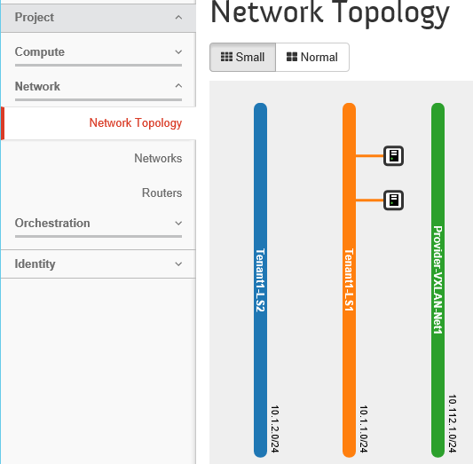
DHCP – OpenStack Validation (1/2)
Tenant1-LS1
10.1.1.0/24
Tenant1-LS2
10.1.2.0/24
Visualize in OpenStack VM IP@
Horizon (UI)
Under "Project - Network – Network Topology"
VM
VM

Slide 37
DHCP – OpenStack Validation (2/2)
Tenant1-LS1
10.1.1.0/24
Tenant1-LS2
10.1.2.0/24
Visualize in OpenStack VM IP@
CLI (API)
More information on specific VM "nova show <instance-uuid>"
VM
VM
root@controller01:~# nova list
+--------------------------------------+-----------------+--------+------------+-------------+----------------------+
| ID | Name | Status | Task State | Power State | Networks |
+--------------------------------------+-----------------+--------+------------+-------------+----------------------+
| db623270-421d-44b8-a506-2245667fb318 | Tenant1-LS1-VM1 | ACTIVE | - | Running | Tenant1-LS1=10.1.1.3 |
| a4e3aefc-c852-4adc-81d4-594078511e54 | Tenant1-LS1-VM2 | ACTIVE | - | Running | Tenant1-LS1=10.1.1.4 |
+--------------------------------------+-----------------+--------+------------+-------------+----------------------+

Slide 38
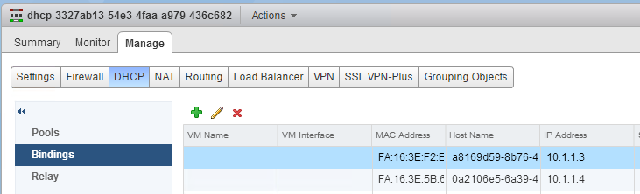
DHCP – What happens in the backend (1/1)
Tenant1-LS1
10.1.1.0/24
Tenant1-LS2
10.1.2.0/24
For each OpenStack Instance created:
The DHCP Edge is updated
Under "NSX – NSX Edges"
with VM mac@ - IP@ binding
Note: The hostname is the "Neutron port" (neutron port-list)
Note: The DHCP Edge has been created in the LS creation.
See "Switching – What happens in the backend (2/3) + (3/3)"
VM
VM
.2
.2
Trunk interface
DHCP-Edge
LS-to-metadata
169.254.128.0/17
To metadata
server
In OpenStack UI the DHCP-Edge and LS-to-metadata are not represented.
This allow VMs to reach the metadata server when the network is created with no gateway (more info in the metadata section)
In OpenStack CLI the admin can see the LS-to-metadata network called "inter-edge-net" (neutron net-list --all-tenants)

Slide 39
DHCP – Limitation or bug (1/1)
Tenant1-LS1
10.1.1.0/24
Tenant1-LS2
10.1.2.0/24
None
VM
VM
.2
.2
Trunk interface
DHCP-Edge
LS-to-metadata
169.254.128.0/17
To metadata
server

Slide 40
List of network and security services
L2
Switching
DHCP
L3
External Network
Logical Routing Centralized
Logical Routing Distributed
Static Route
Floating IP@
No-NAT
Security
Firewalling
Port Security
Load Balancing
Metadata Service

Slide 41
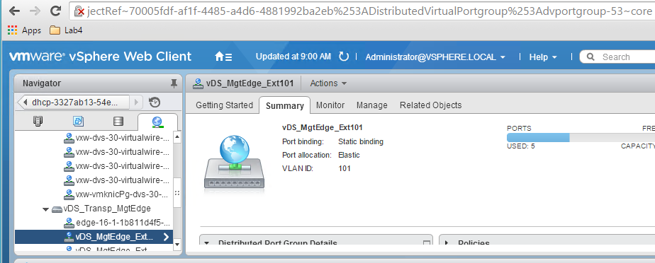
External Network – OpenStack Configuration (1/5)
External-VLAN101
20.20.20.0/24
Create an External Network (OpenStack Network)
Retrieve the vCenter external VLAN port group
Under "vCenter – Networking", select external VLAN port group
And retreive dvportgroup-id from URL
Tenant1-LS1
10.1.1.0/24
Tenant1-LS2
10.1.2.0/24

Slide 42
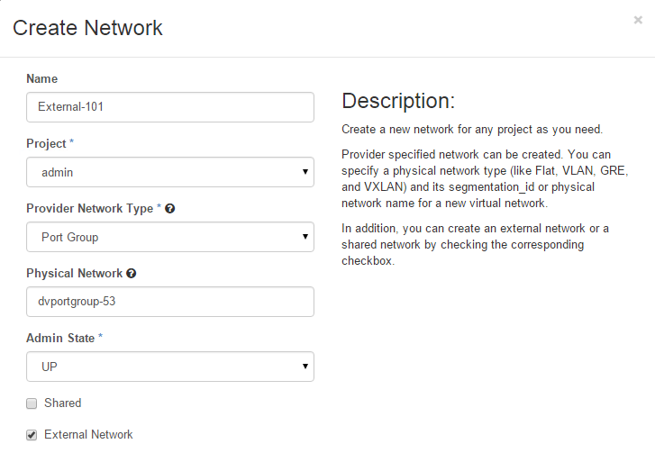
External Network – OpenStack Configuration (2/5)
Physical
Router
.1
External-VLAN101
20.20.20.0/24
Create an External Network (OpenStack Network)
Horizon (UI)
Under "Admin – System Panel – Networks", Create Network
Tenant1-LS1
10.1.1.0/24
Tenant1-LS2
10.1.2.0/24
1
This network is "External".
No VMs can be deployed in.
Only future Tenant Routers

Slide 43
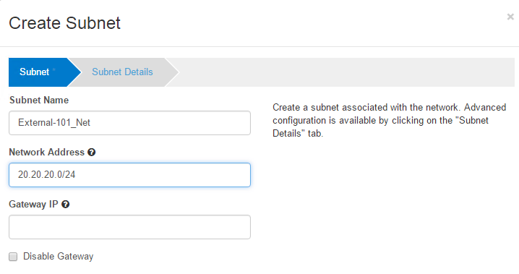
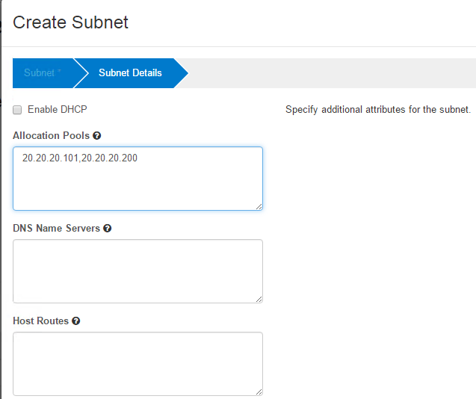
External Network – OpenStack Configuration (3/5)
Physical
Router
.1
External-VLAN101
20.20.20.0/24
Create an External Network (OpenStack Network)
Horizon (UI)
Under "Admin – System Panel – Networks", Edit Network and create subnet
Tenant1-LS1
10.1.1.0/24
Tenant1-LS2
10.1.2.0/24
2
3
Since no VMs will be deployed in that network, DHCP is not supported on External Networks.
When no IP@ specified, it takes the first IP@ of the subnet
IP pool available for future Tenant Routers and their floating IP.
This option is irrelevent for External Networks (only for Tenant Networks to accept or not a default gw for that subnet)

Slide 44
External Network – OpenStack Configuration (4/5)
Physical
Router
.1
External-VLAN102
21.21.21.0/24
Create an External Network (OpenStack Network)
CLI (API)
From VIO Controller (how to access the VIO Controller in the Notes)
Tenant1-LS1
10.1.1.0/24
Tenant1-LS2
10.1.2.0/24
1
root@controller01:~# neutron net-create External-102 -- --provider:network_type=portgroup
--provider:physical_network=dvportgroup-1443 --router:external=True
(requires admin credentials)
Created a new network:
+---------------------------+--------------------------------------+
| Field | Value |
+---------------------------+--------------------------------------+
| admin_state_up | True |
| id | 5f4a2f7a-b888-4d99-8089-ed2f93178476 |
| name | External-102 |
| port_security_enabled | True |
| provider:network_type | portgroup |
| provider:physical_network | dvportgroup-187 |
| provider:segmentation_id | 0 |
| router:external | True |
| shared | False |
| status | ACTIVE |
| subnets | |
| tenant_id | 423a48a7cf7b43689fa529692299e7ab |
+---------------------------+--------------------------------------+
Notes:
Access to the VIO Controller:
SSH to the VIO OMS (viouser / pwd)
ssh viouser@x.x.x.x
Note: First time go on console to set up your password
From VIO OMS, SSH to the VIO Controller01
viouser@localhost:~$ ssh controller01
Note: You don’t need to use the IP@, the VIO OMS has in its /etc/hosts file the "VIO VM names / IP" resolution
Enter your OpenStack credentials
viouser@controller01:~$ sudo su -
. For admin: root@controller01:~# source cloudadmin.rc
Note: To avoid entering each time the admin pwd, add the following line in cloudadmin.rc "export OS_PASSWORD=vmware"
. For tenant1: copy the cloudadmin.rc to tenant1.rc and modify the following variables "export OS_TENANT_NAME", "export OS_USERNAME", "export OS_PASSWORD"

Slide 45
External Network – OpenStack Configuration (5/5)
Physical
Router
.1
External-VLAN102
21.21.21.0/24
Create an External Network (OpenStack Network)
CLI (API)
From VIO Controller (how to access the VIO Controller in the Notes)
Tenant1-LS1
10.1.1.0/24
Tenant1-LS2
10.1.2.0/24
2
root@controller01:~# neutron subnet-create --name External-102_Net --allocation-pool
start=21.21.21.101,end=21.21.21.200 External-102 21.21.21.0/24 -- --enable_dhcp=False
Created a new subnet:
+-------------------+--------------------------------------------------+
| Field | Value |
+-------------------+--------------------------------------------------+
| allocation_pools | {"start": "21.21.21.101", "end": "21.21.21.200"} |
| cidr | 21.21.21.0/24 |
| dns_nameservers | |
| enable_dhcp | False |
| gateway_ip | 21.21.21.1 |
| host_routes | |
| id | 2b7afa0f-0db3-4b50-9880-1e70d11f0578 |
| ip_version | 4 |
| ipv6_address_mode | |
| ipv6_ra_mode | |
| name | External-102_Net |
| network_id | 5f4a2f7a-b888-4d99-8089-ed2f93178476 |
| subnetpool_id | |
| tenant_id | 423a48a7cf7b43689fa529692299e7ab |
+-------------------+--------------------------------------------------+
Notes:
Access to the VIO Controller:
SSH to the VIO OMS (viouser / pwd)
ssh viouser@x.x.x.x
Note: First time go on console to set up your password
From VIO OMS, SSH to the VIO Controller01
viouser@localhost:~$ ssh controller01
Note: You don’t need to use the IP@, the VIO OMS has in its /etc/hosts file the "VIO VM names / IP" resolution
Enter your OpenStack credentials
viouser@controller01:~$ sudo su -
. For admin: root@controller01:~# source cloudadmin.rc
Note: To avoid entering each time the admin pwd, add the following line in cloudadmin.rc "export OS_PASSWORD=vmware"
. For tenant1: copy the cloudadmin.rc to tenant1.rc and modify the following variables "export OS_TENANT_NAME", "export OS_USERNAME", "export OS_PASSWORD"

Slide 46
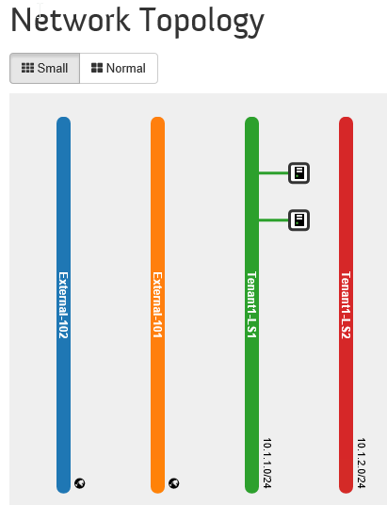
External Network – OpenStack Validation (1/3)
Physical
Router
.1
External-VLAN101
20.20.20.0/24
Visualize in OpenStack External networks
Horizon (UI)
Under "Project - Network – Network Topology"
Tenant1-LS1
10.1.1.0/24
Tenant1-LS2
10.1.2.0/24

Slide 47
External Network – OpenStack Validation (2/3)
Physical
Router
.1
External-VLAN101
20.20.20.0/24
Visualize in OpenStack External networks
CLI (API)
root@controller01:~# neutron net-show External-101
+-----------------------+--------------------------------------+
| Field | Value |
+-----------------------+--------------------------------------+
| admin_state_up | True |
| id | ccee6823-360d-43d7-99b0-a7e22b82433f |
| name | External-101 |
| port_security_enabled | True |
| router:external | True |
| shared | False |
| status | ACTIVE |
| subnets | e303cc61-40be-4fcf-a241-9780fb9c6a3c |
| tenant_id | 423a48a7cf7b43689fa529692299e7ab |
+-----------------------+--------------------------------------+
Tenant1-LS1
10.1.1.0/24
Tenant1-LS2
10.1.2.0/24

Slide 48
External Network – OpenStack Validation (3/3)
Physical
Router
.1
External-VLAN101
20.20.20.0/24
Visualize in OpenStack External networks
CLI (API)
root@controller01:~# neutron subnet-show External-101
+-----------------------+--------------------------------------------------+
| Field | Value |
+-----------------------+--------------------------------------------------+
| adv_service_providers | |
| allocation_pools | {"start": "20.20.20.101", "end": "20.20.20.200"} |
| cidr | 20.20.20.0/24 |
| dns_nameservers | |
| enable_dhcp | False |
| gateway_ip | |
| host_routes | |
| id | 5b9b2af5-d9a4-4903-a5c3-5d63bde97d16 |
| ip_version | 4 |
| name | External-101 |
| network_id | 32c1da26-5c0f-42b2-ad73-8926b7a15da1 |
| tenant_id | 3f67f0bbc089414da0fa8d214f541d50 |
+-----------------------+--------------------------------------------------+
Tenant1-LS1
10.1.1.0/24
Tenant1-LS2
10.1.2.0/24

Slide 49
External Network – What happens in the backend (1/2)
Physical
Router
.1
External-VLAN101
20.20.20.0/24
For each OpenStack External Network created:
Nothing happens on NSX-v
Tenant1-LS1
10.1.1.0/24
Tenant1-LS2
10.1.2.0/24

Slide 50
External Network – Limitation or bug (1/1)
Physical
Router
.1
External-VLAN101
20.20.20.0/24
None
Tenant1-LS1
10.1.1.0/24
Tenant1-LS2
10.1.2.0/24

Slide 51
List of network and security services
L2
Switching
DHCP
L3
External Network
Logical Routing Centralized
Logical Routing Distributed
Static Route
Floating IP@
No-NAT
Security
Firewalling
Port Security
Load Balancing
Metadata Service

Slide 52
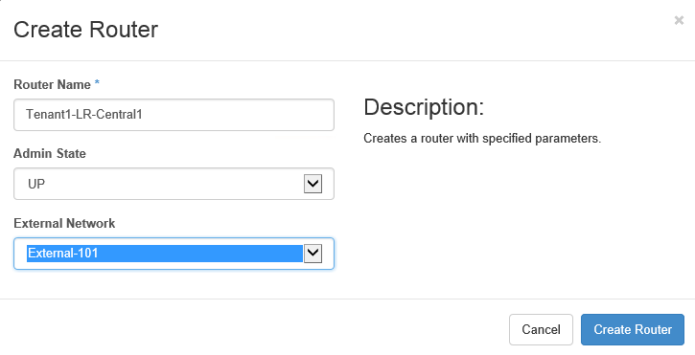
LR Centralized – OpenStack Configuration (1/5)
Physical
Router
.1
External-VLAN101
20.20.20.0/24
Create a Logical Router Centralized (OpenStack Router)
Horizon (UI)
Create Router
Under "Project - Network – Routers", Create Router
1
Tenant1-LS1
10.1.1.0/24
Tenant1-LS2
10.1.2.0/24
VM
VM
VM
VM

Slide 53
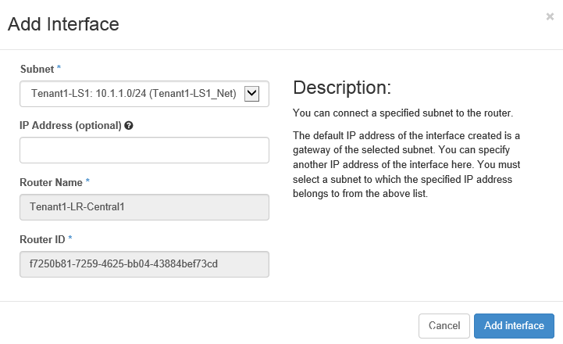
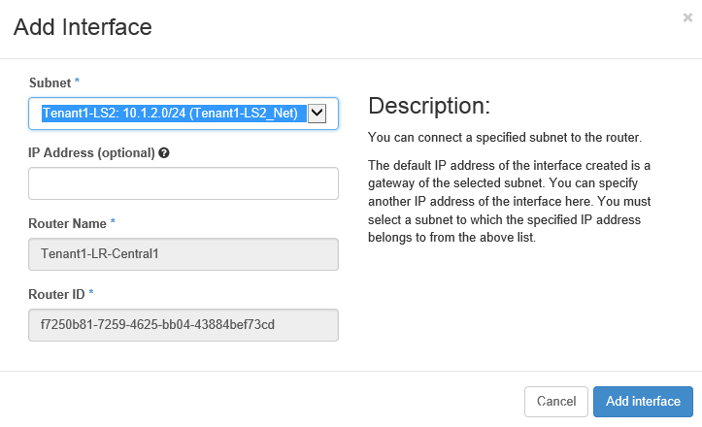
LR Centralized – OpenStack Configuration (2/5)
Physical
Router
.1
External-VLAN101
20.20.20.0/24
Create a Logical Router Centralized (OpenStack Router)
Horizon (UI)
Add internal interface to Router
Under "Project - Network – Routers", Edit Router and add interface
2
Tenant1-LS1
10.1.1.0/24
Tenant1-LS2
10.1.2.0/24
VM
VM
VM
VM

Slide 54
LR Centralized – OpenStack Configuration (4/5)
Physical
Router
.1
External-VLAN101
20.20.20.0/24
Create a Logical Router Centralized (OpenStack Router)
CLI (API)
From VIO Controller (how to access the VIO Controller in the Notes)
Create Router
Tenant1-LS1
10.1.1.0/24
Tenant1-LS2
10.1.2.0/24
1
root@controller01:~# neutron router-create Tenant1-LR-Central1
Created a new router:
+-----------------------+--------------------------------------+
| Field | Value |
+-----------------------+--------------------------------------+
| admin_state_up | True |
| distributed | False |
| external_gateway_info | |
| id | f85c4454-f6c9-4b4a-8011-f909f7de8b75 |
| name | Tenant1-LR-Central1 |
| router_type | shared |
| routes | |
| status | ACTIVE |
| tenant_id | 5e695adfe85d458ba5ef7503ceb27fe7 |
+-----------------------+--------------------------------------+
VM
VM
VM
VM
Notes:
Access to the VIO Controller:
SSH to the VIO OMS (viouser / pwd)
ssh viouser@x.x.x.x
Note: First time go on console to set up your password
From VIO OMS, SSH to the VIO Controller01
viouser@localhost:~$ ssh controller01
Note: You don’t need to use the IP@, the VIO OMS has in its /etc/hosts file the "VIO VM names / IP" resolution
Enter your OpenStack credentials
viouser@controller01:~$ sudo su -
. For admin: root@controller01:~# source cloudadmin.rc
Note: To avoid entering each time the admin pwd, add the following line in cloudadmin.rc "export OS_PASSWORD=vmware"
. For tenant1: copy the cloudadmin.rc to tenant1.rc and modify the following variables "export OS_TENANT_NAME", "export OS_USERNAME", "export OS_PASSWORD"

Slide 55
LR Centralized – OpenStack Configuration (5/5)
Physical
Router
.1
External-VLAN101
20.20.20.0/24
Create a Logical Router Centralized (OpenStack Router)
CLI (API)
Add internal interface to Router
Add upstream interface to Router
2
Tenant1-LS1
10.1.1.0/24
Tenant1-LS2
10.1.2.0/24
root@controller01:~# neutron router-interface-add
Tenant1-LR-Central1 Tenant1-LS1_Net
Added interface da0e94b4-a5f1-4954-88e7-26b12fa11aed
to router Tenant1-LR-Central1.
root@controller01:~# neutron router-interface-add
Tenant1-LR-Central1 Tenant1-LS2_Net
Added interface dc801f6a-610f-421a-beb0-59244fb6c616
to router Tenant1-LR-Central1.
VM
VM
VM
VM
3
root@controller01:~# neutron router-gateway-set
Tenant1-LR-Central1 External-101
Set gateway for router Tenant1-LR-Central1

Slide 56
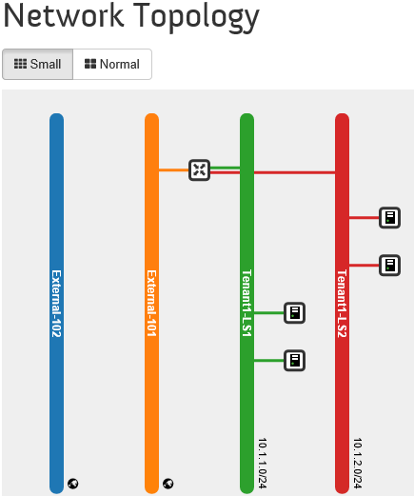
LR Centralized – OpenStack Validation (1/2)
External-VLAN101
20.20.20.0/24
Tenant1-LS1
10.1.1.0/24
Tenant1-LS2
10.1.2.0/24
Visualize in OpenStack LR Centralized
Horizon (UI)
Under "Project - Network – Network Topology"
VM
VM
VM
VM

Slide 57
LR Centralized – OpenStack Validation (2/2)
External-VLAN101
20.20.20.0/24
Tenant1-LS1
10.1.1.0/24
Tenant1-LS2
10.1.2.0/24
Visualize in OpenStack LR Centralized
CLI (API)
root@controller01:~# neutron router-list
+--------------------------------------+---------------------+----------------------------------------------------------------------------------------------------------
| id | name | external_gateway_info
+--------------------------------------+---------------------+----------------------------------------------------------------------------------------------------------
| f7250b81-7259-4625-bb04-43884bef73cd | Tenant1-LR-Central1 | {"network_id": "ccee6": [{"subnet_id": "e303cc61-40be-4fcf-a241-9780fb9c6a3c", "ip_address": "20.20.20.10
+--------------------------------------+---------------------+----------------------------------------------------------------------------------------------------------
root@controller01:~# neutron router-port-list Tenant1-LR-Central1
+--------------------------------------+------+-------------------+---------------------------------------------------------------------------------+
| id | name | mac_address | fixed_ips |
+--------------------------------------+------+-------------------+---------------------------------------------------------------------------------+
| 80e0829d-8a5f-43f9-b73b-6d99ee244716 | | fa:16:3e:8d:32:bc | {"subnet_id": "a8175a61-9162-4253-971d-9e675aba3cbf", "ip_address": "10.1.1.1"} |
| d7a4ac97-95b6-406f-b84e-0caf12eaf183 | | fa:16:3e:9c:ae:70 | {"subnet_id": "d7eb0562-95d9-42ab-99b7-cfb40519b45c", "ip_address": "10.1.2.1"} |
+--------------------------------------+------+-------------------+---------------------------------------------------------------------------------+
root@controller01:~# neutron router-port-list Tenant1-LR-Central1 (requires admin credentials)
+--------------------------------------+------+-------------------+--------------------------------------------------------------------------------------+
| id | name | mac_address | fixed_ips |
+--------------------------------------+------+-------------------+--------------------------------------------------------------------------------------+
| 6b0390ad-d676-4d00-89f1-74a025a90a75 | | fa:16:3e:3a:4b:67 | {"subnet_id": "a2546d83-2e5c-466b-9cfb-b969b3409c94", "ip_address": "169.254.128.5"} |
| 80e0829d-8a5f-43f9-b73b-6d99ee244716 | | fa:16:3e:8d:32:bc | {"subnet_id": "a8175a61-9162-4253-971d-9e675aba3cbf", "ip_address": "10.1.1.1"} |
| 9d05077b-afb3-4207-9ebe-9399dfd02102 | | fa:16:3e:15:3d:b6 | {"subnet_id": "e303cc61-40be-4fcf-a241-9780fb9c6a3c", "ip_address": "20.20.20.101"} |
| d7a4ac97-95b6-406f-b84e-0caf12eaf183 | | fa:16:3e:9c:ae:70 | {"subnet_id": "d7eb0562-95d9-42ab-99b7-cfb40519b45c", "ip_address": "10.1.2.1"} |
+--------------------------------------+------+-------------------+--------------------------------------------------------------------------------------+
VM
VM
VM
VM

Slide 58
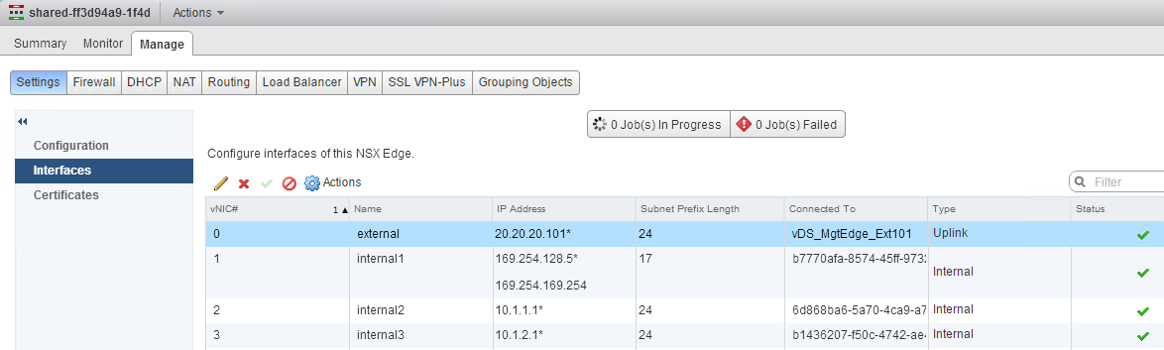
LR Centralized – What happens in the backend (1/6)
Physical
Router
.1
External-VLAN101
20.20.20.0/24
For each OpenStack Logical Router Centralized created:
The Shared Edge interfaces is updated
Under "NSX – NSX Edges"
with new internal interfaces (#2 and #3 in the screenshot)
with new IP@ on external interface (#0 in the screenshot)
Note: interfaces #2 is in the "metadata service section"
1
LS-to-metadata
169.254.128.0/17
To metadata
server
Shared-Edge
Tenant1-LS1
10.1.1.0/24
Tenant1-LS2
10.1.2.0/24
VM
VM
VM
VM
Note: It is also possible to use a dedicated Edge for the Tenant Centralized LR (see notes)
Notes:
Technical Note:
It's also possible to use dedicated Edge for the Tenant Centralized LR if needed.
This is done:
By the Tenant at the Centralized LR creation with the option
neutron router-create Tenant1-LR-Central1 --router_type=exclusive
By a global setting in nsxv.ini
tenant_router_types = exclusive, shared, distributed
# default = shared

Slide 59
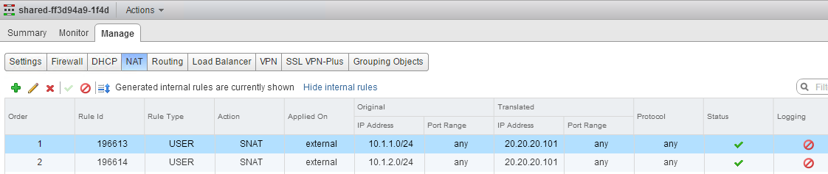
LR Centralized – What happens in the backend (2/6)
20.20.20.106 => 8.8.8.8
Physical
Router
SNAT
.1
External-VLAN101
20.20.20.0/24
For each OpenStack Logical Router Centralized created:
The Shared Edge NAT is updated
Under "NSX – NSX Edges"
with SNAT rules for "South/North"
2
LS-to-metadata
169.254.128.0/17
To metadata
server
Shared-Edge
Tenant1-LS1
10.1.1.0/24
Tenant1-LS2
10.1.2.0/24
VM
VM
VM
VM
10.1.1.11 => 8.8.8.8

Slide 60
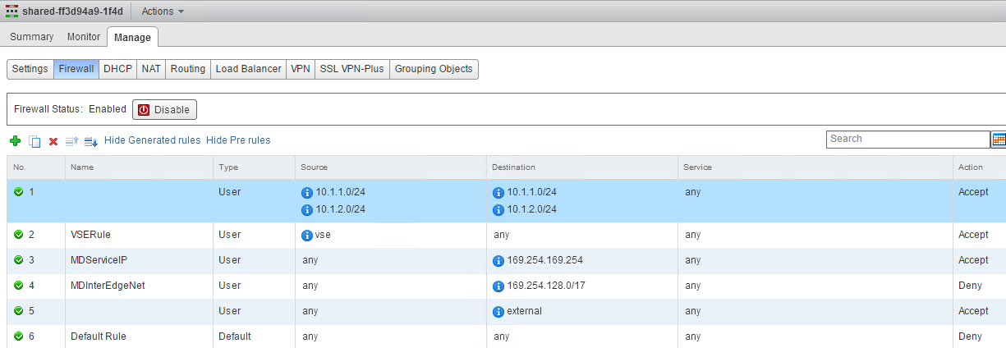
LR Centralized – What happens in the backend (3/6)
For each OpenStack Logical Router Centralized created:
The Shared Edge FW is updated
Under "NSX – NSX Edges"
with rules to allow only Tenant subnets to talk to Tenant subnets
Note: OpenStack Security Group are enforced by DFW (see Firewalling section).
Those Edge rules are to block TenantA to talk to other futureTenant default gw IP@ hosted on the same Shared Edge.
3

Slide 61
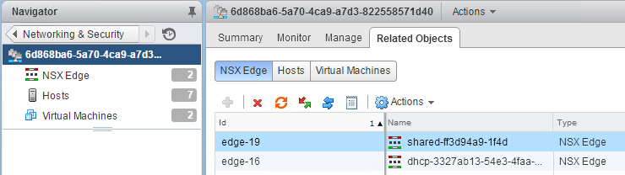
LR Centralized – What happens in the backend (4/6)
Technical Note:
To find the specific Shared Edge for a specific Logical Router Centralized:
Retrieve one of the OpenStack Network UUID on the Logical Router
You can find the OpenStack Network UUID via Horizon (edit the network)
or CLI
Find the Logical Router in NSX
Under "NSX – Logical Switches", edit the Logical Switch and go under "Related Objects – NSX Edges"
1
root@controller01:~# neutron net-list --all-tenants
(requires admin credentials)
+--------------------------------------+---------------------+
| id | name |
+--------------------------------------+---------------------+
| 6d868ba6-5a70-4ca9-a7d3-822558571d40 | Tenant1-LS1 |
| b1436207-f50c-4742-ae45-58226f8dd631 | Tenant1-LS2 |
| ccee6823-360d-43d7-99b0-a7e22b82433f | External-101 |
+--------------------------------------+---------------------+
2

Slide 62
LR Centralized – What happens in the backend (5/6)
Technical Note:
A brand new Shared Edge is created (from the backup-xxx edges*) in case of :
New Logical Router has overlapping IP subnets with existing subnets in Shared Edge
The Shared Edge reached 10 interfaces
Static routes are configured on the Logical Router
*: New deployment of NSX-v Edges or DLR is slow (1 to 2 mns). To speed-up the deployment process, NSX-v plugin pre-deploys NSX Edges and DLR with the name "backup-xxx".
When a new Edge or DLR is needed for Network (logical switch) or Router (logical router), one "backup-xxx" is simply renamed and a new "backup-edge" is pre-deployed.
Note: The number of pre-deployed and maximum Edges and DLR as well as its type (compact, large, etc) is defined in /etc/neutron/plugins/vmware/nsxv.ini with setting "backup_edge_pool"

Slide 63
LR Centralized – What happens in the backend (6/6)
Corner use case1 also covered:
On day1, Tenant1 and Tenant2 do not have any shared subnet
Tenant1-Subnet1A=10.1.1.0/24 + Tenant1-Subnet1B=10.1.2.0/24
Tenant2-Subnet2A=10.2.1.0/24 + Tenant2-Subnet2B=10.2.2.0/24
So Tenant1-Router and Tenant2-Router are on the same “Shared-Edge1”:
Shared-Edge1 with “10.1.1.0/24” + “10.1.2.0/24” + “10.2.1.0/24” + “10.2.2.0/24”
And the appropriate NAT + FW rules so there is no communication between Tenant1-subnets and Tenant2-subnets
On day2, Tenant2 creates a 3rd subnet = Tenant1-Subnet2A and attaches it to its Tenant2-Router
Tenant2-Subnet2C=10.1.1.0/24
Then the NSX-v plugin will automatically move the whole Tenant2-Router to a new “Shared-Edge2”.
Shared-Edge1 with “10.1.1.0/24” + “10.1.2.0/24”
Shared-Edge2 with “10.2.1.0/24” + “10.2.2.0/24” + “10.1.1.0/24”
Corner use case2 also covered:
On day1, Tenant1 + Tenant2 + Tenant3 do not have any shared subnet so they are on the same “Shared-Edge1”
On day2, Tenant1 created a new subnet and attaches it to its Tenant1-Router
That new subnet is not overlapping with Tenant2 nor Tenant3 subnets but now the “Shared-Edge1” router would require more than 10 interfaces.
Then the NSX-v plugin will automatically move the whole Tenant1-Router to a new “Shared-Edge2”.

Slide 64
LR Centralized – Limitation or bug (1/1)
Physical
Router
.1
External-VLAN101
20.20.20.0/24
Limitations:
1 Tenant can not have more than 9 Networks
Shared-Edge
Tenant1-LS1
10.1.1.0/24
Tenant1-LS2
10.1.2.0/24
VM
VM
VM
VM

Slide 65
List of network and security services
L2
Switching
DHCP
L3
External Network
Logical Routing Centralized
Logical Routing Distributed
Static Route
Floating IP@
No-NAT
Security
Firewalling
Port Security
Load Balancing
Metadata Service

Slide 66
LR Distributed – OpenStack Configuration (1/4)
Physical
Router
.1
External-VLAN101
20.20.20.0/24
Create a Logical Router Distributed (OpenStack Router)
Horizon (UI)
Not available
Tenant2-LS1
10.2.1.0/24
Tenant2-LS2
10.2.2.0/24
VM
VM
VM
VM

Slide 67
LR Distributed – OpenStack Configuration (2/4)
Physical
Router
.1
External-VLAN101
20.20.20.0/24
Create a Logical Router Distributed (OpenStack Router)
CLI (API)
From VIO Controller (how to access the VIO Controller in the Notes)
Create Router
Tenant2-LS1
10.2.1.0/24
Tenant2-LS2
10.2.2.0/24
1
VM
VM
VM
VM
root@controller01:~# neutron router-create Tenant2-LR-Dist1 --distributed True
Created a new router:
+-----------------------+--------------------------------------+
| Field | Value |
+-----------------------+--------------------------------------+
| admin_state_up | True |
| distributed | True |
| external_gateway_info | |
| id | a2d8e55c-2f2d-4f7b-909e-cbd364ba6d33 |
| name | Tenant2-LR-Dist1 |
| router_type | exclusive |
| routes | |
| status | ACTIVE |
| tenant_id | dca51dd05f564a79bbf1cf502430397f |
+-----------------------+--------------------------------------+
Notes:
Access to the VIO Controller:
SSH to the VIO OMS (viouser / pwd)
ssh viouser@x.x.x.x
Note: First time go on console to set up your password
From VIO OMS, SSH to the VIO Controller01
viouser@localhost:~$ ssh controller01
Note: You don’t need to use the IP@, the VIO OMS has in its /etc/hosts file the "VIO VM names / IP" resolution
Enter your OpenStack credentials
viouser@controller01:~$ sudo su -
. For admin: root@controller01:~# source cloudadmin.rc
Note: To avoid entering each time the admin pwd, add the following line in cloudadmin.rc "export OS_PASSWORD=vmware"
. For tenant1: copy the cloudadmin.rc to tenant1.rc and modify the following variables "export OS_TENANT_NAME", "export OS_USERNAME", "export OS_PASSWORD"

Slide 68
LR Distributed – OpenStack Configuration (3/4)
Physical
Router
.1
External-VLAN101
20.20.20.0/24
Create a Logical Router Distributed (OpenStack Router)
CLI (API)
Add internal interface to Router
Note: This step could be done in Horizon too (UI)
2
Tenant2-LS1
10.2.1.0/24
Tenant2-LS2
10.2.2.0/24
root@controller01:~# neutron router-interface-add
Tenant2-LR-Dist1 Tenant2-LS1_Net
Added interface 3e3e9e95-0c98-4ac0-8c80-e37c3ca6b7c7
to router Tenant2-LR-Dist1.
root@controller01:~# neutron router-interface-add
Tenant2-LR-Dist1 Tenant2-LS2_Net
Added interface 6d78eb0e-c253-4f52-b81d-45a0dbb95a76
to router Tenant2-LR-Dist1.
VM
VM
VM
VM

Slide 69
LR Distributed – OpenStack Configuration (4/4)
Physical
Router
.1
External-VLAN101
20.20.20.0/24
Create a Logical Router Distributed (OpenStack Router)
CLI (API)
Add upstream interface to Router
Note: This step could be done in Horizon too (UI)
3
Tenant2-LS1
10.2.1.0/24
Tenant2-LS2
10.2.2.0/24
root@controller01:~# neutron router-gateway-set
Tenant2-LR-Dist1 External-101
Set gateway for router Tenant2-LR-Dist1
VM
VM
VM
VM

Slide 70
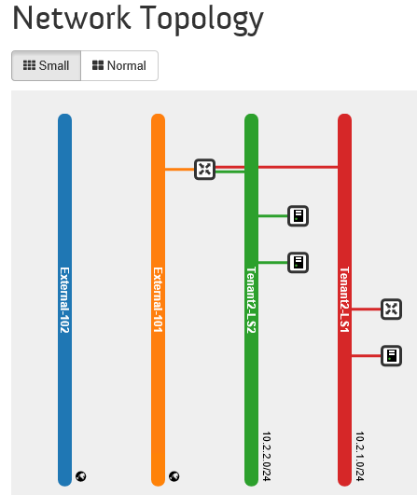
LR Distributed – OpenStack Validation (1/3)
External-VLAN101
20.20.20.0/24
Tenant2-LS1
10.2.1.0/24
Tenant2-LS2
10.2.2.0/24
Visualize in OpenStack LR Distributed
Horizon (UI)
Under "Project - Network – Network Topology"
VM
VM
VM
VM
Note:
No way to differentiate in Horizon (UI) a LR Centralized and a LR Distributed

Slide 71
LR Distributed – OpenStack Validation (2/3)
External-VLAN101
20.20.20.0/24
Tenant2-LS1
10.2.1.0/24
Tenant2-LS2
10.2.2.0/24
Visualize in OpenStack LR Distributed
CLI (API)
VM
VM
VM
VM
root@controller01:~# neutron router-list
+--------------------------------------+------------------+-----------------------------------------------------------------------------
| id | name | external_gateway_info
+--------------------------------------+------------------+-----------------------------------------------------------------------------
| 371604cf-f6e1-4845-a8e7-c57dfe51030d | Tenant2-LR-Dist1 | {"network_id": "ccee6823-360d-43d7-99b0-a7e22b82433f", "enable_snat": true,
+--------------------------------------+------------------+-----------------------------------------------------------------------------
-------------------------------------------------------------------------------------------------------------+-------------+
| distributed |
-------------------------------------------------------------------------------------------------------------+-------------+
"external_fixed_ips": [{"subnet_id": "e303cc61-40be-4fcf-a241-9780fb9c6a3c", "ip_address": "20.20.20.102"}]} | True |
-------------------------------------------------------------------------------------------------------------+-------------+
root@controller01:~# neutron router-port-list Tenant2-LR-Dist1
+--------------------------------------+------+-------------------+---------------------------------------------------------------------------------+
| id | name | mac_address | fixed_ips |
+--------------------------------------+------+-------------------+---------------------------------------------------------------------------------+
| 6333e2b5-db2c-4224-8353-4f912f2c13f6 | | fa:16:3e:48:35:73 | {"subnet_id": "91e82c93-bcee-4612-ae28-dfec84ef2183", "ip_address": "10.2.1.1"} |
| 6cf2c35d-d299-485a-8d63-7f03d6e89842 | | fa:16:3e:e8:a9:02 | {"subnet_id": "6fa9df4b-f1a5-46b4-b0e6-c11a12ee2914", "ip_address": "10.2.2.1"} |
+--------------------------------------+------+-------------------+---------------------------------------------------------------------------------+
root@controller01:~# neutron router-port-list Tenant2-LR-Dist1 (requires admin credentials)
+--------------------------------------+------+-------------------+-------------------------------------------------------------------------------------+
| id | name | mac_address | fixed_ips |
+--------------------------------------+------+-------------------+-------------------------------------------------------------------------------------+
| 6333e2b5-db2c-4224-8353-4f912f2c13f6 | | fa:16:3e:48:35:73 | {"subnet_id": "91e82c93-bcee-4612-ae28-dfec84ef2183", "ip_address": "10.2.1.1"} |
| 6cf2c35d-d299-485a-8d63-7f03d6e89842 | | fa:16:3e:e8:a9:02 | {"subnet_id": "6fa9df4b-f1a5-46b4-b0e6-c11a12ee2914", "ip_address": "10.2.2.1"} |
| 6d43c1c6-f760-44b0-b3b2-2a21379cb9d5 | | fa:16:3e:0d:05:13 | {"subnet_id": "e303cc61-40be-4fcf-a241-9780fb9c6a3c", "ip_address": "20.20.20.102"} |
+--------------------------------------+------+-------------------+-------------------------------------------------------------------------------------+

Slide 72
LR Distributed – OpenStack Validation (3/3)
External-VLAN101
20.20.20.0/24
Tenant2-LS1
10.2.1.0/24
Tenant2-LS2
10.2.2.0/24
Visualize in OpenStack LR Distributed
CLI (API)
To check if a Router is Distributed or not
VM
VM
VM
VM
root@controller01:~# neutron router-show Tenant2-LR-Dist1
+-----------------------+------------------------------------------------------------------------------------------+
| Field | Value |
+-----------------------+------------------------------------------------------------------------------------------+
| admin_state_up | True |
| distributed | True |
| external_gateway_info | {"network_id": "ccee6823-360d-43d7-99b0-a7e22b82433f", "enable_snat": true,
"external_fixed_ips": [{"subnet_id": "e303cc61-40be-4fcf-a241-9780fb9c6a3c", "ip_address": "20.20.20.102"}]} |
| id | 371604cf-f6e1-4845-a8e7-c57dfe51030d |
| name | Tenant2-LR-Dist1 |
| routes | |
| status | ACTIVE |
| tenant_id | 70d2615812644f4790a6c2a6e5e6499e |
+-----------------------+------------------------------------------------------------------------------------------+

Slide 73

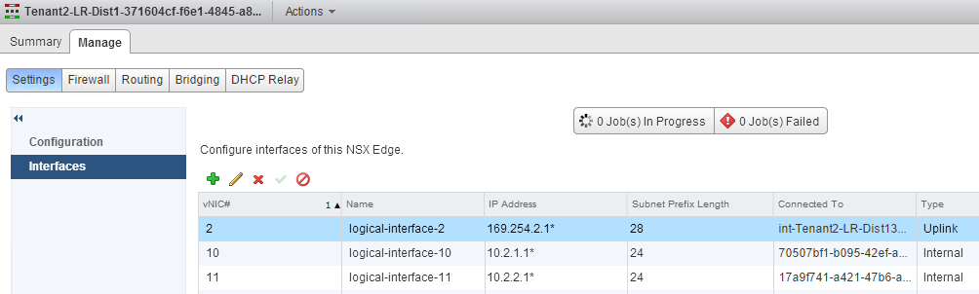
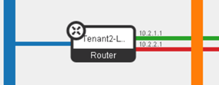
LR Distributed – What happens in the backend (1/5)
Physical
Router
.1
External-VLAN101
20.20.20.0/24
For each OpenStack Logical Router Distributed created:
One dedicated DLR is created
Under "NSX – NSX Edges"
with uplink interface to Tenant-Edge
Internal interfaces
1
Tenant-Edge
inter-Tenant-net
169.254.2.0/28
Tenant-DLR
Tenant2-LS1
10.2.1.0/24
Tenant2-LS2
10.2.2.0/24
VM
VM
VM
VM
In OpenStack the LR is represented at 1 element (see below).
In NSX-v it's implemented with the combination of Edge + DLR

Slide 74
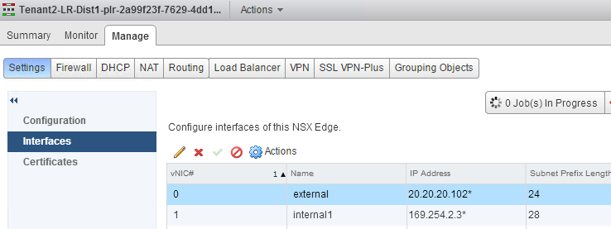
LR Distributed – What happens in the backend (2/5)
Physical
Router
.1
External-VLAN101
20.20.20.0/24
For each OpenStack Logical Router Distributed created:
One dedicated Edge is created
Under "NSX – NSX Edges"
with uplink interface to External
Internal interface to DLR
2
Tenant-Edge
inter-Tenant-net
169.254.2.0/28
Tenant-DLR
Tenant2-LS1
10.2.1.0/24
Tenant2-LS2
10.2.2.0/24
VM
VM
VM
VM
In OpenStack the LR is represented at 1 element (see below).
In NSX-v it's implemented with the combination of Edge + DLR

Slide 75
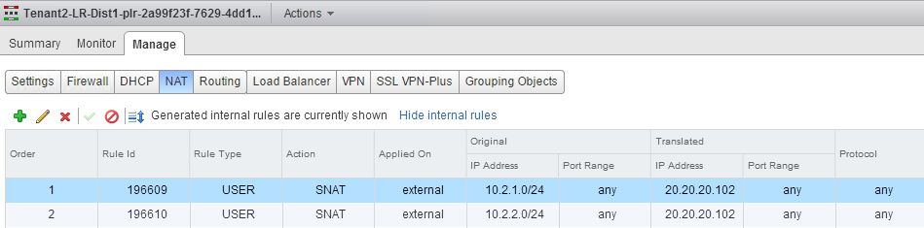
LR Distributed – What happens in the backend (3/5)
20.20.20.107 => 8.8.8.8
Physical
Router
SNAT
.1
External-VLAN101
20.20.20.0/24
For each OpenStack Logical Router Distributed created:
One dedicated Edge is created
Under "NSX – NSX Edges"
with SNAT rules for "South/North"
3
Tenant-Edge
inter-Tenant-net
169.254.2.0/28
10.2.1.11 => 8.8.8.8
Tenant-DLR
Tenant2-LS1
10.2.1.0/24
Tenant2-LS2
10.2.2.0/24
VM
VM
VM
VM
10.2.1.11 => 8.8.8.8

Slide 76
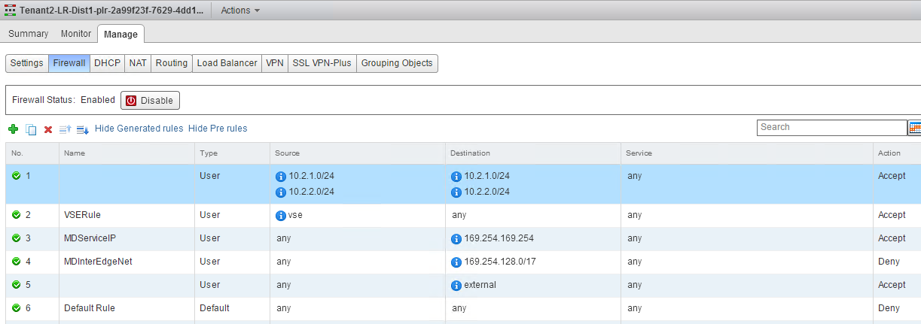
LR Distributed – What happens in the backend (4/5)
For each OpenStack Logical Router Distributed created:
One dedicated Edge is created
Under "NSX – NSX Edges"
with rules to allow only Tenant subnets to talk to Tenant subnets
This rule is not really useful since the internal subnet to internal subnet is routed by the DLR (not the Edge).
Note: OpenStack Security Group are enforced by DFW (see Firewalling section).
4

Slide 77
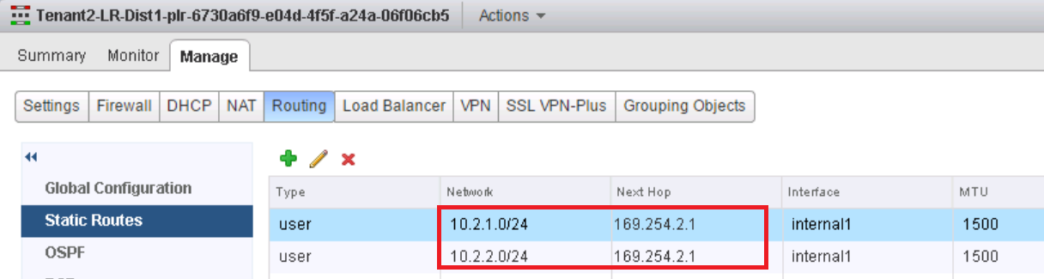
LR Distributed – What happens in the backend (5/5)
Physical
Router
.1
External-VLAN101
20.20.20.0/24
For each OpenStack Logical Router Distributed created:
One dedicated Edge is created
Under "NSX – NSX Edges"
with static routes to reach Tenant subnets behind the DLR
5
Tenant-Edge
inter-Tenant-net
169.254.2.0/28
Tenant-DLR
Tenant2-LS1
10.2.1.0/24
Tenant2-LS2
10.2.2.0/24
VM
VM
VM
VM

Slide 78
LR Distributed – Limitation or bug (1/1)
Physical
Router
.1
External-VLAN101
20.20.20.0/24
None
Tenant-Edge
inter-Tenant-net
169.254.2.0/28
Tenant-DLR
Tenant1-LS1
10.1.1.0/24
Tenant1-LS2
10.1.2.0/24
VM
VM
VM
VM

Slide 79
List of network and security services
L2
Switching
DHCP
L3
External Network
Logical Routing Centralized
Logical Routing Distributed
Static Route
Floating IP@
No-NAT
Security
Firewalling
Port Security
Load Balancing
Metadata Service

Slide 80
Static Route – OpenStack Configuration (1/2)
30.30.30.0/24
Physical
Router
.1
.2
External-VLAN101
20.20.20.0/24
Create a LR Static Router
Note: Works for LR Centralized + Distributed
Horizon (UI)
Not available
Note: Under "Project - Network – Routers - Edit Router - Static Routes",
the UI let you add a route, but this won't be accepted if the user is NOT an admin.
Tenant1-LS1
10.1.1.0/24
Tenant1-LS2
10.1.2.0/24
VM
VM
VM
VM
dgw = 20.20.20.1
static route = 30.30.30.0/24 via 20.20.20.2

Slide 81
Static Route – OpenStack Configuration (2/2)
30.30.30.0/24
Physical
Router
.1
.2
External-VLAN101
20.20.20.0/24
Create a LR Static Router
Note: Works for LR Centralized + Distributed
CLI (API)
From VIO Controller (how to access the VIO Controller in the Notes)
Create route
Note: To delete a route: neutron router-update Tenant1-LR-Central1 --routes action=clear
Tenant1-LS1
10.1.1.0/24
Tenant1-LS2
10.1.2.0/24
VM
VM
VM
VM
root@controller01:~# neutron router-update Tenant1-LR-Central1
--routes type=dict list=true destination=30.30.30.0/24,nexthop=20.20.20.2
(requires admin credentials)
Updated router: Tenant1-LR-Central1
dgw = 20.20.20.1
static route = 30.30.30.0/24 via 20.20.20.2
Notes:
Access to the VIO Controller:
SSH to the VIO OMS (viouser / pwd)
ssh viouser@x.x.x.x
Note: First time go on console to set up your password
From VIO OMS, SSH to the VIO Controller01
viouser@localhost:~$ ssh controller01
Note: You don’t need to use the IP@, the VIO OMS has in its /etc/hosts file the "VIO VM names / IP" resolution
Enter your OpenStack credentials
viouser@controller01:~$ sudo su -
. For admin: root@controller01:~# source cloudadmin.rc
Note: To avoid entering each time the admin pwd, add the following line in cloudadmin.rc "export OS_PASSWORD=vmware"
. For tenant1: copy the cloudadmin.rc to tenant1.rc and modify the following variables "export OS_TENANT_NAME", "export OS_USERNAME", "export OS_PASSWORD"

Slide 82
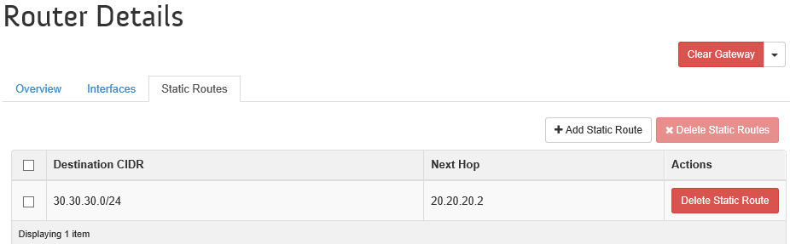
Static Route – OpenStack Validation (1/2)
30.30.30.0/24
Physical
Router
.1
.2
External-VLAN101
20.20.20.0/24
Visualize Static Route
Horizon (UI)
Under "Project - Network – Routers - Edit Router - Static Routes"
Tenant1-LS1
10.1.1.0/24
Tenant1-LS2
10.1.2.0/24
VM
VM
VM
VM
dgw = 20.20.20.1
static route = 30.30.30.0/24 via 20.20.20.2

Slide 83
Static Route – OpenStack Validation (2/2)
30.30.30.0/24
Physical
Router
.1
.2
External-VLAN101
20.20.20.0/24
Visualize Static Route
CLI (API)
root@controller01:~# neutron router-show Tenant1-LR-Central1
+-----------------------+------------------------------------------------------------------------------+
| Field | Value |
+-----------------------+------------------------------------------------------------------------------+
| admin_state_up | True |
| distributed | False |
| external_gateway_info | {"network_id": "ccee6823-360d-43d7-99b0-a7e22b82433f", "enable_snat": true,
"external_fixed_ips": [{"subnet_id": "e303cc61-40be-4fcf-a241-9780fb9c6a3c",
"ip_address": "20.20.20.101"}]} |
| id | f7250b81-7259-4625-bb04-43884bef73cd |
| name | Tenant1-LR-Central1 |
| router_type | shared |
| routes | {"destination": "30.30.30.0/24", "nexthop": "20.20.20.2"} |
| status | ACTIVE |
| tenant_id | 40e97bec2b06462098b241f04a224167 |
+-----------------------+------------------------------------------------------------------------------+
root@controller01:~# neutron subnet-show External-101_Net (requires admin credentials)
+----------------------------+--------------------------------------------------+
| Field | Value |
+----------------------------+--------------------------------------------------+
| advanced_service_providers | |
| allocation_pools | {"start": "20.20.20.101", "end": "20.20.20.200"} |
| cidr | 20.20.20.0/24 |
| dns_nameservers | |
| enable_dhcp | False |
| gateway_ip | 20.20.20.1 |
| host_routes | |
| id | e303cc61-40be-4fcf-a241-9780fb9c6a3c |
| ip_version | 4 |
Tenant1-LS1
10.1.1.0/24
Tenant1-LS2
10.1.2.0/24
VM
VM
VM
VM
dgw = 20.20.20.1
static route = 30.30.30.0/24 via 20.20.20.2

Slide 84
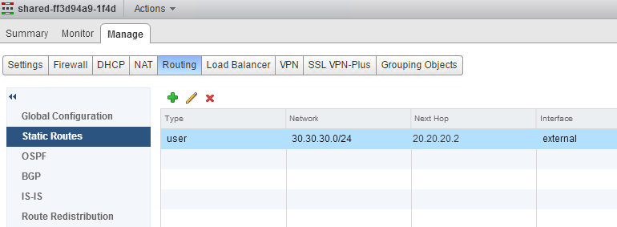
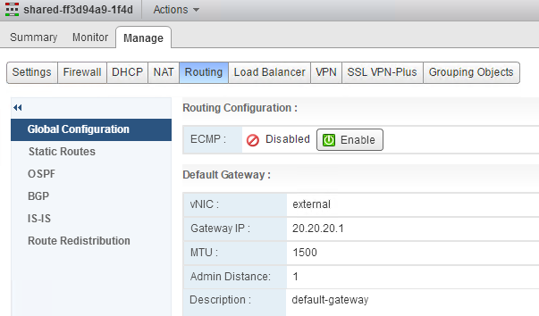
Static Route – What happens in the backend (1/3)
30.30.30.0/24
Physical
Router
.1
.2
External-VLAN101
20.20.20.0/24
For each Static Route created:
Case1: LR Centralized router
The Shared Edge is updated
Under "NSX – NSX Edges"
with static route
Tenant1-LS1
10.1.1.0/24
Tenant1-LS2
10.1.2.0/24
VM
VM
VM
VM
dgw = 20.20.20.1
static route = 30.30.30.0/24 via 20.20.20.2

Slide 85
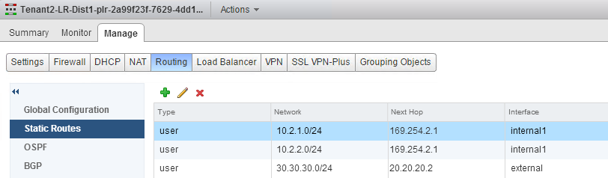
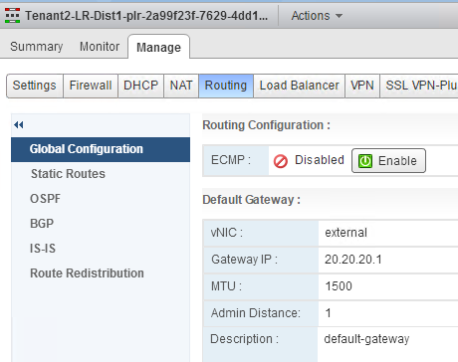
Static Route – What happens in the backend (2/3)
30.30.30.0/24
Physical
Router
.1
.2
External-VLAN101
20.20.20.0/24
For each Static Route created:
Case2: LR Distributed router
The Tenant Edge is updated
Under "NSX – NSX Edges"
with static route
Tenant2-LS1
10.2.1.0/24
Tenant2-LS2
10.2.2.0/24
VM
VM
VM
VM
dgw = 20.20.20.1
static route = 30.30.30.0/24 via 20.20.20.2

Slide 86

Static Route – What happens in the backend (3/3)
Technical Note:
To find the specific Shared Edge for a specific Logical Router Centralized:
Retrieve one of the OpenStack Network UUID on the Logical Router
You can find the OpenStack Network UUID via Horizon (edit the network)
or CLI
Find the Logical Router in NSX
Under "NSX – Logical Switches", edit the Logical Switch and go under "Related Objects – NSX Edges"
1
root@controller01:~# neutron net-list --all-tenants
(requires admin credentials)
+--------------------------------------+---------------------+
| id | name |
+--------------------------------------+---------------------+
| 6d868ba6-5a70-4ca9-a7d3-822558571d40 | Tenant1-LS1 |
| b1436207-f50c-4742-ae45-58226f8dd631 | Tenant1-LS2 |
| ccee6823-360d-43d7-99b0-a7e22b82433f | External-101 |
+--------------------------------------+---------------------+
2

Slide 87
Static Route – Limitation or bug (1/1)
30.30.30.0/24
Physical
Router
.1
.2
External-VLAN101
20.20.20.0/24
None
Tenant1-LS1
10.1.1.0/24
Tenant1-LS2
10.1.2.0/24
VM
VM
VM
VM
dgw = 20.20.20.1
static route = 30.30.30.0/24 via 20.20.20.2

Slide 88
List of network and security services
L2
Switching
DHCP
L3
External Network
Logical Routing Centralized
Logical Routing Distributed
Static Route
Floating IP@
No-NAT
Security
Firewalling
Port Security
Load Balancing
Metadata Service

Slide 89



Floating IP@ – OpenStack Configuration (1/3)
Floating IP@: 20.20.20.x = VM
Physical
Router
.1
8.8.8.8 => 20.20.20.109
External-VLAN101
20.20.20.0/24
Create a Floating IP@
Note: Works for LR Centralized + Distributed
Horizon (UI)
Under "Project – Compute – Instances", on Instance "More – Associate Floating IP"
DNAT
8.8.8.8 => 10.1.1.3
Tenant1-LS1
10.1.1.0/24
Tenant1-LS2
10.1.2.0/24
1
VM
VM
VM
VM
2
3

Slide 90



Floating IP@ – OpenStack Configuration (1/3)
Floating IP@: 20.20.20.x = VM
Physical
Router
.1
8.8.8.8 => 20.20.20.109
External-VLAN101
20.20.20.0/24
Create a Floating IP@
Note: Works for LR Centralized + Distributed
Horizon (UI)
Under "Project – Compute – Instances", on Instance "More – Associate Floating IP"
DNAT
8.8.8.8 => 10.1.1.3
Tenant1-LS1
10.1.1.0/24
Tenant1-LS2
10.1.2.0/24
VM
VM
VM
VM
1
2
3

Slide 91
Floating IP@ – OpenStack Configuration (2/3)
Floating IP@: 20.20.20.x = VM
Physical
Router
.1
8.8.8.8 => 20.20.20.114
External-VLAN101
20.20.20.0/24
Create a Floating IP@
Note: Works for LR Centralized + Distributed
CLI (API)
From VIO Controller (how to access the VIO Controller in the Notes)
Create Floating VIP
DNAT
8.8.8.8 => 10.1.1.4
Tenant1-LS1
10.1.1.0/24
Tenant1-LS2
10.1.2.0/24
1
VM
VM
VM
VM
root@controller01:~# neutron net-external-list
+--------------------------------------+--------------+---------------------------------------+
| id | name | subnets |
+--------------------------------------+--------------+---------------------------------------+
| 5f4a2f7a-b888-4d99-8089-ed2f93178476 | External-102 | 2b7afa0f-0db3-4b50-9880-1e70d11f0578 |
| ccee6823-360d-43d7-99b0-a7e22b82433f | External-101 | e303cc61-40be-4fcf-a241-9780fb9c6a3c |
+--------------------------------------+--------------+---------------------------------------+ root@controller01:~# neutron floatingip-create External-101
Created a new floatingip:
+---------------------+--------------------------------------+
| Field | Value |
+---------------------+--------------------------------------+
| fixed_ip_address | |
| floating_ip_address | 20.20.20.105 |
| floating_network_id | ccee6823-360d-43d7-99b0-a7e22b82433f |
| id | 1a3279e7-878d-4d6d-822c-58039c0dfad2 |
| port_id | |
| router_id | |
| status | DOWN |
| tenant_id | 40e97bec2b06462098b241f04a224167 |
+---------------------+--------------------------------------+
Notes:
Access to the VIO Controller:
SSH to the VIO OMS (viouser / pwd)
ssh viouser@x.x.x.x
Note: First time go on console to set up your password
From VIO OMS, SSH to the VIO Controller01
viouser@localhost:~$ ssh controller01
Note: You don’t need to use the IP@, the VIO OMS has in its /etc/hosts file the "VIO VM names / IP" resolution
Enter your OpenStack credentials
viouser@controller01:~$ sudo su -
. For admin: root@controller01:~# source cloudadmin.rc
Note: To avoid entering each time the admin pwd, add the following line in cloudadmin.rc "export OS_PASSWORD=vmware"
. For tenant1: copy the cloudadmin.rc to tenant1.rc and modify the following variables "export OS_TENANT_NAME", "export OS_USERNAME", "export OS_PASSWORD"

Slide 92
Floating IP@ – OpenStack Configuration (3/3)
Floating IP@: 20.20.20.x = VM
Physical
Router
.1
8.8.8.8 => 20.20.20.114
External-VLAN101
20.20.20.0/24
Create a Floating IP@
CLI (API)
Associate Floating VIP to VM
DNAT
2
8.8.8.8 => 10.1.1.4
Tenant1-LS1
10.1.1.0/24
Tenant1-LS2
10.1.2.0/24
root@controller01:~# neutron port-list
+--------------------------------------+------+-------------------+---------------------------------------------------------------------------------+
| id | name | mac_address | fixed_ips |
+--------------------------------------+------+-------------------+---------------------------------------------------------------------------------+
| 0a2106e5-6a39-484b-b202-41b3b0b9f363 | | fa:16:3e:5b:65:b3 | {"subnet_id": "a8175a61-9162-4253-971d-9e675aba3cbf", "ip_address": "10.1.1.4"} |
| 36e5a962-d5b1-41ed-b029-4d3c303eb9fe | | fa:16:3e:6d:fe:6b | {"subnet_id": "d7eb0562-95d9-42ab-99b7-cfb40519b45c", "ip_address": "10.1.2.3"} |
| 785cfa07-4744-4881-a001-cd859f69fb00 | | fa:16:3e:64:f6:9b | {"subnet_id": "d7eb0562-95d9-42ab-99b7-cfb40519b45c", "ip_address": "10.1.2.4"} |
| 80e0829d-8a5f-43f9-b73b-6d99ee244716 | | fa:16:3e:8d:32:bc | {"subnet_id": "a8175a61-9162-4253-971d-9e675aba3cbf", "ip_address": "10.1.1.1"} |
| 9962e1ef-27f4-4f14-b79b-babe715fab0a | | fa:16:3e:58:28:95 | {"subnet_id": "d7eb0562-95d9-42ab-99b7-cfb40519b45c", "ip_address": "10.1.2.2"} |
| a8169d59-8b76-4c02-a45f-83d7c738f487 | | fa:16:3e:f2:e7:5e | {"subnet_id": "a8175a61-9162-4253-971d-9e675aba3cbf", "ip_address": "10.1.1.3"} |
| d6290e64-1c9e-4aae-979c-354c925cc579 | | fa:16:3e:47:6e:59 | {"subnet_id": "a8175a61-9162-4253-971d-9e675aba3cbf", "ip_address": "10.1.1.2"} |
| d7a4ac97-95b6-406f-b84e-0caf12eaf183 | | fa:16:3e:9c:ae:70 | {"subnet_id": "d7eb0562-95d9-42ab-99b7-cfb40519b45c", "ip_address": "10.1.2.1"} |
+--------------------------------------+------+-------------------+---------------------------------------------------------------------------------+ root@controller01:~# neutron floatingip-associate 1a3279e7-878d-4d6d-822c-58039c0dfad2 0a2106e5-6a39-484b-b202-41b3b0b9f363
Associated floating IP 1a3279e7-878d-4d6d-822c-58039c0dfad2
VM
VM
VM
VM

Slide 93

Floating IP@ – OpenStack Validation (1/2)
Floating IP@: 20.20.20.x = VM
Physical
Router
.1
8.8.8.8 => 20.20.20.109
External-VLAN101
20.20.20.0/24
Visualize in OpenStack Floating IP@
Horizon (UI)
Under "Project – Compute – Instances"
DNAT
8.8.8.8 => 10.1.1.3
Tenant1-LS1
10.1.1.0/24
Tenant1-LS2
10.1.2.0/24
VM
VM
VM
VM

Slide 94
Floating IP@ – OpenStack Validation (2/2)
Floating IP@: 20.20.20.x = VM
Physical
Router
.1
8.8.8.8 => 20.20.20.109
External-VLAN101
20.20.20.0/24
Visualize in OpenStack Floating IP@
CLI (API)
DNAT
8.8.8.8 => 10.1.1.3
Tenant1-LS1
10.1.1.0/24
Tenant1-LS2
10.1.2.0/24
VM
VM
VM
VM
root@controller01:~# neutron floatingip-list
+--------------------------------------+------------------+---------------------+--------------------------------------+
| id | fixed_ip_address | floating_ip_address | port_id |
+--------------------------------------+------------------+---------------------+--------------------------------------+
| 1a3279e7-878d-4d6d-822c-58039c0dfad2 | 10.1.1.4 | 20.20.20.105 | 0a2106e5-6a39-484b-b202-41b3b0b9f363 |
| 37a886a5-430c-4a7b-a94d-8ecedf224386 | 10.1.1.3 | 20.20.20.104 | a8169d59-8b76-4c02-a45f-83d7c738f487 |
+--------------------------------------+------------------+---------------------+--------------------------------------+

Slide 95

Floating IP@ – What happens in the backend (1/5)
Floating IP@: 20.20.20.x = VM
Physical
Router
.1
8.8.8.8 => 20.20.20.109
External-VLAN101
20.20.20.0/24
For each Floating IP@ created:
Case1: LR Centralized router
The Shared Edge is updated
Under "NSX – NSX Edges"
with SNAT + DNAT rules for "South/North" and "North/South"
1
DNAT
8.8.8.8 => 10.1.1.3
Tenant1-LS1
10.1.1.0/24
Tenant1-LS2
10.1.2.0/24
VM
VM
VM
VM

Slide 96

Floating IP@ – What happens in the backend (2/5)
Floating IP@: 20.20.20.x = VM
Physical
Router
.1
8.8.8.8 => 20.20.20.109
External-VLAN101
20.20.20.0/24
For each Floating IP@ created:
Case1: LR Centralized router
The Shared Edge is updated
Under "NSX – NSX Edges"
with FW rule allowing access to the Floating IP@
2
DNAT
8.8.8.8 => 10.1.1.3
Tenant1-LS1
10.1.1.0/24
Tenant1-LS2
10.1.2.0/24
VM
VM
VM
VM

Slide 97

Floating IP@ – What happens in the backend (3/5)
Floating IP@: 20.20.20.x = VM
Physical
Router
.1
8.8.8.8 => 20.20.20.115
External-VLAN101
20.20.20.0/24
For each Floating IP@ created:
Case2: LR Distributed router
The Tenant Edge is updated
Under "NSX – NSX Edges"
with SNAT + DNAT rules for "South/North" and "North/South"
1
Shared-Edge
DNAT
8.8.8.8 => 10.2.1.3
inter-Tenant-net
169.254.2.0/28
Tenant-DLR
Tenant2-LS1
10.2.1.0/24
Tenant2-LS2
10.2.2.0/24
VM
VM
VM
VM

Slide 98

Floating IP@ – What happens in the backend (4/5)
Floating IP@: 20.20.20.x = VM
Physical
Router
.1
8.8.8.8 => 20.20.20.115
External-VLAN101
20.20.20.0/24
For each Floating IP@ created:
Case2: LR Distributed router
The Tenant Edge is updated
Under "NSX – NSX Edges"
with FW rule allowing access to the Floating IP@
2
Shared-Edge
DNAT
8.8.8.8 => 10.2.1.3
inter-Tenant-net
169.254.2.0/28
Tenant-DLR
Tenant2-LS1
10.2.1.0/24
Tenant2-LS2
10.2.2.0/24
VM
VM
VM
VM

Slide 99
Floating IP@ – What happens in the backend (5/5)
Technical Note:
To find the specific Shared Edge for a specific Logical Router Centralized:
Retrieve one of the OpenStack Network UUID on the Logical Router
You can find the OpenStack Network UUID via Horizon (edit the network)
or CLI
Find the Logical Router in NSX
Under "NSX – Logical Switches", edit the Logical Switch and go under "Related Objects – NSX Edges"
1
root@controller01:~# neutron net-list --all-tenants
(requires admin credentials)
+--------------------------------------+---------------------+
| id | name |
+--------------------------------------+---------------------+
| 6d868ba6-5a70-4ca9-a7d3-822558571d40 | Tenant1-LS1 |
| b1436207-f50c-4742-ae45-58226f8dd631 | Tenant1-LS2 |
| ccee6823-360d-43d7-99b0-a7e22b82433f | External-101 |
+--------------------------------------+---------------------+
2

Slide 100
Floating IP – Limitation or bug (1/1)
Floating IP@: 20.20.20.x = VM
Physical
Router
.1
8.8.8.8 => 20.20.20.109
External-VLAN101
20.20.20.0/24
None
DNAT
8.8.8.8 => 10.1.1.3
Tenant1-LS1
10.1.1.0/24
Tenant1-LS2
10.1.2.0/24
VM
VM
VM
VM

Slide 101
List of network and security services
L2
Switching
DHCP
L3
External Network
Logical Routing Centralized
Logical Routing Distributed
Static Route
Floating IP@
No-NAT
Security
Firewalling
Port Security
Load Balancing
Metadata Service

Slide 102
No-NAT – OpenStack Configuration (1/2)
No NAT
Physical
Router
8.8.8.8 => 10.2.1.11
.1
External-VLAN101
20.20.20.0/24
Configure No-NAT on the logical router
Note: Works for LR Centralized + Distributed
Horizon (UI)
Not available
10.2.1.11 => 8.8.8.8
8.8.8.8 => 10.2.1.11
Tenant1-LS1
10.1.1.0/24
Tenant1-LS2
10.1.2.0/24
10.1.1.11 => 8.8.8.8
VM
VM
VM
VM

Slide 103
No-NAT – OpenStack Configuration (2/2)
No NAT
Physical
Router
8.8.8.8 => 10.2.1.11
.1
External-VLAN101
20.20.20.0/24
Configure No-NAT on the logical router
Note: Works for LR Centralized + Distributed
CLI (API)
From VIO Controller (how to access the VIO Controller in the Notes)
Configure Logical Router with No-NAT
10.2.1.11 => 8.8.8.8
8.8.8.8 => 10.2.1.11
Tenant1-LS1
10.1.1.0/24
Tenant1-LS2
10.1.2.0/24
10.1.1.11 => 8.8.8.8
VM
VM
VM
VM
root@controller01:~# neutron net-list
+--------------------------------------+---------------------+----------------------------------------------------+
| id | name | subnets |
+--------------------------------------+---------------------+----------------------------------------------------+
| 5f4a2f7a-b888-4d99-8089-ed2f93178476 | External-102 | 2b7afa0f-0db3-4b50-9880-1e70d11f0578 |
| 6d868ba6-5a70-4ca9-a7d3-822558571d40 | Tenant1-LS1 | a8175a61-9162-4253-971d-9e675aba3cbf 10.1.1.0/24 |
| b1436207-f50c-4742-ae45-58226f8dd631 | Tenant1-LS2 | d7eb0562-95d9-42ab-99b7-cfb40519b45c 10.1.2.0/24 |
| ccee6823-360d-43d7-99b0-a7e22b82433f | External-101 | e303cc61-40be-4fcf-a241-9780fb9c6a3c |
+--------------------------------------+---------------------+----------------------------------------------------+ root@controller01:~# neutron router-update Tenant1-LR-Central1 --external_gateway_info type=dict network_id= ccee6823-360d-43d7-99b0-a7e22b82433f,enable_snat=False
(requires admin credentials)
Updated router: Tenant1-LR-Central1
Notes:
Access to the VIO Controller:
SSH to the VIO OMS (viouser / pwd)
ssh viouser@x.x.x.x
Note: First time go on console to set up your password
From VIO OMS, SSH to the VIO Controller01
viouser@localhost:~$ ssh controller01
Note: You don’t need to use the IP@, the VIO OMS has in its /etc/hosts file the "VIO VM names / IP" resolution
Enter your OpenStack credentials
viouser@controller01:~$ sudo su -
. For admin: root@controller01:~# source cloudadmin.rc
Note: To avoid entering each time the admin pwd, add the following line in cloudadmin.rc "export OS_PASSWORD=vmware"
. For tenant1: copy the cloudadmin.rc to tenant1.rc and modify the following variables "export OS_TENANT_NAME", "export OS_USERNAME", "export OS_PASSWORD"

Slide 104
No-NAT – OpenStack Validation (1/2)
No NAT
Physical
Router
8.8.8.8 => 10.2.1.11
.1
External-VLAN101
20.20.20.0/24
Visualize No-NAT on the Logical Router
Horizon (UI)
Not available
10.2.1.11 => 8.8.8.8
8.8.8.8 => 10.2.1.11
Tenant1-LS1
10.1.1.0/24
Tenant1-LS2
10.1.2.0/24
10.1.1.11 => 8.8.8.8
VM
VM
VM
VM

Slide 105
No-NAT – OpenStack Validation (2/2)
No NAT
Physical
Router
8.8.8.8 => 10.2.1.11
.1
External-VLAN101
20.20.20.0/24
Visualize No-NAT on the Logical Router
CLI (API)
10.2.1.11 => 8.8.8.8
8.8.8.8 => 10.2.1.11
Tenant1-LS1
10.1.1.0/24
Tenant1-LS2
10.1.2.0/24
10.1.1.11 => 8.8.8.8
VM
VM
VM
VM
root@controller01:~# neutron router-show Tenant1-LR-Central1
+-----------------------+------------------------------------------------------------------------------------------+
| Field | Value |
+-----------------------+------------------------------------------------------------------------------------------+
| admin_state_up | True |
| distributed | False |
| external_gateway_info | {"network_id": "ccee6823-360d-43d7-99b0-a7e22b82433f", "enable_snat": false,
"external_fixed_ips": [{"subnet_id": "e303cc61-40be-4fcf-a241-9780fb9c6a3c", "ip_address": "20.20.20.101"}]} |
| id | f7250b81-7259-4625-bb04-43884bef73cd |
| name | Tenant1-LR-Central1 |
| router_type | shared |
| routes | {"destination": "30.30.30.0/24", "nexthop": "20.20.20.2"} |
| status | ACTIVE |
| tenant_id | 40e97bec2b06462098b241f04a224167 |
+-----------------------+------------------------------------------------------------------------------------------+

Slide 106

No-NAT – What happens in the backend (1/5)
For each LR updated with No-NAT:
Case1: LR Centralized router
The Shared Edge is updated
Under "NSX – NSX Edges"
"South/North" NAT rules cleared
Note: If Floating VIP are also configured with No-NAT, those are applied on NSX.
1

Slide 107

No-NAT – What happens in the backend (2/5)
For each LR updated with No-NAT:
Case1: LR Centralized router
The Shared Edge is updated
Under "NSX – NSX Edges"
FW rule to allow external traffic to internal is added
2

Slide 108

No-NAT – What happens in the backend (3/5)
No NAT
Physical
Router
8.8.8.8 => 10.2.1.11
.1
External-VLAN101
20.20.20.0/24
For each LR updated with No-NAT:
Case2: LR Distributed router
The Tenant Edge is updated
Under "NSX – NSX Edges"
"South/North" NAT rules cleared
Note: If Floating VIP are also configured with No-NAT, those are applied on NSX.
10.2.1.11 => 8.8.8.8
1
8.8.8.8 => 10.2.1.11
Shared-Edge
inter-Tenant-net
169.254.2.0/28
10.1.1.11 => 8.8.8.8
Tenant-DLR
Tenant2-LS1
10.2.1.0/24
Tenant2-LS2
10.2.2.0/24
VM
VM
VM
VM

Slide 109

No-NAT – What happens in the backend (4/5)
For each LR updated with No-NAT:
Case1: LR Distributed router
The Shared Edge is updated
Under "NSX – NSX Edges"
FW rule to allow external traffic to internal is added
2

Slide 110
No-NAT – What happens in the backend (5/5)
Technical Note:
To find the specific Shared Edge for a specific Logical Router Centralized:
Retrieve one of the OpenStack Network UUID on the Logical Router
You can find the OpenStack Network UUID via Horizon (edit the network)
or CLI
Find the Logical Router in NSX
Under "NSX – Logical Switches", edit the Logical Switch and go under "Related Objects – NSX Edges"
1
root@controller01:~# neutron net-list --all-tenants
(requires admin credentials)
+--------------------------------------+---------------------+
| id | name |
+--------------------------------------+---------------------+
| 6d868ba6-5a70-4ca9-a7d3-822558571d40 | Tenant1-LS1 |
| b1436207-f50c-4742-ae45-58226f8dd631 | Tenant1-LS2 |
| ccee6823-360d-43d7-99b0-a7e22b82433f | External-101 |
+--------------------------------------+---------------------+
2

Slide 111
No-NAT – Limitation or bug (1/1)
None

Slide 112
List of network and security services
L2
Switching
DHCP
L3
External Network
Logical Routing Centralized
Logical Routing Distributed
Static Route
Floating IP@
No-NAT
Security
Firewalling
Port Security
Load Balancing
Metadata Service

Slide 113


Firewalling – OpenStack Configuration (1/6)
Security Group
Physical
Router
.1
External-VLAN101
20.20.20.0/24
Create Firewalling (OpenStack Security Group)
Horizon (UI)
Create a Security Group
Under "Project – Compute – Access & Security", Create "Security Group"
Tenant1-LS1
10.1.1.0/24
Tenant1-LS2
10.1.2.0/24
VM
VM
VM
VM

Slide 114

Firewalling – OpenStack Configuration (2/6)
Security Group
Physical
Router
.1
External-VLAN101
20.20.20.0/24
Create Firewalling (OpenStack Security Group)
Horizon (UI)
Manage rules in the Security Group
Under "Project – Compute – Access & Security – Manage Rules"
Tenant1-LS1
10.1.1.0/24
Tenant1-LS2
10.1.2.0/24
VM
VM
VM
VM
Rules for traffic from VMs
Rules for traffic from VMs in that SG
Rules for traffic to VMs
Rules for traffic from those IP@
There is an implicit deny all at the end

Slide 115

Firewalling – OpenStack Configuration (3/6)
Security Group
Physical
Router
.1
External-VLAN101
20.20.20.0/24
Create Firewalling (OpenStack Security Group)
Horizon (UI)
Apply Security Group to VMs
Under "Project – Compute – Instances", on Instance "More – Edit Security Groups"
Tenant1-LS1
10.1.1.0/24
Tenant1-LS2
10.1.2.0/24
VM
VM
VM
VM

Slide 116
Firewalling – OpenStack Configuration (4/6)
Security Group
Physical
Router
.1
External-VLAN101
20.20.20.0/24
Create Firewalling (OpenStack Security Group)
CLI (API)
From VIO Controller (how to access the VIO Controller in the Notes)
Create a Security Group
Tenant1-LS1
10.1.1.0/24
Tenant1-LS2
10.1.2.0/24
VM
VM
VM
VM
root@controller01:~# neutron security-group-create Tenant2-SG1
Created a new security_group:
+----------------------+----------------------------------------------------------------------------------------------------------------+
| Field | Value |
+----------------------+----------------------------------------------------------------------------------------------------------------+
| description | |
| id | 16fb831d-986e-476c-a165-d15d6664edd7 |
| name | Tenant2-SG1 |
| security_group_rules | {"local_ip_prefix": null, "direction": "egress", "protocol": null, "remote_group_id": null, "ethertype": "IPv4",
"remote_ip_prefix": null, "port_range_max": null, "security_group_id": "16fb831d-986e-476c-a165-d15d6664edd7",
"port_range_min": null, "tenant_id": "70d2615812644f4790a6c2a6e5e6499e", "id": "b1082cd7-b2d9-4f1f-8f6a-10b75292b476"} |
| | {"local_ip_prefix": null, "direction": "egress", "protocol": null, "remote_group_id": null,
"ethertype": "IPv6", "remote_ip_prefix": null, "port_range_max": null,
"security_group_id": "16fb831d-986e-476c-a165-d15d6664edd7", "port_range_min": null,
"tenant_id": "70d2615812644f4790a6c2a6e5e6499e", "id": "2b2e7fac-efcd-4688-bc10-44a713bfd8f7"} |
| tenant_id | 70d2615812644f4790a6c2a6e5e6499e |
+----------------------+----------------------------------------------------------------------------------------------------------------+
Notes:
Access to the VIO Controller:
SSH to the VIO OMS (viouser / pwd)
ssh viouser@x.x.x.x
Note: First time go on console to set up your password
From VIO OMS, SSH to the VIO Controller01
viouser@localhost:~$ ssh controller01
Note: You don’t need to use the IP@, the VIO OMS has in its /etc/hosts file the "VIO VM names / IP" resolution
Enter your OpenStack credentials
viouser@controller01:~$ sudo su -
. For admin: root@controller01:~# source cloudadmin.rc
Note: To avoid entering each time the admin pwd, add the following line in cloudadmin.rc "export OS_PASSWORD=vmware"
. For tenant1: copy the cloudadmin.rc to tenant1.rc and modify the following variables "export OS_TENANT_NAME", "export OS_USERNAME", "export OS_PASSWORD"

Slide 117
Firewalling – OpenStack Configuration (5/6)
Create Firewalling (OpenStack Security Group)
CLI (API)
Manage rules in the Security Group
root@controller01:~# neutron security-group-rule-create --direction ingress --protocol icmp
--remote-group-id Tenant2-SG1 Tenant2-SG1
Created a new security_group_rule:
+-------------------+--------------------------------------+
| Field | Value |
+-------------------+--------------------------------------+
| direction | ingress |
| ethertype | IPv4 |
| id | 099f3993-668b-4f15-9159-d733075f4deb |
| local_ip_prefix | |
| port_range_max | |
| port_range_min | |
| protocol | icmp |
| remote_group_id | 16fb831d-986e-476c-a165-d15d6664edd7 |
| remote_ip_prefix | |
| security_group_id | 16fb831d-986e-476c-a165-d15d6664edd7 |
| tenant_id | 70d2615812644f4790a6c2a6e5e6499e |
+-------------------+--------------------------------------+
root@controller01:~# neutron security-group-rule-create --direction ingress --protocol tcp
--port_range_min 1 --port_range_max 65535 Tenant2-SG1
root@controller01:~# neutron security-group-rule-create --direction ingress --protocol udp
--port_range_min 1 --port_range_max 65535 Tenant2-SG1
root@controller01:~# neutron security-group-rule-create --direction ingress --protocol tcp
--port_range_min 22 --port_range_max 22 Tenant2-SG1

Slide 118
Firewalling – OpenStack Configuration (6/6)
Security Group
Physical
Router
.1
External-VLAN101
20.20.20.0/24
Create Firewalling (OpenStack Security Group)
CLI (API)
Apply Security Group to VMs
Tenant1-LS1
10.1.1.0/24
Tenant2-LS2
10.2.2.0/24
root@controller01:~# nova secgroup-list
+--------------------------------------+-------------+------------------------+
| Id | Name | Description |
+--------------------------------------+-------------+------------------------+
| 16fb831d-986e-476c-a165-d15d6664edd7 | Tenant2-SG1 | |
| 25970559-e4e2-4bc2-8ed2-4706f4d48e50 | default | Default security group |
+--------------------------------------+-------------+------------------------+
root@controller01:~# nova add-secgroup Tenant2-LS1-VM1 Tenant2-SG1
root@controller01:~# nova add-secgroup Tenant2-LS1-VM2 Tenant2-SG1
root@controller01:~# nova add-secgroup Tenant2-LS2-VM1 Tenant2-SG1
root@controller01:~# nova add-secgroup Tenant2-LS2-VM2 Tenant2-SG1
root@controller01:~# nova remove-secgroup Tenant2-LS1-VM1 default
root@controller01:~# nova remove-secgroup Tenant2-LS1-VM2 default
root@controller01:~# nova remove-secgroup Tenant2-LS2-VM1 default
root@controller01:~# nova remove-secgroup Tenant2-LS2-VM2 default
VM
VM
VM
VM

Slide 119


Firewalling – OpenStack Validation (1/2)
Visualize Firewalling
Horizon (UI)
Under "Project – Compute – Instances", Edit Instance

Slide 120
Firewalling – OpenStack Validation (2/2)
Security Group
Physical
Router
.1
External-VLAN101
20.20.20.0/24
Visualize Firewalling
CLI (API)
root@controller01:~# nova show Tenant2-LS1-VM1
+--------------------------------------+------------------------------------------------------------------+
| Property | Value |
+--------------------------------------+------------------------------------------------------------------+
| OS-DCF:diskConfig | MANUAL |
| OS-EXT-AZ:availability_zone | nova |
| OS-EXT-STS:power_state | 1 |
| OS-EXT-STS:task_state | - |
| OS-EXT-STS:vm_state | active |
| OS-SRV-USG:launched_at | 2015-08-25T17:13:02.000000 |
| OS-SRV-USG:terminated_at | - |
| Tenant2-LS1 network | 10.2.1.3, 20.20.20.106 |
| accessIPv4 | |
| accessIPv6 | |
| config_drive | |
| created | 2015-08-25T17:12:36Z |
| flavor | m1.small (2) |
| hostId | 629fa0ed34b61bfeee8a47f537bf7bdc6acb34b674e2173e00b25d8c |
| id | e6c022a1-7d29-469b-b469-b856e476b0d3 |
| image | ubuntu-14.04-server-amd64 (199e5a05-1b84-43d6-b779-4d8216b997e2) |
| key_name | - |
| metadata | {} |
| name | Tenant2-LS1-VM1 |
| os-extended-volumes:volumes_attached | [] |
| progress | 0 |
| security_groups | Tenant2-SG1 |
| status | ACTIVE |
| tenant_id | 70d2615812644f4790a6c2a6e5e6499e |
Tenant1-LS1
10.1.1.0/24
Tenant2-LS2
10.2.2.0/24
VM
VM
VM
VM

Slide 121

Firewalling – What happens in the backend (1/2)
For each Security Group created:
One NSX Security Group is created
Under "NSX – Service Composer – Security Groups"
1
This NSX OpenStack Security Group contains the VMs associated to that OpenStack Security Group

Slide 122

Firewalling – What happens in the backend (2/2)
For each Security Group created:
One NSX Firewall section is created
Under "NSX – Firewall"
2
The DFW section is applied only to the NSX OpenStack Security Group
(VMs associated to that OpenStack Security Group)

Slide 123

Firewalling – What happens in the backend (2/2)
There is a last section for the implicit deny at the end:
Under "NSX – Firewall"
3
The DFW rule is applied to the NSX Security Group "Security Group container"
(contains all the NSX OpenStack Security Groups => all OpenStack VMs)

Slide 124
Firewalling – Specific use case "VM sending multicast" Tenant VM sends multicast to other VMs in its subnet
Tenant1-LS1
10.1.1.0/24
Create Firewalling rule for multicast (OpenStack Security Group)
Horizon (UI)
Not Available
CLI (API)
VM
VM
VM
VM
VM1 => 239.1.1.1:12345
root@controller01:~# neutron security-group-rule-create --direction ingress
--protocol udp --remote-group-id Tenant1-SG1 Tenant1-SG1 --local-ip-prefix 239.0.0.0/8
Created a new security_group_rule:
+-------------------+--------------------------------------+
| Field | Value |
+-------------------+--------------------------------------+
| direction | ingress |
| ethertype | IPv4 |
| id | 1cc8da3f-efd4-4348-8f00-917fa740a3cb |
| local_ip_prefix | |
| port_range_max | |
| port_range_min | |
| protocol | udp |
| remote_group_id | 54878844-6b6b-4ddf-8f0e-cbd7b7deb8b3 |
| remote_ip_prefix | |
| security_group_id | 54878844-6b6b-4ddf-8f0e-cbd7b7deb8b3 |
| tenant_id | 40e97bec2b06462098b241f04a224167 |
+-------------------+--------------------------------------+
local_ip_prefix is not displayed (bug 1506701).
The show command displays it though:
neutron security-group-rule-show 1cc8da3f-efd4-4348-8f00-917fa740a3cb

Slide 125
Firewalling – Specific use case "logging Firewall rules" ESXi sends logs to syslog server for VM traffic blocked/allowed.
3 options to enable FW logging
option1: nsxv.ini to enable logging for last “any-any-any-block”
option2: nsxv.ini to enable logging for all Tenant SG “allow rules”
option3: CLI only to enable/disable logging for specific Tenant SG “allow rules” (if nsxv.ini enabled logging
Security Group
Physical
Router
.1
External-VLAN101
20.20.20.0/24
Tenant1-LS1
10.1.1.0/24
Tenant2-LS2
10.2.2.0/24
VM
VM
VM
VM

Slide 126

Firewalling – Specific use case "logging Firewall rules" ESXi sends logs to syslog server for VM traffic blocked/allowed.
option1: nsxv.ini to enable logging for last “any-any-any-block”
Edit on both controllers the nsxv.ini file and modify the following
root@controller01:~# vi /etc/neutron/plugins/vmware/nsxv.ini
# Indicates whether distributed-firewall rule for security-groups
# blocked traffic is logged
log_security_groups_blocked_traffic = True
Restart neutron
root@controller01:~# service neutron-server restart
neutron-server stop/waiting
neutron-server start/running, process 3590
NSX DFW last block rule has now logging enabled
Security Group
Physical
Router
.1
External-VLAN101
20.20.20.0/24
Tenant1-LS1
10.1.1.0/24
Tenant2-LS2
10.2.2.0/24
VM
VM
VM
VM

Slide 127

Firewalling – Specific use case "logging Firewall rules" ESXi sends logs to syslog server for VM traffic blocked/allowed.
option2: nsxv.ini to enable logging for all Tenant SG “allow rules”
Edit on both controllers the nsxv.ini file and modify the following
root@controller01:~# vi /etc/neutron/plugins/vmware/nsxv.ini
# Indicates whether distributed-firewall security-groups rules are logged
log_security_groups_allowed_traffic = True
Restart neutron
root@controller01:~# service neutron-server restart
neutron-server stop/waiting
neutron-server start/running, process 3590
NSX DFW Tenant allow rules have now logging enabled
Security Group
Physical
Router
.1
External-VLAN101
20.20.20.0/24
Tenant1-LS1
10.1.1.0/24
Tenant2-LS2
10.2.2.0/24
VM
VM
VM
VM

Slide 128

Firewalling – Specific use case "logging Firewall rules" ESXi sends logs to syslog server for VM traffic blocked/allowed.
option3: CLI only to enable/disable logging for specific Tenant SG “allow rules”
Note: if nsxv.ini enabled logging globally (option2), this option can not disable it
CLI only
NSX DFW specific Tenant Security Group rules have now logging enabled
Security Group
Physical
Router
.1
External-VLAN101
20.20.20.0/24
root@controller01:~# neutron security-group-list
+--------------------------------------+-------------+------------------------+
| id | name | description |
+--------------------------------------+-------------+------------------------+
| 54878844-6b6b-4ddf-8f0e-cbd7b7deb8b3 | Tenant1-SG1 | |
| 609af656-1650-43e3-8b43-735e94be9a44 | default | Default security group |
+--------------------------------------+-------------+------------------------+
root@controller01:~# neutron security-group-update Tenant1-SG1 --logging True
(requires admin credentials)
Updated security_group: Tenant1-SG1
Tenant1-LS1
10.1.1.0/24
Tenant2-LS2
10.2.2.0/24
VM
VM
VM
VM

Slide 129
Firewalling – Limitation or bug (1/1)
Bug
For VM multicast traffic only:
Display of local_ip_prefix at the neutron security rule creation for multicast (bug 1506701)
Limitation
For VM multicast traffic only:
Horizon UI not supporting multicast (bug 1506699)

Slide 130
List of network and security services
L2
Switching
DHCP
L3
External Network
Logical Routing Centralized
Logical Routing Distributed
Static Route
Floating IP@
No-NAT
Security
Firewalling
Port Security
Load Balancing
Metadata Service

Slide 131
Port Security – OpenStack Configuration (1/1)
Port Security (IP/Mac)
Physical
Router
.1
External-VLAN101
20.20.20.0/24
Port Security protects against users changing the IP@ of their Instance
Port Security is enabled by default and can NOT be disabled
Tenant1-LS1
10.1.1.0/24
Tenant1-LS2
10.1.2.0/24
VM
VM
VM
VM

Slide 132
Port Security – OpenStack Validation (1/2)
Port Security (IP/Mac)
Physical
Router
.1
External-VLAN101
20.20.20.0/24
Visualize Port Security
Horizon (UI)
Not Available
Tenant1-LS1
10.1.1.0/24
Tenant1-LS2
10.1.2.0/24
VM
VM
VM
VM

Slide 133
Port Security – OpenStack Validation (2/2)
Visualize Port Security
CLI (API)
root@controller01:~# neutron port-list
+--------------------------------------+------+-------------------+---------------------------------------------------------------------------------+
| id | name | mac_address | fixed_ips |
+--------------------------------------+------+-------------------+---------------------------------------------------------------------------------+
| 0a2106e5-6a39-484b-b202-41b3b0b9f363 | | fa:16:3e:5b:65:b3 | {"subnet_id": "a8175a61-9162-4253-971d-9e675aba3cbf", "ip_address": "10.1.1.4"} |
| 36e5a962-d5b1-41ed-b029-4d3c303eb9fe | | fa:16:3e:6d:fe:6b | {"subnet_id": "d7eb0562-95d9-42ab-99b7-cfb40519b45c", "ip_address": "10.1.2.3"} |
| 785cfa07-4744-4881-a001-cd859f69fb00 | | fa:16:3e:64:f6:9b | {"subnet_id": "d7eb0562-95d9-42ab-99b7-cfb40519b45c", "ip_address": "10.1.2.4"} |
| 80e0829d-8a5f-43f9-b73b-6d99ee244716 | | fa:16:3e:8d:32:bc | {"subnet_id": "a8175a61-9162-4253-971d-9e675aba3cbf", "ip_address": "10.1.1.1"} |
| 9962e1ef-27f4-4f14-b79b-babe715fab0a | | fa:16:3e:58:28:95 | {"subnet_id": "d7eb0562-95d9-42ab-99b7-cfb40519b45c", "ip_address": "10.1.2.2"} |
| a8169d59-8b76-4c02-a45f-83d7c738f487 | | fa:16:3e:f2:e7:5e | {"subnet_id": "a8175a61-9162-4253-971d-9e675aba3cbf", "ip_address": "10.1.1.3"} |
| d6290e64-1c9e-4aae-979c-354c925cc579 | | fa:16:3e:47:6e:59 | {"subnet_id": "a8175a61-9162-4253-971d-9e675aba3cbf", "ip_address": "10.1.1.2"} |
| d7a4ac97-95b6-406f-b84e-0caf12eaf183 | | fa:16:3e:9c:ae:70 | {"subnet_id": "d7eb0562-95d9-42ab-99b7-cfb40519b45c", "ip_address": "10.1.2.1"} |
+--------------------------------------+------+-------------------+---------------------------------------------------------------------------------+
root@controller01:~# neutron port-show a8169d59-8b76-4c02-a45f-83d7c738f487
+-----------------------+---------------------------------------------------------------------------------+
| Field | Value |
+-----------------------+---------------------------------------------------------------------------------+
| admin_state_up | True |
| binding:vnic_type | normal |
| device_id | db623270-421d-44b8-a506-2245667fb318 |
| device_owner | compute:nova |
| fixed_ips | {"subnet_id": "a8175a61-9162-4253-971d-9e675aba3cbf", "ip_address": "10.1.1.3"} |
| id | a8169d59-8b76-4c02-a45f-83d7c738f487 |
| mac_address | fa:16:3e:f2:e7:5e |
| name | |
| network_id | 6d868ba6-5a70-4ca9-a7d3-822558571d40 |
| port_security_enabled | True |
| security_groups | 54878844-6b6b-4ddf-8f0e-cbd7b7deb8b3 |

Slide 134

Port Security – What happens in the backend (1/1)
For each Network created
One NSX SpoofGuard Policy is created
For each Instance created
One NSX SpoofGuard Policy entry is created
Under "NSX – SpoofGuard"

Slide 135
Port Security – Limitation or bug (1/1)
Limitation:
Extension: Allowed Address Pairs (ability to specify from OpenStack another "IP/Mac@") will be available in a future release.

Slide 136
List of network and security services
L2
Switching
DHCP
L3
External Network
Logical Routing Centralized
Logical Routing Distributed
Static Route
Floating IP@
No-NAT
Security
Firewalling
Port Security
Load Balancing
Metadata Service

Slide 137
Load Balancing – OpenStack Configuration (1/8)
Physical
Router
.1
External-VLAN101
20.20.20.0/24
Create a Load Balancer
Horizon (UI)
Not available
Tenant2-LS1
10.2.1.0/24
Tenant2-LS2
10.2.2.0/24
VM
VM
VM
VM

Slide 138
Load Balancing – OpenStack Configuration (2/8)
Physical
Router
.1
External-VLAN101
20.20.20.0/24
Create a Load Balancer
CLI (API)
From VIO Controller (how to access the VIO Controller in the Notes)
Create an Exclusive Router
Tenant2-LS1
10.2.1.0/24
Tenant2-LS2
10.2.2.0/24
1
root@controller01:~# neutron router-create Tenant1-LR-Exclusive1
--router_type=exclusive
Created a new router:
+-----------------------+--------------------------------------+
| Field | Value |
+-----------------------+--------------------------------------+
| admin_state_up | True |
| distributed | False |
| external_gateway_info | |
| id | 49211ba7-589a-46b2-aabe-83b154e7db89 |
| name | Tenant1-LR-Exclusive1 |
| router_type | exclusive |
| routes | |
| status | ACTIVE |
| tenant_id | 40e97bec2b06462098b241f04a224167 |
+-----------------------+--------------------------------------+
VM
VM
VM
VM
Notes:
Access to the VIO Controller:
SSH to the VIO OMS (viouser / pwd)
ssh viouser@x.x.x.x
Note: First time go on console to set up your password
From VIO OMS, SSH to the VIO Controller01
viouser@localhost:~$ ssh controller01
Note: You don’t need to use the IP@, the VIO OMS has in its /etc/hosts file the "VIO VM names / IP" resolution
Enter your OpenStack credentials
viouser@controller01:~$ sudo su -
. For admin: root@controller01:~# source cloudadmin.rc
Note: To avoid entering each time the admin pwd, add the following line in cloudadmin.rc "export OS_PASSWORD=vmware"
. For tenant1: copy the cloudadmin.rc to tenant1.rc and modify the following variables "export OS_TENANT_NAME", "export OS_USERNAME", "export OS_PASSWORD"

Slide 139
Load Balancing – OpenStack Configuration (3/8)
Physical
Router
.1
External-VLAN101
20.20.20.0/24
Create a Load Balancer
CLI (API)
Add internal interface to Router
Note: This step could be done in Horizon too (UI)
2
Tenant2-LS1
10.2.1.0/24
Tenant2-LS2
10.2.2.0/24
root@controller01:~# neutron router-interface-add
Tenant1-LR-Exclusive1 Tenant1-LS1_Net
Added interface 6c784dae-38f7-4025-85ac-e487987c7f35
to router Tenant1-LR-Exclusive1.
root@controller01:~# neutron router-interface-add
Tenant1-LR-Exclusive1 Tenant1-LS2_Net
Added interface eb367864-b5bd-48c3-a2fb-481faadbab01
to router Tenant1-LR-Exclusive1.
VM
VM
VM
VM

Slide 140
Load Balancing – OpenStack Configuration (4/8)
Physical
Router
.1
External-VLAN101
20.20.20.0/24
Create a Load Balancer
CLI (API)
Add upstream interface to Router
Note: This step could be done in Horizon too (UI)
3
Tenant2-LS1
10.2.1.0/24
Tenant2-LS2
10.2.2.0/24
root@controller01:~# neutron router-gateway-set
Tenant1-LR-Exclusive1 External-101
Set gateway for router Tenant1-LR-Exclusive1
VM
VM
VM
VM

Slide 141
Load Balancing – OpenStack Configuration (5/8)
Physical
Router
.1
External-VLAN101
20.20.20.0/24
Create a Load Balancer
CLI (API)
Create LBaaS pool
4
Tenant2-LS1
10.2.1.0/24
Tenant2-LS2
10.2.2.0/24
root@controller01:~# neutron subnet-list
+--------------------------------------+---------------------+---------------+--------------------------------------------------+
| id | name | cidr | allocation_pools |
+--------------------------------------+---------------------+---------------+--------------------------------------------------+
| 37b57796-f919-461d-bdc7-5057eabcbf8f | Provider-VXLAN-Net1 | 10.112.1.0/24 | {"start": "10.112.1.101", "end": "10.112.1.200"} |
| a8175a61-9162-4253-971d-9e675aba3cbf | Tenant1-LS1_Net | 10.1.1.0/24 | {"start": "10.1.1.2", "end": "10.1.1.254"} |
| d7eb0562-95d9-42ab-99b7-cfb40519b45c | Tenant1-LS2_Net | 10.1.2.0/24 | {"start": "10.1.2.2", "end": "10.1.2.254"} |
+--------------------------------------+---------------------+---------------+--------------------------------------------------+
root@controller01:~# neutron lb-pool-create --lb-method ROUND_ROBIN --name WebPool1
--protocol HTTP --subnet-id a8175a61-9162-4253-971d-9e675aba3cbf
Created a new pool:
+------------------------+--------------------------------------+
| Field | Value |
+------------------------+--------------------------------------+
| admin_state_up | True |
| description | |
| health_monitors | |
| health_monitors_status | |
| id | cfb77d4b-06da-4f65-a73b-d24aab09b0e4 |
| lb_method | ROUND_ROBIN |
| members | |
VM
VM
VM
VM
List of LB methods supported (IP_HASH, LEAT_CONN, ROUND_ROBIN, URI)
List of protocols supported (TCP, HTTP, HTTPS)
| name | WebPool1 |
| protocol | HTTP |
| provider | vmwareedge |
| status | PENDING_CREATE |
| status_description | |
| subnet_id | a8175a61-9162-4253-971d-9e675aba3cbf |
| tenant_id | 40e97bec2b06462098b241f04a224167 |
| vip_id | |
+------------------------+--------------------------------------+

Slide 142
Load Balancing – OpenStack Configuration (6/8)
Physical
Router
.1
External-VLAN101
20.20.20.0/24
Create a Load Balancer
CLI (API)
Add members in the LBaaS pool
5
Tenant2-LS1
10.2.1.0/24
Tenant2-LS2
10.2.2.0/24
root@controller01:~# nova list
+--------------------------------------+-----------------+--------+------------+-------------+----------------------+
| ID | Name | Status | Task State | Power State | Networks |
+--------------------------------------+-----------------+--------+------------+-------------+----------------------+
| db623270-421d-44b8-a506-2245667fb318 | Tenant1-LS1-VM1 | ACTIVE | - | Running | Tenant1-LS1=10.1.1.3 |
| a4e3aefc-c852-4adc-81d4-594078511e54 | Tenant1-LS1-VM2 | ACTIVE | - | Running | Tenant1-LS1=10.1.1.4 |
| 24016e6b-bcc0-42eb-803b-3eb0572c369b | Tenant1-LS2-VM1 | ACTIVE | - | Running | Tenant1-LS2=10.1.2.3 |
| 1eb6dcbf-23a3-42f1-b560-8249d0aec09c | Tenant1-LS2-VM2 | ACTIVE | - | Running | Tenant1-LS2=10.1.2.4 |
+--------------------------------------+-----------------+--------+------------+-------------+----------------------+
root@controller01:~# neutron lb-member-create --address 10.1.1.3 --protocol-port 80 WebPool1
Created a new member:
+--------------------+--------------------------------------+
| Field | Value |
+--------------------+--------------------------------------+
| address | 10.1.1.3 |
| admin_state_up | True |
| id | fa37d15f-5bc6-44c9-ba03-e37a05ad4521 |
| pool_id | cfb77d4b-06da-4f65-a73b-d24aab09b0e4 |
| protocol_port | 80 |
| status | PENDING_CREATE |
| status_description | |
| tenant_id | 40e97bec2b06462098b241f04a224167 |
| weight | 1 |
+--------------------+--------------------------------------+
root@controller01:~# neutron lb-member-create --address 10.1.1.4 --protocol-port 80 WebPool1
VM
VM
VM
VM

Slide 143
Load Balancing – OpenStack Configuration (7/8)
Physical
Router
.1
External-VLAN101
20.20.20.0/24
Create a Load Balancer
CLI (API)
Create a Healthmonitor and associated it with the LBaaS pool
6
Tenant2-LS1
10.2.1.0/24
Tenant2-LS2
10.2.2.0/24
root@controller01:~# neutron lb-healthmonitor-create --type HTTP
--http-method GET --url-path / --delay 3 --max-retries 3 --timeout 3
Created a new health_monitor:
+----------------+--------------------------------------+
| Field | Value |
+----------------+--------------------------------------+
| admin_state_up | True |
| delay | 3 |
| expected_codes | 200 |
| http_method | GET |
| id | f83c4571-1dfa-413a-b8b6-f686bd577cf6 |
| max_retries | 3 |
| pools | |
| tenant_id | 40e97bec2b06462098b241f04a224167 |
| timeout | 3 |
| type | HTTP |
| url_path | / |
+----------------+--------------------------------------+
root@controller01:~# neutron lb-healthmonitor-associate f83c4571-1dfa-413a-b8b6-f686bd577cf6 WebPool1
Associated health monitor f83c4571-1dfa-413a-b8b6-f686bd577cf6
VM
VM
VM
VM

Slide 144
Load Balancing – OpenStack Configuration (8/8)
Physical
Router
.1
External-VLAN101
20.20.20.0/24
Create a Load Balancer
CLI (API)
Create VIP
7
Tenant2-LS1
10.2.1.0/24
Tenant2-LS2
10.2.2.0/24
root@controller01:~# neutron lb-vip-create --name VIP-Web1
--protocol-port 80 --protocol HTTP
--subnet-id a8175a61-9162-4253-971d-9e675aba3cbf WebPool1
Created a new vip:
+---------------------+--------------------------------------+
| Field | Value |
+---------------------+--------------------------------------+
| address | 10.1.1.5 |
| admin_state_up | True |
| connection_limit | -1 |
| description | |
| id | 72e870db-259f-4d55-8041-7834bfdd3c79 |
| name | VIP-Web1 |
| pool_id | cfb77d4b-06da-4f65-a73b-d24aab09b0e4 |
| port_id | 8dcf5d54-0cf4-435d-96eb-d1a16f4b3a64 |
| protocol | HTTP |
| protocol_port | 80 |
| session_persistence | |
| status | PENDING_CREATE |
| status_description | |
| subnet_id | a8175a61-9162-4253-971d-9e675aba3cbf |
| tenant_id | 40e97bec2b06462098b241f04a224167 |
+---------------------+--------------------------------------+
VM
VM
VM
VM

Slide 145
Load Balancing – OpenStack Validation (1/5)
Port Security (IP/Mac)
Physical
Router
.1
External-VLAN101
20.20.20.0/24
Visualize Load Balancer
Horizon (UI)
Not Available
Tenant1-LS1
10.1.1.0/24
Tenant1-LS2
10.1.2.0/24
VM
VM
VM
VM

Slide 146
Load Balancing – OpenStack Validation (2/5)
Visualize Load Balancer
CLI (API)
root@controller01:~# neutron lb-pool-list
+--------------------------------------+----------+------------+-------------+----------+----------------+--------+
| id | name | provider | lb_method | protocol | admin_state_up | status |
+--------------------------------------+----------+------------+-------------+----------+----------------+--------+
| cfb77d4b-06da-4f65-a73b-d24aab09b0e4 | WebPool1 | vmwareedge | ROUND_ROBIN | HTTP | True | ACTIVE |
+--------------------------------------+----------+------------+-------------+----------+----------------+--------+
root@controller01:~# neutron lb-pool-show WebPool1
+------------------------+------------------------------------------------------------------------------------------------------+
| Field | Value |
+------------------------+------------------------------------------------------------------------------------------------------+
| admin_state_up | True |
| description | |
| health_monitors | f83c4571-1dfa-413a-b8b6-f686bd577cf6 |
| health_monitors_status | {"monitor_id": "f83c4571-1dfa-413a-b8b6-f686bd577cf6", "status": "ACTIVE", "status_description": ""} |
| id | cfb77d4b-06da-4f65-a73b-d24aab09b0e4 |
| lb_method | ROUND_ROBIN |
| members | fa37d15f-5bc6-44c9-ba03-e37a05ad4521 |
| | 66f9edf9-4617-476d-ac43-a4ef5f84c257 |
| name | WebPool1 |
| protocol | HTTP |
| provider | vmwareedge |
| status | ACTIVE |
| status_description | |
| subnet_id | a8175a61-9162-4253-971d-9e675aba3cbf |
| tenant_id | 40e97bec2b06462098b241f04a224167 |
| vip_id | 72e870db-259f-4d55-8041-7834bfdd3c79 |
+------------------------+------------------------------------------------------------------------------------------------------+
Status of Pool is not displayed correctly. Display always ACTIVE even if healthcheck detected it down. (bug 1501893)

Slide 147
Load Balancing – OpenStack Validation (3/5)
Visualize Load Balancer
CLI (API)
root@controller01:~# neutron lb-member-list
+--------------------------------------+----------+---------------+--------+----------------+--------+
| id | address | protocol_port | weight | admin_state_up | status |
+--------------------------------------+----------+---------------+--------+----------------+--------+
| 66f9edf9-4617-476d-ac43-a4ef5f84c257 | 10.1.1.4 | 80 | 1 | True | ACTIVE |
| fa37d15f-5bc6-44c9-ba03-e37a05ad4521 | 10.1.1.3 | 80 | 1 | True | ACTIVE |
+--------------------------------------+----------+---------------+--------+----------------+--------+
root@controller01:~# neutron lb-member-show 66f9edf9-4617-476d-ac43-a4ef5f84c257
+--------------------+--------------------------------------+
| Field | Value |
+--------------------+--------------------------------------+
| address | 10.1.1.4 |
| admin_state_up | True |
| id | 66f9edf9-4617-476d-ac43-a4ef5f84c257 |
| pool_id | cfb77d4b-06da-4f65-a73b-d24aab09b0e4 |
| protocol_port | 80 |
| status | ACTIVE |
| status_description | |
| tenant_id | 40e97bec2b06462098b241f04a224167 |
| weight | 1 |
+--------------------+--------------------------------------+
Status of Member is not displayed correctly. Display always ACTIVE even if healthcheck detected it down. (bug 1501893)

Slide 148
Load Balancing – OpenStack Validation (4/5)
Visualize Load Balancer
CLI (API)
root@controller01:~# neutron lb-healthmonitor-list
+--------------------------------------+------+----------------+
| id | type | admin_state_up |
+--------------------------------------+------+----------------+
| f83c4571-1dfa-413a-b8b6-f686bd577cf6 | HTTP | True |
+--------------------------------------+------+----------------+
root@controller01:~# neutron lb-healthmonitor-show f83c4571-1dfa-413a-b8b6-f686bd577cf6
+----------------+---------------------------------------------------------------------------------------------------+
| Field | Value |
+----------------+---------------------------------------------------------------------------------------------------+
| admin_state_up | True |
| delay | 3 |
| expected_codes | 200 |
| http_method | GET |
| id | f83c4571-1dfa-413a-b8b6-f686bd577cf6 |
| max_retries | 3 |
| pools | {"status": "ACTIVE", "status_description": "", "pool_id": "cfb77d4b-06da-4f65-a73b-d24aab09b0e4"} |
| tenant_id | 40e97bec2b06462098b241f04a224167 |
| timeout | 3 |
| type | HTTP |
| url_path | / |
+----------------+---------------------------------------------------------------------------------------------------+
Status of Pool is not displayed correctly. Display always ACTIVE even if healthcheck detected it down. (bug 1501893)

Slide 149
Load Balancing – OpenStack Validation (5/5)
Visualize Load Balancer
CLI (API)
root@controller01:~# neutron lb-vip-list
+--------------------------------------+----------+----------+----------+----------------+--------+
| id | name | address | protocol | admin_state_up | status |
+--------------------------------------+----------+----------+----------+----------------+--------+
| 72e870db-259f-4d55-8041-7834bfdd3c79 | VIP-Web1 | 10.1.1.5 | HTTP | True | ACTIVE |
+--------------------------------------+----------+----------+----------+----------------+--------+
root@controller01:~# neutron lb-vip-show VIP-Web1
+---------------------+--------------------------------------+
| Field | Value |
+---------------------+--------------------------------------+
| address | 10.1.1.5 |
| admin_state_up | True |
| connection_limit | -1 |
| description | |
| id | 72e870db-259f-4d55-8041-7834bfdd3c79 |
| name | VIP-Web1 |
| pool_id | cfb77d4b-06da-4f65-a73b-d24aab09b0e4 |
| port_id | 8dcf5d54-0cf4-435d-96eb-d1a16f4b3a64 |
| protocol | HTTP |
| protocol_port | 80 |
| session_persistence | |
| status | ACTIVE |
| status_description | |
| subnet_id | a8175a61-9162-4253-971d-9e675aba3cbf |
| tenant_id | 40e97bec2b06462098b241f04a224167 |
+---------------------+--------------------------------------+
Status of VIP is not displayed correctly. Display always ACTIVE even if healthcheck detected it down. (bug 1501893)

Slide 150

Load Balancing – What happens in the backend (1/3)
For each LBaaS pool created
One NSX Edge LB Pool is created in the Exclusive Edge

Slide 151

Load Balancing – What happens in the backend (2/3)
For each LBaaS Healthcheck created and associated to a pool
One NSX Edge LB Monitor is created in the Exclusive Edge

Slide 152

Load Balancing – What happens in the backend (3/3)
For each LBaaS VIP created
One NSX Edge VIP is created in the Exclusive Edge

Slide 153
Load Balancing – Limitation or bug (1/1)
Bug:
LBaaS status of VIP/server is not displayed correctly in OpenStack (bug 1501893)
Limitation:
No Horizon UI available

Slide 154
List of network and security services
L2
Switching
DHCP
L3
External Network
Logical Routing Centralized
Logical Routing Distributed
Static Route
Floating IP@
No-NAT
Security
Firewalling
Port Security
Load Balancing
Metadata Service

Slide 155
Metadata Service – Tenant network with LR Shared (or Exclusive)
Configuration is automatically done by the Neutron NSX-v plugin
Physical
Router
Metadata packet flow
VM sends a metadata request to its dgw
[10.1.1.11 => 169.254.169.254:80]
Shared-Edge is configured with VIP 169.254.169.254:80 and load balances it to the two Metadata-Edges
[169.254.128.7 => 169.254.128.2:8775]
Note: Information on HTTP headers injected in the notes.
Metadata-Edge is configured with VIP and load balances it to VIO-LB-VIP
[192.168.70.62 => 192.168.70.61:8775]
VIO-LB is configured with VIP and load balances it to the two VIO-Controllers
[192.168.70.61 => 192.168.70.67:8775]
Internal-Mgt
192.168.70.0/24
.1
3
2
External-VLAN101
20.20.20.0/24
Active/Standby
VIO LB
VIO
LB01
.61
.62
.2
VIO
LB01
LS-to-metadata
169.254.128.0/17
Metadata
Edge1
.7
Shared-Edge
.63
.3
Tenant1-LS1
10.1.1.0/24
.1
.1
Tenant1-LS2
10.1.2.0/24
VIO
LB01
.67
.68
VIO
Controllers
VIO
CTRL01
Metadata
Edge2
4
1
VM
VM
VM
VM
Notes:
Deep Information on headers injected by first Edge-LB
Application Profile
* Metadata service identifies an instance by its IP address which is stored in X-Forwarded-For header (added in Application Profile on NSX LB)
Application Rules
* Tenant load balancer inserts an X-Metadata-Provider header which uniquely identifies the source (tenant) load balancer for the request.
* X-Metadata-Provider-Signature is used to authenticate the load balancer with Metadata service.
Standard OpenStack metadata proxy will insert X-Instance-ID header for uniqueness, but generic load balancer won't have access to this information : The metadata agent in OSS will do a lookup based on the "X-Forwarded-For" header and will add an "X-Instance-ID" header with the instance ID.
===
Source: https://bugs.launchpad.net/openstack-manuals/+bug/1481530

Slide 156

Metadata Service – Tenant network with LR Distributed
Configuration is automatically done by the Neutron NSX-v plugin
Physical
Router
Metadata packet flow
VM sends a metadata request to its dgw
[10.1.1.11 => 169.254.169.254:80]
DLR has a static route for 169.254.169.254/32 via DHC-Edge
DHCP-Edge is configured with VIP 169.254.169.254:80 and load balances it to the two Metadata-Edges
[169.254.128.7 => 169.254.128.2:8775]
Note: Information on HTTP headers injected in the previous notes.
Metadata-Edge is configured with VIP and load balances it to VIO-LB-VIP
[192.168.70.62 => 192.168.70.61:8775]
VIO-LB is configured with VIP and load balances it to the two VIO-Controllers
[192.168.70.61 => 192.168.70.67:8775]
.1
External-VLAN101
20.20.20.0/24
Tenant-Edge
Internal-Mgt
192.168.70.0/24
.3
inter-Tenant-net
169.254.2.0/28
4
.2
Active/Standby
VIO LB
VIO
LB01
.61
.62
.2
VIO
LB01
Tenant-DLR
2
Metadata
Edge1
Tenant2-LS1
10.2.1.0/24
.1
.1
Tenant2-LS2
10.2.2.0/24
.67
.68
.63
.3
1
VIO
Controllers
VIO
LB01
VM
VM
VM
VM
VIO
CTRL01
5
Metadata
Edge2
.2
3
LS-to-metadata
169.254.128.0/17
.6
DHCP-Edge

Slide 157
Metadata Service – Tenant network without LR only Provider VXLAN Network
Configuration is automatically done by the Neutron NSX-v plugin
Metadata packet flow
VM sends a metadata request to its DHCP
[20.20.20.11 => 169.254.169.254:80]
Note: The DHCP server (NSX Edge) does not currenlty support DHCP option 121 to inject a static route to the VM. That point can be accomplished injecting the route to the VM (see notes below).
DHCP-Edge is configured with VIP 169.254.169.254:80 and load balances it to the two Metadata-Edges
[169.254.128.7 => 169.254.128.2:8775]
Note: Information on HTTP headers injected in the previous notes.
Metadata-Edge is configured with VIP and load balances it to VIO-LB-VIP
[192.168.70.62 => 192.168.70.61:8775]
VIO-LB is configured with VIP and load balances it to the two VIO-Controllers
[192.168.70.61 => 192.168.70.67:8775]
Physical
Router
Internal-Mgt
192.168.70.0/24
.1
3
Provider-VLAN20
20.20.20.0/24
1
Active/Standby
VIO LB
VIO
LB01
.62
.2
.11
.12
VIO
LB01
.61
Metadata
Edge1
LS-to-metadata
169.254.128.0/17
.2
.7
VM
VM
.67
.68
.63
.3
2
VIO
Controllers
VIO
LB01
DHCP-Server
VIO
CTRL01
4
Metadata
Edge2
Notes:
Here is a script to add to the VM start to get the static route for 169.254.169.254 automatically populated:
ubuntu
#!/bin/bash
meta=$(cat /var/lib/dhcp/dhclient.eth0.leases | grep dhcp-server | uniq | cut -d" " -f5 | cut -d";" -f1)
route add -net 169.254.169.254 netmask 255.255.255.255 gw $meta dev eth0​
centos
#!/bin/bash
meta=$(cat /var/lib/dhclient/dhclient-eth0.leases | grep dhcp-server | uniq | cut -d" " -f5 | cut -d";" -f1)
ip route add 169.254.169.254/32 via $meta dev eth0

Slide 158

Metadata Service – OpenStack Validation (1/1)
Port Security (IP/Mac)
Physical
Router
.1
External-VLAN101
20.20.20.0/24
Validate Instance communication to metadata service
From VM console
Tenant1-LS1
10.1.1.0/24
Tenant1-LS2
10.1.2.0/24
VM
VM
VM
VM

Slide 159


Metadata Service – What happens in the backend (1/3)
1
Shared Edge LB configuration

Slide 160


Metadata Service – What happens in the backend (2/3)
2
Metadata Edge LB configuration

Slide 161

Metadata Service – What happens in the backend (3/3)
3
haproxy configuration
Notes:
Access to the haparoxy UI is via:
http://192.168.70.61:8080/ (lbadmin/lbadmin)

Slide 162
Metadata Service – Tenant network without LR only Provider VXLAN Network – HTTPS with external OpenStack Distro
Configuration is automatically done by the Neutron NSX-v plugin
Physical
Router
Metadata packet flow
VM sends a metadata request to its DHCP
[20.20.20.11 => 169.254.169.254:443]
Note: The DHCP server (NSX Edge) does not currenlty support DHCP option 121 to inject a static route to the VM. That point can be accomplished injecting the route to the VM (see notes below).
DHCP-Edge is configured with VIP end-to-end-SSL (self-cert) 169.254.169.254:443, adds headers + XFF and load balances it to the two Metadata-Edges
[169.254.128.7 => 169.254.128.2:8775]
Metadata-Edge is configured with VIP SSL-passthrough and load balances it to external Metadata-Server
[192.168.70.62 => 192.168.70.xx:8775]
Internal-Mgt
192.168.70.0/24
.1
3
Provider-VLAN20
20.20.20.0/24
1
External
Metadata
server
.62
.2
.11
.12
.xx
Metadata
Edge1
LS-to-metadata
169.254.128.0/17
.2
.7
VM
VM
.63
.3
2
DHCP-Server
Metadata
Edge2
Notes:
Configuration on NSX:
DHCP-Edge
Create/Install a certificate (used to terminate Clients cloud-init)
Under "Edge – Manage – Settings – Certificates"
Self-signed: use "Actions – Generate CSR" + "Actions – Self Sign Certificate"
Signed cert: Import cert/key "+"
Configure VIP "end-to-end-SSL" with headers "X-Forwarded-For" + "X-Metadata-Provider-Signature:xxx" + " X-Metadata-Provider:edge-xx"
Create end-to-end-SSL templace with XFF insert
Under "Edge – Manage – Load Balancer – Application Profiles"
Type: HTTPS
Insert XFF HTTP header
Enable Pool Site SSL
Virtual Server Certificate – Configure Service Certificate enabled (with your cert selected)
Pool Certificates: none
Create HTTPS GET / healthcheck
Under "Edge – Manage – Load Balancer – Service Monitoring"
Type: HTTPS
Method: GET
URL: /
Create Pool
Under "Edge – Manage – Load Balancer – Pools"
Algorithm: Round-Robin
Monitor: Your healthcheck HTTPS
Member: Metadata Edge ("169.254.128.2:8775" + "169.254.128.2:8775")
Transparent: Disabled
Create VIP
Under "Edge – Manage – Load Balancer – Virtual Servers"
Application Profile: Your end-to-end-SSL Application Profile
IP Address: 169.254.169.254
Protocol: HTTPS
Port: 443
Default Pool: Your Metadata Edge pool
Advanced: Your 2 Application Rules ("X-Metadata-Provider-Signature:xxx" + " X-Metadata-Provider:edge-xx")
Metadata-Edge (both)
Configure VIP "SSL-passthrouhg"
Create SSL-passthrough
Under "Edge – Manage – Load Balancer – Application Profiles"
Type: HTTPS
Enable SSL Passthrough: checked
Create HTTPS GET / healthcheck
Under "Edge – Manage – Load Balancer – Service Monitoring"
Type: HTTPS
Method: GET
URL: /
Create Pool
Under "Edge – Manage – Load Balancer – Pools"
Algorithm: Round-Robin
Monitor: Your healthcheck HTTPS
Member: Your external VIP ("x.x.x.x")
Transparent: Disabled
Create VIP
Under "Edge – Manage – Load Balancer – Virtual Servers"
Application Profile: Your SSL-passthrough Application Profile
IP Address: 169.254.128.2/.3
Protocol: HTTPS
Port: 8775
Default Pool: Your External VIP pool

Slide 163
Metadata Service – Limitation or bug (1/1)
None

Slide 164
Thank you

Slide 165
OpenStack Field Resources
OpenStack Vault Page – http://openstack.vmware.com/ (VPN required)
VIO Product Q&A alias (open to subscription by field) – ask-vio-pm@vmware.com
OpenStack Socialcast Group - https://vmware-com.socialcast.com/groups/50866-openstack
NSX & OpenStack Product Questions – ask-nsx-pm@vmware.com

