Slide 1
Where is ECN stripped on the network?
Myles Lamb (2325727L)
Notes:
Hi, I am Myles Lamb and ill be presenting my dissertation topic, "Where is ECN stripped on the network?"

Slide 2
Outline
Background
Aims
Design
Implementation
Results
Notes:
I will begin by giving a brief overview of what I would like to discuss today.
I will go over some of the background knowledge in regard to this research area.
I will then propose and discuss the aims of this research project
I will follow this with the design that was realised to discover to realise the aims
I will then describe some interesting details in regard to the systems that were produced
Lastly, I will present what knowledge was attained through the implementation phase of the project, concluding with some final remarks

Slide 3
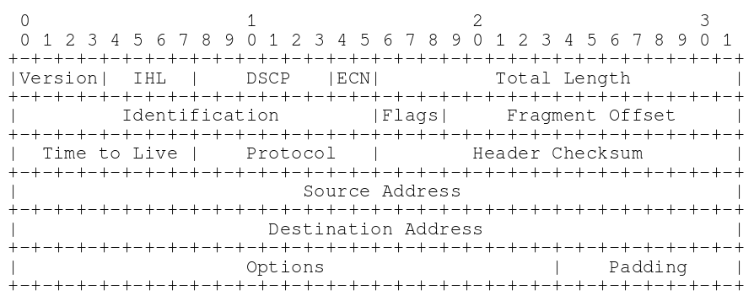
Explicit Congestion Notification (ECN)
Introduced by RFC 3168, in 2001
Replaces two reserved bits of the Traffic Class byte
Four possible bit values
00 = Not ECN capable
01 = ECT(1)
10 = ECT(0)
11 = CE (congestion experienced)
Misconfigured devices have presented deployment issues
Notes:
ECN is an extension to IP and some higher level protocols, such as TCP and RTP, that allows devices on the network to signal incipient congestion before packet loss has occurred, allowing hosts to respond by reducing their sending rates without incurring issues around packet loss on the network
It utilises to previously reserved bits as part of the traffic class byte, as you can see from the diagram to the right
We have four possible bit values for the ECN field.
However, misconfigured devices on the network have presented deployment issues for ECN,

Slide 4
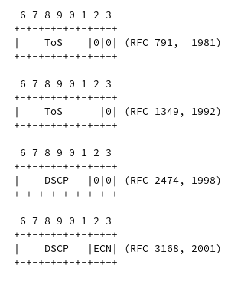
Type of Service field
Bits that constitute the ECN field have served previous purposes
Devices implementing ToS may inadvertently destroy ECN signalling
Notes:
The bits that constitute the ECN field, have previously been defined in a number of different ways across the years
Previously defined as part of the type of service field, which allowed for the precedence of traffic to be defined amongst other purposes
Hence, with these points raised, we have the potential for devices on the network to have differing expections for what this byte ought to look like. Applying modfiications to packets with these expectations potentially destroying ECN signalling.

Slide 5
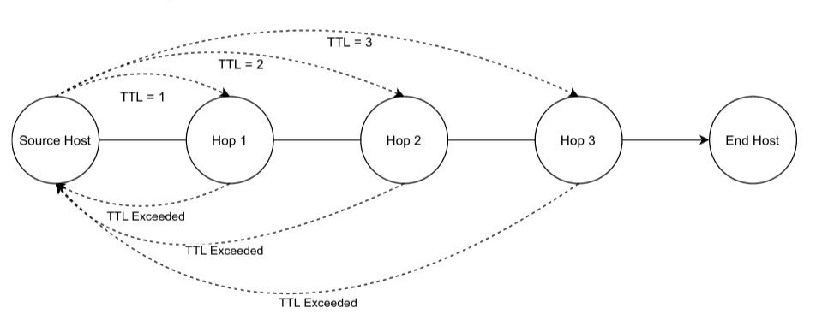
How do we measure ECN traversal?
RFC 792 defines ICMP quotations for time exceeded responses
IP header + first 8 bytes of originating payload
Traceroute style utility
Path level visibility to ECN field
May additionnally attribute to an Autonomous system
Notes:
how do we measure ECN traversal on the network?
IP packets, contain a TTL or a time to live, that describes the lifetime of a packet, as a packet traverses the network the TTL is decremented by network devices, if It reaches zero, an ICMP "time exceeded in transit" is sent to the sending host.
However, we can rely on behaviour defined in RFC 792, which specifies that for certain types of ICMP responses devices on the network must "quote" the ip header and first 8 bytes of content for the packet that caused the ICMP response to be generated. The ECN field is contained within the IP header, hence we can inspect its contents as it traverses the network.
we can implement a traceroute style tool, sending packets onto the network with increasing TTLs such that packets traverse deeper into the network, retrieving quotations from network devices, and inspecting them to determine whether the ECT codepoint is present. This concept is demonstrated visually on the right of the slide
Additionally, we may attribute the actions of network devices to an autonomous system to better understand the behaviours of devices

Slide 6
Aims
When devices remark packets, where does this happen?
Are there deployment issues with ECN under Quic?
Are ECT codepoints equivalent under remarking?
Do IP versions exhibit different marking behaviours?
Do Transport protocols influence modifications?
Notes:
We highlight the following aims that will be discussed across the rest of the paper;
Let us define some aims for this research
When devices remark packets where does this happen? Comparing out results to previous findings
Are there deployment issues with ECN under Quic? A new transport protocol that has proposed ECN functionality
Are ECT codepoints equivalent under remarking?
Do IP versions exhbiit different marking behaviours?
And dooes the transport protocol influence the marking behaviours of devices on the network in regards to ECN?

Slide 7
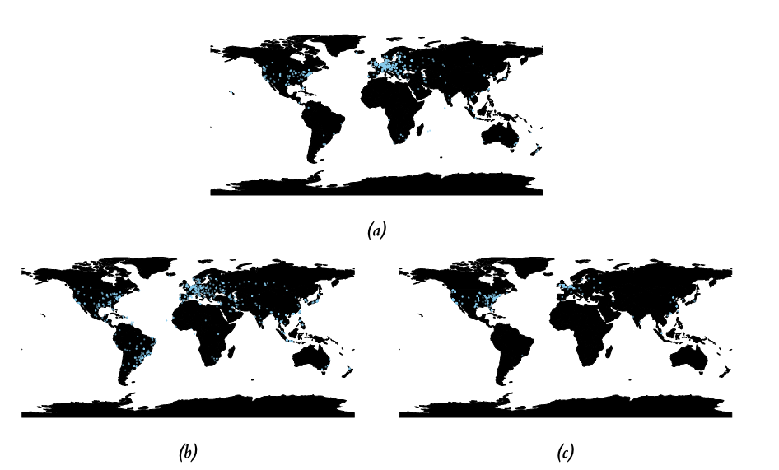

Methodology
3 Host populations (3000 hosts in total)
DNS
NTP
Web servers
Traceroute style probes under each ECT codepoint, and transport protocol
Measured from 12 locations
AWS EC2 instances
Student Volunteers
Several iterations over two weeks
NTP Servers
DNS resolvers
Web servers
Notes:
We select from 3 host populations to realise these aims
We select, a number of DNS resolvers, NTP servers and web servers
The locations of sampled hosts have been presented on the right hand side of the slide
We seek to run traceroute style operations to each host under each ECT codepoint and transport protocol offered
We measure from a variety of locations, such as Amazon web services virtual machine instances, Additionally we recruit volunteers as part of an ethics approved study.

Slide 8
Implementation
Network analysis tool Implemented in C
Utilises
lsquic by LiteSpeed
libpcap
libnetfilter_queue
Various aspects of POSIX sockets
Packer
Ubuntu Server 20.4 substrate
Distributed to VM locations
Terraform
Deployment configuration as a parameterised terraform module
Tool scheduled through cron
Notes:
The network analysis tool was implemented in C
We rely on a number of libraries such as lsquic, an implementation of quic that natively supports ECN
We utilise libpcap to capture exchanged network traffic, which we commit to storage for subsequent analysis
We utilise libnetfilter_queue, a firewalling library to allow for arbitrary modifications of packets in userspace
And various aspects of the posix networking library
We additionally utilise packer and terraform to facilitate a multi-region terraform deployment within AWS
Lastly the tool was scheduled to run at specific times utilising cron

Slide 9
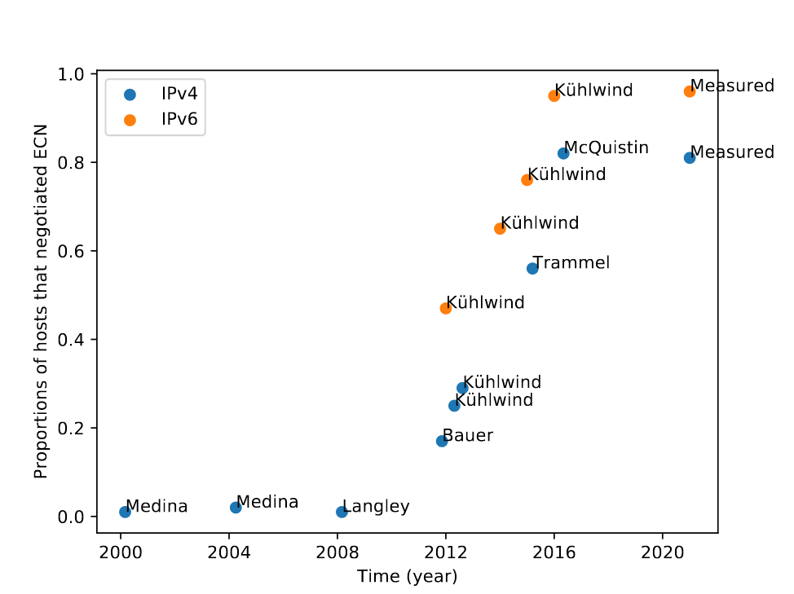
Trends in ECN adoption
96% negotiated ECN under IPv6
80% negotiated ECN under IPV4
Apparent plateau in growth of adoption under IPv4.
Notes:
Fristly, we investigate the overall adoption of ECN on the network, to measure this we report statistics of ECN negotiation under TCP under our sampled web server hosts as this provides the best means of comparison
We found that 96% of IPv6 hosts sampled negotiated ECN
Whilst 80% of sampled IPv4 hosts samples negotiated ECN
When comparing these results to previous measurements, as shown on the diagram to the right, we find an apparent plateau in the growth of support for ECN,
Under IPv6 this was to be expected, as nearly all hosts measured negotiated ECN
However, under IPv4 we have a significant number of hosts that continue to not support ECN

Slide 10
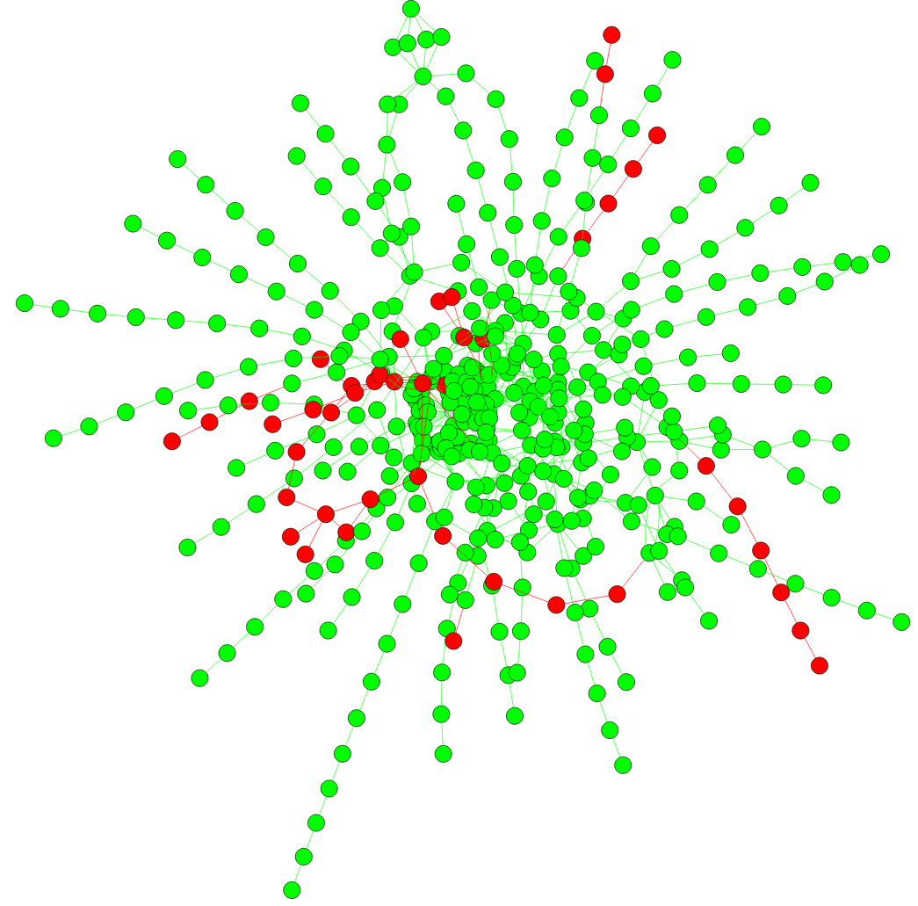
Where is ECN stripped on the network?
Web servers from Alexa Top Sites
Traceroute using ECT(0) to hosts
ICMP responses inspected
Affects 8% of connections
52% of modifications occurring on AS boundaries, lower than previous works
98.2% of network interfaces pass ECT(0) unmodified
One measurement location always clears on 1st hop
Notes:
We begin by presenting results in the general case under our sampled webserver hosts.
We select traces from each vantage point using a traceroute operation under TCP to webserver hosts, inspecting ICMP responses determining whether the ECT codepoint is present.
We present some sample results of this data on the diagram on the right, the vantage point we measure from is centered with hosts being mesured towards the edges, network hops that preserved the ECT codepoint are shown in green, and ones that did not are shown in red.
We find that ECT removal on the network effects around 8% of connections, which is slightly lower than what previous studies have indicated at around 17%.
we found that 52% of removals occur on AS boundaries which is slightly lower than previous works.
We also found that 99% of network interfaces pass the ECT(0) codepoint unmodified
we did identify one device, a participants home router that would remark ECT codepoints at the first network level hop

Slide 11
ECT Removal Under Quic
Subset of web servers identified supporting Quic (205 hosts)
8.5% connections experience ECT removal
Comparable to TCP
Generally occurring on AS boundaries
No specific inhibitors to ECN deployment specific to Quic
Although, no hosts negotiated ECN under ietf-draft-29
Notes:
We additionally identified webserver hosts that exposed services over Quic, around 20% of hosts sampled, exposed services over quic
We found that the connections that experience ECT removal comparable to TCP, additionally generally occuring on AS boundaries suggesting no specific inhibitor to the deployment of ECN within Quic
However in our measurements, we found that no hosts actually negotiated ECN under Quic

Slide 12
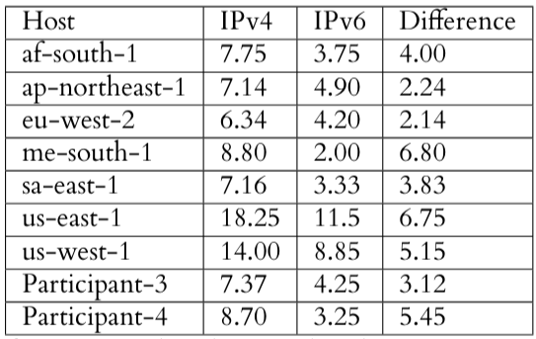
IP Version Dependant Remarking
Basic matching employed on web servers identifying dual stack hosts
Counting paths that experience ECT removal within identified hosts
IPv4 paths more exposed to destructive ECN remarking
Under IPv6 DSCP+ECN always set to zero on destructive hop
Notes:
We additionally determined whether the IP version in use lead to differences in remarking behavior on the network
We identify dual stack web server hosts by measuring the number of interface hops to the IPv4 and IPv6 addresses of the resolved domain names, if they were equal we identify them as a dual stack host
We count the instances within a vantage point that experience ECT removal towards a given host, we subsequently conducted a paired t-test finding a statistically significant difference between the two groups of hosts, we generated a confidence interval over the mean difference between these groups, finding that IPv4 paths to these dual stack hosts were more destructive to the ECN field.
We additionally investigated the specific remarking behaviors of devices on the IPv6 path, finding that all of the remarking behavior zeroes out the entire DSCP and the ECN field

Slide 13
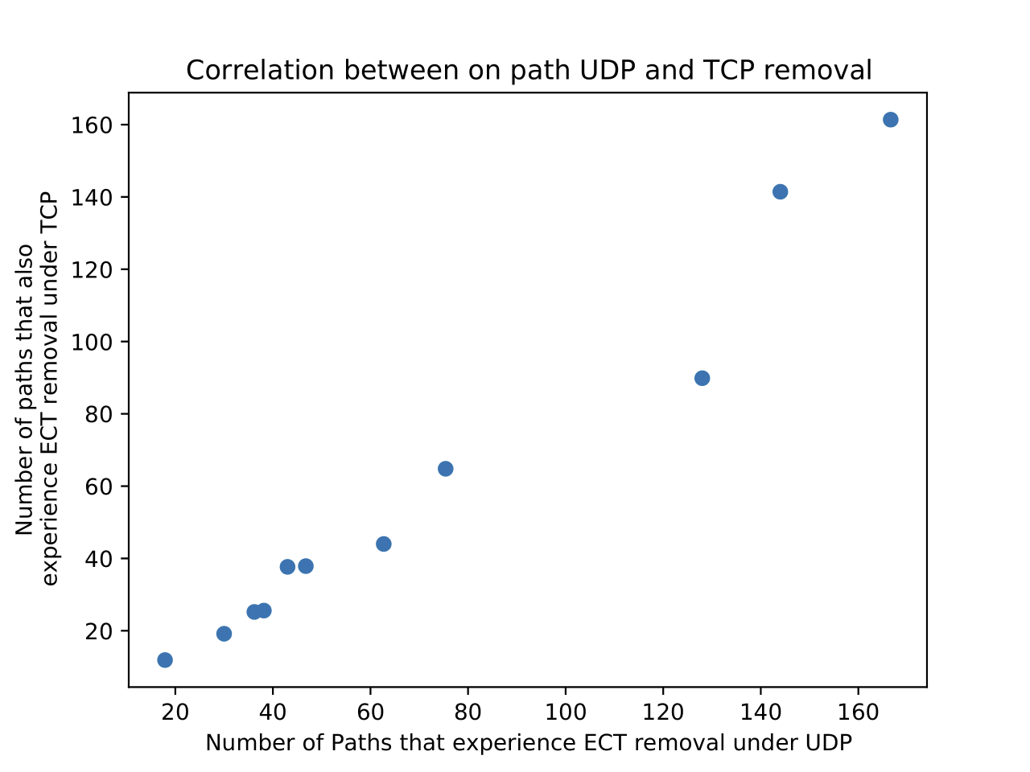
Transport Dependant Remarking
UDP + TCP probes to DNS resolvers
63% of traces indicate removal within the same network hop.
95% of traces within the same AS
One outlier clearing ECT on all UDP traffic but not TCP.
Notes:
We continue to demonstrate whether the transport protocol in use has an effect on the treatment of ECN markings on the network.
We utilise DNS resolvers, offering DNS over TCP and UDP both over port 53. Essentially keeping all variables constant except transport protocol.
The number of instances of removal between transport protocols was largely the same within a given vantage point, slight difference largely due to measurement error in the general case
We perform a basic matching across traces for each vantage point, we find that in over half of cases, the same network interface reports the removal of the ECT codepoint.
Additionally 95% of paired traces indicate removal within the same AS
However, one vantage point, a participant in the study, experienced removal of ECT codepoints under UDP within the first hop, but not under TCP. Suggests that differential treatment exists on the network in exceptional cases. Although this does not appear to be widespread

Slide 14
ECT Dependant remarking
Instances of remarking
Remarking behaviour
Collecting ECT(0), ECT(1), CE traces to web servers.
Around 8% of connections experience removal under each codepoint
Simple Zeroing DSCP+ECN
ECN zeroed + changed DSCP
Partial change of ECT codepoint
Notes:
We also sought to determine whether a given ECT codepoint experienced more adverse behavior on the network than others, we found that instances of of the ECN field being zeroed was largely identical between each ECT codepoint in use.
However, we additionally investigate the remarking behaviours of individual codepoints on the network, finding that the majority of remarking behaviour could be attributed to simple zeroing behaviour, perhaps through overzelous attempts to clear the ToS field.
Additionally we have instances where the DSCP is changed, with the ECN field being zeroed.
Laslty, although making an incredibly small percentage of modifications under the CE codepoint at around 1.2% of destructive modifications to the ECN field, we have instances where the CE codepoint is remarked to an ECT(0) codepoint, suggesting that devices on the network are behaving as RFC 1349 defines

Slide 15
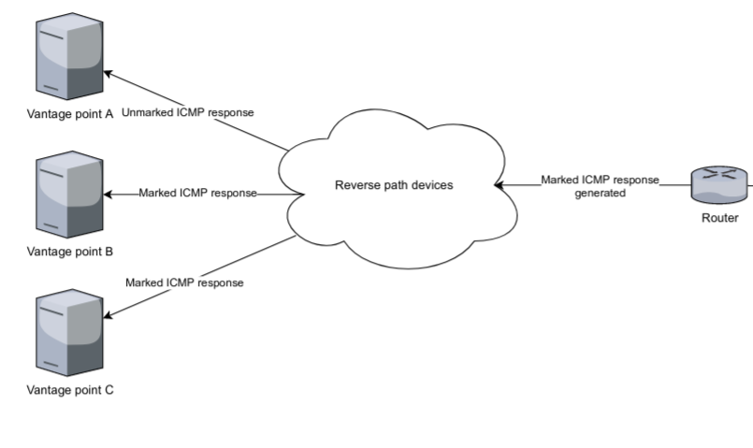
ECN on the reverse path
Identified that some devices return ECT marked ICMP responses
70% of connections
RFC 1349 apparent root cause
Some ICMP responses should mimic ToS of source packet
Implications?
Notes:
Identified early in the project, was the fact that some network devices returned what appeared to be ECT marked ICMP responses.
This is interesting as ICMP does not use ECN hence it would not be expected that it would utilise the field.
Around 70% of connections conducted contained at least one device that would mark ICMP responses in this way,
The marking used generally matched the ECT codepoint in use during that traceroute operation, suggesting that the device is imitating at least the ECN field
In consulting relevant literature, RFC 1349 seems to be the root cause of this behaviour, where some ICMP responses should mimick the ToS of the packet that caused the ICMP responses to be generated. However, ICMP TTL exceeded responses are defined to be sent with a ToS value of 0, so it is unclear why devices are behaviing in this way
What are the implications?
If a device near a host being measured is known to behave in this way, one way measure ECT traversal on the reverse path, notably without the cooperation of the end host

Slide 16
Conclusion
ECN deployment appears to be plateauing
ECN remarking more common within IPv4 paths
Devices generally agnostic of transport substrate
ECT codepoint does not affect remarking behaviours
No immediate inhibitors of ECN deployment within Quic

