Slide 1
ATMOS (Autonomous Traffic Monitoring and Observing System): A Deep-Learning Based Traffic Monitoring System using CCTV footage

Slide 2
Introduction
The apparent lack of comprehensive traffic flow and network analysis in the Philippines, which is crucial for urban planning and road infrastructure management is rather concerning. The most recent report of Numbeo published last January 2021 shows that the country scored 192.88 for the traffic index and 243.20 for the inefficiency index.

Slide 3
Introduction
Thus, in an effort to improve our understanding of traffic interactions in Philippine roads, the researchers have proposed a vehicle detection and counting system. The proposed project uses a deep-learning based system to detect, classify and count vehicles in real-time. The project aims to provide a systematic solution to counting vehicles and monitoring congestion using computer vision-based techniques.

Slide 4
Objective
The main objective of this project is to create a deep-learning based monitoring system that will analyze CCTV footage of traffic flow to detect real-time congestion based on the weighted count of vehicles in roads.

Slide 5
Specific Objectives
Deploy the system in roads with varying volume and density levels.
Test the system in several types of environments, lighting conditions, and weather conditions.
Publish a dashboard/web app that will show the real time data (timelines, etc.)

Slide 6
Significance
SDG 11 - Make cities and human settlements inclusive, safe, resilient and sustainable (Sustainable transport)
R&D Priority Area and Program (HNRDA): Industry, Energy, Emerging Technology - Intelligent transportation solutions

Slide 7
Economy
Road congestion costs our economy a significant portion of the gross domestic product. High levels of traffic congestion and density cause huge delays in transport of goods and delivery of services, and increased fuel wastage.

Slide 8
Environment
The long time spent by vehicles on the road also contributes to the increase in emission of pollutants. Thus, minimizing the time spent by vehicles on the road can help lessen their carbon footprint.

Slide 9
Efficiency
Plenty of Filipinos spend a few hours each day stuck in traffic. Philippines is always among the top countries with longest traffic wait times. Commuters lose valuable time that can instead be spent on productive activities. Traffic costs people income opportunities. Filipinos can do away with delayed transactions and the mental and physical fatigue caused by traffic.

Slide 10
Safety
Efficient traffic networks also translate to safer commute and roads. With better road networks, we can significantly reduce the risk of accidents and hazards in roads.

Slide 11
Society
If the project is deployed successfully, especially in highly urbanized areas, it can help local governments to employ efficient routes, implement better policies, and plan effective road infrastructure projects. This could also provide road users with vital information that would help them understand traffic flow and interactions better, and consequently, navigate the roads better and more safely.

Slide 12
Related Literature
Different algorithms used by similar studies.
R-CNN (Region Convolutional Neural Network)
GMM (Gaussian Mixture Modelling)
YOLO (You Only Look Once)
SVM (Support Vector Machine)
SSD (Single Shot MultiBox Detector)

Slide 13
Related Literature
A combination of shallow learning and deep learning techniques can also be used. A system developed by Adu-Gyamfi et al. (2017) separated object recognition to two tasks: localization and classification. Selective Search is used to localize region proposals.

Slide 14
Related Literature
A study conducted by Zhang et al (2019), employed the Faster R-CNN algorithm. However, the frame rate achieved was only 12 fps and is therefore not appropriate for real-time deployment. Several techniques can be done to improve the speed of the model. However, the detection accuracy suffered at the expense of these attempts.

Slide 15
Related Literature
In another study (Al-Ariny, 2020), the algorithm used was an enhanced variation of the Faster R-CNN called the Mask R-CNN. This is a framework that was first discussed in 2017. The network adds a parallel channel to give a segmentation mask for each detected object in addition to the bounding-box and the class label.

Slide 16
Related Literature
The YOLO approach can process images in real-time at a frame rate of up to 45 fps. Another paper (Kadim et al, 2020) showed that the YOLO model consistently achieved the highest accuracy and highest detection rate in all videos as compared to the other algorithm used which is SSD.

Slide 17
Methodology

Slide 18
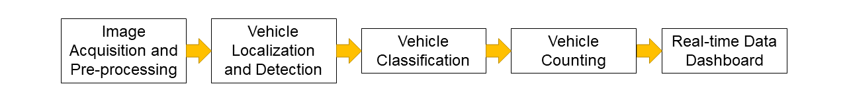
Framework

Slide 19
Image Acquisition and Pre-processing
The training and testing images will be collected from CCTV cameras detected for traffic surveillance. The footage will be cropped out to include only the segment or side of the road with frontal view of the vehicles.

Slide 20
Vehicle Localization and Detection
The model that will be used for the proposed method is the You Only Look Once version 3 or YOLOv3. YOLOv3 unifies the separate components of object detection (classification and localization) into a single neural network. A region of interest will be defined to avoid the multiple detection and counting of a single vehicle. Then, the each of the vehicles detected within the region will be associated with their respective individual trackers. This is to ensure that vehicles are consistently labeled within the tracking period.

Slide 21
Vehicle Classification
For each vehicle, the history of predicted classes within a time period (before it reaches the LOI) will be kept. The frequency of the detected classes will be recorded and updated in each frame. This will be done using the cumulative confidence value of the class starting from the moment the tracker is initialized. Then, the class with the highest frequency will be decided as the final vehicle class.

Slide 22
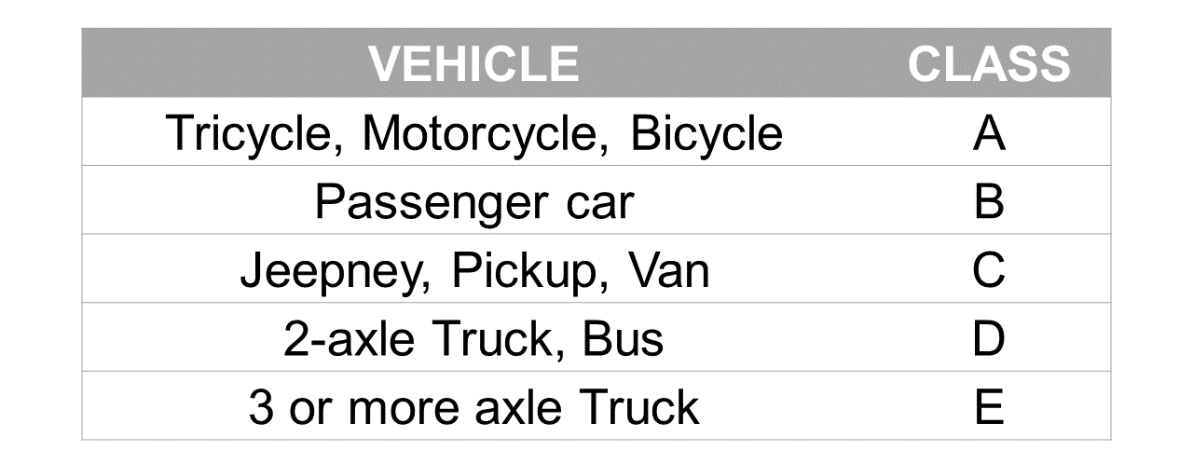
Vehicle Classification

Slide 23
Vehicle Counting
The counting will be executed using a user defined region-of-interest virtual ROI and virtual line-of-interest (LOI). The ROI will be used to filter out vehicles that are outside the desired area of tracking from being detected. Once a vehicle crosses the LOI, the counter will be updated and incremented. To make sure that each vehicle is only counted once, counted vehicles will be indicated as “already counted”. The estimated overall vehicle volume will be quantified according to the weighted vehicle class.

Slide 24
Real-time Data Dashboard
Aside from showing the classifications in the video feed, the real-time count and data will be reflected and published real-time in a web application/dashboard. Several visualizations such as bar (reflecting the vehicle count) and time-series (reflecting the vehicle count trend over time) charts will be published in the dashboard.

Slide 25

What is the expected output?
A Traffic Monitoring System that will analyze real-time traffic flow using CCTV footage to detect congestion.

Slide 26
Changes/adjustments being considered
Holistic approach
Anomaly detection
Background subtraction
SVM
R-CNN

Slide 27
References
Y. O. Adu-Gyamfi, S. K. Asare, A. Sharma, and T. Titus, “Automated vehicle recognition with deep convolutional neural networks,” Transportation Research Record, vol. 2645, no. 1, Art. no. 1, 2017.
Z. Al-Ariny, M. A. Abdelwahab, M. Fakhry, and E.-S. Hasaneen, “An efficient vehicle counting method using mask r-cnn,” in 2020 International Conference on Innovative Trends in Communication and Computer Engineering (ITCE), 2020, pp. 232–237.
S. Awang and N. M. A. N. Azmi, “Vehicle counting system based on vehicle type classification using deep learning method,” in IT Convergence and Security 2017, Springer, 2018, pp. 52–59.
C. M. Bautista, C. A. Dy, M. I. Mañalac, R. A. Orbe, and M. Cordel, “Convolutional neural network for vehicle detection in low resolution traffic videos,” in 2016 IEEE Region 10 Symposium (TENSYMP), 2016, pp. 277–281.
Z. Cai, Q. Fan, R. S. Feris, and N. Vasconcelos, “A unified multi-scale deep convolutional neural network for fast object detection,” in European conference on computer vision, 2016, pp. 354–370.

Slide 28
References
Z. Dong, Y. Wu, M. Pei, and Y. Jia, “Vehicle type classification using a semisupervised convolutional neural network,” IEEE transactions on intelligent transportation systems, vol. 16, no. 4, Art. no. 4, 2015.
Y. Du, C. Liu, and W. Shi, “A real-time vehicle recognition method based on video sequence images,” in 2009 9th International Conference on Electronic Measurement & Instruments, 2009, pp. 4–400.
Z. Kadim, K. M. Johari, D. F. Samaon, Y. S. Li, and H. W. Hon, “Real-Time Deep-Learning Based Traffic Volume Count for High-Traffic Urban Arterial Roads,” in 2020 IEEE 10th Symposium on Computer Applications & Industrial Electronics (ISCAIE), 2020, pp. 53–58.
Z. Kadim, K. M. Johari, D. Fairol, Y. S. Li, and H. W. Hon, “Real-time vehicle counting in complex scene for traffic flow estimation using multi-level convolutional neural network,” International Journal of Advanced Technology and Engineering Exploration, vol. 8, no. 75, Art. no. 75, 2021.

Slide 29
References
V. Lempitsky and A. Zisserman, “Learning to count objects in images,” Advances in neural information processing systems, vol. 23, pp. 1324–1332, 2010.
S. Maqbool, M. Khan, J. Tahir, A. Jalil, A. Ali, and J. Ahmad, “Vehicle detection, tracking and counting,” in 2018 IEEE 3rd International Conference on Signal and Image Processing (ICSIP), 2018, pp. 126–132
M. Peppa, D. Bell, T. Komar, and W. Xiao, “URBAN TRAFFIC FLOW ANALYSIS BASED ON DEEP LEARNING CAR DETECTION FROM CCTV IMAGE SERIES.,” International Archives of the Photogrammetry, Remote Sensing & Spatial Information Sciences, vol. 42, no. 4, Art. no. 4, 2018.
J. Redmon, S. Divvala, R. Girshick, and A. Farhadi, “You only look once: Unified, real-time object detection,” in Proceedings of the IEEE conference on computer vision and pattern recognition, 2016, pp. 779–788.

Slide 30
References
Y. Xia, X. Shi, G. Song, Q. Geng, and Y. Liu, “Towards improving quality of video-based vehicle counting method for traffic flow estimation,” Signal Processing, vol. 120, pp. 672–681, 2016.
Y. Gao and H. J. Lee, “Vehicle make recognition based on convolutional neural network,” in 2015 2nd International Conference on Information Science and Security (ICISS), 2015, pp. 1–4.
F. Zhang, C. Li, and F. Yang, “Vehicle detection in urban traffic surveillance images based on convolutional neural networks with feature concatenation,” Sensors, vol. 19, no. 3, Art. no. 3, 2019.

