Slide 1
What I have built so far: fifteen working legal tools
Built on my own time with invented clients. Orange marks three that could be used right away.
CONFLICTS AND INTAKE
TRANSACTIONS AND PRACTICE GROUPS
Conflion
Finds the conflicts a letter-for-letter search misses and routes each intake to the right approvers.
Matter Desk
First read of a new matter in five practice areas, with every deadline dated.
Party Finder
Reads the complaint or deal papers and lists every name to run, so intake misses no one.
Synthesis
Buy-side deal workbench: schedules against reps, the markup explained, closing list built.
LexAtlas
Maps how companies, people and matters connect, for conflicts and diligence.
Skippy
Answers questions about a matter's files, every answer cited to the page.
VigilMark
Ranks new trademark filings against clients' marks before the opposition window closes.
BILLING AND TIME
Guideline Guard
Checks each prebill against that client's own guidelines and proposes the fix.
LITIGATION
Win your case ASAP
First read of a complaint: which motions could end the case early, with filing dates.
Hour Catch
Reads a lawyer's day in Outlook and Teams and drafts the time entries that would be lost.
Testimony Check
Finds where a witness's story conflicts with the documents and drafts the deposition outline.
FIRM STRATEGY AND MARKETING
Citation Gate
Checks every cited case and quotation against real opinions before a brief goes out.
Praxis
Lets leadership compare AI ideas on impact, risk and effort, and track the pilots.
Case Wins Debrief
Turns each trial win into lessons and a tool the next team can reuse.
Marketing Studio
Drafts bios, client alerts and RFP responses in the firm's voice, then checks the rules.

Slide 2





How I use AI: start with the work, then build and prove it
The same four steps for every tool, using whichever AI fits the job.
Start with the work
Build with AI
Test against reality
Ship it complete
Write down how the task is really done here, who touches it and which rules apply, before any screen is built.
Claude and Claude Code for most building. Open models such as Qwen on local hardware where client data must stay inside.
Score the tool against real outcomes, such as public court rulings, and keep a record of every run.
Tests, walkthroughs, plain-language guides and a features list for IT, so it can be reviewed and supported.
FOUR RULES EVERY TOOL FOLLOWS
Lawyers decide
AI output stays a suggestion until a person confirms it.
Code checks the model
Quotes, dates and totals are verified in code.
Client data protected
Firm hardware, walls in the data, nothing sent without approval.
Everything is traceable
Each finding cites its source; each decision is logged.

Slide 3

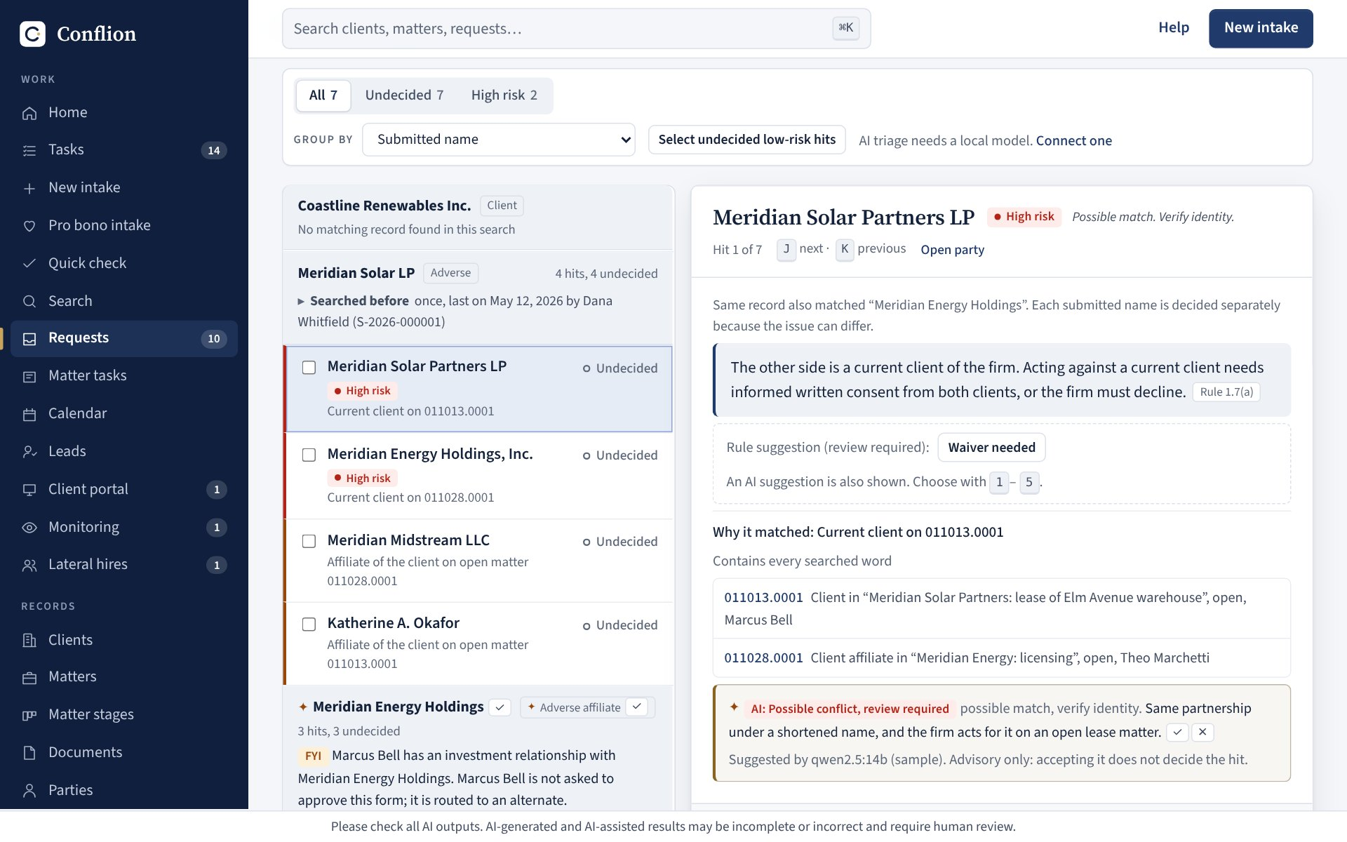



Conflion shows what a full firm tool looks like
A conflicts and intake system that puts all four pieces together.
Secure
Sign-on and roles. Ethical walls enforced in what each user can see. A tamper-evident audit trail.
Connected
Each intake routes to the right approvers. Walls feed a block list for the document system.
Local model
The AI runs on the firm's own hardware, so client names never leave the building.
Hit review: each match explained in plain English. The AI note is marked advisory; a person decides.
Built to our rules
Catches what a letter-for-letter search misses (Smyth, Kate for Katherine, parent companies) and cites the conduct rule.
The same pattern could serve any workflow at the firm.

Slide 4


What I could build next, from small to firm-wide
Ideas I think are worth exploring. Which ones, and in what order, is leadership's call.
Start small
Connect
Firm-wide, for discussion
Use what already works
Plug proven tools into firm systems
One firm-owned platform
Pilot Guideline Guard, Party Finder or Marketing Studio with our own documents.
No connection to firm systems needed.
A person reviews every output.
Ask the matter: questions over a matter's files, answered with page cites.
Hour Catch: draft time entries from Outlook and Teams.
Client risk radar: flag lawsuits and audits hitting our clients.
Every tool as a module over all files, matters and systems.
One set of permissions, one audit trail, models on firm hardware.
Includes a knowledge engine: "who here has handled this?"

Slide 5


How I can help the firm with AI
Two ways I can be an asset, each backed by work already done.
AI tools and implementation
AI strategy going forward
Building, testing and rolling out tools
Choosing what to pursue, and how
Fifteen working legal tools, each built and tested end to end.
Built for client data: local models, ethical walls, audit trails (Conflion).
Rollout that sticks: walkthroughs, plain-language guides and training.
Picking ideas on impact, effort, data readiness, risk and adoption.
Matching each job to the right AI, and knowing where client data can go.
A practical path from quick wins to a firm-owned platform.
For discussion
Which problems would you most like AI to solve here, and how could I help?

