Slide 1
HANDWRITTEN DIGIT RECOGNITION USING DEEP LEARNING
CAPSTONE PROJECT
REVIEW - 1
TEAM MEMBERS:
Vasanthakumar.P(18BCS0022)
Manibharathi.S(18BCS0023)
E.Nithyashri(18BCS0070)
MENTOR:
Dr.VANITHA.M

Slide 2

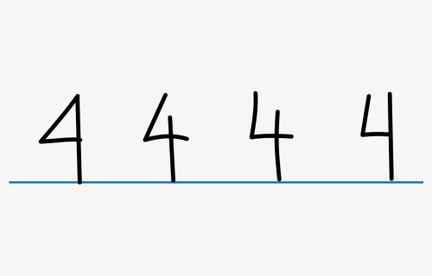
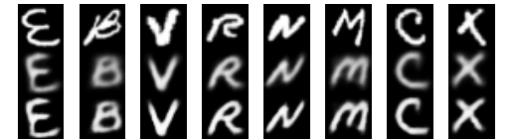
ABSTRACT
Handwritten transcription can easily be identified and understood by humans, but computer cannot identify as easily as humans because different handwriting has different patterns to spot.
This project is built based upon the most vital and integral concepts of Deep learning and Conventional Neural Networks,(CNN) along with the essential libraries and tools like Tensorflow, Keras and MNIST datasets for training and testing.

Slide 3
LITERATURE SURVEY
[1] Comparison between the online and offline handwriting recognition using digitizer technology and various algorithms like shape recognition algorithms, preprocessing and post processing techniques, and experimental systems are done and discussed.
[2] Recognition of unconstrained handwritten text is very challenging as it is hard to segment the data. Instead of using the most approached Markov models for speech and handwriting recognition, this paper relies on a novel type of recurrent neural network(RNN) which overcomes the challenging tasks and gives accuracy of 79.7% on online data and 74.1% on offline data.
[3] It is an offline Roman cursive handwriting recognition system where the input is provided in form of a digit or a word or text. After a number of processing procedures, the ASCII format of the input is obtained as the output.
[4] This paper discusses about the character termination using a finite state automaton where an unknown stroke is compared with the database of strokes to match and identify the stroke.
[5] Components such as input interpretation, trainable segmentation, and minimum-error rate training for feature combination are used in this system, which currently supports 97 languages.

Slide 4
[6] This paper uses a novel technology for 3D handwriting recognition where accelerometers and gyroscope are attached. A Support vector machine(SVM) is used to identify the data segments whereas the Hidden Markov models(HMM) are used to generate a text representation from the captures gestures. These individual characters are concatenated to word models.
[7] Compares “one against one”(digit recognition) and “one against all”(easy to train) and found that the former is more significant. Also when compared to Multi Layer Perceptron(MLP), SVM’s strategies shows a better estimation than MLP.
[8] This paper discusses about the application of neuroevolution and therefore developing solutions based on genetic algorithms and grammatical evolution. MNIST data set consists of handwritten digits that are difficult even for humans to recognize. In spite of this, the system has produced an impressive result without any kind of data augmentation or preprocessing methods.
[9] For a modified CNN-RNN hybrid architecture, training is done using efficient initialization of network, image normalization, and domain specific data transformation.
[10] A deep neural network architecture that supports for 102 languages, has put back the segment-and-decode-based system by reducing the error rate by 20–40%. This system recognizes 10 times faster than previous system.

Slide 5
SYSTEM ARCHITECTURE
Import Dataset
Preprocessing
Initialize a Model
Build a Multi layer CNN
Train Model
Evaluate Model
Classify Digit

Slide 6
MODULE DESCRIPTION
DATASET
MNIST (Modified National Institute of Standards and Technology) database
70000 number of images ( 60000 training images + 10000 testing Image )
DATA PREPROCESSING
Four categories ( trainX, testX, trainY, testY )
Each pixel value is converted from 0-255. Subset of Deep learning with three types of layers:
ACCURACY
Convolutional Layer(filters are used to extract the feature)
Pooling Layer(reduces the size of data coming from Convolutional layer)
Fully connected
From the research we made about CNN and the similar projects, we expect an accuracy of 90% to 95%(approximately) .

Slide 7
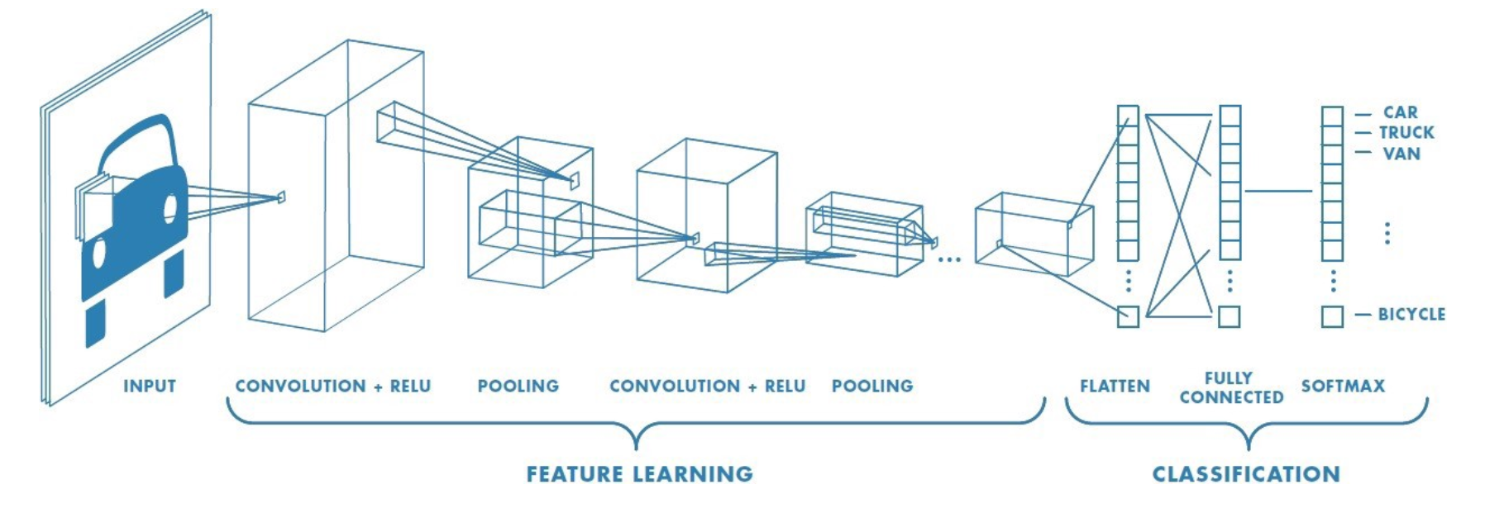
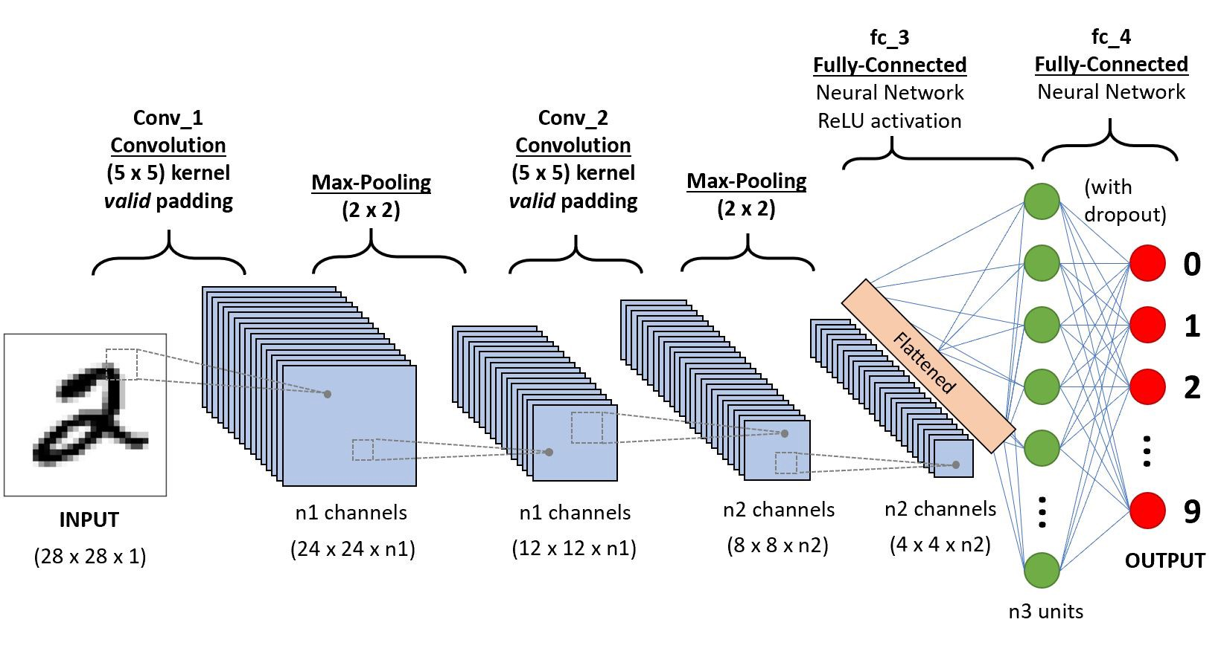

Slide 8
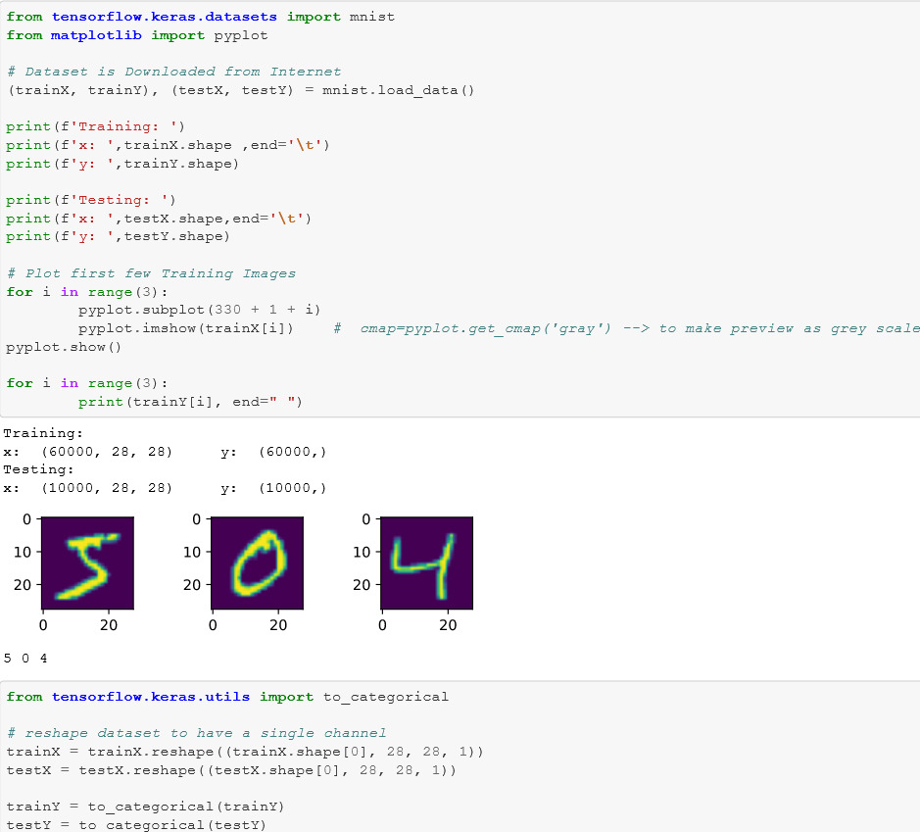
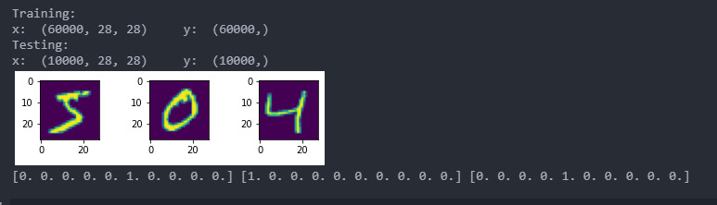
CODE AND OUTPUT

Slide 9
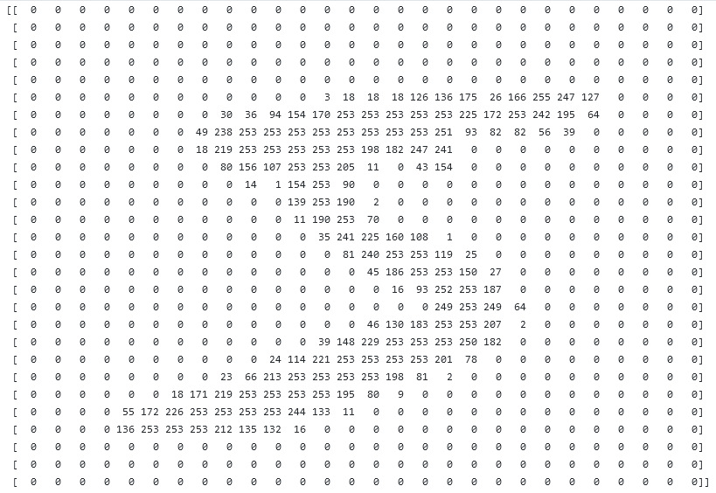

Slide 10
REFERENCES
[1] Tappert, C. C., Suen, C. Y., & Wakahara, T. (1990). The state of the art in online handwriting recognition. IEEE Transactions on pattern analysis and machine intelligence, 12(8), 787-808.
[2] Graves, A., Liwicki, M., Fernández, S., Bertolami, R., Bunke, H., & Schmidhuber, J. (2008). A novel connectionist system for unconstrained handwriting recognition. IEEE transactions on pattern analysis and machine intelligence, 31(5), 855-868.
[3] Bunke, H. (2003, August). Recognition of cursive Roman handwriting: past, present and future. In Seventh International Conference on Document Analysis and Recognition, 2003. Proceedings. (pp. 448-459). IEEE.
[4] Aparna, K. H., Subramanian, V., Kasirajan, M., Prakash, G. V., Chakravarthy, V. S., & Madhvanath, S. (2004, October). Online handwriting recognition for Tamil. In Ninth international workshop on frontiers in handwriting recognition (pp. 438-443). IEEE.
[5] Keysers, D., Deselaers, T., Rowley, H. A., Wang, L. L., & Carbune, V. (2016). Multi-language online handwriting recognition. IEEE transactions on pattern analysis and machine intelligence, 39(6), 1180-1194.

Slide 11
[6] Amma, C., Georgi, M. & Schultz, T. Airwriting: a wearable handwriting recognition system. Pers Ubiquit Comput 18, 191–203 (2014).
[7] Milgram, J., Cheriet, M., & Sabourin, R. (2006, October). “One against one” or “one against all”: Which one is better for handwriting recognition with SVMs?. In tenth international workshop on Frontiers in handwriting recognition. Suvisoft.
[8] Baldominos, A., Saez, Y., & Isasi, P. (2018). Evolutionary convolutional neural networks: An application to handwriting recognition. Neurocomputing, 283, 38-52.
[9] Dutta, K., Krishnan, P., Mathew, M., & Jawahar, C. V. (2018, August). Improving cnn-rnn hybrid networks for handwriting recognition. In 2018 16th international conference on frontiers in handwriting recognition (ICFHR) (pp. 80-85). IEEE.
[10] Carbune, V., Gonnet, P., Deselaers, T., Rowley, H. A., Daryin, A., Calvo, M., ... & Gervais, P. (2020). Fast multi-language LSTM-based online handwriting recognition. International Journal on Document Analysis and Recognition (IJDAR), 1-14.

