Slide 1
FallingTalk: An IoT-Based Real-Time Falling Detection System
Advanced Design and Implementation of IOT Applications
2021/01/10 ver2.1
林明佑, 黃胤錚

Slide 2
Outline
Abstract
Motivation
Introduction
Results
Discussion

Slide 3
Abstract
We present a system for detection of human falling from web-cam or video for support of elderly people living alone in their homes.
In this system, we have the main two parts, which are IoTTalk part and Detection part.
IoTTalk part, including DAI and Line API.
Detection part, including peopleDetector and FallingdownDetector.
The algorithms in this system are implemented in C++ using OpenCV.

Slide 4
System Architecture
Detection part
CAM
PeopleDetector
FallDownDetector
IoTTalk part
Line API
IoTTalk
DAI

Slide 5
Outline
Abstract
Motivation
Introduction
Results
Discussion

Slide 6
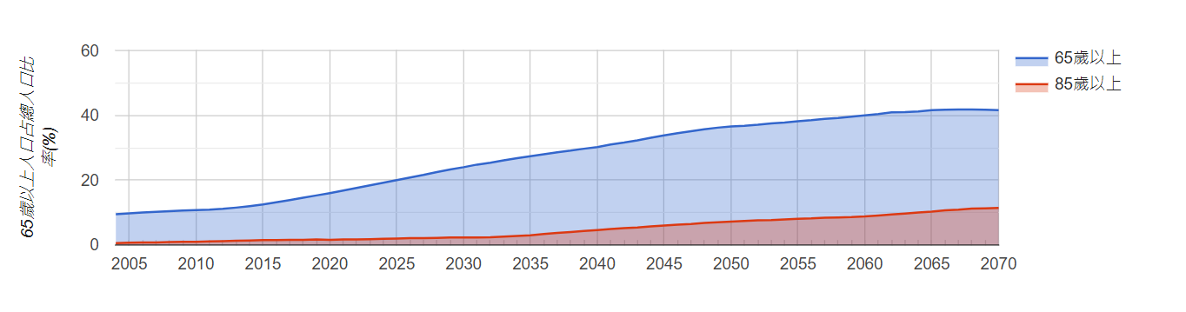
Motivation
隨著近年來社會高齡化的趨勢，我們會需要一些方法來幫助老年人來提高其獨居的能力[1]
在此Project，我們希望能夠提出一個方法，透過IoTTalk來及時通報老年人有無跌倒現象的發生
[1]鍾文平教授「智慧醫療」演講
Notes:
1993進入高齡化社會
2018進入高齡社會
預估2074年將進入超高齡社會

Slide 7
Outline
Abstract
Motivation
Introduction
Results
Discussion

Slide 8
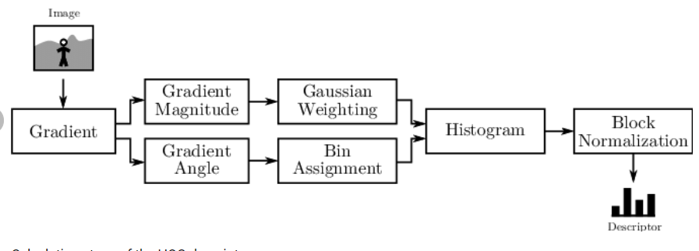
PeopleDetector(optional)
使用HOG Feature + SVM來進行判斷畫面內是否是“人”
Linear SVM
Result
Ref :https://www.researchgate.net/figure/Calculation-steps-of-the-HOG-descriptor_fig1_261285146

Slide 9
FallDownDetector
使用BackgroundSubstractor(Gaussian Mixture-Based)來繪製運動輪廓
並透過IOU Tracker[-]來對每個進入畫面的人進行Label
新影像
計算Movement Coefficient
BackgroundSubstractor
IOU Tracker
Result
Shape analysis

Slide 10
Dummy Sensor
負責接收當前是否有跌倒狀況發生並push data到IoTTalk
Dummy Control
負責從IoTtalk server pull data 並傳送訊息到Line

Slide 11
Outline
Abstract
Motivation
Introduction
Results
Discussion

Slide 12
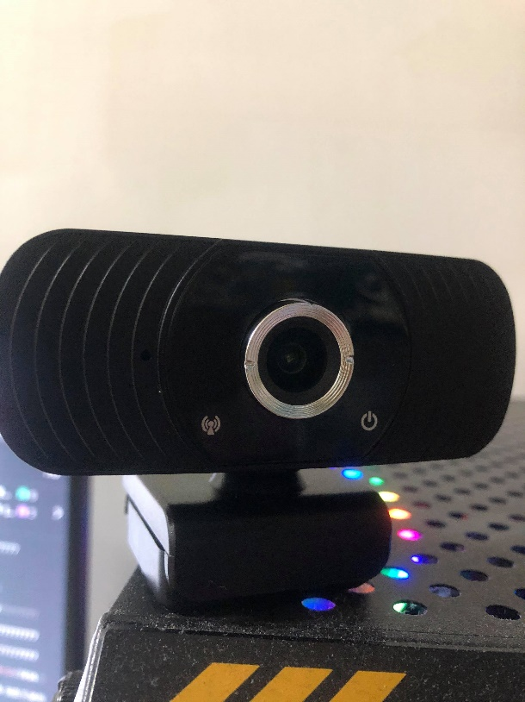
Experiment Setup
OpenCV 4.2.0
Python 3.7.0
C++ 11(or later)
1920 x 1080p resolution web-camera

Slide 13
Dataset
自行錄製的video
Fall detection Dataset[-]
Fall detection Dataset | ??? frames
自行錄製 video | ??? frames

Slide 14
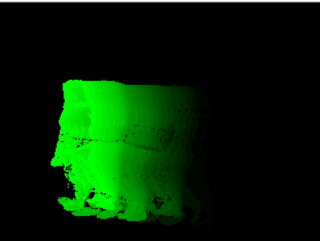
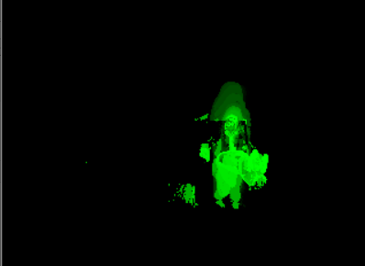
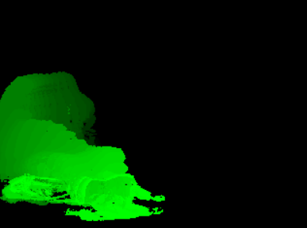
Motion History Image(MHI)
Walk
Sit
Fall

Slide 15
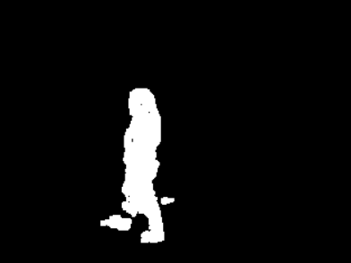
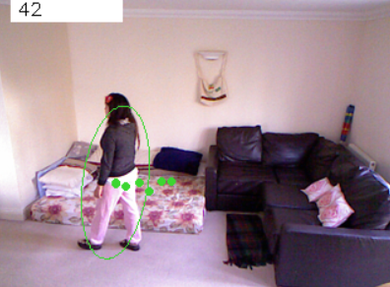
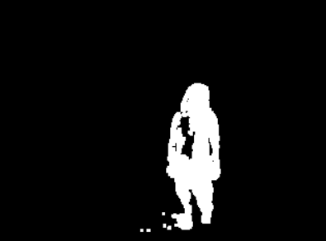
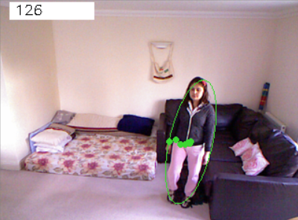
BackgroundSubstractor + shape analysis
Walk
Stand

Slide 16
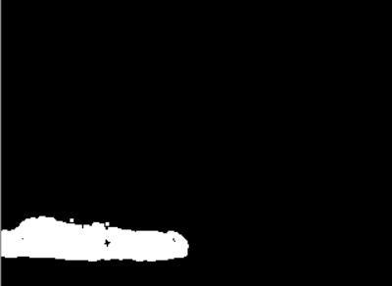
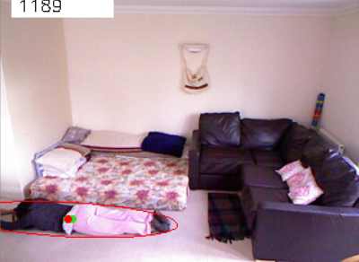
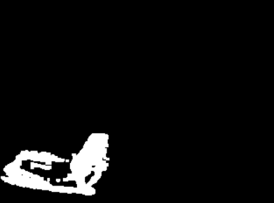
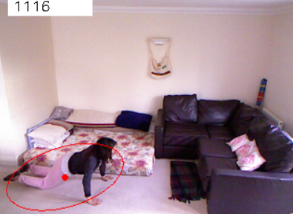
BackgroundSubstractor + shape analysis
Fall
Fall

Slide 17
IoTtalk

Slide 18
Line

Slide 19
Results
Recognition results(Table 1)
Action | Test positive(TP) | Test negative(TN)
Fall
normal

Slide 20
Outline
Abstract
Motivation
Introduction
Results
Discussion

Slide 21
Discussion
We implement an IoT-based real-time falling detection system with high accuracy.
FallingTalk can track a person and LINE users in real-time.
In the future, …

