Slide 1
FallingTalk: An IoT-Based Real-Time Falling Detection System
Advanced Design and Implementation of IOT Applications
2021/01/19 ver2.2
Speaker: 林明佑, 黃胤錚

Slide 2
Outline
Abstract
Motivation
Introduction
Results
Discussion

Slide 3
Abstract
We present a system for detection of human falling from web-cam or video for support of elderly people living alone in their homes.
In this system, we have the main two parts, which are IoTTalk part and Detection part.
IoTTalk part, including DAI and Line API.
Detection part, including MHI Calculator and Falling Detector.
The algorithms in this system are implemented in C++, Python with OpenCV and ZeroMQ library.

Slide 4
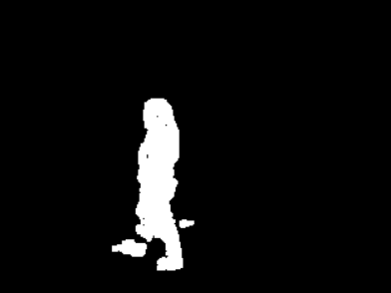
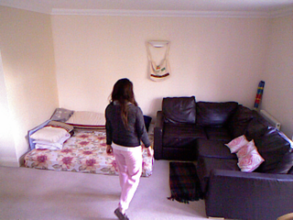
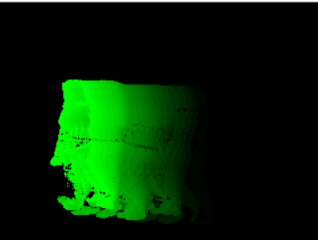
Overview
Overview of FallingTalk
Image-Based solution
Feature vector contains
α(width of human)
β(height of human)
C_{motion}(MHI coefficient)
δ(shape change parameter)
Background Subtraction
Shape analysis
Input Image
Motion History Image
MHI coefficient calc()

Slide 5


Overview
IoT-Based solution(IoTtalk)
Line API
IoTtalk Server
FallingTalk_Server
Warning Message

Slide 6
Outline
Abstract
Motivation
Introduction
Results
Discussion

Slide 7
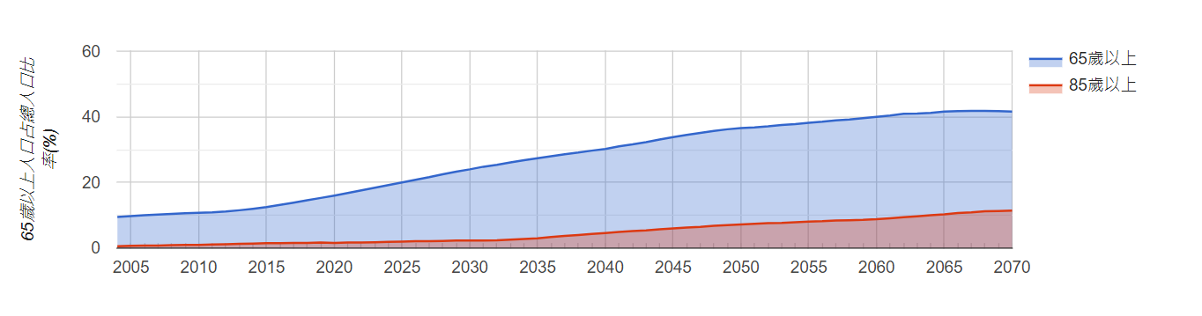
Motivation
隨著近年來社會高齡化的趨勢，我們會需要一些方法來幫助老年人來提高其獨居的能力[1]
在此Project，我們希望能夠提出一個方法，透過IoTTalk來及時通報老年人有無跌倒現象的發生
[1]鍾文平教授「智慧醫療」演講
Notes:
1993進入高齡化社會
2018進入高齡社會
預估2074年將進入超高齡社會

Slide 8
Outline
Abstract
Motivation
Introduction
Results
Discussion

Slide 9
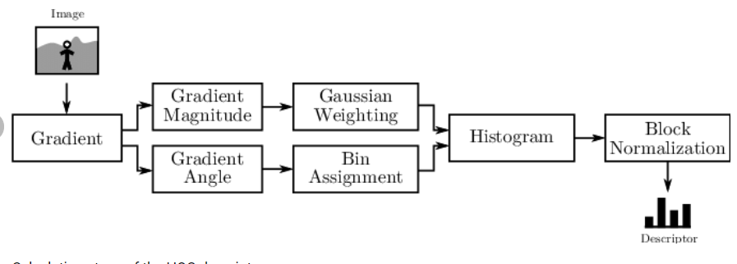
PeopleDetector(optional)
使用HOG Feature + SVM來進行判斷畫面內是否是“人”
Linear SVM
Result
Ref :https://www.researchgate.net/figure/Calculation-steps-of-the-HOG-descriptor_fig1_261285146

Slide 10
FallDownDetector
使用BackgroundSubstractor(Gaussian Mixture-Based)來繪製運動輪廓
並透過IOU Checker來對每個進入畫面的人進行Label
新影像
計算MHI Coefficient
BackgroundSubstractor
IOU Checker
Server
Result
Shape analysis

Slide 11
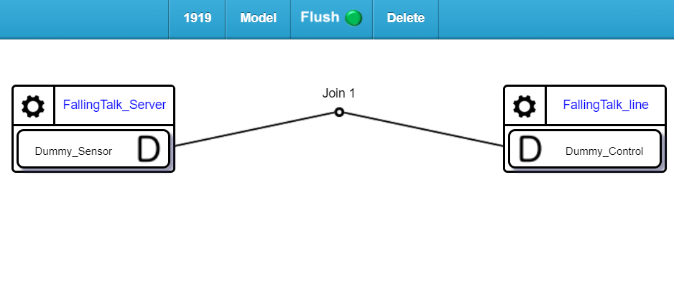
FallingTalk Server, FallingTalk Line
Server負責接收當前是否有跌倒狀況發生並push data到IoTTalk
Line 負責從IoTtalk server pull data 並傳送訊息到Line

Slide 12
Outline
Abstract
Motivation
Introduction
Results
Discussion

Slide 13
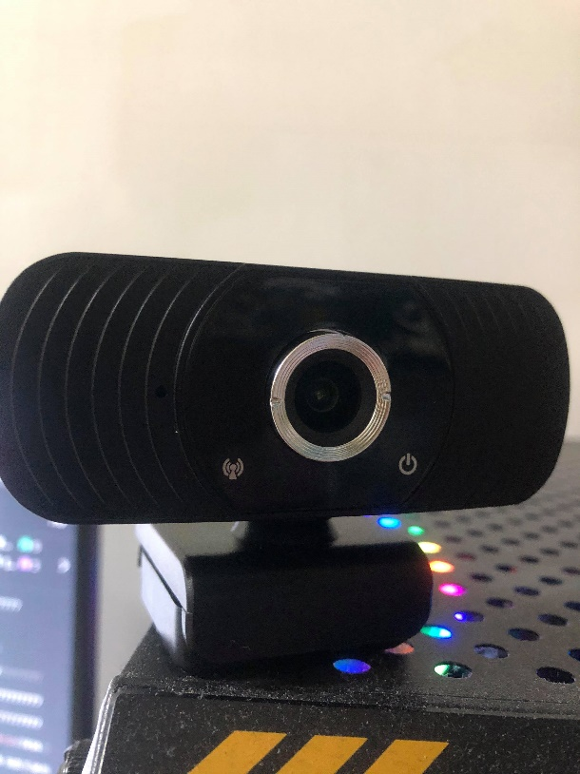
Experiment Setup
OpenCV 4.2.0
Python 3.7.0
C++ 11(or later)
ZeroMQ
1920 x 1080p resolution web-camera

Slide 14
Dataset
Video Recording in NCTU EC015
Fall detection Dataset
Fall detection Dataset | 108 selected frames
Video Recording in EC015 | 94 selected frames

Slide 15
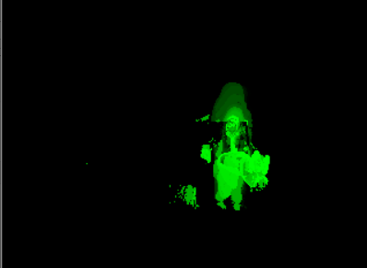
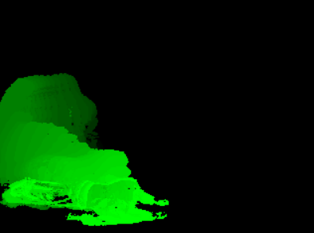
Motion History Image(MHI)
Walk
Sit
Fall

Slide 16
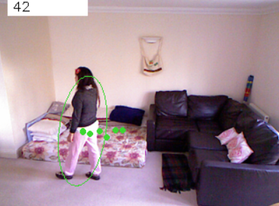
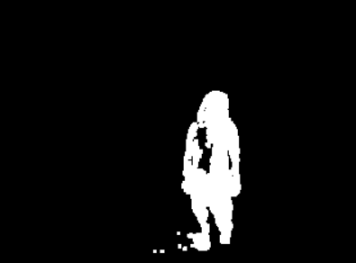
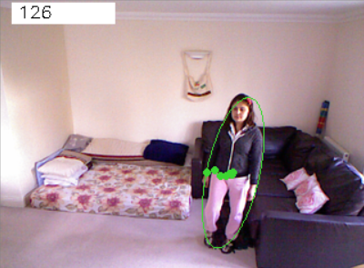
BackgroundSubstractor + Shape Analysis + MHI
Walk
Stand

Slide 17

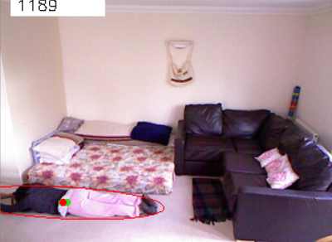
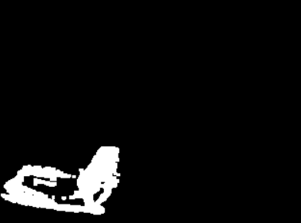
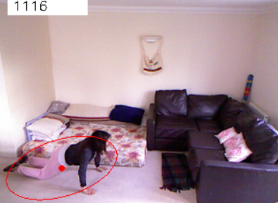
BackgroundSubstractor + Shape Analysis + MHI
Fall
Fall

Slide 18
Recognition Results Summary
Recognition results summary
91.1% accuracy
Action | Test Positive(Detected) | Test negative(Not Detected)
Fall | 91 | 2
normal | 16 | 93

Slide 19
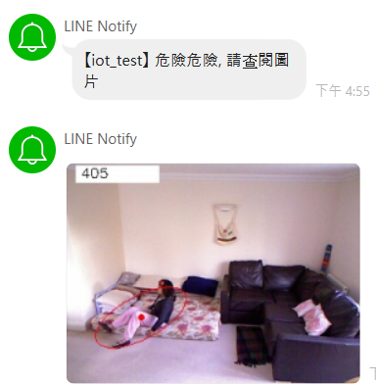
IoTtalk + Line API

Slide 20
Outline
Abstract
Motivation
Introduction
Results
Discussion

Slide 21
Discussion
We implement an IoT-based real-time falling detection system with high accuracy.
FallingTalk can track a person and LINE users in real-time with message and picture
In the future，我們希望能夠為FallingTalk加上聲音感測器、三軸加速度感測器、陀螺儀、心率等等，增加多個features，以最佳化偵測老年人的健康狀態完成一套完整健康偵測系統。

