Slide 1
轻院直播
我们毕业啦
其实是答辩的标题地方
答辩人
第一小组
指导老师
何晓蓉老师

Slide 2
研发背景
技术简要
功能介绍
软件演示
未来展望
项目总结

Slide 3

研发背景

Slide 4
研发背景
功能介绍
技术简要
软件演示
未来展望
项目总结
1
随着技术的不断发展及网络带宽的不断改善，流媒体实时传输技术已成为当前火热的话题。
2
It was the best of times, it was the worst of times; it was the age of wisdom, it was the age of foolishness. It was the epoch of belief, and it was the epoch of incredulity. It was the season of light, and it was the season of darkness. It was the spring of hope, and it was the winter of despair.
3
It was the best of times, it was the worst of times; it was the age of wisdom, it was the age of foolishness. It was the epoch of belief, and it was the epoch of incredulity. It was the season of light, and it was the season of darkness. It was the spring of hope, and it was the winter of despair.

Slide 5
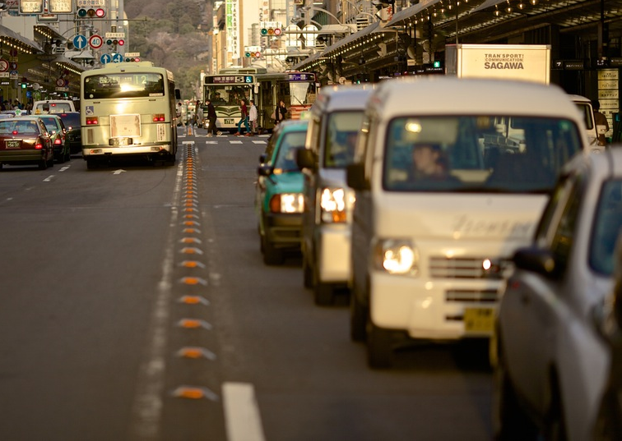
论文绪论
研究背景
研究方法
研究结果
问题讨论
论文总结
It was the best of times, it was the worst of times; it was the age of wisdom, it was the age of foolishness. It was the epoch of belief, and it was the epoch of incredulity. It was the season of light, and it was the season of darkness. It was the spring of hope, and it was the winter of despair.
It was the best of times, it was the worst of times; it was the age of wisdom, it was the age of foolishness. It was the epoch of belief, and it was the epoch of incredulity. It was the season of light, and it was the season of darkness. It was the spring of hope, and it was the winter of despair.

Slide 6
技术简要
功能介绍
软件演示
三 位 一 体

Slide 7
计划架构图
手机
PC
端
管理端
服务器层
流媒体
数据接口
Mysql

Slide 8
现实架构图
手机
PC
端
管理端
服务器层
流媒体
数据接口 (apache)
Tomcat
Mysql

Slide 9

模块介绍
1 前端
2 接口
3 管理端
4 android
5 其他技术

Slide 10
前端技术介绍
在html5、css3、javascript、ajax基本上
bootstrap框架
1使用简单
2界面简洁
3响应式布局
4兼容各种主流浏览器

Slide 11
前端技术介绍
在html5、css3、javascript、ajax基本上
angularjs框架
1MVVM模式
2强大的validator
3用户体验极佳的路由
4便捷的数据过滤器
5自动的依赖注入技术
6简洁的指令渲染技术

Slide 12
前端演示

Slide 13
接口技术介绍
PHP的Laravel
1 全球最流行的框架
2 通过路由映射到控制器
3 eloquent orm操作数据库
4 Hash加密
5 返回自动转载为json
6 自动CSRF令牌保护
7 简洁的请求验证验证

Slide 14
接口演示

Slide 15
其他技术
markdown:普通文档标记语言
Github/git:版本控制
(全球最大的同性社会)

Slide 16
研究方法
It was the best of times, it was the worst of times; it was the age of wisdom, it was the age of foolishness.

Slide 17
THANKS
NAME
DAMEN

