Slide 1
The Costs of Production
7
LO7-1 What the production function represents.
LO7-2 What the law of diminishing returns means.
LO7-3 How the various measures of cost relate to each other.
LO7-4 How economic and accounting costs differ.
LO7-5 What (dis)economies of scale are.

Slide 2
The Costs of Production
Before anyone can consume to satisfy wants and needs, goods and services must be produced.
Producers are profit-seeking, so they aim to produce a salable product at the lowest cost of resources used.
Notes:
It might be useful to really stress that production must precede consumption, that producers are not “our enemies.”

Slide 3
The Costs of Production II
In this chapter we look at the costs of production.
How much output can a firm produce?
How do the costs of production vary with the rate of output?
Do larger firms have a cost advantage over smaller firms?
Notes:
It might be wise to move a bit more slowly through this chapter.
Cost curves are boring, and most students have little experience to draw upon in business.

Slide 4
The Costs of Production III
Costs are not the only consideration. Productivity is also important.
Paying $10 an hour to typist A who types 90 words a minute is a lot cheaper than paying $2 an hour to typist B who types 10 words a minute.
Exercise: Compare the cost of words per hour in the example above.
A: 5,400 words/$10 = 540 words/$1
B: 600 words/$2 = 300 words/$1
Notes:
This exercise is simple but gets the productivity point across.

Slide 5
The Production Function
Production function: shows the maximum quantity of a good attainable from different combinations of factor inputs.
How much can we produce with the land, labor, and capital available?
Consider the land to be a fixed amount.
Capital can be varied in the long run.
Only labor can be varied in the short run production period.
Notes:
Right away, we introduce the decisions a firm has to make: What mix of resources will I use? How much of each?
What happens if I increase one resource but not the other?

Slide 6
The Production Function II
In order for labor to produce, it needs land and capital. With neither, production is zero.
With fixed land and capital, adding more labor will increase production.
First, at a rapid rate as the added workers put the capital to full use.
Later, more workers will not add as much new production as workers overwhelm the available capital.
Notes:
In the short run, we will keep capital fixed and vary labor.
It will be a long-run decision to increase or decrease capital.

Slide 7
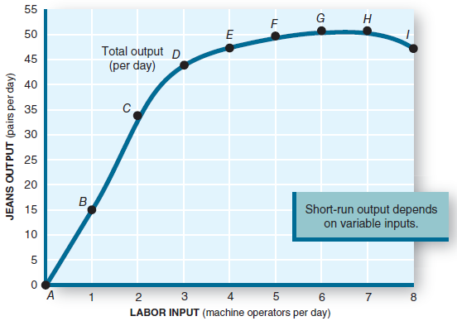
The Production Function III
The productivity of any factor of production (e.g., labor) depends on the amount of other resources (land and capital) available to it.
Notes:
Point out diminishing marginal returns setting in as more workers are added to the fixed amount of capital.

Slide 8
The Production Function IV
Capital is fixed. As labor increases, output increases but ultimately at a slower rate. Output maxes out at point H and begins to decline.
The measure of added output as labor increases is marginal physical product (MPP).
Notes:
It might be useful to point out the parallel between MPP and MU.
“Anytime you put a variable amount of something into a fixed-size facility, diminishing returns occur.”
Pizza into a fixed-size stomach; workers into a fixed-size workplace.

Slide 9
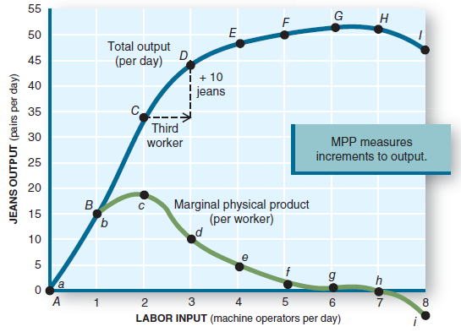
Marginal Physical Product (MPP)
Marginal physical product (MPP) goes up at low levels of output but peaks and then diminishes throughout other levels of production.
Notes:
At the third worker, MPP stops increasing and will decrease with added workers.
Total output continues to increase, but at a decreasing rate, as shown by diminishing MPP.

Slide 10
Diminishing Marginal Returns
Law of diminishing returns: the marginal physical product of a variable input declines as more of it is employed with a given quantity of other (fixed) inputs.
Added output begins to decrease and ultimately goes negative as more and more workers are added with no increase in capital.
Notes:
This formalizes the definition.
Now might be the time to discuss when MPP goes negative and total output (utility) begins to decrease.
Too many workers get in each other’s way and retard production.
Too many slices of pizza make the consumer feel sick.

Slide 11
Resource Costs
The sales manager wants to maximize sales revenue.
The production manager wants to minimize production costs.
The business owner wants, instead, to maximize profit.
There is no reason to expect these three goals to occur at the same output.
Notes:
The bulk of the remainder of this chapter is concerned about costs of production.
We know that the ATC has a minimum point. That’s where the production manager would like to be.
The other decision makers in the firm have different ideas.
The owner will prevail and will try to maximize profit.

Slide 12
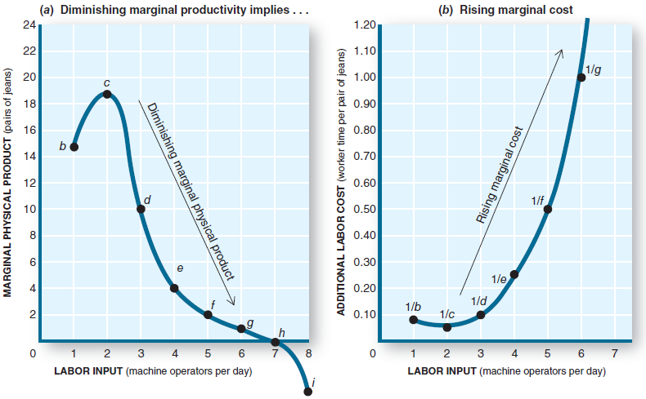
Resource Costs II
As MPP diminishes, it takes more variable input to make a product, so marginal costs (MC) rise.
Notes:
As MPP falls, the added output per added worker decreases. Assume each worker costs the same to hire.
Then as MPP falls, MC (the added cost to produce more output) rises.
The reverse is true at the start-up: MPP rises and MC falls.

Slide 13
Resource Costs III
As MPP decreases with added workers, we continue to pay the added workers, but we get less added product with each added worker.
Therefore, the cost per added product increases as MPP declines.
Marginal cost (MC): the increase in total cost associated with a one-unit increase in production.
Notes:
Summarizes the previous slide.

Slide 14
Marginal Cost (MC)
Change in total cost
Marginal cost (MC) =
Change in output
When MPP decreases, MC must increase, and vice versa.
For any production with fixed capital, the MC curve will fall at low levels of production but will rise sharply at higher levels when diminishing marginal returns set in.
Notes:
This formally defines MC.

Slide 15
Dollar Costs
Total cost (TC): the market value of all resources used to produce a good or service.
Fixed cost (FC): costs of production that don’t change when the rate of output is altered.
Variable cost (VC): costs of production that change when the rate of output is altered.
Total Costs = Fixed costs + Variable costs
TC = FC + VC
Notes:
FC are the costs of the fixed input (capital). VC are the costs of the variable input (raw materials, labor). They add up to total costs.

Slide 16
Fixed Costs
Payments for the fixed inputs.
Includes the cost of basic plants and equipment.
Must be paid even if output is zero.
Do not increase as output increases.
Notes:
Emphasize that FC stay the same no matter what the output level is, including zero output.

Slide 17
Variable Costs
Payments for the variable inputs.
Include the costs of labor and raw materials.
At zero output, these costs are zero.
As output increases, variable costs increase rapidly at first, then more slowly, and finally very fast as the firm approaches maximum capacity.
Notes:
If nothing is produced, no raw materials or labor are needed, so VC = 0 when output = 0.
VC rise fast during start-up (when MPP is rising). VC rise more slowly during the middle or production range.
VC again rise fast as maximum capacity to produce is approached (MPP goes negative).

Slide 18
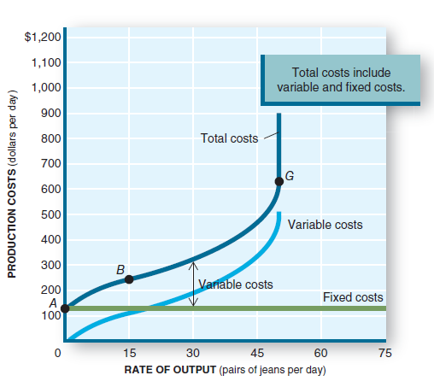
Dollar Costs II
TC = FC + VC
FC exist at Q = 0 and stay the same at all levels of output.
VC start at 0 when Q = 0, increase rapidly to point B, then less so to point G. At point G, VC rise steeply.

Slide 19
Average Costs
Average total cost (ATC): total cost divided by the quantity of output in a given time period.
ATC = TC / Q
Average fixed costs (AFC): total fixed cost divided by the quantity of output in a given time period.
AFC = FC / Q
Average variable cost (AVC): total variable cost divided by the quantity of output in a given time period.
AVC = VC / Q
Notes:
Cost per unit produced is the preferred measure for the production manager. For each level of q, divide q into FC, VC, and TC to get the variables on the slide.
It would not be difficult to create an in-class exercise requiring students to actually do this.

Slide 20
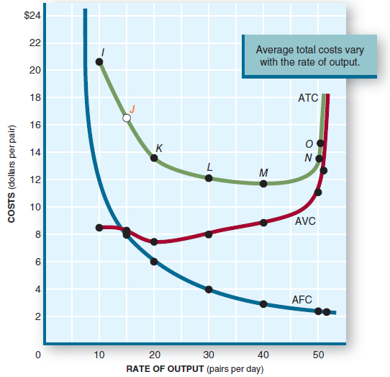
Average Costs II
Notes:
Discuss the general shapes of the three curves. AFC continuously decreases with increasing q.
AVC falls at low output, hits a minimum, then rises as q increases.
ATC is the sum of AFC and AVC. So it falls at low levels of q as q increases, hits its minimum, then rises along with AVC at higher levels of q.
At low levels of q, ATC is dominated by AFC. At high levels of q, ATC is dominated by AVC.

Slide 21
Characteristics of the Cost Curves
Falling AFC: as output increases, AFC decreases rapidly.
U-shaped AVC: AVC decreases at first, hits a minimum, and then rises as output increases (as a result of diminishing returns).
U-shaped ATC: at low output, falling AFC dominates and ATC decreases. As output increases, rising AVC begins to dominate. ATC hits a minimum, then begins to rise.
Notes:
Summarizes the previous slide.

Slide 22
Minimum Average Cost
The output at which ATC switches from being dominated by AFC to being dominated by rising AVC is the point where average costs are minimal.
At this output the firm can produce at the lowest cost per unit.
And the firm minimizes the amount of resources being used.
However, this is not necessarily the output where profit is maximized.
Notes:
This point is the production manager’s dream: to produce at minimum average cost.
It is also the economist’s dream, since at this point production occurs at the minimum consumption of resources (i.e., efficiently).

Slide 23
Marginal Cost (MC)
Change in total cost
Marginal cost (MC) =
Change in output
Diminishing returns in production cause MC to increase as output increases.
After a brief drop in MC at low output, MC rises rapidly as output increases.
As MC rises, it intersects ATC at its minimum point.
ATC decreases when MC<ATC.
ATC increases when MC>ATC.
Notes:
Time to drive the MC curve through the ATC curve at its minimum point.
You could use GPA as an example of the MC - ATC relationship.
If you have a B average (equivalent to ATC), and you make a C in the next class (equivalent to MC below ATC), your GPA goes down.
If you have a B average (equivalent to ATC), and you make an A in the next class (equivalent to MC above ATC), your GPA goes up.

Slide 24
A Guide to Costs
Total costs are made up of fixed costs and variable costs: TC = FC + VC
An average cost is a cost divided by the quantity of output: ATC = TC/Q; AVC = VC/Q; AFC = FC/Q
Also, ATC = AFC + AVC
Marginal cost is the increase in total costs when an additional unit of output is produced.
MC = (change in total cost)/(change in output)

Slide 25
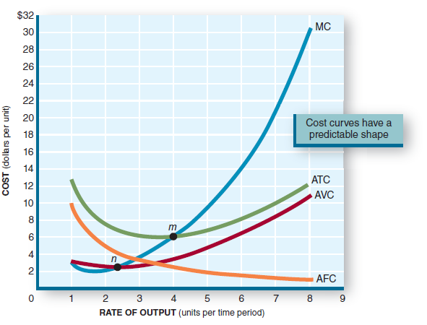
Summary of the Basic Cost Curves
Note that
MC intersects
AVC at its
minimum point (n)
and ATC at its
minimum point (m).
Notes:
Here is a stylized picture of the cost curves.
MC shoots up through the minimum points of both the AVC and the ATC curves.
AFC has no minimum point. It has no direct relationship with MC.
AFC is asymptotic to both the x- and y-axes.

Slide 26
Economic vs. Accounting Costs
Accountants count only dollar costs of production – that is, the explicit costs.
Explicit costs: a payment made for the use of a resource.
Notes:
We switch now from the concern of the production manager to the concern of the owners.
Economists also look to this concept when considering costs. Economists want to include all resources consumed in production, implicit and explicit.
The owners also want to do this.
In particular, the implicit costs are for resources that the owners usually input into the production.

Slide 27
Economic vs. Accounting Costs II
Economists add the value of all other resources used in production, including resources not paid for in dollars.
Implicit costs: the value of resources used in production, even when no direct payment is made.
Notes:
We switch now from the concern of the production manager to the concern of the owners.
Economists also look to this concept when considering costs. Economists want to include all resources consumed in production, implicit and explicit.
The owners also want to do this.
In particular, the implicit costs are for resources that the owners usually input into the production.

Slide 28
Economic vs. Accounting Costs III
Economic cost = Explicit costs + Implicit costs
Explicit costs can be identified by the accountant with a paper trail denominated in dollars.
Implicit costs are the cost of resources for which no payment is made – that is, the opportunity cost of using those resources. They can be identified only by the entrepreneur.
Notes:
Since the owners contribute the resources that generate implicit costs and there might be no paper trail accounting for them, only the owners can evaluate them.
They do this by recognizing their opportunity cost.

Slide 29
Long-Run Costs
The short run is characterized by fixed costs.
The objective is to make the best use of those fixed inputs while making the production decision.
In the long run, we can change the plants and equipment.
Long run: a period of time long enough for all inputs to be varied.
There are no fixed costs in the long run. All costs are variable.
Notes:
The owners decide whether to acquire fixed assets in a start-up or an expansion.
Also the owners decide whether to close and dispose of fixed assets.
Thus in the long run, all costs become variable as fixed costs can be increased or decreased.

Slide 30
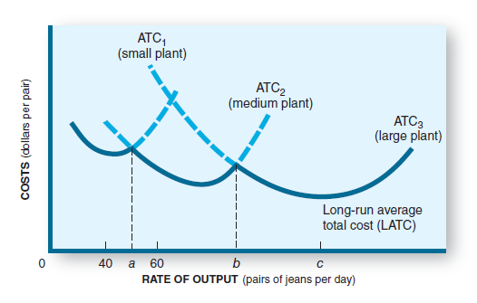
Long-Run Average Costs
In the long run, a firm can build a plant of any desired size.
As plant size gets larger, each plant’s ATC curve has a lower minimum point.
In this case, building a larger plant would lower production costs.
Notes:
Here are three plants, of different sizes. As size grows, the AVC drops.
Sculpting the three plants for outputs that don’t overlap gives us a look at long-run ATC.

Slide 31
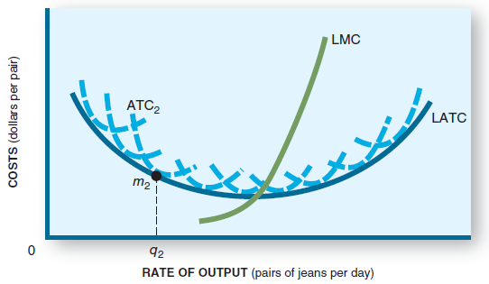
Long-Run Average Costs II
There are unlimited options.
One option delivers the lowest ATC.
It is at this point where the long-run marginal cost curve intersects the long-run average total cost curve.
Notes:
Now expand the possibilities of plant size, and the long-run ATC curve smoothes out.
Its MC curve intersects the long-run ATC at its minimum point.

Slide 32
Economies of Scale
Economies of scale: reductions in minimum average costs that come through increases in the size (scale) of plants and equipment.
Larger plants reduce minimum average costs.
Greater efficiency may come from:
specialization vs. multifunction workers.
mass production vs. small batch mode production.
Notes:
Costs fall as size increases due to economies of scale.
In many cases, efficiencies can be obtained in a larger facility than in a smaller one.
Each type of production tends to have its “ideal size” where economies of scale have been achieved.
Each was probably found by trial and error. This is the reason why many retail outlets are the same size, many supermarkets are the same size, etc.

Slide 33
Diseconomies of Scale
If the plant size gets too big, however, long-run average costs begin to rise, creating diseconomies of scale.
Operating efficiency may be reduced.
Worker alienation may increase.
Rigid corporate structures emerge.
Off-site management may be unresponsive.
Bigger isn’t always better.
Notes:
If a plant is built that is larger than the ideal size, costs rise.
There are many examples of diseconomies of scale in government bureaucracies.

Slide 34
Application: The Economy Tomorrow
Global competitiveness
Lower-cost production allows a firm to compete more effectively in global markets.
Cheap foreign labor?
A lower wage does not mean lower labor costs.
Lower wages usually are paid to those with lower productivity (output per hour), and vice versa.
Unit labor cost (wage divided by output per hour) is the true measure of labor cost.
Notes:
“We are exporting American jobs overseas when we buy foreign goods.”
All firms, U.S. and foreign, are seeking ways to lower costs.
Some do silly things like moving production to places where wages are low but worker productivity is also low.
“You get what you pay for.”

Slide 35
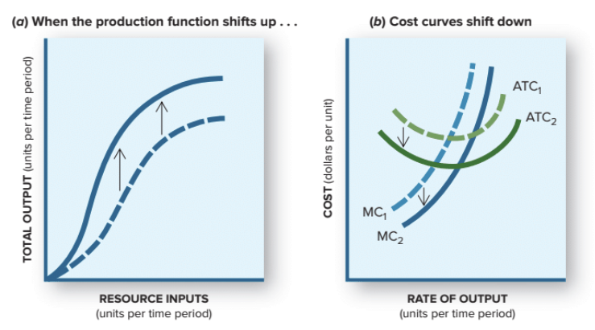
Application: The Economy Tomorrow II
Changes in technology or managerial knowledge push the production function upward and shift MC and ATC downward.
International competitiveness will increase.
Notes:
Productivity gains come from advances in physical capital and human capital.
The United States is a world leader in doing this.

Slide 36
Application: The Economy Tomorrow III
Productivity advances and lower costs of production will:
enable us to produce more goods and services with available resources.
improve our competitiveness in global markets.
U.S. productivity must continue to advance at a brisk pace if we want to stay competitive in the economy tomorrow.
Notes:
The world will become even more competitive as other countries improve productivity. However, low-wage countries with improved productivity also have rising wages.

Slide 37
Revisiting the Learning Objectives
LO7-1 Know what the production function represents.
A production function indicates the maximum amount of output that can be produced with different combinations of inputs.
As the variable input is increased, more output is produced. This is measured by marginal physical product (MPP).
Notes:
Here begins the summary of the chapter.

Slide 38
Revisiting the Learning Objectives II
LO7-2 Know how the law of diminishing returns applies to the production process.
Given a fixed input (usually capital), adding a variable input (usually labor) will increase total product but at a diminishing rate.
The MPP of the variable input tends to decline as more of it is used in a given production facility.
As returns diminish and MPP declines, marginal cost (MC) increases.

Slide 39
Revisiting the Learning Objectives III
LO7-3 Know how the various measures of cost are related.
Total costs equal total fixed costs plus total variable costs. TC = FC + VC.
Average costs are calculated by dividing each of the above by quantity produced.
ATC = TC/Q; AFC = FC/Q; AVC = VC/Q.
MC intersects ATC at its minimum point.

Slide 40
Revisiting the Learning Objectives IV
LO7-4 Know how economic and accounting costs differ.
Economic costs include the value of all resources used.
They equal the sum of explicit costs and implicit costs.
Accounting costs include only those dollar costs actually paid.
They equal explicit costs only.

Slide 41
Revisiting the Learning Objectives V
LO7-5 Know what (dis)economies of scale are.
In the long run, the size (scale) of production can be varied.
The long-run ATC indicates a size where the lowest cost of production can be found.
Economies of scale arise when cost savings occur as size increases.
Diseconomies of scale arise when costs increase as plant size grows beyond the minimum ATC point.

Slide 42
Looking Ahead: Chapter 8
The Competitive Firm
After learning about this chapter, you should know
How profits are computed.
The characteristics of perfectly competitive firms.
How a competitive firm maximizes profit.
When a firm will shut down.
The difference between production and investment decisions.
What shapes or shifts a firm’s supply curve.

