Slide 1
The Competitive Firm
8
LO8-1 How profits are computed.
LO8-2 The characteristics of perfectly competitive firms.
LO8-3 How a competitive firm maximizes profit.
LO8-4 When a firm will shut down.
LO8-5 The difference between production and investment decisions.
LO8-6 What shapes or shifts a firm’s supply curve.

Slide 2
Competition and Profits
The degree of competition is a major determinant of product prices, quality, and availability.
All firms want to make a profit, but their opportunities to do so are limited by the amount of competition they face.
Little competition, easier to be profitable.
Lots of competition, much more difficult.
Notes:
Ask a businessman if he is in favor of competition, and he will probably answer “yes.”
In reality, competition makes him work harder to be profitable. He would really like no competition.

Slide 3
Competition and Profits II
In this chapter we examine
How firms make price and production decisions.
How profits are computed.
How perfectly competitive firms maximize profits.
Specifically,
What are profits?
What are the unique characteristics of competitive firms?
How much output will a competitive firm produce?
Notes:
We start simply. Perfect competition. Students may try to complicate the discussion right from the outset.
Fend off these diversions until you get the basics down. Promise to return to their complications later.

Slide 4
The Profit Motive
The expectation of profit is the basic incentive to produce.
Profit: the difference between total revenue and total cost.
The profit motive encourages firms to produce the goods and services that consumers desire, at prices they are willing to pay.
What will happen to a firm if it produces goods that no consumers want or are willing to pay for?
Notes:
Possible discussion: Is profit a good thing? Or should a firm operate only to serve the needs of society?

Slide 5
Is the Profit Motive Bad?
Some think so. They believe:
it results in inferior products at higher prices.
it leads to pollution, restricted competition, and an unsafe workplace.
In reality:
it encourages firms to produce products customers desire at prices they are willing to pay.
it causes markets to adapt to changing economic conditions and customer preferences.
Notes:
You could generate quite a spirited discussion here. Many students have been sufficiently indoctrinated by media against the profit motive.

Slide 6
Explicit and Implicit Costs
Economic cost: the value (i.e., opportunity cost) of all resources used to produce a good or service.
Explicit cost: a payment made for the use of a resource.
Implicit cost: the value of resources used for which no payment is made.

Slide 7
Economic vs. Accounting Profits
Profit equals total revenue minus total costs.
Economists include both implicit costs and explicit costs.
Accountants include only explicit costs.
Economic profit, then, is smaller than accounting profit because more costs are subtracted.
Economic profit = Total revenue – Explicit costs – Implicit costs
Accounting profit = Total revenue – Explicit costs only
Economic profit = Accounting profit – Implicit costs
Notes:
Implicit costs are difficult for some students to grasp.
You could build a picture where a commuter, tired of the rat race, is considering quitting her job and opening a business.
What would she have to give up to do this? Obviously her day job. Maybe some savings that are earning interest. Maybe some assets she owns, like a building that she could lease. It wouldn’t be too hard to calculate the opportunity costs of lost salary and redeployment of assets as implicit costs of starting a business.

Slide 8
Normal Profit
Normal profit: the opportunity cost of capital.
The owner could have invested these resources elsewhere. If the opportunity cost is a lost return of 10%, then the owner will expect at least a 10% return in this business, preferably higher.
Notes:
Economists want to see the receivers of a good (the customers) pay exactly the cost of the resources used in producing that good.
If they pay more, economic profit exists.
If they pay less, economic losses exist.
If they pay exactly that amount, no economic profits exist, but the resources we cited as implicit costs are paid for.
This is normal profit.

Slide 9
Normal Profit II
Normal profit is equivalent to an implicit cost.
Normal profit is earned if economic profit is zero which, it might surprise you, is the typical case.
A firm can earn a positive economic profit (greater than zero) if it earns more than its opportunity cost.
Notes:
Economists want to see the receivers of a good (the customers) pay exactly the cost of the resources used in producing that good.
If they pay more, economic profit exists.
If they pay less, economic losses exist.
If they pay exactly that amount, no economic profits exist, but the resources we cited as implicit costs are paid for.
This is normal profit.

Slide 10
Entrepreneurship and Risk
The entrepreneur starts a business only if the prospect of earnings is greater than the alternative use of resources.
The owner expects a return of more than a normal profit.
There is no guarantee of profit. Thus, the owner is willing to undertake the risk of suffering economic losses.
The inducement to face this risk is the potential for economic profit.
Notes:
A prospective businessperson should do homework before jumping in.
If this person can’t see a return of more than the normal profit (what those assets are earning now), then the decision to start the business should be “no.”
Obviously there is uncertainty, and the risk factor needs to be included in the calculation.

Slide 11
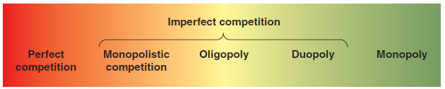
Market Structure
Market structure: the number and relative size of firms in an industry.
The market structures range from monopoly at one extreme to perfect competition at the other extreme. Most real-world firms are along the continuum of imperfect competition.
Notes:
This figure serves as a good introduction to the next few chapters.

Slide 12
A Survey of Market Structures
Perfect competition: a market in which no buyer or seller has market power.
Monopolistic competition: a market with many firms and very little market power.
Oligopoly: a market with a few firms, each having considerable market power.
Duopoly: a market with two firms.
Monopoly: a market with one firm only.
Notes:
This is further introduction to the next few chapters.

Slide 13
Perfect Competition
Characteristics
Many firms compete for consumer purchases.
The products of each firm are identical.
Low entry barriers make it easy to get into the business.
No firm has any market power, thus they cannot manipulate the price. They are price takers.
Each firm’s output is small relative to the total market amount.
Notes:
This is the first, and simplest to describe, market structure.

Slide 14
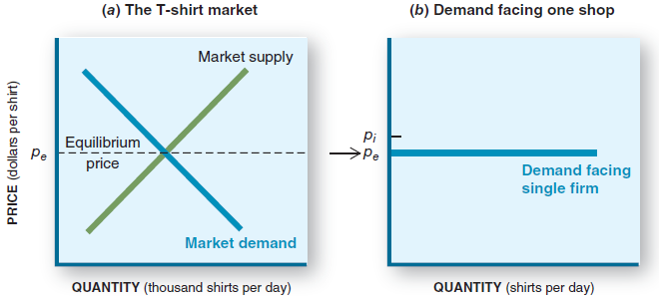
Market Demand vs. Firm Demand
Although the entire market has a typical downward-sloping demand curve, the individual firm perceives its demand curve to be horizontal.
Notes:
Example: An egg rancher takes his eggs to a central location where they are cleaned and graded.
He is one of many farmers to do so. On the way into the facility, the current buying price is posted.
It doesn’t matter how many eggs he has; that’s the price. So quantity can be higher or lower, but the price is the same.
Sketch that out on a graph, and the perceived demand curve is horizontal.

Slide 15
A Firm’s Demand Curve
Why horizontal?
The firm is a price taker. It will charge only the market price.
If it raises its price, nobody will buy.
If it lowers its price, it will sell out, but it can do that at the market price.
It can sell increased quantities at the market price.
Notes:
Example: T-shirts sell for $5 at dozens of shops all over the boardwalk.
You insist on $10 for your shirts. What will the customers do?
Also, you would sell for $4 only if you wanted to get home early since you can sell all you have for $5.

Slide 16
The Production Decision
There are no pricing decisions. Firms take the market price.
There are no quality decisions. All products are identical.
The only decision left is the production decision, i.e., how much to produce.
Notes:
Remember, this is the simple case.
There is no quality difference or price difference between competitors.
The only question left is “How many to produce?”

Slide 17
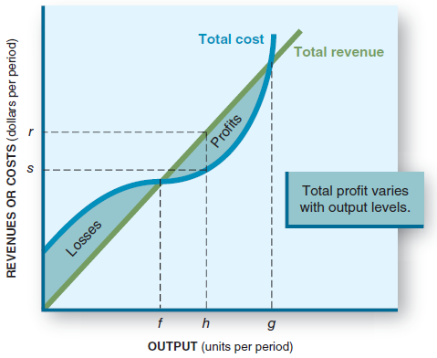
The Production Decision II
The goal: to maximize profits, not revenues.
Profit equals total revenue minus total costs.
We need to find the output that maximizes profits.
Is h that output?
Notes:
You could point out the break-even point f.
You could point out that if you produce too much, costs will eat you up (point g).
Somewhere between points f and g, profits maximize.
It is difficult to identify point h as that point.

Slide 18
The Production Decision III
Never produce a unit of output that yields less revenue than it costs.
For perfect competition, marginal revenue is equal to price (MR = P), the added amount received from selling one more unit.
As output increases, marginal cost (MC) increases, squeezing the profit from the added units.
MR = Change in total revenue Change in output
Notes:
On this graph, it is much easier to find the profit-maximizing quantity.
Profits grow as long as we produce those units where MR=P=MC.
At the intersection of MR=P and MC, profits cease to be added.
If we go beyond that point, MR=P < MC, and we make a loss on each unit we produce.
Clearly profits max out when we reach the intersection.

Slide 19
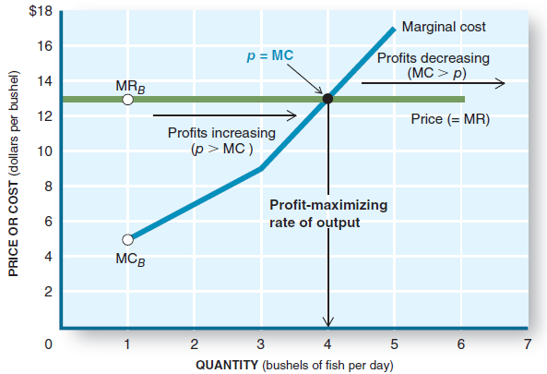
The Production Decision IV
Compare P to MC
If P>MC, we add to profit by selling that one.
If P<MC, we make a loss by selling that one.
If P=MC, we make no profit or loss on that one.
Notes:
If a firm finds itself producing where MR=P < MC, it should cut back production, getting rid of those units on which it is losing money. Profits will rise.

Slide 20
Profit Maximization Rule
For perfectly competitive firms (where P = MR)
If P > MC, increase output and profits will grow.
If P < MC, decrease output and losses will go away.
If P = MC, produce this output because it is the quantity at which profits are maximized.
Profit maximization rule
Produce at that rate of output where marginal revenue (MR = P) equals marginal cost (MC).
Notes:
Summary slide.

Slide 21
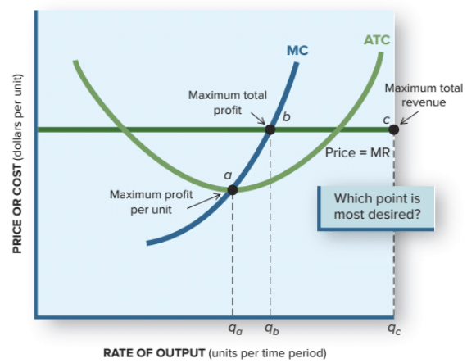
Graphical Look at Profit Maximization
Here we relate ATC and MC to P=MR.
To maximize profits, choose the quantity related to point b. That is where MR=MC.
Note that it is not the same as maximum profit per unit (point a) or maximum revenues (point c).
Notes:
Here is a good way to contrast some decisions a firm faces.
Produce at the lowest cost per unit (point a)?
Produce at maximum revenue (point c)?
Produce at maximum profit (point b)?

Slide 22
The Shutdown Decision
Shutting down the firm does not eliminate all costs.
Fixed costs must be paid even if all output ceases.
If a firm makes losses, it cannot pay all its fixed costs and its variable costs.
The firm will lose less by shutting down (output=0) if losses from continuing production exceed fixed costs.
Notes:
Firms make losses sometimes.
Most react by either boosting sales (if possible) or reducing costs.
Their intention is to get back to profitability.
However, at times the best decision is to shut down.
No production eliminates VC; only FC remain.

Slide 23
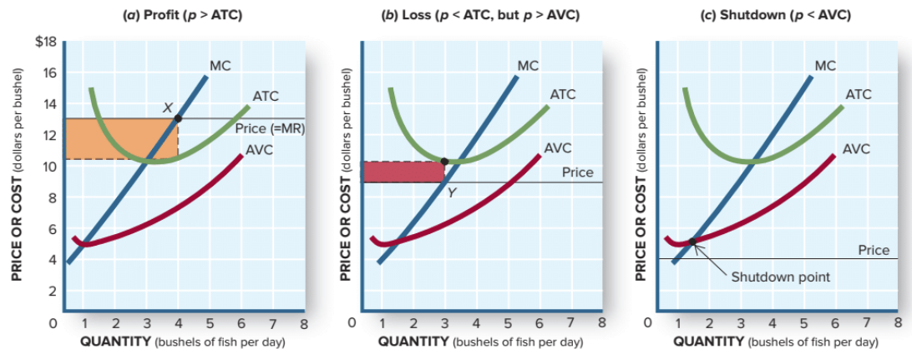
The Shutdown Decision II
Always set P=MR=MC to maximize profits or minimize losses.
If prices fall below ATC, a loss is made.
The firm should not shut down until the price falls below AVC. When this happens the firm can’t pay its labor and suppliers, so shutting down is the best option.
Notes:
As price falls, what was a profit becomes a loss.
P falling below ATC generates a loss.
If P falls below AVC, it is time to shut down.

Slide 24
The Investment Decision
Investment decision: the decision to build, buy, or lease plants and equipment or to enter or exit an industry.
The shutdown decision is a short-run decision.
Investment decisions are long-run.
Fixed costs are the owners’ investment in the business. They must generate enough revenue to recoup the investment.
Investment will occur if the anticipated profits are large enough to compensate for the effort and risk.
Notes:
Now we are in the long run.
The investment decision concerns paying for fixed inputs and incurring FC.
Shutdown is short-run in that it can be reversed.
Closing a factory and selling its assets is a long-run decision.
Same for opening a factory.

Slide 25
Determinants of Supply
In the short-run, a firm will increase output only if profits are increasing. Conversely, a firm will decrease output if profits are decreasing.
Each of these determinants affects a firm’s willingness and ability to supply a product:
the price of factor inputs
technology
expectations
taxes and subsidies
Notes:
This is a review of the law of supply and the determinants of supply.

Slide 26
The Short-Run Supply Curve
The supply curve shows the quantity a firm is willing to supply at each price.
The profit maximization rule leads us to the short-run supply curve.
At any price, the firm sets output where:
P = MR = MC
The firm resets this output when price changes.
Raise the price, produce more.
Lower the price, produce less.
The marginal cost curve is the firm’s short-run supply curve.
Notes:
The MC curve relates to how much quantity the firm will produce at any given price.
Thus it is the firm’s supply curve (above the AVC minimum; shut down if below).

Slide 27
Supply Shifts
If any determinant of supply changes, the supply curve shifts.
A change that lowers costs will cause the supply curve to shift right.
A change that raises costs will cause the supply curve to shift left.
Notes:
If supply shifts right, the firm’s MC shifts right, and vice versa.

Slide 28
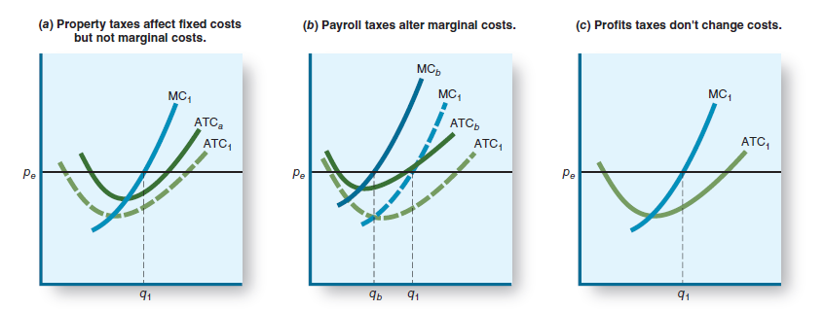
Tax Effects
If a tax increase increases MC, the firm will decrease output. If not, it just decreases profits.
Here are the impacts of various taxes on the firm’s decisions:
Notes:
“Let’s raise taxes on business.”
Which tax gets raised or lowered is significant.
Want more production? Lower payroll taxes and profit taxes.
Want less production? Well …

Slide 29
Application: The Economy Tomorrow
Taxing Business
Property Taxes: a tax levied by local governments on land and buildings.
Fixed cost that increases Average Total Cost.
Payroll Taxes: taxes levied on the wages paid by the firm.
Variable cost tied to the amount of workers.
Increases both the Marginal Cost and Average Total cost.
Notes:
There are great possibilities to get students involved here in a discussion of buying online versus buying at the store.

Slide 30
Application: The Economy Tomorrow II
Taxing Business
Profit Taxes: a tax levied on the profits of a business.
Neither a fixed cost nor a variable cost.
Reduces take-home (after-tax) profits of a business.
May reduce investments in new businesses.
President Trump made reduction of corporate taxes a priority.
Notes:
There are great possibilities to get students involved here in a discussion of buying online versus buying at the store.

Slide 31
Revisiting the Learning Objectives
LO8-1 Know how profits are computed.
Economic profit is the difference between total revenue and total cost (including both explicit and implicit costs).
Notes:
Here begins the chapter review.

Slide 32
Revisiting the Learning Objectives II
LO8-2 Know the characteristics of perfectly competitive firms.
Many firms compete for consumer purchases.
The products of each firm are identical.
Low entry barriers make it easy to get into the business.
No firm has any market power; thus firms cannot manipulate the price. They are price takers.
Each firm’s output is small relative to the total market amount.
Each firm confronts a horizontal demand curve.

Slide 33
Revisiting the Learning Objectives III
LO8-3 Know how a competitive firm maximizes profit.
The profit-maximizing firm will produce an output where marginal cost equals price (marginal revenue).
P = MR = MC

Slide 34
Revisiting the Learning Objectives IV
LO8-4 Know when a firm will shut down.
A loss occurs if price falls below ATC.
If revenues at least cover variable costs, the firm’s operating loss is less than its fixed costs.
A firm should not shut down until price falls below AVC.

Slide 35
Revisiting the Learning Objectives V
LO8-5 Know the difference between production and investment decisions.
In the short run, a firm determines how much to produce (the profit-maximizing output). That is the production decision.
In the long run, a firm must commit to incur fixed costs and to enter or exit an industry. That is the investment decision.

Slide 36
Revisiting the Learning Objectives VI
LO8-6 Know what shapes or shifts a firm’s supply curve.
A firm’s MC curve is its supply curve (above the shutdown point at minimum AVC).
The determinants of supply include the price of inputs, technology, taxes, and expectations.
An increase in costs shifts the supply curve to the left, and vice versa.
Taxes affect business in different ways. Property taxes raise fixed costs; payroll taxes raise variable costs; profit taxes diminish after-tax profits.

Slide 37
Looking Ahead: Chapter 9
Competitive Markets
After learning about this chapter, you should know
The market characteristics of perfect competition.
How prices are established in competitive markets.
Why long-run economic profits approach zero in competitive markets.
How society benefits from market competition.

