Slide 1
Competitive Markets
9
LO9-1 The market characteristics of perfect competition.
LO9-2 How prices are established in competitive markets.
LO9-3 Why long-run economic profits approach zero in competitive markets.
LO9-4 How society benefits from market competition.

Slide 2
Competitive Markets
If an industry is profitable (customers like the product), it lures in new firms and existing firms expand. Supply shifts right.
This causes price to fall and profits to decline.
Some firms, both old and new, fail and close.
Notes:
A key point in the competitive market is the relentless profit squeeze.
The long-run outcome is zero economic profits.
Only normal profit will continue to exist – that is, owners will get a return on their investment equal to their opportunity cost.

Slide 3
Competitive Markets II
In this chapter we focus on competitive behavior.
Specifically,
How are prices determined in competitive markets?
How does competition affect the profits of a firm or industry?
What does society gain from market competition?
Notes:
Sometimes students fail to grasp that zero economic profit is okay.

Slide 4
The Market Supply Curve
Each firm’s supply curve is its marginal cost (MC) curve.
The market supply curve, then, is the sum of the MC curves of all the firms.
It is determined by:
the price of factor inputs.
technology.
expectations.
taxes and subsidies.
the number of firms in the industry.
Notes:
This is a review of the supply curve, its equivalence to the MC curve, and the determinants of supply.

Slide 5
Entry and Exit
It is easy to enter or exit an industry in perfect competition.
If more firms enter (lured in by economic profits), the market supply curve shifts right and price falls.
As price falls, economic profits decrease and when they approach zero, entry will cease.

Slide 6
Entry and Exit II
It is easy to enter or exit an industry in perfect competition.
If more firms reduce output or exit the industry (due to economic losses), the market supply curve shifts left and price rises.
As price rises, economic losses decrease and when they approach zero, exit will cease.

Slide 7
Entry and Exit III
Economic profits draw in new firms.
Supply shifts right and prices fall.
Economic profits decrease, halting new entries.
The market stabilizes at a lower price, more producers, and zero economic profits.
Economic losses drive out firms.
Supply shifts left and prices rise.
Economic losses decrease, halting new exits.
The market stabilizes at a higher price, fewer producers, and zero economic profits.
Notes:
This step-by-step outline indicates how the ultimate outcome is zero economic profits.

Slide 8
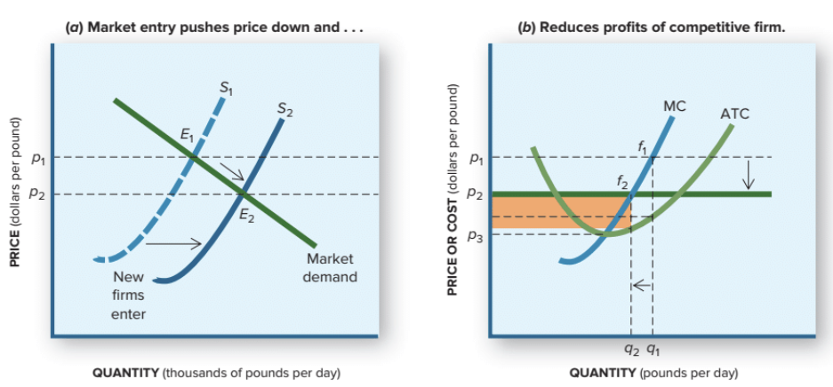
Market Entry
P = MR = MC at point f₁ before market entry, generating large economic profits. After entry, MR = MC at point f₂, with decreased economic profits.
Notes:
Left panel: As new firms enter in search of economic profits, the supply curve shifts right, which brings the price down.
Right panel: As the price falls, each individual firm must readjust its quantity so that P=MR=MC again.
Market supply increases with the new firms, but each individual firm reduces its output to maintain profit maximization.

Slide 9
Market Characteristics of Perfect Competition
Many firms, all small relative to the industry.
Identical products.
Perfect information.
Profit maximized at MC = P (= MR).
Low barriers to entry and exit.
Zero economic profit.
Notes:
This is a summary of the characteristics of perfect competition.

Slide 10
Competition at Work
Few, if any, markets are perfectly competitive, but many function that way.
The existence of economic profits in a low entry barrier market lures in new firms, which lowers the price of the product.
Firms compete by improving product quality and lowering costs.
Those who cannot compete this way leave the industry. Others flourish and expand.
Notes:
It is difficult to find a market that acts completely in perfect competition.
Some agricultural products come close.
Eggs might be a good example.
In not completely perfect, but close, markets, nonprice competition appears as indicated by quality improvements (making the product different) and cost reductions.

Slide 11
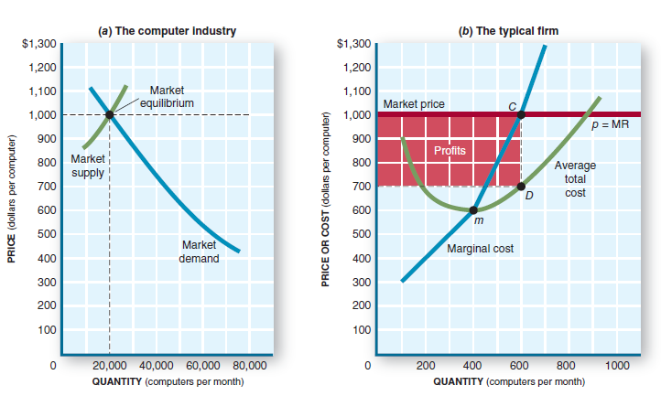
Competition at Work II
When a product is popular; economic profits exist. Profit will lure in new firms, which pushes the market supply curve to the right.

Slide 12
Competition at Work III
Each firm, old and new, in the short run, maximizes profits by setting an output where MC = P (=MR).
Price falls, squeezing profit. Each firm must:
reset its profit-maximizing quantity to a smaller amount.
compare P to ATC to see if it is making a loss.
compare P to AVC to see if it should shut down (exit the industry).
Those who are still profitable expand; others leave the industry.
Notes:
It might be worthwhile to emphasize that the profit-max rules are used in ALL market structures.
Also, this might be a good time to say that, even though each firm is producing an identical product, their cost structures do not need to be identical.
Example: One producer operates in a high-rent city while a competitor operates in a low-rent rural area.
When the price and profit squeeze starts, the high-cost operator will face the loss and shut down decision first, but the low-cost operator is still profitable.

Slide 13
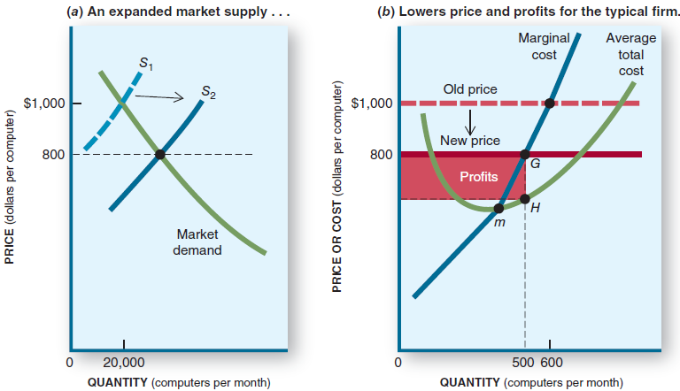
Profit Squeeze
New entrants shift supply to the right, squeezing profits.
Notes:
Customers like the product; they are willing to pay more for it than needed to cover the cost of resources.
Economic profits are being made.
Low barriers allow new entrants. Market supply shifts right. Price falls.
For each firm, output is reset to where P=MR=MC, and profits decrease.

Slide 14
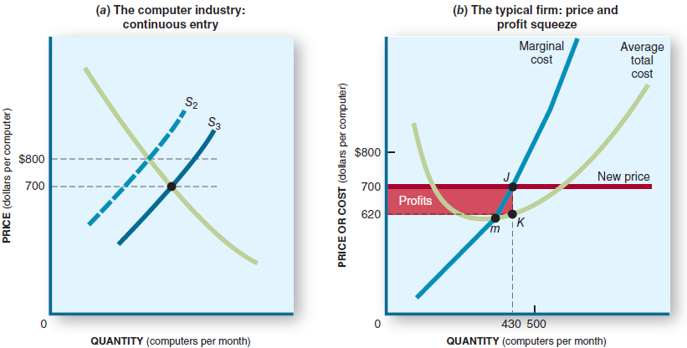
Profit Squeeze II
Continuous new entrants, cause profits to be squeezed more.
Notes:
New entrants continue to cause the market supply to shift right, and the price falls.
The profit rectangle shrinks as prices fall.
All firms reset output so that P=MR=MC, which maximizes the shrinking profit.
High-cost firms begin to experience losses. (They still reset output so that P=MR=MC to minimize the loss.)

Slide 15
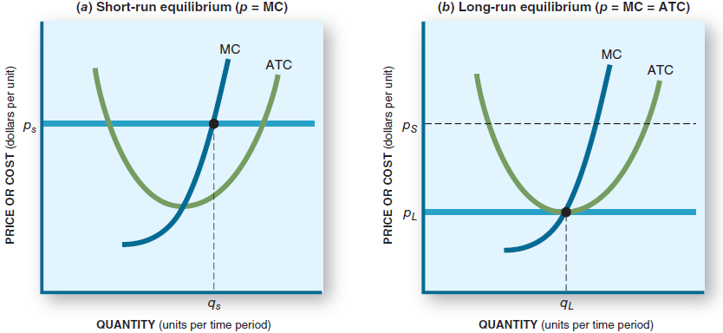
Short- vs. Long-Run Equilibrium
Ultimately economic profits are squeezed to zero (right), a far cry from what they were at the beginning (left).
Notes:
Left panel: In the short run, say daily or weekly, the firm can only adjust output to the point where P=MR=MC to maximize profit.
Right panel: The entrance of new firms in search of economic profit will continue until the price falls enough to yield zero economic profit. This is where the market will stabilize in the long run.

Slide 16
Rules for Entry and Exit
If P > ATC, economic profits exist.
Enter the industry or expand capacity.
If P < ATC, economic losses exist.
Reduce capacity (or exit if P < AVC).
If P = ATC, economic profits are zero.
Maintain existing capacity (no entry or exit).
Notes:
This summarizes the individual firm’s rules for entry and exit.
If a firm is already in the industry and makes economic profits, it should expand.
With low entry barriers, other firms will enter in competition.
When economic profits fall to zero, the firm is still earning a normal profit – that is, it is using resources in this business just as well as it could in its next best alternative use of those resources.
In an economic loss situation, the firm has to decide whether to continue at a loss or shut down.

Slide 17
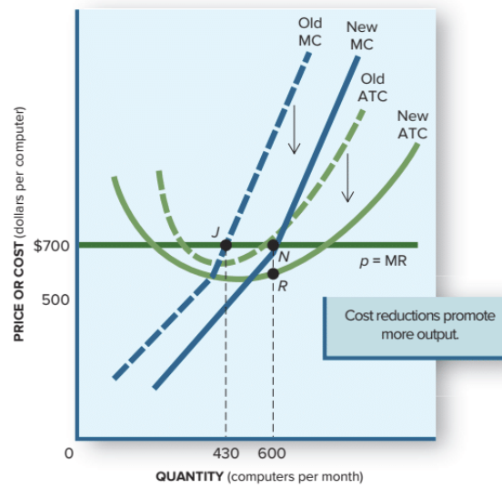
Lower Costs: Improve Profits and Stimulate Output
If a firm lowers its costs of production, it will encourage increases in output.
The cost curves fall, and MC appears to shift right.
Profit maximization occurs at point J before and point N after the reduced costs take effect.
Notes:
One alternative in a loss situation is to continue at a loss.
The firm’s goal is to return to profitability.
It can do this by lowering its cost structure.
Note that the lower ATC drops below the price. P>ATC means economic profits have returned.
Note also that the lower MC has the effect of shifting right, so the P=MR=MC intersection occurs at a higher output.

Slide 18
Shutdown
If competition drives price below AVC for a firm, it will shut down and exit the industry.
If the exiting firm has inventory, it will dump that inventory on the market at a reduced price.
This will cause the industry price to drop further, possibly causing losses for other industry firms.
Notes:
The slide tells how a firm that is closing will dump its inventory onto the market at close-out prices.
The resultant price drop could be short-lived, however.
The losses other firms might experience also could be short-lived.
They could return to profitability when the dumped products are sold and no more show up.

Slide 19
The Competitive Process
Competitive forces drive the product’s price down, making it more affordable to more consumers. Thus, the market expands.
Also, competitive forces spur firms to improve quality, add features, and look for lower costs.
This is the market mechanism (the use of market prices and sales to signal desired outputs or resource allocations) at work.
Notes:
Here we move a bit away from the perfect competition model by allowing a firm to modify the product.

Slide 20
The Competitive Process II
If economic profits are high, consumers are willing to pay more than the opportunity cost of resources to acquire a product.
It signals they want more of that industry’s goods.
Profit-seeking producers respond by producing more to satisfy consumer demand.
This is allocative efficiency: the industry will end up producing the right output mix.
Notes:
Nobody is determining the mix of outputs.
If consumers do not want to buy the good, firms quit making it.
If consumers are overeager to buy the good, more firms will make it.
The pursuit of economic profit and the flight from economic loss change the output mix.

Slide 21
The Competitive Process III
If economic profits are negative (losses), consumers are unwilling to pay the opportunity cost of resources to acquire a product.
It signals they want fewer of that industry’s goods.
Profit-seeking producers respond by producing less to satisfy a waning consumer demand.
This is also allocative efficiency: the industry will end up producing the right output mix.
Notes:
Allocative efficiency: firms adjust their production mix to match the mix of goods and services the consumers want to buy.

Slide 22
Zero Economic Profit
Competition drives costs to minimum ATC, and economic profits to zero.
The HOW question is answered: produce at maximum productive efficiency.
Firms earn zero economic profit. However, this means they earn normal profit, which covers the opportunity cost of owners who could deploy their resources elsewhere.
Notes:
In the long run, economic profits reach zero and an industry stabilizes (no more entry, no more exit, no reason to change the output amount).
Firms earn enough to deter them from considering switching to an alternative use of their resources in another industry. They earn normal profit.

Slide 23
Relentless Profit Squeeze
High price and profits signal consumers’ demand for more output.
Economic profit attracts new suppliers.
The market supply curve shifts right, and the price falls.
The market stabilizes at higher output, lower price, minimum ATC, and economic profit at zero.
All this time, producers must improve their product and innovate technologically to remain competitive.
Notes:
This is a summary slide.

Slide 24
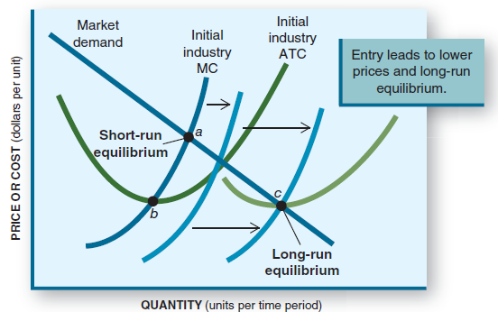
Summary of Competitive Process
Notes:
The industry MC curve shifts right as new firms enter.
Market demand need not change (but it could).
Short-run equilibrium (point a) also shifts down the market demand curve to point c when long-run equilibrium is reached.
ATC doesn’t decrease (but it could) - it just shifts right. At point c, P=MR=MC and minimum ATC are the same.
At that point P=ATC, and economic profits have disappeared.

Slide 25
Application: The Economy Tomorrow
The continuous parade of new products.
PCs to iPods to iPads to iPhones to what?
Popular new products have high economic profits and draw in competitors, who “clone” the idea.
Those products are improved in order to compete.
New products and features are introduced to stay a step ahead of the competition.
We will see a continuous introduction of new products to captivate our imaginations and pocketbooks in the economy tomorrow.
Notes:
Once there was one tablet. Now there are several competing tablets, each more or less clones of the others.
Not all will survive.
As consumers declare their preferences, those preferred will see economic profits and those shunned will see economic losses.
Some will disappear. The survivors will improve their products to maintain a competitive presence.
Then something new will come along and make the tablet obsolete.

Slide 26
Revisiting the Learning Objectives
LO9-1 Know the market characteristics of perfect competition.
A perfectly competitive firm:
has no market power to influence price.
produces a product identical to those of its competitors.
produces an output level where MC = P = MR.
has easy entry and exit.
Notes:
We begin our chapter review here.

Slide 27
Revisiting the Learning Objectives II
LO9-2 Know how prices are established in competitive markets.
If profits exist in a competitive market, new firms will enter the market, shifting the supply curve right and pushing the price down.
As the price falls, economic profits approach zero.
Then expansion stops, and the price will equal the minimum ATC.

Slide 28
Revisiting the Learning Objectives III
LO9-3 Know why economic profits approach zero in competitive markets.
When economic profits exist, they lure in new firms. This shifts the supply curve right. Prices fall, and economic profits approach zero.
There will be no more expansion or entry when economic profit reaches zero. The market will stabilize at that price and output.

Slide 29
Revisiting the Learning Objectives IV
LO9-4 Know how society benefits from market competition.
The pressure of competition is a tremendous incentive for firms to:
respond quickly to consumer demands.
seek more efficient means of production.
improve their products.
make technological advances.
All of these help to efficiently allocate resources.
Consumers get more and better products at lower prices.

Slide 30
Looking Ahead: Chapter 10
Monopoly
After learning about this chapter, you should know:
How a monopolist sets prices and output.
How monopoly and competitive outcomes differ.
The pros and cons of monopoly.

