Slide 1
Monopoly
10
LO10-1 How a monopolist sets price and output.
LO10-2 How monopoly and competitive outcomes differ.
LO10-3 The pros and cons of monopoly.

Slide 2
Monopoly
A monopoly is an industry in which there is only one producer.
Thus, there is no competition.
A monopolist has significant market power; it can dictate the price.
A monopolist does not have to continuously modify its product since there is no competition.
Notes:
We jump to the other extreme of the market structure spectrum.
Just as there was difficulty finding an industry in perfect competition, it is difficult to find one (not required by government) that is a monopoly.

Slide 3
Monopoly II
In this chapter we examine how a market controlled by a single producer behaves.
Specifically,
What price will a monopolist charge?
How much output will a monopolist produce?
Are consumers better or worse off when only one firm controls an entire market?
Notes:
In the perfect competition chapter, the term P=MR=MC was used to indicate the point of profit maximization.
Now it is necessary to drop the “P=” part of that.

Slide 4
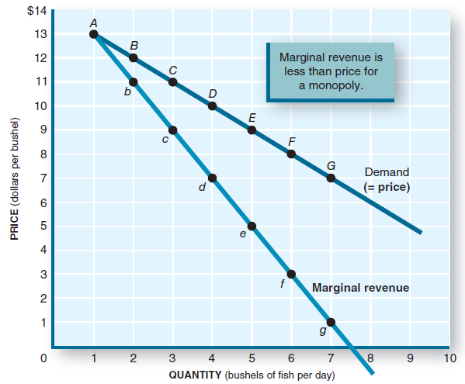
Price and Marginal Revenue (MR)
Points on the demand curve indicate a price for each output.
However, to sell more the monopolist must lower the price, so MR will always be less than price.
For the most part, the MR curve lies below the demand curve.
Notes:
The monopolist owns the market supply curve. So it faces the market demand curve.
The market demand curve says that if you want to sell more, lower the price.
Also, if you want to get a higher price, you must accept that you will sell less.
The data accompanying this graph in the book could be used to do a board presentation.

Slide 5
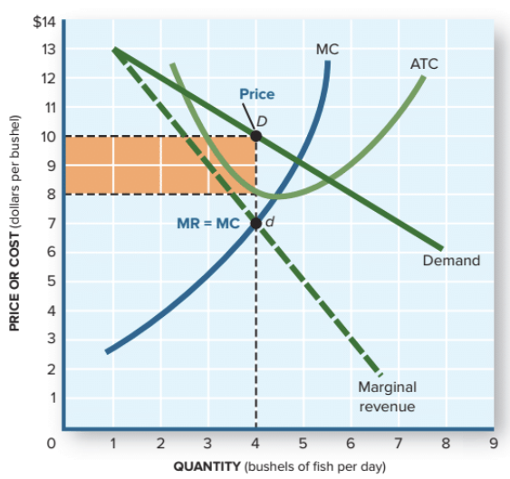
Profit Maximization
Find where the MR curve intersects the MC curve (point d).
Drop down to the output axis to find the profit-maximizing quantity.
Go up to the demand curve and then left to the price axis to find the profit-maximizing price.
Notes:
This is a step-by-step procedure to find the monopolist’s profit-maximizing quantity and the associated price.
Now might be a good time to expand this application to ALL forms of imperfect competition.

Slide 6
Market Power
Market power: the ability to alter the market price of a good or service.
A monopoly firm has total market power and confronts the downward-sloping market demand curve for its own output.
This complicates the profit maximization procedure.
In imperfect competition (including monopoly), MR no longer equals price.
Notes:
In perfect competition, no one had any market power at all. They simply took the market price.
In a monopoly (one seller), the supply curve for the firm is the market supply curve.
When the firm makes decisions that influence its MC curve, it is influencing the market supply curve.

Slide 7
Profit Maximization
Only one price is compatible with the profit-maximizing output.
The monopolist will charge that price.
If it charges a higher price, profits fall.
If it charges a lower price, profits also fall.
Notes:
A discussion about “price gouging” is appropriate here.
Will the greedy firm jack the price up high? Not if that means charging a price higher than the profit-maximizing price.
What price gouging is depends on the definition chosen, but in relation to natural disasters, several U.S. states have put their own definitions into law, ranging from the vague to the specific. If the result is to generate a price ceiling on the good, then it will be in shortage because of the law.

Slide 8
The Production Decision
A monopolist will select an output quantity that corresponds to the profit maximization rules:
if MR>MC, increase output and profits rise.
if MR<MC, decrease output and profits rise.
if MR=MC, produce this profit-maximizing output.
Notes:
Will the monopolist increase output if society indicates it needs more of the good?
Maybe not, if the firm is operating at its profit-maximizing quantity.

Slide 9
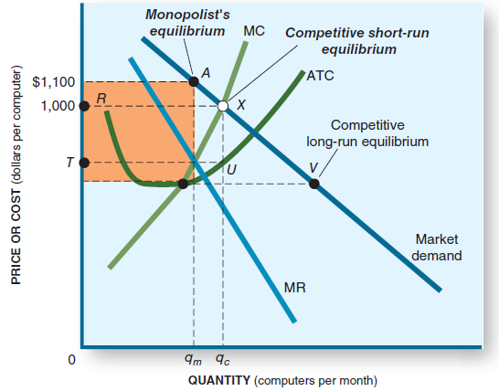
Monopoly Profit
The profit-maximizing output is q_{m}.
The rectangle indicates the size of profit.
Note that the monopolist will produce less (q_{m} vs. q_{c} ) and charge a higher price (A vs. X) than a competitive market.
Notes:
It might be a good exercise to ensure that students recognize that the rectangular area actually is profit.
Our society disapproves of monopolies because they produce less and charge more than competitive firms for the good.

Slide 10
Characteristics of Monopoly
There has to be a total barrier to entry. If not, a new firm will enter and end the monopoly.
There can be no close substitutes for the monopolist’s product.
There is no competitive pressure. A monopolist will charge a higher price and produce a smaller quantity and will not experience a profit squeeze.
A monopolist need not increase quantity even if consumer demand increases.
Notes:
These are typical characteristics of monopoly.

Slide 11
Comparing Monopoly and a Competitive Industry
Competitive
High profits attract more suppliers.
Supply shifts right and price falls.
Economic profits go to zero.
P = MC.
Profits are squeezed, so there is great pressure to reduce costs and improve quality.
Monopoly
High profits, but barriers to entry exclude new suppliers.
No production change, so price does not fall.
Economic profits do not change.
P > MC.
No profit squeeze, so no pressure to reduce costs or improve quality.
Notes:
A step-by-step procession highlighting the difference could be instructive.

Slide 12
Comparing Monopoly and a Competitive Industry II
A monopolist receives larger profits than a comparable competitive industry by reducing quantity and pushing prices up.
Consumers receive fewer products and pay more for them.

Slide 13
Where Does Market Power Come From?
A significant barrier to entry will keep competition out. The sole producer then has total power over market price.
The barrier could be due to control of an input, sheer size, or some legal means of excluding competition.
Notes:
Note that monopoly power comes from sanction by a government agency.
This might encourage “rent seeking”: the desire of a firm to acquire monopoly power by spreading influence in the halls of government.
Once attained, this power need not only be directed into the market but could be used to influence government itself.
The result is called “crony capitalism.”

Slide 14
Where Does Market Power Come From? II
Significant barriers
Patents
Exclusive franchises
Political appointment
Control of key inputs
Lawsuits (sue the opposition out of existence)
Acquisition
Economies of scale
Considerable market power generates resources that could be used by the firm to exert political power.
Notes:
Note that monopoly power comes from sanction by a government agency.
This might encourage “rent seeking”: the desire of a firm to acquire monopoly power by spreading influence in the halls of government.
Once attained, this power need not only be directed into the market but could be used to influence government itself.
The result is called “crony capitalism.”

Slide 15
Not Absolute Power
The customer does not have to buy from the monopolist, although it may be difficult.
Demand could shift left and the monopolist would have no control over it.
When a substitute for the monopolist’s product appears, customers will switch.
The monopolist, in any event, will not “gouge” the customer. It will set its price in accordance with the profit-maximizing rules.
Notes:
The monopolist controls the supply curve, but not the demand curve.
It will try to suppress all potential entrants and all potential substitutes.

Slide 16
Price Discrimination
Some customers (customer A) have a more inelastic demand for a good. They are willing to pay more for a product than others (customer B) who have an elastic demand.
A monopolist can increase profits by selling to customer A at a higher price than customer B.
Airlines charge business travelers higher fares but lower their prices to attract more nonbusiness travelers.
Notes:
This practice is not solely one of a monopolist. Other structures (except perfect competition) can do it too.
One needs only to separate customers by their price elasticity of demand (or by geographical split) and then keep them from interacting.
Examples: airlines, movie theaters, college tuition.

Slide 17
Pros and Cons of Market Power
Monopolies could be of some benefit to society. The following pros have been suggested:
greater ability to pursue research and development (R&D).
tremendous incentive for invention and innovation.
large companies can produce more efficiently.
they have to worry about potential competition and will act accordingly.
Notes:
There is ammunition for a class discussion here.
The textbook outlines several points pro and con.

Slide 18
Pros and Cons of Market Power II
R&D. Since there is no competition, monopolies have little incentive to improve the product.
Invention and innovation. Most new products come from entrepreneurs who were not allowed to pursue their dreams while working for a large firm. They break away and start their own firms.
Notes:
Here are some counterpoints for each of the pros.
The Jobs - Wozniak story is a good breakaway tale.

Slide 19
Pros and Cons of Market Power III
Economies of scale. Increasing scale does lower costs as economies of scale kick in. However, there is no incentive for the monopolist to expand to achieve this advantage.
Potential competition. It is likely the monopolist will take action to suppress potential competition.
Notes:
More counterpoints.

Slide 20
Natural Monopolies
Natural monopoly: an industry in which one firm can achieve economies of scale over the entire range of the market.
Economies of scale acts as a “natural” barrier to entry.
Utilities are examples of natural monopolies.
Notes:
Why does only one power company distribute to a city (or area)?
You could have your students imagine what the city would look like if there were several power companies operating in competition.
Power lines everywhere, duplicating, criss-crossing, touching, shorting out, etc.
Aside from this aesthetic reason, if only one power distribution firm can reach economies of scale in this market, then you have made the case for natural monopoly.

Slide 21
Natural Monopolies II
Government sets up natural monopolies.
Government describes the quality and area of service.
Government sets the rate (price) the natural monopoly can charge its customers.
The rate is set so there is no economic profit.
A normal profit is allowed.
Notes:
Typically the government level that establishes the natural monopoly also sets up a public utility commission of some sort to judge what rate should be set.

Slide 22
Contestable Markets
Contestable market: an imperfectly competitive industry subject to potential entry if price or profits increase.
Monopolies may be constrained by potential competition.
Entry barriers become important.
One firm may seem to monopolize an industry, but if other firms can enter, the “monopolist” must compete.
Notes:
A good example is TV news. First the three networks (ABC, CBS, NBC) dominated TV news. Then CNN came in.
CNN was a cable news monopolist for years, but new entries (MSNBC, FNC) caused CNN to compete.

Slide 23
Application: The Economy Tomorrow
Microsoft and Google: bullies or geniuses?
Both dominate their industry.
Microsoft: antitrust lawyers charged that it erected entry barriers to potential competitors.
Since Microsoft dominated, consumers had little incentive to buy competing products.
The court determined that Microsoft was more of a bully than a genius.
The court contended that Microsoft's dominance actually suppressed product improvement and falling prices.
Notes:
The question to ask is whether being big and dominant mean you are a monopolist.
The two stories here involve Microsoft and Google.
An older story concerned ATT, which ended with its breakup in 1984.
Even older, Standard Oil and American Tobacco, just after the turn of the last century.

Slide 24
Application: The Economy Tomorrow II
Microsoft and Google: bullies or geniuses?
Similar charges have been levied against Google.
Google’s search engine dominance lets it monopolize this service.
Google places entry barriers such as unique key search words, advertising contracts, and suppression of rival’s search results.
Is Google a bully or a genius? Courts in both the United States and Europe are reviewing this.

Slide 25
Application: The Economy Tomorrow III
Does consumer preference for the products and services of Microsoft and Google constitute bullying or suppression?
The structure and actions of firms like these will continue to be critical to the outcomes in the economy tomorrow.

Slide 26
Revisiting the Learning Objectives
LO10-1 Know how a monopolist sets price and output.
A monopolist controls the supply curve and faces a downward-sloping demand curve. Therefore, MR < P.
A monopolist uses the profit maximization rules to identify where MR = MC, produces the corresponding output, and charges the corresponding price.
Notes:
Here begins the summary of the chapter.

Slide 27
Revisiting the Learning Objectives II
LO10-2 Know how monopoly and competitive outcomes differ.
A monopolist will produce less output and charge a higher price than a competitive industry.
There will be no profit squeeze for a monopoly.
Barriers prevent entry into the monopoly industry.

Slide 28
Revisiting the Learning Objectives III
LO10-3 Know the pros and cons of monopoly.
Some allege that monopolies have better R&D, greater incentive to grow and innovate, and better efficiency. Others say that competitive firms must do those things to survive, while the monopolist does not.
A natural monopoly makes sense when it can achieve economies of scale and provide a good at a lower cost than competing firms.

Slide 29
Looking Ahead: Chapter 11
Oligopoly
After learning about this chapter, you should know
The unique characteristics of oligopoly.
How oligopolies maximize profits.
How interdependence affects oligopolists’ pricing decisions.

