Slide 1
Oligopoly
11
LO11-1 The unique characteristics of oligopoly.
LO11-2 How oligopolies maximize profits.
LO11-3 How interdependence affects oligopolists’ pricing decisions.

Slide 2
Oligopoly
In the real world, most firms are part of oligopoly or monopolistic competition, with few monopolies or perfect competition.
These two market structures are called imperfect competition.
In these structures, you can find both intense competition and some evidence of monopoly.
Notes:
You might want to sketch out a time line showing how an industry (for example, PCs) evolves from intense monopolistic competition with thousands of tiny competitors at the start of the PC era to oligopoly, where now the PC industry is dominated by a few large, worldwide firms.

Slide 3
Oligopoly II
In this chapter we focus on oligopoly, where market power, the ability to manipulate the market price, is shared by a few dominating firms.
Specifically,
What determines how much market power a firm has?
How do firms in an oligopoly set prices and output?
What problems does an oligopoly have in maintaining price and profit?
Notes:
We will start off by defining market power.
Also, you might wish to evoke the Greek origins of the term oligopoly: the prefix “oligos-” means few; the suffix “-opoly” comes from “polein,” which means seller.

Slide 4
Market Structure
In imperfect competition, individual firms have some market power in their product market.
The determinants of market power include:
number of producers
size of each firm
barriers to entry
availability of substitute goods
Notes:
We will see that market power is total in monopoly, considerable in oligopoly, much smaller in monopolistic competition, and nonexistent in perfect competition.

Slide 5
Measuring Market Power
Concentration ratio: the proportion of total industry output produced by the largest firms (usually the four largest).
If the industry produces 1 million products and the four biggest firms produce 700,000 of them, the concentration ratio is 70%.
Notes:
This measurement is the basic way one determines whether or not an industry is an oligopoly.
A few (three or four) firms dominate by producing over 60% of the industry’s output.

Slide 6
Measuring Market Power II
An industry with a concentration ratio above 60% is considered an oligopoly.
Examples are beer, soft drinks, batteries, cigarettes, computer printers, Internet browsers, baby food, cereal, and credit cards.
Notes:
This measurement is the basic way one determines whether or not an industry is an oligopoly.
A few (three or four) firms dominate by producing over 60% of the industry’s output.

Slide 7
Oligopoly
In an oligopoly:
there are only a few firms, generally big relative to the size of the market.
barriers to entry are high.
each sells a basically standardized product, but with differentiating elements. Generally one firm’s product will substitute for another's.
each dominant firm has substantial market power.
Notes:
These are the characteristics of oligopoly.

Slide 8
Oligopoly Behavior
Firms in an oligopoly are interdependent in their decision making because they make decisions based on what they think their competitors will do.
They are very protective of their market share: the percentage of the total market produced by a single firm.
If the total produced is 1,000,000 units, and firm A produces 300,000, A’s market share is 30%.
Notes:
Interdependence means that no one firm can make decisions without retaliation by the others, which might negate the original decision.
So each firm “games” the others to figure out what to do: If we do this, what will they do? If they come back and do that, what should we do?
The reason is the possessiveness each firm has over its market share.

Slide 9
Oligopoly Behavior II
A significant behavior of an oligopolist is to preserve market share.
If firm A sees its market share drop from 30% to 28%, that means one of its rivals took sales away from firm A. This is not acceptable.
An increase in market share of one firm reduces the market share of other firms.
How can one firm accomplish this?
What will the other firms do?
Notes:
When a few firms dominate, one firm’s loss in market share is a rival firm’s gain. That will not do! CEOs get fired when this happens.

Slide 10
Oligopoly Behavior III
Firm A could lower its price and undercut its rivals.
At the lower price, sales would increase and firm A would increase its market share.
However, others in the oligopoly would immediately notice this ploy. Since they do not want to lose market share to firm A, they would retaliate by lowering their prices also.
Notes:
This is the simplest method to acquire increased market share. Lower the price and buyers will buy more.
Note the retaliation. Also, if each firm is operating at profit-maximizing quantity, lowering the price to sell more (and increase market share) will move the firm away from its profit-maximizing quantity, lowering profits.
It seems that increasing or preserving market share is more important than profit maximization to an oligopolist.

Slide 11
Oligopoly Behavior IV
Any attempt by one firm in an oligopoly to increase its market share by cutting prices will lead to a general price reduction in the industry.
Each firm would see its profits drop as a result of preserving market share. They don’t like this.
If firm A raised its price to improve its profit margin, the others would not follow.
They will gain market share from firm A.
So firm A will not unilaterally raise its price.
Notes:
A unilateral price increase is highly unlikely because it leads to lost market share.
Later we will see an alternative mechanism to increase prices.

Slide 12
Nonprice Competition
Oligopolists avoid price competition and instead pursue nonprice competition.
Advertising: convince the consumer that firm A’s product is a better buy than those of its rivals.
Product differentiation: firm A could modify its products to make them appealingly different in order to sell more.
Both strategies are designed to improve brand loyalty, thus maintaining or gaining market share.
Notes:
Oligopolists are heavy advertisers. The principal goal is to instill in consumers a strong brand loyalty. If successful, then the consumer will replace a used-up product with the identical brand. This preserves market share.
One way to convince consumers to do this is to point out (real or imagined) appealing differences between the firm’s product and those of its competitors.

Slide 13
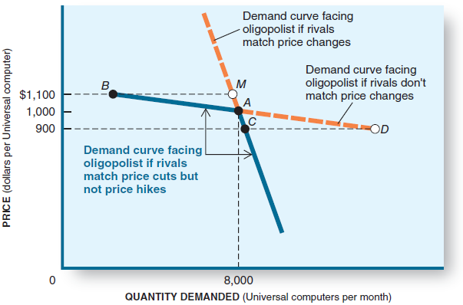
The Kinked Demand Curve
A firm will match a rival’s price decrease but will not match a rival’s price increase.
The different responses can be seen in the firm’s demand curve, which is kinked at point A.
Notes:
It might be worthwhile to trace the change in P and Q as one goes up the kinked demand curve and as one goes down the kinked demand curve.

Slide 14
The Kinked Demand Curve II
The shape of the demand curve an oligopolist faces depends on the responses of its rivals to a change in the price of its own output.
That demand curve will be kinked if rivals match price reductions but not price increases.
Notes:
It is not so important that the demand curve is kinked as it is to comprehend that the interactive response is different if you raise the price than if you lower the price.

Slide 15
Game Theory
Playing the “What if?” game: each oligopolist has to consider the potential responses of rivals when formulating price or output strategies.
Game strategy requires consideration of all possible outcomes. These are shown in a payoff matrix: a table showing the risks and rewards of alternative decision options.
Notes:
Game theory is much more elaborate than this. However, the “What if?” game is indeed played. Two of the greatest players of this game (with the highest stakes) were the U.S. and the USSR during the Cold War.

Slide 16
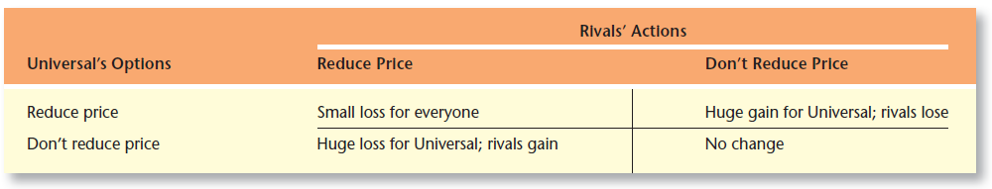
Game Theory II
Each cell in the payoff matrix shows how profit will change for each action/response combo.
In the example above, Universal’s best bet is to initiate a price cut. Why?
Notes:
Remember that each “player” can choose only from his two options. He cannot choose his opponent’s option (but he’d like to).
To maximize his payout, he has to guess what his opponent will do.
It might be worthwhile to play out the various options in class.

Slide 17
Coordination
Oligopolies try to behave like a monopoly, choosing an industry output that maximizes total industry profit.
This requires each firm to agree to restrict its output and raise prices – that is, to no longer compete.
Each must be content with its market share, and that share must occur at its individual profit-maximizing output.
Notes:
What if, instead of trying to outguess what the others will do, the firms agree to coordinate their actions?
The profit maximization rule can be applied to the entire industry. Once found, the quantity produced can be allotted in proportion to the firms’ market share. The ideal situation occurs when each firm’s assigned quota is identical to the quantity where it realizes profit maximization.

Slide 18
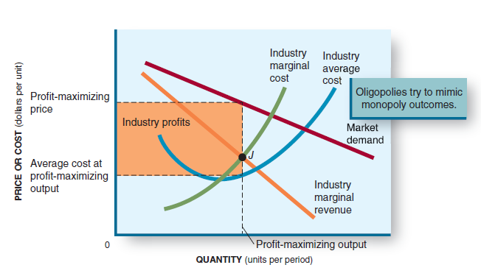
Coordination II

Slide 19
Coordination III
Three methods of coordination
Price-fixing: they could explicitly agree to charge the same price.
Price leadership: one firm would set the price and the others would match it.
Allocation of market shares: each firm would be assigned a quota of production, with the sum of all output being the industry’s profit-maximizing rate of output.
Notes:
Instead of undercutting each other in price, they could collectively agree to one price for the entire industry.
Or they might agree to let the industry “leader” set the price and have all others match it.
Or they might simply divide up the customers in some way – say, geographically.

Slide 20
Cartels
Cartel: a group of firms with an explicit, formal agreement to fix prices and output shares in a particular market.
Cartels openly violate U.S. antitrust laws, so we have to go abroad to find an example.
The Organization of Petroleum Exporting Countries (OPEC) is a cartel. OPEC assigns explicit production quotas for each of its members.
Notes:
A formal coordination agreement is called a cartel.
Such coordination is illegal in the United States.
This is the reason why the oil-producing United States is not a member of OPEC.

Slide 21
Cartels II
Cartels are most effective when:
all producers are included in the cartel.
each producer obeys the quota that is assigned.
OPEC sometimes has problems maintaining its desired price of oil because:
not all oil producers are members of OPEC.
some OPEC producers “cheat” by increasing production to their individual profit-maximizing level.
Notes:
This slide outlines why sometimes the OPEC members squabble with each other and “cheat” on each other.
When members “cheat” and produce more than their quotas, the market supply shifts right, leading to falling prices.

Slide 22
Barriers to Entry
Oligopoly, like monopoly, maintains economic profits due to barriers to entry.
Barriers to entry include:
patents
distribution control
Input lock-ups
mergers and acquisition
government regulations
nonprice competition
training
brand loyalty
network economies
Notes:
The Polaroid Land camera is an example of a patent as a barrier to entry.
DeBeers has worldwide distribution control on diamonds.
A merger between competitors reduces competition.
In New York, the city allocates only a few taxi permits, thereby limiting competition.
Brand loyalty, if successful, makes it extremely difficult for new competitors to get shelf space or to get the customer to try the product.
If everyone else is using Microsoft Office, it will be very difficult to get you to use a new competing office package.

Slide 23
Application: The Economy Tomorrow
Antitrust enforcement
Market power leads to market failure when:
restricted output causes resource misallocation.
profits and higher prices lead to greater inequity.
Antitrust laws explicitly forbid collusive agreements, but much tacit collusion goes undetected or unpunished.
Notes:
The Antitrust Division of the Justice Department is charged with monitoring these practices and prosecuting those who violate the rules.

Slide 24
Application: The Economy Tomorrow II
Antitrust enforcement
The broad mandates of antitrust laws need to be transformed into specific guidelines for government intervention.
The goal is to preclude the amassing of market power – to maintain competition.
To accomplish this, the Department of Justice will continue to monitor the effects of mergers in the economy tomorrow.
Notes:
At times the Justice Department has been lax in enforcement, and at other times it has been strict.

Slide 25
Revisiting the Learning Objectives
LO11-1 Know the unique characteristics of oligopoly.
A few firms produce all or most of the industry’s product. They are essentially a shared monopoly.
The firms are large compared to the total output of the industry.
Notes:
Here begins the review of the chapter.

Slide 26
Revisiting the Learning Objectives II
LO11-2 Know how oligopolies maximize profits.
They would like to produce a profit-maximizing output (where MR = MC) but are more interested in preserving or expanding their market share.
Collectively, they would agree to produce an industry-wide profit-maximizing output, but in the United States, this is illegal.
To maintain profits, there must be effective barriers to entry.

Slide 27
Revisiting the Learning Objectives III
LO11-3 Know how interdependence affects oligopolists’ pricing decisions.
Each firm must consider the effect of its price and output decisions on the behavior of its rivals.
Decision making becomes interdependent. The “What if?” game is played.
Because of this, oligopolies move away from price competition to nonprice competition.

Slide 28
Looking Ahead: Chapter 12
Monopolistic Competition
After learning about this chapter, you should know
The unique structure of monopolistic competition.
The unique behavior of monopolistically competitive firms.
How monopolistically competitive firms maximize profits.
Why economic profits tend toward zero in monopolistic competition.

