Slide 1
Monopolistic Competition
12
LO12-1 The unique structure of monopolistic competition.
LO12-2 The unique behavior of monopolistically competitive firms.
LO12-3 How monopolistically competitive firms maximize profits.
LO12-4 Why economic profits tend toward zero in monopolistic competition.

Slide 2
Monopolistic Competition
Starbucks is a huge, worldwide corporation. But its competition is all local. For each Starbucks, there are several nearby places that also sell coffee.
Starbucks will never be a monopoly, but the idea and panache of Starbucks make the chain unique. If you are a Starbucks fan, it is the only place to get your favorite latte.
Locally, Starbucks is in monopolistic competition.
Notes:
Starbucks is a worldwide company in competition with a few other coffeehouse firms. So worldwide it is an oligopoly.
Locally, however, Starbucks competes with a variety of coffee providers in its immediate vicinity.
Same for McDonalds, a worldwide oligopolist in the fast-food industry, but locally, competing with a wide variety of food providers in the vicinity.

Slide 3
Monopolistic Competition II
In this chapter, we look at monopolistic competition.
Specifically,
What are the unique features of monopolistic competition?
How are market outcomes affected by this market structure?
What are the long-run consequences of different market structures?
Notes:
It might be a good idea to parse the name of this market structure.
The local competition is intense – hence competition.
Each firm in this competition strives to make itself unique in the mind of the customer.
If successful, that firm becomes, at least for a short while, a monopolist.

Slide 4
Monopolistic Competition III
Monopolistic competition: a market in which many firms produce similar goods or services but each maintains some independent control of its own price.
Notes:
Price competition is small. The profit margin (P – ATC) could be thin. This in itself limits price competition.
If one outlet does lower its price, the other local outlets could follow by lowering theirs, but the consequences are not nearly so great as in oligopoly.
Market share among large numbers of competitors is not so precious.

Slide 5
Monopolistic Competition IV
Concentration ratios in monopolistic competition are low.
Most of the local outlets and retail centers are examples of monopolistic competition.
Your local McDonalds competes with other nearby fast-food outlets, for example.
Notes:
Price competition is small. The profit margin (P – ATC) could be thin. This in itself limits price competition.
If one outlet does lower its price, the other local outlets could follow by lowering theirs, but the consequences are not nearly so great as in oligopoly.
Market share among large numbers of competitors is not so precious.

Slide 6
Market Power
The monopoly aspect comes from a firm’s ability to make variations in its basic good and make modest changes in its price.
They have some market power.
Their demand curve is downward sloping.
Their decisions are much less interdependent than those of the oligopolist.
There are low barriers to entry.
Notes:
Once the firm creates some unique aspect of its products, and the customers increase their demand for this good (and decrease demand for the competitor’s version), then the unique firm can raise its price and increase economic profit.
The others will scramble as demand for their product decreases. To get back in the game, they will clone the unique firm’s idea. They can do this because the barriers are low to nonexistent.

Slide 7
Monopolistic Competition Behavior
Profit margins are small and competitor’s products are substitutes.
Firms resort to non-price competition, for example, product differentiation, features that make your product appear different from competing products.
Your goal is to create a distinct identity, a brand image. Consumers become loyal to your brand and buy only at your outlet. You become a monopolist to them.
Notes:
This is the technique one firm will use to make its product unique compared to the competitors.
The uniqueness may be due to a real difference between the competing products, or it may be totally fabricated in the creation of a brand image that resonates with the customers.

Slide 8
Monopolistic Competition Behavior II
With brand loyalty the consumer is convinced that your version of a product is unique and more desirable than that of the competition.
As long as the consumer remains brand-loyal, you are a monopolist and you can increase the price without losing the consumer’s business.
Your “monopoly” will continue until your competition clones your special feature or convinces the fickle consumer to switch to their brand.
Notes:
The monopoly aspect will be short-lived if the competitors simply add your unique feature to their goods.
Then they offer their products at a lower price than your “unique” good, and customer loyalty disappears and competition is back to its intense original state. It will stay that way until some firm makes the next breakout.

Slide 9
Monopolistic Competition Behavior III
Brand-loyal consumers have high repurchase rates; they buy the same brand again and again.
This preserves market share.
They will pay a higher price, boosting profits.
In order to keep the brand-loyal consumer, your firm must constantly expand services or product offerings.
If you don’t, competitors will and your brand loyalty may disappear.
Notes:
You could trace the new features on sound systems in autos over the years to demonstrate this behavior.
Starting in the 1960s, all you could get was an AM radio, then AM-FM, then AM-FM stereo, then four speakers, then cassette, then CD, then satellite radio, then iPod compatibility.

Slide 10
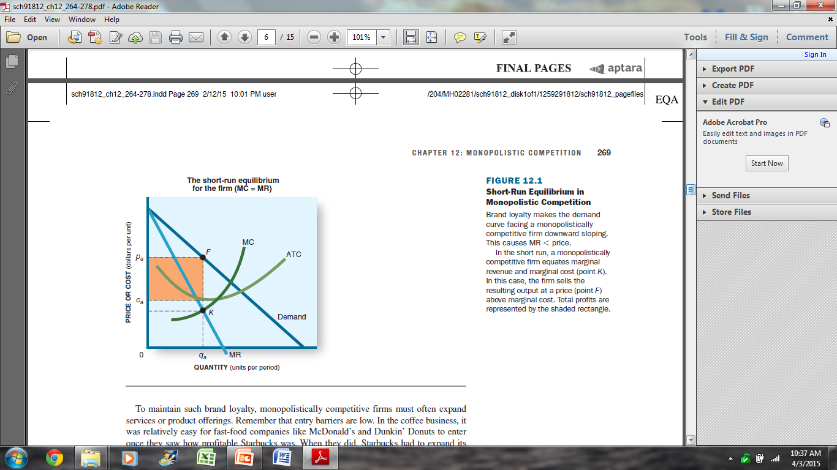
Profit Maximization
Monopolistically competitive firms are profit maximizers.
Produce an output where MR = MC, and economic profits are made on their “unique” product.
Notes:
The graphical depiction is identical to monopoly.
Profit squeeze occurs as it does in perfect competition because of low barriers to entry.

Slide 11
Entry Effects
New entrants can’t be kept out of the market as economic profits draw in new competitors.
Profits, existing due to having a unique product and brand loyalty, will be squeezed to zero as the new entries clone the uniqueness.
In the long-run, economic profits tend to zero as new entrants shift supply to the right and drive down prices.
Notes:
This cloning of unique features is instrumental to product improvement across the industry.

Slide 12
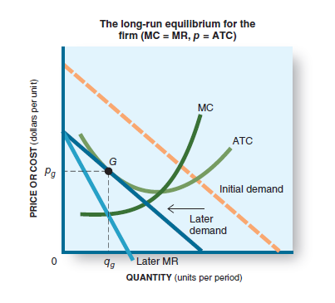
Entry Effects II
Individual firms’ demand curves will shift to the left as new firms enter.
Industry wide supply shifts right as new firms enter, driving down price.
Ultimately, economic profits are eliminated.
Notes:
This cloning of unique features is instrumental to product improvement across the industry.

Slide 13
Inefficiency
With a downward-sloping demand curve, long-run equilibrium will not occur at minimum ATC.
This form of market structure will use more than the minimum amount of resources to produce the product.
It will be inefficient compared to perfect competition.
There also will be more outlets than needed. There is excess capacity.
Notes:
LR equilibrium will occur at a quantity to the left of minimum ATC.
If economic profits are being made in fast food at a certain location in the city, new entrants will be lured to that area.
Soon more fast-food outlets are located there. It is not out of the question that the capacity to serve all the fast-food customers in that area will become excessive.

Slide 14
Inefficiency II
“There is a Starbucks on every corner!”
“There are 10 fast-food outlets on this block!”
Statements like these say, in monopolistic competition, there are more outlets than necessary to satisfy consumer demand. Thus, there is excess capacity.
Monopolistic competition results in both:
productive inefficiency (above-minimum ATC).
allocative inefficiency (wrong mix of output).
Notes:
One intersection in Boston has three Dunkin Donuts.

Slide 15
Application: The Economy Tomorrow
No cease-fire in advertising wars.
In imperfect competition markets, non-price competition prevails.
A firm advertises to enhance its product’s image and capture a brand-loyal market.
A firm can use promotions to lure consumers to its product: special extras with a purchase, the use of coupons, and tie-in purchases are examples.
Notes:
Advertising is a strong industry as firms try to convince customers that their products are better, more effective, cheaper, or whatever than those of the competition.
Promotions? Does anyone buy a delivery or take-away pizza without a coupon?

Slide 16
Application: The Economy Tomorrow II
Advertising campaigns consume considerable resources.
These resources could have been used to produce more of the desired goods and services.
Marketing costs for advertised brands are high and are reflected in their higher prices.
Generic brands have no advertising costs and, therefore, have lower prices.
Nevertheless, expect advertising to be just as pervasive in the economy tomorrow.
Notes:
An advertising campaign is effective if it increases sales revenue by more than the cost of the campaign.

Slide 17
Revisiting the Learning Outcomes
LO12-1 Know the unique structure of monopolistic competition.
Many firms, usually locally competitive and small.
Easy entry.
They aspire to brand loyalty so that they are unique and in a small way, a monopolist.
They are somewhat independent in making price and output decisions.
Notes:
Here we begin the review of the chapter.

Slide 18
Revisiting the Learning Outcomes II
LO12-2 Know the unique behavior of monopolistically competitive firms.
They can increase profits and market share if they successfully differentiate their products from similar products of their competitors.
They generate excess capacity and operate with both allocative and productive inefficiency.
They encourage nonprice competition: features, packaging, advertising, service add-ons, and the like.

Slide 19
Revisiting the Learning Outcomes III
LO12-3 Know how monopolistically competitive firms maximize profits.
As do all market structures facing downward-sloping demand curves, monopolistically competitive firms use the profit-maximizing rules and produce an output where MR = MC.

Slide 20
Revisiting the Learning Outcomes IV
LO12-4 Know why economic profits tend toward zero in monopolistic competition.
Low entry barriers allow new entrants when economic profits exist.
As new firms enter, individual demand curves shift left and the industry demand curve shifts right, lowering prices and driving economic profits to zero.

Slide 21
Looking Ahead: Chapter 13
Natural Monopolies:
(De)Regulation?
After learning about this chapter, you should know
The characteristics of natural monopoly.
The regulatory dilemmas posed by natural monopoly.
The costs associated with regulation.
How deregulation has fared in specific industries.

