Slide 1
Natural Monopolies: (De)regulation?
13
LO13-1 The characteristics of natural monopoly.
LO13-2 The regulatory dilemmas posed by natural monopoly.
LO13-3 The costs associated with regulation.
LO13-4 How deregulation has fared in specific industries.

Slide 2
Government Intervention
Markets sometimes fail. Unregulated markets may produce the wrong mix of output, undesirable methods of production, or an unfair distribution of income.
But government intervention can fail as well.
Notes:
Activities run by the government can be highly effective; however, they are nearly always very expensive to operate.
Because of this, a government intervention that is not effective would fail the MB - MC test.

Slide 3
Government Intervention II
In this chapter, we explore government regulation of industry.
Specifically,
When is government regulation necessary?
What form should that regulation take?
When is it appropriate to deregulate an industry?
Notes:
Regulation affects the WHAT to produce question, the HOW to produce question, and also the FOR WHOM to produce question.

Slide 4
Ideal Market Conditions
The market’s answer to WHAT, HOW, and FOR WHOM to produce would be ideal if:
all producers would be perfect competitors.
people had full information about tastes, costs, and prices.
all costs and benefits were reflected in market prices.
pervasive economies of scale were absent.
Notes:
These were the basic ideals we set forth in the discussion of perfect competition.
Since almost all firms are in the other three market structures, ideal market conditions cannot possibly exist in great numbers.

Slide 5
Market Failure and Government Intervention
The market does not operate in this ideal way.
Market failure prevents optimal outcomes.
Government Intervention
Antitrust: government intervention to alter market structure or prevent abuse of market power.
Regulation: government intervention to alter the behavior of firms – for example, pricing, output, or advertising.
Notes:
Antitrust looks out for illegal coordination and adjudicates the merit of mergers.
Regulation arises from laws passed in Congress that establish a government agency to administer the regulation.

Slide 6
Natural Monopoly
Natural monopoly: an industry in which one firm can achieve economies of scale over the entire range of market supply.
One firm can provide the good or service at a lower cost than several competing firms.
It operates on a downward-sloping ATC curve.
It has high fixed costs – that is, a large capital input – and low marginal costs.
Notes:
You can demonstrate this by drawing a downward-sloping LRATC and intersecting the market demand curve at the low end of the LRATC.
Then identify one firm to produce a quantity equal to the intersection. On the vertical axis, identify the corresponding price as C₁. Now go to the left along the horizontal axis to one-fourth the quantity as the intersection. If there were four equal-sized firms in competition, they would be this big. On the LRATC, identify the cost associated with this firm and label it C₄. This cost would have to be much higher than that of the natural monopolist.

Slide 7
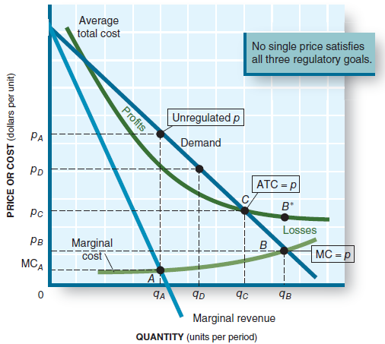
Natural Monopoly II
An unregulated natural monopoly produces output q_{A} and charges p_{A}, related to MR = MC.
Efficiency calls for marginal cost pricing, p = MC, at point B.
Zero economic profits occur at point C, where p = ATC.
Notes:
Note that the market is not fully supported and the corresponding price is high.

Slide 8
Regulatory Options
Price regulation: the monopoly will not be allowed to charge p_{A,} its profit-maximizing price.
Economic profits lure in new firms, but only one can achieve economies of scale. No new entry is needed.
Notes:
There is no need for the natural monopolist to profit-maximize. A normal profit is all that is necessary.
Economic profits are zero. Economic profits lure in new suppliers, which will not be allowed.

Slide 9
Regulatory Options II
Price Efficiency
(p = MC) Set price to equal opportunity cost. Efficient, but generates a loss to the firm (p<ATC).
To get the firm to produce, it must be provided a subsidy that equals the loss, B*- B.
Notes:
This would be the economically most efficient approach, but it requires a subsidy (out of tax dollars) to induce the firm to perform.

Slide 10
Regulatory Options III
Production Efficiency
(p = min ATC). The ATC curve slopes downward; by increasing output we lower costs more.
Again, the firm operates at a loss and would need a subsidy.
Notes:
Per-unit costs would be the lowest in this case, and, if passed to the customers, the price would be at its lowest.
However, to induce the firm to produce, a government subsidy would be needed.

Slide 11
Regulatory Options IV
Profit Regulation
Require production at output q_{C}; charge price p_{C}.
At that point p = ATC at zero economic profits.
No subsidy is needed.
Allows a normal profit.
Rate increase requests must be approved by a competent board.
Notes:
This method allows the firm to have a normal profit (its stockholders receive a return on investment equal to their alternative investment choices).
No subsidy is needed.
The competent board must understand how the cost structure of the industry operates.
The firm will petition for a rate increase based on the need to cover rising costs.

Slide 12
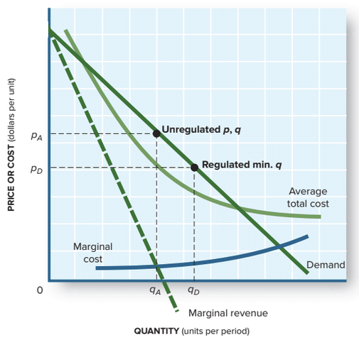
Regulatory Options V
Output Regulation
Since only one firm is allowed, it must serve all customers – that is, output q_{D}.
By doing this, there is a risk of reduced quality if the firm cuts costs to increase profits.
Government requires a minimal level of service.
Notes:
Imagine a franchise of In-and-Out Burgers in your city. The owner of the franchise puts one store in the affluent north part of town, another in the vibrant center, and a third in the not-so-wealthy south. After a year or so, the first two are highly profitable; the third is losing money. So the owner closes that one. This would be perfectly legal and makes good business sense.
Now do the same for an electric distribution company. Even though it may lose money in the south part of town, it must continue to provide service.

Slide 13
Government Regulation
The options are conflicting. Ideally we want marginal cost pricing, no subsidy, full service, and quality service.
The choice society has is between imperfect markets and imperfect government intervention.
However, sometimes government failure occurs.
Notes:
When the government intervenes, it implements legislation that was created in a highly political arena. There is no reason to expect that the results of this legislation will lead to perfection. The unintended consequences of implementation could make market outcomes worse.

Slide 14
Government Regulation II
Government failure: government intervention that fails to improve economic conditions.
Government failure may be worse than market failure.
Market outcomes after regulation may be worse than before the industry was regulated.

Slide 15
Costs of Regulation
In any event, success or failure, government regulation has significant costs.
Collecting information on demand and costs in the industry.
Creating and staffing bureaucracies to administer and ensure compliance with the regulations.
Regulated firms have huge compliance costs.
Government failure can alter the mix of output in undesired ways, causing a cost to society.
Notes:
Compliance costs are often overlooked when assessing the cost of government regulation.

Slide 16
Costs of Regulation II
Regulatory intervention must balance the anticipated improvements in market outcomes against the economic cost of regulation.
If anticipated added benefits (MB) do not exceed the added costs (MC), then the added regulation should be rejected.
Notes:
This is not to imply that Congress actually does a benefit-cost analysis when passing legislation.

Slide 17
Deregulation
Two reasons to consider deregulation of an industry:
the regulated industry is less productive than desired, due to regulation.
advancing technology destroys the reason for regulation.
Notes:
In the 1930s, many industries were regulated: telephone, radio, trucking, and airlines, for example.
To staff the regulatory agencies, the industries themselves provided expert people.
After their time at the regulatory agency is over, they go back into industry.
Thus it is likely that the regulator and the existing firms in the industry begin to “scratch each other’s backs.”
The regulatory body ends up restricting new entrants into the industry.
When this happens, the industry is better off being deregulated than remaining in regulation.

Slide 18
Deregulation II
A regulated industry might no longer be a natural monopoly as substitutes for its good or service become available.
Cars, trucks, airplanes, and pipelines in competition with the regulated railroads.
Cellular, Internet, and cable delivery of phone service in competition with telephone companies.
Deregulating an industry grants firms more freedom to compete in the widened market.
Notes:
Technology is another way to promote competition.
Two examples are shown.
A major problem with regulation – especially those regulations governing HOW TO produce – is that legislation freezes technology to the time of enactment. New technology cannot be implemented because the law does not specify it.

Slide 19
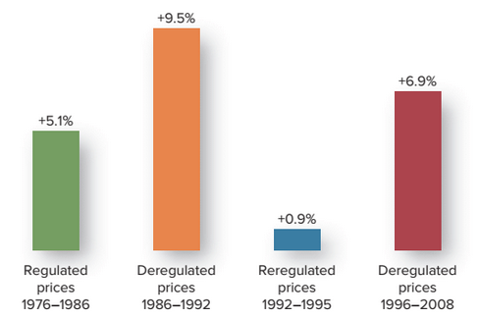
Deregulation III
Other examples:
airlines
electricity (generation, not delivery)
cable TV (shown below both regulated and deregulated)

Slide 20
Application: The Economy Tomorrow
Deregulate everything?
Deregulation of many industries yielded benefits: more competition, lower prices, improved services.
New competition with substitute goods, and technological changes, make regulation obsolete and counterproductive.
Notes:
Eliminate the Food and Drug Administration? No standards for what is in that can of beans?

Slide 21
Application: The Economy Tomorrow II
Deregulate everything?
Should we eliminate all regulations? Food and drugs, for example?
As always, in the economy tomorrow, each case should compare all the benefits to society of deregulation with all the costs to society of doing so.
Notes:
Eliminate the Food and Drug Administration? No standards for what is in that can of beans?

Slide 22
Revisiting the Learning Outcomes
LO13-1 Know the characteristics of natural monopoly.
High fixed costs and negligible marginal costs.
Downward-sloping ATC curve.
Only one firm can reach economies of scale in a market.
Notes:
Here begins the review of this chapter.

Slide 23
Revisiting the Learning Outcomes II
LO13-2 Know the regulatory dilemmas posed by natural monopoly.
Price regulation may require subsidies.
Profit regulation may induce cost escalation.
Output regulation may lead to quality deterioration.

Slide 24
Revisiting the Learning Outcomes III
LO13-3 Know the costs associated with regulation.
Opportunity costs associated with regulatory administration and compliance.
Efficiency losses resulting from inflexible pricing and production rules.
Both new and existing regulation activity should pass the benefit-cost test: do the added benefits to society exceed the added costs to society?

Slide 25
Revisiting the Learning Outcomes IV
LO13-4 Know how deregulation has fared in specific industries.
Deregulation in the railroad, telephone, and airline industries has been a success.
After deregulation, these industries became more competitive, output increased, and prices fell.

Slide 26
Looking Ahead: Chapter 14
Environmental Protection
After learning about this chapter, you should know
How markets encourage pollution.
Alternative strategies for reducing pollution.
Why zero pollution may not be desirable.

