Slide 1
The Farm Problem
15
LO15-1 What makes the farm business different from others.
LO15-2 What mechanisms are used to prop up farm prices and incomes.
LO15-3 How subsidies affect farm prices, output, and incomes.

Slide 2
U.S. Agriculture
Should American farmers participate in a free market?
No federal subsidies.
Produce what you want and how much.
Determine how much farmland to use or leave fallow.
Or …
Notes:
Agriculture is still a large industry, providing many benefits for over 300 million people here in addition to exporting to other countries.
It is also heavily politicized, receiving many benefits from the government as Congress members provide “pork” for the voters back home.

Slide 3
U.S. Agriculture II
Should the government dictate what, how, and how much product American farmers should produce?
Restrictions on what you can grow and how much.
Price guarantees.
Income guarantees.
The Farm Act of 2008 generated subsidies to many more farmers, and “free-market” agriculture seemed to disappear.
Notes:
This chapter tries to identify reasons for continued government intervention and reasons for returning the industry to market forces.

Slide 4
U.S. Agriculture III
In this chapter we examine the rationale for agricultural subsidies and their effect on markets.
Specifically,
Why do farmers need any subsidies?
How do government subsidies affect farm production, prices, and incomes?
Who pays for farm subsidies?
Notes:
A side question might be, Why do some crops need subsidies while others do not?

Slide 5
Destabilizing Forces
The agriculture industry is one of the most competitive in America.
Individual farmers have no market power.
There are low barriers to entry.
When there are economic profits, farm production expands and new farmers enter the industry.
Individual farmers behave like perfect competitors.
They produce an output where MC = p.
Notes:
Many of the examples used when we talk about perfect competition are agriculture markets.

Slide 6
Destabilizing Forces II
Technological advance
There has been a spectacular technological advancement in agriculture.
Production has increased enormously.
Productivity has increased even faster.
The supply curve for agricultural products has shifted radically to the right, causing farm prices to fall.
Notes:
The tech advance is not only in capital goods but also in process techniques (how to grow).
We have seen a huge increase in capital input, accompanied by decreases in land use and labor employed on the farm.

Slide 7
Destabilizing Forces III
Inelastic demand
There is an upper limit to the amount of food people want to eat.
When farm prices fall, consumers do not increase their food purchases much.
Added production actually yields lower revenues.
A bumper crop would drop prices so much that farmers actually earn less than in a normal production year.
Notes:
Therefore, supply has increased far to the right, but demand increased much less far to the right.
You might wish to combine the two in a board graph, first moving supply far right then moving demand less far right.

Slide 8
Destabilizing Forces IV
Low income elasticity
As consumers’ incomes rise, they do not significantly increase their consumption of food.
They may alter the types of food purchased, but not the amount by much.
The increasing quantity of food produced in the United States must be reconciled with very slow growth of U.S. demand for food.
Notes:
We have seen worldwide increases in (real) incomes also. But an individual’s stomach size has not grown.

Slide 9
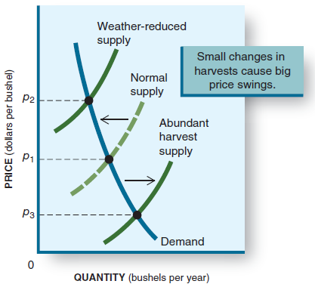
Destabilizing Forces V
Abrupt shifts in supply
There are abrupt short-term production swings.
Good weather: abundant harvests.
Bad weather or natural disaster: scant harvests.
In either case, farm income falls.
Notes:
Headlines are made of these swings – the huge bumper crop that drives down prices and the weather disaster (hailstorm, drought) that drives up prices but there’s nothing to sell.

Slide 10
Destabilizing Forces VI
Response lags
The production decision for farmers occurs before the beginning of the planting season.
The results of that production come at harvest, after all natural influences on growing have occurred.
High prices last year? Plant more this year.
All farmers do this independently, so more crop reaches the market, and the price plunges.
Notes:
Most costs accrue to the farmer at the beginning of the season; revenues accrue at the end of the season. Revenues are dependent on all of these destabilizing forces.
To buy some insurance (hedge) against a low price at harvest, many farmers sell crop futures to lock in a price they can live with.
Speculators buy the crop futures, betting on a price at harvest higher than what they paid for the future.

Slide 11
U.S. Farm Policy
Congress has responded to agricultural problems with a variety of programs designed to raise or stabilize farm products’ prices.
These include:
price supports
supply restrictions
demand distortions
cost subsidies
direct income support
Notes:
A look at the home districts for senators, especially, indicates that the farm belt has quite a clout in Congress.

Slide 12
Price Supports
Congress sets a minimum price (above market equilibrium) that a farm good can sell for.
This encourages producers to grow more.
This encourages buyers to purchase less.
A market surplus is created.
Since the price cannot fall, the surplus must be disposed of some other way.
Usually government buys up the surplus and stockpiles it.
Notes:
The economic concept is a price floor.

Slide 13
Supply Restrictions
Set-asides: reduce acreage used
Dairy Termination: reduce dairy herds
Marketing Orders: limit the amount brought to market
Import Quotas: restrict foreign competition
Notes:
Each element of this concept is akin to a quota in international trade.
Note that the first two are resource destroyers.

Slide 14
Demand Distortions
Government stockpiles: if price drops too low, government buys surplus crops.
Price supports: set an artificially high price and government buys up the surplus.
Deficiency payments: government partially pays for the crop.
Notes:
This program ensures that farmers plant and produce a set amount of crop and do not suffer any consequences if the market has a surplus.

Slide 15
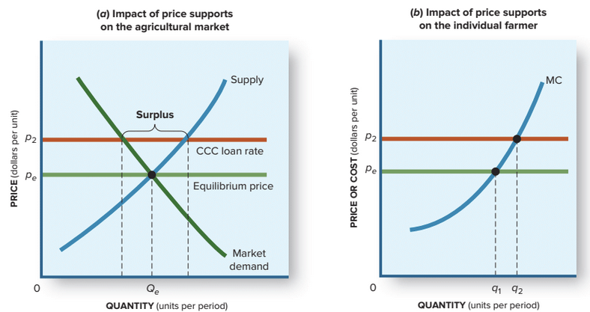
Impact of Price Supports

Slide 16
Cost Subsidies
Government can subsidize water use, fertilizer, drainage, and other costs.
Government funds research, insurance, marketing, grading, and inspection services for farmers.
Notes:
Artificially lowering the costs yields profits that, in a free market, would never exist.
This activity delays the transition of resources from a low-profit industry to other, more productive uses.

Slide 17
Application: The Economy Tomorrow
Farmers on the dole.
In the 1980s and 1990s, several agricultural programs were reduced or eliminated and the agricultural businesses crept back toward free-market realities.
In the late 1990s and in the 2000s, farm exports fell sharply and prices tumbled. Farmers returned for federal aid.
Notes:
As long as the farm belt has access to a large number of Congress members, there will be government largesse to agriculture.

Slide 18
Application: The Economy Tomorrow II
The 2018 Farm Bill
The 2014 Farm Bill expires and must be replaced in 2018.
In the economy tomorrow, we expect a continuation of Congressional involvement in agricultural markets and the American farmer to remain dependent on government assistance.
Notes:
As long as the farm belt has access to a large number of Congress members, there will be government largesse to agriculture.

Slide 19
Revisiting the Learning Outcomes
LO15-1 Know what makes the farm business different from others
Agriculture has enjoyed enormous technological gains and increasing productivity, increasing supply greatly.
However, domestic demand has not grown as fast.
Seasonal variations and a rigid production schedule creates harvest variations and huge price swings.
Notes:
Here begins the review of the chapter.

Slide 20
Revisiting the Learning Outcomes II
LO15-2 Know what mechanisms are used to prop up farm prices and incomes.
Price supports
Supply restrictions
Demand distortions
Cost subsidies
Direct income supports

Slide 21
Revisiting the Learning Outcomes III
LO15-3 Know how farm subsidies affect farm prices, output, and incomes.
Price supports create surpluses of products that can’t be disposed of easily.
Supply restrictions push up prices in the market.
Resources are wasted in overproduction and destruction of excess crops and herds.
Propped-up incomes keep people on the farm rather than moving into other growing industries.

Slide 22
Looking Ahead: Chapter 16
The Labor Market
After learning about this chapter, you should know
What factors shape labor supply and demand.
How market wage rates are established.
How wage floors alter labor market outcomes.

