Slide 1



A JOURNEY TOWARD A GREENER, SMARTER FUTURE
Green Skilling,
Sustainability & AI
Sustainable Development • Renewable Energy • Artificial Intelligence
Name
Raj Lad
Enrollment No.
240840131054
Stream
B.Tech Computer Science
R.N.G Patel Institute of Technology
Notes:
Welcome the audience. Introduce the presentation topic: Green Skilling, Sustainability, and AI. Mention this is a college project connecting environmental awareness with emerging technology skills.

Slide 2






INTRODUCTION
About Me
ENROLLMENT NUMBER
BRANCH / STREAM
240840131054
B.Tech Computer Science
COLLEGE
SEMESTER
Raj Lad
R.N.G Patel Institute of Technology
As per current academic year
B.Tech – Computer Science
Passionate about Artificial Intelligence and its role in building a sustainable future for our planet.
Why AI & Sustainability?
I am a Computer Science student exploring how technology can protect the environment. I'm keen to build AI-driven solutions — from smart monitoring systems to data-driven decision tools — that support a cleaner, more sustainable world.
GREEN SKILLING, SUSTAINABILITY & AI
2
Notes:
Introduce yourself briefly: name, enrollment number, branch, college, and semester. Share a short personal note on why AI and sustainability interest you.

Slide 3





LEARNING JOURNEY
Things I Learned
SDG 17
Green Data Centres
Govt. Initiatives
Partnerships & collaboration driving global sustainability goals.
Energy-efficient, eco-friendly digital infrastructure.
National policies and missions promoting a greener India.
05
Renewable Energy
AI for Environment
Key Learning Areas Explored
Solar, wind & clean power replacing fossil fuels.
Smart applications that monitor and protect nature.
GREEN SKILLING, SUSTAINABILITY & AI
3
Notes:
Summarize the five key themes from the learning links: SDG 17, green data centres, government sustainability initiatives, renewable energy, and AI applications for environmental protection. Keep each point brief — one sentence per topic.

Slide 4


MY FAVORITE TOPIC
SDG 17 – Partnerships for the Goals
Why It Matters
17
No single nation, company, or individual can solve climate change, poverty, or pollution alone. SDG 17 unites governments, businesses, and citizens toward shared sustainability targets.
Collaboration in Action
Cross-sector partnerships pool funding, technology, and expertise — accelerating progress on clean energy, education, and equitable growth far faster than isolated efforts.
GLOBAL GOAL
Partnerships
for the Goals
How AI Strengthens SDG 17
AI enables real-time data sharing, predictive analytics, and transparent monitoring — helping partners coordinate resources and track progress toward inclusive, sustainable development.
Why it's my favorite — it connects every other goal through collaboration.
GREEN SKILLING, SUSTAINABILITY & AI
4
Notes:
Note: SDG 17 is officially 'Partnerships for the Goals' (not 'Reduced Inequalities', which is SDG 10). Explain why partnerships matter, give a real-world example of collaboration, and describe how AI-powered data sharing helps different stakeholders work together more effectively.

Slide 5



DOCUMENTARY INSIGHTS
Learning from Data Centre Documentaries
Why Data Centres Consume Energy
Continuous server operation, cooling systems, and 24/7 uptime demand massive electricity.
Green Data Centres
Eco-friendly facilities using efficient hardware and sustainable design to cut energy waste.
Digital Infrastructure
& Energy Demand
Renewable Energy Usage
Leading data centres now run on solar and wind power instead of fossil fuels.
Every search, stream, and AI query runs on power-hungry servers — making data centres a key focus for sustainable computing.
AI-Based Cooling & Power Optimization
AI predicts cooling needs and adjusts power use in real time, reducing waste.
Carbon Emission Reduction
Smarter infrastructure and clean energy together shrink the carbon footprint of computing.
GREEN SKILLING, SUSTAINABILITY & AI
5
Notes:
Explain why data centres use so much energy, then describe the shift toward green data centres, renewable power, AI-optimized cooling, and lower carbon emissions as seen in the documentaries.

Slide 6



POLICY & INITIATIVES
Learning from Government Websites
Digital India
Smart Cities Mission
Nationwide push for e-governance, digital literacy, and connected infrastructure across the country.
Urban development using technology for efficient energy, water, waste, and transport systems.
Renewable Energy Missions
Environmental Conservation
Programs like the National Solar Mission expanding clean, affordable power generation.
Afforestation, pollution control, and biodiversity protection initiatives nationwide.
GREEN SKILLING, SUSTAINABILITY & AI
6
Notes:
Summarize key government initiatives related to sustainability and technology: Digital India, Smart Cities Mission, renewable energy missions, and environmental conservation programs.

Slide 7
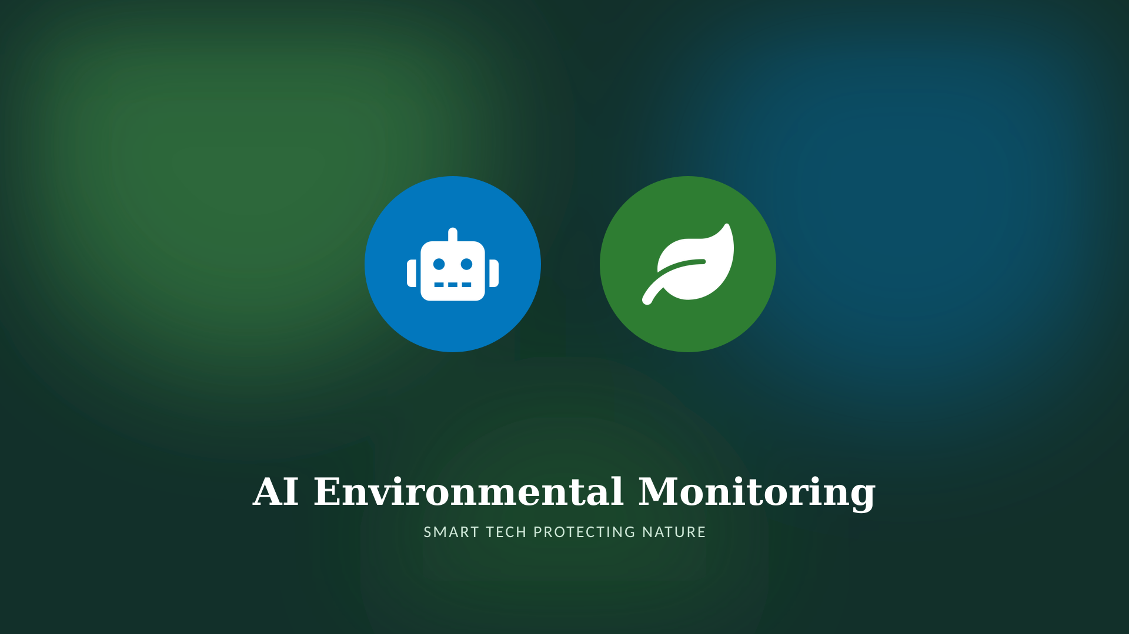
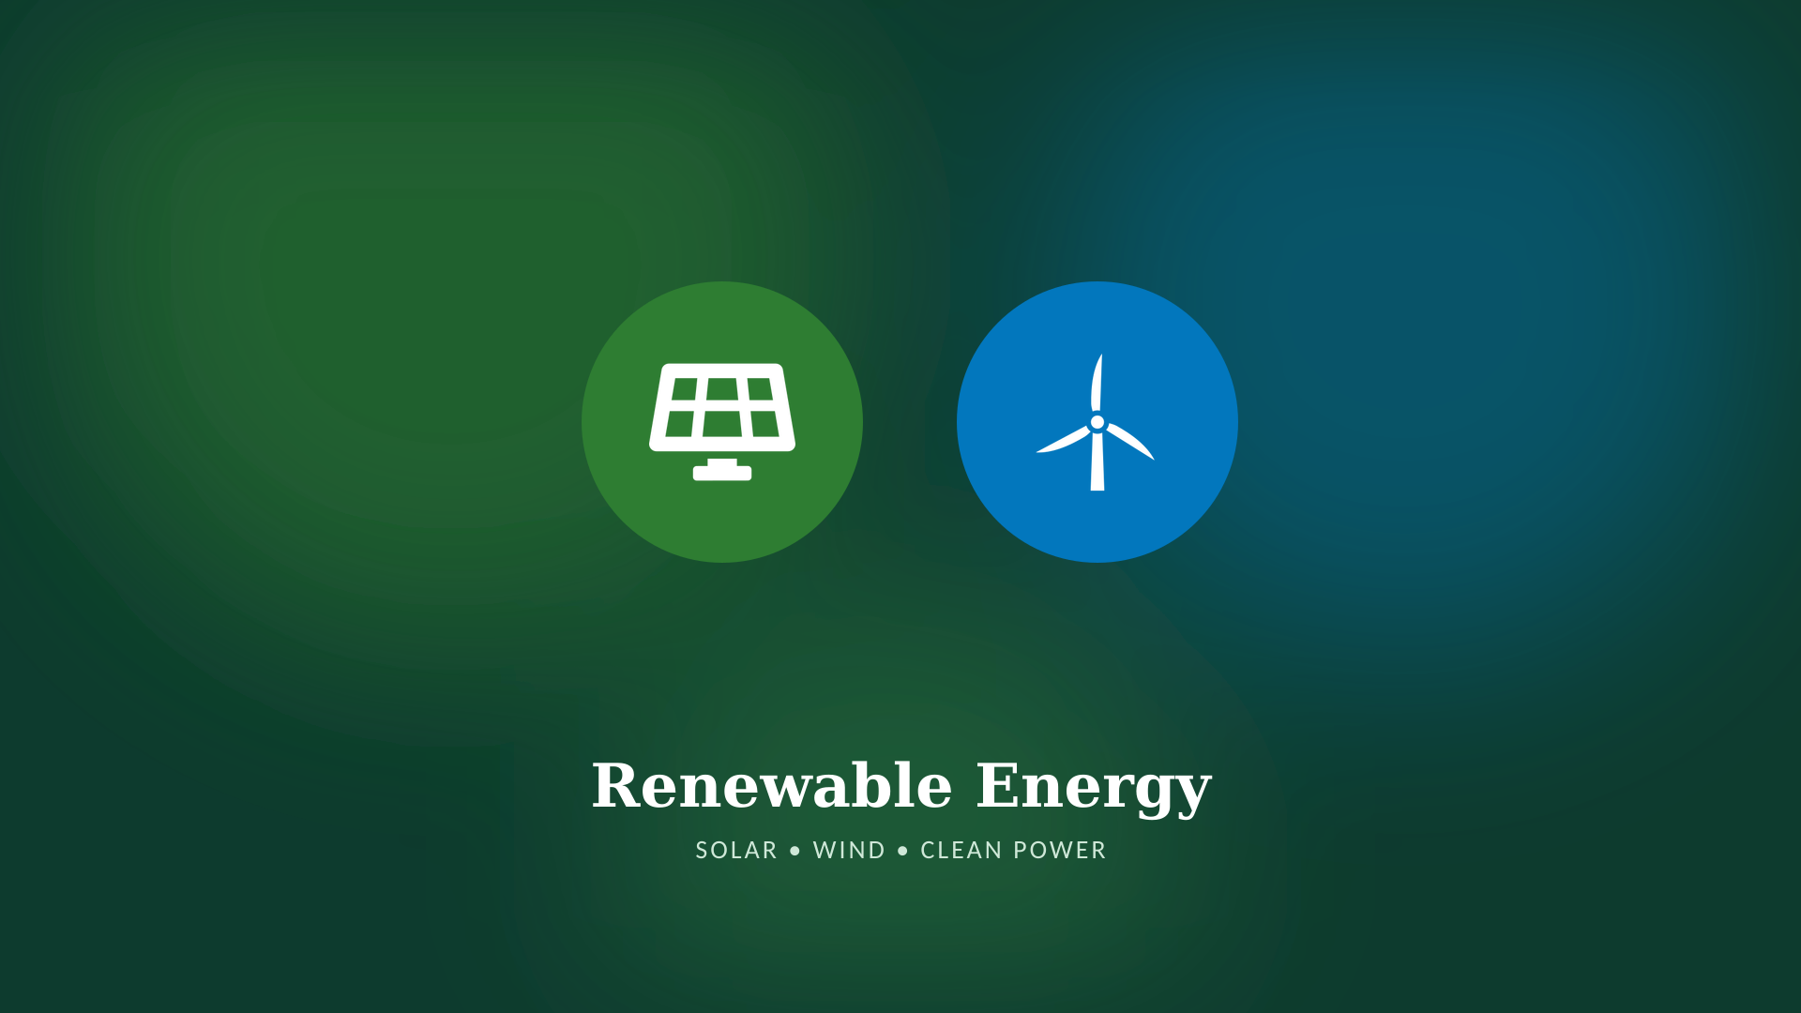



HANDS-ON ACTIVITY
Activity Screenshots
Screenshot 1
Screenshot 2
Screenshot 3
Screenshot 4
GREEN SKILLING, SUSTAINABILITY & AI
7
Notes:
Replace each placeholder box with your actual activity screenshots. Add a one-line caption describing what each screenshot demonstrates.

Slide 8






CONCEPT
What is Green Skilling?
Definition Training people with the knowledge and technical skills needed for jobs that protect, restore, or sustain the environment — from clean energy to eco-conscious technology.
Why It Matters
Career Opportunities
Prepares the workforce to meet climate goals, drive green innovation, and reduce environmental impact across every industry.
Opens roles in renewable energy, sustainable manufacturing, environmental data science, and green consulting.
EXAMPLES
Renewable
Energy
Electric
Vehicles
Waste
Management
Sustainable
Agriculture
AI Environmental
Solutions
GREEN SKILLING, SUSTAINABILITY & AI
8
Notes:
Define green skilling, explain why it matters for future careers, and walk through the five examples: renewable energy, EVs, waste management, sustainable agriculture, and AI-based environmental solutions.

Slide 9


CONCEPT
What is Sustainability?
Definition Meeting the needs of the present without compromising the ability of future generations to meet their own needs.
Environmental
Social
Economic
Protecting ecosystems, biodiversity, air, and water for the long term.
Ensuring equity, wellbeing, and quality of life for all communities.
Building growth that is resource-efficient and viable long-term.
Why It Matters for the Future
Everyday Sustainable Practices
Protects resources, climate, and opportunity so future generations inherit a livable, thriving planet.
Saving energy and water, reducing waste, recycling, and choosing eco-friendly transport and products.
GREEN SKILLING, SUSTAINABILITY & AI
9
Notes:
Define sustainability and explain the three pillars — environmental, social, and economic — then connect it to why it matters for future generations and simple everyday practices.

Slide 10






BALANCED VIEW
AI – Benefits & Challenges for Sustainability
BENEFITS
CHALLENGES
Smart agriculture – precision crop & resource management
High energy consumption of large AI models
Climate prediction – forecasting extreme weather events
Data centre emissions contributing to carbon output
Waste segregation – automated sorting & recycling
Electronic waste from constant hardware upgrades
Energy optimization – smarter grids & consumption
Heavy water usage for server cooling systems
Water management – leak detection & conservation
Need for responsible, transparent, and ethical AI
Forest monitoring – satellite-based deforestation alerts
GREEN SKILLING, SUSTAINABILITY & AI
10
Notes:
Present a balanced view: AI offers powerful sustainability benefits like smart agriculture and climate prediction, but also carries real costs — energy use, emissions, e-waste, and water consumption — which is why responsible AI development matters.

Slide 11







CAPSTONE PROJECT
EcoVision AI
Intelligent Environmental Monitoring System
TECHNOLOGIES
Problem Statement
Rising pollution and resource strain make real-time, data-driven environmental monitoring essential for timely, informed action.
Python
Machine
Learning
Computer
Vision
IoT
Cloud
KEY FEATURES
Objectives
Air quality monitoring
Waste classification
Monitor air & environmental quality in real time
Automate waste classification using computer vision
Predict pollution trends with machine learning
Visualize carbon footprint & impact data
Pollution prediction
Carbon footprint dashboard
AI chatbot assistant
Expected Impact
Empowers communities with real-time environmental insight — directly advancing SDG 13 (Climate Action) and SDG 11 (Sustainable Cities).
GREEN SKILLING, SUSTAINABILITY & AI
11
Notes:
Walk through EcoVision AI: the problem it solves, its objectives, the technology stack (Python, ML, computer vision, IoT, cloud), key features, and its expected impact on sustainability and relevant SDGs.

Slide 12

Thank You
Questions & Discussion
Raj Lad • B.Tech Computer Science • R.N.G Patel Institute of Technology
GREEN SKILLING, SUSTAINABILITY & AI
Notes:
Thank the audience and invite questions. Be ready to discuss SDG 17, green data centres, or the EcoVision AI capstone project in more depth.

