Slide 1
Link flap issue - status update
xAI – December 2025

Slide 2
Test Beds - Coverage
Daily Status Updates
Next Steps
Q/A

Slide 3
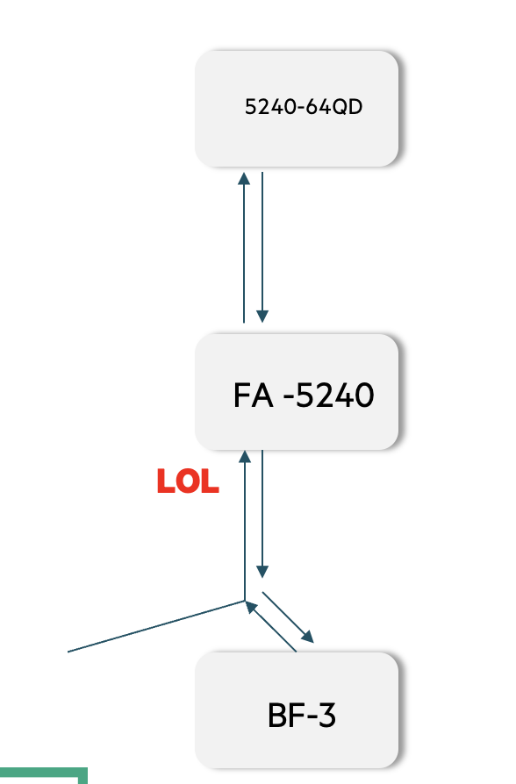
SysTest Reproduction Summary
We have been able to reproduce the issue in more than 3 instances ( multiple times in each instance)
  The behavior is same - local_ reason_ opcode = alignment loss on the NIC end ( Amber log )
  NIC initializes - Link goes down
  Link comes back up.
  Resulting in 12 second link flap
We can group the reproduction into 3 buckets
  One leg of the AEC cable was connected to BF-3 ; other one dangling
  Voltage Margin Variation -> -5% to + 3.16% of the nominal
  Built a scaled-upFA Unit ( 2 occurrences of flap of one AEC – same signature as above )
    14x 800G AEC – to ( 2x400G BF-3140)
    22 x 800G – AEC – to QFX5240-64QD
    28x 800G – OSFP- 800G DR8 to QFX5240-64OD
Notes:
The issue seems to be happening every time we build a new test bed.

Slide 4
Juniper Lab Topology – XAI Flap
QFX5240-QD (25.2X100)
800G/400G QSFP-DD
san-q5240-q08
CREDO AEC (1x800G OSFP -> 2x400G QDD112 )
70x400G
et-0/0/0-30
AEC0
AEC3
AEC7
AEC8
AEC 9
san-q5240-06
QFX5240-OD
D40.7- 800G OSFP
XAI FA
4x800G-DR8
AEC4
AEC1
AEC4
AEC5
AEC6
ET-36:0
ET-40:0
ET-24:1
ET-14:1
ET-36:1
enp180s0f0np0
enp13s0f0np0
enp13s0np0
enp55s0np0
BF3
BF3
BF3 NIC
thor2
thor2
CX8
san-rt-ai-srv01
san-rt-ai-srv02
svl-d-ai-srv04
svl-hp-ai-srv02
BF3 NIC
Notes:
xai-qfx5240-01:
1. Move ET-24:1 from FA unit to QFX5240-06
2. Move ET-14:1 from FA Unit to QFX5240-06
3. Reboot Server - san-rt-ai-srv01 and san-rt-ai-srv02
4. Run few iterations on AN On-OFF on both the server San-rt-ai-srv01/02 ( make sure in each iteration links come up)
5. Ensure AN is set to ON in both the servers (san-rt-ai-srv01/02)
6. Move ET24:1 cable back to FA unit from QFX5240-06
7. Move ET-14:1 cable back to FA unit from QFX5240-06
8. Monitor FA unit for any flaps.
9. Increase number connection from FA to QFX5240-06 - using DR4 (2x200G)
10. OIR on Et-40:0 and Et-36:1

Slide 5
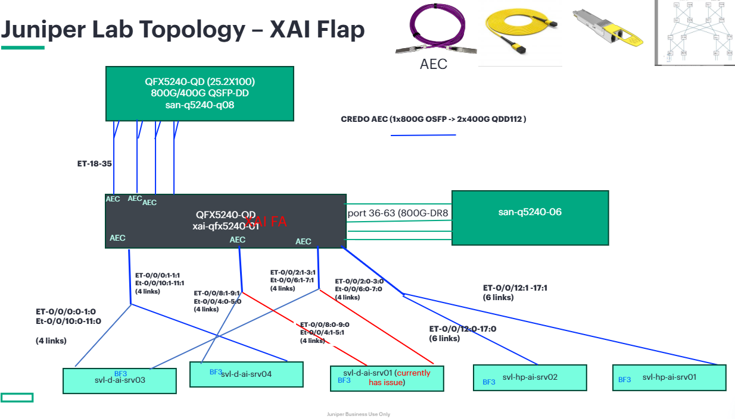
Juniper Lab Topology – Scaled-up

Slide 6
HW LAB

Slide 7
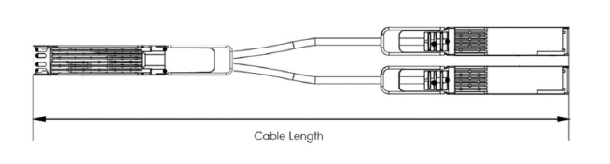
HW FA #1 – OPTICS (ODVT) testing for aEC on QFX5240
Goal :
Results
Investigate near-end (TP4) and far-end (MCB) optical signal quality and margins for AEC.
Testing done with 2 different QFX5240 – one from the lab and one RMA from customer.
Far end signals were characterized on both 400G Q112 ends of the 5m AEC Y-cable.
In each case, all lanes show passing results with no issues seen.
Also, no notable difference in optical signal quality between lab and RMA chassis.
400G Q112
MCB
QFX5240
800G OSFP
[Ports 0, 34]
Credo 5m AEC Y-cable

Slide 8
HW FA #2 – “BAD BATCH” Investigation
Goal :
Results
Next Steps
Investigate the possibility of any “bad batch” / “bad lot” issue causing failures
Build Date: 11 failed S/Ns are from 9 different assembly dates. (Oct 2024 – June 2025)
Mfg Site: 11 failed units from 3 different Accton production lines in 3 locations (VN, TW-ZB, TW-ZN)
11 failures out of 700+ systems in x.AI deployment. Customer reports once a failing unit is replaced, new unit is stable and does not show same failure mode.
Investigating DC/LC trends for timing module and components
Broadcom TH5: 3 different date codes, 5 different lot codes
Notes:
By SM

Slide 9
HW FA #3 – Power
Goal :
Status
Next Steps
Evaluate power as a potential source of disruption that could impact multiple optical links simultaneously.
3.3V optics power rails have been scoped and associated circuits reviewed. No issues found so far.
Attempts to force link flaps on an RMA QFX5240 by injecting noise have not been successful.
Looking for: potential sources of power noise or instability in Accton power design / schematics.
Instrument QFX5240 in SysTest replication test-bed with probes and attempt to replicate link flaps.
Flapping ports [0-35] map to 3 different power groups. Each group includes some ports that do not flap.
Notes:
By SM

Slide 10
HW FA #4 – Timing
Goal :
Status
Next Steps
Evaluate timing as a potential source of disruption that could impact multiple optical links simultaneously.
8 separate 312.5MHz clock signals for 64 SerDes on TH5. Difficult to access these signals directly for phase noise type of measurements due to how they are routed (BGA -> BGA, buried vias).
Re-tracing the clock tree up-stream has shown a couple of promising areas where we can scope and look for instability or other issues.
Looking for: jitter, temperature variation and other issues with clocks driving SerDes / TH5.
Attaching probes and working through different parts of the clock tree.
Notes:
By SM

Slide 11
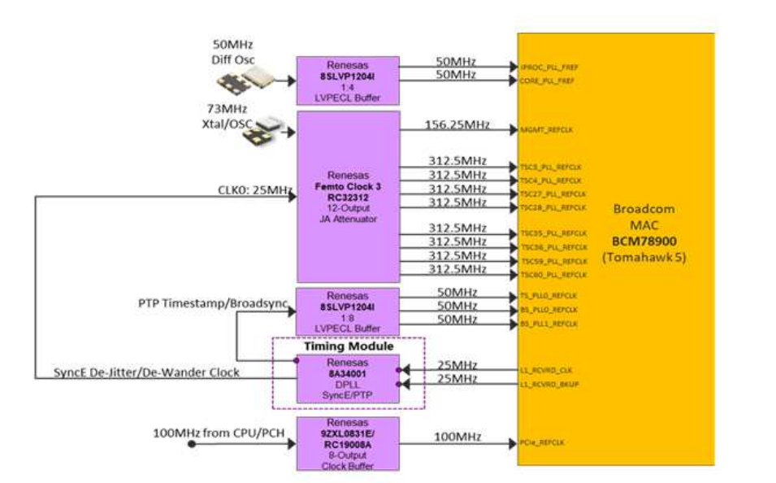

Slide 12
HW FA #5: EDVT with AEC = Replication
Goal
Status
Next Steps
Attempt to replicate link flaps using RMA QFX5240 in thermal chamber with temp cycling.
One RMA QFX5240 from customer has been installed in thermal chamber in Bldg 8 with 31 AEC Y-cables and various other optics modules on remaining ports.
Evaluate possibility of thermal dependence on failure mode suggested by some data.
Continue testing over next 48 hours.
Running scripts to dump temp and fan speed data periodically and log necessary diagnostic information if a link flap is observed.
No link flaps or issues seen so far.
Testing in progress since 6:30PM on 12/17/2025. One thermal cycle [-5C -> room temp -> +40C -> room temp] has been completed.
Notes:
By SM

Slide 13
Next steps
Probes connected FA Unit
  unit is being monitored for any new occurrence of the flap
  probes to monitor voltage for optics, chassis etc.
  will use oscilloscope to monitor
Hardware Lab –
  Attaching probes and working through different parts of the clock tree
Notes:
By SM

Slide 15
Daily Status update – 12/18/2025
Test Bed # 1
Test Bed # 2
Test Bed # 3
Testing Type: Stress
Testing updates
Testing Type: Optics
Testing updates
Observations:
Status: In progress
Observations:
Status: Completed
Testing Type: Hardware
Testing Updates
Observations:
Status: In Progress
Notes:
By SM

Slide 16
Systest - Test bed # 1
Reproduction 1
Setup
Additional details specific to the test bed and coverage
Hardware: QFX5240-OD-FA, QFX5240-OD, QFX5240-QD, BF3-3140 – 28 NICs, 37 AEC (Credo), 27 DR-8(2x400G) optics
Stress testing
Scripts executions – Periodic log collection ( DSC, Amber logs from NIC, syslog , switch log )
BF3 NICs Installed on HPE and DELL Servers
Credo 2x400G Y cable (OSFP – QSFP112) connection towards QFX5240 FA unit.
Test Configuration loaded with xAI FA unit QFX5240
Credo Cable Version 1.6 , 1.4
multiple power reset, Optics insertion/removal, All ports populated
Voltage Margin variation test (-5%, +3.16%)
ROCEv2 traffic
Co relation between the switch logs and NIC logs
Notes:
Test – Voltage margining -
Cues for sudden temp increase, fan speed 13K RPM , clock drifts , Voltage margin

Slide 17
DELL Server
Server 1 :
product: PowerEdge R760xa (SKU=0B72;ModelName=PowerEdge R760xa)
product: Intel(R) Xeon(R) Gold 5418Y
HPE:
Server SKU: P52534-B21
Product: ProLiant DL380 Gen11 (P52534-B21)
CPU: Intel(R) Xeon(R) Gold 5416S
HOST OS: Ubuntu 22.04.5 LTS

Slide 18
Scenario-1
Scenarios
1) Baseline functional test
- Objective: confirm current state and capture baseline metrics.
- Steps: run baseline capture; ping/test traffic across et-0/0/14:0; monitor sensors for 30–60 minutes.
- Expected: stable link, normal temps, logged baseline.

Slide 19
SCENARIO-2
2) Reboot / recovery verification
- Objective: confirm whether reboot permanently clears issue.
- Steps: if flap observed, record pre-reboot state, perform controlled soft reboot of switch, bring back to same traffic profile, monitor for 24 hours (or agreed period).
- Variations: immediate reboot after flap; delayed reboot (e.g., 15/30/60 minutes after flap).
- Expected: if reboot is a durable fix, no further flaps in monitoring window. If flaps recur, capture time-to-failure and correlate logs.

Slide 20
SCENARIO-3
3) Repeatability / stress replay
- Objective: reproduce flap under controlled load to determine reproducibility.
- Steps: generate high-rate traffic, mix of L2/L3 flows, synthetic packet bursts, and sustained flows; run traffic ramp-up/ramp-down cycles. Repeat cycles multiple times.
- Duration: 6–24 hours or until flap reproduces.
- Expected: reproduce flap if traffic-related. Capture CPU, mem, interrupts, and ASIC counters.

Slide 21
4) Thermal stress (EDVT chamber)
- Objective: test thermal sensitivity of chassis / optics to ambient changes.
- Steps: place chassis in thermal chamber; run defined temperature profile: ramp up from ambient to high operating temp in steps (e.g., 25°C -> 40°C -> 55°C), hold at each step for set period (e.g., 30–60 minutes); monitor fan speed behavior, board temps, and link stability.
- Also record front/back ambient temps and take photos at each stage.
- Variations: rapid temp transitions vs slow ramps.
- Expected: identify temperature thresholds where flaps or increased fan speeds correlate.
5) Soak test / long-duration run
- Objective: reveal intermittent or latent issues.
- Steps: run steady-state traffic and monitoring for 24–72 hours with periodic health checks.
- Expected: no flaps (pass) or intermittent failures (fail + correlation).
6) Transceiver / module isolation
- Objective: determine if Credo AEC transceiver (OSFP/QSFP) is implicated.
- Steps: test with known-good spare transceiver of same type; swap OSFP/QSFP sides; test with different ports/cables; run optics diagnostics (temperature, voltage, bias current).
- Expected: if flap disappears with different transceiver, module implicated.
7) Port/Link isolation and adjacency testing
- Objective: check cabling, peer device behavior, and port-level settings.
- Steps: move the affected server to a different port, connect to a different switch, test split-mac/duplex/speed settings, run loopback tests.
- Expected: if flap follows server or cable, isolate hardware; if remains on chassis port, suspect switch HW/SW.
.

Slide 22
8) Firmware / software regression test
- Objective: check for known bugs in current software/firmware.
- Steps: reproduce on same software version; if reproduces, test on alternative stable/patch versions (lab validation) and collect debug logs.
- Expected: identify SW-linked issue if flap behavior changes with version.
9) Power / thermal coupling test
- Objective: rule out power/thermal interaction (fans, PSU).
- Steps: monitor PSU voltages, currents; test with redundant PSU combos; vary ambient cooling; observe fan speed thresholds and any correlation to flaps.
- Expected: identify PSU or thermal control correlation.
10) Probe testing / post-move verification
- Objective: confirm behavior after device relocation (Probe testing).
- Steps: repeat baseline and stress tests after move; compare event logs pre/post move.
- Expected: ensure flap not introduced by handling or environment.
Reporting requirements for each scenario
- Timestamped logs, packet captures, sensor data (CSV), photos (front/back, transceiver sides), and a short summary: test steps, duration, observed events, time-to-fail (if any), and preliminary cause hypothesis.
- Recommendation: tag each run with an ID and store artifacts in shared location for analysis.
Priority execution order
1. Baseline capture
2. Reboot verification (short-term then extended monitoring)
3. Thermal chamber stress
4. Transceiver isolation
5. High-load stress & repeatability
6. Soak test
7. Firmware regression and power tests
8. Probe/move verification
If you want, I can convert these into a checklist with estimated durations and owners for each test

