Slide 1



Big data Topic 2 book ratings prediction
Group 4
Notes:
can you hear me ? is my voice clear?
okk Hello everyone here is group 4 presentation, we choose the topic2 as our final project.
we want to share what we have done.

Slide 2
Domain analysis
Totally we got 11 features
MAY BE irrelevant:
- ISBN (International Standard Book Number ), bookid ( given by the book’s website)
MAY BE relevant:
- authors, title, publisher, language_code, num_pages ratings_count, text_reviews_count, publication_date
We are going to pick out some irrelevant features and the features left are more relational to the book rating in our opinion
Notes:
predicting the book rating is not a simple work. Fisrt of all，we go through the data we got.
totally we got 11features, and some here may be irrelevant and the others may be irrelevant.
...
here may be irrelevant features,
...
But for authors and publisher: popular authors or popular publisher may got higher book rating in the scores. eg J. K. Rowling's books usually got high quality
maybe we can learn something from the title if the title show some popular topic, and attract readers, and got a high rating score
rating_count, text_reviews_count may represent readers' willing to give the book a high socre to some extend
...

Slide 3
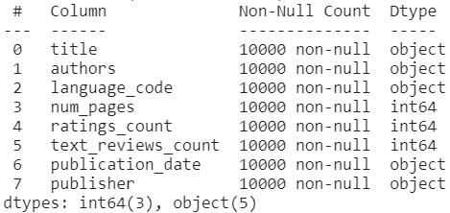
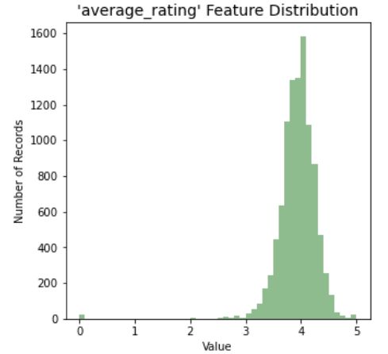
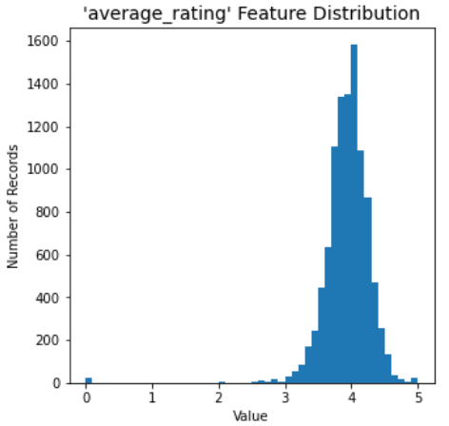
Preview dataset
Here are the things to do:
Find out and deal with the null value
Find out the data types of each feature
Find out the total count
Filter the outlier points
Notes:
next to the preview of dataset
look at the right hand diagram, 5 features are object type, and 3 features are int64 type.
For regression task, we can directly input the numerical type feature, but we do need to deal with the text feature before we feed the model.
here are the things we have done.
(指一下左边，然后指右边)
Look at the picture, we can know that majorty of the rating score is near 4, and there are a few points under rating 2.0 which we regarded as the ouliers, because these points will have great influence on the model training and may lead to high variance, so we should filter them.

Slide 4
Feature processing
1. Text Feature:
On-hot encode
Splitting words
TF-IDF
Mapreduce
2. Numerical Feature（continuous）:
Log
Minmax
standard
Notes:
In the feature processing step, for different types feature we have to do different works.
Text feature is different from the numerical feature, it is difficult to describe, so we should extract more infomation by more other methods

Slide 5
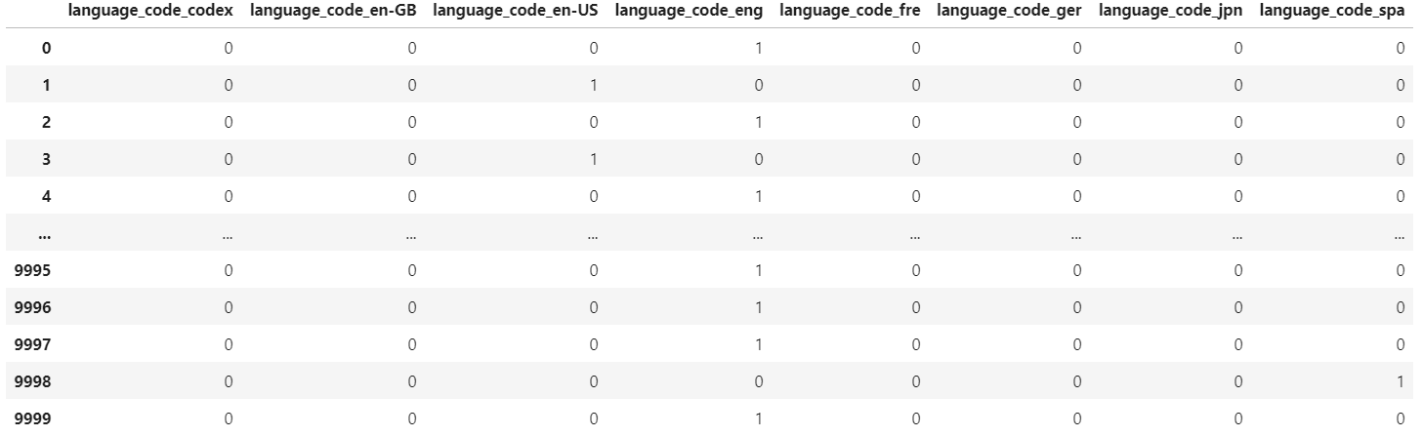
Feature processing
1. Text Feature (One-hot):
If variables of text feature are the same weight,
such as language_code : [eng, en-US ], then one-hot encode is used.
Notes:
One-hot is very popular encoding mothod to handle the categories feature.
For the categories feature, if the variable is finite and having the same weight, such as language_code in our data, each variable may represent different public or countries, the one-hot encoding can be used.
The picture here show after one-hot we get another serveral numerical feature to replace previous language_code.

Slide 6
Feature processing
1. Text Feature (Splitting Words):
For more complicated text feature like title ,
We try to deploy word2vec model to describe them in a certain amount of features as we like. And the first thing we need to do is splitting sentences into words.
Notes:
...
one-hot encoding can not be used, because it will generate thousands of features.
...
Here, for more details we implement a more convenient function to split the sentence instead of using library.

Slide 7
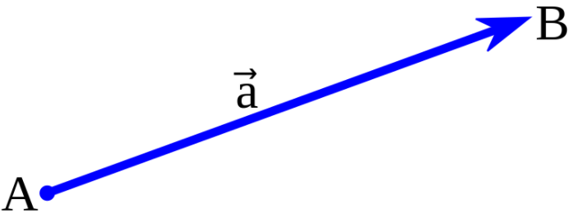
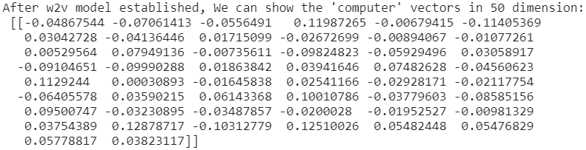
Feature processing
1. Text Feature (word2vec):
The word2vec algorithm uses a neural network model to learn word associations from a large corpus of text
word2vec represents each distinct word with a particular list of numbers called a vector.
Notes:
As a embedding method, word2vec .
...
As for our dataset totally we got nearly ten thousand words as our corpus after splitting. Finally it means that these 50 feature can describe a single word.

Slide 8
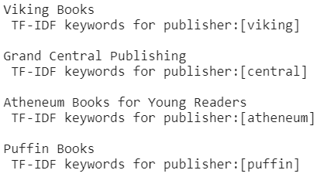
Feature processing
1. Text Feature (TF-IDF):
As we learned, more frequent terms in a document are more important, and terms that appear in many different documents are less indicative of overall topic. So we can use this to get the key-words of the features.
(e.g. publishers)
Notes:
Text feature may have many meaningful words, how can we extract the specific information from them. here we use tf-idf.
For feature publishers, as the picture shown, we extract the “Viking” as keyword from“Viking books”

Slide 9
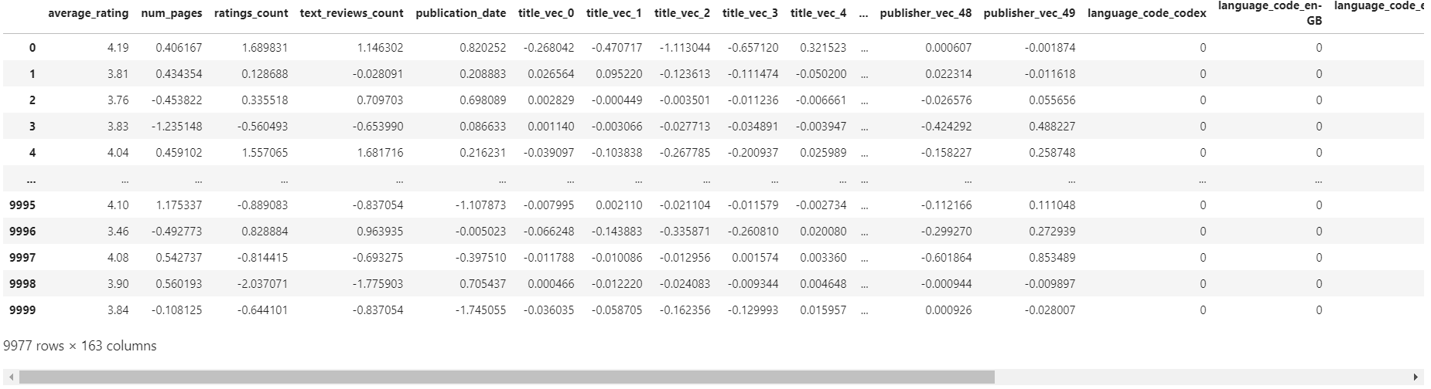
Feature processing
1. Text Feature (summary):
With the help of word2vec and TF-IDF, we can use the vectors to represent the keywords of text feature. Finally we can use the only 50 extra features to conclude the meaning of one text feature.
9977 rows * 163 columns
Notes:
...
the diagram belows is the dataset we use to train our models.
and now i will give the time to my partner

Slide 10
Feature processing
1. Text Feature (Mapreduce):
The last we are going to deal with is the publication_date.

Slide 11

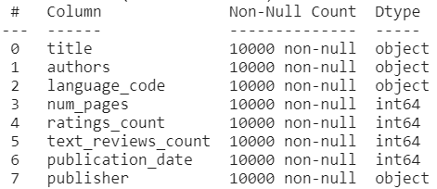
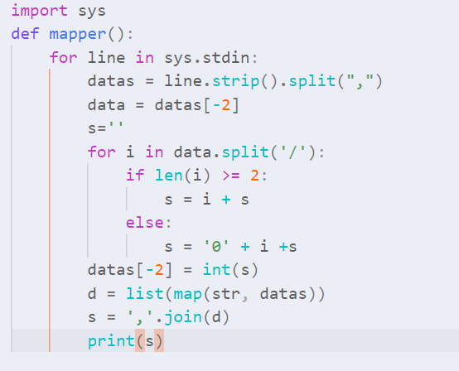
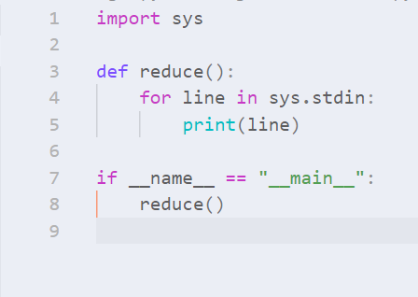
Feature processing
1. Text Feature (Mapreduce):
Notes:
As you can see, the type of publication_date is int64,
This is because we used mapreduce to convert the datetime from string to int, we just scan each row and then generate the new training dataset

Slide 12
Feature processing
1. Text Feature :
On-hot encode
Splitting words
TF-IDF
Mapreduce
2. Numerical Feature（continuous）:
Log
Minmax
standard
Notes:
The next part we are going to process is the numerical feature.

Slide 13
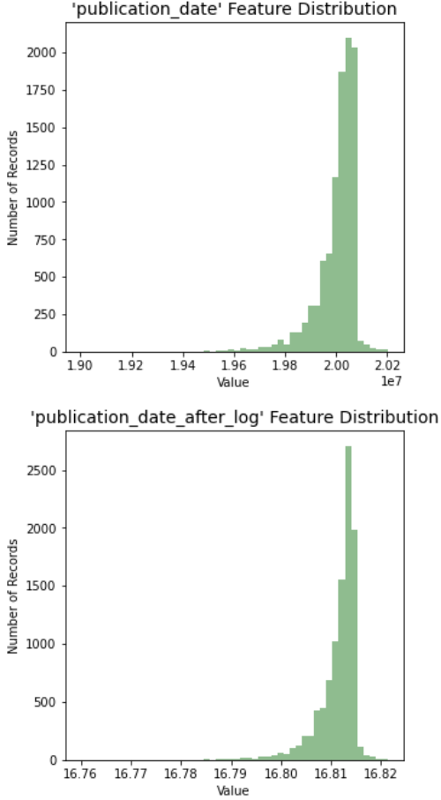
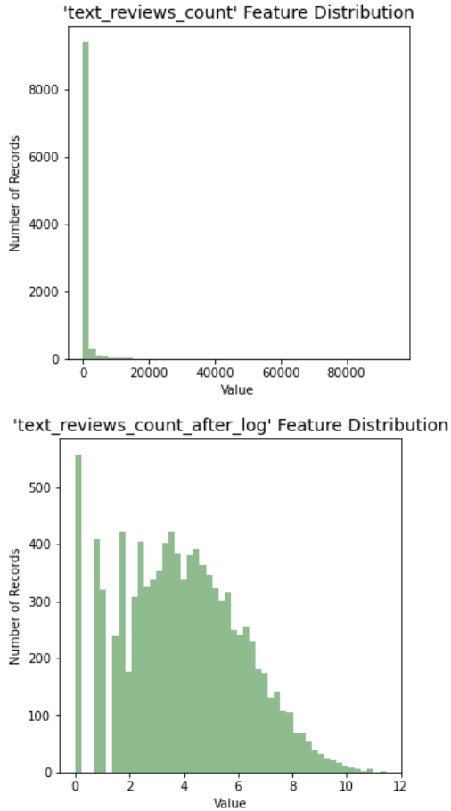
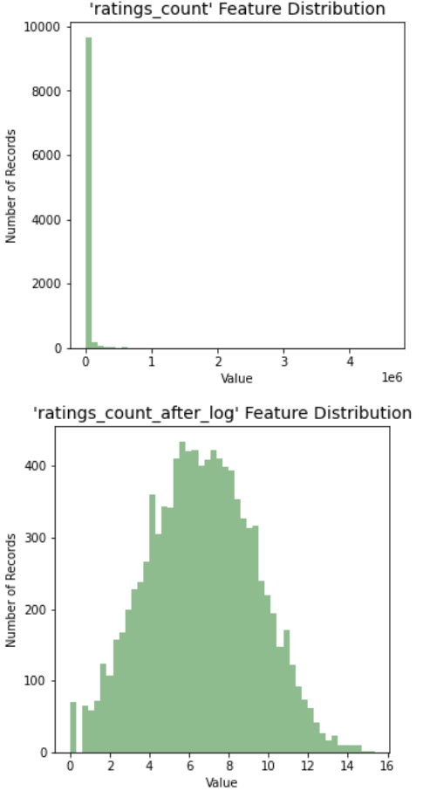
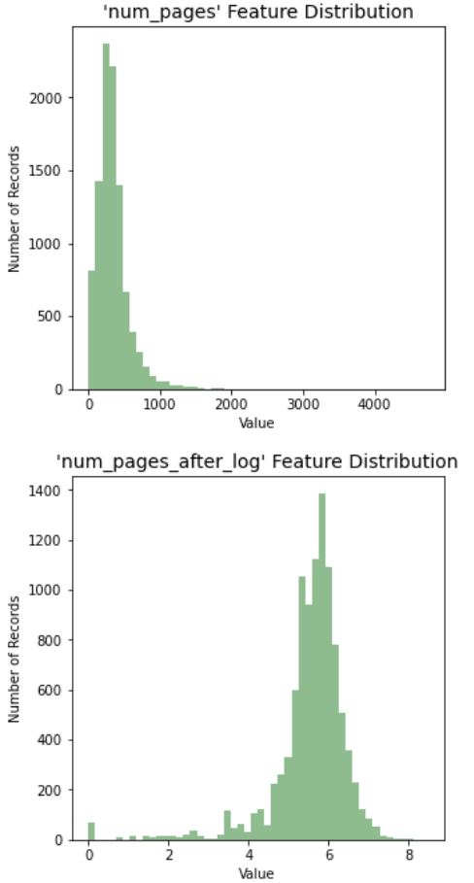

Feature processing
2. Numerical Feature (log):
As we can see, initial features are not in accord
with normal distribution, but we can use log()
function to fit the central-limit theorem

Slide 14
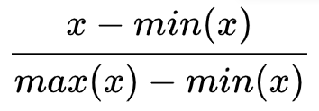
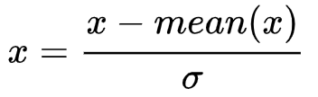
Feature processing
2. Numerical Feature (minmax/standard):
We use minmax and standard function to normalization
- After normalization, the speed of gradient descent to find the optimal solution is accelerated
Normalization has the potential to improve accuracy
Min max standardization
Notes:
It reduces the information capacity of features and reduces the differentiation
After log functions, we use minmax and standard function to do more normalization to reduces the information capacity of features and reduces the differentiation.

Slide 15
model Training
1. Split the dataset
2. Try SVR model
3. Try MLP model
4. Try Stacking model

Slide 16
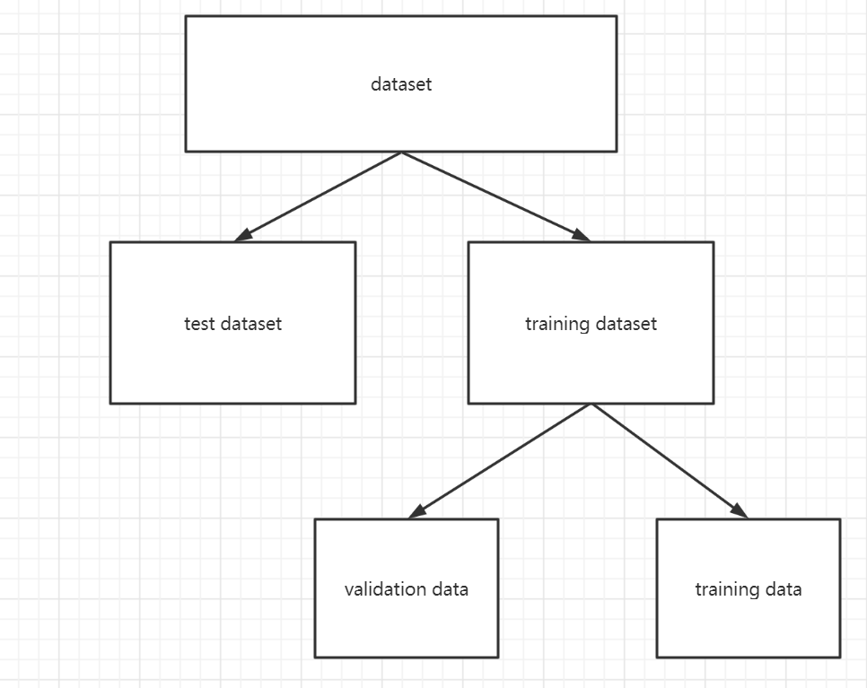
Training model
1. Split the dataset
Split the original dataset as test dataset (10%), training dataset (90%) randomly. Then we will split training dataset again and get two parts of data, training data and validation data.
Why we use validation data?
To find better hyper-parameters as well
as avoid overfitting
Notes:
The first thing that we do is to split the dataset.
We split the dataset into training dataset and test dataset.
And split the training dataset into training data and validation data
We use validation data is to find better hyper-parameters as well as avoid overfitting

Slide 17
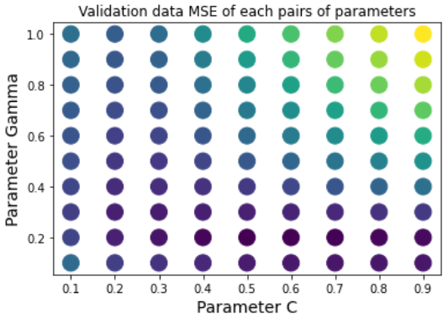
Training model
2. try SVR model
Advantage
SVR is a powerful algorithm that allows us to choose how tolerant we are of errors, both through an acceptable error margin(ϵ) and through tuning our tolerance of falling outside that acceptable error rate.
Notes:
The first model we used is SVR model.
As you can see from the picture. the deeper the color is , the result is better. as a example, you can the point(0.2, 0.6) is a good result.
Ans here is our best Mse when using SVR.
And we use 3-fold to calculate MES using validation data

Slide 18
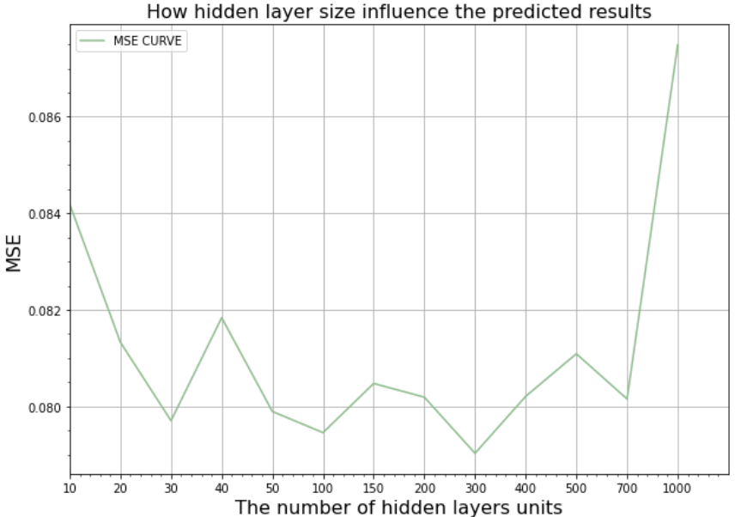
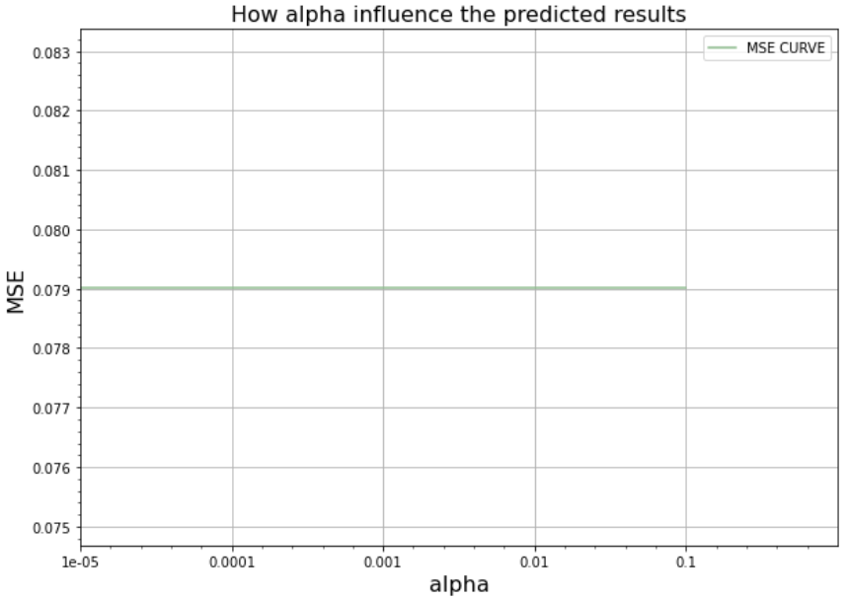
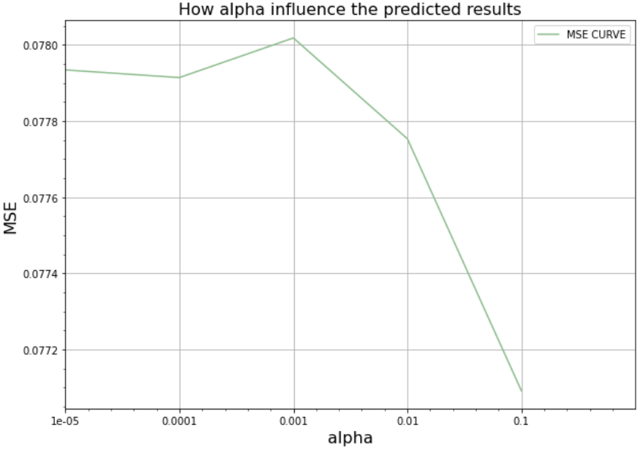
Training model
3. try MLP model
Notes:
While facing with the large number of features, nurel network may be good to avoid the high variance. MLP is the simple structure to do this job.
After testing different number of hidden layer (more hidden layer may leads to overfitting ). Here we decide a single hidden layer mlp, and try different number of the units and the L2 penalty.
On the left hand side is the process of ajusting the hyper-parameters. We can see for our validation data, the best number of one hidden layer units is 300, and l2 penalty is 0.1.

Slide 19
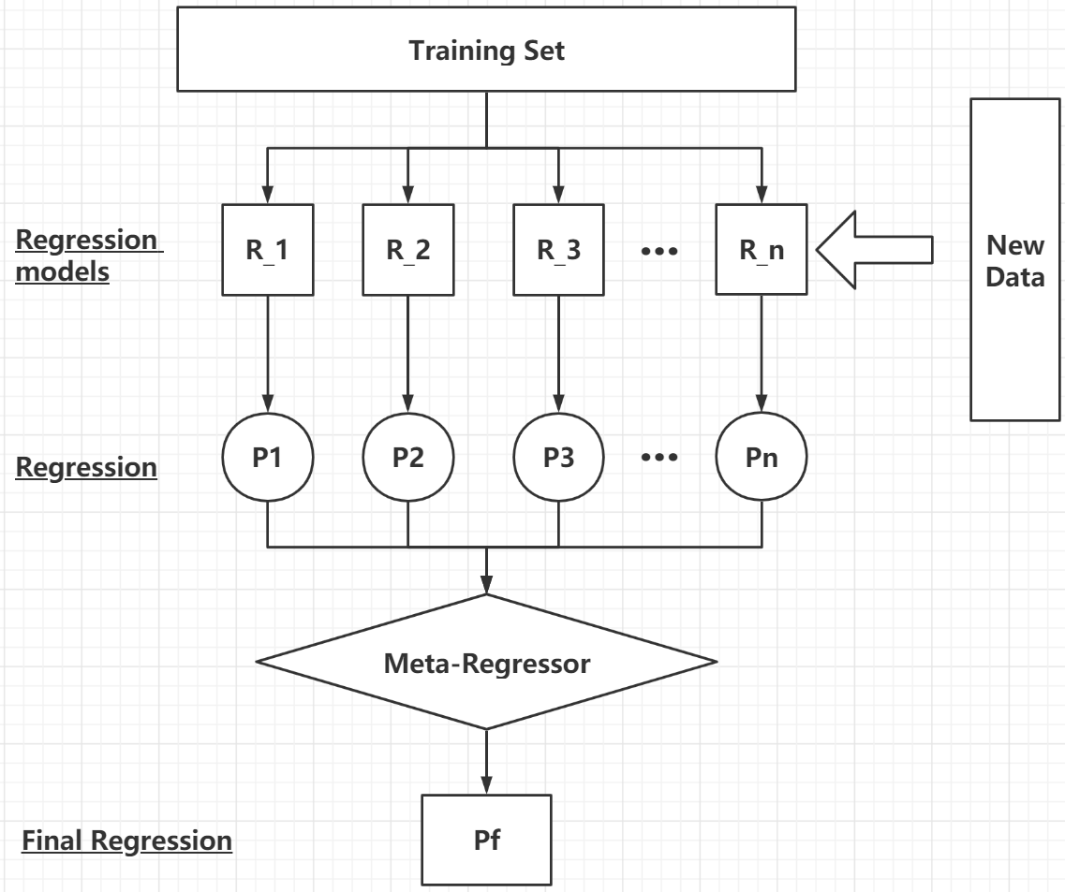

Training model
4. try stacking model
Notes:
Stacking is a very popular ensemble learning model. It has many different types of models as basic learners and combines them with a meta model.
Look at the picture that is how the stacking work.
Firstly we get a subset of training data as New Data (示意一下), Then we train each basic regression model and use them to predict the new data.
After that we regard the output is new feature X, and the book rating of new data is Y, to train a meta regressor.
You can see , mlp and svr are as basic models and we feed the model to stacking model to get a better final regressor.

Slide 20
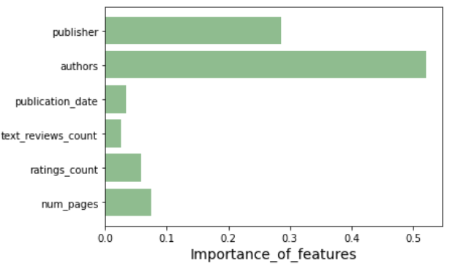
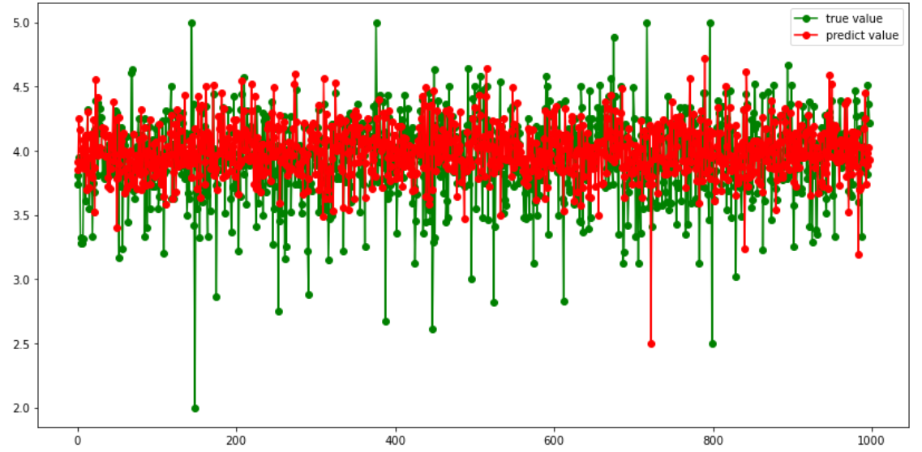
optimization
methods:
cross-validation (k-fold)
visualization
drop feature to get better MSE:
title feature
language_code feature
Notes:
cross-validation and visualization are main mothods we use to do our optimization.
And in the end, we decide to drop feature to get better MSE.
picture here show the validation data predicted results. the red is predicted value and green one is true value.
Here we got the best MSE.
May be in the next few days we are going to feed more different models such as random forest to improve the stacking model.

Slide 21

Thank you!
Notes:
This is all we want to share. thank you.

