Slide 1
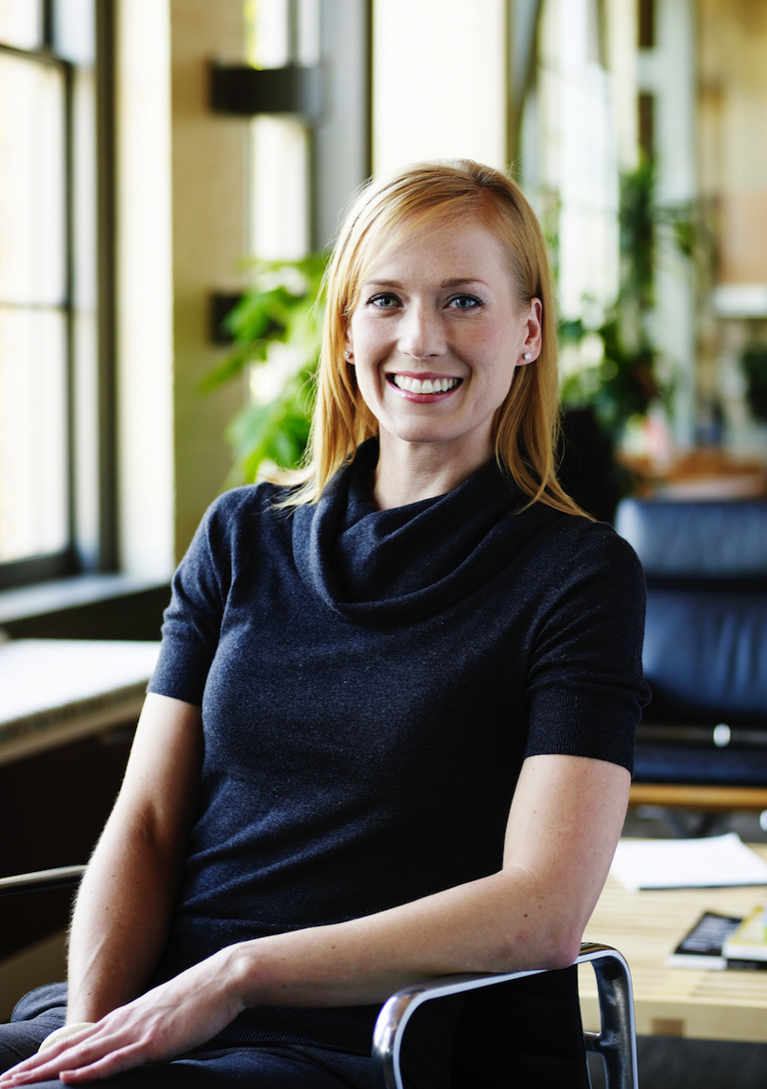
SALLY
The Specialist
“ I like get things done quickly since I am on the move all the time, dealing with million things. ”
40, married, 7 years of facility specialist experience
Being the person who makes the energy consumption decisions, I have to keep the balance between improving the energy efficiency and our working comfort.
Very mobile, moving from building to building during the day
Chief Facility Engineer, Technicians, Admins
I am responsible for office and data center buildings.
I am responsible for multiple projects per week and each project is tied to a specific building.
I spend more than half of my time outside my office, but I also do work on the computer, in my office.
I enter time once a week on a project by project basis.
Being the person who makes the energy consumption decision, I have to keep the balance between improving the energy efficiency and our working comfort.
Better management of actual time spent in each building.
I always need the project building number to record time. It can become hard to locate.
I need to know the amount of time spent on a project. Currently I take notes on paper.
I need the ability to record time instantly since I am away from my desk most of the time.
Can’t record time quickly on the go.
The timesheet entry is very complex, and very time consuming.
Need to see the weekly view of complete and incomplete entries.
Need the ability to bulk enter.

Slide 2
NAME
Role
“ Quote ”
Paste a photo
Fill with background information describing the demographic (if exists), work context, overall goals and tasks
Fill with stakeholder information
Fill the bulleted list
Fill the bulleted list
Fill the bulleted list
Fill the bulleted list

