Slide 1
STOCK SAVVY
"Wealth Shouldn't Be a Secret"

Slide 2

Financial Illiteracy & Market Volatility
90% of Americans don't own stocks.
The top 10% control 89% of all stock wealth.
Generational wealth is not attainable due to lack of knowledge.
Missed stock alerts can mean missed rent, tuition, or opportunities.
SOURCE: Yahoo Finance - Stock Market Live, Quotes,Business & Finance News

Slide 3
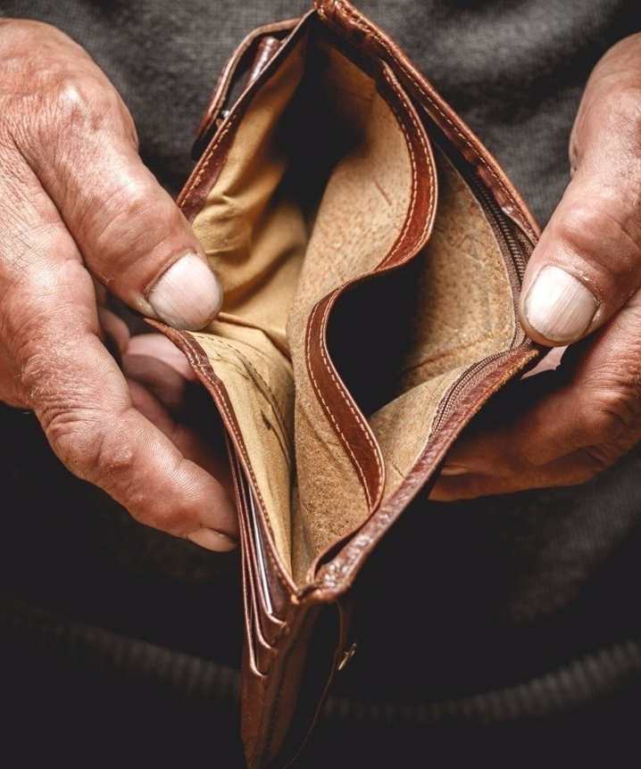
The Urgency: Real-Time Market Changes
Stock market shifts happen in seconds; without timely information, losses are inevitable.
We're solving the problem of financial illiteracy.
If you have a solid financial education, you could avoid grave mistakes such as the 2021 GameStop crisis that caused many people to lose money.

Slide 4


Slide 5
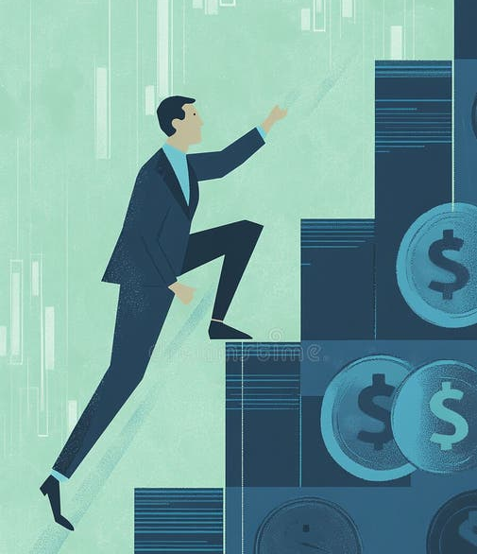
Empowering individuals to reach financial freedom through stock market education. Wealth Shouldn't Be a Secret!
Our mission

Slide 6

Why it matters
For some families, a $300 investment win can cover essential expenses.
Access to timely information can be life-saving.
Wealth isn't just about income—it's about access to opportunities.

Slide 7
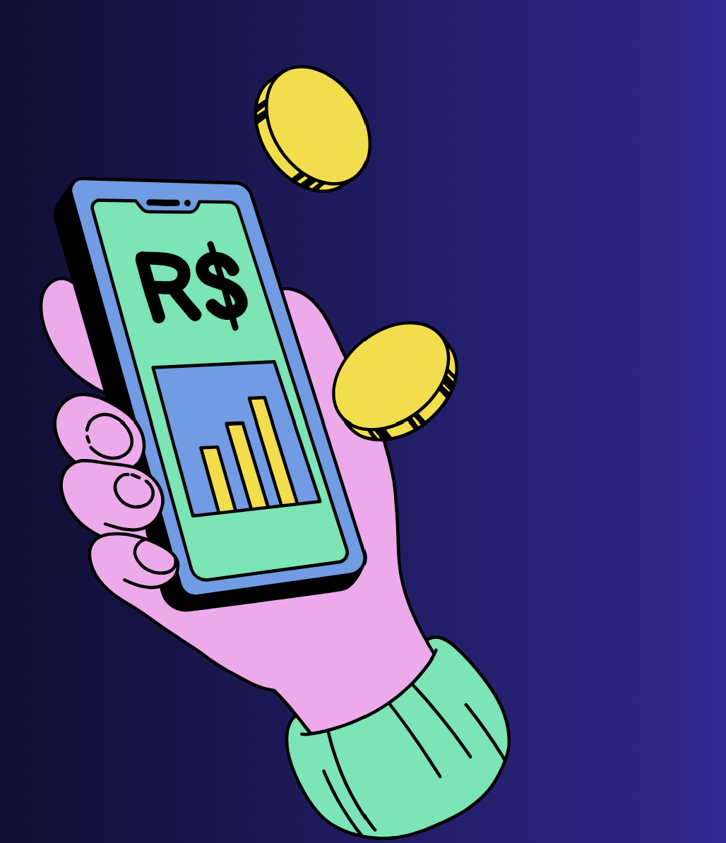
Real-Time Alerts: Subscribers receive immediate notifications about significant stock movements.
Educational Resources: Access to tutorials and articles to understand market dynamics.
Revenue Prediction Tools: For startups and individuals to forecast potential earnings.
Integration with Alpha Vantage API: Ensures accurate and up-to-date market data.
Visual: Screenshots or mockups of the app interface highlighting these features.
APP OVERVIEW

Slide 8
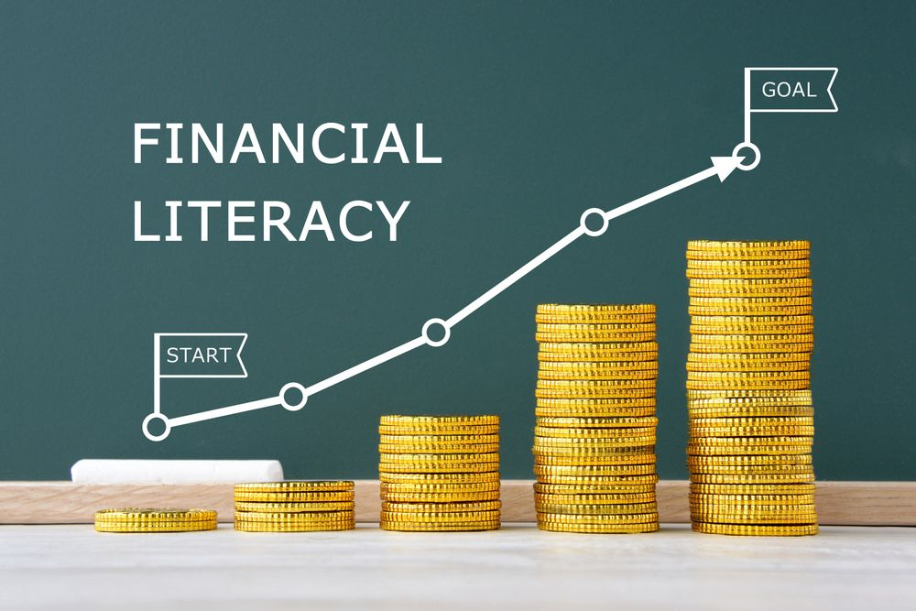
ENGAGING AUDIENCE
Individuals Seeking Financial Literacy: Those new to investing or looking to understand the stock market.
Startups and Small Businesses: Companies aiming to predict revenue and understand market positioning.
Everyday Investors: People wanting to make informed decisions without being overwhelmed by complex data.
Visual: Collage of diverse individuals representing different user personas

Slide 9
CALL FOR ACTION
"Join us in revolutionizing financial education. Empower yourself with the tools to navigate the stock market confidently."

Slide 10
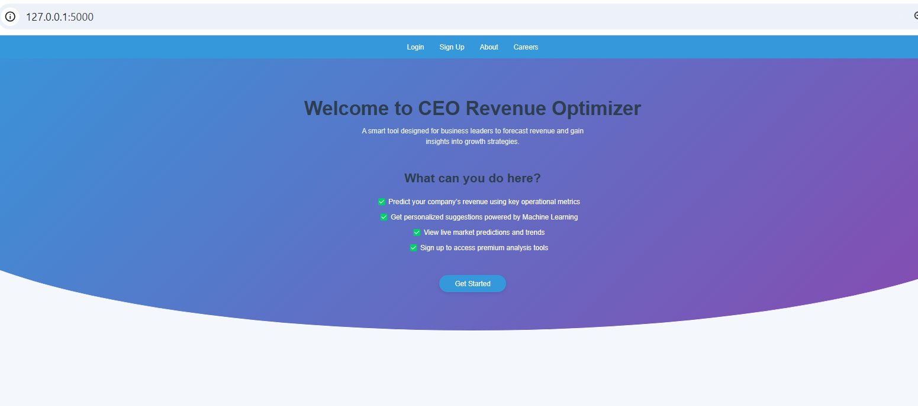

Slide 11
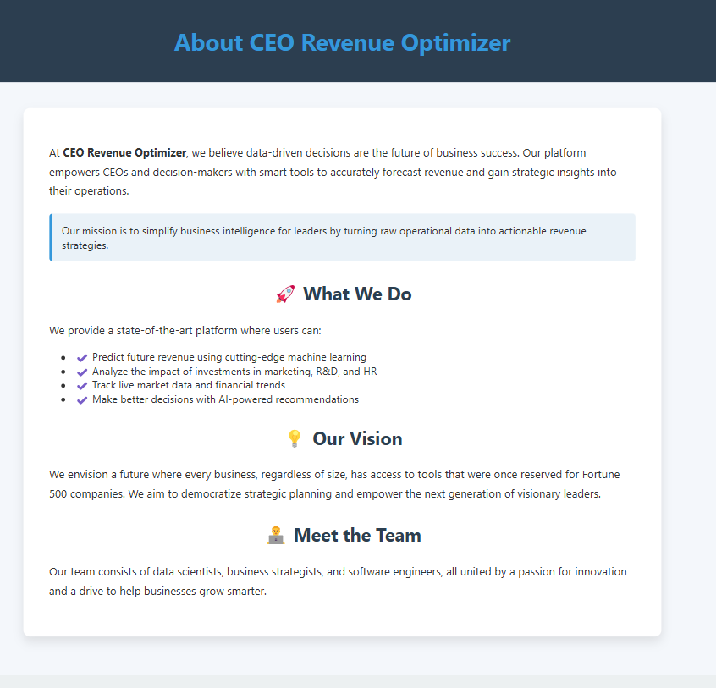

Slide 12
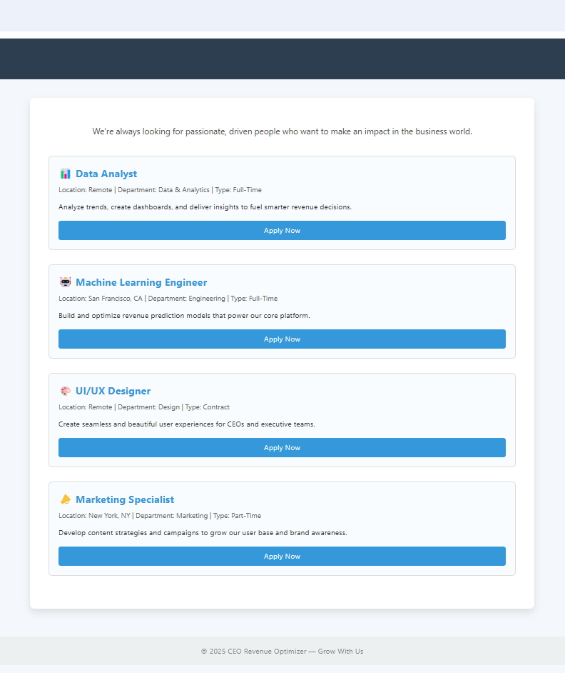

Slide 13
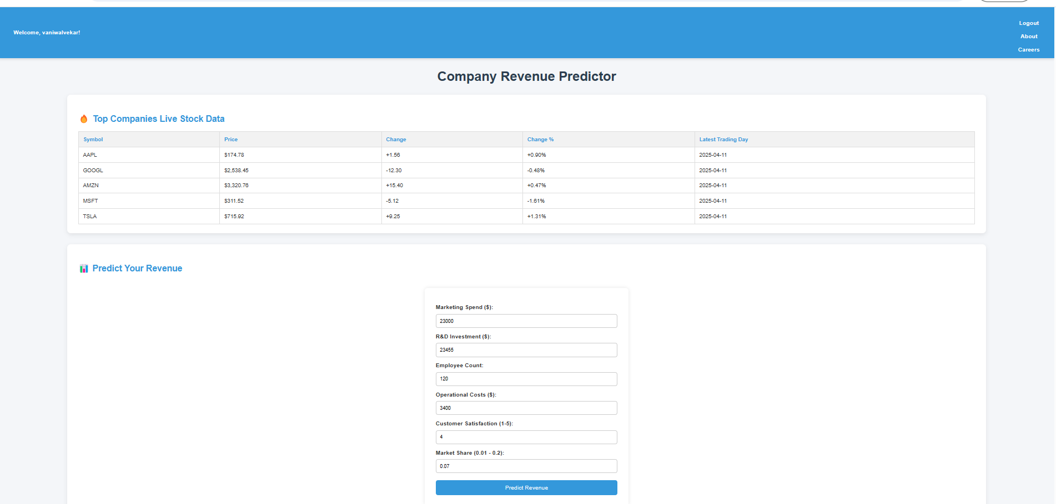

Slide 14
THANK YOU
Avee' Brown
Briaris Sayles
Etaf Abdallah
Mymoon SHaik
Vani Walvekar
Tyra Jones-WILLIAMSON

