Slide 1
Subject:
Object-oriented analysis and design
Chapter 1: Introduction to OOAD
M.Sc. Lê Văn Vinh
Department of Software Engineering
Faculty of Information Technology
University of Technical Education HCMC

Slide 2
Contents
I.
Software development
II.
Basic concepts of OOAD
III.
OOAD Methodologies
IV.
OOAD Approadches

Slide 3
Software development
All software development requires the following things to occur:
  Requirements
    Requirements capture/determination: During this stage, the needs of the customers are determined, including a case-by-case analysis of the functionality required.
    Requirements analysis: During this stage the functionality is described in terms of interactions between the user and the system. Relationships between related functional requirements may also be determined at this stage.

Slide 4
Software development
All software development requires the following things to occur:
  Design
    System design: The overall system structure is determined, including a description of modules (subsystems) and sub-modules and their interaction
    Class-level design: The classes are designed which are to make up the modules, etc.
    User interface design: The appearance and operation of the user interface is determined
    Data design: The structure of the database model is determined

Slide 5
Software development
All software development requires the following things to occur:
  Construction
    Implementation: At this stage, the design is converted into an implementation using a (normally object-oriented) programming language
    Testing: At this stage, the implementation is tested for coding and integration errors, as well as conformity to the requirements and design

Slide 6
Software development
The Unified Process
  The Unified Process (UP) is a methodology proposed by the “three amigos” (Booch, Jacobson, Rumbaugh)
    These three are also the co-developers of the Unified Modeling Language (UML)
    The Unified Process is also sometimes called the Unified Software Development Process (USDP), as it is in the textbook (and also RUP – Rational Unified Process)
  The UP introduces a way to develop software where the phases are not distinct, but instead have significant overlap

Slide 7
Software development
The waterfall model
Requirements
Analysis
Design
Implementation
Testing

Slide 8
Software development
The iterative waterfall model
Requirements
Analysis
Design
Implementation
Testing

Slide 9
Basic concepts
Object-oriented Technology:
  Object-oriented Analysis (OOA)
  Object-oriented Design (OOD)
  Object-oriented Programming (OOP)

Slide 10
Contents
I.
Software development
II.
Basic concepts of OOAD
III.
OOAD Methodologies
IV.
OOAD Approadches

Slide 11
Basic concepts (cont.)
Object-oriented Technology enables reuse:
  Libraries (i.e through APIs)
  Data structures and Algorithms (low level)
  Components: connected modules
  Architectures: designs (i.e structured components)

Slide 12
Basic concepts (cont.)
  Analysis emphasizes an investigation of the problems and requirements, rather than a solution.
    For example, if a new computerized library information system is desired, how will it be used?
  Design emphasizes a conceptual solution that fulfills the requirements, rather than its implementation.
    For example, a description of a database schema and software objects. Ultimately, designs can be implemented.

Slide 13
Basic concepts (cont.)
Analysis and design have been summarized in the phase:
  Do the right thing (analysis)
  and do the thing right (design).

Slide 14
Basic concepts (cont.)
Object-Oriented Analysis
  Emphasis on finding and describing the objects—or concepts—in the problem domain
  For example, in the case of the library information system, some of the concepts include Book, Library, and Reader.

Slide 15
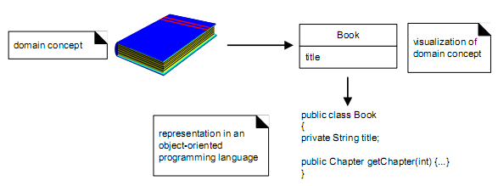
Basic concepts (cont.)
Object-Oriented Design
  Emphasis on defining software objects and how they collaborate to fulfill the requirements
  For example, in the library system, a Book software object may have a title attribute and a getChapter method.

Slide 16
Basic concepts (cont.)
What is OOAD?
  Object-Oriented = Objects + Communication + Classification + Inheritance
Both the world of the client, and the world of the developer are modelled in terms of OBJECTS.

Slide 17
Basic concepts (cont.)
Object-Orientation Benefits:
  Problem domain is modelled in terms of real-world objects.
  Abstraction, encapsulation, and generalization help managing complexity and achieving reuse.
  No real distinction between analysis and design terminology & tools.

Slide 18
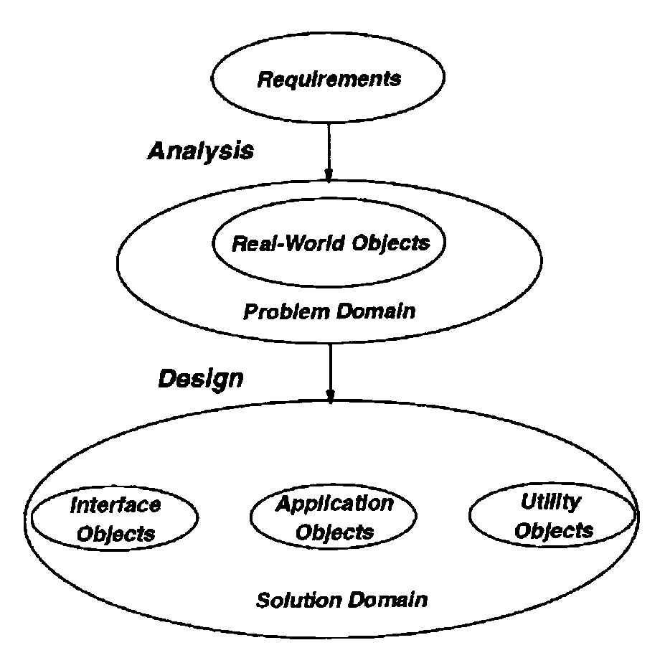
Basic concepts (cont.)
OOAD Model:

Slide 19
Contents
I.
Software development
II.
Basic concepts of OOAD
III.
OOAD Methodologies
IV.
OOAD Approadches

Slide 20
OOAD Methodologies
There are 2 basic types:
  The unary type
  The ternary type

Slide 21
OOAD Methodologies (cont.)
The unary type:
  Objects combine data (attributes) and processes (methods).
  Only one notation is needed.
  Simple, easy to use.
  Difficult to manage complexity when the system is large.

Slide 22
OOAD Methodologies (cont.)
The ternary (three-pronged) type:
  Includes 3 separate notations: data, dynamics and processes.
  Dynamic modelling is concerned with events and states (state transition diagrams).
  Process modelling (functional modelling) is concerned processes that transform data values (DFDs)

Slide 23
Contents
I.
Software development
II.
Basic concepts of OOAD
III.
OOAD Methodologies
IV.
OOAD Approadches

Slide 24
OOAD Approaches
Booch
Coad & Yourdon
Fusion
Jacobson Objectory & OOSE
LBMS SEOO
Rumbaugh OMT
Shlaer and Mellor OO Analysis
UML & RUP

Slide 25
OOAD Approaches (cont.)
Booch
  Grady Booch, Object-Oriented Design with Applications, Benjamin/Cummings, 1994.
  Strong in design, although also covers requirements and domain analysis.
  Booch’s method is ONE of 3 major contributors to UML.

Slide 26
OOAD Approaches (cont.)
Coad & Yourdon
  Coad & Yourdon, Object-Oriented Analysis and Object-Oriented Design, Prentice-Hall, 1990 and 1991.
  Focuses on analysis of business problems, and uses a friendlier notation.

Slide 27
OOAD Approaches (cont.)
Coad & Yourdon
  Consists of 5 stages in analysis (SOSAS):
    Subjects
    Objects
    Structures
    Attributes
    Services

Slide 28
OOAD Approaches (cont.)
Coad & Yourdon
  Consists of 4 components in design:
    Problem domain
    Human interaction
    Task management
    Data management

Slide 29
OOAD Approaches (cont.)
Fusion
  Developed in 1990 by Derek Coleman of HP.
  Incorporate some major ideas from Booch, Jacobson, Rumbaugh, and others.
  Not widely marketed, thus not popularly used.

Slide 30
OOAD Approaches (cont.)
Fusion
  Developed in 1990 by Derek Coleman of HP.
  Incorporate some major ideas from Booch, Jacobson, Rumbaugh, and others.
  Not widely marketed, thus not popularly used.

Slide 31
OOAD Approaches (cont.)
Jacobson Objectory & OOSE
  Objectory is proprietary.
  OOSE is a simplified version of Objectory.
  Use Object-oriented concepts, plus the “use case”
  Use cases and actors are used to model the system requirements.
  The SECOND of 3 major contributors to UML.

Slide 32
OOAD Approaches (cont.)
LBMS SEOO
  Systems Engineering Object-Oriented.
  Proprietary to LBMS – a U.K company.
  Tightly integrated with PowerBuilder.
  Consists of 4 major components:
    Work-breakdown structures and techniques
    An object modeling methodology
    GUI design techniques
    Relational database linkages

Slide 33
OOAD Approaches (cont.)
Rumbaugh OMT
  James Rumbaugh, Object-Oriented Modeling and Design, Prentice-Hall, 1991.
  Analysis consists of 3 models:
    Object model
    Dynamic model
    Functional model
  The THIRD of 3 major contributors to UML.

Slide 34
OOAD Approaches (cont.)
Shlaer and Mellor OO Analysis
  First came in 1988.
  Shlaer and Mellor, Object-Oriented Systems Analysis -- Modeling the World in Data and Object Lifecycles: Modeling the World in States, Prentice-Hall, 1988 and 1992.
  Considered an object-based extension of data modeling.

Slide 35
OOAD Approaches (cont.)
UML & RUP
  Unified Modeling Language
  Administrated by OMG – Object Management Group.
  First came in 1997 (version 1.1)
  The latest version is UML 2.3 (05/2010)
  Combine “best of the best” from many different methodologies.

Slide 36
OOAD Approaches (cont.)
UML & RUP
  UNIFIED Modeling Language
  OMG adopted UML in November 1997 as the standard for object-oriented modeling
  Combines commonly accepted concepts from many OO methods
  Seamless from requirements to deployment
  Applicable to any domain
  Language and platform independent
  Usable with any development process

Slide 37
OOAD Approaches (cont.)
UML & RUP
  Unified MODELING Language
  All engineering disciplines have adopted modeling techniques
  Allow to capture the important aspects of a system while omitting the rest
  Help all software systems stakeholders understand what the system will be and what are the possible options available
  Multiple models reveal different perspectives on the system

Slide 38
OOAD Approaches (cont.)
UML & RUP
  Unified Modeling LANGUAGE: used for
    Visualizing: Graphical models with precise semantics
    Specifying: Models are precise, unambiguous and complete to capture all important Analysis, Design, and Implementation decisions.
    Constructing: Models can be directly connected to programming languages, allowing forward and reverse engineering
    Documenting: Diagrams capture all pieces of information collected by development team, allowing to share and communicate the embedded knowledge.

Slide 39
Chapter’s summary
The basic concepts (Analysis, Design, OO Analysis, OO Design)
OOAD Methodologies
  Unary type
  Ternary type
OOAD Approaches
  3 major approaches contribute to UML
    Booch’s method
    Jacobson Objectory & OOSE
    Rumbaugh OMT

