Slide 1

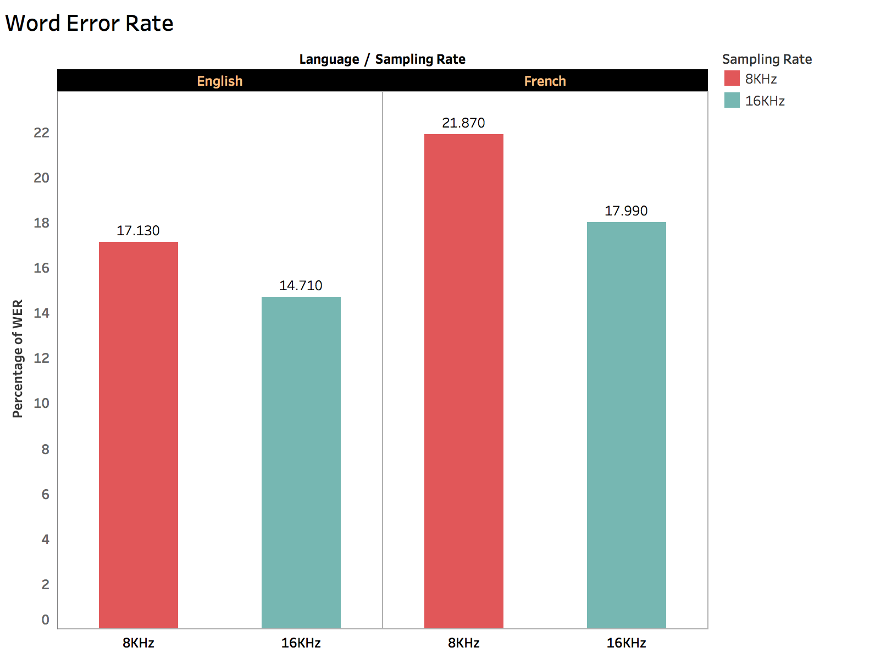
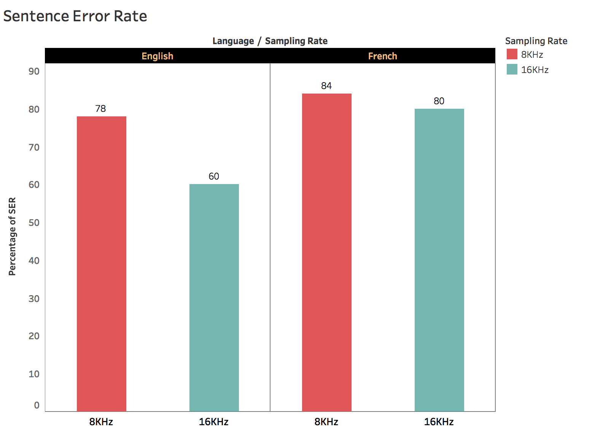
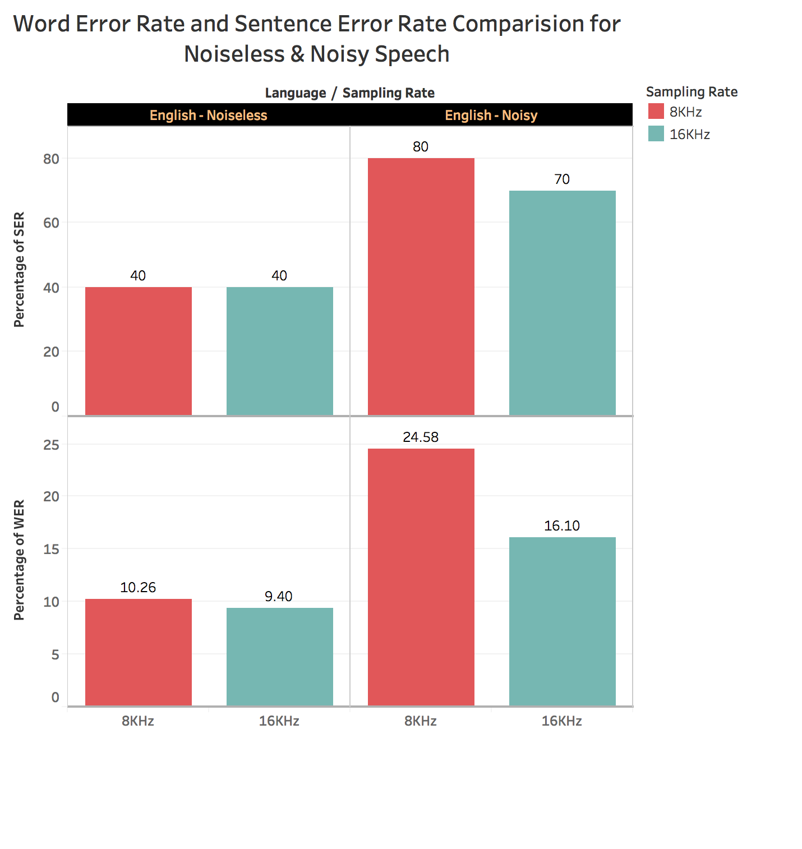
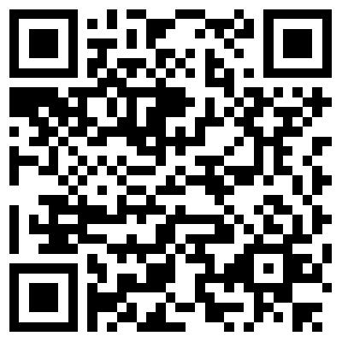
Enterprise Computing WS18
Group-8
Service Benchmarking
Google Cloud Speech Recognition API
Qualities & Trade-Off
Correctness & Completeness
WER : (S+D+I)/N
where S= # of substitutions
D = # of deletions
I = # of insertions
N = # of words in the reference
SER: Exact Match
Detection Rate: Speech Detected or Not
Benchmark Results
[Headline 2]
[Headline2]
50 files each one from 4 to 7 seconds for both language and total 100 audio samples
50 files each one from 4 to 7 seconds for both language and total 100 audio samples
Percentage of WER for each Sampling Rate for Noiseless and Noisy audio Color shows details about Sampling Rate. The view is filtered on Language i.e. for English - Noiseless and English - Noisy.
10 files each one from 4 to 7 seconds for English language
For further info of our benchmarking - https://gitlab.tubit.tu-berlin.de/leonav/EC-GoogleSpeechAPI-Benchmarking
Ananya Bhanja Chowdhury, Aslihan Özmen, Navya Basavaraju & Yuchun Chen

