Slide 1
CHAPTER 11 Dataset
11.1 Dataset을 사용할 시기
11.2 Dataset 생성
11.3 액션
11.4 트랜스포메이션
11.5 조인
11.6 그룹화와 집계
CHAPTER 12 RDD
12.1 저수준 API란
12.2 RDD 개요
12.3 RDD 생성하기
12.4 RDD 다루기
12.5 트랜스포메이션
12.6 액션
12.7 파일 저장하기
12.8 캐싱
12.9 체크포인팅
12.10 RDD를 시스템 명령으로 전송하기
CHAPTER 13 RDD 고급 개념
13.1 키-값 형태의 기초(키-값 형태의 RDD)
13.2 집계
13.3 cogroup
13.4 조인
13.5 파티션 제어하기
13.6 사용자 정의 직렬화
스파크의 데이터 구조는 크게 3종류 - RDD (Resillient Distributed Data) - Dataframe - Dataset
도입시기
-Spark v1.0
-Spark v1.3
-Spark v1.6
속도(빠르기) : DF>Dataset>RDD
RDD vs DataFrames and Datasets: A Tale of Three Apache Spark APIs (databricks.com)

Slide 2
chap 11 DATASET

Slide 3
When to Use Datasets 198
Creating Datasets 199
DF 기능 만으로는 부족할 때
data type 안정성↑
In Java: Encoders 199
In Scala: Case Classes 199
Import org.apache.spark.sql.Encoders;
public class Flight implements Serializable{
String DEST_COUNTRY_NAME;
String ORIGIN_COUNTRY_NAME;
Long DEST_COUNTRY_NAME;
}
Dataset<Flight> flights = spark.read
.parquet("/data/flight-data/parquet/2010-summary.parquet/")
.as(Encoders.bean(Flight.class));
case class Flight(DEST_COUNTRY_NAME: String,
ORIGIN_COUNTRY_NAME: String, count: BigInt)
val flightsDF = spark.read
.parquet("/data/flight-data/parquet/2010-summary.parquet/")
val flights = flightsDF.as[Flight]

Slide 4
Actions 200
flights.show(2)
+-----------------+-------------------+-----+
|DEST_COUNTRY_NAME|ORIGIN_COUNTRY_NAME|count|
+-----------------+-------------------+-----+
| United States | Romania | 1|
| United States | Ireland | 264|
+-----------------+-------------------+-----+
flights.first.DEST_COUNTRY_NAME // United States

Slide 5
Transformations 200
(스칼라) val, var, def의 차이 →
https://sung-studynote.tistory.com/m/81
Filtering 201
def originIsDestination(flight_row: Flight): Boolean = {
return flight_row.ORIGIN_COUNTRY_NAME == flight_row.DEST_COUNTRY_NAME
}
flights.filter(flight_row => originIsDestination(flight_row)).first()
Flight = Flight(United States,United States,348113)
Mapping 202
val destinations = flights.map(f => f.DEST_COUNTRY_NAME)
val localDestinations = destinations.take(5)
Joins 202
case class FlightMetadata(count: BigInt, randomData: BigInt)
val flightsMeta = spark.range(500).map(x => (x, scala.util.Random.nextLong))
.withColumnRenamed("_1", "count").withColumnRenamed("_2", "randomData")
.as[FlightMetadata]
val flights2 = flights.joinWith(flightsMeta, flights.col("count") === flightsMeta.col("count"))
flights2.selectExpr("_1.DEST_COUNTRY_NAME")
flights2.take(2)
Array[(Flight, FlightMetadata)] = Array((Flight(United States,Romania,1),...
val flights2 = flights.join(flightsMeta, Seq("count"))
val flights2 = flights.join(flightsMeta.toDF(), Seq("count"))

Slide 6
Grouping and Aggregations 203
flights.groupBy("DEST_COUNTRY_NAME").count()
flights.groupByKey(x => x.DEST_COUNTRY_NAME).count()
flights.groupBy("DEST_COUNTRY_NAME").count().explain
== Physical Plan ==
*HashAggregate(keys=[DEST_COUNTRY_NAME#1308], functions=[count(1)])
+- Exchange hashpartitioning(DEST_COUNTRY_NAME#1308, 200)
+- *HashAggregate(keys=[DEST_COUNTRY_NAME#1308], functions=[partial_count(1)])
+- *FileScan parquet [DEST_COUNTRY_NAME#1308] Batched: tru...
flights.groupByKey(x => x.DEST_COUNTRY_NAME).count().explain
== Physical Plan ==
*HashAggregate(keys=[value#1396], functions=[count(1)])
+- Exchange hashpartitioning(value#1396, 200)
+- *HashAggregate(keys=[value#1396], functions=[partial_count(1)])
+- *Project [value#1396]
+- AppendColumns <function1>, newInstance(class ...
[staticinvoke(class org.apache.spark.unsafe.types.UTF8String, ...
+- *FileScan parquet [D...

Slide 7
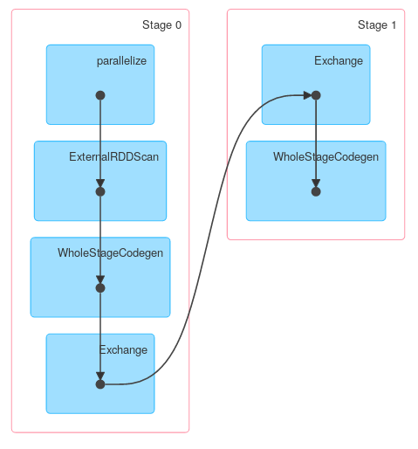
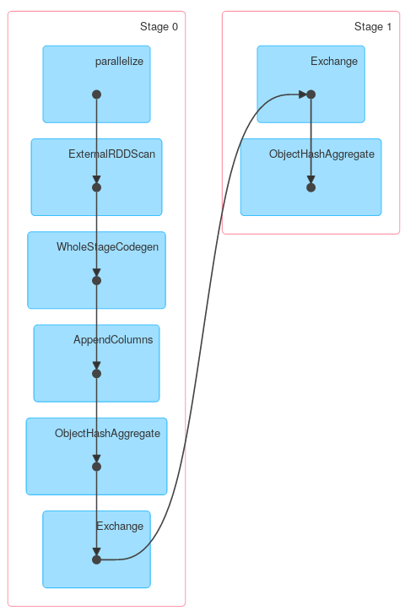
groupBy
groupByKey
https://stackoverflow.com/questions/32902982/dataframe-dataset-groupby-behaviour-optimization

Slide 8
chap 12 RDD
Resillient Distributed Data
- Resillient(회복력 있는, 변하지 않는) : 메모리 내부에서 데이터가 손실 시 유실된 파티션을 재연산해 복구할 수 있음 - Distributed(분산된) : 스파크 클러스터를 통하여, 메모리에 분산되어 저장됨 - Data
→ 불변성을 가지며 병렬로 처리할 수 있는 파티셔닝된 레코드의 모음

Slide 9
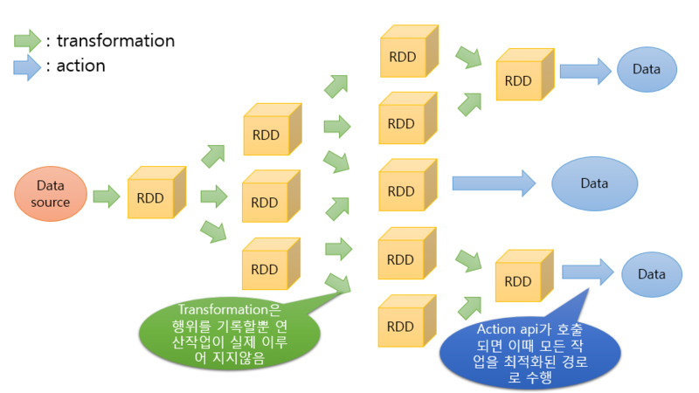

Slide 10
저수준 APIs? 209
언제 사용? 209
어떻게 사용? 210
RDDs
broadcast variables and accumulators
고수준 API에서 제공하지 않는 기능이 필요한 경우
RDD를 사용해 개발된 기존 코드 유지
사용자가 정의한 공유 변수를 다뤄야하는 경우
spark.sparkContext
sc = SparkContext()

Slide 11
About RDDs 210
Types of RDDs 211
When to Use RDDs? 212
“generic” RDD type
key-value RDD
물리적으로 분산된 데이터에 세부적인 제어가 필요할 때
하지만 비권장
파이썬의 RDD 실행과정:
직렬화 과정을 거친 데이터를 파이썬 프로세스에 전달
→파이썬 처리
→직렬화
→JVM에 반환

Slide 12
Creating RDDs 213
Interoperating Between DataFrames,
From a Local Collection 214
From Data Sources 214
spark.range(10).rdd
spark.range(10).toDF("id").rdd.map(lambda row: row[0])
spark.range(10).rdd.toDF()
Datasets, and RDDs 213
myCollection = "Spark The Definitive Guide : Big Data Processing Made Simple".split(" ")
words = spark.sparkContext.parallelize(myCollection, 2)
words.setName("myWords")
words.name() # myWords
spark.sparkContext.textFile("/some/path/withTextFiles")
spark.sparkContext.wholeTextFiles("/some/path/withTextFiles")

Slide 13
Manipulating RDDs 215
Transformations 215
distinct 215
filter 215
map 216
sort 217
Random Splits 217
words.distinct().count()
def startsWithS(individual):
return individual.startswith("S")
words.filter(lambda word: startsWithS(word)).collect()
words2 = words.map(lambda word: (word, word[0], word.startswith("S")))
words2.filter(lambda record: record[2]).take(5)
words.flatMap(lambda word: list(word)).take(5)
words.sortBy(lambda word: len(word) * -1).take(2)
fiftyFiftySplit = words.randomSplit([0.5, 0.5])

Slide 14
Actions 217
reduce 217
spark.sparkContext.parallelize(range(1, 21)).reduce(lambda x, y: x + y)
def wordLengthReducer(leftWord, rightWord):
if len(leftWord) > len(rightWord):
return leftWord
else:
return rightWord
words.reduce(wordLengthReducer)
count 218
words.count()
val confidence = 0.95
val timeoutMilliseconds = 400
words.countApprox(timeoutMilliseconds, confidence)
words.countApproxDistinct(0.05)
words.countApproxDistinct(4, 10)
words.countByValue()
words.countByValueApprox(1000, 0.95)

Slide 15
first 219
max and min 219
take 220
words.first()
spark.sparkContext.parallelize(1 to 20).max()
spark.sparkContext.parallelize(1 to 20).min()
words.take(5)
words.takeOrdered(5)
words.top(5)
val withReplacement = true
val numberToTake = 6
val randomSeed = 100L
words.takeSample(withReplacement, numberToTake, randomSeed)

Slide 16
Saving Files 220
saveAsTextFile 220
SequenceFiles 221
words.saveAsTextFile("file:/tmp/bookTitle")
// in Scala
import org.apache.hadoop.io.compress.BZip2Codec
words.saveAsTextFile("file:/tmp/bookTitleCompressed", classOf[BZip2Codec])
words.saveAsObjectFile("/tmp/my/sequenceFilePath")
Caching 221
words.cache()
# in Python
words.getStorageLevel()
Checkpointing 221
spark.sparkContext.setCheckpointDir("/some/path/for/checkpointing")
words.checkpoint()

Slide 17
Pipe RDDs to System Commands 222
mapPartitions 222
words.pipe("wc –l").collect()
# in Python
words.mapPartitions(lambda part: [1]).sum() # 2
파티션 단위로 map 연산을 수행
# in Python
def indexedFunc(partitionIndex, withinPartIterator):
return ["partition: {} => {}".format(partitionIndex, x) for x in withinPartIterator]
words.mapPartitionsWithIndex(indexedFunc).collect()
foreachPartition 223
words.foreachPartition { iter =>
import java.io._
import scala.util.Random
val randomFileName = new Random().nextInt()
val pw = new PrintWriter(new File(s"/tmp/random-file-${randomFileName}.txt"))
while (iter.hasNext) {
pw.write(iter.next())
}
pw.close()
}
각 파티션을 순회하는 함수.
정의
실행
glom 224
# in Python
spark.sparkContext.parallelize(["Hello", "World"], 2).glom().collect()
# [['Hello'], ['World']]
모든 파티션→ 배열로 변환

Slide 18
chap 13 RDD 고급개념
# in Python
myCollection = "Spark The Definitive Guide : Big Data Processing Made Simple".split(" ")
words = spark.sparkContext.parallelize(myCollection, 2)

Slide 19
Key-Value Basics (Key-Value RDDs) 226
keyBy 226
Mapping over Values 226
# in Python
words.map(lambda word: (word.lower(), 1))
#('spark', 1)
# in Python
keyword = words.keyBy(lambda word: word.lower()[0])
#('s', 'Spark')
# in Python
keyword.mapValues(lambda word: word.upper()).collect()
keyword.flatMapValues(lambda word: word.upper()).collect()
# [('s', 'SPARK’), ('t', 'THE’), ('d', 'DEFINITIVE'), ('g', 'GUIDE'), (':', ':'), ('b', 'BIG'), ('d', 'DATA'), ('p', 'PROCESSING'), ('m', 'MADE'), ('s', 'SIMPLE')]
# [('s', 'S'), ('s', 'P'), ('s', 'A'), ('s', 'R'), ('s', 'K'), ('t', 'T'), ('t', 'H'), ('t', 'E'), ('d', 'D'), ('d', 'E'), ('d', 'F'), ('d', 'I'), ('d', 'N'), ('d', 'I'), ('d', 'T'), ('d', 'I'), ('d', 'V'), ('d', 'E'), ('g', 'G'), ('g', 'U'), ('g', 'I'), ('g', 'D'), ('g', 'E'), (':', ':'), ('b', 'B'), ('b', 'I'), ('b', 'G'), ('d', 'D'), ('d', 'A'), ('d', 'T'), ('d', 'A'), ('p', 'P'), ('p', 'R'), ('p', 'O'), ('p', 'C'), ('p', 'E'), ('p', 'S'), ('p', 'S'), ('p', 'I'), ('p', 'N'), ('p', 'G'), ('m', 'M'), ('m', 'A'), ('m', 'D'), ('m', 'E'), ('s', 'S'), ('s', 'I'), ('s', 'M'), ('s', 'P'), ('s', 'L'), ('s', 'E')]

Slide 20
Extracting Keys and Values 227
lookup 227
sampleByKey 227
# in Python
keyword.keys().collect()
keyword.values().collect()
#['s', 't', 'd', 'g', ':', 'b', 'd', 'p', 'm', 's']
#['Spark', 'The', 'Definitive', 'Guide', ':', 'Big', 'Data', 'Processing', 'Made', 'Simple']
#['Spark', 'Simple']
keyword.lookup("s")
# in Python
import random
distinctChars = words.flatMap(lambda word: list(word.lower())).distinct().collect()
sampleMap = dict(map(lambda c: (c, random.random()), distinctChars))
words.map(lambda word: (word.lower()[0], word)).sampleByKey(True, sampleMap, 6).collect()
# ['a', 'c', 'e', 'g', 'i', 'k', 'm', 'o', 's', 'u', 'b', 'd', 'f', 'h', 'l', 'n', 'p', 'r', 't', 'v', ':']
# {'a': 0.4377717125364248, 'c': 0.52998811272829, 'b': 0.49367391834811003, 'e': 0.25097915010316185, 'd': 0.1863611900303559, 'g': 0.8005829765547584, 'f': 0.21160572660382126, 'i': 0.0626914415852331, 'h': 0.32641546285833, 'k': 0.7873874498515002, 'm': 0.7867173996140838, 'l': 0.6667746796370511, 'o': 0.46474903524444244, 'n': 0.2805960988175852, 'p': 0.05780103083391408, 's': 0.1490655594281819, 'r': 0.9525083889834155, 'u': 0.9505059785463654, 't': 0.15029180181608137, 'v': 0.2879820374525892, ':': 0.9272234968191728}
# [(':', ':'), ('m', 'Made')]

Slide 21
Aggregations 228
# in Python
chars = words.flatMap(lambda word: word.lower())
KVcharacters = chars.map(lambda letter: (letter, 1))
def maxFunc(left, right):
return max(left, right)
def addFunc(left, right):
return left + right
nums = sc.parallelize(range(1,31), 5)
's’ …
(key, value) 형식 만들기위해
('s', 1) …
준비과정
countByKey 229
# in Python
KVcharacters.countByKey()
# defaultdict(<type 'int'>, {'a': 4, 'c': 1, 'b': 1, 'e': 7, 'd': 4, 'g': 3, 'f': 1, 'i': 7, 'h': 1, 'k': 1, 'm': 2, 'l': 1, 'o': 1, 'n': 2, 'p': 3, 's': 4, 'r': 2, 'u': 1, 't': 3, 'v': 1, ':': 1})
groupByKey() vs. reduceByKey ()
# in Python
KVcharacters.groupByKey().map(lambda row: (row[0], reduce(addFunc, row[1]))).collect()
[('a', 4), ('c', 1), ('e', 7), ('g', 3), ('i', 7), ('k', 1), ('m', 2), ('o', 1), ('s', 4), ('u', 1), ('b', 1), ('d', 4), ('f', 1), ('h', 1), ('l', 1), ('n', 2), ('p', 3), ('r', 2), ('t', 3), ('v', 1), (':', 1)]
KVcharacters.reduceByKey(addFunc).collect()
Array((d,4), (p,3), (t,3), (b,1), (h,1), (n,2), ... (a,4), (i,7), (k,1), (u,1), (o,1), (g,3), (m,2), (c,1)) //알파벳 순으로 정렬은 X

Slide 22
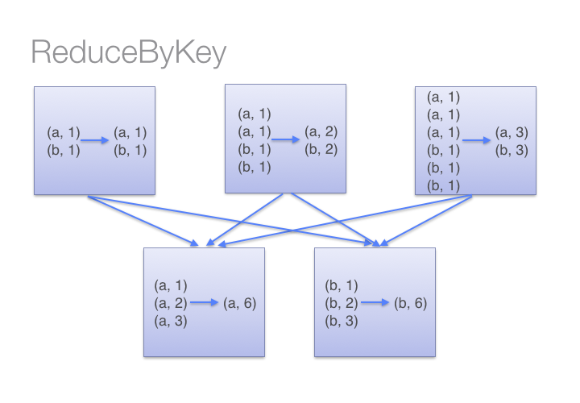
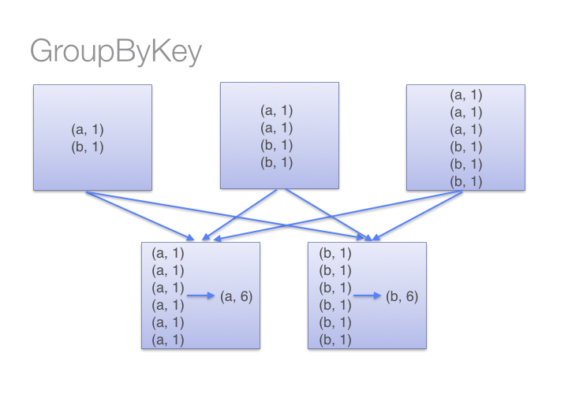
reduceByKey() vs. groupByKey()
셔플링을 하기 전에 미리 각 파티션 내에 있는 데이터들을 먼저 combine
모든 key-value 페어에 대해 셔플을 수행 → 네트워크 자원을 더 많이 소모
→ 큰 데이터 셋에서는 reduceByKey가 더 효율적으로 동작

Slide 23
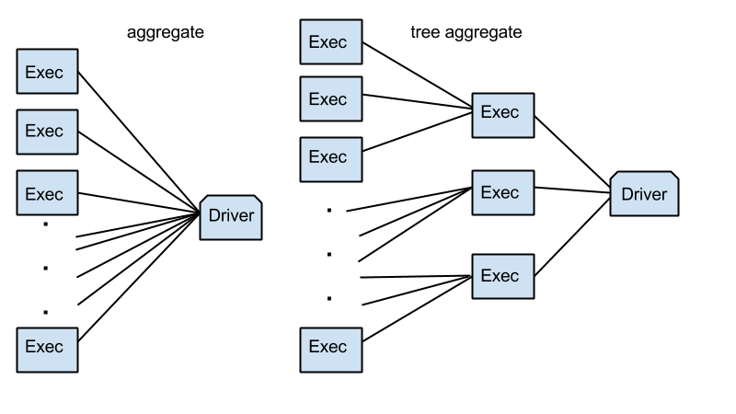
Other Aggregation Methods 230
def maxFunc(left, right):
return max(left, right)
def addFunc(left, right):
return left + right
nums = sc.parallelize(range(1,31), 5)
aggregate
aggregateByKey
combineByKey
foldByKey
#1부터 30까지 (5개의 파티션으로 나눠서)
1 | 7 | 13 | 19 | 25
2 | 8 | 14 | 20 | 26
3 | 9 | 15 | 21 | 27
4 | 10 | 16 | 22 | 28
5 | 11 | 17 | 23 | 29
6 | 12 | 18 | 24 | 30
aggregate(zeroValue, seqOp, combOp)
zeroValue: The initialization value, for your result, in the desired format. //초기값
seqOp: The operation you want to apply to RDD records. Runs once for every record in a partition. //파티션 내의 연산
combOp: Defines how the resulted objects (one for every partition), gets combined. //파티션 간의 연산
1
treeAggregate(zeroValue, seqOp, combOp, depth)
4. depth: suggested depth of the tree (default: 2)
2
aggregate
# in Python
nums.aggregate(0, maxFunc, addFunc)
depth=2
#90
# in Python
depth = 3
nums.treeAggregate(0, maxFunc, addFunc, depth)
#90

Slide 24
# in Python
KVcharacters.aggregateByKey(0, addFunc, maxFunc).collect()
#키 기준으로 agregate
aggregateByKey
#키를 기준으로 연산 수행
파라미터로 함수를 사용
combineByKey
# in Python
def valToCombiner(value):
return [value]
def mergeValuesFunc(vals, valToAppend):
vals.append(valToAppend)
return vals
def mergeCombinerFunc(vals1, vals2):
return vals1 + vals2
outputPartitions = 6
KVcharacters\
.combineByKey(
valToCombiner,
mergeValuesFunc,
mergeCombinerFunc,
outputPartitions)\
.collect()
# 결과
[('b', [1]),
('d', [1, 1, 1, 1]),
('f', [1]),
('h', [1]),
('l', [1]),
('n', [1, 1]), ('p', [1, 1, 1]), ('r', [1, 1]), ('t', [1, 1, 1]), ('v', [1]), (':', [1]), ('a', [1, 1, 1, 1]), ('c', [1]), ('e', [1, 1, 1, 1, 1, 1, 1]), ('g', [1, 1, 1]), ('i', [1, 1, 1, 1, 1, 1, 1]), ('k', [1]), ('m', [1, 1]), ('o', [1]), ('s', [1, 1, 1, 1]), ('u', [1])]
//리스트에 추가
//계속 추가
//파티션 개수 설정
각 파티션별 초기값 (key, 0)
각 파티션별 초기값 (key, 1)
#reducebykey와 동일한데
데이터 타입과 동일한 ZeroValue (e.g 0 or 1 ) 와 함께 병합
각 파티션별 초기값 (key, 2)
foldByKey
# in Python
KVcharacters.foldByKey(0, addFunc).collect()
KVcharacters.foldByKey(1, addFunc).collect()
KVcharacters.foldByKey(2, addFunc).collect()
# [('a', 4), ('c', 1), ('e', 7), ('g', 3), ('i', 7), ('k', 1), ('m', 2), ('o', 1), ('s', 4), ('u', 1), ('b', 1), ('d', 4), ('f', 1), ('h', 1), ('l', 1), ('n', 2), ('p', 3), ('r', 2), ('t', 3), ('v', 1), (':', 1)]
# [('a', 6), ('c', 2), ('e', 9), ('g', 5), ('i', 9), ('k', 2), ('m', 3), ('o', 2), ('s', 6), ('u', 2), ('b', 2), ('d', 6), ('f', 2), ('h', 2), ('l', 2), ('n', 4), ('p', 5), ('r', 4), ('t', 5), ('v', 2), (':', 2)]
# [('a', 8), ('c', 3), ('e', 11), ('g', 7), ('i', 11), ('k', 3), ('m', 4), ('o', 3), ('s', 8), ('u', 3), ('b', 3), ('d', 8), ('f', 3), ('h', 3), ('l', 3), ('n', 6), ('p', 7), ('r', 6), ('t', 7), ('v', 3), (':', 3)]

Slide 25
CoGroups 232
# in Python
import random
distinctChars = words.flatMap(lambda word: word.lower()).distinct()
charRDD = distinctChars.map(lambda c: (c, random.random()))
charRDD2 = distinctChars.map(lambda c: (c, random.random()))
charRDD.cogroup(charRDD2).take(5)
최대 3개의 key-value RDD를 그룹화할 수 있는 함수
//[(‘a’, 0.1111111)]
//[(‘a’, 0.2222222)]
//[(‘a’, (0.1111111, 0.222222)]
Joins 233
# in Python
keyedChars = distinctChars.map(lambda c: (c, random.random()))
outputPartitions = 10
KVcharacters.join(keyedChars).count()
KVcharacters.join(keyedChars, outputPartitions).count()
key-value RDD 조인
('s', 1) …
#51
random.random()
→ 랜덤 모듈의 랜덤함수: 0 이상 1 미만의 숫자 중에서 하나 뽑아줌
print(keyedChars.take(30))
[('a', 0.9790288149111314), ('c', 0.30517217903319294), ('e', 0.8654866959237848), ('g', 0.32551405415763746), ('i', 0.9124280370478347), ('k', 0.8436192345293789), ('m', 0.0991064224176027), ('o', 0.010110479837522113), ('s', 0.5700132604915846), ('u', 0.579764736386516), ('b', 0.8806164087725769), ('d', 0.26243165337328467), ('f', 0.19974923223585972), ('h', 0.5939468627379818), ('l', 0.5147910077020837), ('n', 0.3284266139754749), ('p', 0.8718616157472152), ('r', 0.8750979069188741), ('t', 0.056517448866367226), ('v', 0.8790661351658092), (':', 0.6167403799716868)]
KVcharacters.countByKey()
//defaultdict(<type 'int'>,
{'a': 4, 'c': 1, 'b': 1, 'e': 7, 'd': 4, 'g': 3, 'f': 1, 'i': 7, 'h': 1, 'k': 1, 'm': 2, 'l': 1, 'o': 1, 'n': 2, 'p': 3, 's': 4, 'r': 2, 'u': 1, 't': 3, 'v': 1, ':': 1}) → 얘가 총 51개임

Slide 26
Joins 233
Inner Join 233
zips 233
print(words.take(10))
# ['Spark', 'The', 'Definitive', 'Guide', ':', 'Big', 'Data', 'Processing', 'Made', 'Simple']
print(numRange.take(10))
# [0, 1, 2, 3, 4, 5, 6, 7, 8, 9]
key
value
# in Python
numRange = sc.parallelize(range(10), 2)
words.zip(numRange).collect()
# [('Spark', 0), ('The', 1), ('Definitive', 2), ('Guide', 3), (':', 4), ('Big', 5), ('Data', 6), ('Processing', 7), ('Made', 8), ('Simple', 9)]

Slide 27
Controlling Partitions 234
coalesce (numPartitions: Int, shuffle: Boolean = false)
# in Python
words.coalesce(1).getNumPartitions() # 1
coalesce 234
repartition 234
words.repartition(10) // gives us 10 partitions
Custom Partitioning 235
# in Python
def partitionFunc(key):
import random
if key == 17850 or key == 12583:
return 0
else:
return random.randint(1,2)
keyedRDD = rdd.keyBy(lambda row: row[6])
keyedRDD\
.partitionBy(3, partitionFunc)\
.map(lambda x: x[0])\
.glom()\
.map(lambda x: len(set(x)))\
.take(5)
#[2, 4301, 4304]

