Slide 1

SMART INDIA HACKATHON 2026
TITLE PAGE
Problem Statement ID – SIH26171
Problem Statement Title – On-device Visual Perception for Light-weight Browser Agents
Theme – Smart Automation
PS Category – Software
Team ID – 124701
Team Name (Registered on portal) – NEXORA_
AEGISBROWSE
Privacy-Preserving Visual Browser Agent
Video walkthrough: youtu.be/heZiO6_-ZtE
Notes:
Source: original user-supplied NEXORA_AegisBrowse.pptx. Identification fields and source template artwork retained. The demonstration URL was supplied in the original deck.

Slide 2
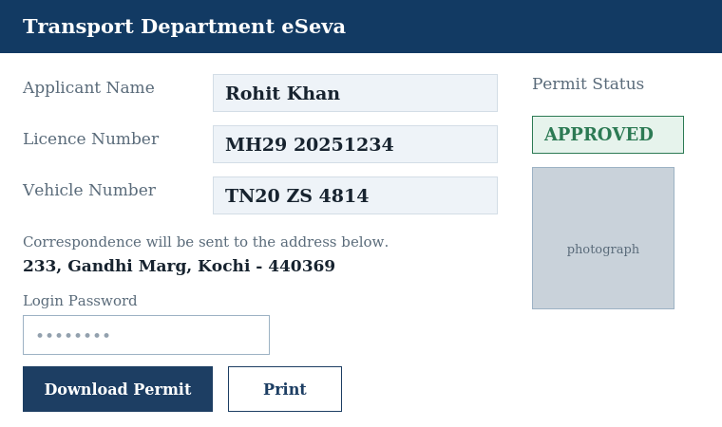
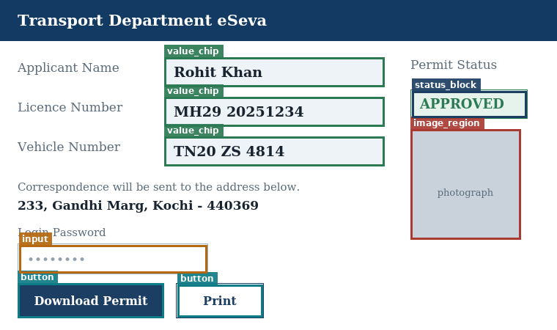
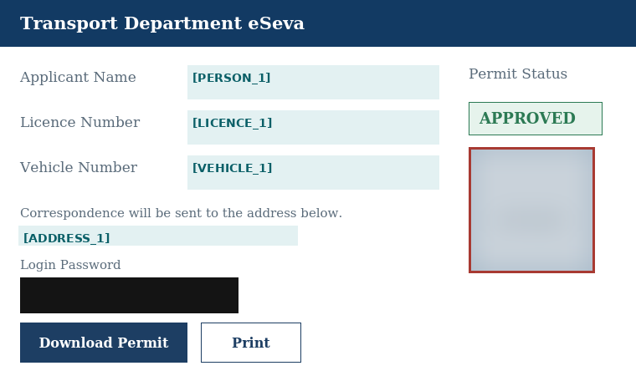
NEXORA
AEGISBROWSE
Proposed solution and how it addresses the problem
A local privacy layer between the screen and the server
1
Observe privately
2
Locate sensitive regions
3
Prepare safe context
Raw screenshot + DOM
DOM signals / reference CV overlay
Redacted pixels + metadata
Illustration, not browser-model output
CAPTURE AND REDACTION STAY ON THE DEVICE
Then select only task-relevant context for the server
Innovation and uniqueness
Fuse privacy signals
Escalate selectively
Disclose by task
Browser: pixels + metadata filtering
CPU benchmark: OCR on DOM gaps
Browser: crop + selected controls
2
Notes:
Synthetic transport-portal illustration from the source deck, not evidence of zero leakage or face recognition. Panels illustrate capture, localisation and sanitization; task selection follows the third panel. Browser demo currently uses DOM privacy filtering and goal-aware cropping. Visual/OCR selective escalation is evaluated in the offline CPU reference harness. Source: project README and SELECTIVE_RESULTS.md.

Slide 3
NEXORA
TECHNICAL APPROACH
Technologies and implementation approach
One user-triggered step, with privacy before transmission
REQUEST
BOUNDARY
CHROME EXTENSION
LOCAL FASTAPI SERVER
Filtered PNG
+ metadata
1 Observe
2 Redact
3 Minimize
4 Plan
Screenshot + DOM
Role, label, position
Mask recognized PII
Filter sensitive controls
Crop by task
Tokenize PII in goal
Rules select a control
Return a JSON action
7 Verify
6 Execute
Allow
5 Gate
JSON action
Check download / UI
Report result to user
Recheck live target
Perform allowed action
Target + origin
User can run the next step after verification.
Blocked: stop. TYPE: request confirmation.
Demo endpoint: localhost:8000
Demo stage
ONNX Runtime Web: integration scaffold
DOM privacy + goal crop + guarded execution
Rules planner uses disclosed control metadata
Optional loader with DOM fallback is in place.
Trained detector + real runtime assets are pending.
Next: browser visual/OCR path, WebGPU / WASM timing, VLM integration tests and Firefox validation.
3
Notes:
Source: aegisbrowse_extension/src/service_worker.js and privacy.js, src/ort/README.md, models/README.md, aegisbrowse_server/app.py. The demo executes one AEGIS_STEP per user trigger; it is not an autonomous repeating loop. Endpoint is restricted to loopback port 8000. The rules planner uses control metadata, not visual understanding. Goal sanitization is regex-based and does not cover every name/address. Missing optional ONNX assets produce DOM fallback. The local gate can BLOCK, CONFIRM TYPE, or ALLOW. Live target revalidation precedes execution. Browser verification is heuristic and needs broader testing. The trained model, real runtime assets, browser OCR, VLM validation and Firefox support are pending.

Slide 4
NEXORA
FEASIBILITY AND VIABILITY
Analysis of feasibility
CPU reference benchmark: 48 fresh synthetic pages / 408 sensitive annotations
Criterion and measure | Always-on | Selective
Visual context (25%) UI F1 @ IoU ≥ 0.5 | 0.924 | 0.924
PII detection (20%) precision / recall | 0.937 / 0.955 | 1.000 / 0.958
Redaction (20%) pixel precision / recall | 0.643 / 0.977 | 1.000 / 0.973
Resources (20%) process RAM / CPU per page | 57.3 MB / 52.1 ms | 56.4 MB / 25.7 ms
Latency (15%) sanitize-to-plan median / p95 | 339 / 467 ms | 47 / 48 ms
CPU reference harness, Intel Core Ultra 9 275HX: classical CV + rules planner. UI F1 is not mAP.
RAM and CPU exclude the Tesseract child process. Latency excludes browser execution and verification.
Challenges and improvement strategy
DOM-blind redaction recall: 0.878. Add label-aware OCR, then port and test selective escalation in the browser.
Still not measured
1
Trained ONNX detector
2
WebGPU timing in the browser
3
Whole-task time inside the browser
Accuracy on held-out screens
Cold / warm inference and memory
Observe through verified completion
4
Notes:
Sources: SELECTIVE_RESULTS.md, selective_results.json, loop_results.json, dated 2026-10-04. Stored results were cross-checked in the previous revision; the experiments were not rerun. 408 annotations comprise 312 PII instances and 96 password/OTP fields; secret-field accuracy is reported separately in the benchmark. UI detector is classical CV. The selective 1.000 precision applies only to this synthetic corpus; recall is 0.973, not zero leakage. DOM-blind redaction recall is 0.878. Process memory is not browser memory. Exact full browser end-to-end task latency is unmeasured. Three named milestones are planned work, not achieved results.

Slide 5
NEXORA
IMPACT AND BENEFITS
Potential impact on the target audience
Private assistance for authenticated portal tasks
Government services, scholarships, banking KYC, health records and employee self-service.
Example: download a certificate or report
01
Protect on the device
02
Plan from safe context
03
Act and confirm
Observe
Sanitize
Send
Plan
Execute
Verify
Screen + DOM; local privacy filter
Filtered request; choose Download
Guarded click; confirm download
CPU harness: 48 pages, sanitized context sent and target selected
Demo flow; completion timing pending
Benefits of the solution
PRIVACY
SPEED
COMPUTE
PLANNING
0
7.3×
51%
48/48
PII strings in sent metadata
Faster sanitize-to-plan median
Lower Python-process CPU / page
Correct Download target chosen
5
Notes:
Source: SELECTIVE_RESULTS.md and loop_results.json, fresh pages_v3 set only. 339.2/46.7=7.3 times sanitize-to-plan speedup. CPU reduction (52.1-25.7)/52.1=50.7%, rounded to 51%. Zero PII strings refers solely to metadata checks on 48 pages, not image privacy or a system guarantee. 48/48 is control-selection success, not end-to-end task completion. Browser click/verification flow is described in the supplied README; browser execution timing is still unmeasured. No energy or carbon saving is claimed.

Slide 6
NEXORA
RESEARCH AND REFERENCES
Details / links of reference and research work
Mind2Web
Generalist web-agent benchmark
Prototype and demonstration
arxiv.org/abs/2306.06070
GitHub repository
SeeAct
Grounding web actions
github.com/mynameisizhan-coder/AegisBrowse
arxiv.org/abs/2401.01614
Extension, server, benchmark scripts and results
OmniParser
Visual screen parsing
arxiv.org/abs/2408.00203
YouTube walkthrough
PrivWeb
Local privacy filtering and controls
youtu.be/heZiO6_-ZtE
arxiv.org/abs/2509.11939
Prior work and our contribution
WebPII
Visual PII benchmark and detector
arxiv.org/abs/2603.17357
Prior work already covers local privacy filtering.
Our CPU study tests container rejection + selective OCR.
Task-aware disclosure needs a separate ablation.
Our research work: synthetic Indian-portal benchmark
12 development pages
48 fresh test pages
48 DOM-blind variants
Scholarship + HR
4 held-out families / 408 items
Reduced DOM on the same test pages
Benchmark report: nexora_benchmark/SELECTIVE_RESULTS.md
Ground truth: scorer only
6
Notes:
Project repository supplied by user: https://github.com/mynameisizhan-coder/AegisBrowse. Original demo URL https://youtu.be/heZiO6_-ZtE resolves to AegisBrowse by NEXORA; video content was not independently reviewed. Research URLs linked. Sources: SELECTIVE_RESULTS.md and stored JSON. Development families scholarship/HR; held-out health/municipal/banking/transport. pages_v3 is a fresh seed on the same four held-out families. DOM-blind variants remove image entries and about one third of value-field DOM data, not all DOM. Benchmark visual/OCR improvements are in Python, not the extension. Task-aware crop benefit needs a separate ablation.

