Slide 1
Analyzing Survey Data
Project

Slide 2
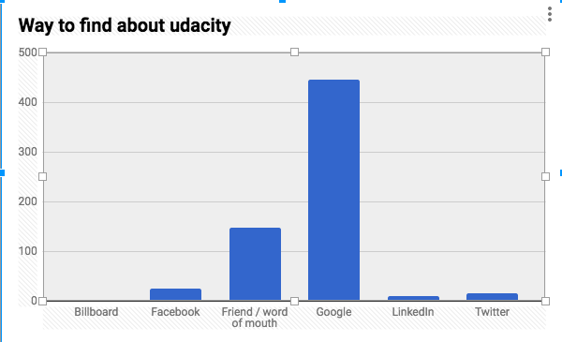
What is the most common way people find out about Udacity?
Sol-From the graph we can see that
Best way to find about udacity is google (68.8%) .Second best way people are knowing about udacity is through friend (22.7%)
MEAN=108,MEDIAN=21,STDEV=174.125
Mean is 108 and way to find about udacity through google is more than 400.Which means more than average number are people are finding about udacity is through google.

Slide 3
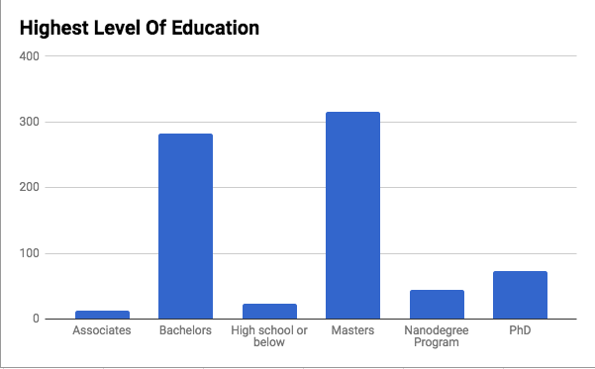
What is the highest level of education for most students?
Sol-Most number of students have master degree.Second is Bachelor and the least is associates
MEAN=125.5,MEDIAN=59,STDEV=136.76
Since mean is 125.5 and number of students having master or bachelor degree are more than 250+.So more than avg students are having master or bachelor degree .The dispersion of data from mean is 136.76

Slide 4
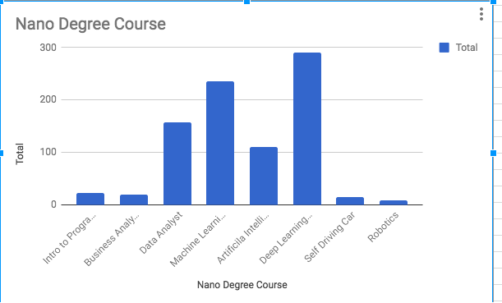
What is the most common Nanodegree program represented in the survey results?
Sol-Most common Nanodegree program is Deep learning foundation which has more than 250+ student and second is machine learning is which has more than 200+ student and so on..
MEAN=107.375,MEDIAN=67,STDEV=110.724
Since mean is 107.375.More than average number of students are learning deep learning,machine learning,Data science.Distribution of learning of nanodegree program is 110.724

Slide 5
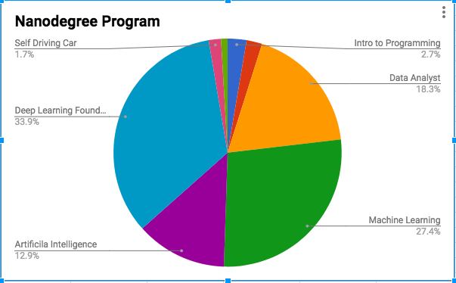
Is there a connection between the Nanodegree certificate earned job title?
Yes,Deep Learning Foundation ,Data Science and machine learning are interrelated course so most of the student are taking both the courses.
MEAN=107.375,MEDIAN=67,STDEV=110.724
More than average students are learning deep learning,machine learning,Data science
Distribution of learning of nanodegree program is 110.724

Slide 6
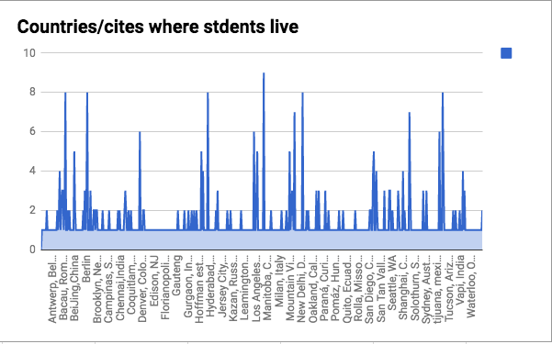
What are the most common countries/cities where students live?
Sol-Most common countries/cites where student live are madrid spain,Hyederabad India,Bangalore India,Berlin Germany and so on…
MEAN=1.376,MEDIAN=1,MODE=1,STDEV=1.098034
Since mode is 1,most of the sudents are from different country/city and distribution of students is 1.098034

Slide 7
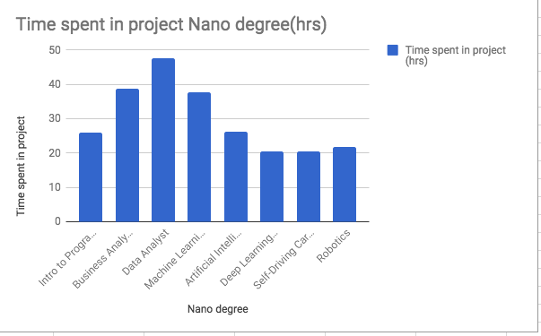
How many hours per week do students spend on projects/content? Does this differ by program?
Sol-Data sciecne,Business analyst and machine learning project are taking more number of hrs in project wrt to other nanodegree program
MEAN=29.8806,MEDIAN=26.1297,STDEV=10.1590
On average students are taking 29.8806 hrs to complete the project.Bussiness analyst,data analyst,machine learning are taking more than avg time to complete the project.Standard deviation to complete the project is 10.1590

Slide 8
Are there any interesting findings regarding sleep, commute times, amount of time sitting per day, etc. worth mentioning? Does this differ by where someone lives? Does this differ by Nanodegree program or job title?

Slide 9
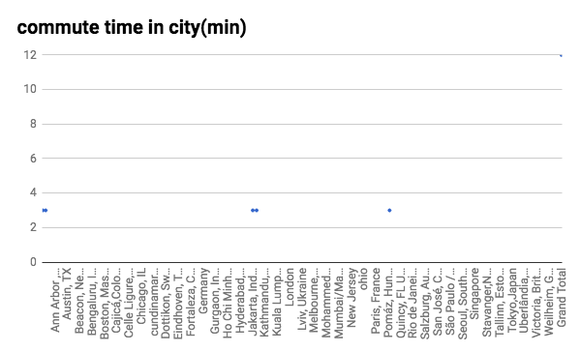
From the graph we can see that,there is no co-relation between city and commute time .

Slide 10
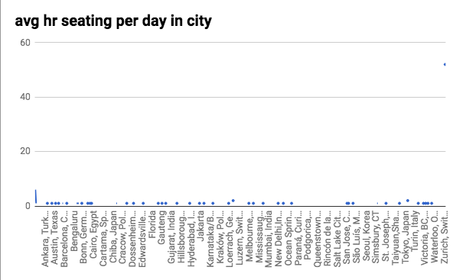
From the graph we can see that avg hr sleeping day in city is almost same.So number of hr seating in city is independent of city.

Slide 11
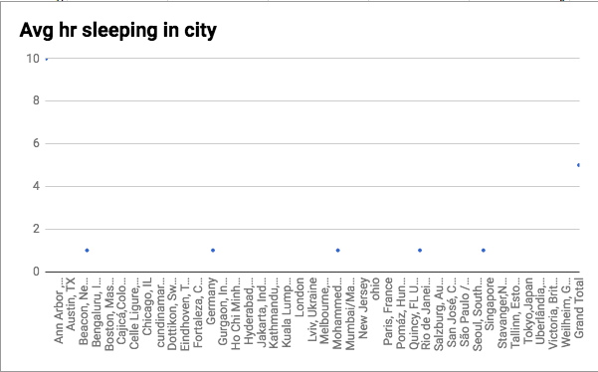
From the graph we can see that avg hr sleeping is independent of city.There is no co-relation between avg hr sleeping in city

Slide 12
Does this differ by Nanodegree program or job title?
Sol-There is no co-relation between sleep, commute times, amount of time sitting per day, etc. and Nanodegree program or job title.Since there is no co-relation ,I was not able to draw graph.

